Slide 1

Towards the Strip CMOS Demonstrator Module
17 February 2016, ITk Week
J. J. John, M. Stanitzki
with input from many colleagues

Slide 2
Purpose
Reminder/recap:
This activity is to develop the readout ASIC for Strip CMOS sensors, the ABCN’
  via an FPGA solution
  based on the ABC series of readout ASICs
This links closely to developing a demonstrator Strip CMOS module.
Agenda
This meeting in particular is to:
  Define the CMOS demonstrator module/object, for the TDR timeframe.
  Get consensus on basing the ABCN' on either the ABC130 or ABC130*.

Slide 3
Demonstrator module - introduction
What: demonstrate readout of several CHESS-2 sensors in a module object
When: by the Strips TDR though (Q4 2016)
General concept:
CHESS-2
ABCN’
CHESS-2
ABCN’
FPGA(s) initially
CHESS-2
ABCN’
HCC ?
Include HCC or not?
to be determined
hybrid/support
DAQ s/w
DAQ h/w

Slide 4
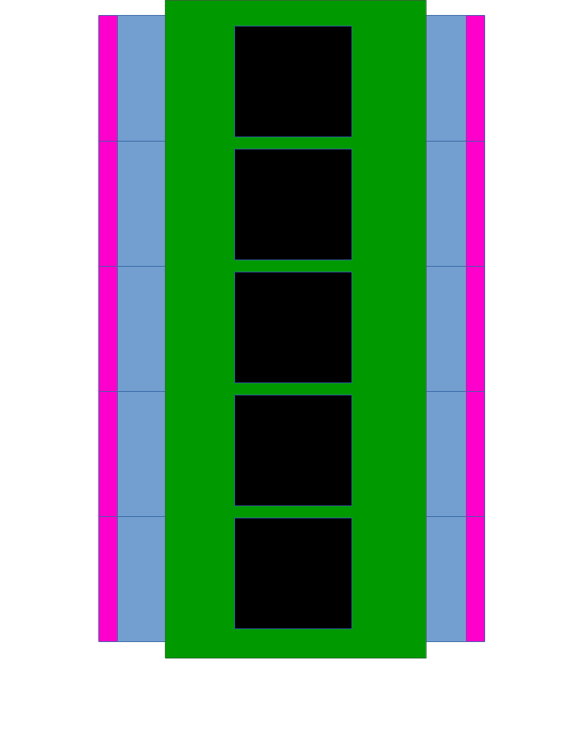
Demonstrator - proposal
After discussion this week: the demonstrator needs to closely approach a module.
hybrid
CHESS-2
ABCN’
CHESS-2
CHESS-2
ABCN’
CHESS-2
CHESS-2
ABCN’
CHESS-2
CHESS-2
ABCN’
CHESS-2
CHESS-2
ABCN’
CHESS-2
output section
FPGAs
output section

Slide 5
Demonstrator – open questions
Do we need to include an HCC?
  ITSDAQ can presently interface either to an HCC or to ABC130s
  HCC makes the demonstrator more complete, but more work
Power board?
  For this iteration, need to power FPGAs which have different voltages compared to baseline modules
  So can’t directly use the baseline power board on the demonstrator

Slide 6
Basis for ABCN’ - 1
The ABCN’ could be based on the ABC130 or ABC130*
Green = already exists. Yellow = in progress or to be adapted. Orange = to start.
1. Base ABCN’ on ABC130:
2. Base ABCN’ on ABC130*:
CHESS-2
ABCN’
CHESS-2
ABCN’
CHESS-2
ABCN’
CHESS-2
ABCN’
CHESS-2
ABCN’
CHESS-2
ABCN’
HCC
HCC*
hybrid
hybrid
DAQ s/w
DAQ h/w
DAQ s/w
DAQ h/w
SCTDAQ
e.g. Atlys
SCTDAQ with * added
e.g. Atlys – new firmware

Slide 7
Basis for ABCN’ - 2
After discussion with colleagues this week:
given the timeframe, it seems advantageous to re-use as much infrastructure as possible (DAQ firmware, software).
The ABC130* is also still evolving to some extent (L0 tagging, interface to HCC*).
This points to basing the ABCN’ on the ABC130.
Re-using infrastructure frees up time for the FPGA and hybrid work.

Slide 8
Towards the demonstrator
As a step towards the module, could prepare a single chip readout:
CHESS-2
ABCN’
DAQ h/w
DAQ s/w
single chip board = CHESS-2 daughterboard
from SLAC?
FPGA board
- Atlys or
ABC130 Driver Board?
Atlys
or
HSIO-2
SCTDAQ
or
TBD
+ interface board as need be

Slide 9
Backup Slides

Slide 10
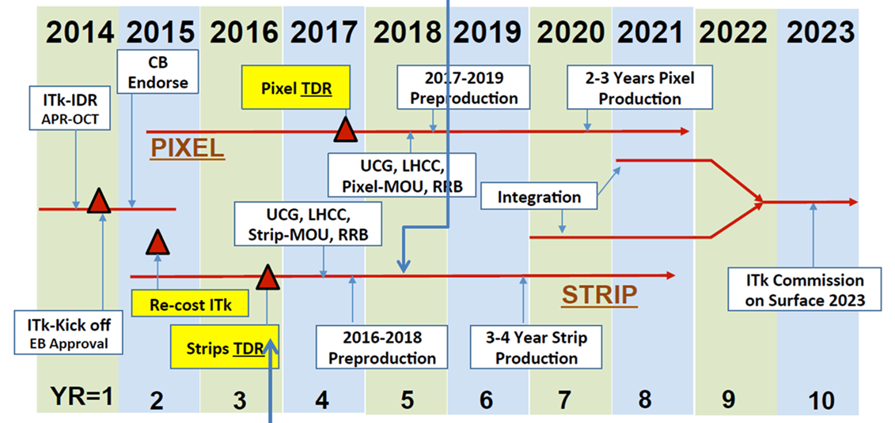
Reminder of schedule
Demonstrator module by time of Strips TDR
-- R. Nickerson
Pre-production
Mid 2018
First review
candidate technology, good results
If S/N ok, likely to pass this review
Second Review
large scale chip, ABCn’ read-out

