Slide 1

25 February 2016
J. J. John
with input from many colleagues

Slide 2
Agenda
  Summarise decisions taken at ITk Week
  Go over CHESS-2 interfaces and number of I/Os, also compared to FMC connectors
  Talk about first implementation steps
Reminder
Please fill in the Doodle poll for a weekly meeting time slot:
  http://doodle.com/poll/r6ugqgyy3y7hdwyd

Slide 3
Summary of decisions at ITk Week
At the meeting Wednesday 17 February, we agreed:
The CHESS-2 demonstrator will not include an HCC or emulated HCC*
(main reason = manage complexity)
The ABCN’ will be based on the ABC130* codebase
(main reason = avoid future work, compared to starting with ABC130 basis; DAQ firmware and software will anyway need adapting, due to CHESS-2 data format)
CHESS-2
ABCN’
FPGA(s)
initially
CHESS-2
ABCN’
HCC ?
hybrid/support
DAQ s/w
DAQ h/w

Slide 4
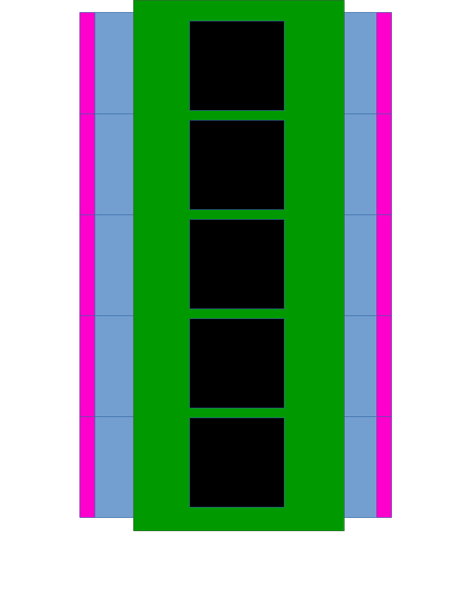
Summary of decisions at ITk Week, cont.
We discussed this concept diagram of the CHESS demonstrator quite a bit.
hybrid
CHESS-2
ABCN’
CHESS-2
CHESS-2
ABCN’
CHESS-2
CHESS-2
ABCN’
CHESS-2
CHESS-2
ABCN’
CHESS-2
CHESS-2
ABCN’
CHESS-2
output section
FPGAs
output section

Slide 5
Summary of decisions at ITk Week, cont.
We were cautioned that integrating several FPGAs onto a hybrid or PCB (even allowing many layers) is non-trivial and time-consuming.
At the same time, the agreement governing the Strip CMOS work has set stages and milestones. This demonstrator module is vital to be able to continue, given the Strip production timeframe.
The rough consensus seemed to be to aim for one of these two objects:
PCB
PCB
CHESS-2
ABCN’
CHESS-2
CHESS-2
ABCN’
CHESS-2
CHESS-2
ABCN’
CHESS-2
output section
FPGA
output section
output section
FPGAs
output section

Slide 6
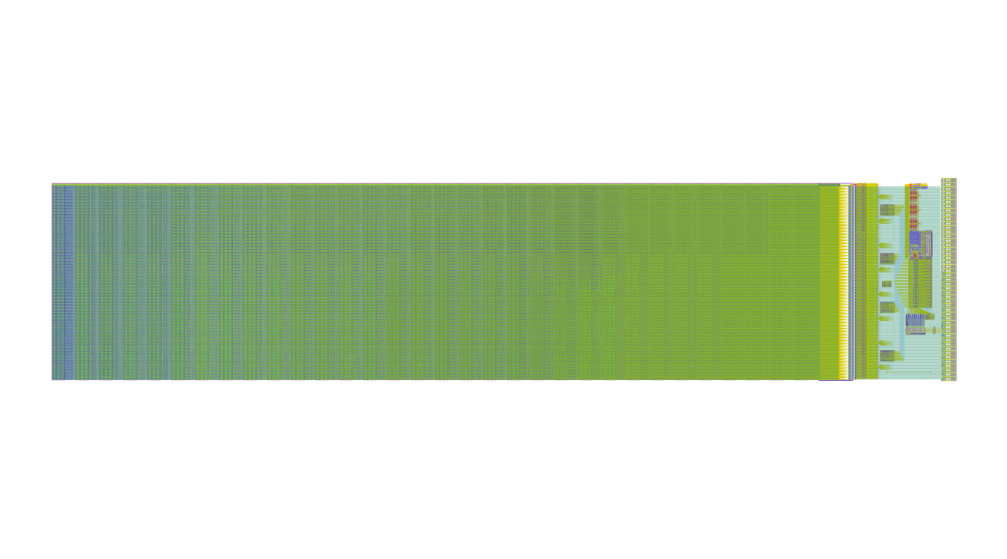
CHESS-2 interfaces
From Hervé’s slides at ITk week - H. Grabas, P. Caragiulo, C. Tamma, X. Xu, I. Peric
Reticle floorplan – 3 independent arrays:
Array 1
Independent:
- Clocks
- Data output
- SACi
Common:
- HV
- Power supplies
- Bias voltages
Test structures
2cm
Array 2
Array 3 - high gain amplifier
2.4 cm

Slide 7
List of CHESS-2 pads
Summary:
  37 pads per array, of which 14 LVDS pairs (data out)
  x 3 arrays
  = 111 pads, of which 42 LVDS pairs
  + 18 common pads for the sensor .
  = 129 pads in total, of which 42 LVDS pairs
List of pads
– black = appear once per array, blue = common, appear once per chip
1x HV
1x HV Ground
1x Ground Digital
1x Ground Analog
1x Supply 3.3V Analog
1x Supply 3.3V Digital
1x Supply 1.8V Analog
1x Supply 2.5V Digital
1x Bias 3.6V
1x Bias Cascode
1x Bias Threshold
1x Bias Baseline
1x Bias BaselineFilter
1x Signal Injection
14x2 LVDS Data
1x LVDS Supply
1x LVDS Ground
1x LVDS Bias TX
1x LVDS TX Vcommon
1x LVDS RX 320MHz
1x LVDS Bias RX
1x CMOS 25MHz
1x SACIsel
1x SACIclk
1x SACIrsp
1x SACIcmd
1x Global Reset
1x Digital Monitor

Slide 8
List of CHESS-2 pads – connections to ABCN’
Summary:
  37 pads per array, of which 14 LVDS pairs (data out)
  x 3 arrays
  = 111 pads, of which 42 LVDS pairs
  + 18 common pads for the sensor .
  = 129 pads in total, of which 42 LVDS pairs to ABCN’
  + 9 single-ended connections to/from ABCN’
  = 93 connections
List of pads
– black = appear once per array, blue = common, appear once per chip
1x HV
1x HV Ground
1x Ground Digital
1x Ground Analog
1x Supply 3.3V Analog
1x Supply 3.3V Digital
1x Supply 1.8V Analog
1x Supply 2.5V Digital
1x Bias 3.6V
1x Bias Cascode
1x Bias Threshold
1x Bias Baseline
1x Bias BaselineFilter
1x Signal Injection
14x2 LVDS Data to ABCN'
1x LVDS Supply
1x LVDS Ground
1x LVDS Bias TX
1x LVDS TX Vcommon
1x LVDS RX 320MHz
1x LVDS Bias RX
1x CMOS 25MHz from ABCN’
1x SACIsel from ABCN'
1x SACIclk from ABCN'
1x SACIrsp from ABCN'
1x SACIcmd from ABCN'
1x Global Reset from ABCN'
1x Digital Monitor to ABCN'

Slide 9
FMC connectors
(FPGA mezzanine connector)
Low Pin Count (LPC) = more usual
68 user-defined pins / 34 user-defined differential pairs
High Pin Count (HPC) = more espensive
160 user-defined pins / 80 user-defined differential pairs

