Slide 1
FXE Scientific Instrument:
Day 1
C. Bressler
Femtosecond X-ray Experiments (FXE)
European XFEL
christian.bressler@xfel.eu

Slide 2
Molecular dynamics using the FXE instrument
Parameter | Monochromatic | Pink beam
Energy range | 5-20(25) keV | 5-20(25) keV
Beam position | Sample (fixed) | Sample (fixed)
Energy bandwidth | 1.4x10⁻⁴ Si(111) 3x10⁻⁵ Si(311) | 0.3-1 %
Bunch charge | ≤ 250 pC | ≤ 250 pC
X-ray pulse duration | < 25 fs | < 25 fs
Optical pulse duration | 15 fs | 15 fs
Sample delivery: Liquid flat-sheet jets | Up to 15 m/s (sapphire nozzles) Up to 100 m/s (colliding μjets) | Up to 15 m/s (sapphire nozzles) Up to 100 m/s (colliding μjets)
X-ray beam spot | 1-10 μm in focus Up to 0.1 mm out of focus | 1-10 μm in focus Up to 0.1 mm out of focus
Energy resolution | ca. 1 eV (cylindrical) 0.3 - <1eV (spherical) | ca. 1 eV (cylindrical) 0.3 - <1eV(spherical)
Q range ( XDS) | 0.7 – 13 Å⁻¹ | 0.7 – 13 Å⁻¹
FXE Overview Specifications
FXE will offer world-wide unique and versatile end station for dynamical studies of guest-host interactions
It will exploit the high repetition rate, x-ray photon flux and ultrashort pulse duration of the European XFEL
FXE will offer a flexible sample environment optimized for liquid-phase photochemistry using a suite of complementary x-ray spectroscopic and scattering techniques in pump-probe arrangement.
Simultaneous measurements of several observables deliver a more complete picture of the dynamics both of the solute (guest) and solvent molecules (host).
Coupled electronic, spin and nuclear changes of solute and solvent molecules can be resolved in “real-time”
Notes:
I assumed 50 mm sample-detector distance (L) and 500 pixels x 0.5 mm height (H)
2Theta_max = arctan (H/L) = 79 degress
2Theta_min = 4 degrees
Wavelength = 0.62 angstroms (20 keV)
Qmax = 20 x sin(2Theta/2) = 13 angstroms-1
Qmin = 0.7
Structural resolution < 1 Å (0.8 Å, according to simulations)
For λ_{XFEL} = 12.4 keV, we need to measure up to 2θ=80° or even higher 2θ≈100°
This implies measuring scattering vectors up to Q=4πsin(θ)/λ≅8-10 Å⁻¹
Angular range = ±100° = 200°
According to time-resolved SR data, one expects typically 5-10 oscillations in Q-range up to 10 Å⁻¹
Since both LPD and AGIPD will have 1k x 1k sensor size so let’s assume we have 500 sampling points/Q-range (for positive angles)
The total of 1000 sampling points for angular range = 200° yields an angular
Resolution of 200° /1000 = 0.2°=3.5 mrad
This implies that L≅ 144 mm for the LPD detector and L≅ 57 mm for AGIPD
Both detectors should be OK. More concern with available Q-range.
Multiple detectors proposed or higher photon energies requested

Slide 3
FXE: Quick Summary for Day 1 XFEL Specs
Any Single SASE1 Energy >5 keV (Mn: 6.5 keV) can be used by us
Any Rep-rate fine (10 Hz, 100 kHz)
Have Synch‘ed fs Laser

Slide 4
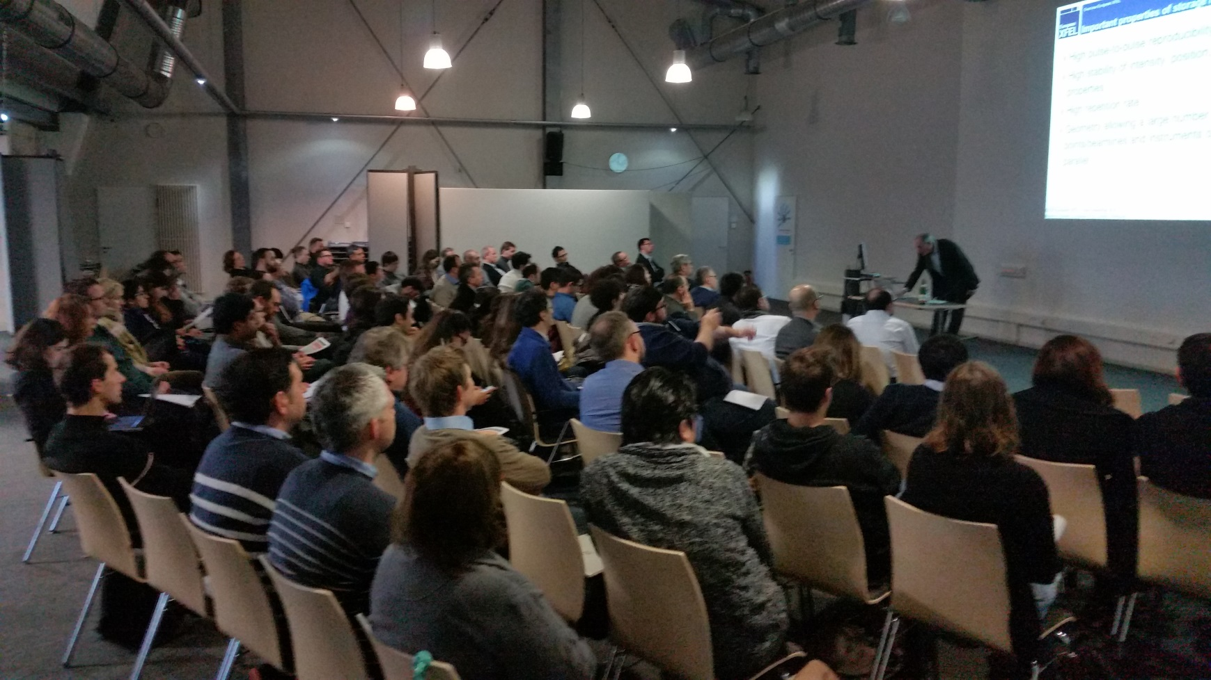
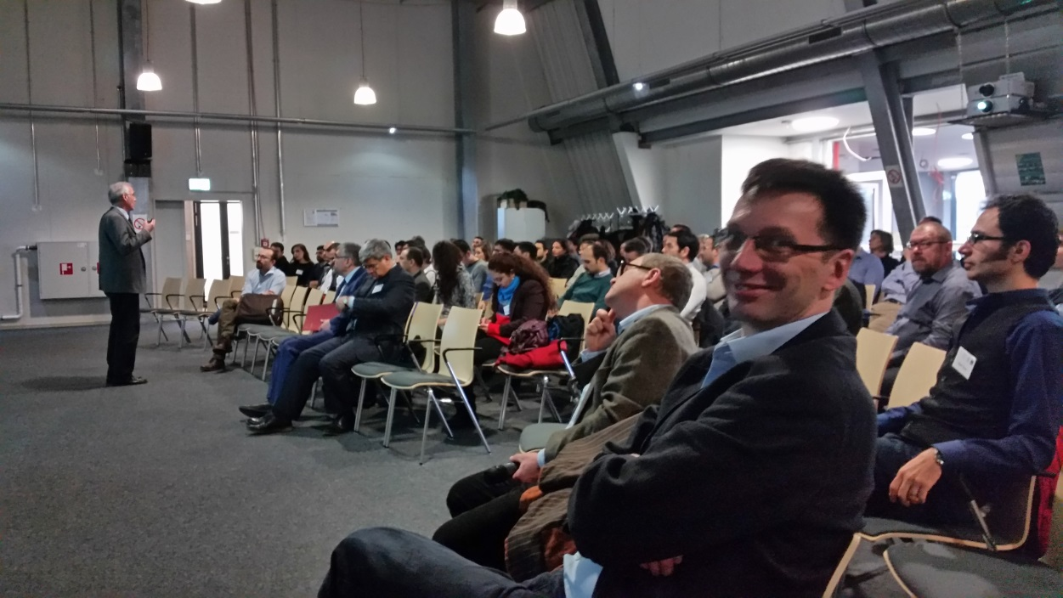
Workshop: From Picoseconds to Femtosecond X-Ray Experiments, Jan 26, 8:30 – 18:00
Day 1 Ideas

Slide 5
Simultaneous Techniques at the FXE instrument
X-Ray Absorption Spectroscopy (XAFS)
XANES: oxidation state changes, valence orbitals, DOS…
EXAFS: coordination shells (geometric)
X-Ray Emission Spectroscopy (XES)
spin momentum of the absorber, charge state, molecular orbitals,...
X-Ray Diffuse Scattering (WAXS, SAXS)
Short- and medium-range geometric environment, solute + solvent (cage) contributions to the structural factor
Resonant Inelastic X-Ray Scattering (RIXS)
Low energy excitations (d-d, charge transfer, even phonons), tunable to different final states, i.e. 3d orbitals (dipole-forbidden for 1s→nd excitation)
X-Ray Raman Spectroscopy (XRS)
Access K-edges of light elements (N, O, C...) constituting solvent molecules
…

Slide 6
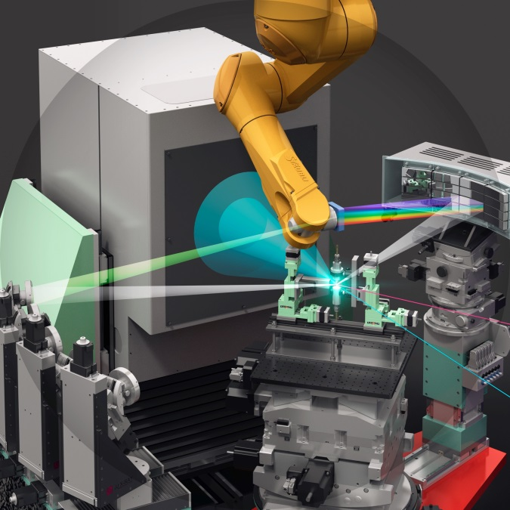
Simultaneous ultrafast X-ray tools at FXE
Make use of complementary observables simultaneously
→ employ different experimental techniques)
K. Haldrup et al., J. Phys. Chem. B, Just Accepted (2016)
1 dispersive XES spectrometer
(no moving elements, Gotthard/Jungfrau)
1 scanning spectrometer
(limited movements possible, diode)
1 forward scattering detector (LPD)
1 primary 4-bounce monochromator
1 synch’ed MHz laser system (operational!)
Courtesy by European XFEL/Rey.Hori

Slide 7
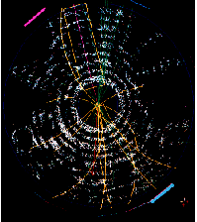
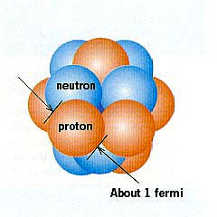
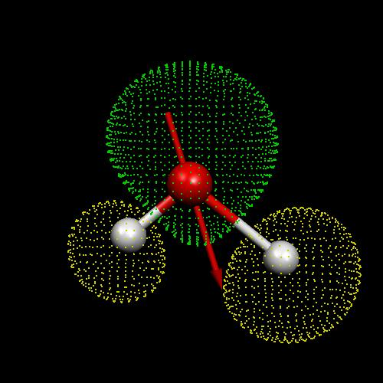
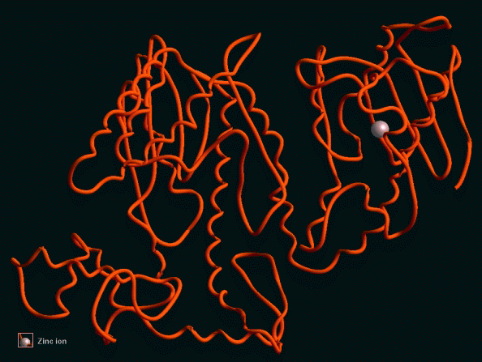
Femtoseconds Desired, slower timescales also useful
Femtochemistry, Photosynthesis and Catalysis
Molecular
Vibrations
Protein Folding
Strings,
Cosmology
Particle Collisions
Molecular Rotations
Solvation Dynamics
Electron dynamics
harpo
10⁻²⁷
yacto
10⁻²⁴
zepto
10⁻²¹
atto
10⁻¹⁸
femto
10⁻¹⁵
pico
10⁻¹²
nano
10⁻⁹
micro
10⁻⁶
milli
10⁻³
Time /seconds

Slide 8
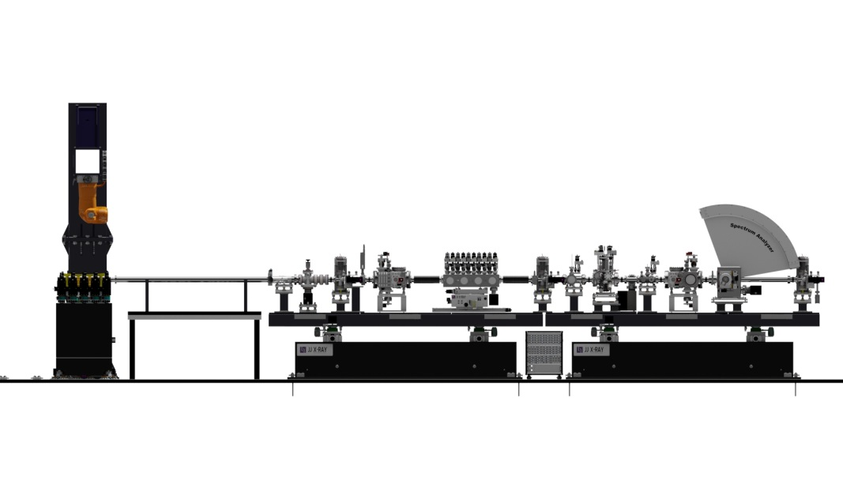
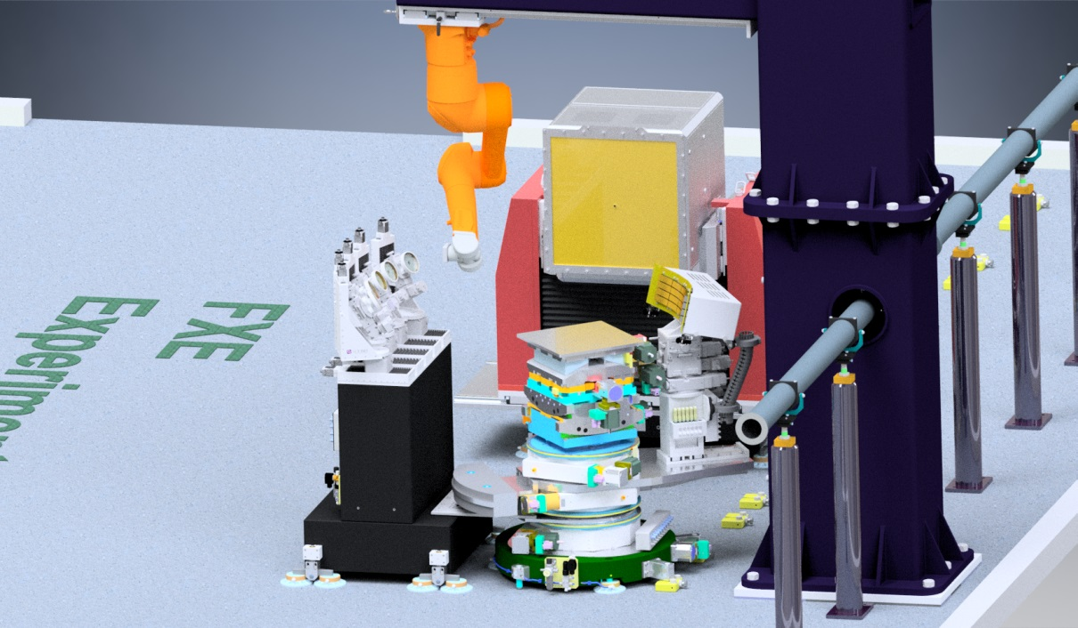
Flexible sample environment
Sample Environment
- He Environment (ambient conditions, liquid jets)
- Solid State Chamber

Slide 9
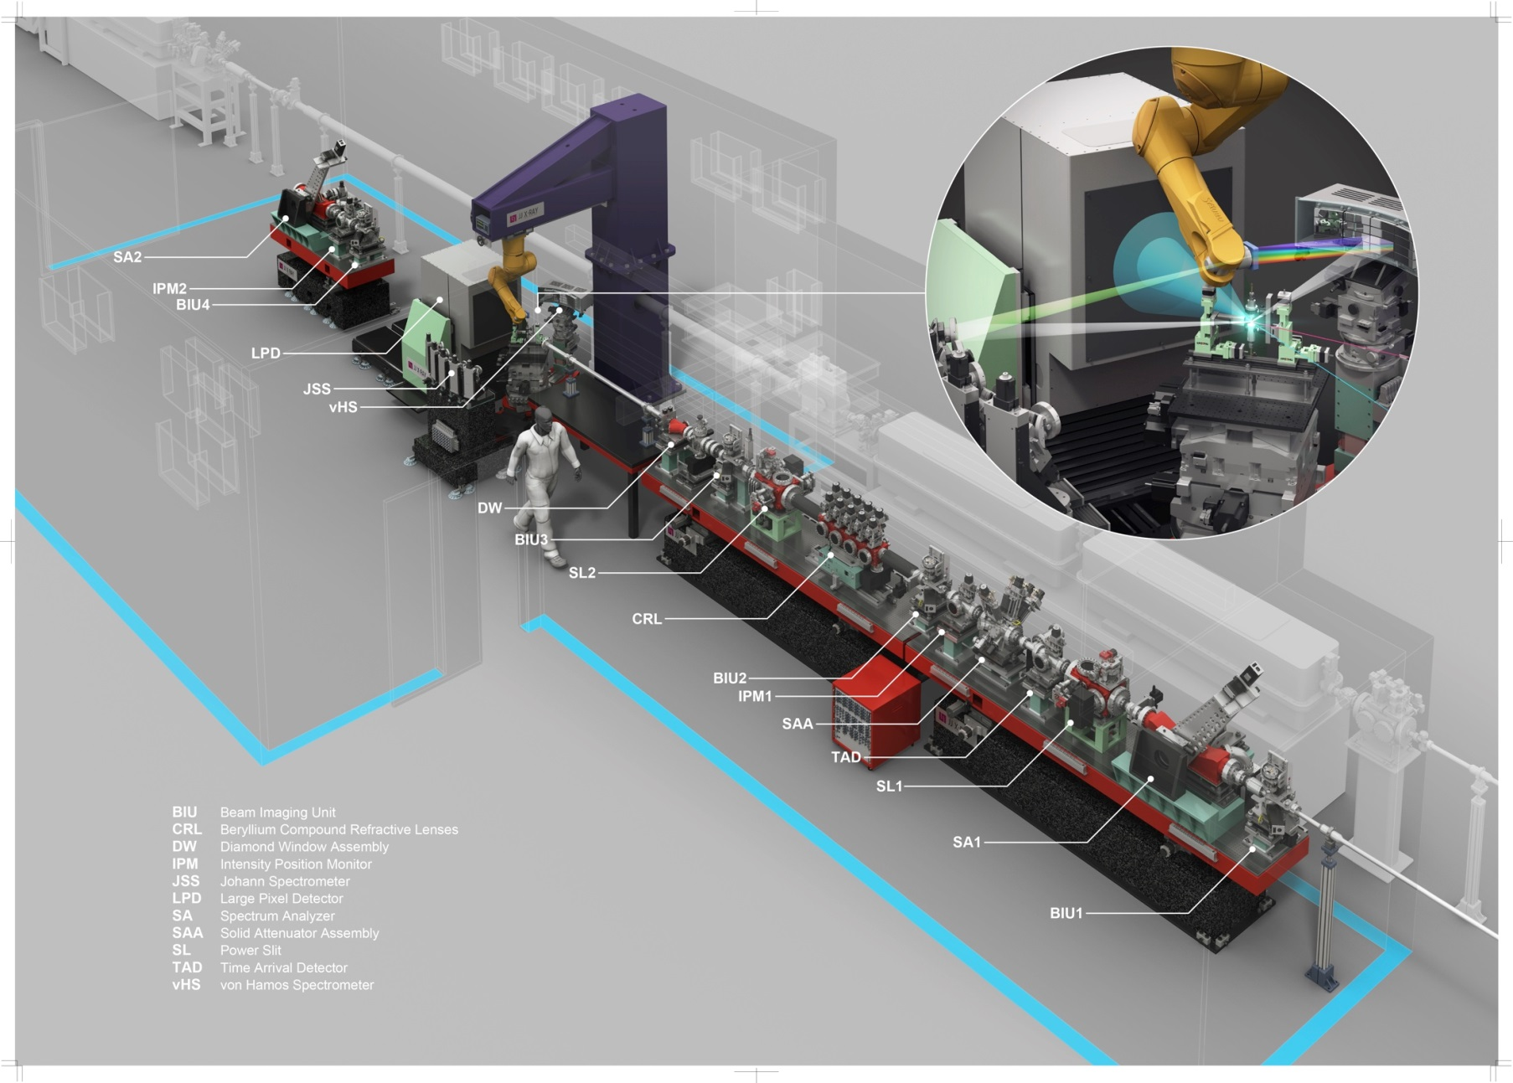
FXE Instrument (Jan. 2016)
Courtesy by European XFEL/Rey.Hori

Slide 10
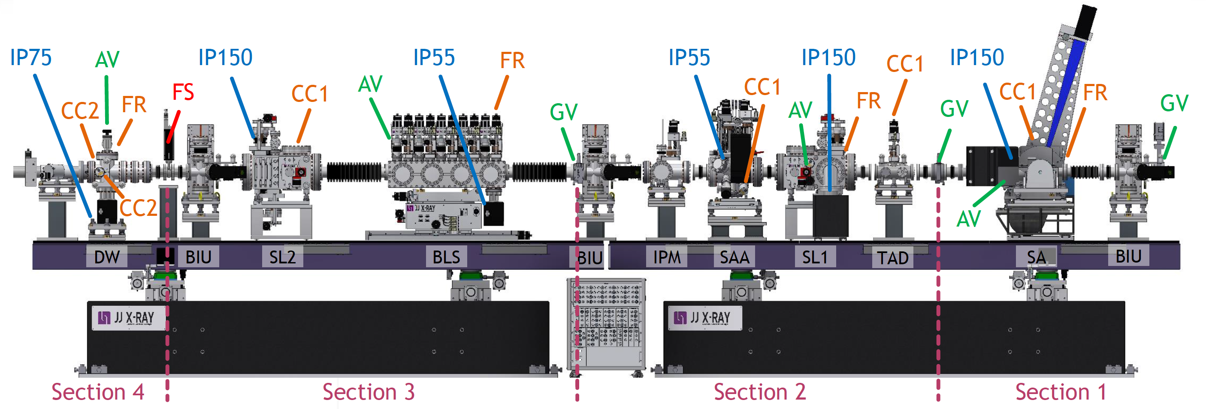
FXE Optics Section for Day 1
Beam direction

Slide 11
Worst Case Scenario on Day 1
Beam direction

Slide 12
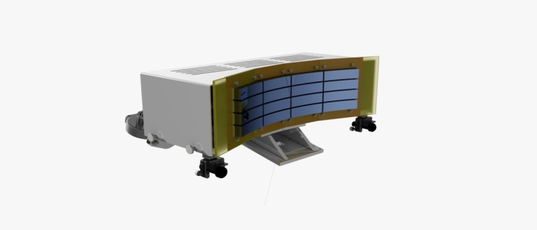
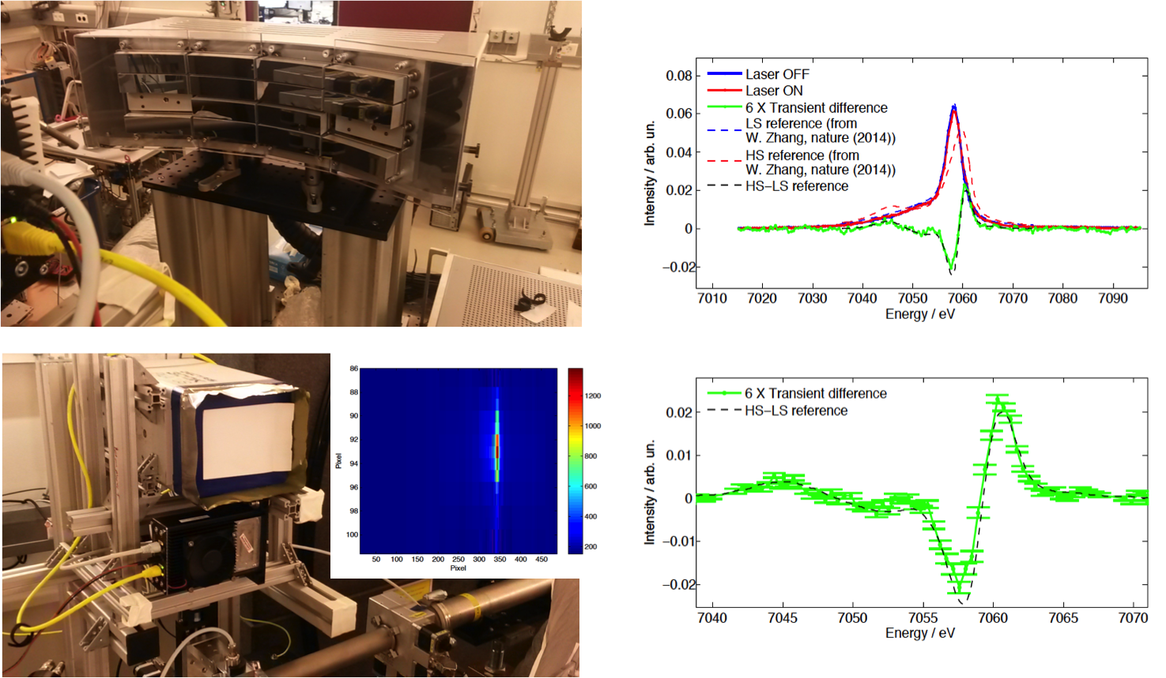
Dispersive XES at FXE
Single-shot NXES and RXES
Does not require scanning the Bragg angle
Multiple analyzer crystal can be used to record simultaneously different emission lines
Extension to RXES → scanning the incident x-ray photon energy
Self-normalized → crucial!
Energy resolution → 1-1.2 eV (segmented analyzers ca. 0.3 eV)
Test beamtimes at Petra III
(see poster session!!)
APS (7ID)
DELTA
Notes:
Single-shot acquisition is compatible with the simultaneous XDS
Von Hamos-type spectrometer uses no movable parts and allows to record multiple XES lines simultaneously.
Co Kalpha Si(531)
33.6 msr delat E 0.4 eV –Johann (0.3 % of the sphere = 12.57 sr)
104.12 msr 4.34 msr/0.4 eV – von Hamos
Solid angle is larger by factor of 10 for Johann!!

Slide 13

Day 1: Easy femtosecond experiment (XES only)
XFEL Requirements
Pink Beam fine (no mono)
Any single X-Ray Energy
(5-12 keV)
Synch‘ed Laser
(PP or Tangerine)
1 Gotthard (10 Hz → 1 MHz)
(1 Jungfrau 10Hz, 1 Diode)
MHz DAQ Scheme (< 8 MHz)

Slide 14
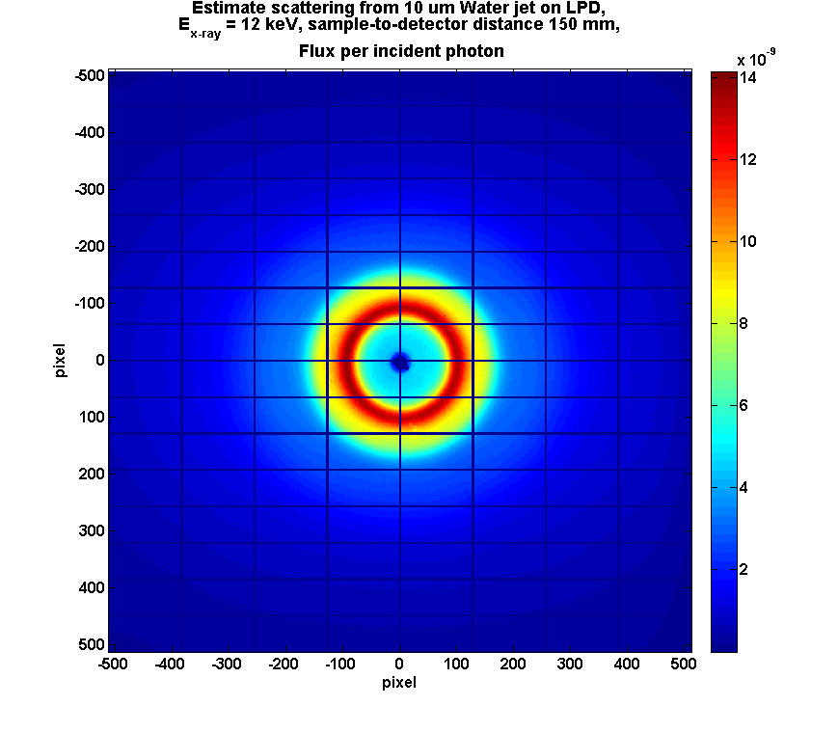
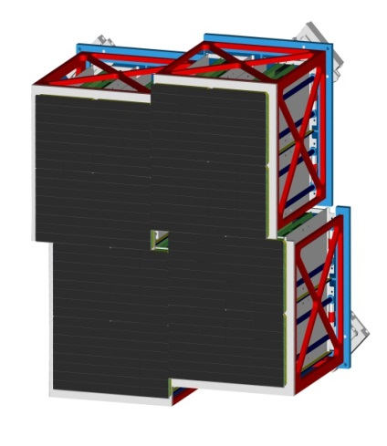
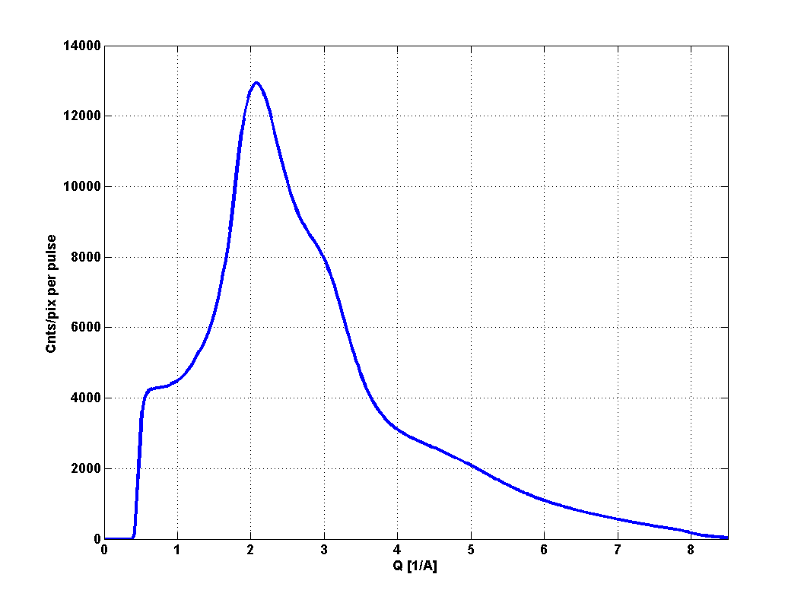
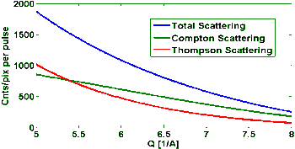
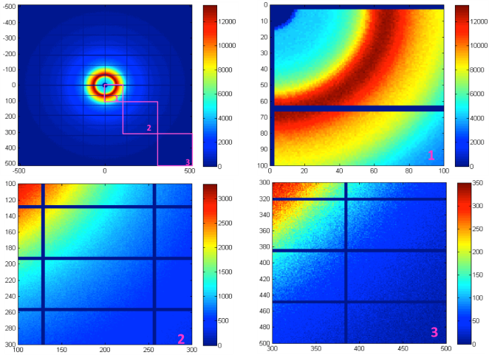
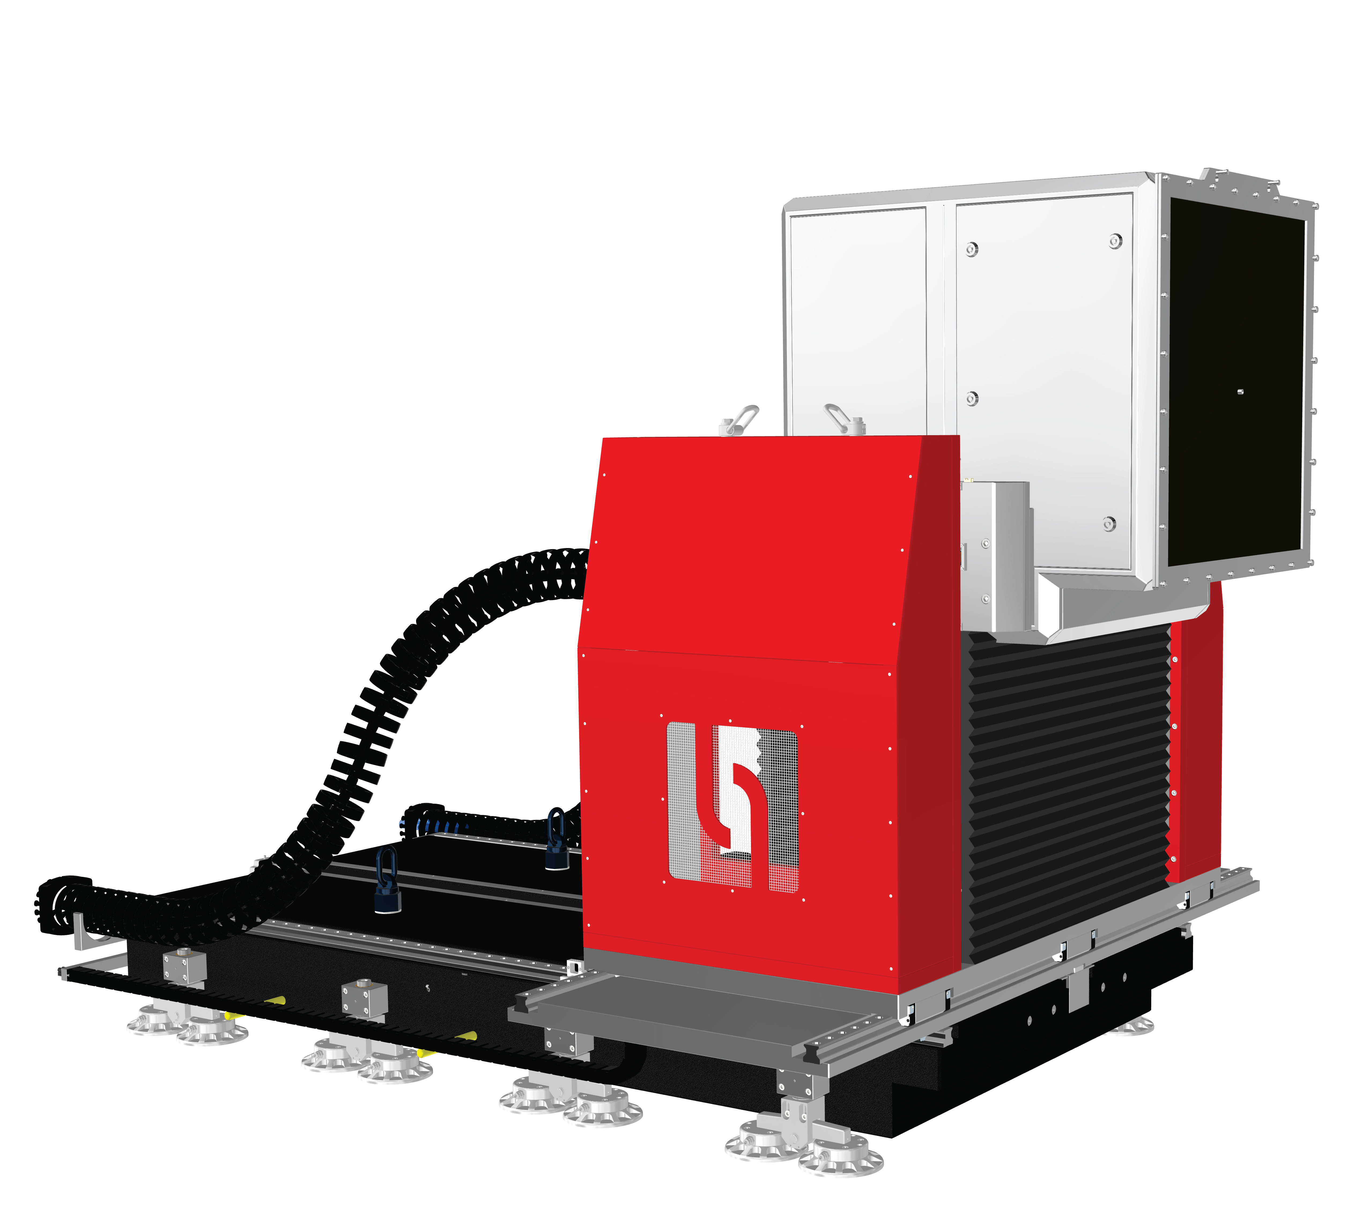
Liquid WAXS for probing solvation cage
Wide-Angle X-ray Scattering (WAXS) delivers global geometric structural dynamics of the solute and the surrounding solvent
Scattering from 10 um flat water jet,
10¹² photons/pulse @ 15keV
Sample-to-detector distance120mm
Raw data
No monochromatization needed → pink beam compatible
Moderate focusing requirements → < pixel size (0.5 mm)
High repetition rate desired!
Variable sample-detector distance desired → WAXS/SAXS
He environment compatible
High dynamics range (single photon→10⁵ photons/pixel)
Notes:
Systems:
1 Mpix with adjustable central hole (in construction)
2-Tile prototype: 32 x 256 pixels.
Super-module prototype: 256 x 256 pixels.
Technology: Hybrid pixel detector constructed from 4-side buttable sensor modules. 86% active area.
Pixel size: (500 μm)², 500 μm thick Si.
Energy range: 5 – 20 keV.
Frame rate: 4.5 MHz, output rate: 5120 images/s.
512 images analogue on-chip storage.
Read noise: 1000 e⁻ rms, referred to sensor input.
Dynamic range: 10⁵ 12 keV photons
Amplifier architecture: 3 parallel gain settings merged off chip within DAQ system, 0.03 lsb/ph to 30 lsb/ph.

Slide 15

LPD for Wide-Angle X-ray Scattering
Large Pixel Detector
XFEL Beam Parameters
Pink Beam fine (no mono)
Any single X-Ray Energy
(5-12 keV)
Synch‘ed Laser
(PP or Tangerine)
1 LPD

Slide 16
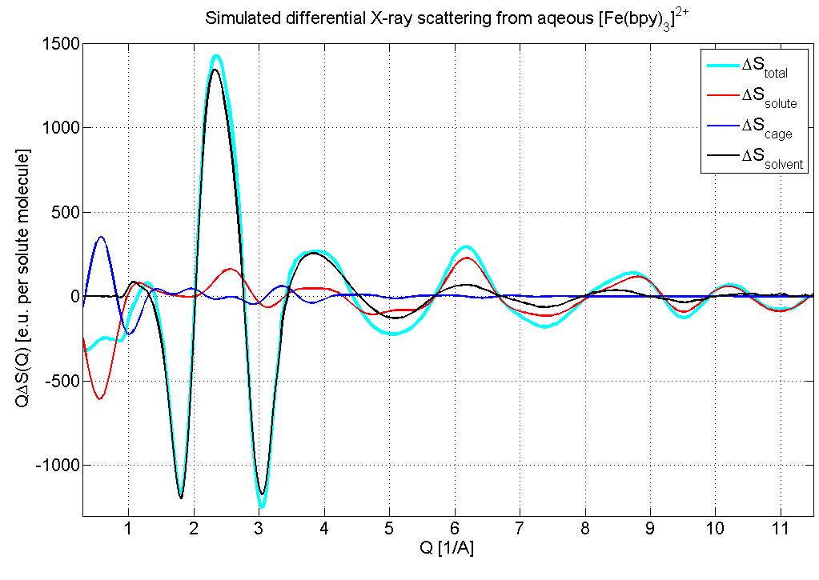
fs Wide-Angle X-ray Scattering: Nice Potential
High Q-Range Attractive
XFEL Beam Parameters
Pink Beam fine (no mono)
16→20 keV
Synch‘ed Laser
(PP or Tangerine)
1 LPD
solvent
solute
cage+solute
Femtoseconds: NEW!!

Slide 17
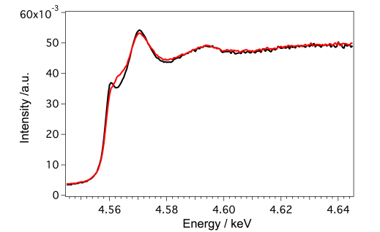
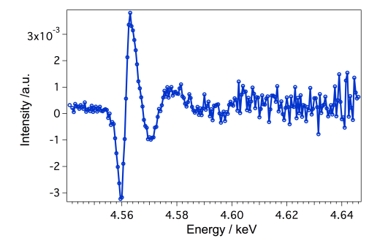
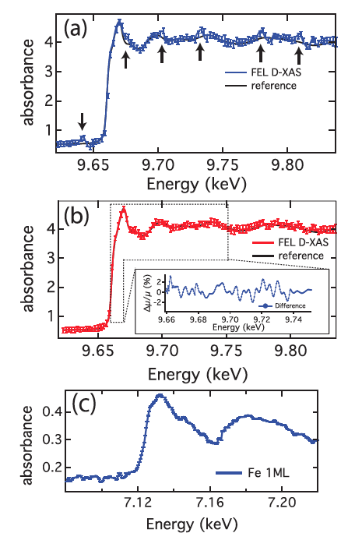
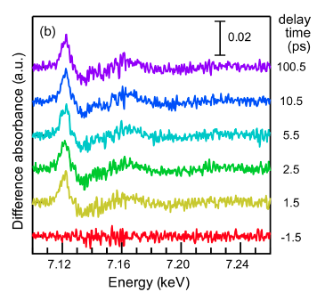
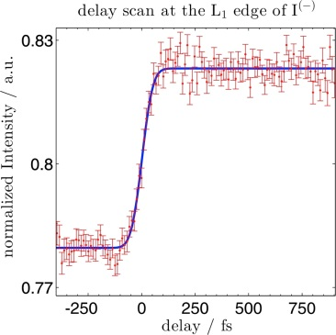
Scanning XANES at FXE (4-bounce mono)
Currently: Point-by-point XAS (scanning mode)
XFEL Beam Parameters
Mono Beam
Tunable X-Ray Energy (5-12 keV)
Synch‘ed Laser (PP or Tangerine)
1 Diode (APD,…)
1 MHz DAQ
Y. Obara et al., Optics Express, 22 (2014) 1105
Notes:
1) Both modes require timing correction
2) Scanning modes requires precise incident intensity normalization
3) Variable-gap undulators allow to scan XXX eV range (gap scans in synch with the monochromator)

Slide 18
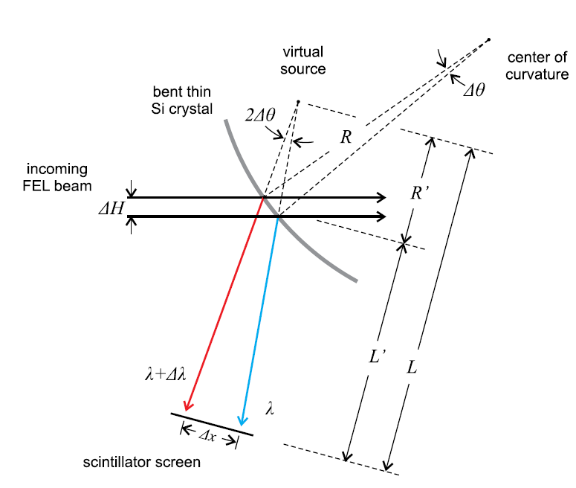
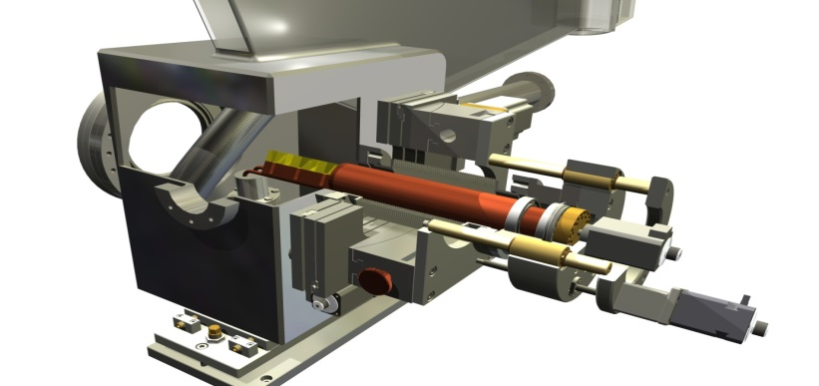
Dispersive XANES at FXE
Currently: Point-by-point XAS (scanning mode)
XFEL Beam Parameters
Pink Beam fine (no mono)
Dial-in X-Ray Energy (5-12 keV)
Synch‘ed Laser (PP or Tangerine)
2 Gotthards
Scanning mode → 4-bounce monochromator
Beam focusing chromaticity → transfocator
Requires reliable intensity normalization!
(Single energy @ time delay) /shot
Gated point detector (APD)
Single-shot measurements→ require 2 Spectrum Analyzers (SA)
Pink beam would provide up to 1% bandwidth
(Entire XANES spectrum @ time delay) /shot
Self-normalization!
Requires a fast readout gated 1D detector (Gotthard)
Notes:
1) Both modes require timing correction
2) Scanning modes requires precise incident intensity normalization
3) Variable-gap undulators allow to scan XXX eV range (gap scans in synch with the monochromator)

Slide 19
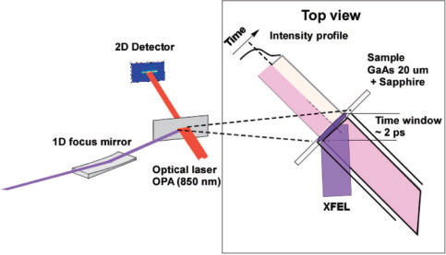
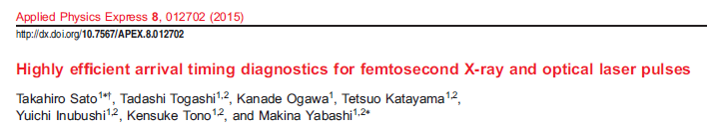
Timing Tool and Femtosecond time resolution
Day 1: LCLS/SACLA Solution (FXE: grating solution)
(10 Hz, spectral + spatial encoding, 30 fs fwhm → 1 fs)
Stabilized arrival time by machine nice to have, 30 fs
1-2 Gotthards 2.0
MHz timing tool for < 30 fs under development (EUCALL)

Slide 20
Summary
Any SASE Energy in 5-12 keV range (pink beam fine)
fine for startup/first (limited) experiments (XES)
Special SASE Energies in 5-12 keV range (XANES)
(TM edges, Mn → Fe → Cu, Co → Pt (L), etc…)
4-bounce monochromator + special 5-12 keV range
16 → 20 keV attractive for High-Q WAXS
Timing: jitter → time-stamped, stepwise (10 Hz, ...) fine

Slide 21
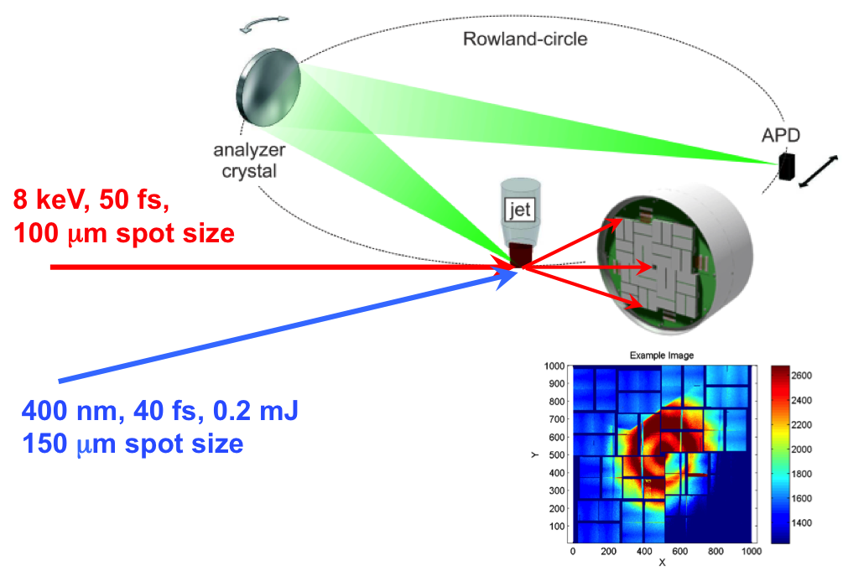


Summary: Towards a High-Speed Molecular Camera
for tracking chemical reaction dynamics
XES
User operation in 2017!
XFEL beam
XDS
Diode
Optical laser beam
XAS
A Suite of Simultaneous X-Ray Tools available:
- XAS
- Non resonant XES
- Resonant XES (RIXS)
- X-Ray Raman Scattering
- Wide(Small)-Angle X-ray Scattering
- …
Courtesy by European XFEL/Rey.Hori

Slide 22
Day -1 Experimental Conditions
XES experiment on photoexcited solvated chromophores
WAXS (=XDS) experiment on solvated chromophores
…and each of the above Time-Resolved (< 1 ps)
TR-XANES (with 4-bounce mono), dispersive XANES
Experimental Conditions for Incident Beam
>5 keV, 12 keV, 16-20 keV
Pink Beam, mono (4-bounce)
Single Pulse (10 Hz), 100 kHz, 4.5 MHz
Experimental Conditions for TR Experiment
Synchronized PP Laser at same rep-rate as XFEL beam
Backup: FXE Tangerine laser (synchronizable, gatable, tunable)
(may also be borrowed from other instruments)
Available Instrumentation
Femtosecond Laser System (10 uJ, 1 mJ), synch‘ed to XFEL
Liquid Jet collection (flat sheet)
1 LPD
2 strip detectors, various diodes, MHz DAQ schemes,…
Notes:
Copy & paste an element from the Clip Board to the particular slide:
1) Click on a box to mark it.
2) Position the mouse pointer on the box frame: Copy!
3) Click on the particular slide: Paste!
How you intend to use the elements is your choice.
You can combine the text block style with the background colour
in different manner.
How to change the height or the width (or both) of a box
(including its background):
Mark the box, and grip and draw the specific edge of the box frame.
You can position a text block inside a frame: 1) Mark the text block.
2) Click on the menu point “Format”: “Text box”, “Text Box”,
“Text Anchor Point”.
Insert a new slide: Menu button “New Slide”
For more bullet levels (max. 5) use the tab stop button →| on your keyboard,
back with |←
The default colour scheme for font, line and fill is (1st row, from left to right):
White  Violet  Grey  Black  Violet  Orange  Violet  Orange

Slide 23
Acknowledgments FXE group
Christian Bressler (Group leader)
Wojciech Gawelda
Andreas Galler
Dmitry Khakhulin
Martin Knoll
Sebastian Schulz
Peter Zalden (CUI)
Christina Bömer
Alexander Britz
Tadesse Assefa
Michael Diez
Christian Mammen et al. (JJ X-Ray)
Martin M Nielsen (DTU)
WP73, 74, 90s, PSPO,
Funding (since 2009):
European XFEL
DFG (SFB925, TPA4)
BMBF (VP302)
CUI Hamburg
Uni Hamburg
PIER Hamburg
IMPRS-UFAST
EU-CRISP (- 2014)
EUCALL (2015 -)

