Slide 1
CHESS2 design update
H. Grabas

Slide 2
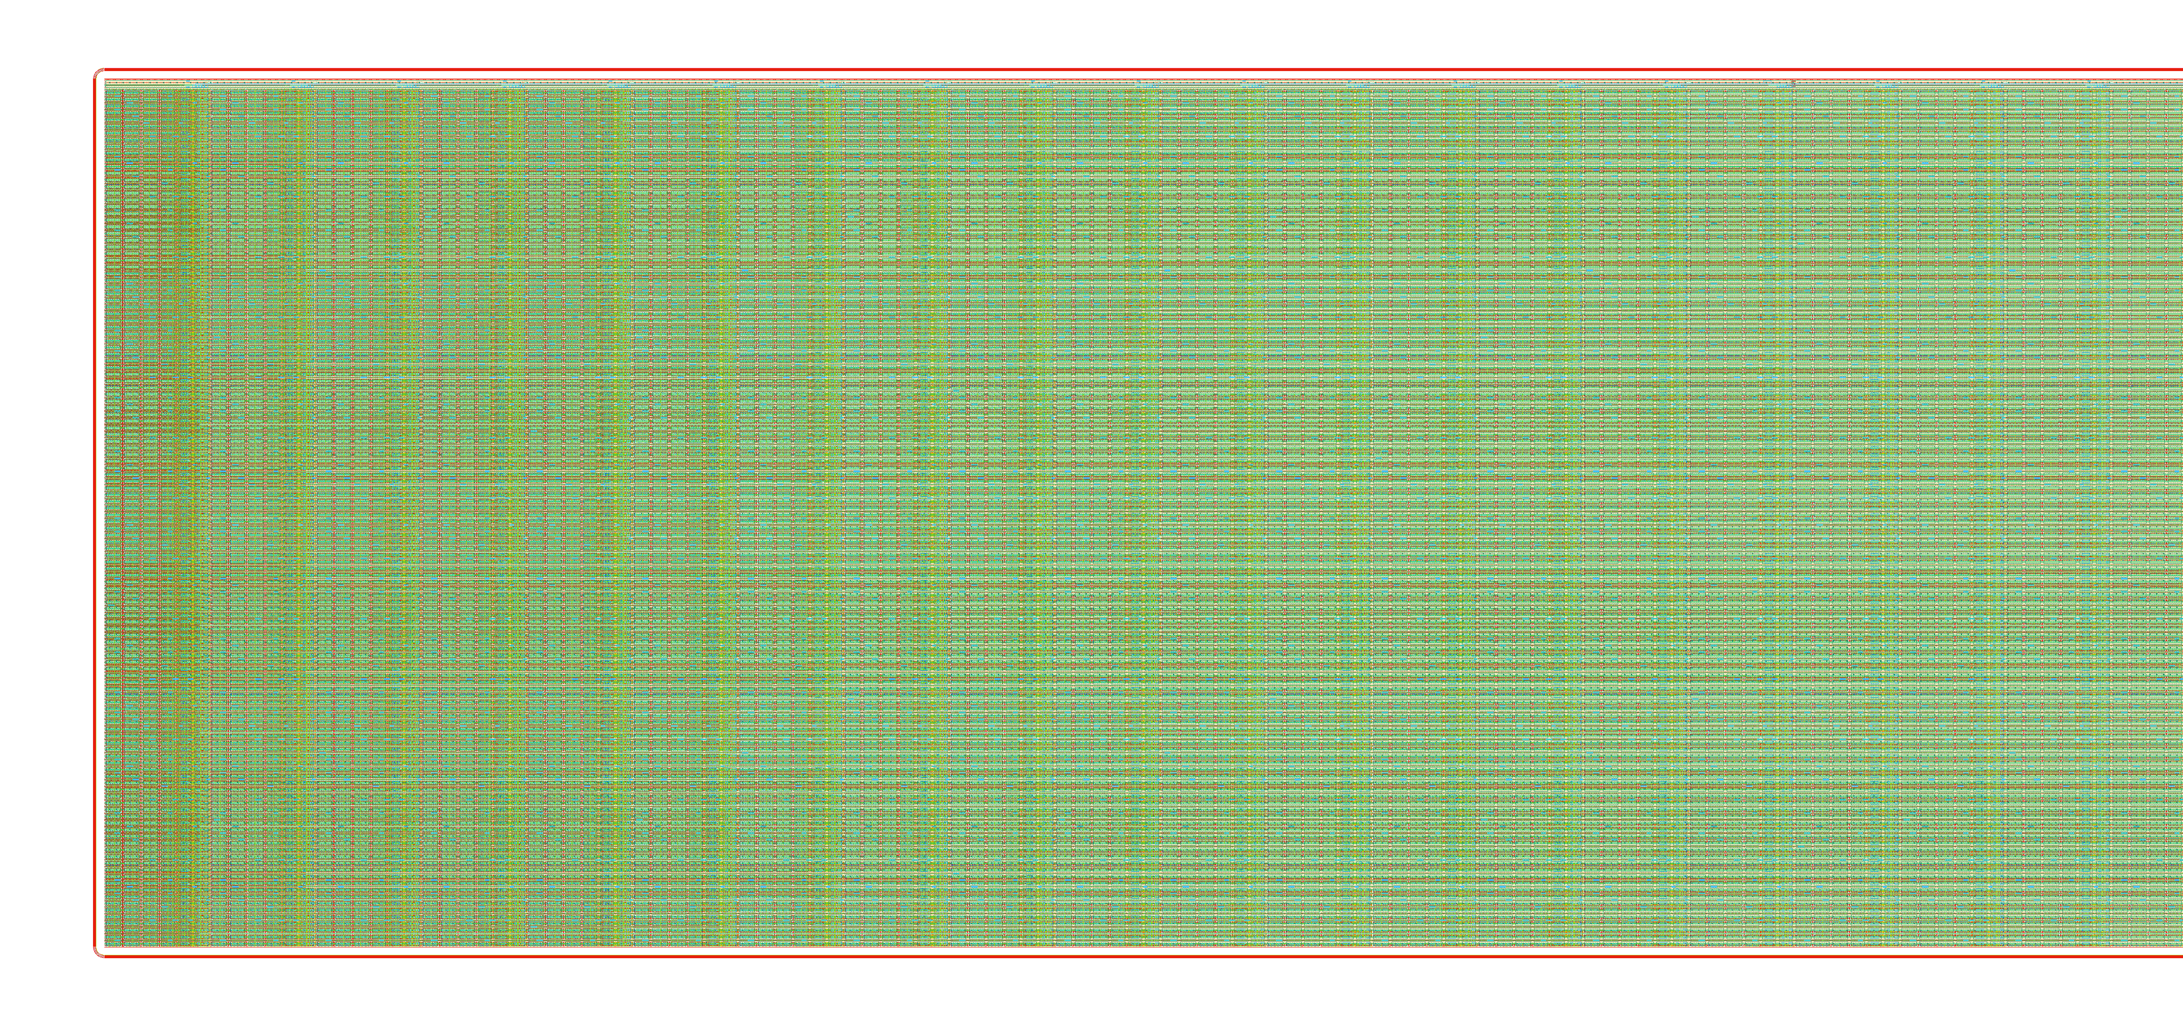
Status
Guardring added around the pixels.

Slide 3
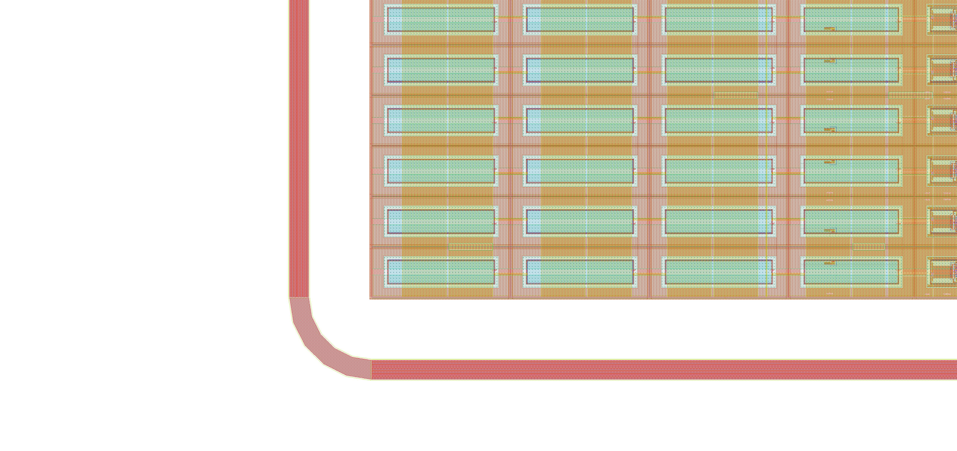
Guard-ring
15µm width
50µm spacing to the HV contacts
5 segments corner

Slide 4
Update
- Found that parasitic capacitive coupling between dynamic lines - major issue – present for capacitance down to 100aF.
- Can be fixed in layout adding metal shields – in progress.
- Laser injection from the top not possible anymore
- Full chip simulation including the pixels have started.
- Clean DRC on all the pixels + row and column selectors and clock tree.

Slide 5
Test structures - reminder
  Passive pixel array real size 3x3.
  Passive pixel array real size 3x3 disconnected amplifier.
  Passive pixel array real size 3x3 without guard-ring.
  Passive pixel array half-size 3x3.
  Edge TCT real-size nothing inside.
  Large passive array 1x1mm or larger
  32 stand-alone amplifiers in a pixels with signal injection in nwell.
  Isolated transistor, cap, res isolated in a nwell
  Latchup test structure
  HV switch
  3*128strip on edge - no spacing between the 2 arrays. + dicing street one the isolated one.
  LVDS small swing receiver connected to transmitter. on opposite ends.
  Huge nwell 1x1mm or larger
  Active pixel array 32x9 real size pixel

