Slide 1
TJ-Chess1 Characterization
K. Kanisauskas, T. Binnie, J. Dopke, T. Huffman, J. John, R. Plackett, L. Vigani, Q. Xiu
ATLAS Strip CMOS Regular Meeting
March 1, 2016

Slide 2
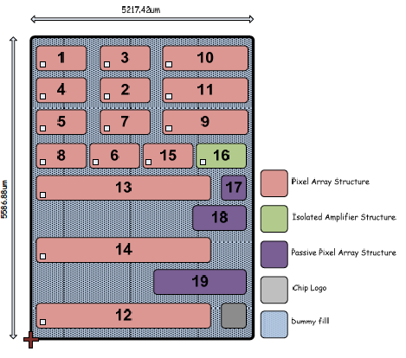
TJ-Chess1
Analogue pixel response tested on TJ-Chess1 p-on-p test chip
Active pixel structures arranged in 5x5 pixel matrices
Structures 1 and 10 were investigated
Detailed results obtained from structure 1
Laser scans performed at different bias voltages
I-V measurements

Slide 3
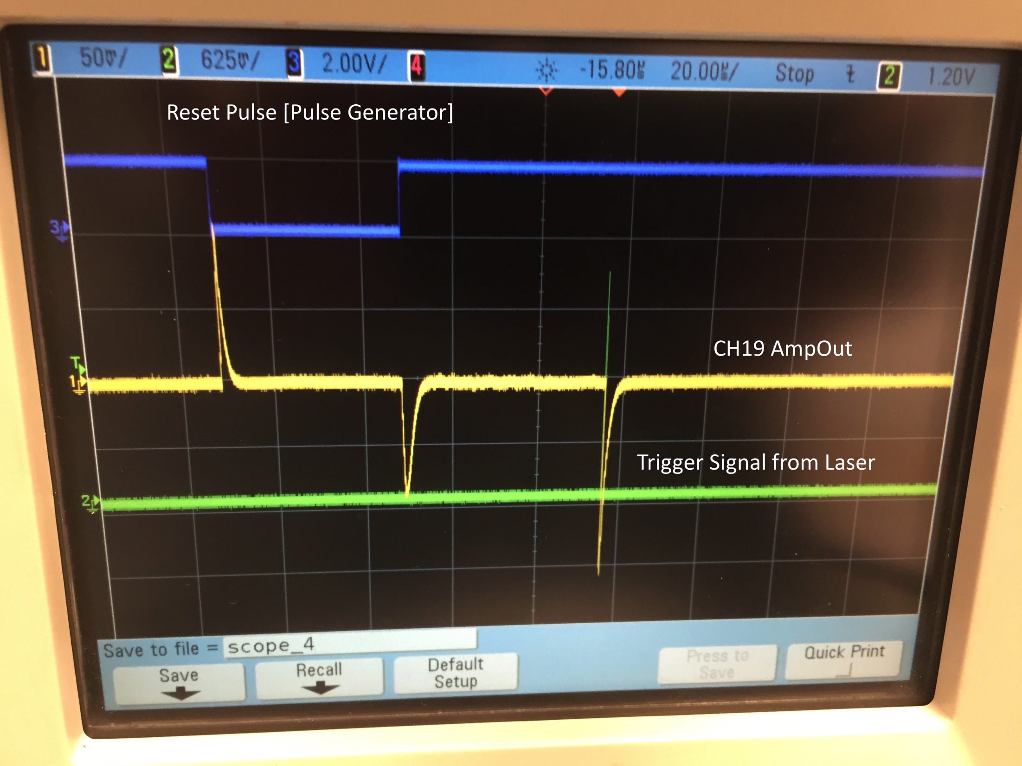
Initial Testing
TJ-Chess1 placed in the laser setup
Pre-amplifier reset by generating external pulse
Reset pulse
  1.8V high, 0V low
  40μs width
Laser power set close to max
Not focused ➔ beam spot covers large area
First AmpOut signal seen from channel 19 in structure 10
40×400μm² pixels

Slide 4
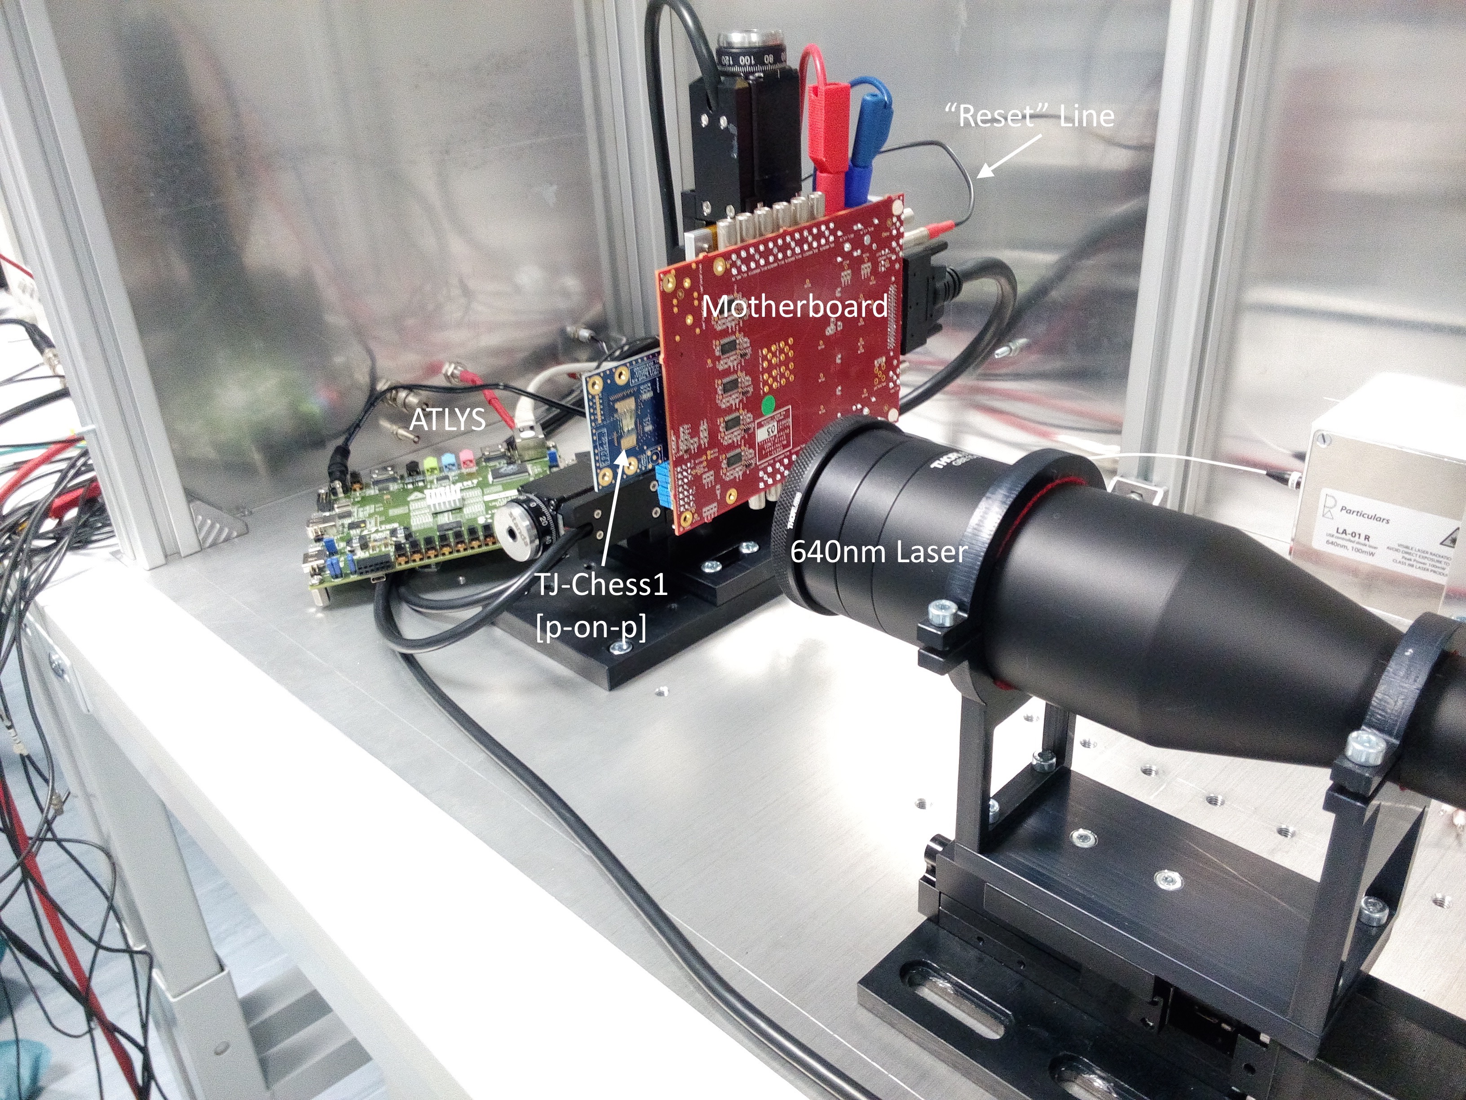
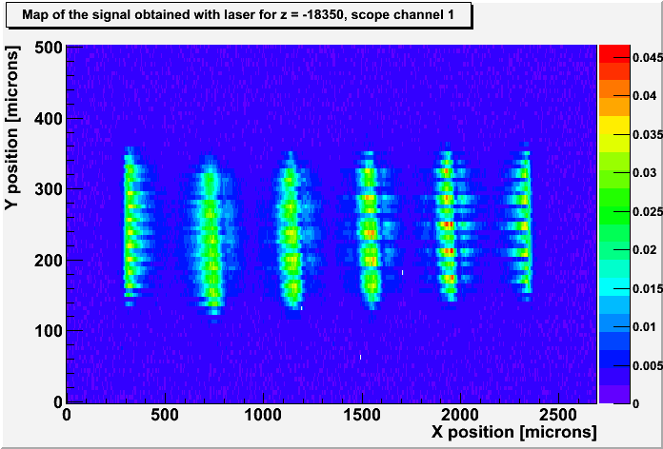
Structure 10
To get more details laser power was reduced
Several scans performed over the whole structure 10
No clear image of single pixel structure obtained
Signal from single pixel over large area (≈200×2000μm²)
  Corresponds to area of all pixels

Slide 5
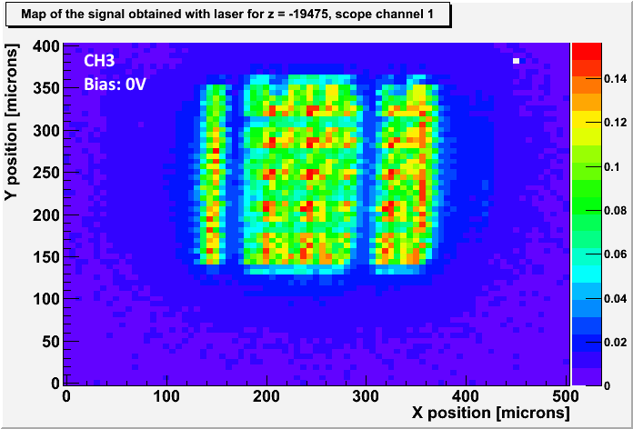
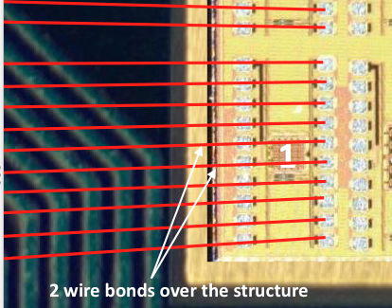
Structure 1
Pixels?
Structure 1 contains 40×40μm² pixels (6.25μm steps)
Scans performed for two channels with the laser focused
Two gaps seen are believed to be wire bonds
Again ➔ signal from single pixel over large area i.e. ≈200×200μm²

Slide 6
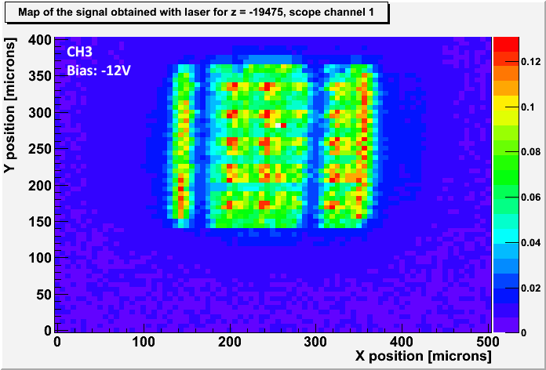
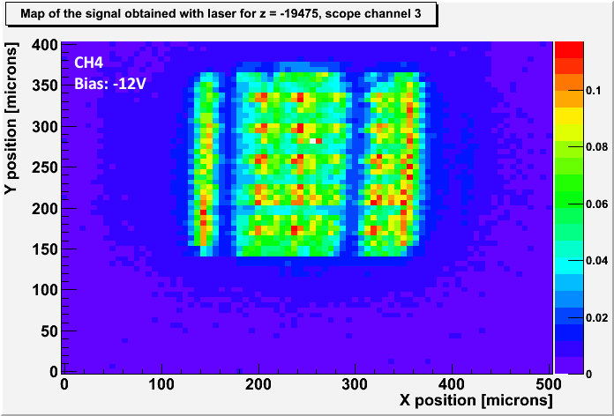
Structure 1 Continued…
Almost identical signal map from CH3 and CH4 (shorted pixels?)
Very high leakage current observed, 7.65mA at -12V
No difference in signal height compared to 0V bias
Signal rise times range between 100-250ns in the active area

Slide 7
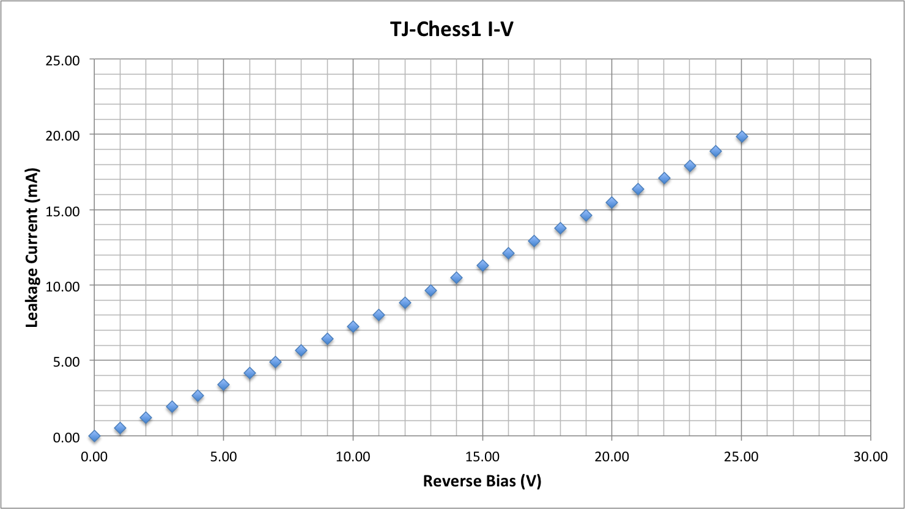
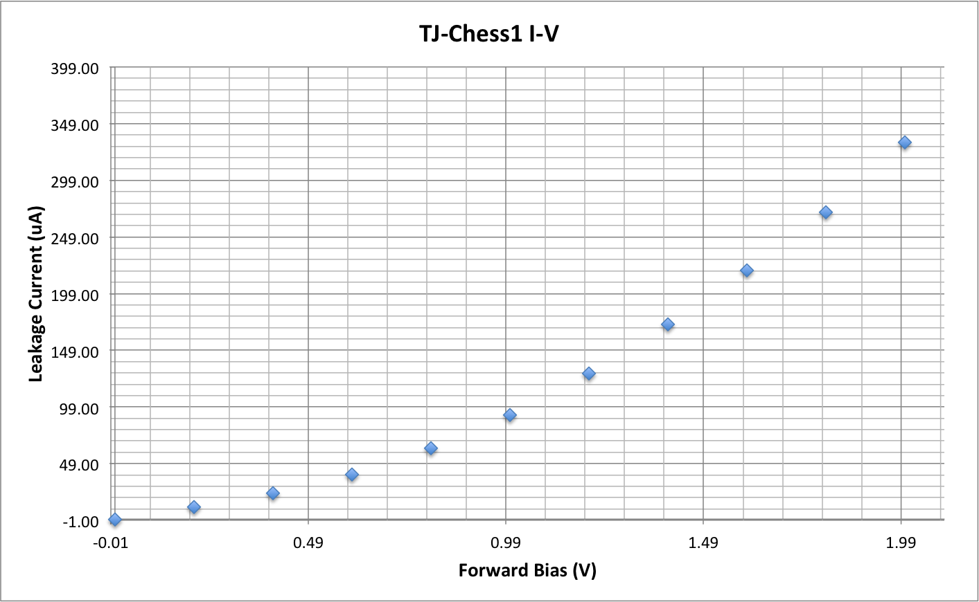
I-V Measurements
Two sets of measurements i.e. at forward and reverse bias
500 samples obtained at each bias step
≈20mA observed at -25V
Resistor-like behavior seen in reverse bias range
Exponential-like dependence in forward bias region

Slide 8
Summary
AmpOut signal seen from structures 1 and 10
Unclear structure map seen for structure 10 (wire bonds?)
Signal seems to arrive from all the pixels within the structure
Very high leakage current observed (in order of mA) at relatively low bias voltages

Slide 9
Next Steps
Try out different reset signal configurations
Obtain Fe-55 spectra for different structures
Attempt to test passive structures on irradiated AMS-Chess1

Slide 10
Backup Slides

Slide 11
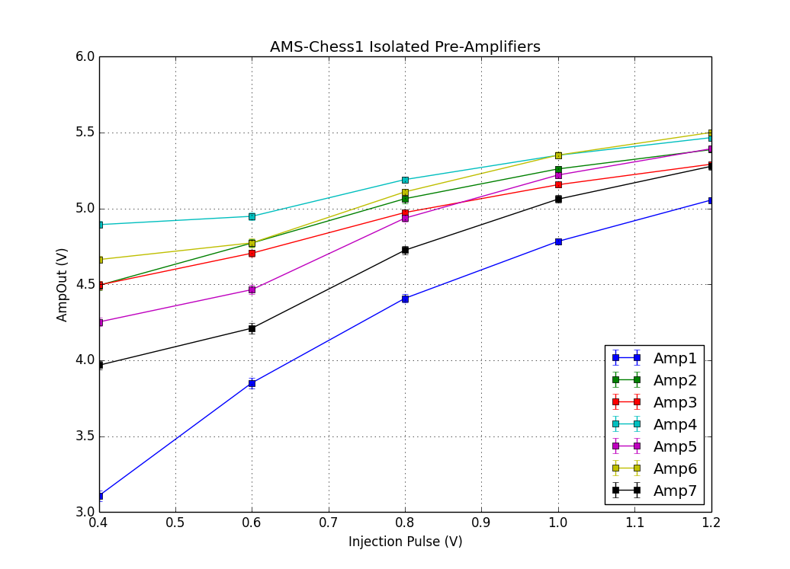
AMS-Chess1
Isolated Amplifier matrix tested on AMS-Chess1
Input pulses from 0.4V-1.2V, 10μs of width
High output signal (in order of volts)
Response non-linear

