Slide 1
HR CHESS News
Jens (et. al.)

Slide 2
Schedule
HR-CHESS designer has resigned
  BIG THANKS: He (who is not to be named) has spent a lot of time and effort on the project, and we’ll miss him!
Schematics and simulation of HR CHESS-2 is mostly done, but layout hasn’t started (as far as I am aware)
No idea about a time scale for providing CHESS-2

Slide 3
Testing
Currently have two diced substrates in hand:
  25um HR PonP
  18um HR PonP
Both substrates show some features when biasing them:
  Leakage current dramatically increases, once beyond ~2V
  May well be due to conductive connection through EPI, all P-type material from deep P-well (@GND) to P-type substrate (Backside bias)

Slide 4
Active Structures
Checked isolated amplifiers to start with:
  Very good results, gain about 30 (mV output per mV input)
Then started firing at Pixels with IR laser:
  Uniform response within one structure, no matter where we fire!
  Full 5x5 matrix seems to be sensitive, output reacts any time we aim the laser within the guard rings
  Crosstalk not visible on other substructures bonded to the same daughter-card: No crosstalk through bias lines (at least nothing we can decouple on the boards)
Amplifier peaking time is O(0.5-1us…)

Slide 5
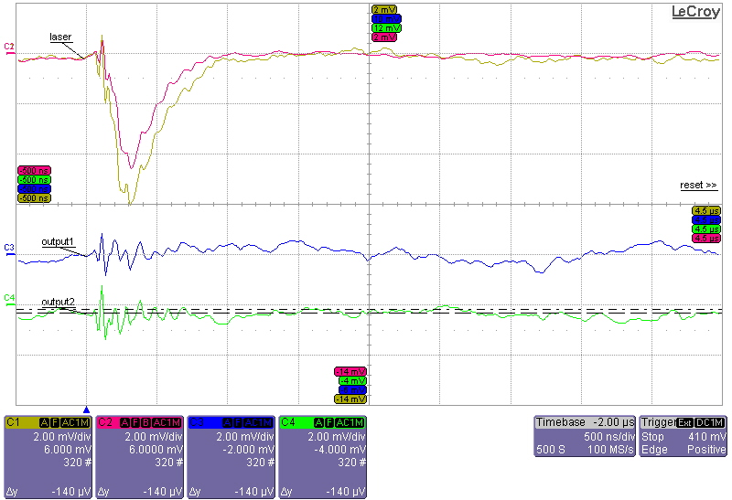
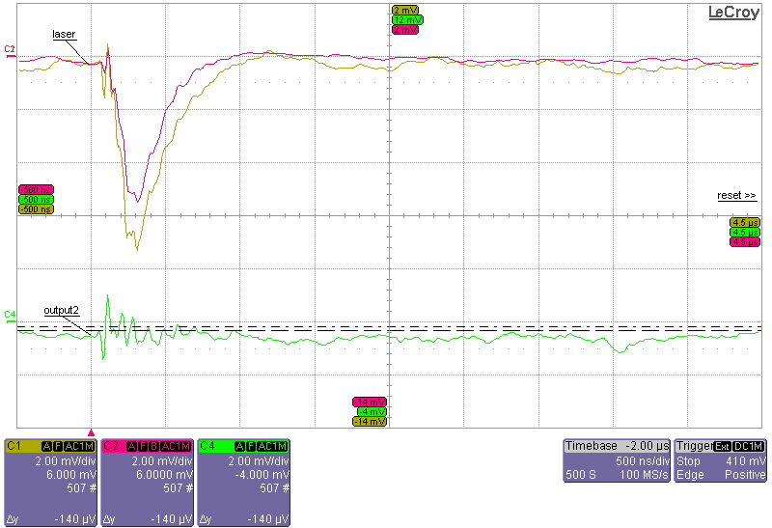
Example of Laser injection
Laser Position
Laser are fired on two different position of brick 10
Brick 10 (Channel 1→ Pixel 1; Channel 2→ Pixel 5)
Brick 3 ( Channel 3→ Pixel 8; Channel 4→ Pixel 9)
1
4
7
2
5
8
3
6
9
Thanks to Qinglei (IHEP) and Gary (RAL) for putting lots of time into this

Slide 6
Next
Passive pixels are currently being hooked up at RAL to have a go at those:
  Fast amplifier could provide for TCT measurements
Irradiate at Ljubiliana
  O(10) chips to be run up to different levels
  Backside bias current might show that we cannot run fully depleted when collecting electrons
    Need to check why this never appeared in TCAD sims
Who wants chips?
  Need to know whether people want daughtercards as well
  Igor will get some (2), IHEP and UCSC have asked
  Anyone else? (I suppose DESY…)

