Slide 1
AMS-Chess1 Characterization
K. Kanisauskas, T. Binnie, J. Dopke, T. Huffman, J. John, R. Plackett, L. Vigani, Q. Xiu
ATLAS Strip CMOS Regular Meeting
March 15, 2016

Slide 2
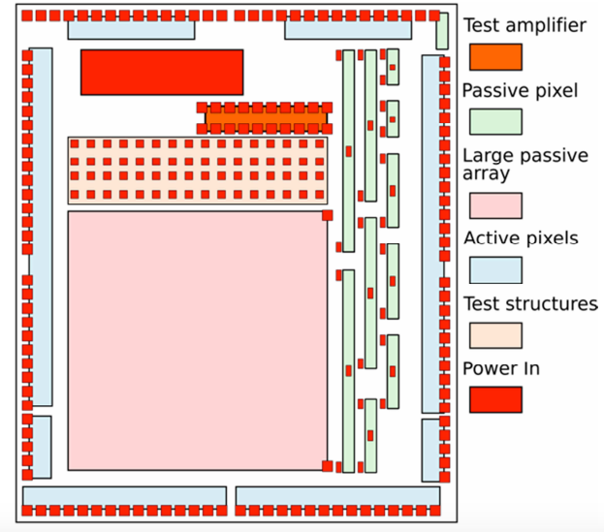
AMS-Chess1
Measurements performed for irradiated and non-irradiated samples
Laser scans done at different bias voltages
APA6 structure investigated
45×400μm² size pixels
Isolated amplifiers tested on irradiated sample

Slide 3
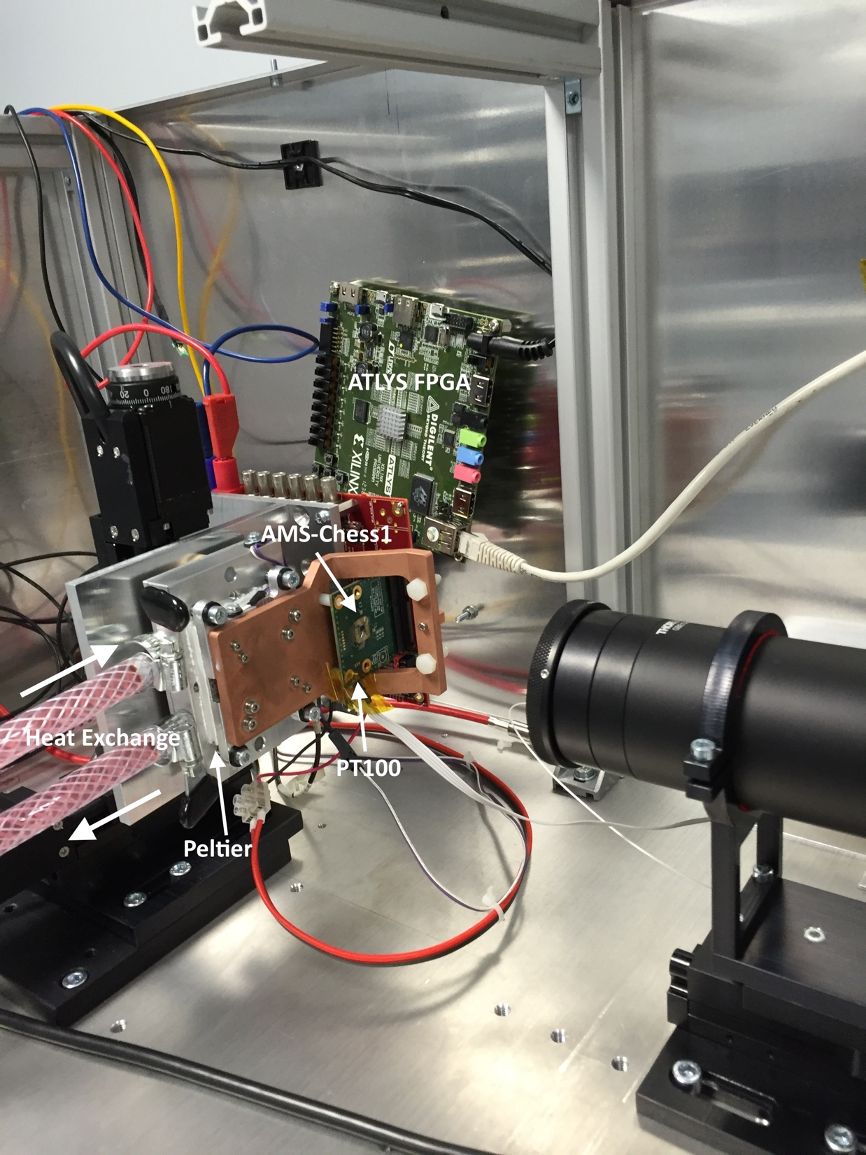
Laser Setup
1060nm laser was used
Measurements for non-irradiated sample done at room temperature
Irradiated device is cooled down using peltier
Constant dry air supply available (dew point ≈ -11℃)
Temperature monitored close to AMS-Chess1 chip during measurements

Slide 4
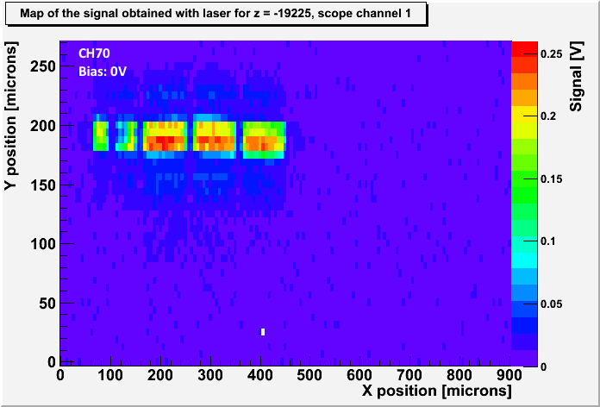
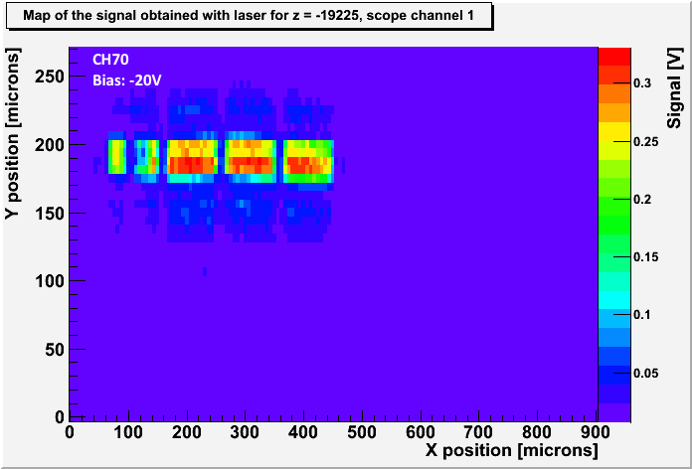
Non-Irradiated Sample (1)
Output Signal Maps
Data was taken for CH65 and CH70 at -70, -50, -20 and 0 bias voltages
No strong dependence of signal height on bias voltage observed
Default DAC settings were used

Slide 5
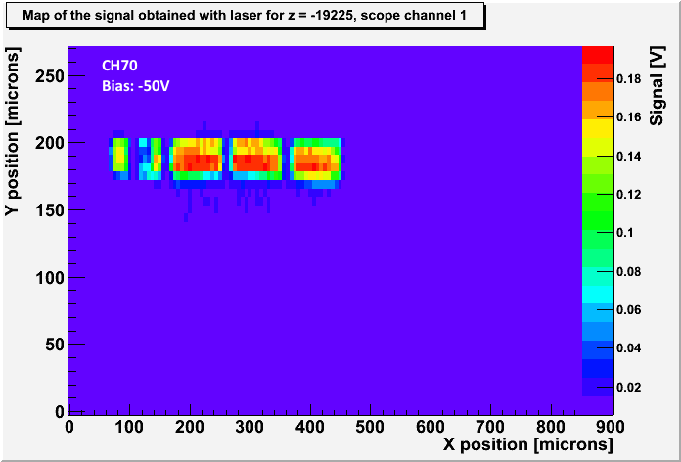
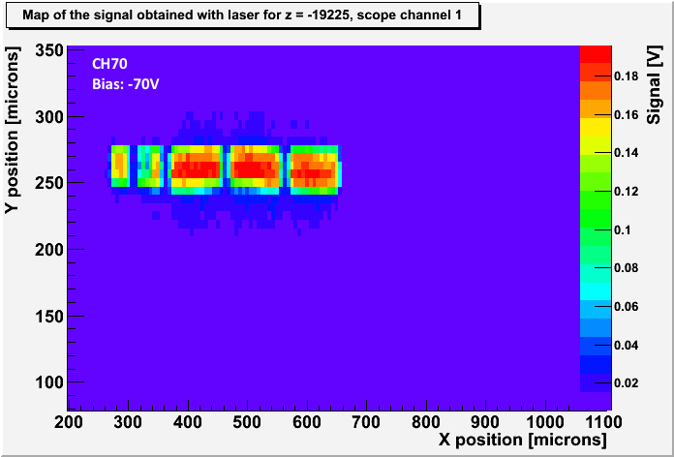
Non-Irradiated Sample (2)
Output Signal Maps

Slide 6
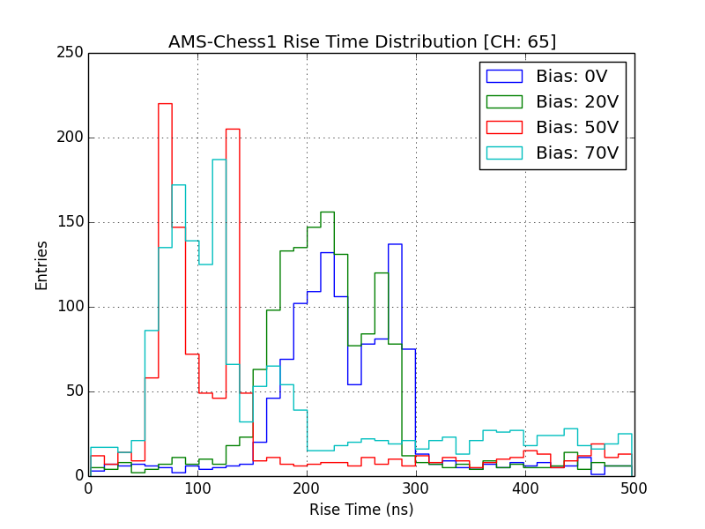
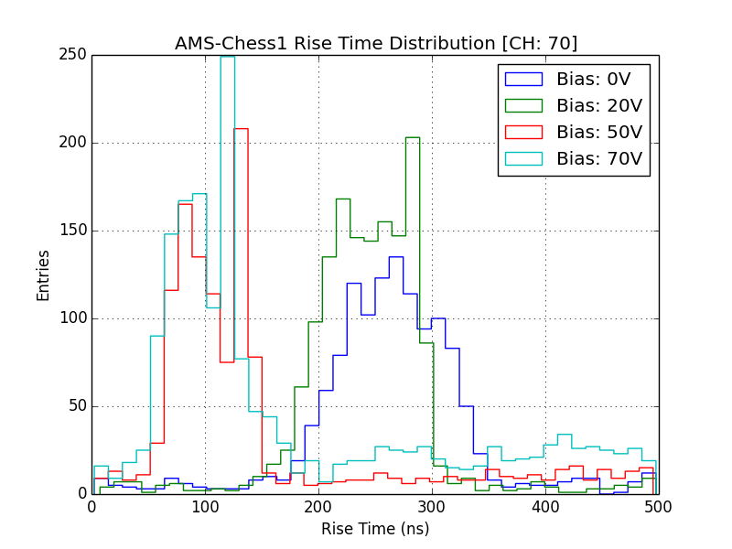
Non-Irradiated Sample (3)
Signal Rise Time Distributions
Strong dependence of rise time distribution on bias voltage observed for both channels
The previous could be attributed to different charge collection mechanisms (drift and diffusion)

Slide 7
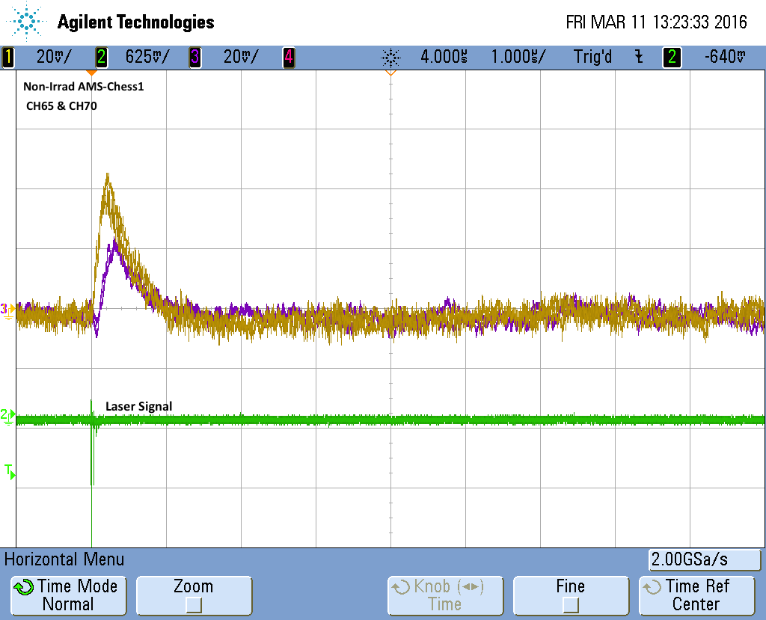
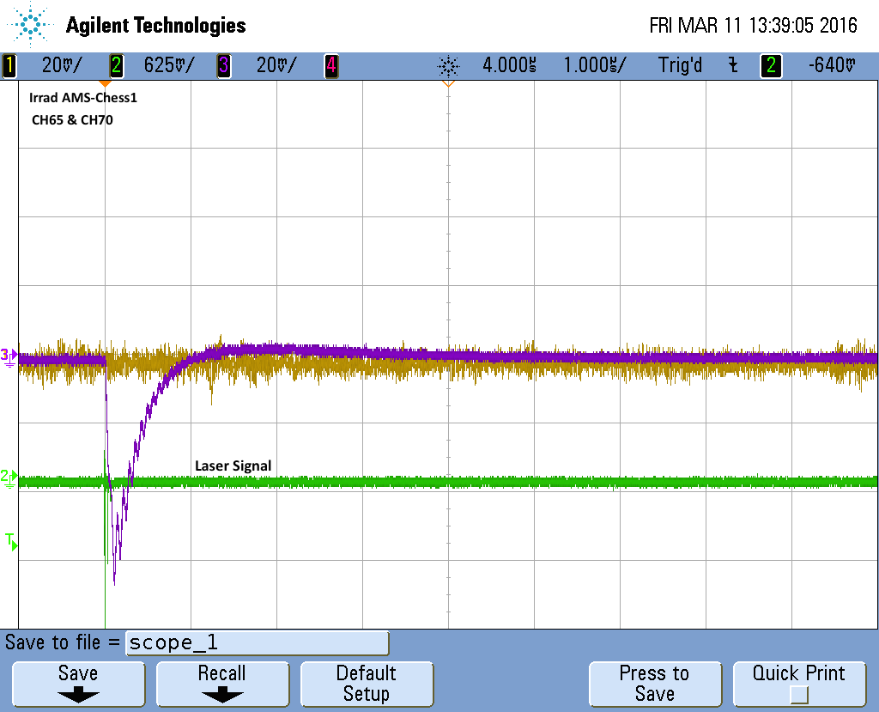
Irradiated Sample (1)
Estimated fluence received by AMS-Chess1 ≈ 0.4×10¹⁵n_{eq}/cm²
After global DAC adjustment the output signal from channels 65 and 70 seen on irradiated sample
The output signal seems to be inverted (still need to figure out why)
Much larger laser power was needed to get a response

Slide 8
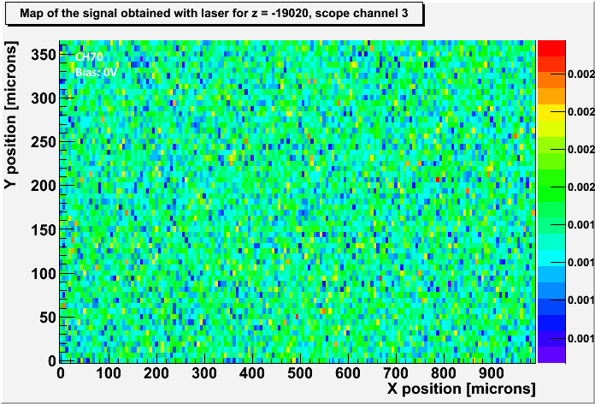
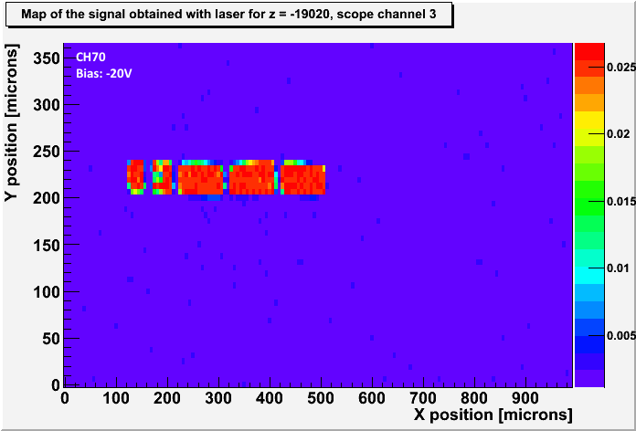
Irradiated Sample (2)
Output Signal Maps
Bias: 0V
Bias: -20V
During the measurements the average temperature near the chip was T=-8.6 ℃
Data was taken for CH65 and CH70 at -80, -70, -50,-40,-30, -20 and 0 bias voltages
Strong dependence of pixel output signal height on bias voltage

Slide 9
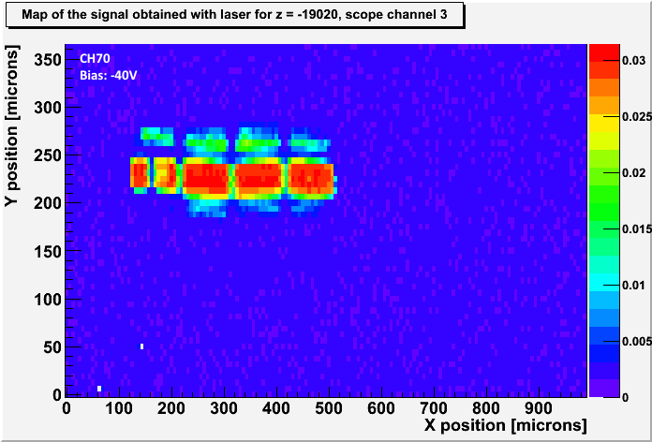
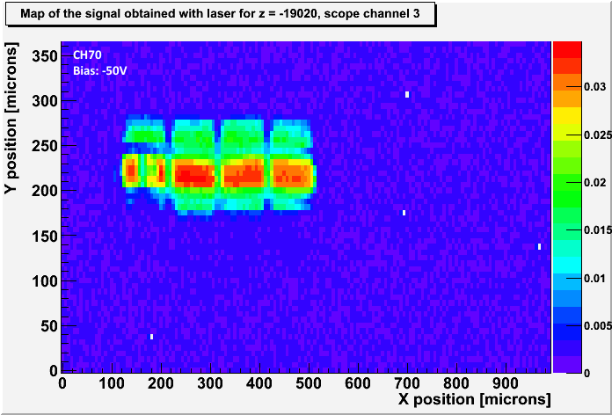
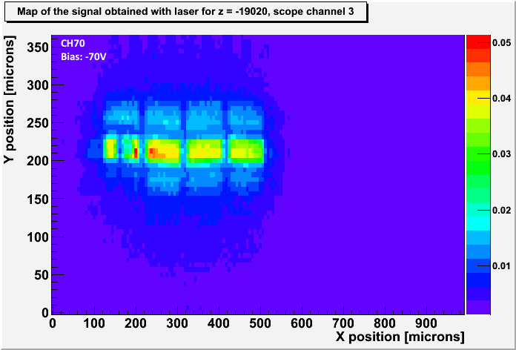
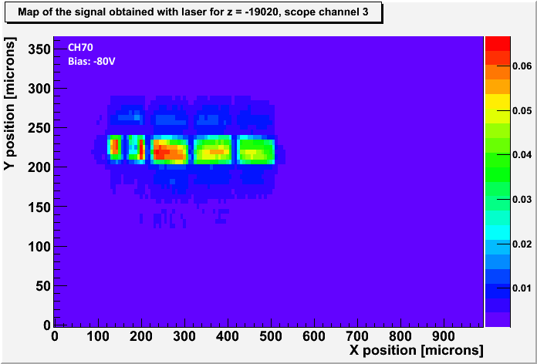
Irradiated Sample (3)
Output Signal Maps

Slide 10
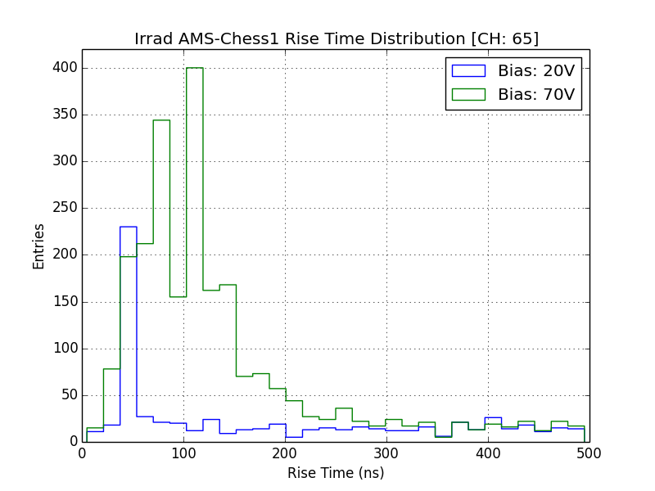
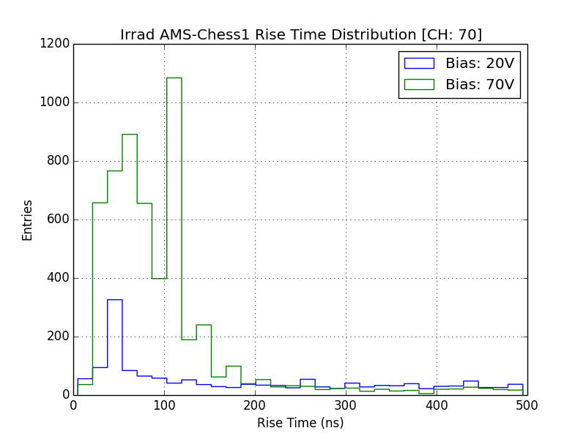
Irradiated Sample (4)
Signal Rise Time Distributions
Not as strong dependence of rise time distribution on bias voltage
Average signal rise times lower than for non-irradiated chip
Charge collection dominated by drift?

Slide 11
Summary
Pixel output signal observed for irradiated device
The signal is inverted compared to non-irradiated sample
Rise-time distributions of signal from irradiated chip indicate that drift dominates charge collection

Slide 12
Next Steps
Test the response from different active pixel structures
Edge-TCT measurements on APA8 pixels
  Observe depletion depth as a function of bias voltage
  Compare rise-time distributions

Slide 13
Backup Slides

Slide 14
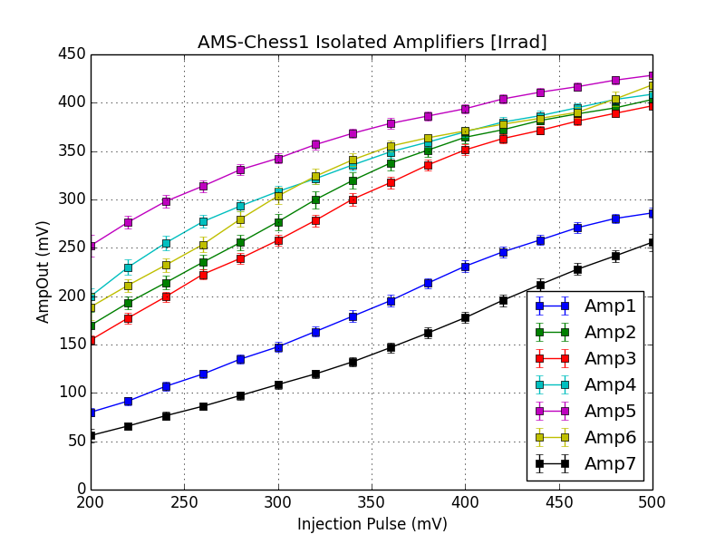
Isolated Amplifiers
Isolated Amplifier matrix tested on irradiated AMS-Chess1 sample
4nF capacitor implemented in injection circuit
Input pulses range 0.2V-0.5V, 10μs of width
Non-linear response observed

Slide 15
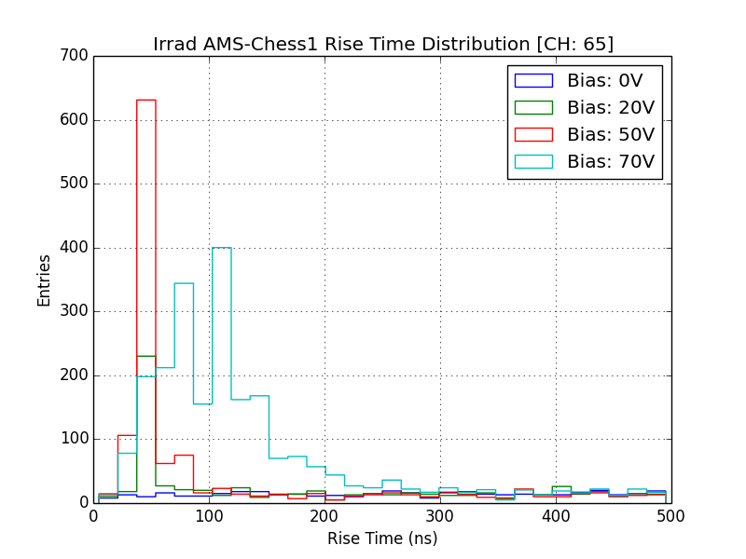
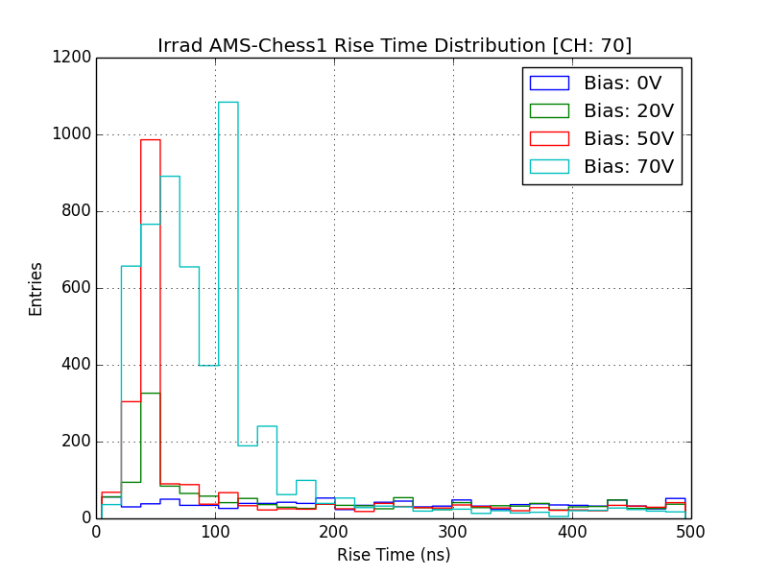
APA6 Rise Time Distributions
Non-Irradiated Sample
Irradiated Sample

Slide 16
DAC Settings
Default
VPLoad: 2100
Casc: 2600
iNSF: 570
iN: 1000
iNBias: 340
iPFB: 2664
APA6 Scan of Irradiated Sample
VPLoad: 2100
Casc: 2600
iNSF: 570
iN: 1000
iNBias: 700
iPFB: 2800
Isolated Amp Testing of Irradiated Sample
VPLoad: 2100
Casc: 2600
iNSF: 570
iN: 1000
iNBias: 340
iPFB: 2225

