Slide 1
First E-TCT results with passive pixels on
CHESS-1 chip irradiated with PS protons
I. Mandić, B. Hiti et al.,
Jožef Stefan Institute, Ljubljana, Slovenia

Slide 2
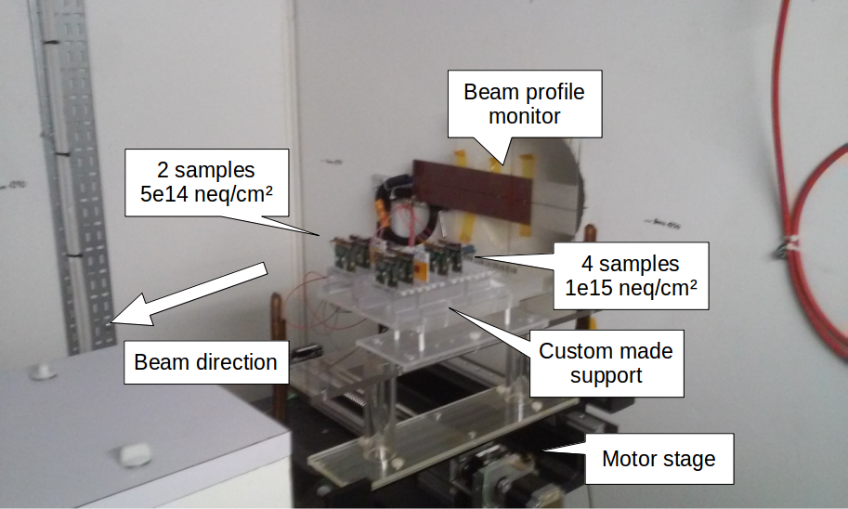
6 chess1 chips mounted on daughter boards irradiated with 24 GeV protons
at CERN PS in november 2015
  More detail in slides by B. Hiti from November 10th 2015
https://indico.desy.de/conferenceDisplay.py?confId=13299
due to broader beam and missalignment the actual equivalent fluences were
3.3e14 n/cm2 and 4.6e14 n/cm2

Slide 3
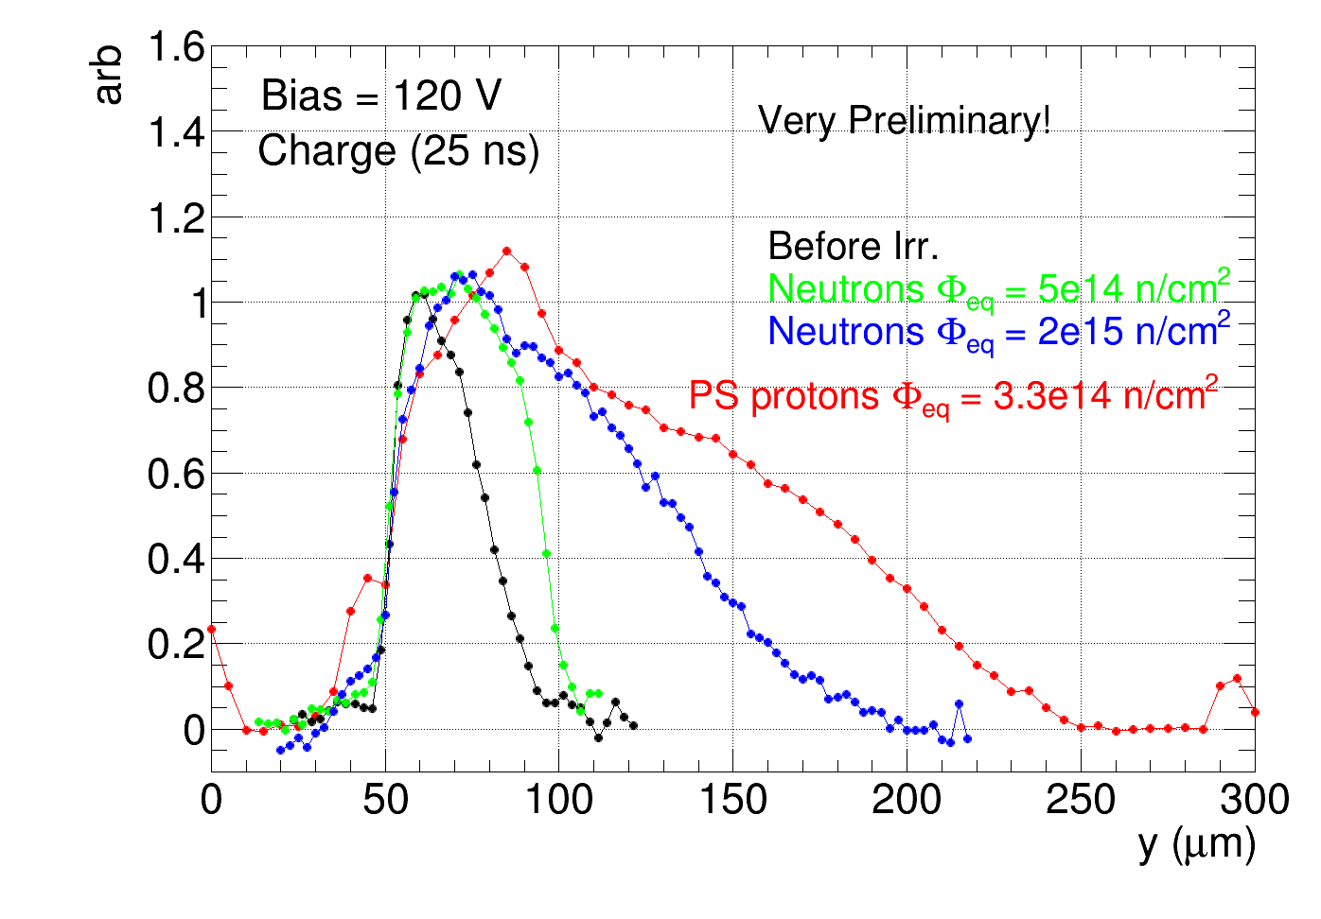
very first E-TCT measurements wit passive pixel array (PPA9) irradiated with 3.3e14
➔ very preliminary, not fully understood, probably not perfect focus
➔ plots may change
large charge collection width measured on sample irradiated with protons
➔ larger than the largest irradiated with neutrons (at 1e15 n/cm2 or 2e15 n/cm2)

Slide 4
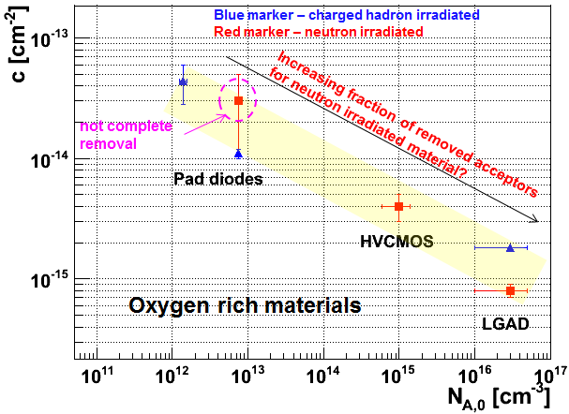
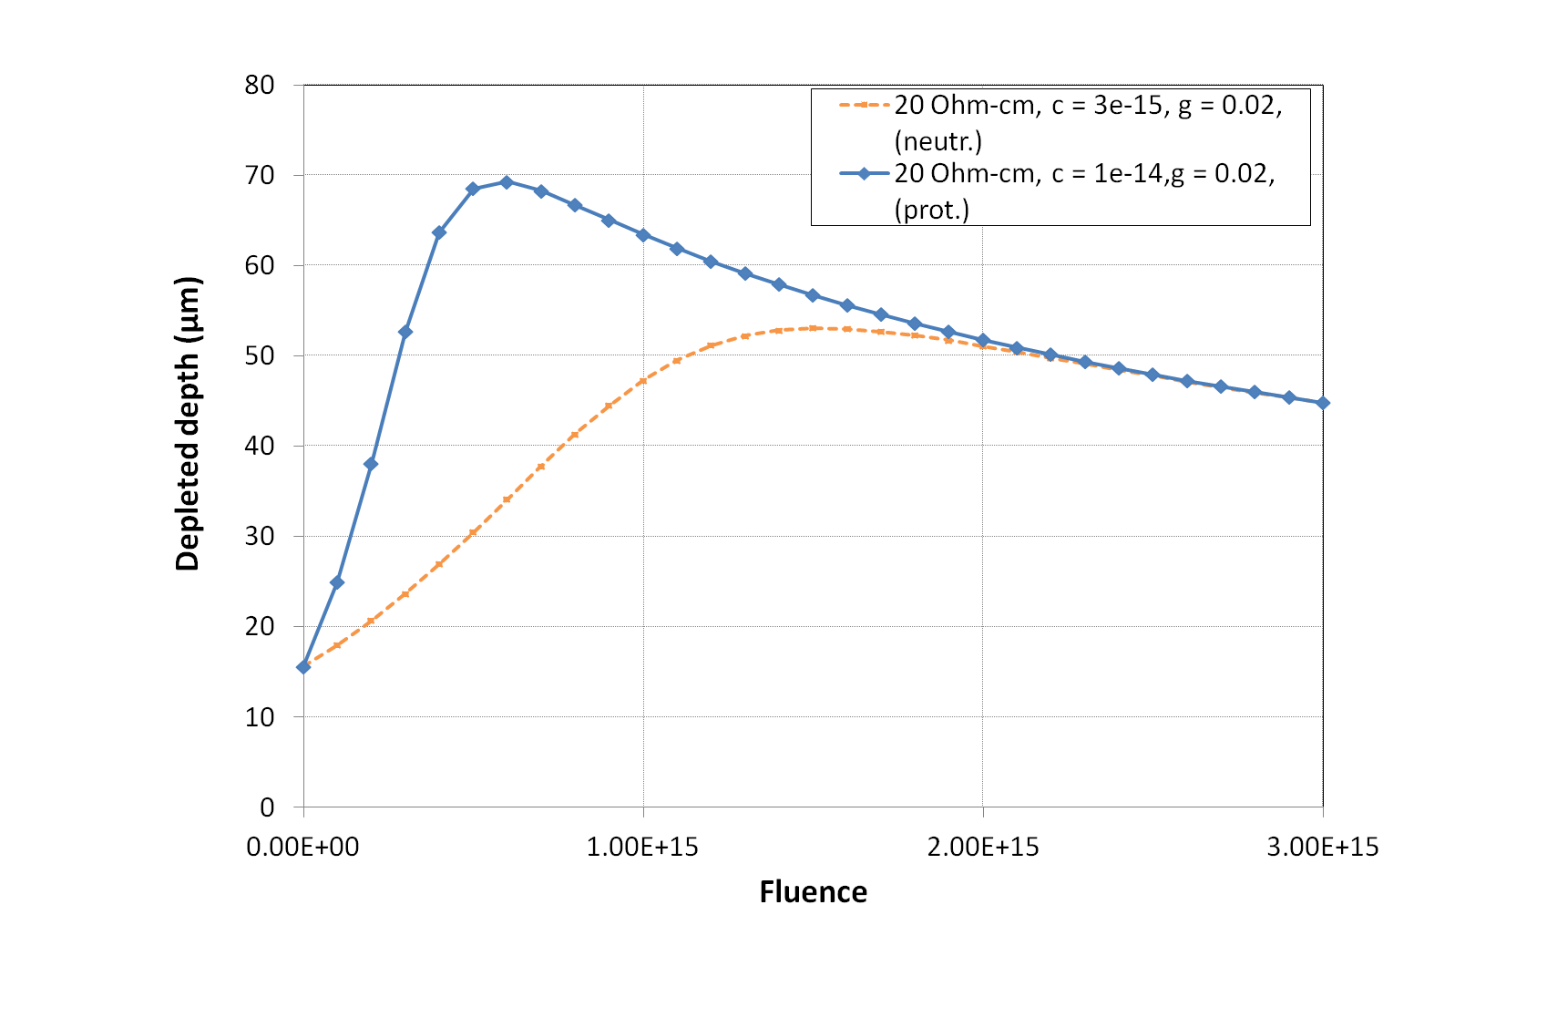
Larger acceptor removal constant may be expected for irradiation with
charged hadrons than with neutrons
Depleted depth vs. fluence calculated for
different acceptor removal constants
➔ max. depleted depth expected at lower fluences for protons than for neutrons
p-n difference could be even larger if also g smaller for protons (expected in oxigenated Si)

Slide 5
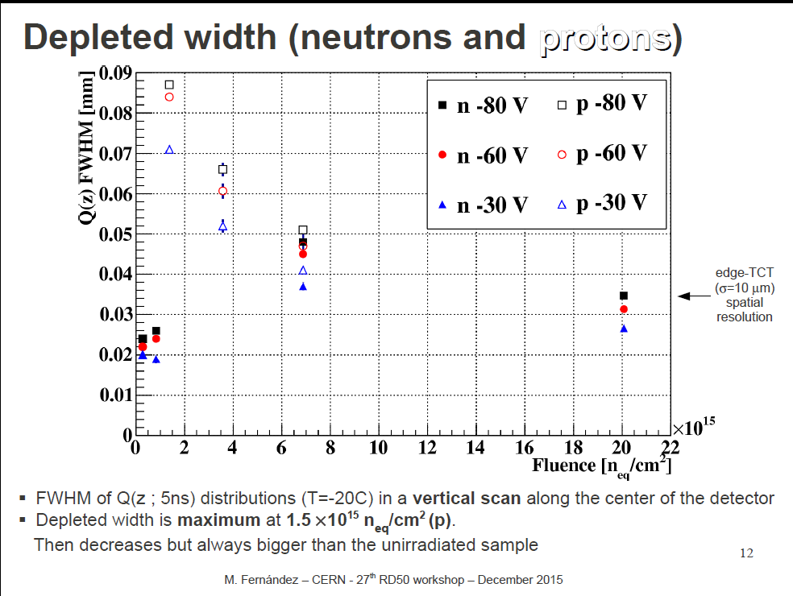
E-TCT with HVCMOSv3, (AMS 180 nm, 10 Ohm-cm) irradiated with PS protons
M Fernandez, RD50 meeting, December 2015:
https://indico.cern.ch/event/456679/session/5/contribution/32/attachments/1196309/1742128/MarcosFernandez_27thRD50-CERN_v0.pdf
large increase of depleted width after irradiation
no measurements at low fluence

