Slide 1
Characterisation of AMS Chess 1 chip with fluorescence X-rays
Dima Maneuski
Richard Bates, Andrew Blue, Craig Buttar, Kestutis Kanisauskas, Conor O’Reilly
Special thanks to Luigi and Jaya John

Slide 2
Motivation
Motivation
Fe55 benchmark
  PRO: Gives real gain
  PRO: Allows signal and noise conversion from mV / ADC to electrons
  CON: Standard laboratory sources are relatively weak. Typical data acquisition many hours (Never mind 2.7 years half-life)
  CON: Time constrains makes multiple measurements impractical
  CON: Also what about linearity and/or offset? How can we be sure based on one point that a device has linear response?
Solution: X-ray fluorescence

Slide 3
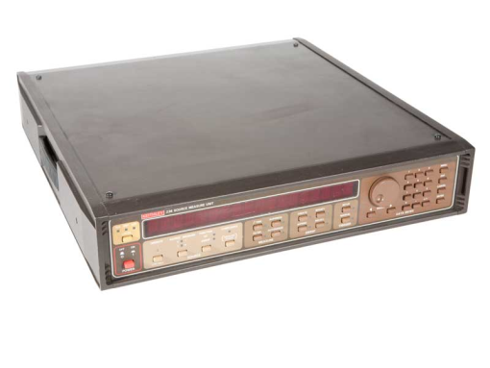
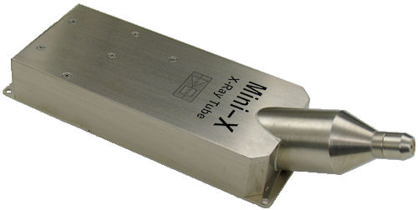
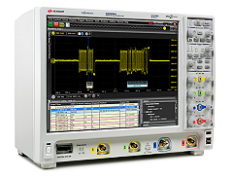
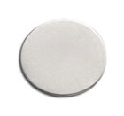
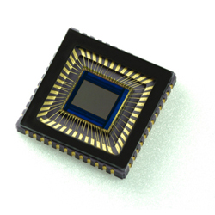
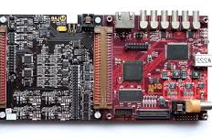
X-ray fluorescence setup
Principle setup schematic
Bias
Fluorescence target
X-ray tube
DUT
Analog
waveform
X-ray bremsstrahlung
X-ray fluorescence
Digital control
NB: Many target materials available.
For this experiments we used:
Fe (6 keV), Cu (8 keV), Nb (16 keV), Sn (25 keV), Ba (32 keV)

Slide 4
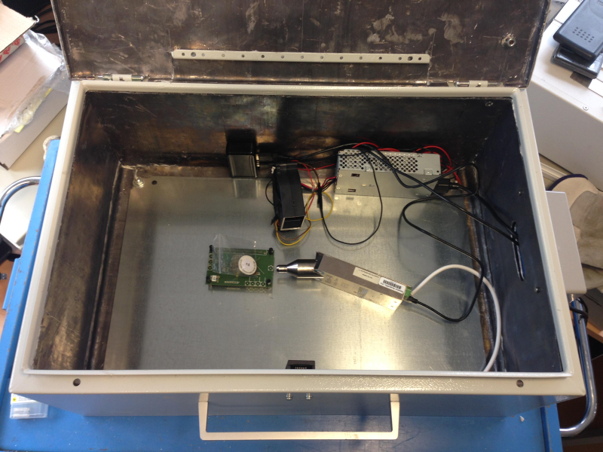
X-ray fluorescence setup
Setup photograph
Powered USB hub
Lead loaded box
Fan
Power supply 12V and 5V
Fluorescence target
Chicane
1 power
1 USB
1 AmpOut
DUT Area
Mini-X X-ray tube
Safety interlock

Slide 5
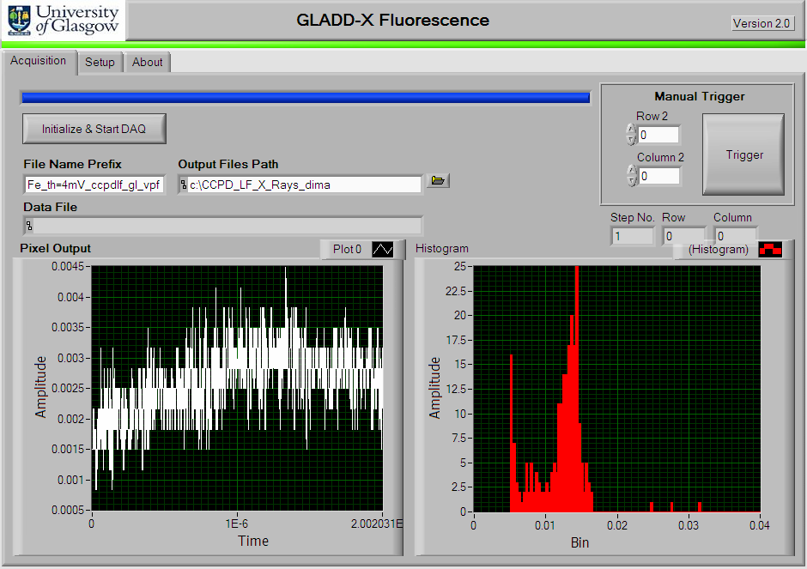
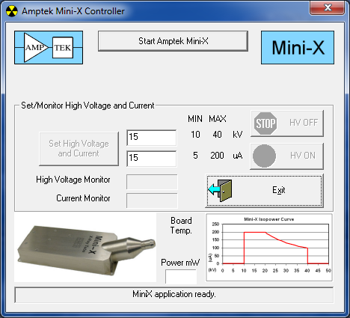
X-ray fluorescence setup
Acquisition and analysis software
X-ray tube control
Custom Labview waveform acquisition with online histograming
Output is a text file with number of waveforms
We use ROOT to read waveforms and produce offline histograms

Slide 6
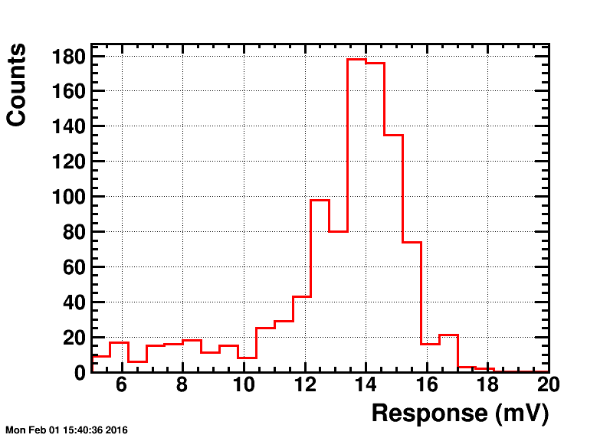
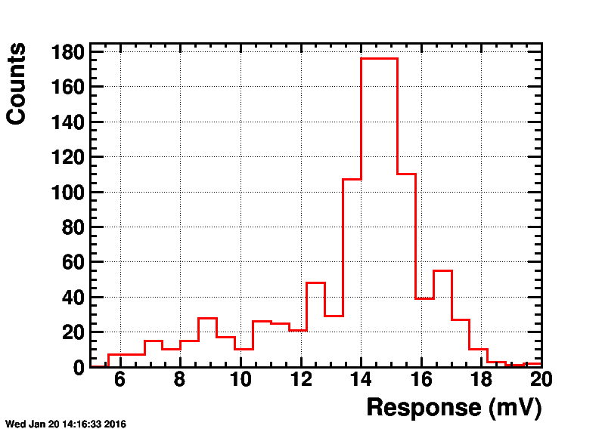
Source vs fluorescence benchmark
Fe 55 vs. Fe fluorescence benchmarking (LFoundry chip A)
Fe55 1.85 MBq lab source
1000 waveforms acquired
Acquisition time: ~20h
Acquisition time: ~5 mins
* Peaks are in different positions due to slightly different gain setting

Slide 7
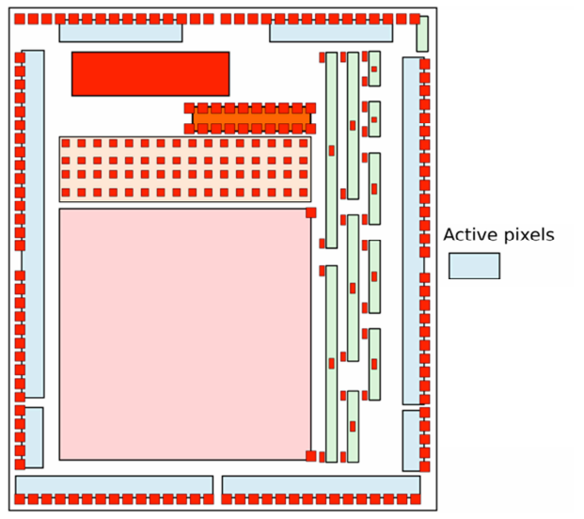
What was tested?
APA 4
APA 3
Two devices received from Oxford:
On front TCT board and on eTCT board
Front TCT device didn’t work at all.
On eTCT device:
APA2 and APA3 showed no response to X-rays
APA8 responds to X-rays but either gain is too low or sensitivity is poor.
APA 8
APA 7
APA 1
APA 2
APA 6
APA 5

Slide 8
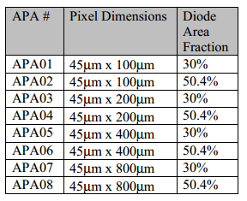
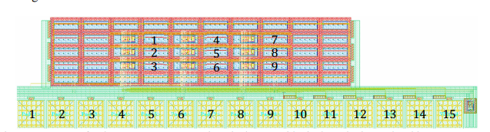
What was tested?
9 pixels in each group
Central pixel 5 was connected to output
Software Inkler
DAC 1 (VPLoad) = 2100 mV
DAC 2 (Casc) = 2600 mV
DAC 3 (iNSF) = 750 mV
DAC 4 (iN) =1000 mV
DAC 5 (iBias) = 150 mV
DAC 6 (iFB) = 2700 mV

Slide 9
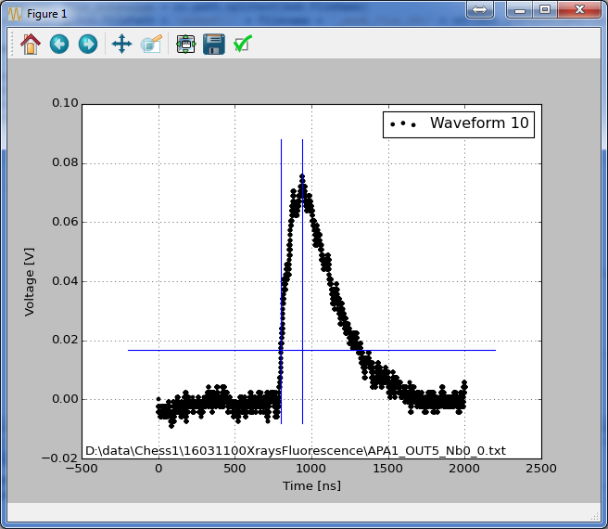
General remarks
Acquisition settings
X-ray tube 40 kVp, 100 uA
Output 1 Mohm, AC
Trigger level: 5 mV
Trigger window: 200 ns
Bias -40V, 3-4 mA current
Threshold level between 20 and 30 % of (Max-Min) [V] depending on test structure
Good waveform example
Peak position
Rise time extraction region
20%
Noise extraction region

Slide 10
Results
Current voltage characteristics
Worth pointing out that at start of measurements some weeks ago, current was 10 mA @ 40V.
As time progressed it dropped to 3-4 mA under same conditions of operation

Slide 11
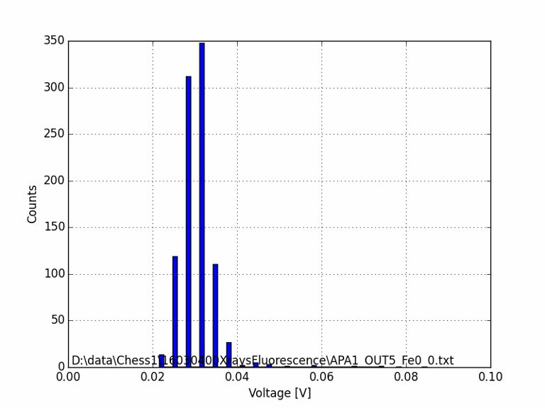
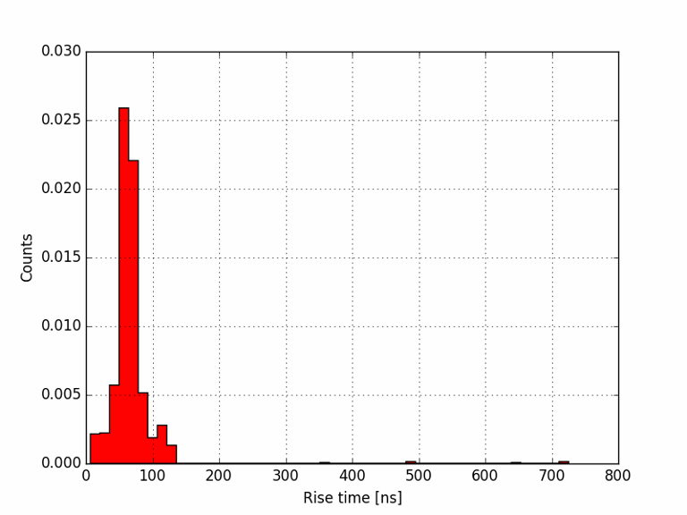
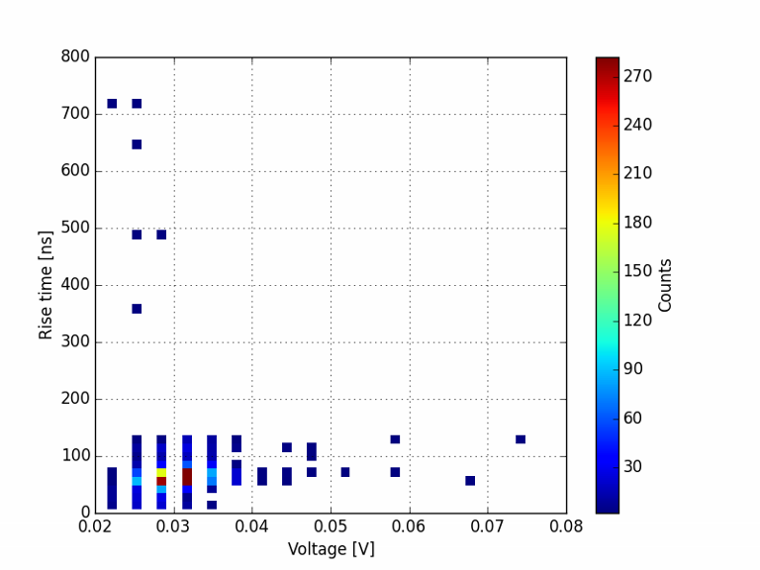
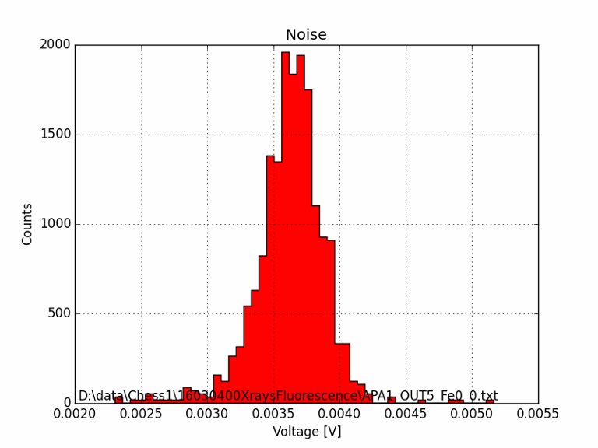
Results APA1 – Fe (6 keV)

Slide 12
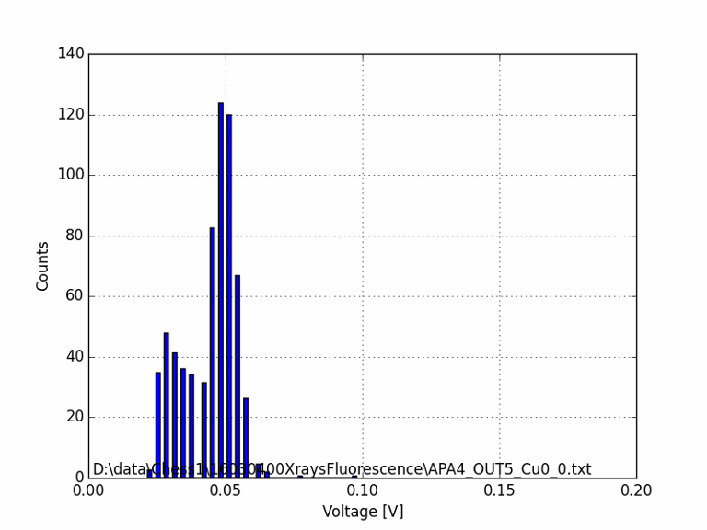
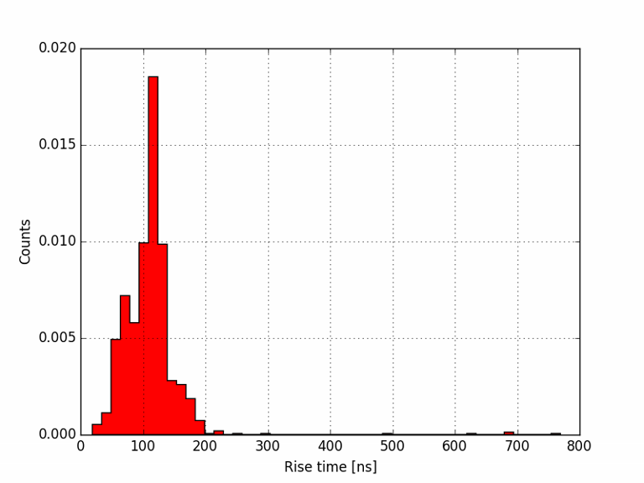
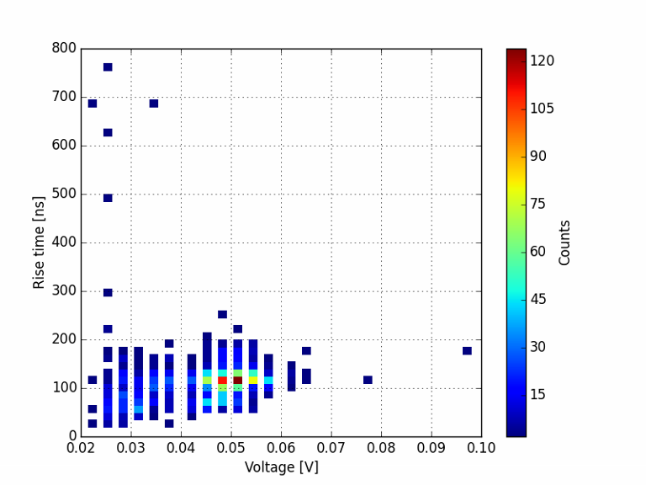
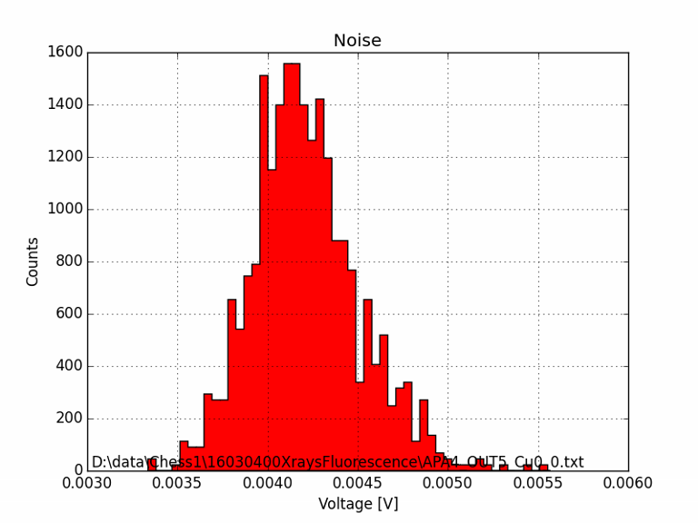
Results APA4 – Cu (8 keV)
Threshold 30%

Slide 13
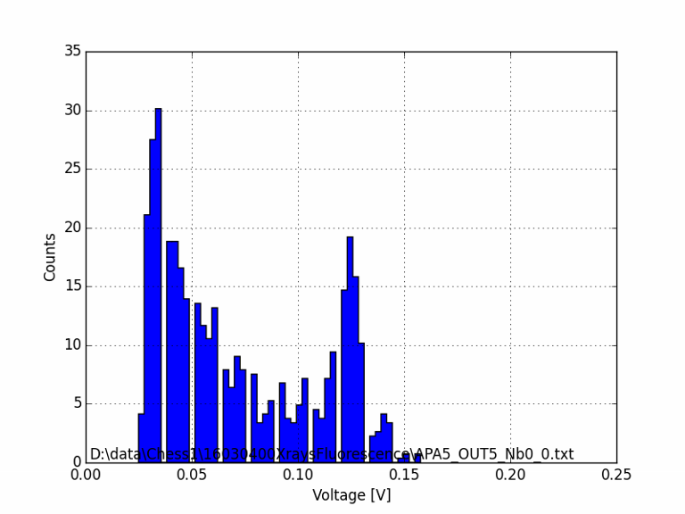
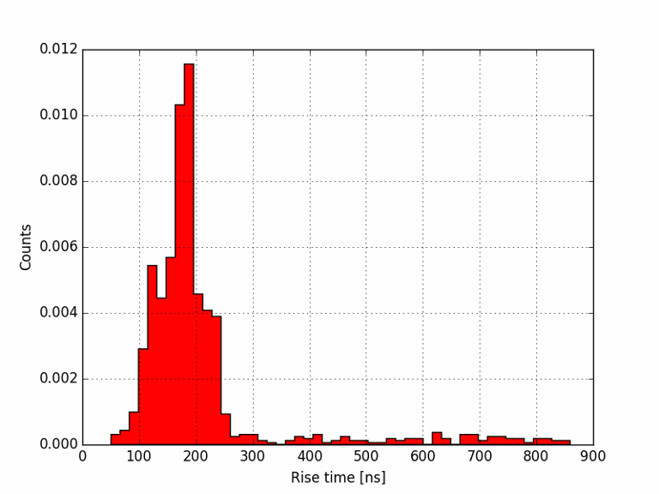
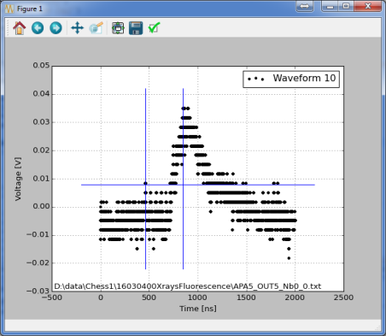
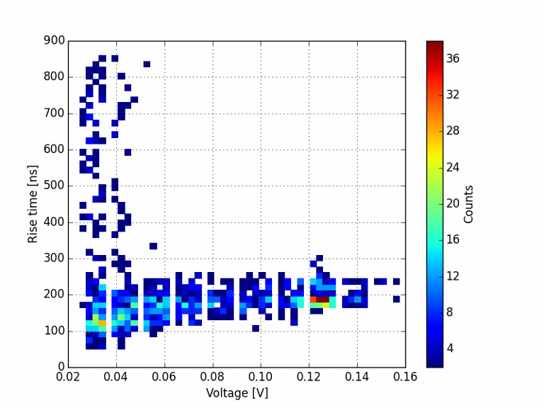
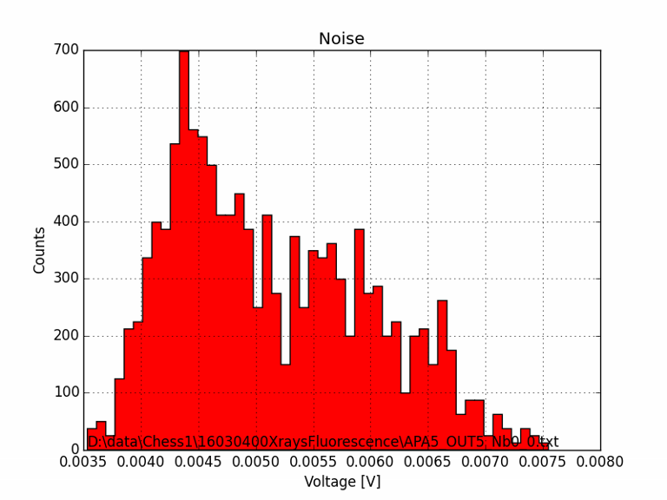
Results APA5 – Nb (15 keV)
Rise time extraction algorithm triggers earlier than it should due to poor waveform quality
Not an actual noise but part of the signal grabbed by analysis
Will improve algorithm in the future to get nice peak

Slide 14
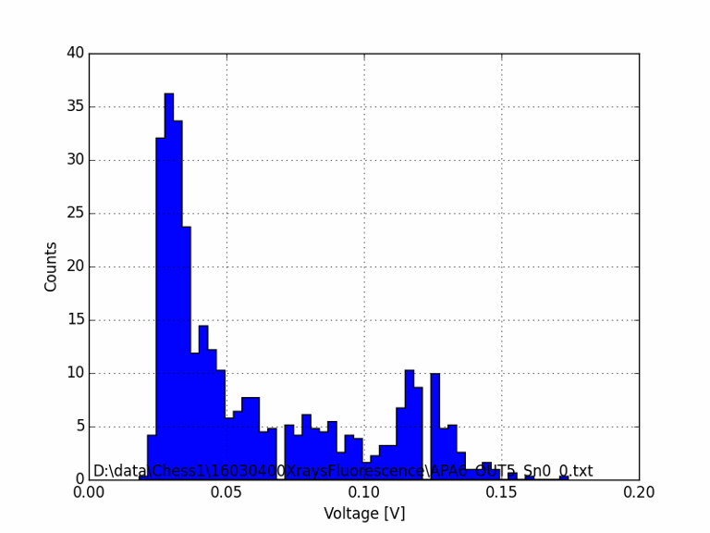
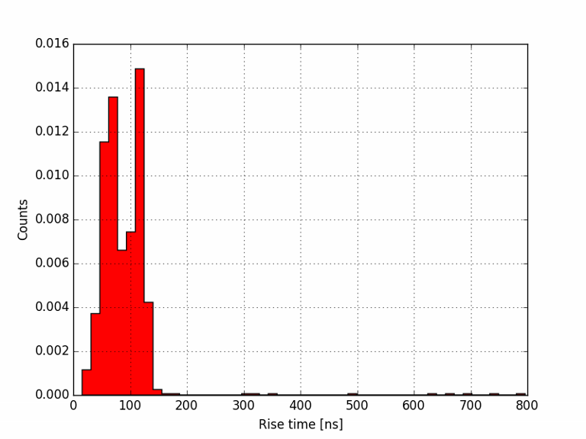
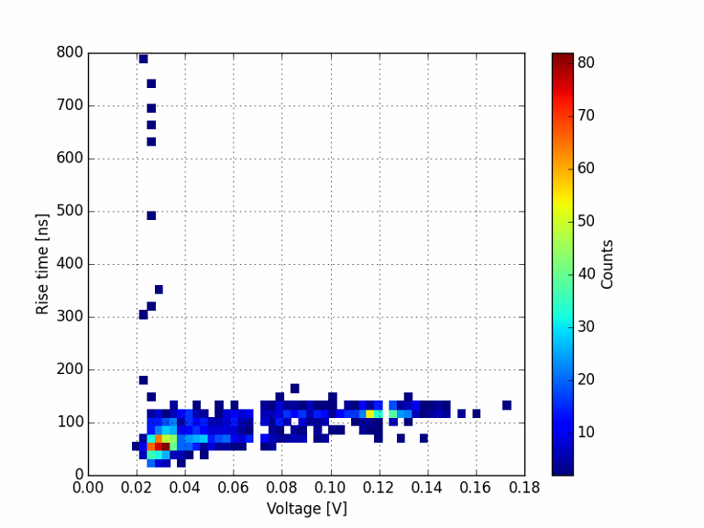
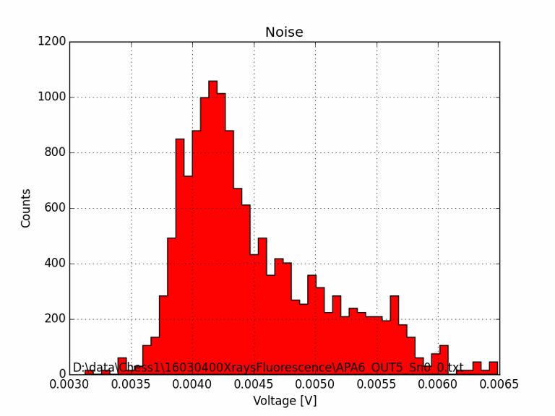
Results APA6 – Sn (25 keV)
Two rise time components:
Low energies from the tube
Fluorescence from target
Not an actual noise but part of the signal

Slide 15
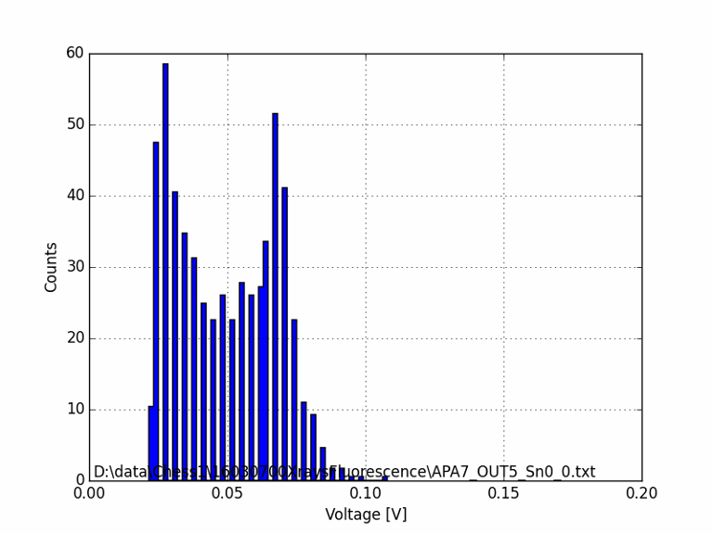
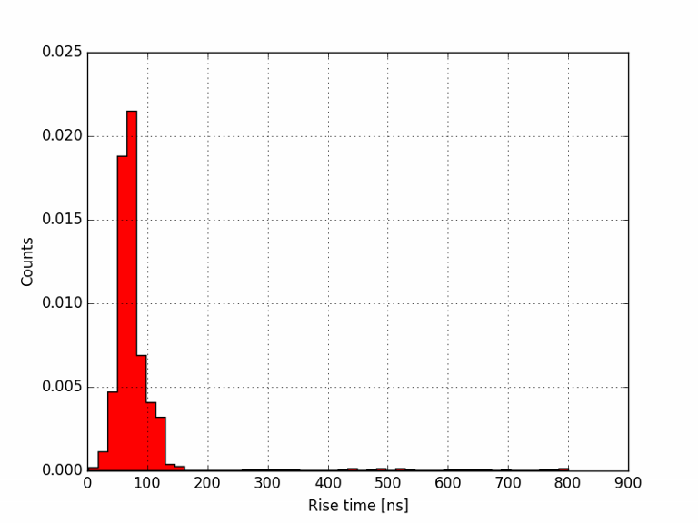
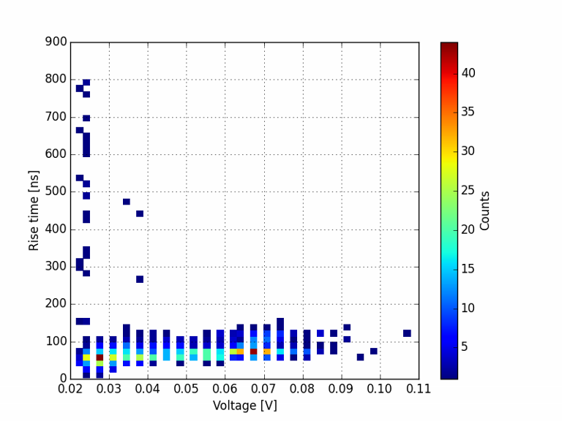
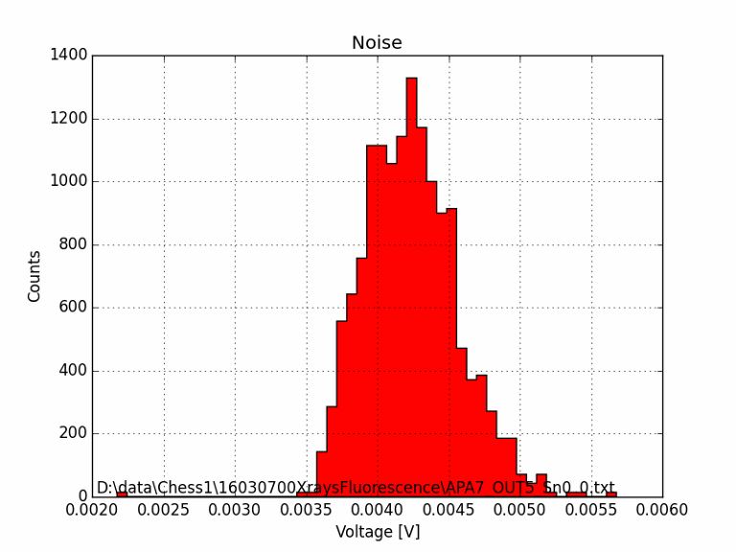
Results APA7 – Sn (25 keV)

Slide 16
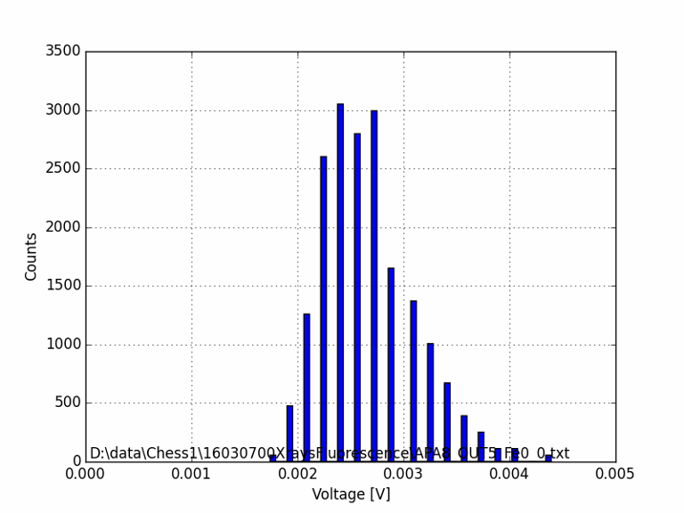
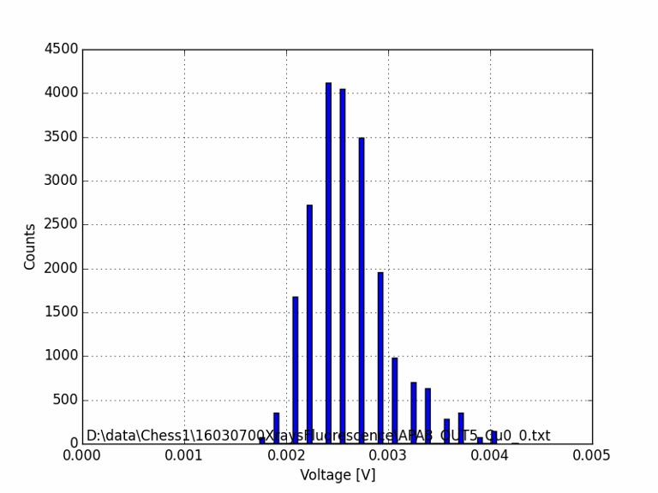
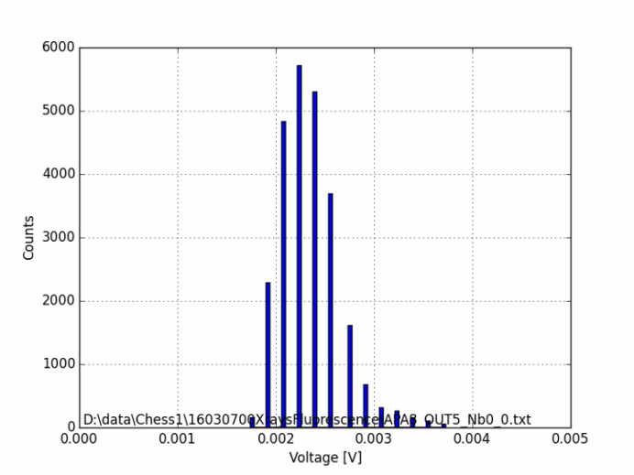
Results APA8 – all targets
Fe (6 keV), Cu (8 keV) and Nb (15 keV) targets
Not much difference in spectrum
Probably only low energy photons directly from the tube
Pulses disappear if the tube is off

Slide 17
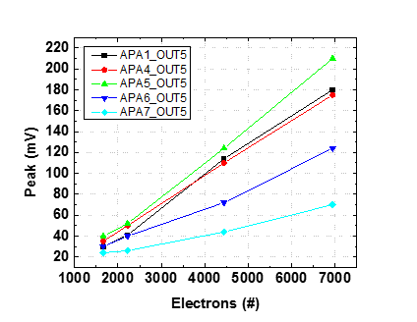
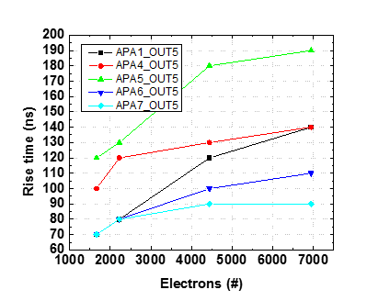
First attempt to summarise data
First summary of data
APA 2 and 3 did not show response to X-rays
APA 8’s response is suspicions
APA 1, 4, 5, 6, 7 response look reasonable
All histograms for the test structures can be found in PDF file

Slide 18
First attempt to summarise data
First summary of data (c’d)
 | APA1_OUT5 | APA4_OUT5 | APA5_OUT5 | APA6_OUT5 | APA7_OUT5 | APA8_OUT5
Pixel size [um] | 45x100 | 45x200 | 45x400 | 45x400 | 45x800 | 45x800
Diode area [um^2] | 1350 | 4536 | 5400 | 9072 | 10800 | 18144
Noise [mV] | 3.6 | 4.0 | 4.3 | 4.0 | 4.1 | 3.8
Rise time @ Fe [nS] | 75 | 100 | 120 | 60 | 70 | 70
Gain [e/mV] | 51 | 38 | 31 | 57 | 113
Gain [mV/fC] | 123 | 164 | 202 | 110 | 55
Noise [e] = G [e/mV]*N[mV] | 184 | 152 | 133 | 228 | 463

