Slide 1
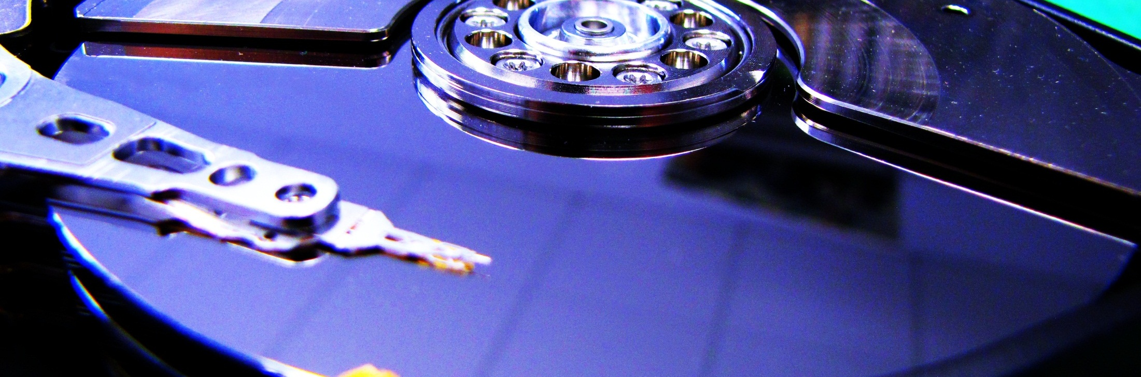

“The Challenge of Big Data in Science”
Opening
Achim Streit
The 5th International
LSDMA Symposium

Slide 2
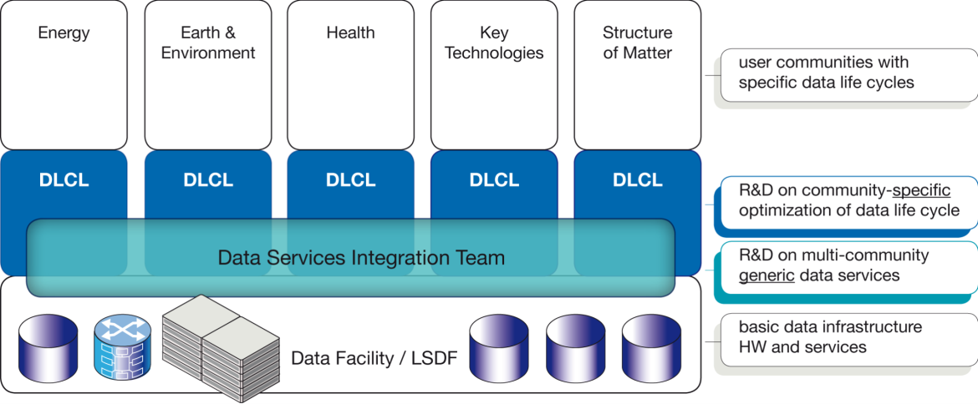

Structure and Aims of LSDMA
R&D
Data Life Cycle Labs
Joint R&D with communities
Optimizing the data life cycle
Specific data analysis tools and services
Data Services Integration Team
Generic, multi-community R&D
Interface between federated data infra-structures and DLCLs resp. Communities
Integration of data services in scientific working process

Slide 3


















Facts and Figures
Helmholtz portfolio extension
Initial project duration: 2012-2016
Partners:
Continuation as cross-programme initiative from 2015-2019
  Build a research bridge on data-intensive science in Helmholtz and beyond
  7 programmes in 3 research fields, coordinated by
Connected to many projects and initiatives

Slide 4
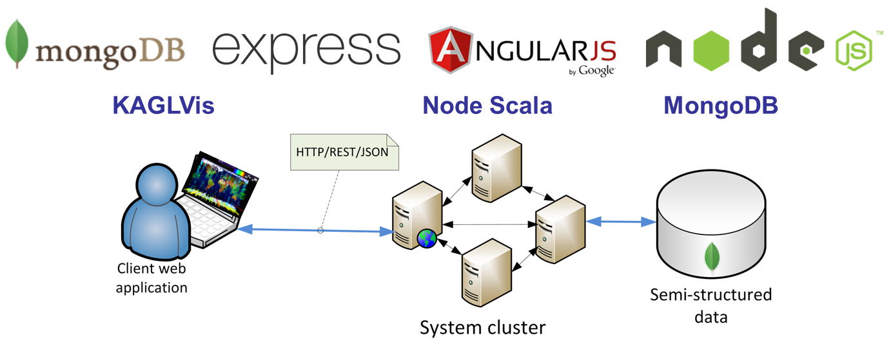
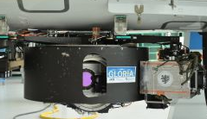
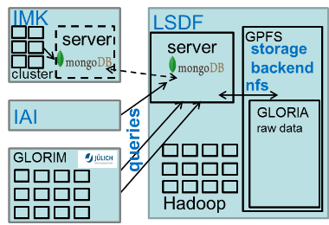
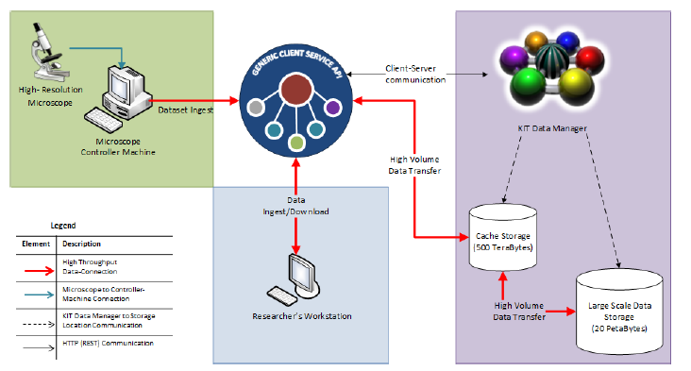
Selected Activities of Joint R&D
Climatology
  Climate Analysis
  with MEAN Stack
  NoSQL DBs for
  GLORIA data
Key Technologies
  Automated processing in
  Light Sheet Microscopy
  (zebrafish imaging data)
  Open reference data repository
  to manage large datasets of
  approx. 100 TB each for
  Light Optical Nanoscopy
  (membrane and nucleus
  architecture on the nano-scale)

Slide 5
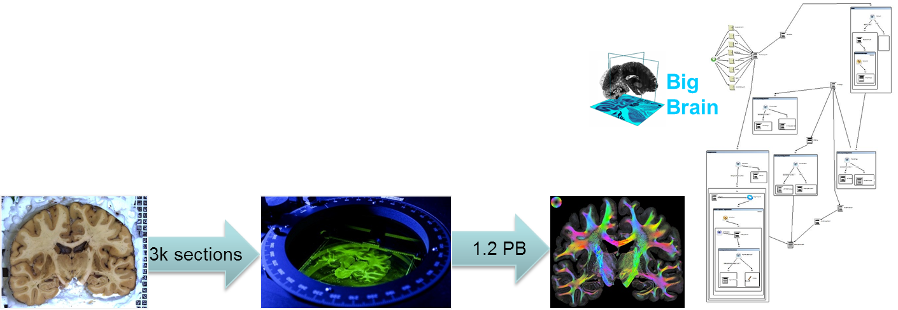
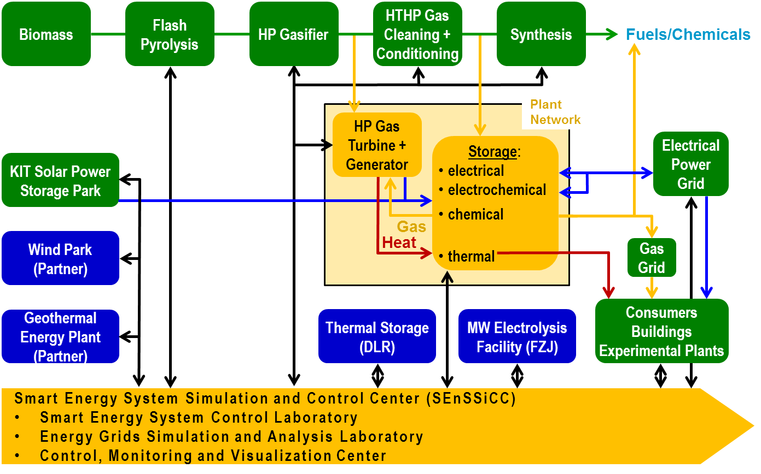
Selected Activities of Joint R&D
Neuroscience
  Provenance integration in analysis
  workflow of human brain decoding
Energy
  Secure data management
  for tech. & eco. analysis
  Analysing, modelling and
  simulating future smart power
  grids with a high amount of
  renewable energies (SEnSSiCC)

Slide 6
Selected Activities of Generic R&D
AAI / federated Identities
  Integration of FedID (eduGAIN) and OpenID in various services
  SAML on the commandline (via LDAP Facade)
  Interoperability of AAIs and Levels of Assurance, identity harmonisation
Archive technologies
  Intn. harmonization of QoS policies for storage via RDA and SNIA/CDMI
  User registration workflow for long-term archived data
  Unified approach within EUDAT, INDIGO-DataCloud, RADAR, …
CDMI support in UNICORE and dCache
Repository System KIT-Data-Manager released as v1.1
Provenance extensions for UNICORE and KIT DM
Generic Meta Data approach across various communities
UNICORE extensions
  REST support (for HBP), Hadoop support, Data Driven Processing

Slide 7









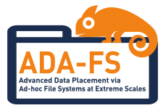







Collaborations, Projects, Initiatives

Slide 8
Helmholtz Data Federation (HDF); coordinated by KIT
Helmholtz Association is developing a federated research data infrastructure in Germany for the benefit of and open to the full German science system to promote and foster excellent science
  Addressing community-specific requirements
  Finding, accessing, linking, analysing scientific multi-disciplinary data
  Long-term preservation, curation, availability and usability of research data
  Data ownership remains with the scientific disciplines
  Secure federation of existing data centres with uplinks to EU/Intl.
National building block for the European Open Science Cloud (EOSC)
Comprising three elements
  1) Innovative software technologies for data management and analysis
  2) Excellent user support and joint R&D
  3) Leading-edge storage and analysis hardware

Slide 9
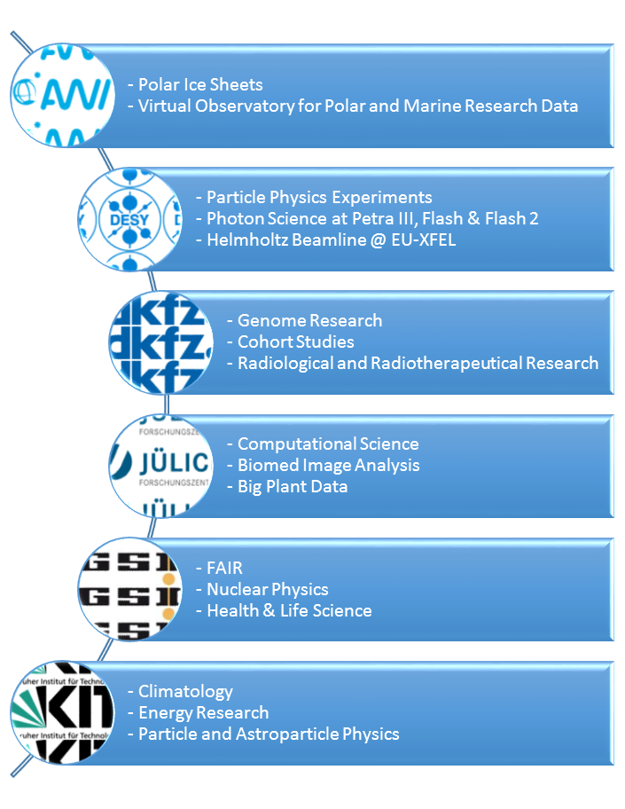
Helmholtz Data Federation (HDF)
Initial set of scientific cases identified
by the 6 Helmholtz partners
Reviewer statements:
  “Sharing of infrastructure, services and
  datasets opens the way for improved
  cross-disciplinary working and
  re-use of data.”
  “…great potential to contribute to
  solving major challenges facing
  society (including pure attainment
  of new insights).”
  “…will be a first example of a
  national shared research data
  infrastructure in Europe.”

Slide 10
Agenda for Today
9:00 – 9:30 | Welcome, Introduction | Michael Decker Achim Streit
9:30 – 10:30 | Moving data from research enabler to trusted research output: challenges for infrastructure providers and national services | Andrew Treloar (Australian National Data Service)
10:30 – 11:00 | Coffee break
11:00 – 11:30 | Funding Research Data Management and related Infrastructures | Bas Cordewener (Knowledge Exchange)
11:30 – 12:00 | Getting Science out of eScience | Wilco Hazeleger (Netherlands eScience Center)
12:00 – 12:30 | The role of the EDISON Framework in building Data Science professionals: one size definitely does not fit all | Steve Brewer (University of Southampton)

Slide 11
Agenda for Today – cont‘d
12:30 – 14:00 | Lunch break
14:00 – 14:30 | The development of national road maps for digital research infrastructures in the international context | Otto Rienhoff (University of Göttingen)
14:30 – 15:00 | User Community Driven Development in Trust and Identity | Christos Kanellopoulos (GRNET)
15:00 – 15:30 | Coffee break
15:30 – 16:00 | Assessing Societal Aspects of Big Data - the Project ABIDA | Reinhard Heil (KIT)
16:00 – 17:00 | Beyond the "under-desk datacentre": lessons from research data management in the UK | Matthew Dovey (JISC)
We plan to collect the slides and provide them on the Symposium webpage: https://indico.desy.de/conferenceTimeTable.py?confId=14574

Slide 12
Logistics
Breaks
  Two coffee breaks at 10:30 and 15:00 with coffee, tea, water, juice, fruits and cookies
  Lunch break from 12:30-14:00 with buffet in guest area of KIT canteen
WIFI
  eduroam
  Guest account info in your conference bag

Slide 13
Thanks
To the organising team
  Elnaz Azmi
  Ugur Cayoglu
  Melanie Ernst
  Christopher Jung
  Yannick Nesselhauf
  Christoph-Erdmann Pfeiler
  Ingrid Schäffner
  Marcus Strobl
  Frank Tristram

