Slide 1


The role of the EDISON Framework in building Data Science professionals: one size definitely does not fit all
The Challenge of Big Data in Science
Karlsruhe Institute of Technology
5 October 2016
Steve Brewer
EDISON, University of Southampton
EDISON – Education for Data Intensive Science to Open New science frontiers
Grant 675419 (INFRASUPP-4-2015: CSA)

Slide 2




Outline
Introduction
The emergence of Data Science technologies
Establishing the Data Science profession
The EDISON Data Science Framework (EDSF)
Building the supporting community
Data Science Framework: EDISON sustainability strategy
Getting involved: benefits and opportunities

Slide 3
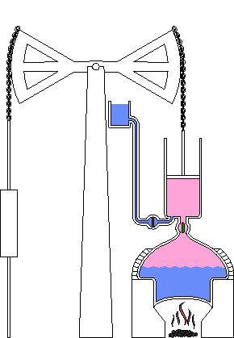
Introduction
The Challenge of Big Data in Science:
Where did this data come from?
Whose challenge is it?
Talking about Big Data
Extracting stories from big data
What do we do next?
Amazon’s Neil Lawrence: “Data is the new coal”
https://en.wikipedia.org/wiki/Thomas_Newcomen

Slide 4
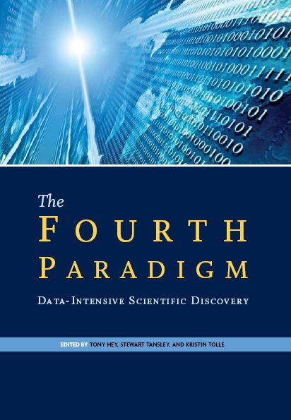


The emergence of Data Science technologies
The Fourth Paradigm: Data-Intensive Scientific Discovery.
By Jim Gray, Microsoft, 2009. Edited by Tony Hey, et al.
http://research.microsoft.com/en-us/collaboration/fourthparadigm/
Riding the wave: How Europe can gain from the rising tide of scientific data.
Final report of the High Level Expert Group on Scientific Data. October 2010.
http://cordis.europa.eu/fp7/ict/e-infrastructure/docs/hlg-sdi-report.pdf
The Data Harvest: How sharing research data can yield knowledge, jobs and growth.
An RDA Europe Report. December 2014
https://rd-alliance.org/data-harvest-report-sharing-data-knowledge-jobs-and-growth.html
https://www.rd-alliance.org/
NIST Big Data Working Group (NBD-WG) https://www.rd-alliance.org/ (since 2013)
ISO/IEC JTC1 Big Data Study Group (SGBD) http://jtc1bigdatasg.nist.gov/home.php (2014)

Slide 5
Background to EDISON: Riding the Wave
Data are becoming infrastructure themselves
(Report “Riding the Wave”)
This requires large infrastructure resources to collect, store, process and archive heterogeneous multi-faceted and linked data.
Data centric/data driven infrastructure has to support different types of data, including text data, structured and unstructured data, relational and vector data, linked data.
Data appear in various contexts: large number strings from experiments or sensors, in software code, music, films, publications, digital art, web pages, social media, public and business statistics, and also orphan data.
We need data scientists with the knowledge and skill to work with existing and future data intensive infrastructure and tools.

Slide 6
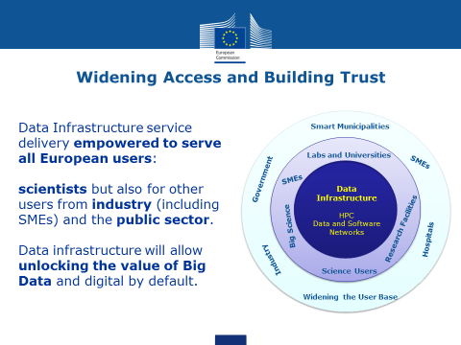

Slide 7
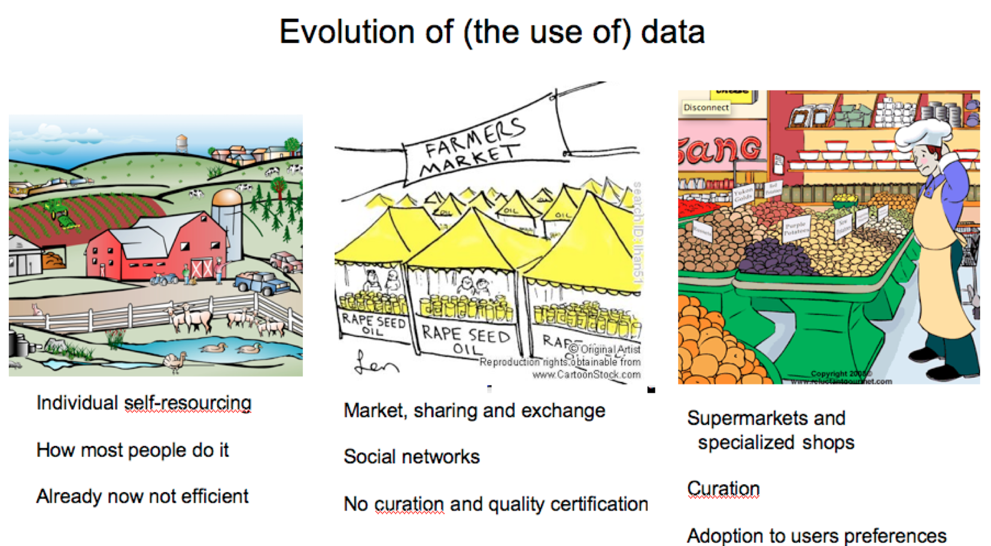
Establishing the Data Science profession: motivation

Slide 8
EDISON: Idea → Community Initiative → H2020
1st RDA Plenary meeting – 18-20 March 2013
  1st BoF on Education and Skills Development in Data Intensive Science
  Attended by 16 representatives from universities, libraries, e-Science, data centers, research coordination bodies
3rd RDA Plenary meeting – 26-28 March 2014, Dublin
  3rd BoF on Education and Skills Development in Data Intensive Science
  EDISON (Education for Data Intensive Science to Open New science frontiers) Initiative announced
4th RDA Plenary meeting – 22-24 September 2014, Amsterdam
  IG Education and Training on Handling of Research Data (ETHRD) established
  EDISON Workshop – 21 Sept 2014, Science Park Amsterdam
  Decision to form a consortium and submit a proposal to IINFRASUPP-4-2015 call
8th RDA Plenary meeting – 15-17 September 2016, Denver, USA
  BoFs and IG meetings – now developing Certification and Accreditation proposal

Slide 9







The Data Science supply chain
Potential
Data Scientists
Data Scientist “Producers”
- SUPPLY-
DS Employers
- DEMAND -
“Competitive product”: Skilled DS
Universities
Industry
Other Training Centres
Research
Organisations
In-house training centres
Research
Infrastructures
Self-made DS channels
Public
Administration

Slide 10
EDISON Impact goal and objectives
Dramatically increase the number of data scientists
IMPACT
Create a Data Science profession
Services to education and training
Engage stakeholder communities
Data Science professional profiles
Support for accreditation and certification
Sustain platforms of communities of practice
Interact with demand and supply sides
Service for collaborating and sharing expertise and materials
Organise “champion” universities
Career path building and skills transferability
Design model curricula
Interact with Expert Liaison Groups
“Competence Framework” and “Body of Knowledge”

Slide 11

EDISON: The Mission
Data
Scientist
Professionals
Education
Training
Certification
DSP “Supply”
Employers:
DSP “Demand”

Slide 12
Overview of EDISON EU H2020 project
Horizon-funded EU project
2-year project (started September 2015) with the purpose of:
Accelerating the creation of the Data Science profession
Within DG Connect: Communications Networks, Content & Technology
  Directorate C - Digital Excellence & Science Infrastructure
    C.1: eInfrastructure & Science Cloud
Focus on Research Infrastructures
Reaching out to wider context: economic landscape / flux
We need to grasp the problem and communicate the options
Then listen and revise our understanding and message

Slide 13
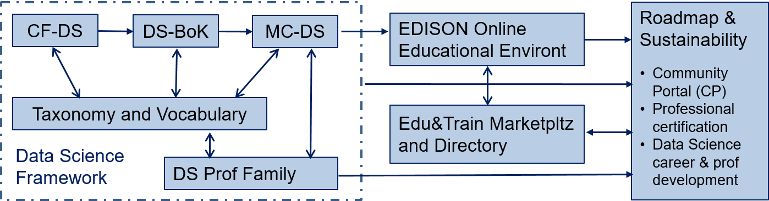
EDISON Data Science Framework (EDSF)
EDISON Data Science Framework components.

Slide 14
EDISON approach
Addressing commonly recognized needs for digital and Data Science skills
New concept and approach for education and training and skills management
  Responsibility for skills and competences supported by variety of training and learning possibilities
Using general multi-stakeholders model to create competences and skills management
  Based on best industry practices, community practices, standards
EDISON Data Science Framework (EDSF) provides essential components:
  Competence Framework, Body of Knowledge, Model Curriculum, DS Professional profiles
  DS Competence Framework based on market Demand-Supply analysis & stakeholder survey
Other EDISON components and prospective services include:
  EDISON Online Education Environment (EOEE) with virtual lab facilities & educational datasets
  Certification and accreditation framework and roadmap for services
  Data Science Professional Portal with professional community services

Slide 15

Political, Economic, Social and Technological landscape
“Raw material”
Potential DSP
DSP “Producers”
- SUPPLY-
“Competitive product”
fit-for-purpose DSP
DSP Employers
- DEMAND -
Universities
Research
Infrastructures
Training Institutions
Other
Research
Organisations
Corporate training centres
Industry
Self-made DSP channels
Public
Administration
Vital, professional &economic expectations
Value Propositions ROI
Recruitment needs/
Selection criteria
Gaps
Gaps

Slide 16
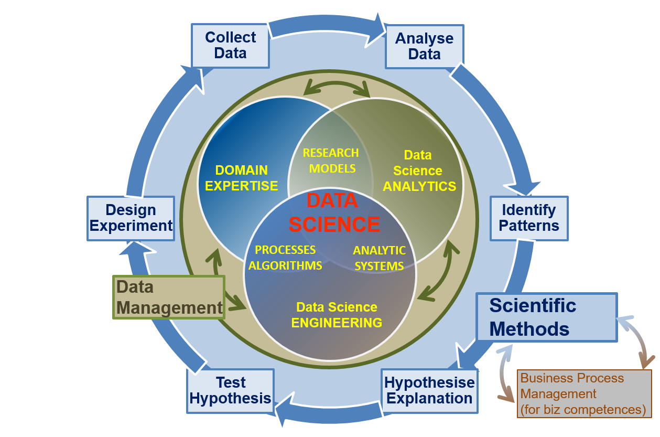
Data Science competence groups (research)
Data Science competence groups for general or research oriented profiles.

Slide 17
Applications for the EDSF
Competences and skills can be used for benchmarking
  For individuals to assess their skills against desirable job profile or vacancy description and develop individual training program
  For organisation to assess the skills and competences of a prospective or existing team of Data Scientists – consequently define gap and required new positions
  Data Science Competence Framework together with the Data Science Body of Knowledge provides basis for professional certification on a selected Data Science profile
Data Science Profession profiles definition can be used
  By individuals and HR to define a skills development program for employers and career development path
  By HR to construct job advertisements and assess candidates
The major goal of EDSF is to support and assist in developing and designing customizable curricula for specific groups of users and professionals
  Designing curricula starting from target professional profiles
  via required competences and learning outcomes
  mapped to required Knowledge Units in the Body of Knowledge
  to select necessary Learning Units in the Model Curricula

Slide 18
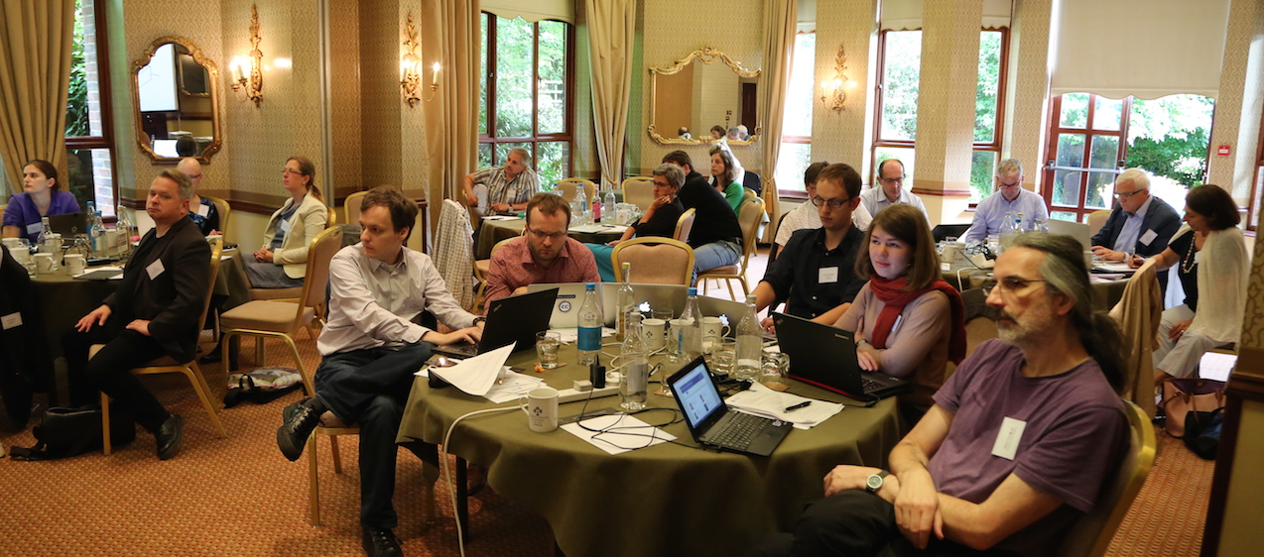
EDISON Education and Training Champions
Renewed focus from existing formal Champions
Reinforced links with existing collaborators such as those in RDA groups
Reinforced at partner institutions eg. Southampton DS and also EDSA project
EDISON Women’s group created
New Forest Milestone emerged as an output – see next slide
Motivation for a couple more meetings reaching out to other regions
  Madrid – spring 2017
  Warsaw – summer 2017

Slide 19
Accreditation and Certification: RDA 8th Plenary BoF
Aim: contribute to the sustainable development of the data science profession.
Goal: deliver a report that presents a concise but representative picture of the various accreditation and certification schemes that exist around the world
Outcome: Need to develop 9 months working group proposal centered on supporting the members of RDA to develop their own professional career paths around their own skills, interests and contexts.

Slide 20
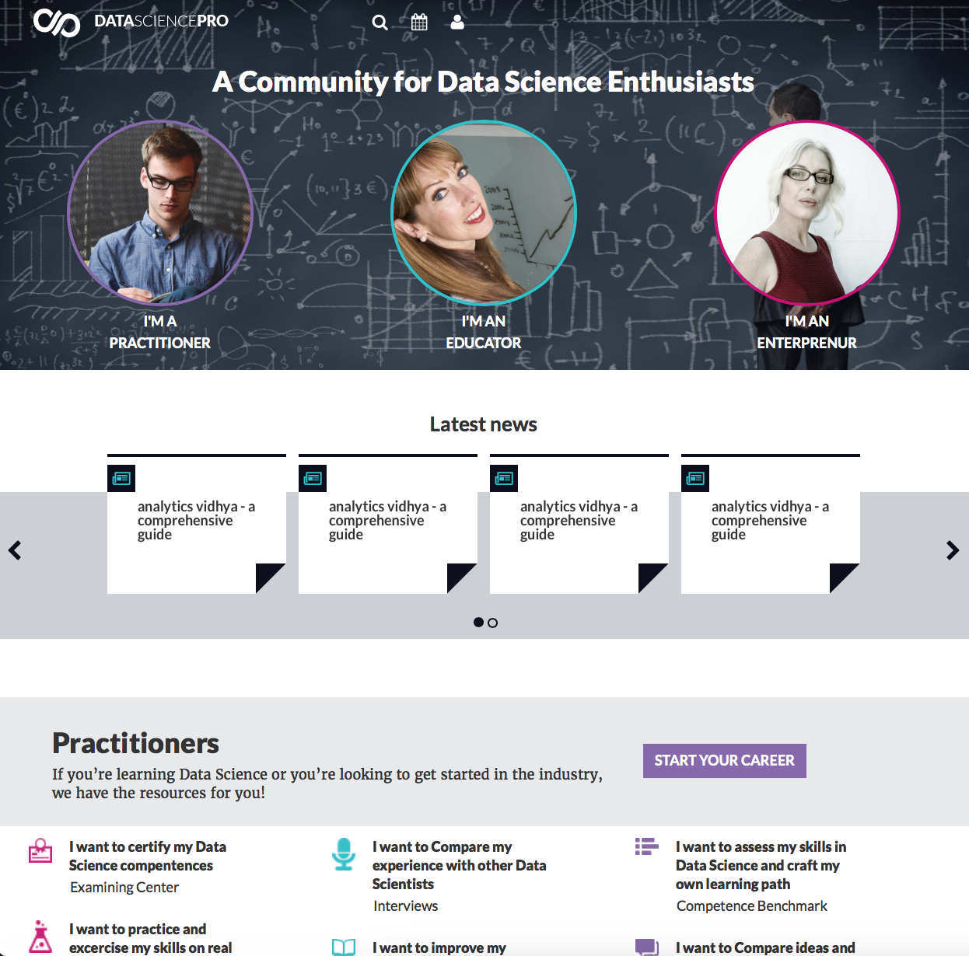
EDISON Community portal: Data Science Pro

Slide 21
Beneficiaries of the EDSF
Universities and professional training organisations
  Compliant curriculum design for Data Science in general and for specific scientific domains
  Accreditation scheme for Data Science program
Individual Data Scientists and related Data professionals, including self-made Data Scientists
  Academic education and professional training
  Skills benchmarking, re-skilling, career path development
  Certification
  Professional Portal services
Managers of modern Agile Data Driven Enterprises
  Framework for defining required competences and skills for Data Science related roles
  Building effective Data handling capacity
  HR can use EDSF for vacancy description construction, CV evaluation and candidates interview
Managers of Research Infrastructures
  The same as above with focus on collaborative nature of the RI community and diverse of domain related specifics and knowledge
  Specific skills and roles for Open Access
Governmental bodies (eg. Ministries of Education)
  EDSF will provide a roadmap and a framework/tool to address digital skills gap and creating consistent and competitive Data Science education programs
  Demand-supply market analysis and roadmap to address skills gaps

Slide 22
Key issues going forwards:
Mapping and comparing career paths and opportunities for Continuing Professional Development (CPD)
Supporting and aligning training needs and availability across the research infrastructures
Certification: from badges to professions
Identifying the “soft skills”: how to ask a question?
Identifying the need: from stewards to scientists

Slide 23
Thanks! s.brewer@soton.ac.uk
Keep in touch and get involved:
National Initiatives – all countries welcome
Education and Training Champions
EDISON-net
Use the EDISON Data Science Framework (EDSF)
Feedback, credit and endorsement welcome!
http://edison-project.eu

