Slide 1
Moving data from research enabler to trusted research output: challenges for infrastructure providers and national services
Andrew Treloar
ANDS Director of Technology
RDA TAB Co-chair
05 Oktober 2016

Slide 2
Overview
The business of eresearch infrastructure
A national response
Some thoughts on trust

Slide 3
The business of eResearch Infrastructure

Slide 4
The research process
?
!
Magic Happens

Slide 5
In a little more detail
Researcher Magic
?
!
Infrastructure Magic

Slide 6
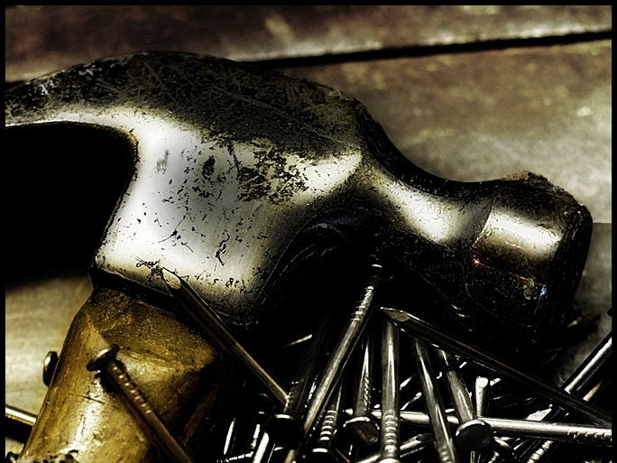
Photo CC-BY www.flickr.com/photos/spookman01/4904264919/
Notes:
If the only tool you have is a hammer, then everything looks like a nail (apparently no direct Norwegian equivalent according to my hopefully future daughter-in-law native speaker informant)
Yes, I work for a data organisation, and so I might be biased, but let’s look hard at some e-Research infrastructure businesses

Slide 7
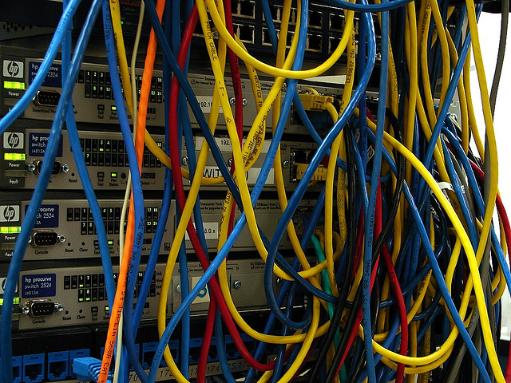
Photo CC-BY www.flickr.com/photos/jerryjohn/63351338/
Notes:
Networks exist to move what around? Data, and data derivatives (to a first approximation)

Slide 8
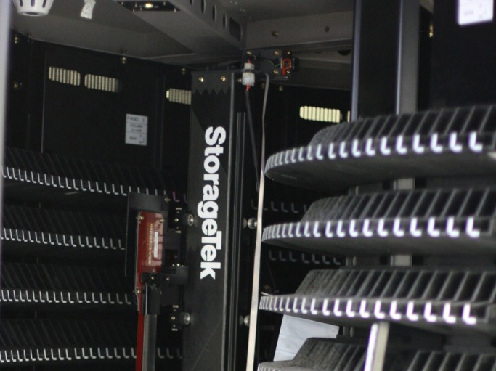
Photo CC-BY www.flickr.com/photos/stiefkind/6454784607/
Notes:
Storage exists to store what? Data, and data derivatives

Slide 9
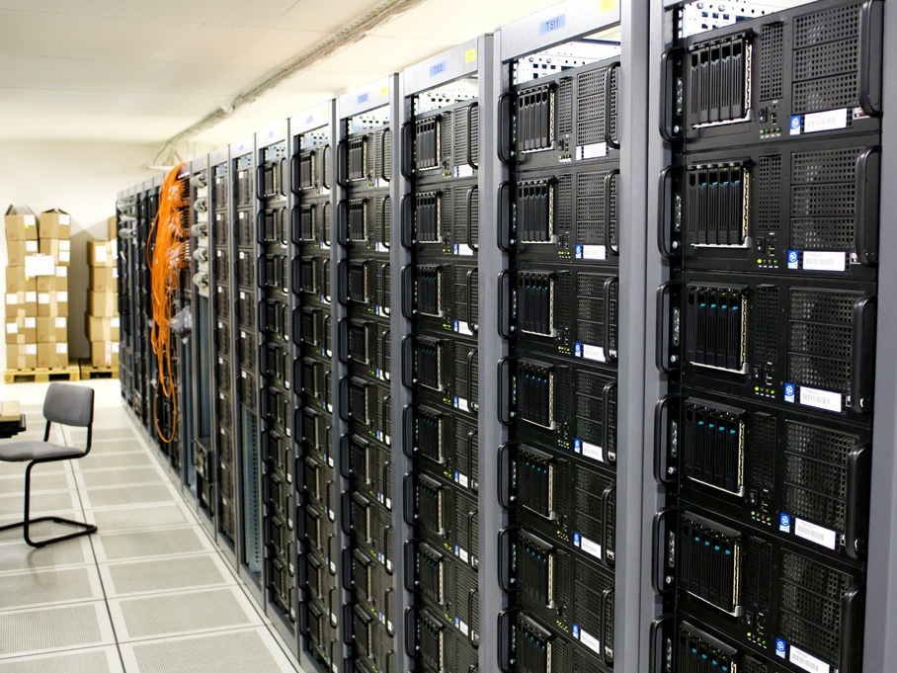
Photo CC-BY www.flickr.com/photos/torkildr/3462607995/
Notes:
HPC exists to generate and process what? Data
I could go on:
Visualisation? Data
Calculation? Data
etc.

Slide 11
Some context from Downunder

Slide 13
National Collaborative Research Infrastructure Scheme
Funded since 2004
Covers large research infrastructure across most science disciplines
Also funds eResearch infrastructure:
Access Australia Federation (AAF)
Australian Academic Research Network (AARNet)
Research Data Services (actually storage)
National eResearch Collaboration Tools and Resources (NeCTAR)
Australian National Data Service (ANDS)

Slide 14
Australian National Data Service
A national response

Slide 15
ANDS Overview
Funded since 2009
Approx 100M AUD of funding (c. 68M EUR)
50 staff
300+ projects completed
Currently funded to mid 2017 (extension likely)
Shape of successor to NCRIS still being worked out
Roadmap issues paper makes it clear there will be a data investment of some form

Slide 16
Key differentiators for ANDS
Don’t store data
Describe data at collections level
Nationally co-ordinated approach
Bulk of funds spent outside ANDS
https://projects.ands.org.au/getAllProjects.php?start=all
All disciplines covered

Slide 17
ANDS enables the transformation of
Data that are:
Unmanaged
Disconnected
Invisible
Single use
To Structured Collections that are:
Managed
Connected
Findable
Reusable
so that Australian researchers can easily publish, discover, access and use/re-use research data.

Slide 18
The Australian National Data Service (ANDS) makes Australia’s research data assets more valuable for researchers, research institutions and the nation.

Slide 19
Trusted Partnerships
Most important partners are research-producing institutions
we don’t partner directly with researchers
Work with institutions to meet their research data ambitions
Also strong engagement on policy issues with national research funders (NHMRC, ARC)
advocacy and education role
Increasing engagement with national disciplinary generators of data

Slide 20
Reliable Services
Identify my data
DataCite DOIs
Handles
Describe my data
Research Vocabularies Australia
Publish my data
100K collections
Find my data
Research Data Australia
Connect my data
Grants and Projects PURL infrastructure
ORCID (run by AAF)

Slide 21
Enhanced Capability
Initially targeted at research data librarians
Extensive set of webinars on data topics
23 Research Data Things
Workshops around the country
Expanding now to data technologists
Monthly TechTalks
Hub and Spoke model
And supporting Australian Provenance community

Slide 22
and International Engagement
ANDS was one of the founding members of the Research Data Alliance, and remains heavily involved
Why?
research is international
Australia is small (0.28 DE in population, 21.5 DE in area)
need to partner to adopt/adapt/develop solutions
good idea if Australian research collaborators are using compatible research data approaches

Slide 23
Some thoughts on trust

Slide 24
A system perspective
Van de Sompel, et al. (2004), “Rethinking Scholarly Communication: Building the System that Scholars Deserve”, Dlib, September, V10, N9
Roosendaal, H., and Geurts, P. (1997), “Forces and functions in scientific communication: an analysis of their interplay”, Cooperative Research Information Systems in Physics, August 31—September 4 1997, Oldenburg, Germany.

Slide 25
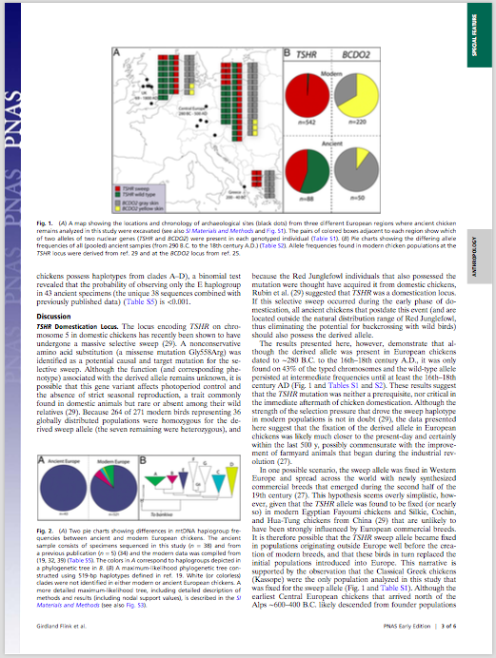
Life used to be simple
1001001011010011001011010010100101100101

Slide 26
Scholarly Communication Functions - Publications
Registration
submission to journal
Certification
peer review
Awareness
citations, indexing services
Archiving
libraries (print), publishers (electronic)

Slide 27
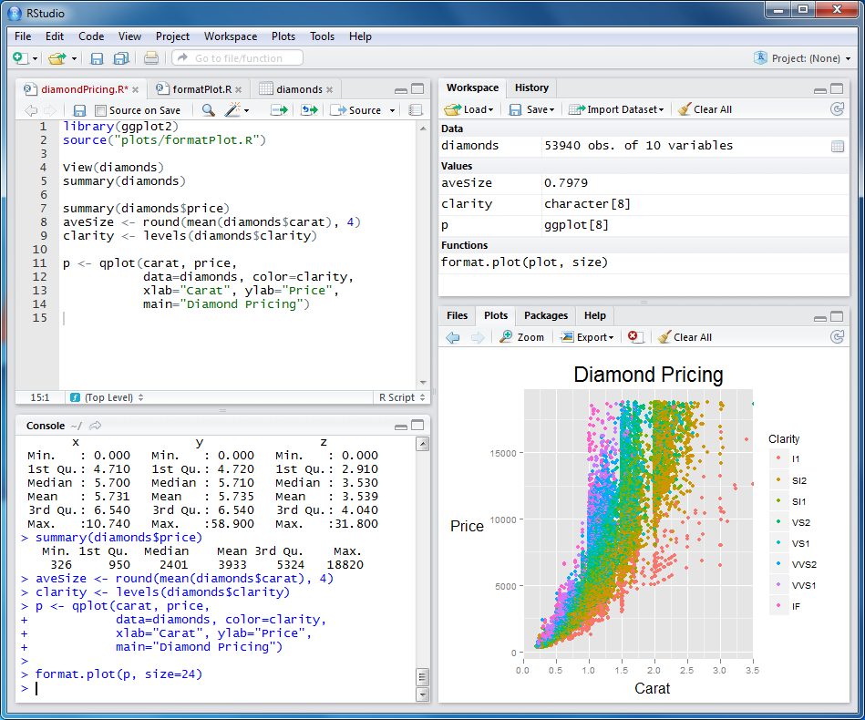
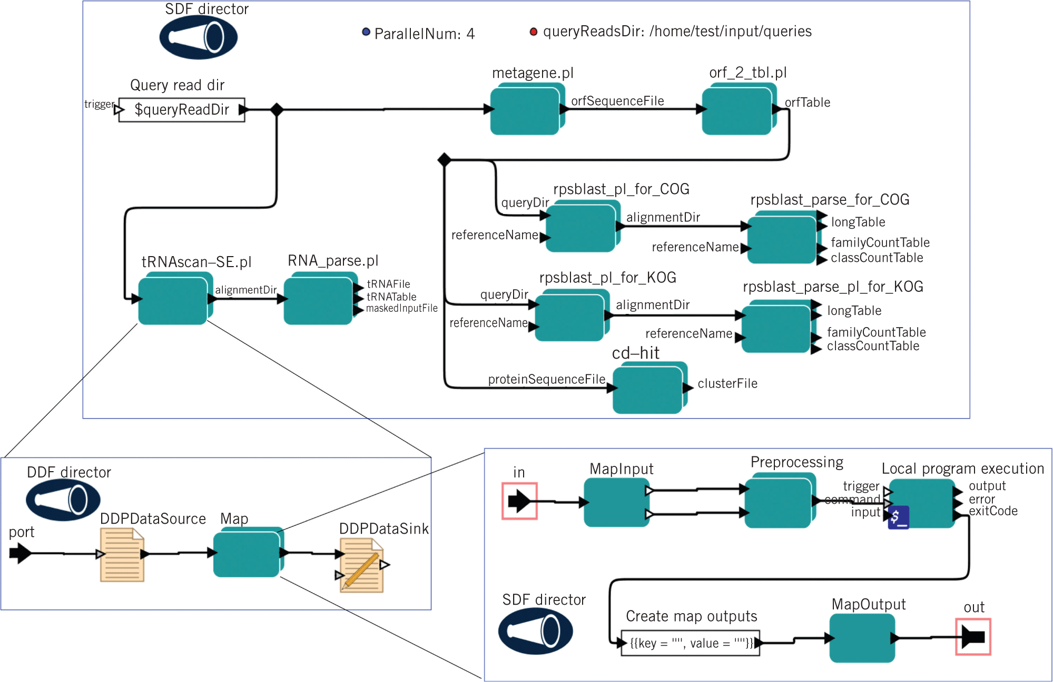
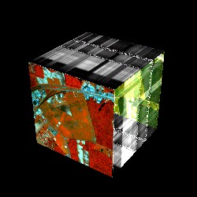
But now…
1001001011010011001011010010100101100101
1001001011010011001011010010100101100101
1001001011010011001011010010100101100101
1001001011010011001011010010100101100101

Slide 28
But what about data?
Registration
deposit in repository/data archive
Certification
ingest checks? provenance? re-use?
Awareness
data citations, search engines
Archiving
repositories (but challenge of change!)

Slide 29
And software/workflows/models?
Registration
deposit in RCS Subversion Git Zenodo
Certification
the Bazaar? your peers? Apache Foundation?
Awareness
methods sections? software citations?
Archiving
repositories (but challenge of change!), VM images

Slide 30
Trust in
Processes
Actors
Systems

Slide 31
Containers and Contents
Or 🍾 versus 🍷
The Economy of Ideas: A framework for rethinking patents and copyrights in the Digital Age (Everything you know about intellectual property is wrong)
John Perry Barlow, Wired 2.03

Slide 32
A FAIR definition
A trusted FAIR data repository is:
Sustainable - provided by an organisation with a long-term commitment, supported by appropriate processes and building on reliable data storage services
Findable – has connections to relevant local/national/international /discipline discovery services
Accessible – provides services that support both machine and human access with clear licensing about conditions on access
Interoperable - processes to ensure adequate descriptions for integration with other data
Reusable - provides rich metadata for quality assurance and assessment as evidence for research claims

Slide 33
Trusted Digital Repositories
Funding four initial projects:
National Imaging Facility nodes
CSIRO Water data
Proteomics models (with NZ)
Australian Data Archive

Slide 34
Trusted Research Outputs - I
Funding six projects (together with NeCTAR Virtual Laboratory activities) focusing on capturing and exposing provenance:
Astronomy (All Sky Virtual Observatory)
links to data pipelines, provenance for ingestion
Characterisation of Bio Samples (CVL)
standard workflows and libraries for data processing
Earth Sciences (Virtual Geophysics Laboratory)
provenance connections between researchers, workflows, tools
libraries of identified and tracked software

Slide 35
Trusted Research Outputs - II
Ecology (Biodiversity and Climate Change VL)
apply existing trust framework to all processing undertaken
increased visibility of provenance information
Genetics (Genomics Virtual Laboratory)
ability to save and publish analyses and workflows as independent, self describing data objects
Marine (Marine Virtual Laboratory)
enhanced provenance for imported and derived datasets

Slide 36
Andrew Treloar
ANDS is supported by the Australian Government through the National Collaborative Research Infrastructure Strategy Program. Monash University leads the partnership with the Australian National University and CSIRO.
With the exception of third party images or where otherwise indicated, this work is licensed under the Creative Commons 4.0 International Attribution Licence.
Director of Technology
E: andrew.treloar@ands.org.au
T: @atreloar
W: andrew.treloar.net

