Slide 1
AMS-Chess1 Characterization
K. Kanisauskas, T. Binnie, C. Buttar, J. Dopke, T. Huffman, J. John, D. Maneuski, R. Plackett, L. Vigani, Q. Xiu
ATLAS Strip CMOS Regular Meeting
March 29, 2016

Slide 2
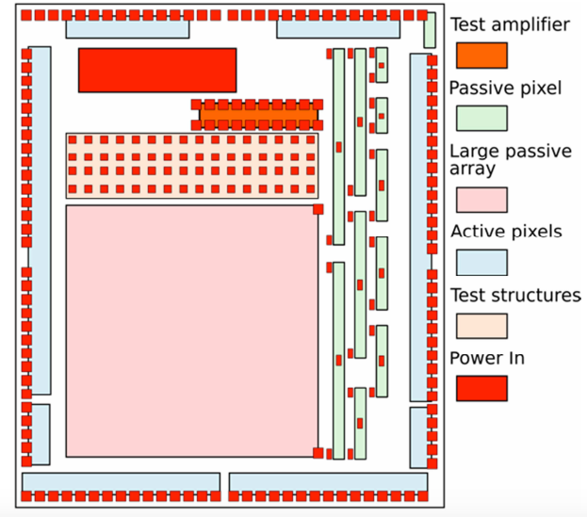
AMS-Chess1
Edge-TCT measurements performed for irradiated and non-irradiated samples
Laser scans done at different bias voltages
APA8 structure investigated
45×800μm² size pixels
Same DAC settings used for both samples:
VPLoad: 2100
Casc: 2600
iNSF: 570
iN: 1000
iNBias: 340
iPFB: 2475

Slide 3
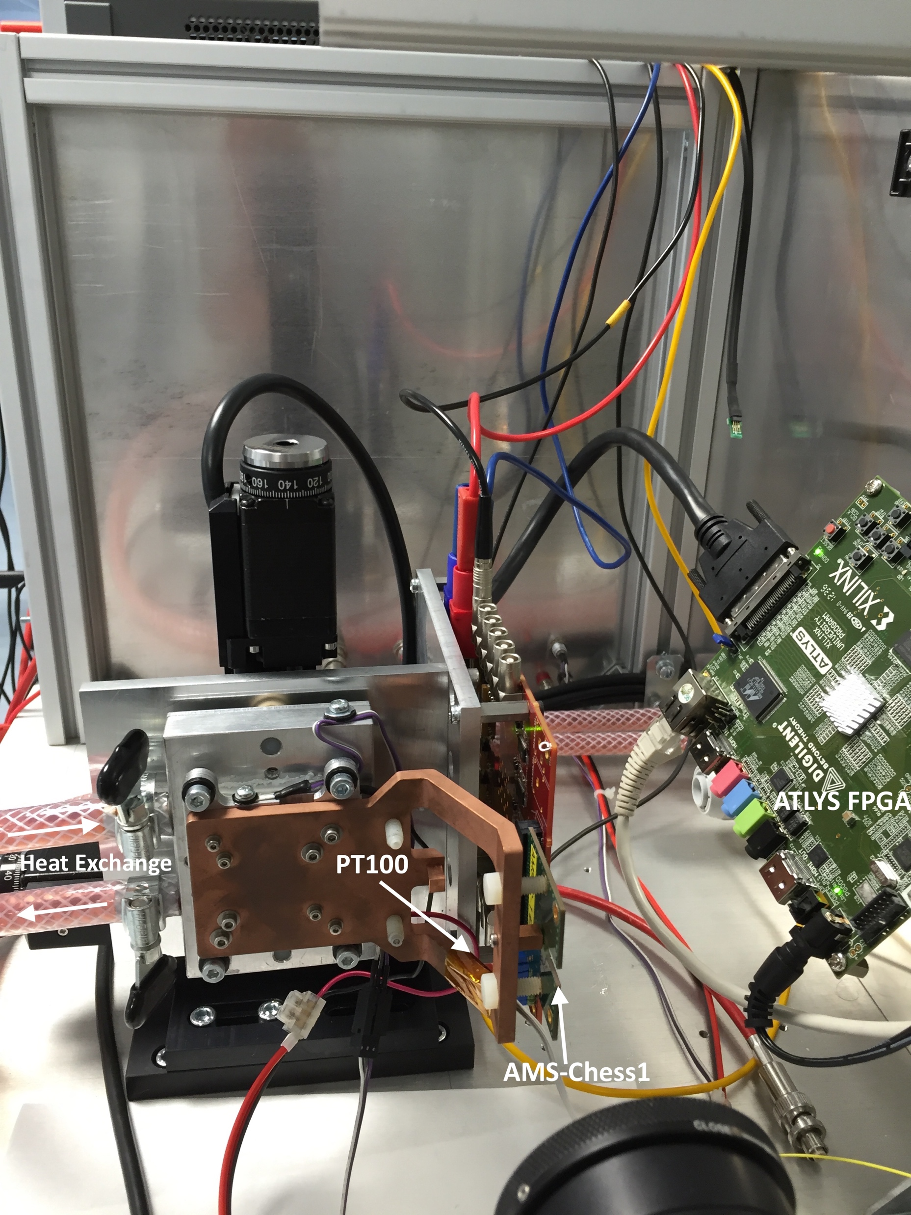
Laser Setup
1060nm laser was used
Test chip is cooled down using peltier
Temperature monitored close to AMS-Chess1 chip during measurements
Measurements for non-irradiated and irradiated samples done at the same temperature (≈ -8℃)
Constant dry air supply available (dew point ≈ -11℃)

Slide 4
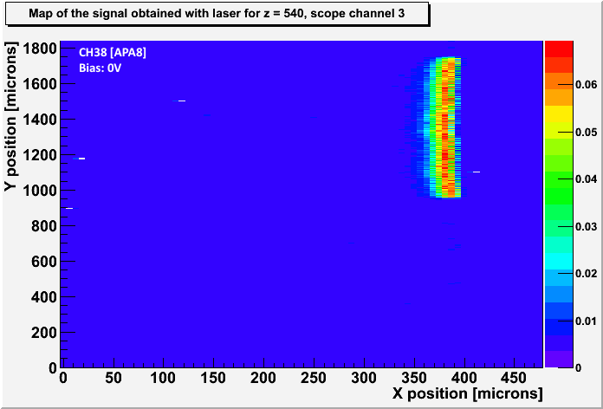
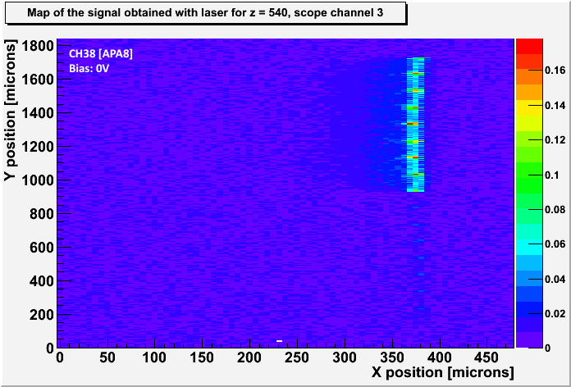
Edge-TCT (1)
Output Signal Maps
Non-Irradiated
Irradiated
Surface
Data was taken for CH38 and CH41 (correspond to APA8 pixels) between -45 and 0 bias voltages
In this case positive signal observed from pixels
For irradiated device the signal completely disappears below -50V bias
Rise-times of the signal were dismissed due to jitter

Slide 5
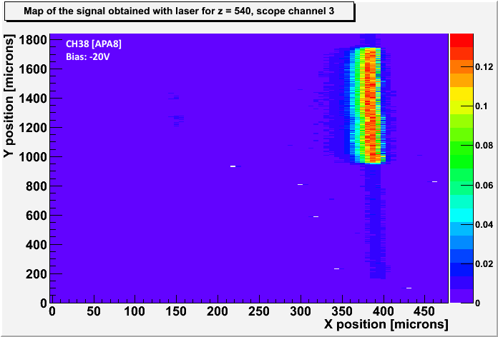
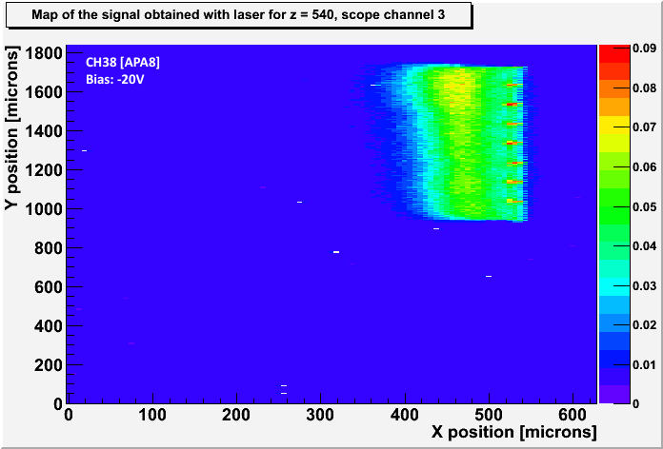
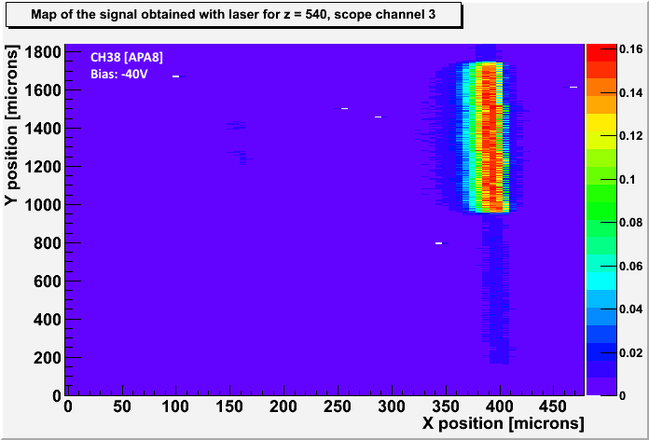
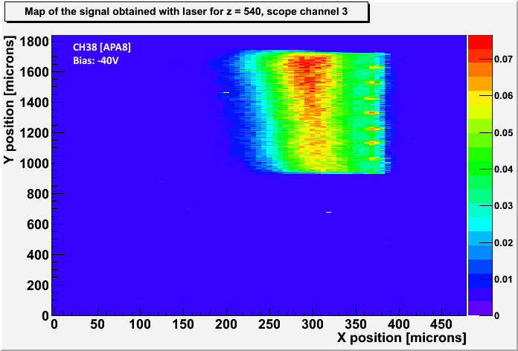
Edge-TCT (2)
Non-Irradiated
Irradiated
Surface
Different X-axis range

Slide 6
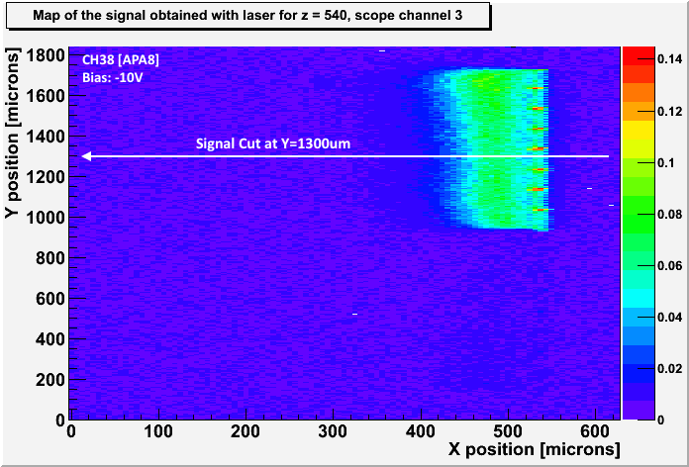
Edge-TCT (3)
Signal cut was done for CH38 at the center of the pixel
Plots produced of relative signal vs x-coordinate
Depletion regions compared between irradiated and non-irradiated samples at different bias voltages

Slide 7
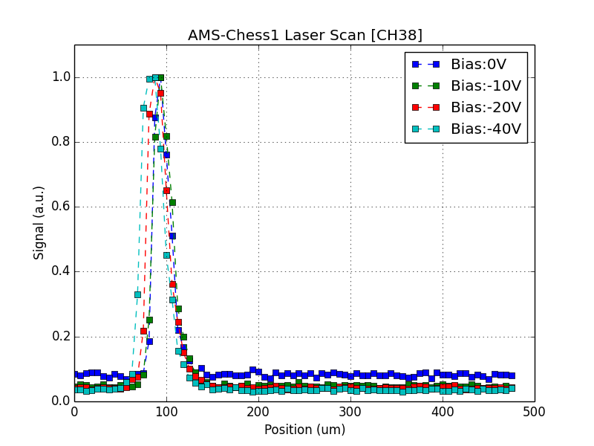
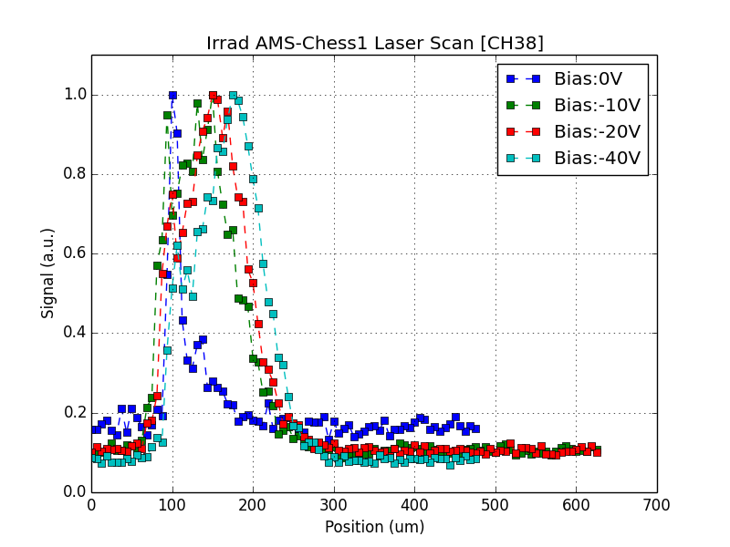
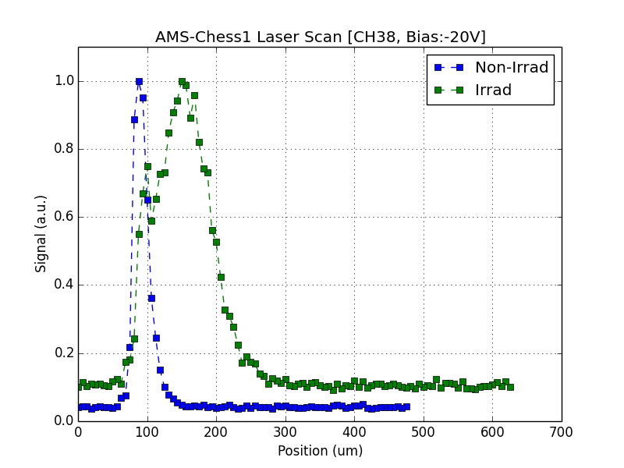
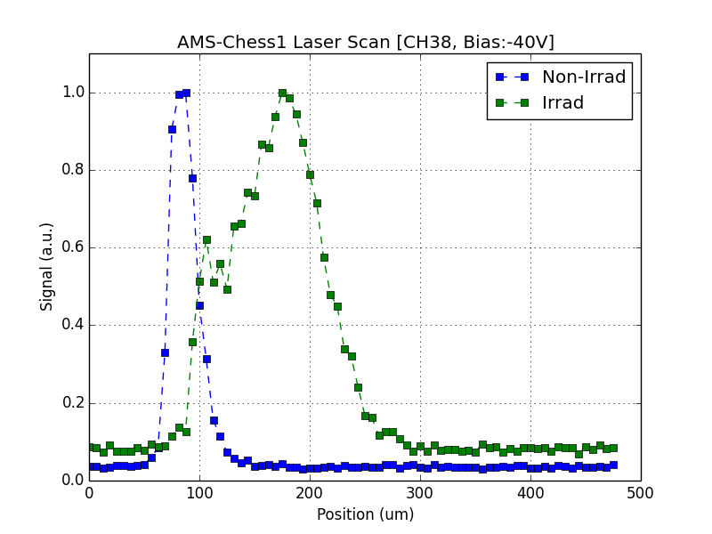
Edge-TCT (4)

Slide 8
Summary
Increase in depletion region observed for irradiated device
Different behavior of amplitude vs bias voltage seen between non-irradiated and irradiated samples
Unknown reason for signal disappearance below -50V

