Slide 1

3D TCAD
Jens
(With help from Giulio)

Slide 2
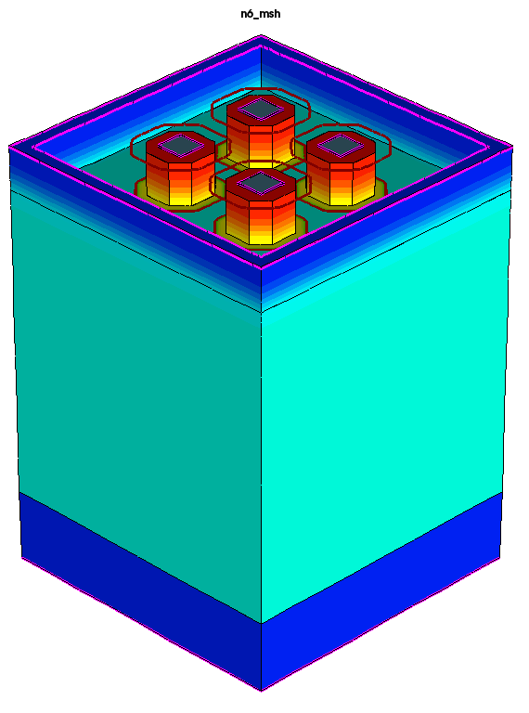
Model PonP
4 implants as per Layout with Dips prescription for implantation
  PonN Layout has been modified according to what I read from TJ SIMS measurements
Surrounding Well is O(XXX)
Implants are O(YYY)
Electrodes either on top of well or on Metal
  Metal electrodes mildly smaller (0.2um) than in Layout

Slide 3
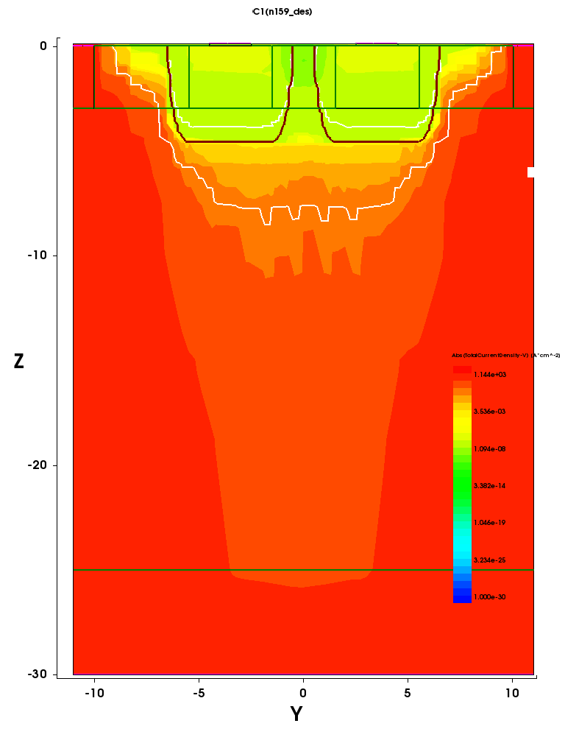
Biasing the structure

Slide 4
Biasing pads
Wiggle N1 (rear electrode in first picture) and observe currents on N1/2/3/4
  With trapped charge on the scale of 2e10 and beyond very nice linear behaviour
  Below that still conductive but with an asymmetry around 0
Our observed total resistance roughly compares with 6e10 surface trapped charges

Slide 5
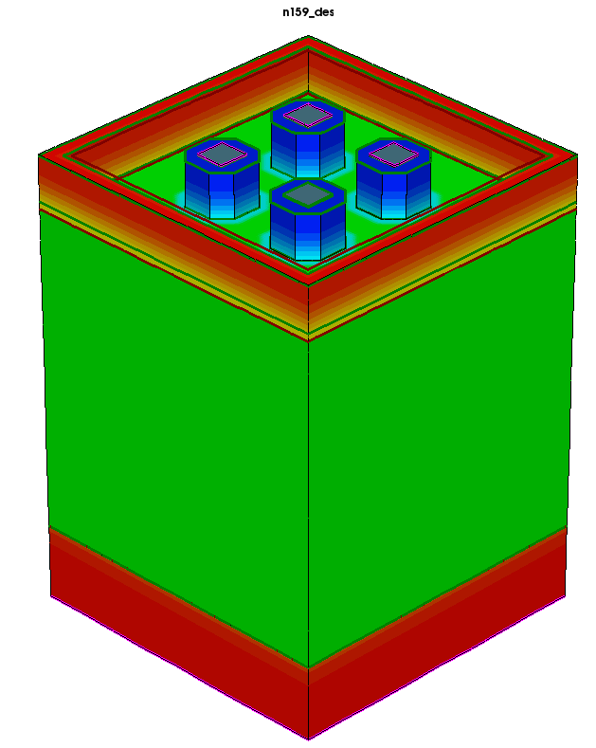
Model PonN
Same as PonP, just inverted
Depletion starts from Deep N-well as well as from backside
  For electronics deep N needs to sit at 1.8V
  Full depletion between deep N and N-sub seems to exist from ~18V upwards.
Same problem as PonP, never fully depletes
  Instead large currents through the epi

Slide 6
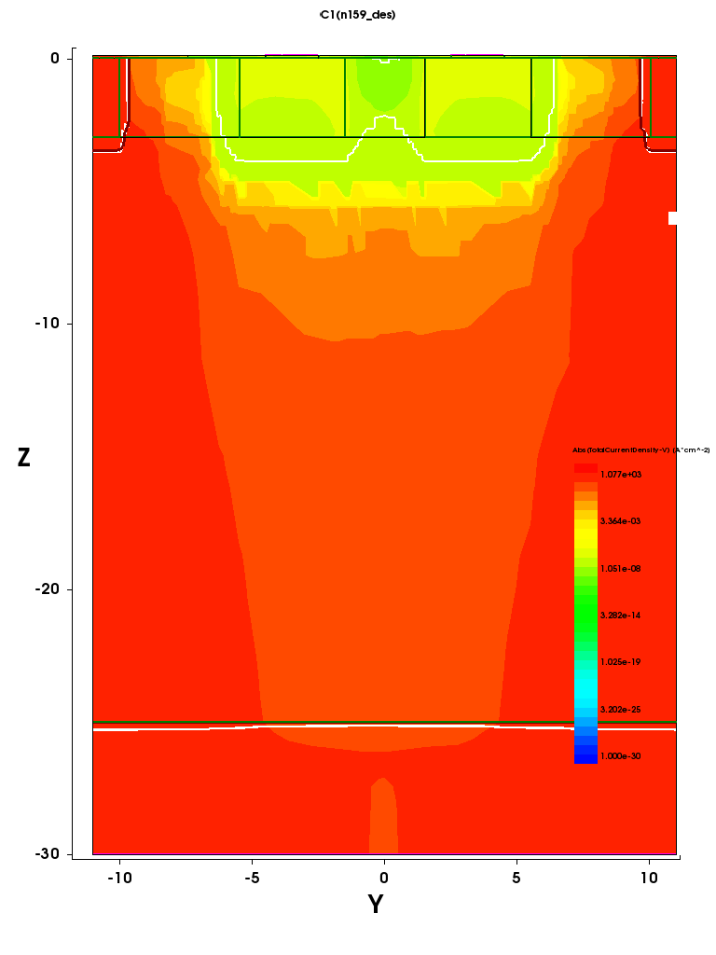
Biasing the structure

Slide 7
Biasing Pads
Here the surface charge actually helps
Still, 100V bias, enormous bias currents, not fully depleted

Slide 8
Next Steps
???

