Slide 1
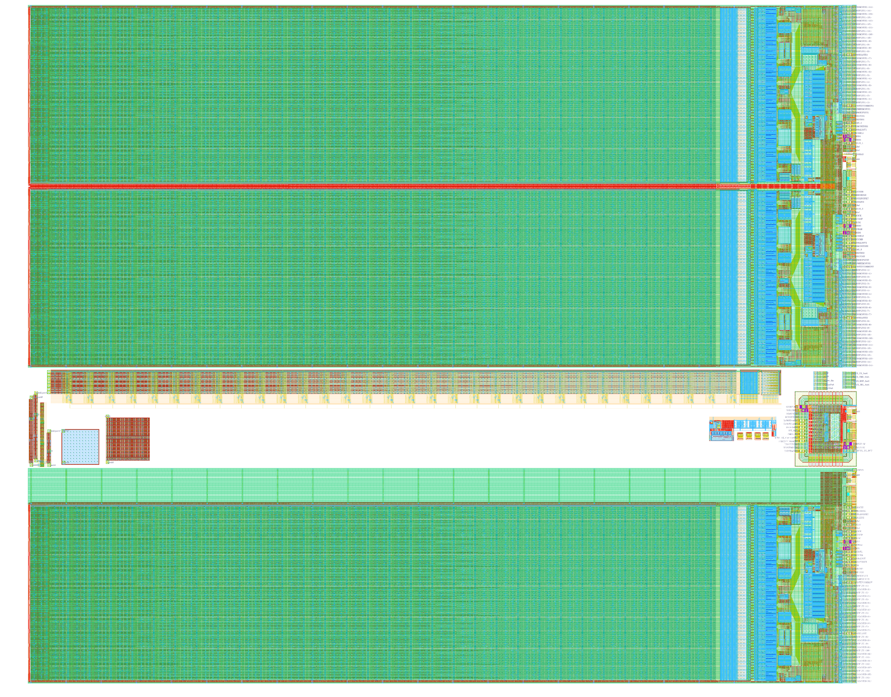
CHESS2 reticle

Slide 2
2.44cm x 2cm

Slide 3
2 array mirrored
Tests structures
Single array

Slide 4
Test structures ETCT accessible:
3x3 pixels array
Big nwell
Big array of nwells
512 pixels with multiplexed comparator output and 7 analog outputs.
Standalone SACI
4 internal DACs
Standalone TX-RX LVDS to CMOS
1 day of routing remaining
for the test structures
+ adding decoupling cap for
analog supplies and bias

Slide 5
Total of
3x4096 pixels
74000 nwells
1.5million transistors

