Slide 1
Characterisation of AMS Chess 1 chip with fluorescence X-rays
Dima Maneuski
Richard Bates, Andrew Blue, Craig Buttar, Kestutis Kanisauskas, Conor O’Reilly

Slide 2
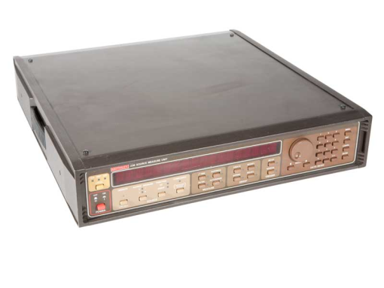
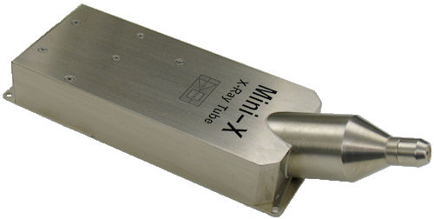
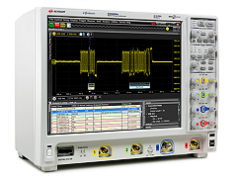
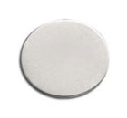
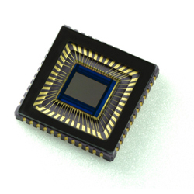
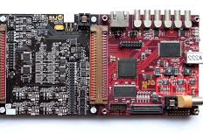
X-ray fluorescence setup
Principle setup schematic
Bias
Fluorescence target
X-ray tube
DUT
Analog
waveform
X-ray bremsstrahlung
X-ray fluorescence
Digital control
NB: Many target materials available.
For this experiments we used:
Fe (6 keV), Cu (8 keV), Nb (16 keV), Sn (25 keV)

Slide 3
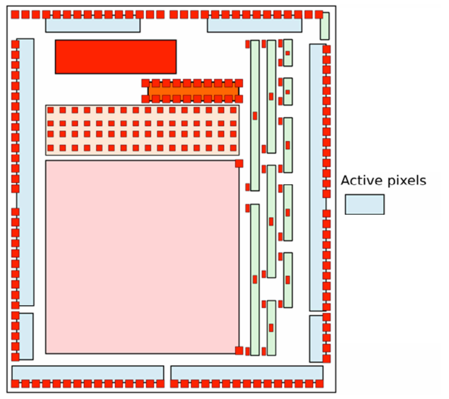
What was tested?
APA 4
APA 3
We have three devices
One on front TCT board one on eTCT board
One Irrad on front TCT
Front TCT devices didn’t work at all yet ☹
On eTCT device:
APA2 and APA3 showed no response to X-rays
APA8 responds to X-rays but either gain is too low or sensitivity is poor.
APA 8
APA 7
APA 1
APA 2
APA 6
APA 5

Slide 4
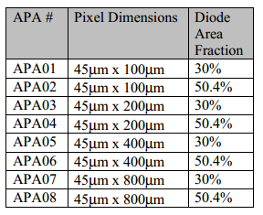
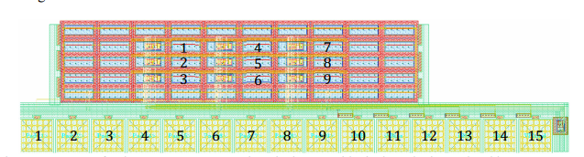
What was tested?
9 pixels in each group
Software Inkler
DAC 1 (VPLoad) = 2100 mV
DAC 2 (Casc) = 2600 mV
DAC 3 (iNSF) = 750 mV
DAC 4 (iN) =1000 mV
DAC 5 (iBias) = 150 mV
DAC 6 (iFB) = 2700 mV

Slide 5
What was tested?
Bias dependence
Bias voltages 0, -10, -20, -30, -40, -50, -60, -70 [V]
Nb target (15 keV)
APA4 and APA6, OUTPUT 5 (middle pixel)
Group uniformity
APA4 , APA5, APA6
Nb target (15 keV)
-40V bias
9 pixels on each test structures

Slide 6
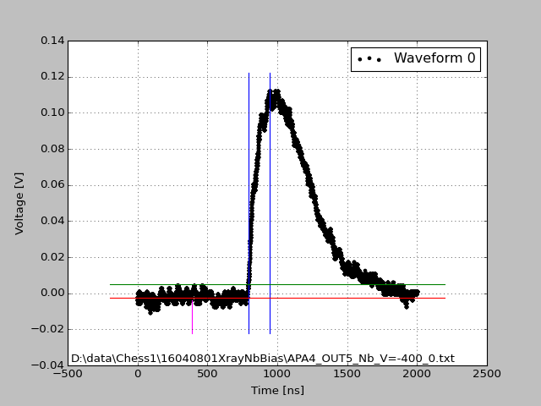
General remarks
Acquisition settings
X-ray tube 40 kVp, 100 uA
Output 1 Mohm, AC
Trigger level: 5 mV
Trigger window: 200 ns
Improved algorithm for rise time extraction
Good waveform example
Peak position
Rise time extraction region
3 sigma
Noise extraction region up to magenta line

Slide 7
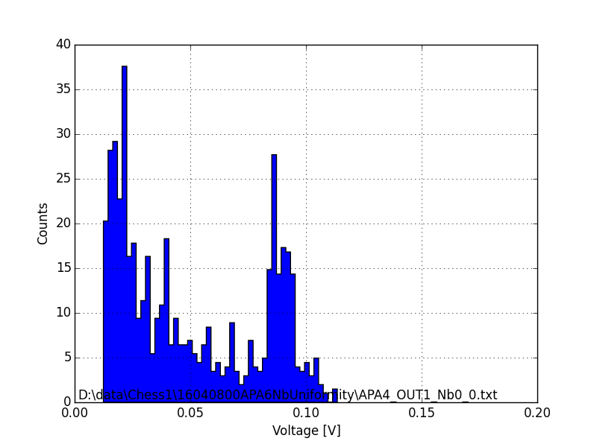
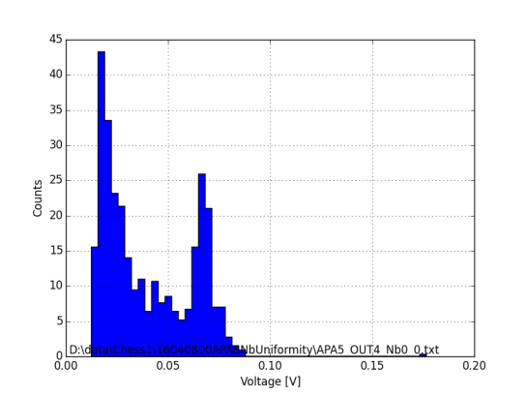
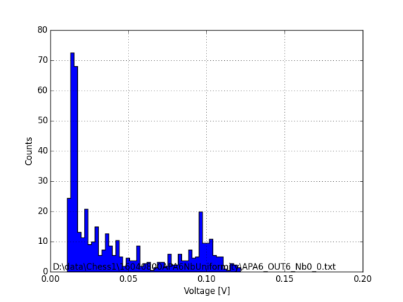
Group uniformity
Peak position [V]
APA4
APA5
APA6
Some examples
APA4-1
0.085 | 0.075 | 0.125
0.075 | 0.110 | 0.120
0.06 | 0.120 | 0.120
Mean: 0.099 V
St.Dev: 0.024 V
APA5-4
0.100 | 0.080 | 0.085
0.070 | 0.120 | 0.055
0.100 | 0.065 | 0.055
Mean: 0.081 V
St.Dev: 0.021 V
0.080 | 0.070 | 0.075
0.055 | 0.060 | 0.100
0.080 | 0.090 | 0.070
Mean: 0.076 V
St.Dev: 0.013 V
APA6-6

Slide 8
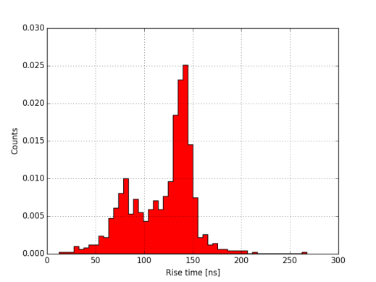
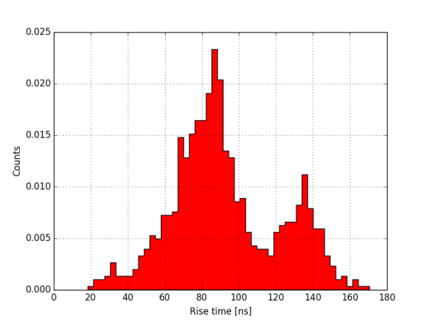
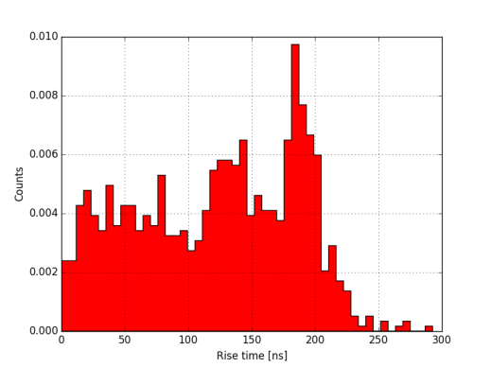
Group uniformity
Rise time of full K-alpha peak [ns]
APA4
APA5
APA6
Some examples
APA4-1
140 | 85 | 200
90 | 145 | 200
85 | 200 | 200
Mean: 150 ns
St.Dev: 53 ns
APA5-4
190 | 140 | 140
90 | 200 | 80
200 | 85 | 80
Mean: 134 ns
St.Dev: 53 ns
APA6-6
150 | 135 | 140
80 | 90 | 190
145 | 145 | 140
Mean: 135 ns
St.Dev: 33 ns

Slide 9
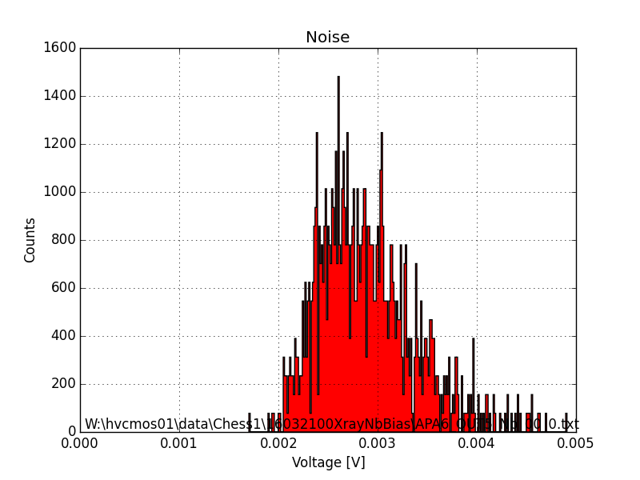
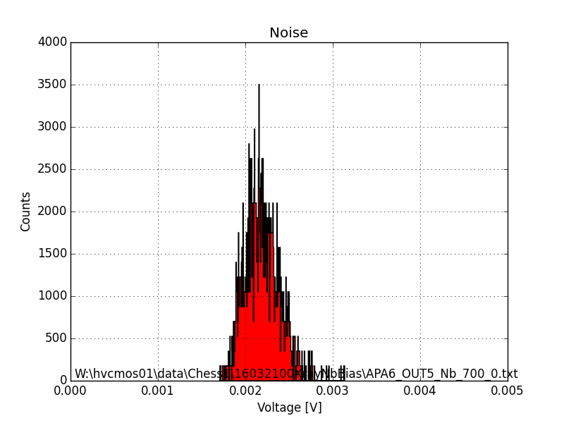
Bias dependence [1]
Noise

Slide 10
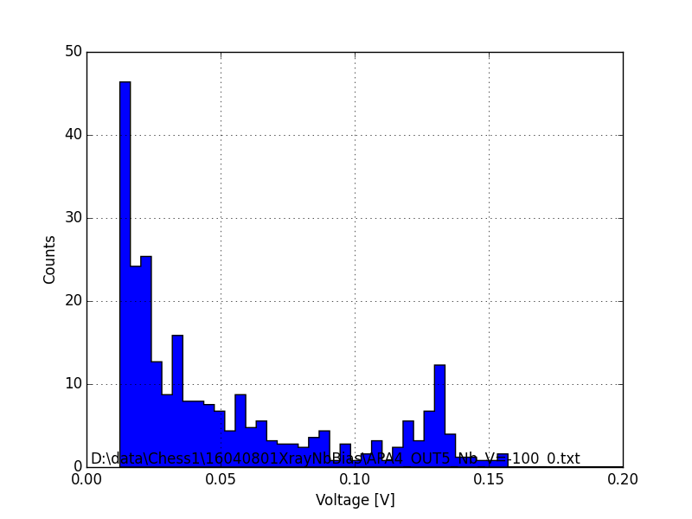
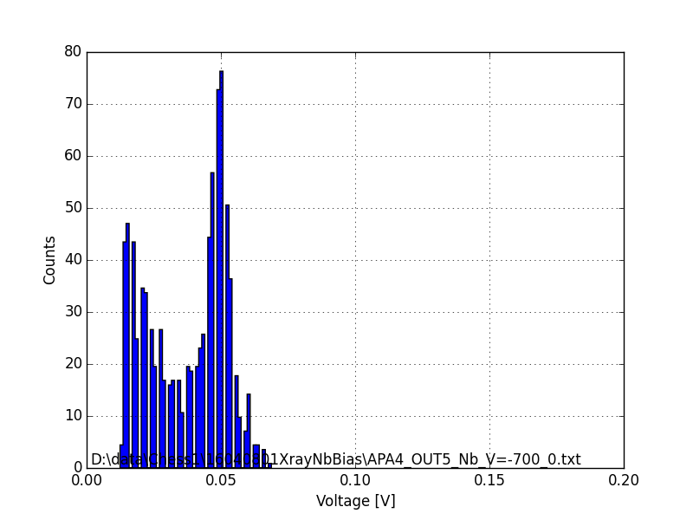
Bias dependence [2]
Peak position [V]
No peak at 0 V

Slide 11
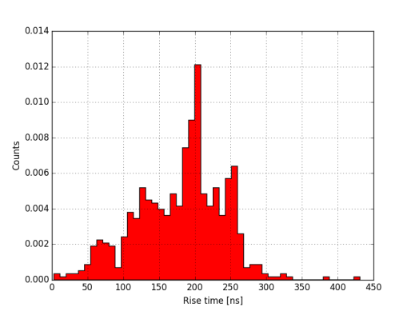
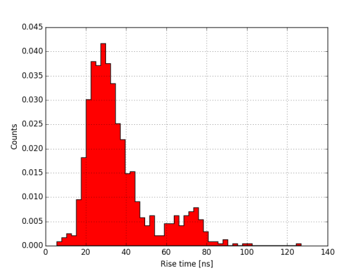
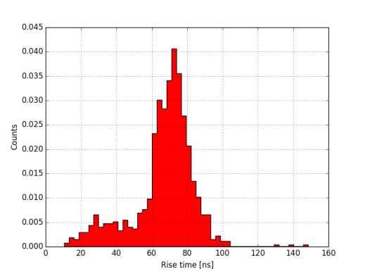
Bias dependence [3]
Rise time of full K-alpha peak [ns]

Slide 12
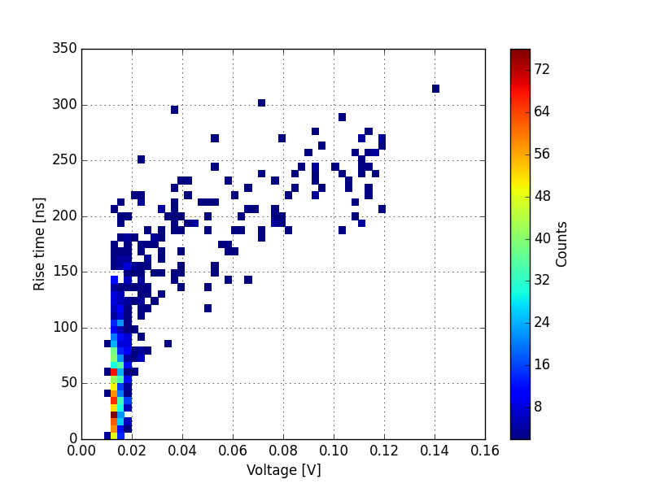
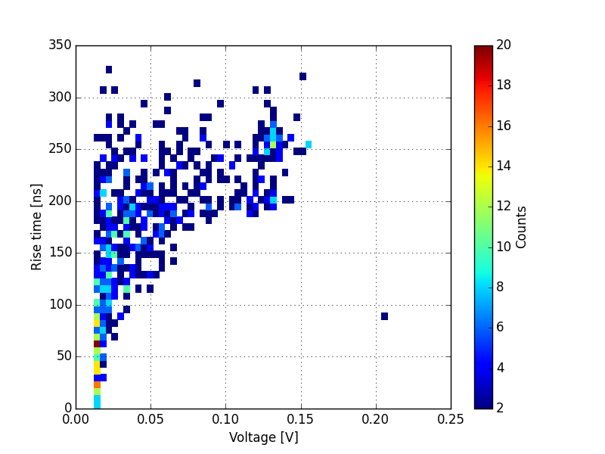
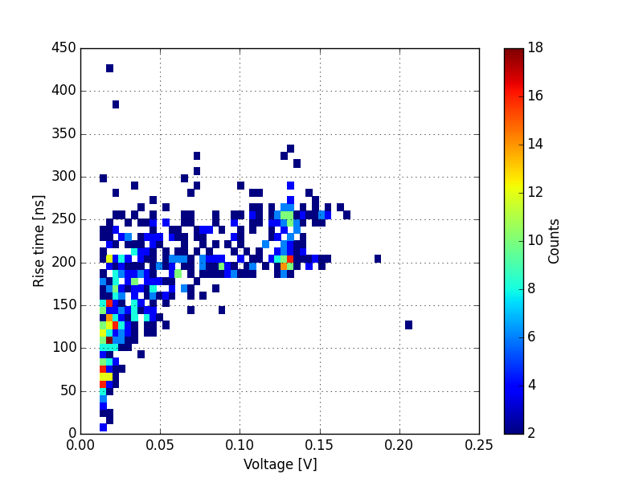
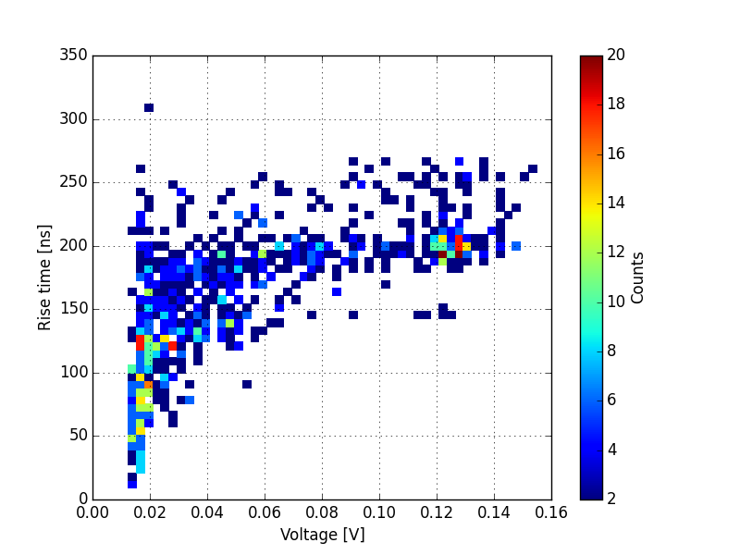
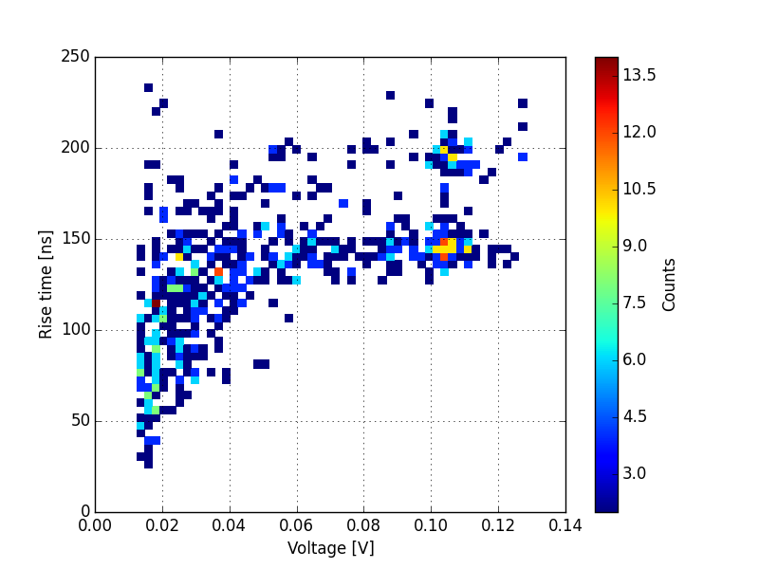
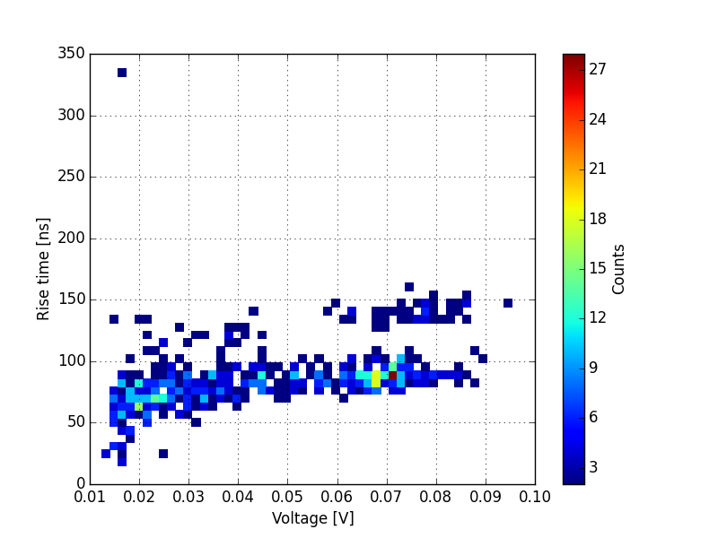
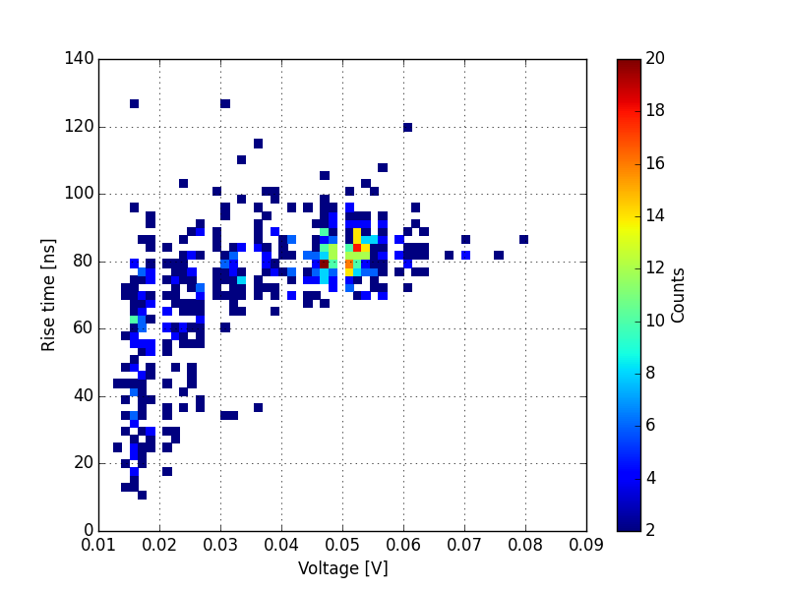
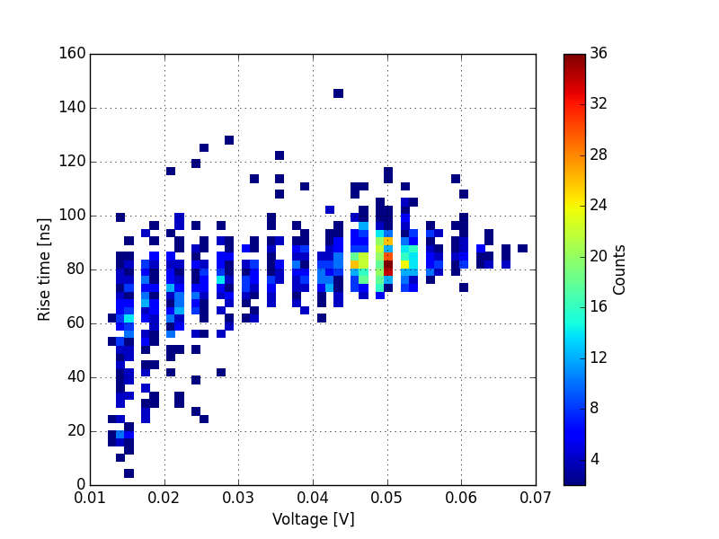
Bias dependence [3]
Peak-rise time response [APA4]
0 V
-10 V
-20 V
-30 V
Drift-diffusion?
-40 V
-50 V
-60 V
-70 V

Slide 13
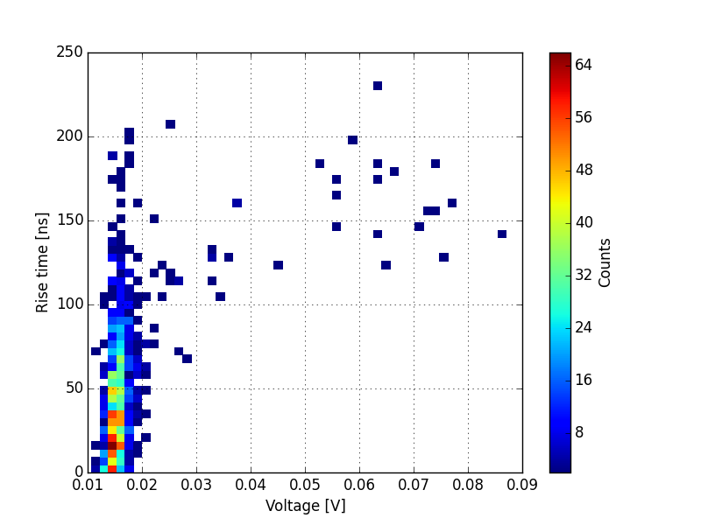
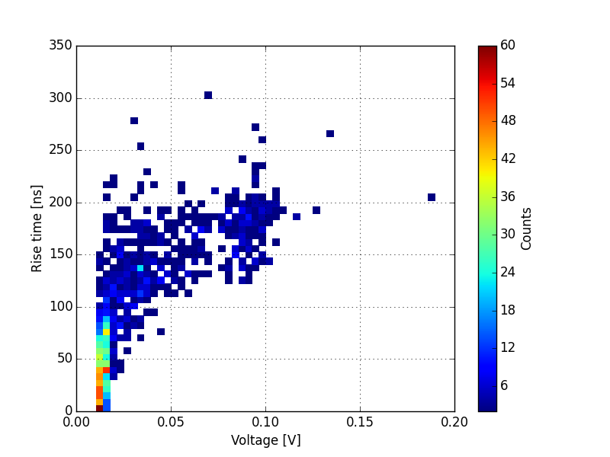
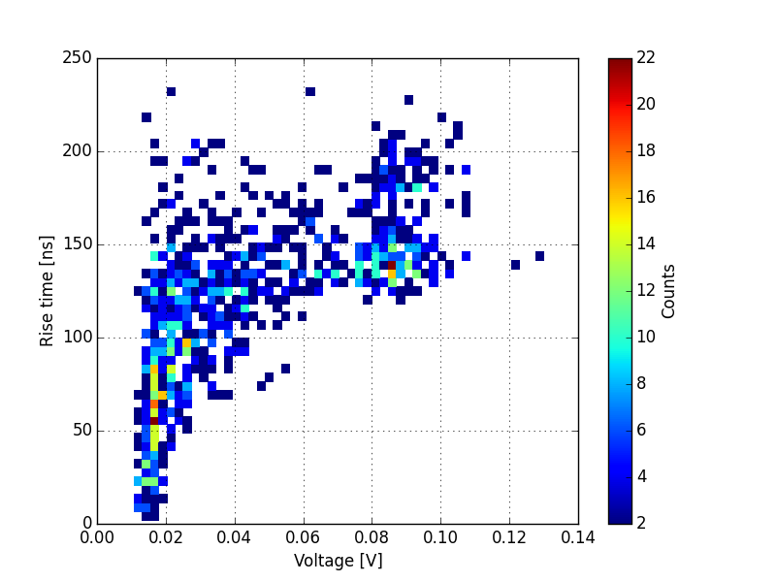
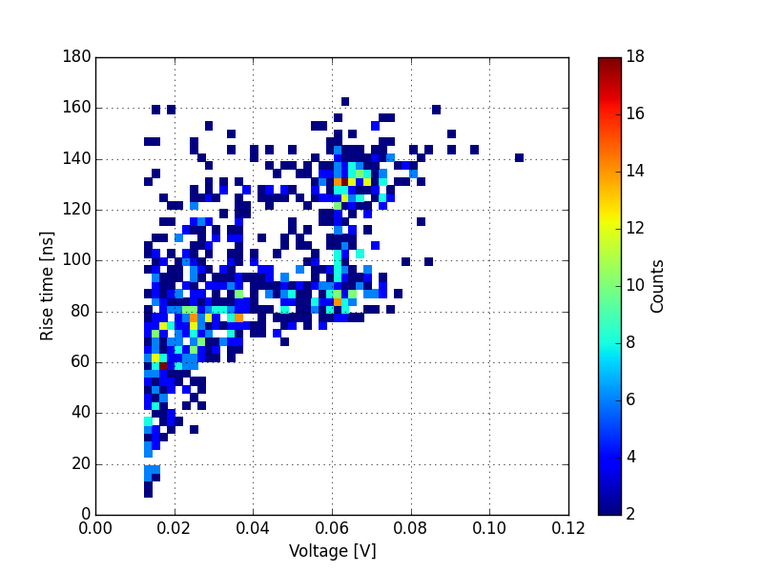
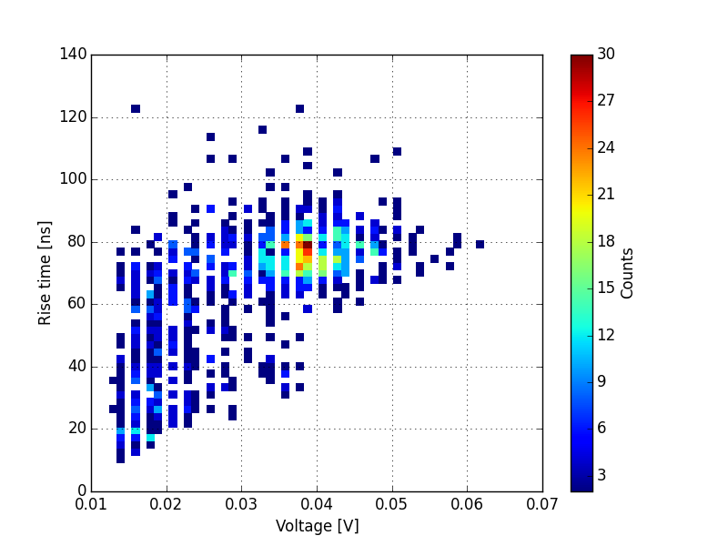
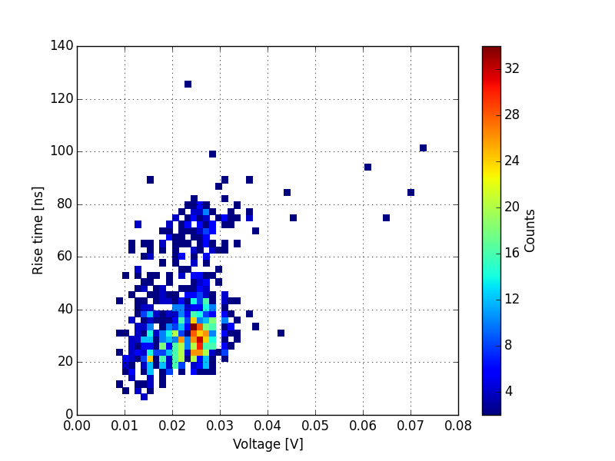
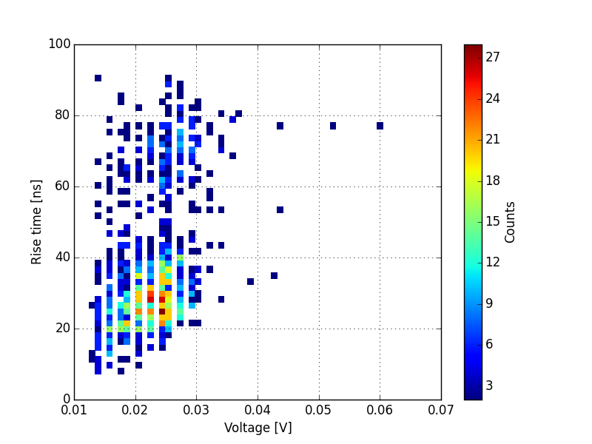
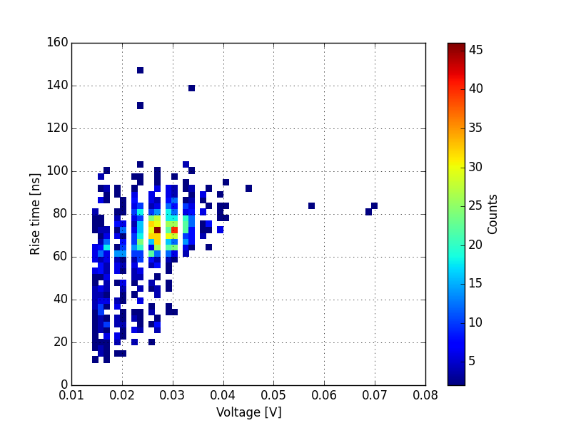
Bias dependence [4]
Peak-rise time response [APA6]
0 V
-10 V
-20 V
-30 V
Drift-diffusion?
-40 V
-50 V
-60 V
-70 V

Slide 14
Thoughts out loud
Some preliminary observations
Test structures non uniformity is 25%-ish for 3x3 pixels
Cannot yet explain peak separation (drift + diffusion?)
Cannot yet explain why peak shifts left rather than right as bias is increased.
Observed that it takes much longer in time to acquire 1000 waveforms at 70 V compared say to 40V. Need to study this systematically and put numbers-> Efficiency drop of some sort.
Could someone provide schematics for the pixels please?
Could someone provide physical layout for the pixels please?

