Slide 1
Characterisation of AMS Chess 1 chip with fluorescence X-rays
Dima Maneuski
Richard Bates, Andrew Blue, Craig Buttar, Kestutis Kanisauskas, Conor O’Reilly

Slide 2
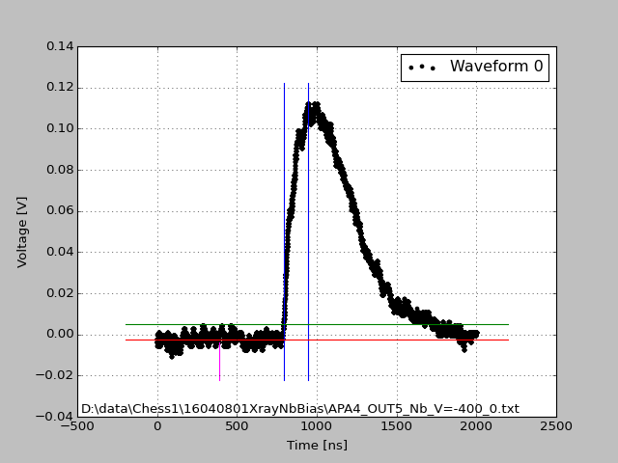
General remarks
Acquisition settings
X-ray tube 40 kVp, 100 uA
Output 1 Mohm, AC
Trigger level: 5 mV
Trigger window: 200 ns
Improved algorithm for rise time extraction
Good waveform example
Peak position
Rise time extraction region
3 sigma
Noise extraction region up to magenta line

Slide 3
What was tested?
DAC performance
Bias voltages -40, -70 [V]
Nb target (15 keV)
APA6, OUTPUT 5 (middle pixel)
Peak position, rise time

Slide 4
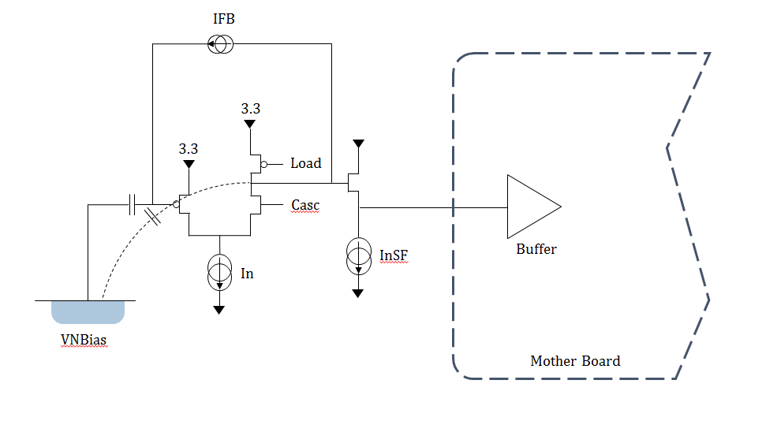
What DACs do we have?
Adjusts gain
 | Typical value | Can change?
VPFB | 2.65V to 2.8V | Yes adjust gain
VNSF | 0.5V to 0.8V | Yes adjust to your output load
VCasc | 2.6V | Not needed
VPload | 2.1V | Not needed
VN | 1V | Not needed
VNBias | 250mV | Not needed
Adjusts SF current

Slide 5
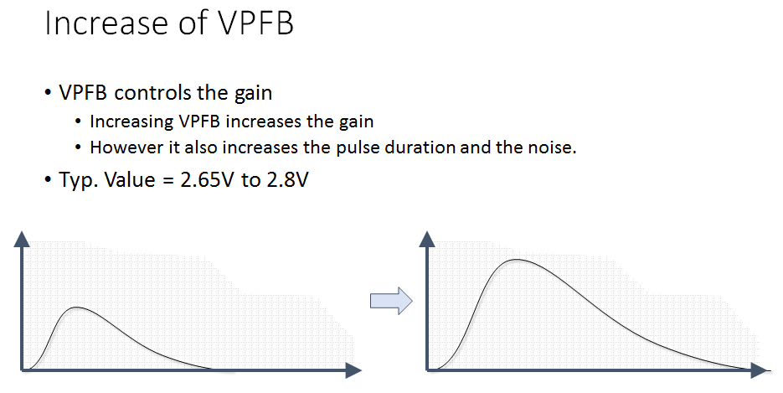
VPFB

Slide 6
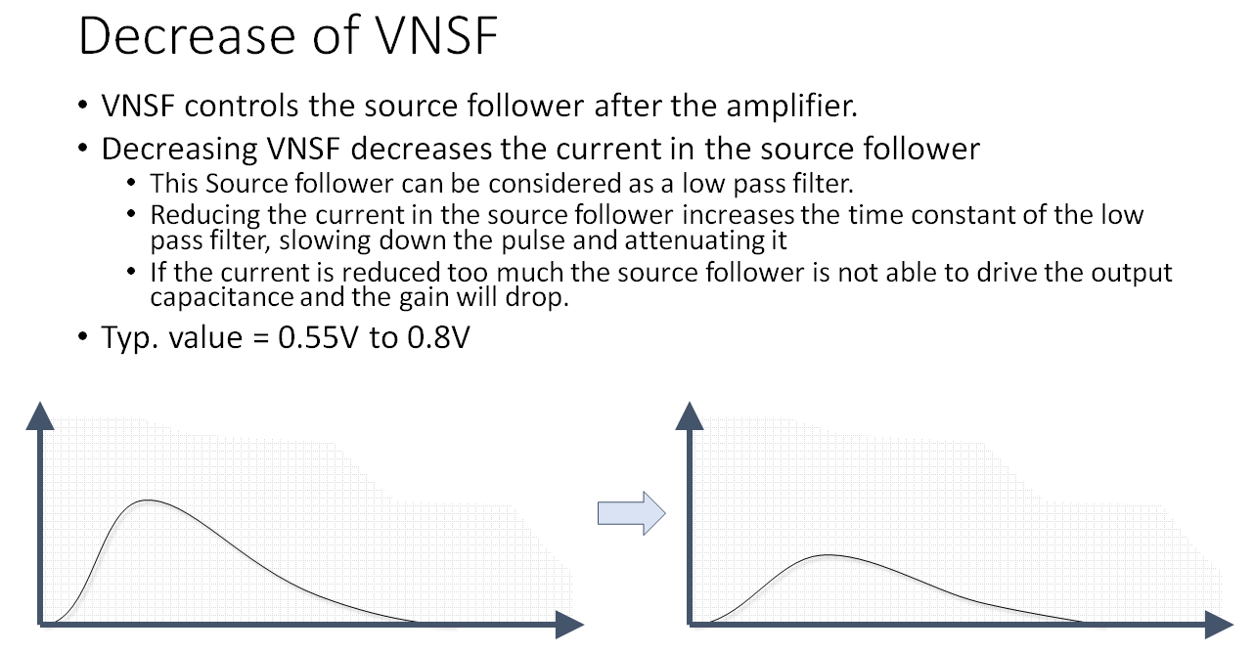
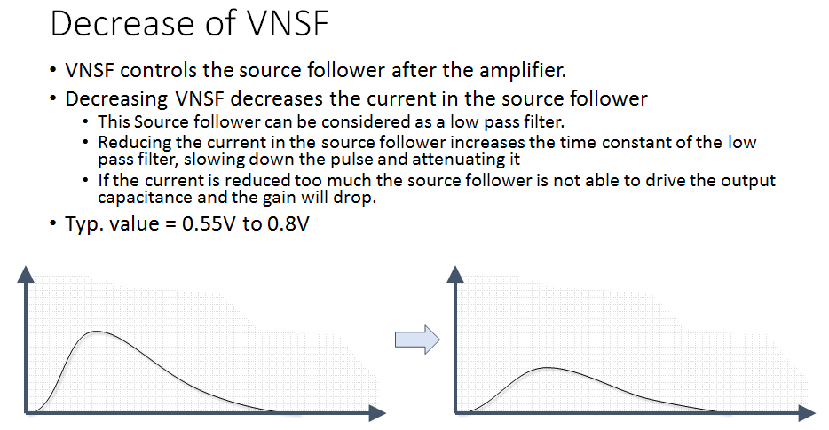
VNSF

Slide 7
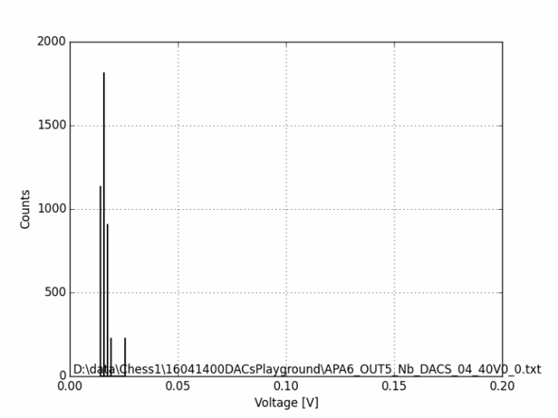
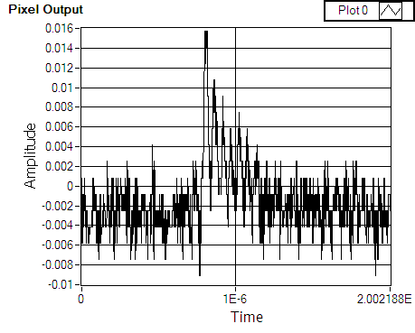
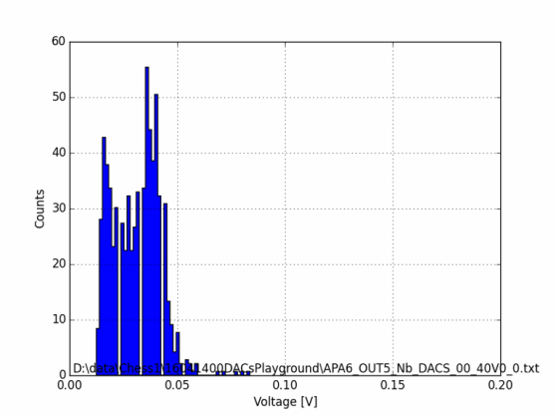
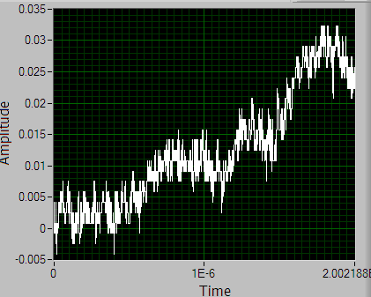
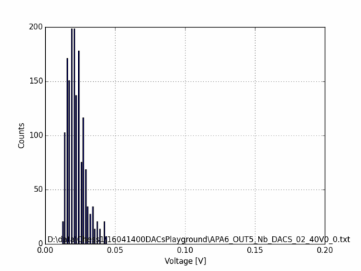
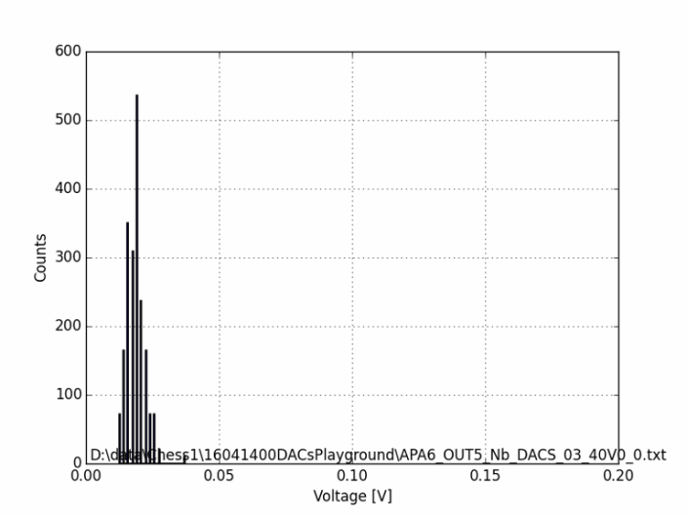
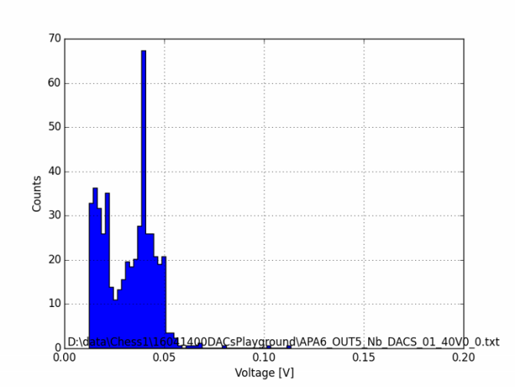
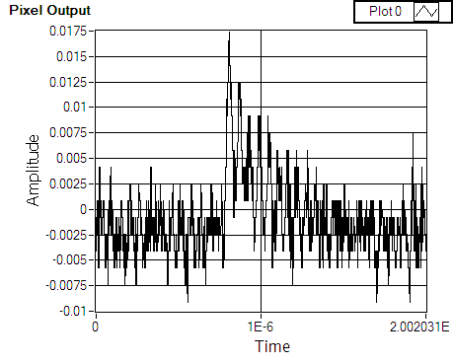
VPFB variation : spectrum -40V
DACS_04
DAC 1 (VPLoad) = 2100
DAC 2 (Casc) = 2600
DAC 3 (iNSF) = 750
DAC 4 (iN) =1000
DAC 5 (iBias) = 150
DAC 6 (iFB) = 2500
DACS_03
DAC 1 (VPLoad) = 2100
DAC 2 (Casc) = 2600
DAC 3 (iNSF) = 750
DAC 4 (iN) =1000
DAC 5 (iBias) = 150
DAC 6 (iFB) = 2600
DACS_00
DAC 1 (VPLoad) = 2100
DAC 2 (Casc) = 2600
DAC 3 (iNSF) = 750
DAC 4 (iN) =1000
DAC 5 (iBias) = 150
DAC 6 (iFB) = 2700
DACS_01
DAC 1 (VPLoad) = 2100
DAC 2 (Casc) = 2600
DAC 3 (iNSF) = 750
DAC 4 (iN) =1000
DAC 5 (iBias) = 150
DAC 6 (iFB) = 2800
DACS_02
DAC 1 (VPLoad) = 2100
DAC 2 (Casc) = 2600
DAC 3 (iNSF) = 750
DAC 4 (iN) =1000
DAC 5 (iBias) = 150
DAC 6 (iFB) = 2900
Waveform ripples

Slide 8
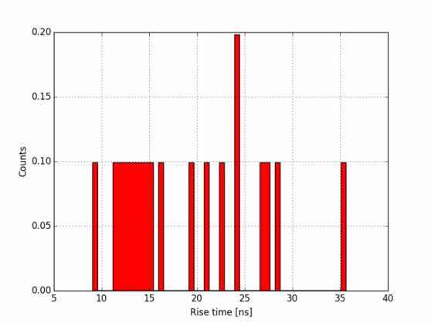
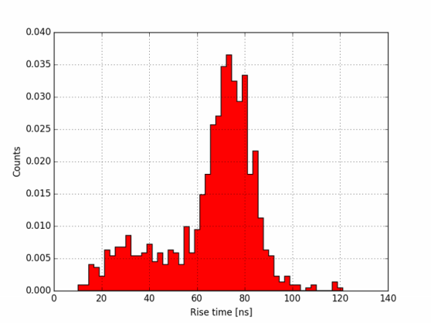
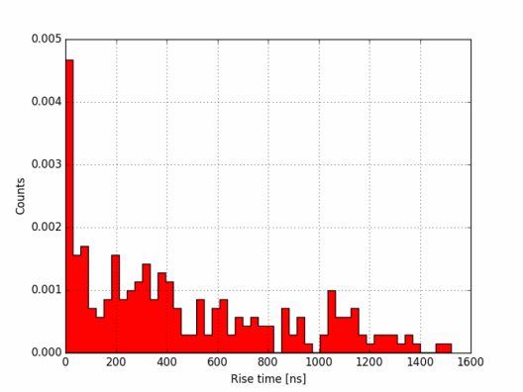
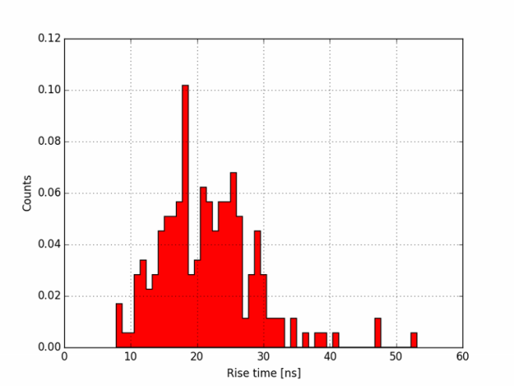

VPFB variation : rise time -40V
DACS_04
DAC 1 (VPLoad) = 2100
DAC 2 (Casc) = 2600
DAC 3 (iNSF) = 750
DAC 4 (iN) =1000
DAC 5 (iBias) = 150
DAC 6 (iFB) = 2500
DACS_03
DAC 1 (VPLoad) = 2100
DAC 2 (Casc) = 2600
DAC 3 (iNSF) = 750
DAC 4 (iN) =1000
DAC 5 (iBias) = 150
DAC 6 (iFB) = 2600
DACS_00
DAC 1 (VPLoad) = 2100
DAC 2 (Casc) = 2600
DAC 3 (iNSF) = 750
DAC 4 (iN) =1000
DAC 5 (iBias) = 150
DAC 6 (iFB) = 2700
DACS_01
DAC 1 (VPLoad) = 2100
DAC 2 (Casc) = 2600
DAC 3 (iNSF) = 750
DAC 4 (iN) =1000
DAC 5 (iBias) = 150
DAC 6 (iFB) = 2800
DACS_02
DAC 1 (VPLoad) = 2100
DAC 2 (Casc) = 2600
DAC 3 (iNSF) = 750
DAC 4 (iN) =1000
DAC 5 (iBias) = 150
DAC 6 (iFB) = 2900

Slide 9
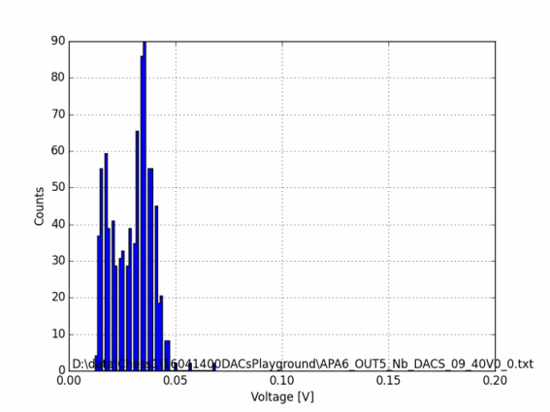
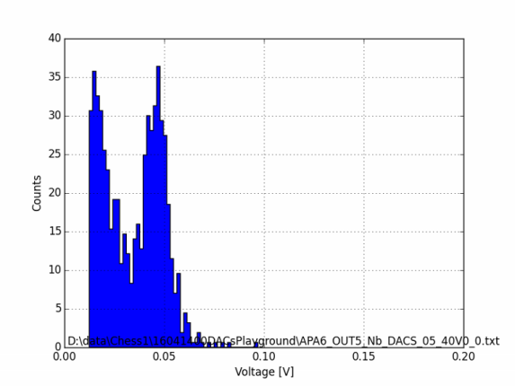
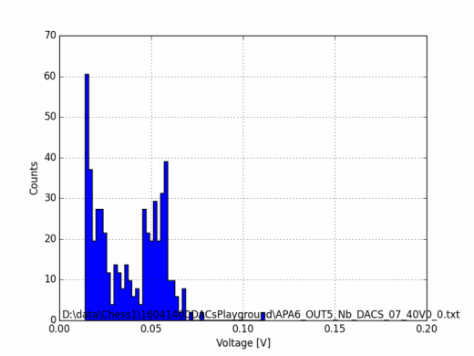
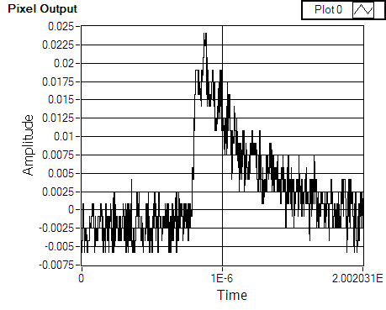
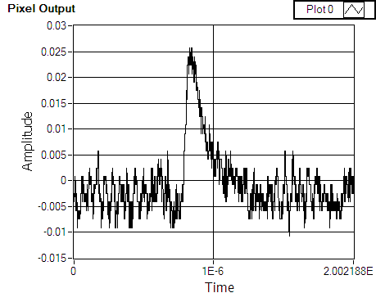
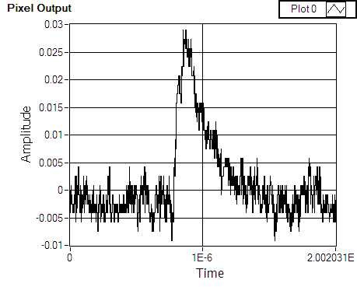
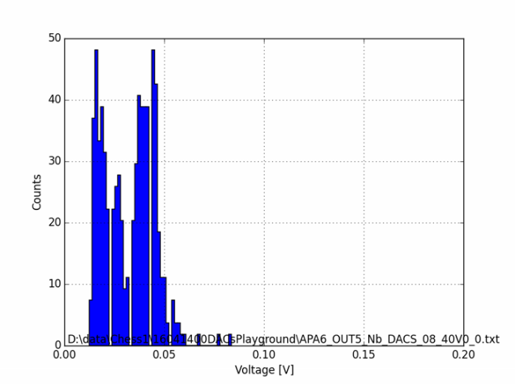
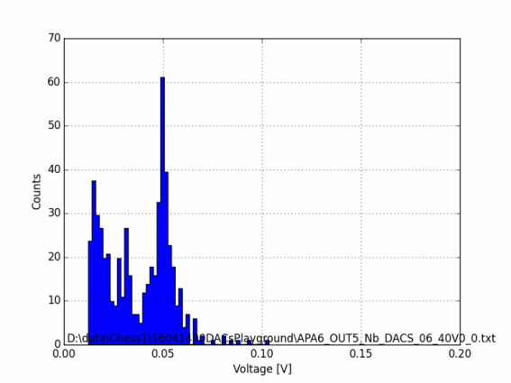
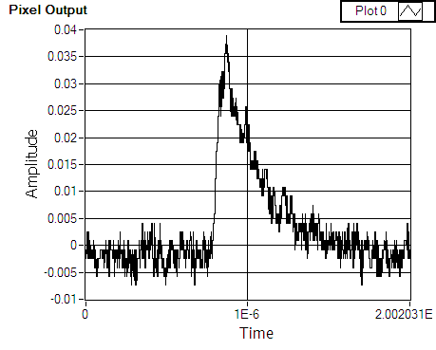
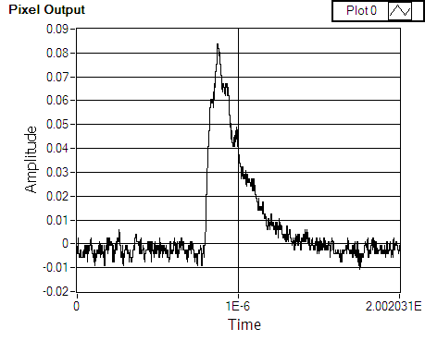
VNSF variation : spectrum -40V
DACS_09
DAC 1 (VPLoad) = 2100
DAC 2 (Casc) = 2600
DAC 3 (iNSF) = 600
DAC 4 (iN) =1000
DAC 5 (iBias) = 150
DAC 6 (iFB) = 2700
DACS_08
DAC 1 (VPLoad) = 2100
DAC 2 (Casc) = 2600
DAC 3 (iNSF) = 700
DAC 4 (iN) =1000
DAC 5 (iBias) = 150
DAC 6 (iFB) = 2700
DACS_05
DAC 1 (VPLoad) = 2100
DAC 2 (Casc) = 2600
DAC 3 (iNSF) = 800
DAC 4 (iN) =1000
DAC 5 (iBias) = 150
DAC 6 (iFB) = 2700
DACS_06
DAC 1 (VPLoad) = 2100
DAC 2 (Casc) = 2600
DAC 3 (iNSF) = 900
DAC 4 (iN) =1000
DAC 5 (iBias) = 150
DAC 6 (iFB) = 2700
DACS_07
DAC 1 (VPLoad) = 2100
DAC 2 (Casc) = 2600
DAC 3 (iNSF) = 1000
DAC 4 (iN) =1000
DAC 5 (iBias) = 150
DAC 6 (iFB) = 2700

Slide 10
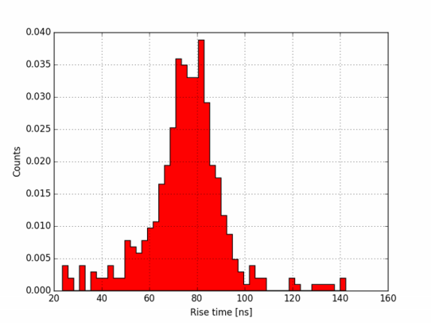
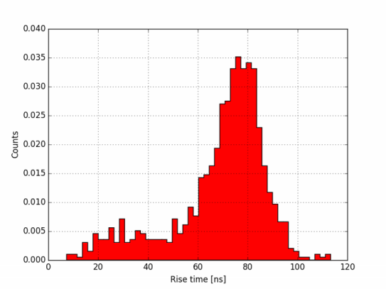
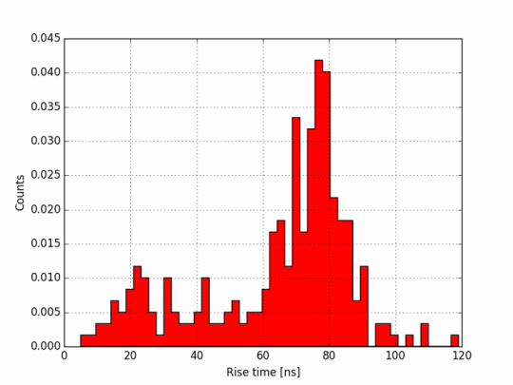
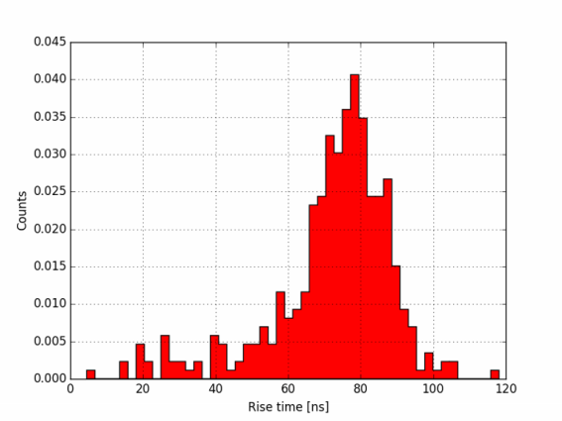
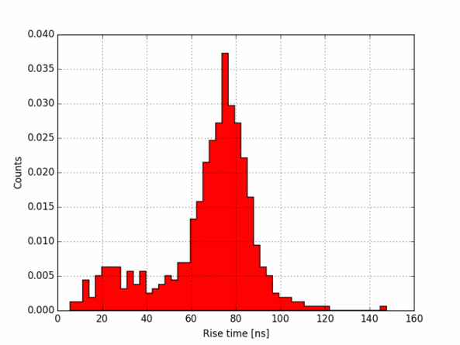
VNSF variation : rise time -40V
DACS_09
DAC 1 (VPLoad) = 2100
DAC 2 (Casc) = 2600
DAC 3 (iNSF) = 600
DAC 4 (iN) =1000
DAC 5 (iBias) = 150
DAC 6 (iFB) = 2700
DACS_08
DAC 1 (VPLoad) = 2100
DAC 2 (Casc) = 2600
DAC 3 (iNSF) = 700
DAC 4 (iN) =1000
DAC 5 (iBias) = 150
DAC 6 (iFB) = 2700
DACS_05
DAC 1 (VPLoad) = 2100
DAC 2 (Casc) = 2600
DAC 3 (iNSF) = 800
DAC 4 (iN) =1000
DAC 5 (iBias) = 150
DAC 6 (iFB) = 2700
DACS_06
DAC 1 (VPLoad) = 2100
DAC 2 (Casc) = 2600
DAC 3 (iNSF) = 900
DAC 4 (iN) =1000
DAC 5 (iBias) = 150
DAC 6 (iFB) = 2700
DACS_07
DAC 1 (VPLoad) = 2100
DAC 2 (Casc) = 2600
DAC 3 (iNSF) = 1000
DAC 4 (iN) =1000
DAC 5 (iBias) = 150
DAC 6 (iFB) = 2700

Slide 11
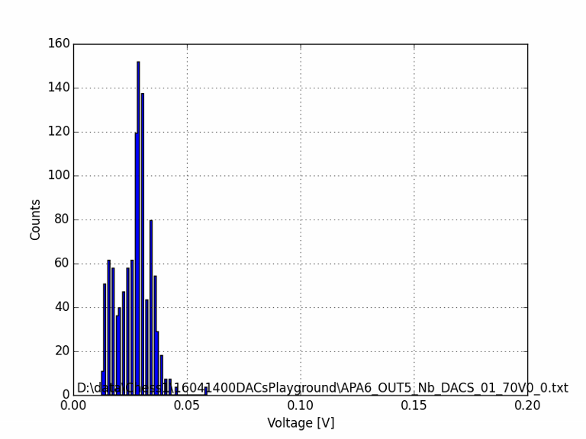
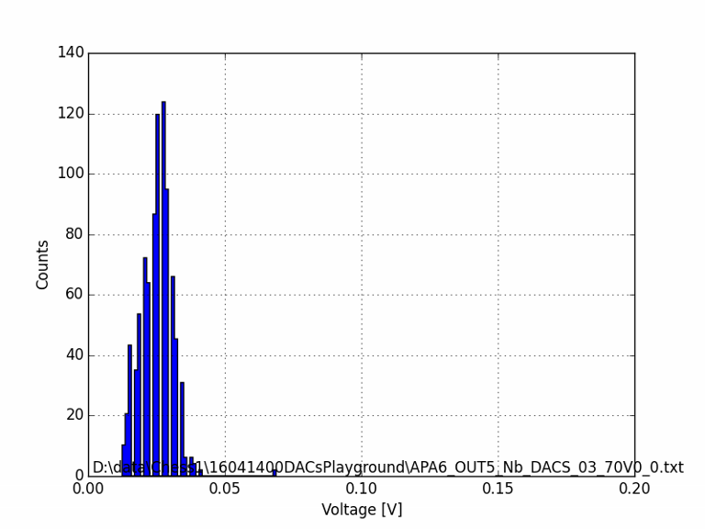
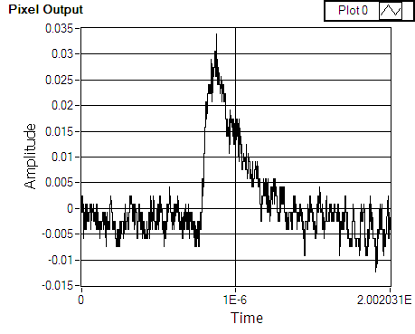
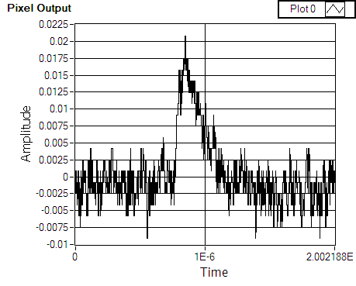
VPFB variation : spectrum -70V
DACS_03
DAC 1 (VPLoad) = 2100
DAC 2 (Casc) = 2600
DAC 3 (iNSF) = 750
DAC 4 (iN) =1000
DAC 5 (iBias) = 150
DAC 6 (iFB) = 2600
DACS_01
DAC 1 (VPLoad) = 2100
DAC 2 (Casc) = 2600
DAC 3 (iNSF) = 750
DAC 4 (iN) =1000
DAC 5 (iBias) = 150
DAC 6 (iFB) = 2800

Slide 12
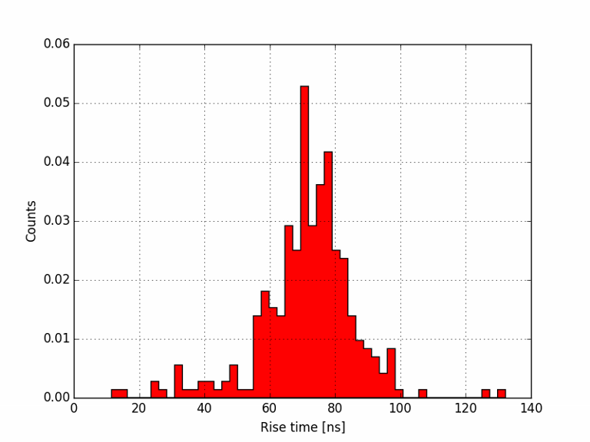
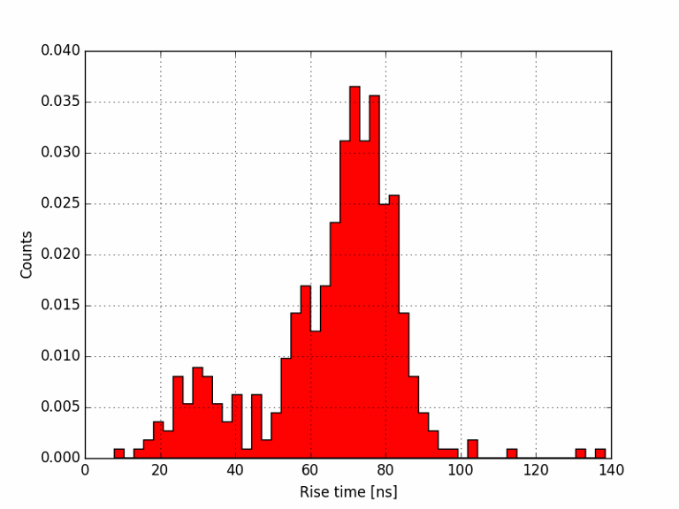
VPFB variation : rise time -70V
DACS_03
DAC 1 (VPLoad) = 2100
DAC 2 (Casc) = 2600
DAC 3 (iNSF) = 750
DAC 4 (iN) =1000
DAC 5 (iBias) = 150
DAC 6 (iFB) = 2600
DACS_01
DAC 1 (VPLoad) = 2100
DAC 2 (Casc) = 2600
DAC 3 (iNSF) = 750
DAC 4 (iN) =1000
DAC 5 (iBias) = 150
DAC 6 (iFB) = 2800

Slide 13

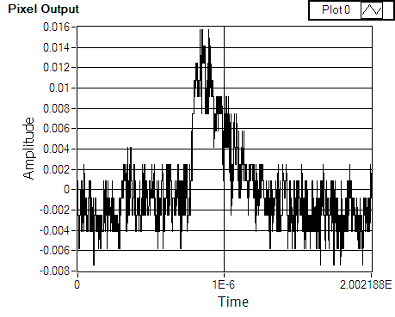
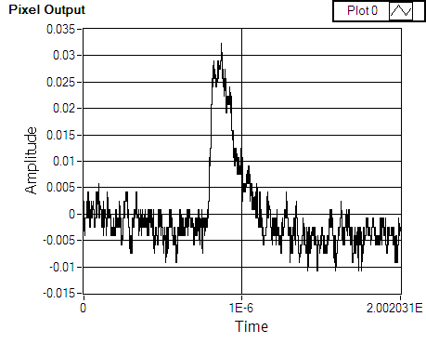
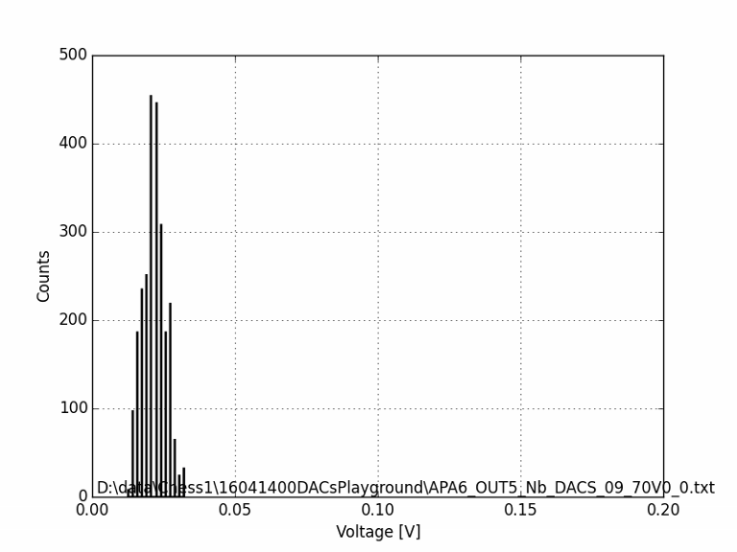
VNSF variation : spectrum -70V
DACS_09
DAC 1 (VPLoad) = 2100
DAC 2 (Casc) = 2600
DAC 3 (iNSF) = 600
DAC 4 (iN) =1000
DAC 5 (iBias) = 150
DAC 6 (iFB) = 2700
DACS_07
DAC 1 (VPLoad) = 2100
DAC 2 (Casc) = 2600
DAC 3 (iNSF) = 1000
DAC 4 (iN) =1000
DAC 5 (iBias) = 150
DAC 6 (iFB) = 2700

Slide 14
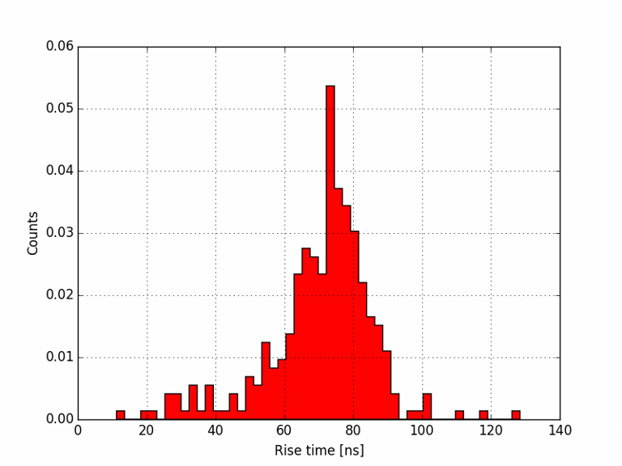
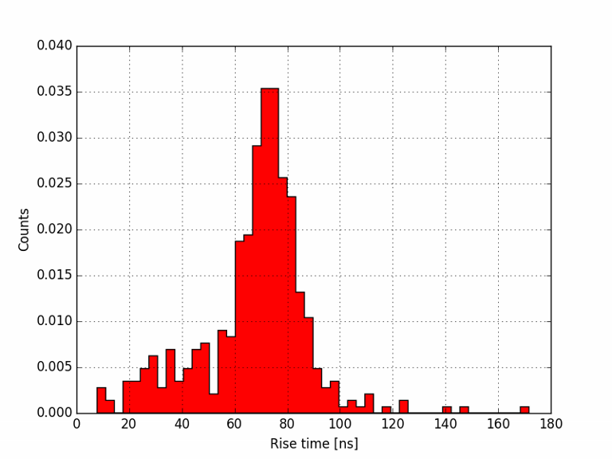
VNSF variation : rise time -70V
DACS_09
DAC 1 (VPLoad) = 2100
DAC 2 (Casc) = 2600
DAC 3 (iNSF) = 600
DAC 4 (iN) =1000
DAC 5 (iBias) = 150
DAC 6 (iFB) = 2700
DACS_07
DAC 1 (VPLoad) = 2100
DAC 2 (Casc) = 2600
DAC 3 (iNSF) = 1000
DAC 4 (iN) =1000
DAC 5 (iBias) = 150
DAC 6 (iFB) = 2700

Slide 15
Conclusions
Conclusions
Baseline shift in DC mode
iPFB no effect
iNSF 500 -> 1.63V, 1000 -> 1.29V
IFB variation
Reducing IFB moves peak left and creates "ripples" in the waveform. Rise time is also reduces from 75 to 70 ns.
iNSF variation
Rise time is not changed. Reducing iNSF moves peak a bit left.
With voltage peak moves left but looks “nicer”, also detection efficiency drops.

