Slide 1
Chess2 Review
ASIC Backend
April 1st 2016
P. Caragiulo*, C. Tamma, X. Xiaobin, A. Dragone, C. Kenney, P. Grenier, Su Dong, H. Grabas, V. Fadeyev
(* pietroc@slac.stanford.edu)

Slide 2

Outline
Hit Encoding Architecture (from last review)
Hit Encoding/Serializer Simulation
  Serial Output Data Format
  Process Corners & RCX Simulations
  Simulation at higher clock frequency
  Power Consumption
LVDS TX/RX
  Process Corners & Montecarlo Simulations
Serializer / LVDS TX Simulations
Supply and clock routing
Full Chip Simulation results
Programmability and Debug Mode (SACI)

Slide 3
Hit Encoding and Read Out blocks
INPUTS
for each row the hit encoder has:
column address (5b) + double hit (1b)
hit
every 25ns
HIT ENCODER
detect the pixel address of the first 8 hits
OUTPUTS
It returns:
8x
every 25ns
INPUTS
It receives:
column address (5b) + double hit (1b) + row address (7b)
LVDS TX
Parallel transmission of the 13b lines
every 3.125ns
OUTPUTS
It returns:
column address (5b) + double hit (1b) + row address (7b)
every 3.125ns

Slide 4
Hit Encoding – Processing the Strip Encoding
Find first 8 hits in 128 rows
2x Find first 8 hits in 32 rows
13 x 8b Memory
13 x 8b Memory

Slide 5
Hit Encoding – ReadOut interface
2x Find first 8 hits in 32 rows
13
13
13 x 8b Memory
13x LVDS Driver
13

Slide 6
LVDS TX/RX and Sync
2x Find first 8 hits in 32 rows
Sync pad
13
13
13 x 8b Memory
13x LVDS Driver
13
320MHz Clock
1 LVDS Receiver

Slide 7
Hit Encoding/Serializer Simulation - Serial Data Output format
Outs<12> | Outs<11> | Outs<10> | Outs<9> | Outs<8> | Outs<7> | Outs<6> | Outs<5> | Outs<4> | Outs<3> | Outs<2> | Outs<1> | Outs<0>
Row<6> | Row<5> | Row<4> | Row<3> | Row<2> | Row<1> | Row<0> | Col<0> | Col<1> | Col<2> | Col<3> | Col<4> | Sync/Data Valid
14 LVDS Output (28 lines total)
  13 Serial Data
  1 Sync/Data Valid
Encode the position of the hits in the matrix (row/column address)
Serial clock speed is 320MHz (40MHz x 8).

Slide 8
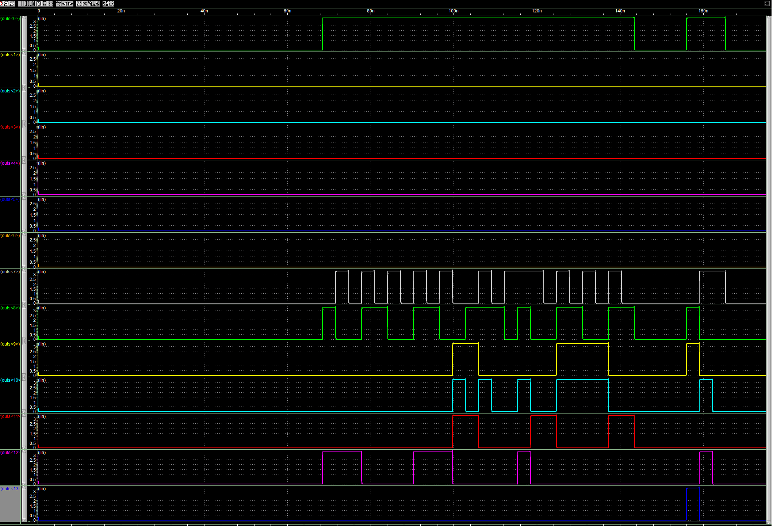
Hit Encoding/Serializer Simulation
Sync/Data Valid
Col<0:4>
Row<0:6>
Sync / Data Valid is Logic 1 the data on col<0:4> row<0:6> is valid.
Full chain simulation including the columns will be shown later.

Slide 9
Hit Encoding/Serializer Simulation
Sync/Data Valid
Col<0:4>
Row<0:6>
Hit on Row 34

Slide 10
Hit Encoding/Serializer Simulation
Sync/Data Valid
Col<0:4>
Row<0:6>
Hit on Row 33

Slide 11
Hit Encoding/Serializer Simulation
Sync/Data Valid
Col<0:4>
Row<0:6>
Hit on Row 32

Slide 12
Hit Encoding/Serializer Simulation
Sync/Data Valid
Col<0:4>
Row<0:6>
Hit on Row 0

Slide 13
Hit Encoding/Serializer Simulation
Sync/Data Valid
Col<0:4>
Row<0:6>
NO Hit

Slide 14
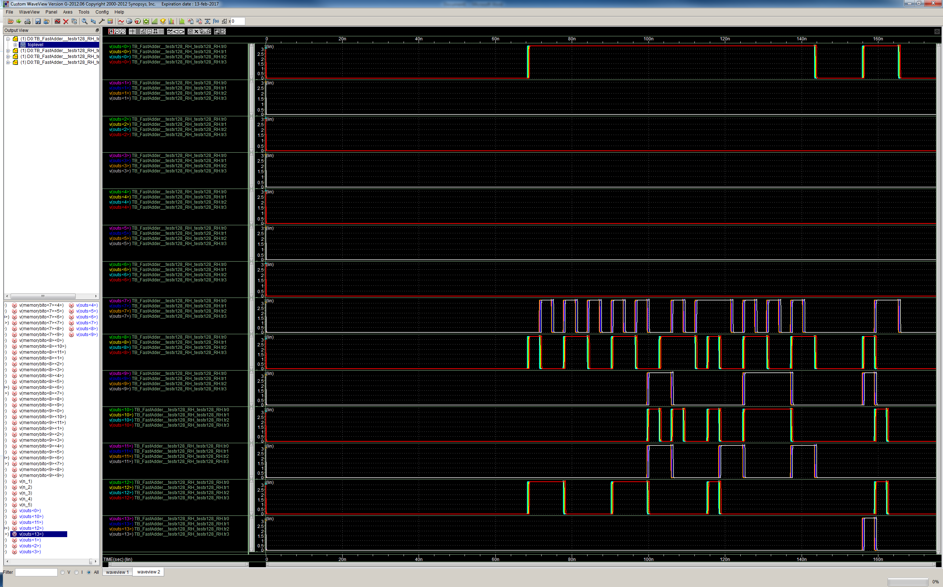
Hit Encoding/Serializer Simulation – Process Corners
Sync/Data Valid
Col<0:4>
Row<0:6>

Slide 15
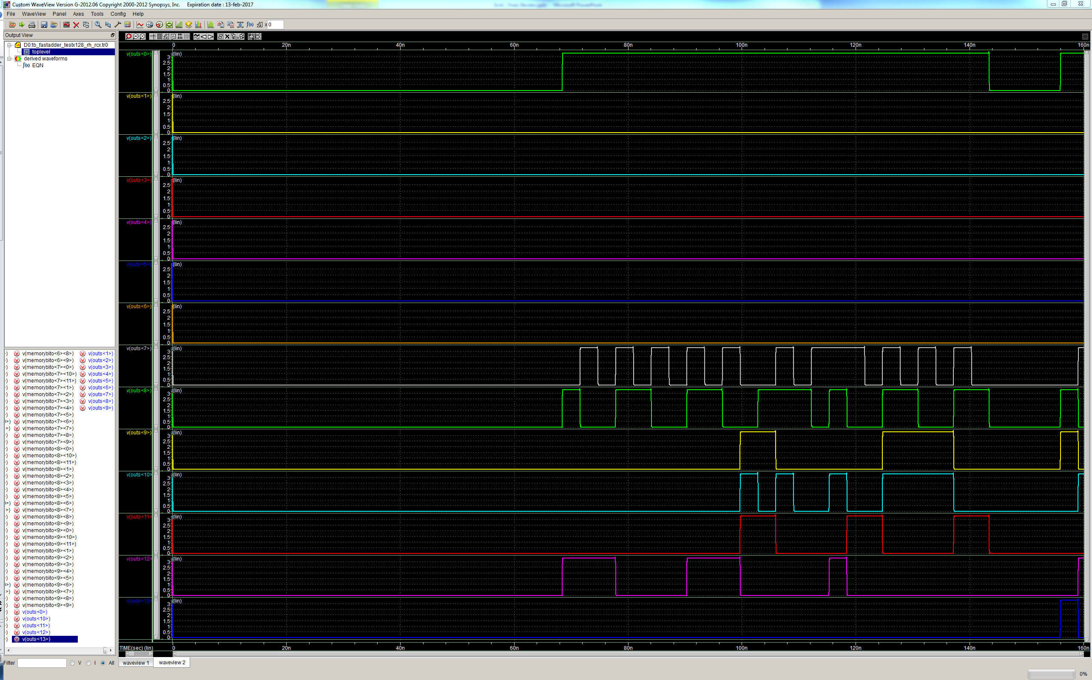
Hit Encoding/Serializer Simulation – RCX
Sync/Data Valid
Col<0:4>
Row<0:6>

Slide 16
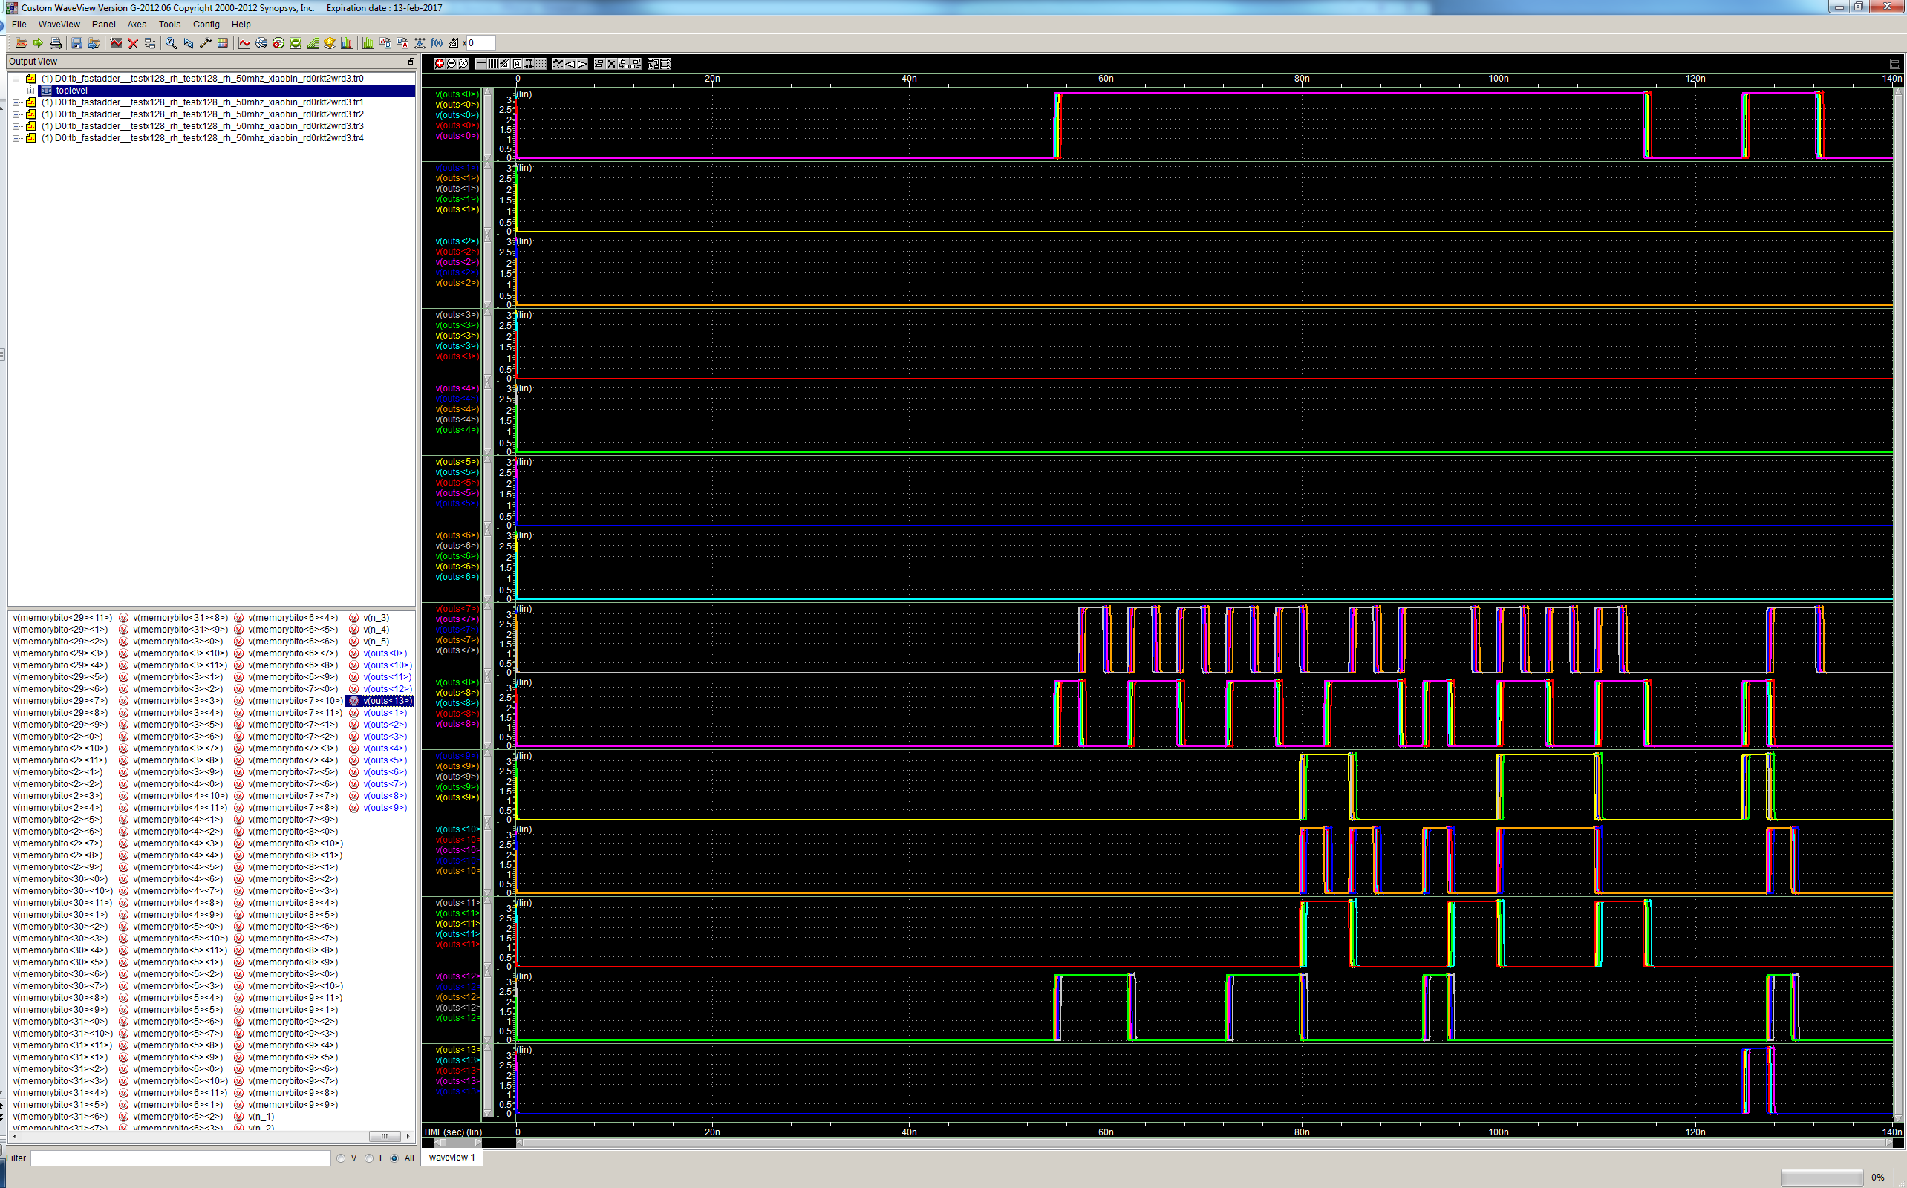
Hit Encoding Simulation – 50 MHz Test
Simulation done to prove functionality with 25% increased clock speed.
Sync/Data Valid
Col<0:4>
Row<0:6>

Slide 17
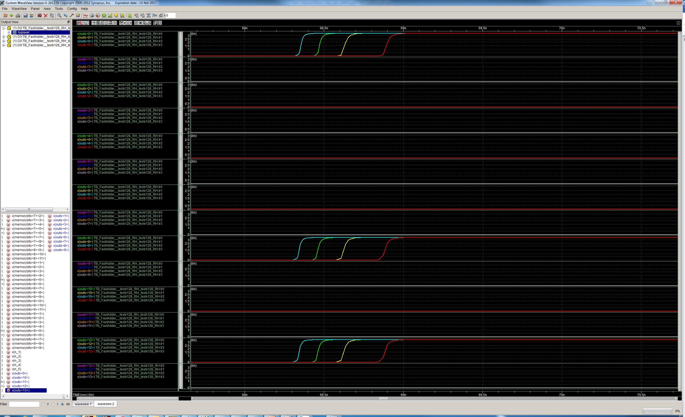
Hit Encoding/Serializer Simulation – Process Corner
Sync/Data Valid
Col<0:4>
Row<0:6>
Sync / Data Valid always in sync with Data (<10ps skew in all corner).
Max delay between corners is 500ps.

Slide 18
Hit Encoding + Serializer Power Consumption (40MHz)
Corner | Peak Current [mA] | Average Current [mA]
Typical | 300 | 35
Worst – Power | 380 | 35
Worst – Speed | 200 | 35
Worst 0 | 300 | 35
Worst 1 | 300 | 35
RCX | 350 | 55

Slide 19
Hit Encoding + Serializer Power Consumption (50MHz)
Corner | Peak Current [mA] | Average Current [mA]
Typical | 300 | 40
Worst – Power | 380 | 40
Worst – Speed | 200 | 40
Worst 0 | 300 | 40
Worst 1 | 300 | 40

Slide 20
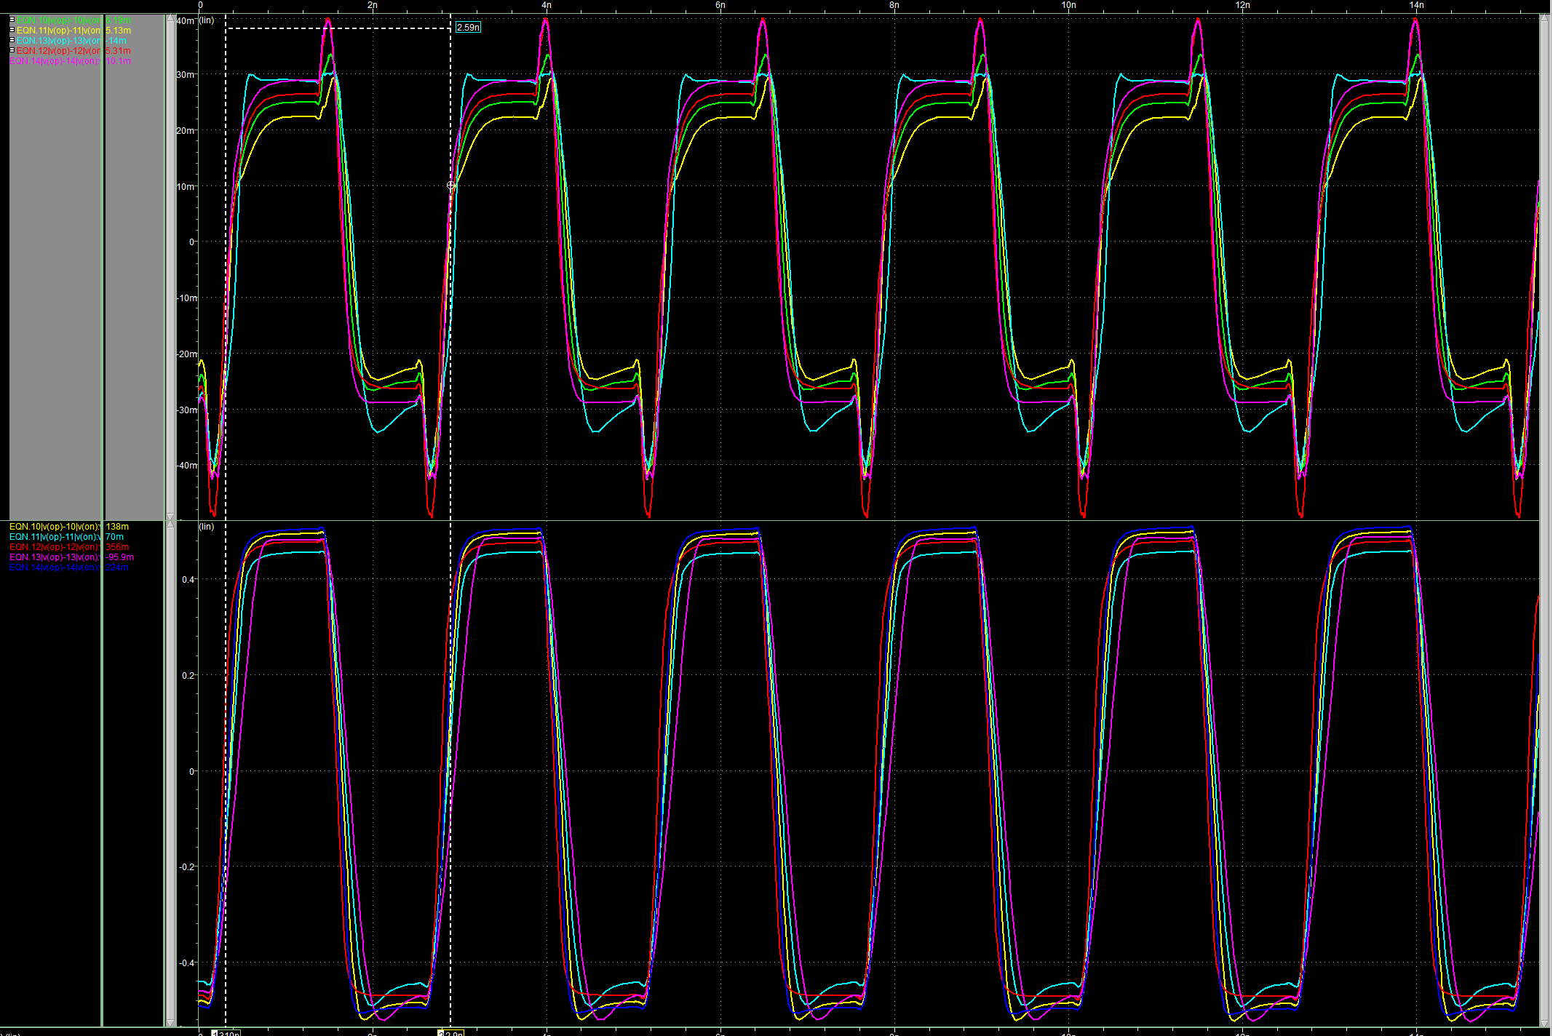
LVDS TX Simulation – Process Corners
Low Current Mode
High Current Mode
Process variation simulation of the LVDS TX at 800MHz (targeted speed is 320MHz) at minimum current (200µA) and typical current (3mA).

Slide 21
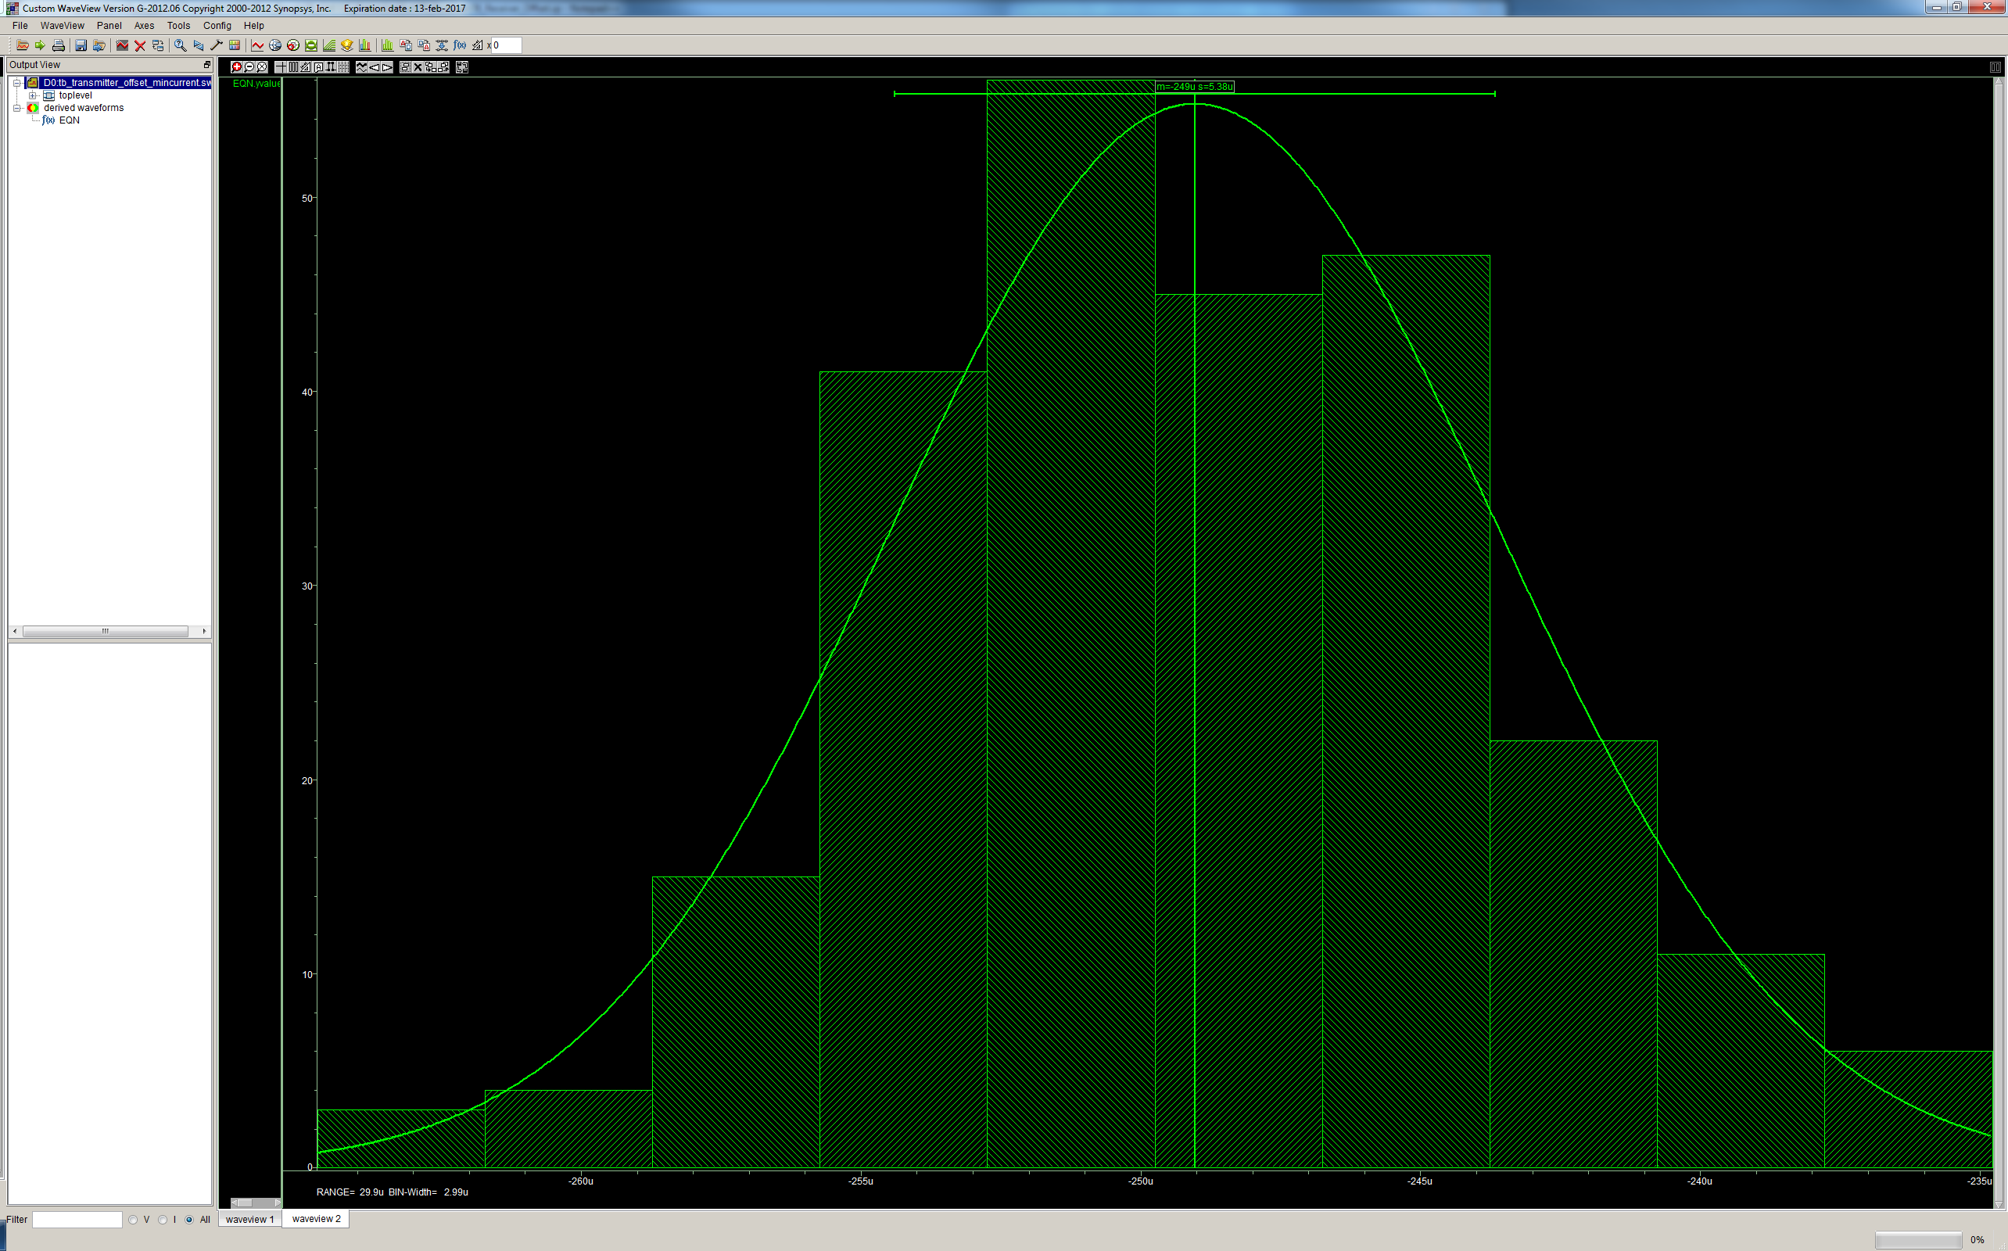
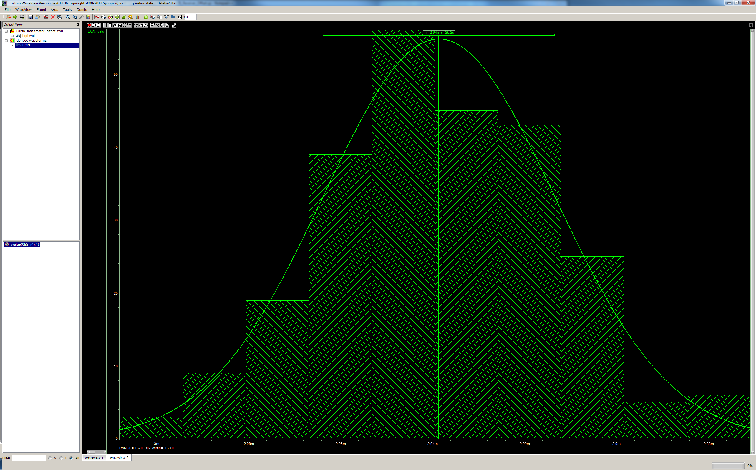
LVDS TX Simulation – Offset
Low Current Mode
High Current Mode
Mean = 250uA
σ = 5.4uA (2%)
Mean = 3mA
σ = 25uA (0.8%)

Slide 22
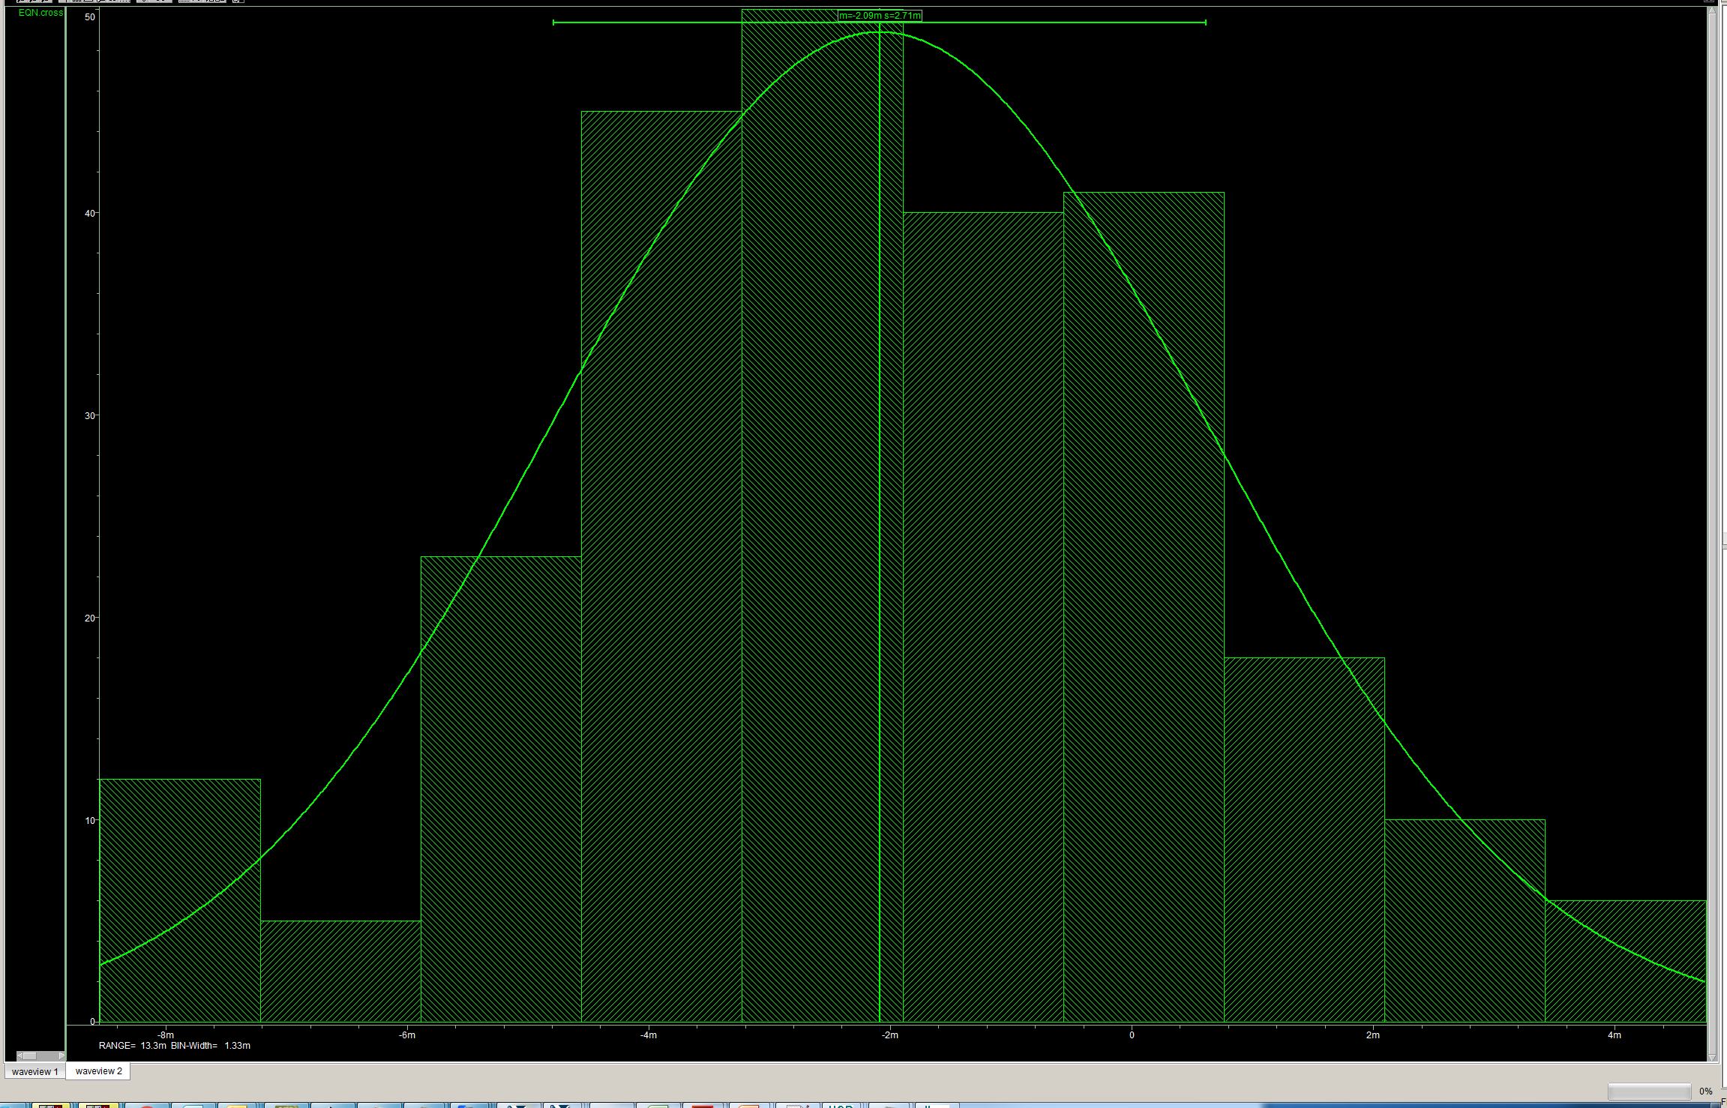
LVDS RX Simulation – Offset
Mean = 2mV
σ = 2.7mV

Slide 23
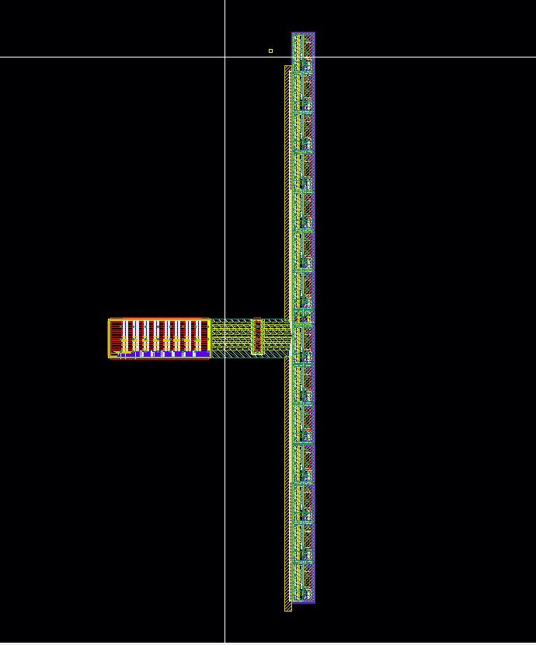
Serializer + LVDS Trasmitter
Serializer
14xLVDS TX
Buffers to minimize delay and improve driving strength

Slide 24
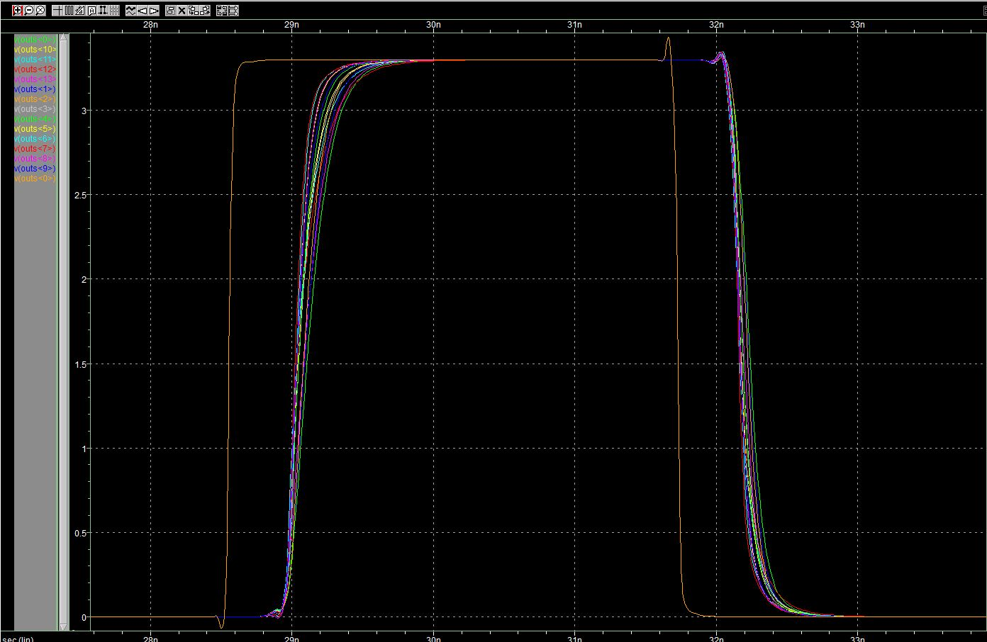
Serializer + LVDS Trasmitter Simulation
∆t
∆t
 | Average delay [ns]
Rising Edge | 0.505
Falling Edge | 0.452

Slide 25
Serializer + LVDS Trasmitter Simulation
Worst case QRC (parasitic extraction)
t_{rise}/t_{fall} measured @ 1.65 V.
RELATIVE ERROR

Slide 26
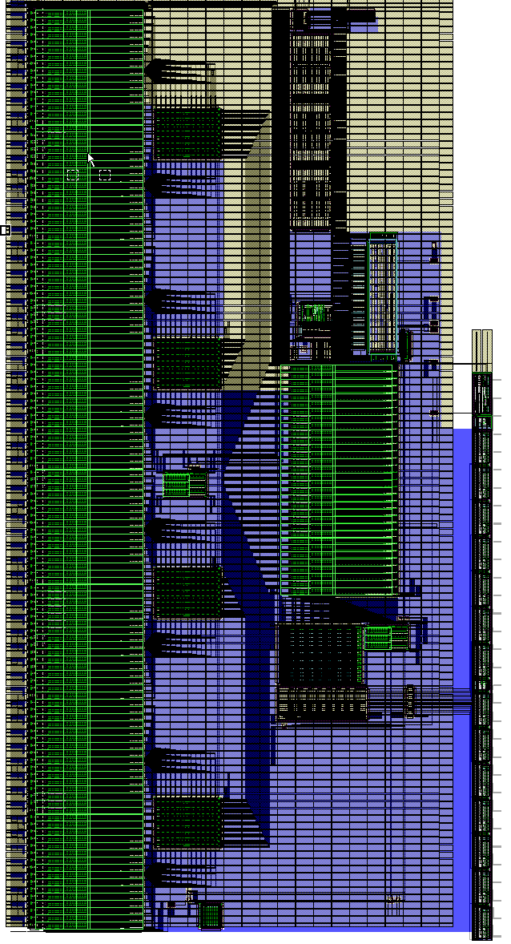
Supply Routing
Digital Ground/Supply
Connection to top Metal
Substrate connection

Slide 27
Clock Routing and Buffering
40 MHz
320 MHz
SACIclk
40 MHz Buffer
320 MHz Buffer
40/320 MHz Sync
SACIclk
40 MHz to Matrix

Slide 28
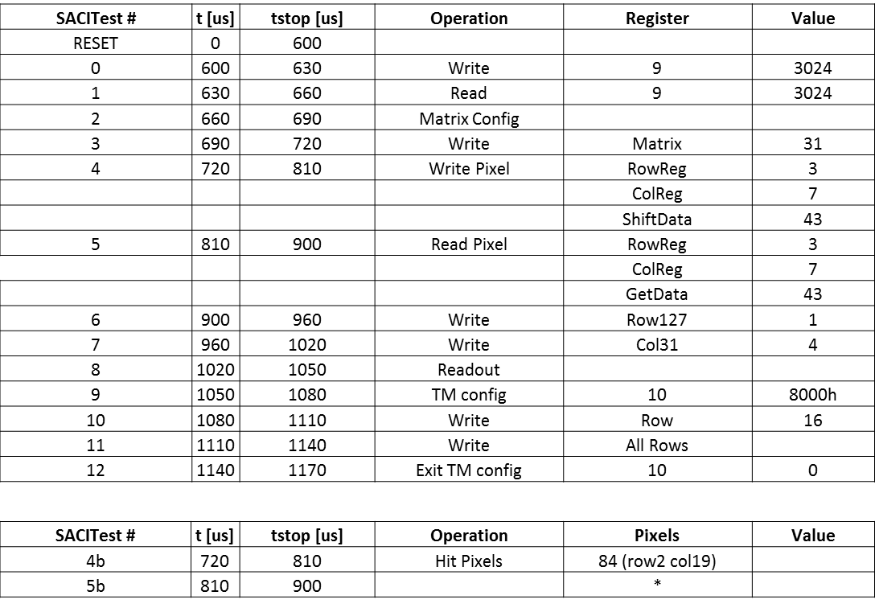

Full Chip Simulation
SACI_RESET
_SACI0
_SACI1
_SACI2
_SACI3
_SACI4
_SACI4b
_SACI5b
_SACI5
_SACI6
_SACI7
…
Blocks inside the full chip simulation:
Matrix Netlist with pixel model (see next slide)
Matrix Bias Netlist
Complete Balcony
Pads

Slide 29
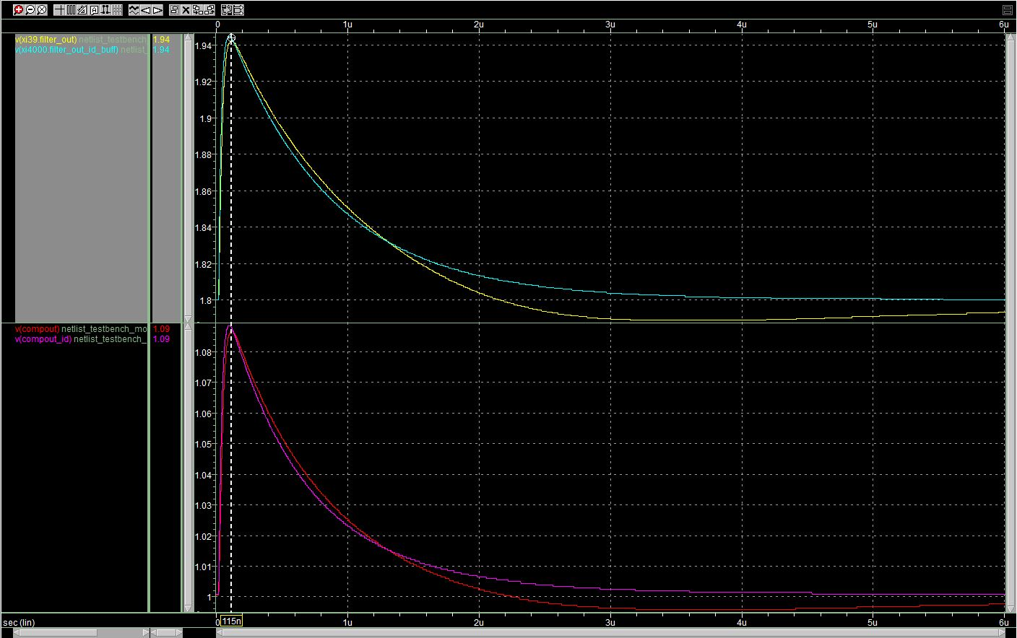
Pixel Model vs Transistor Level Pixel

Slide 30
_SACItest4b
Command:
  Hit pixel 84* (row 2 col 20) @725us
*pixels<0:4095>

Slide 31
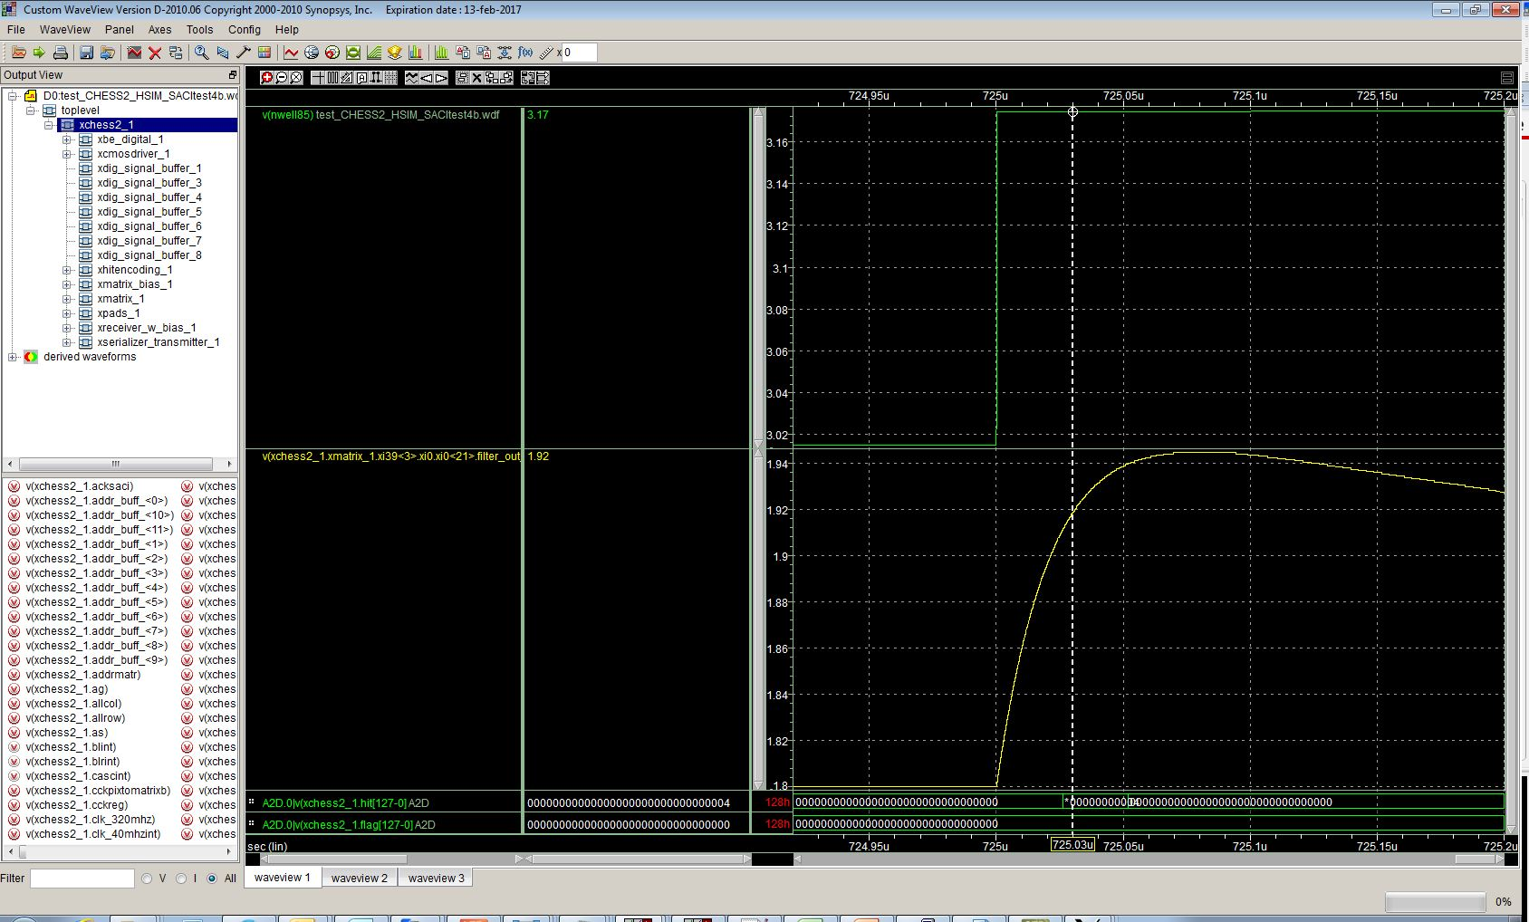
_SACItest4b

Slide 32
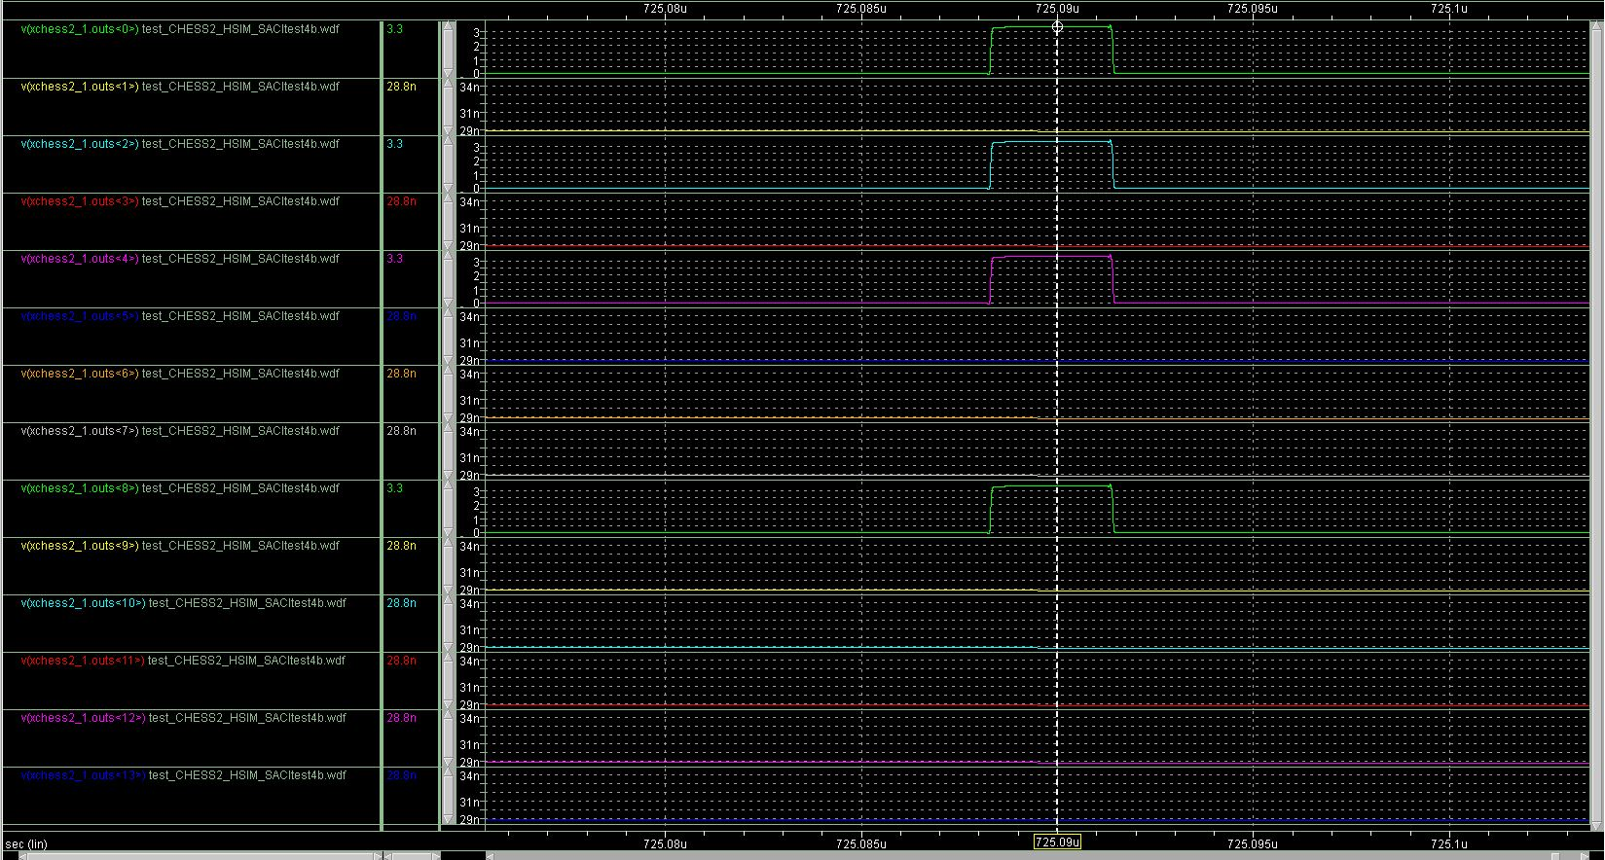
_SACItest4b

Slide 33
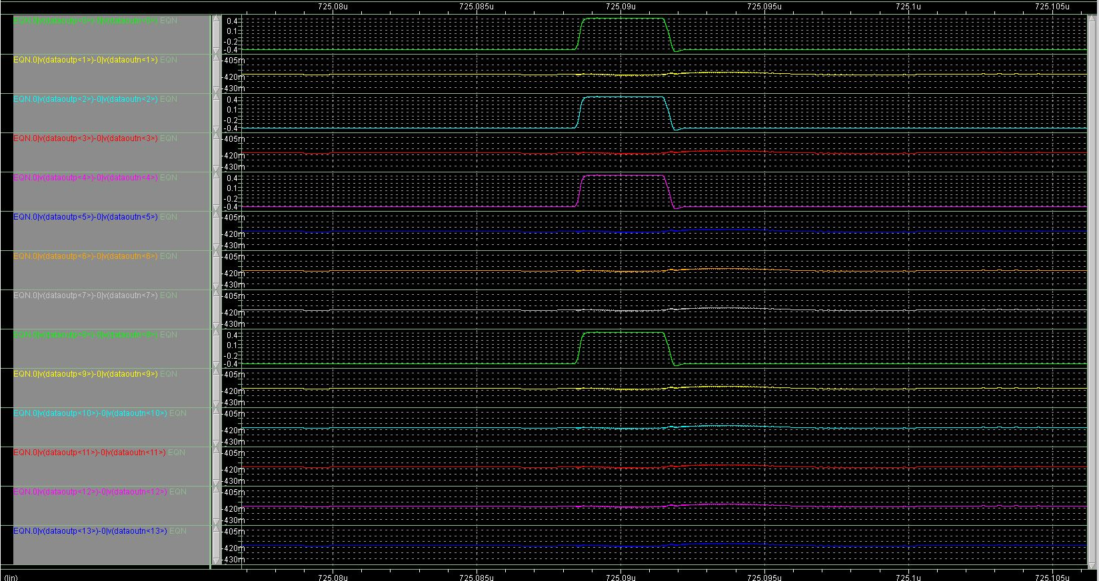
_SACItest4b

Slide 34
_SACItest5b
Command:
  Hits @735us:
  pixel 63 (row 1 col 31)
  pixel 32 (row 1 col 0)
  pixel 1267 (row 39 col 19)
  pixel 1702 (row 53 col 6)
  pixel 1961 (row 61 col 9)
  pixel 2223 (row 69 col 15)
  pixel 2916 (row 91 col 4)
  pixel 3188 (row 99 col 20)
  pixel 3491 (row 109 col 3)
  pixel 4095 (row 127 col 31)
  Hit & Flag
  Hit transferred Data

Slide 35
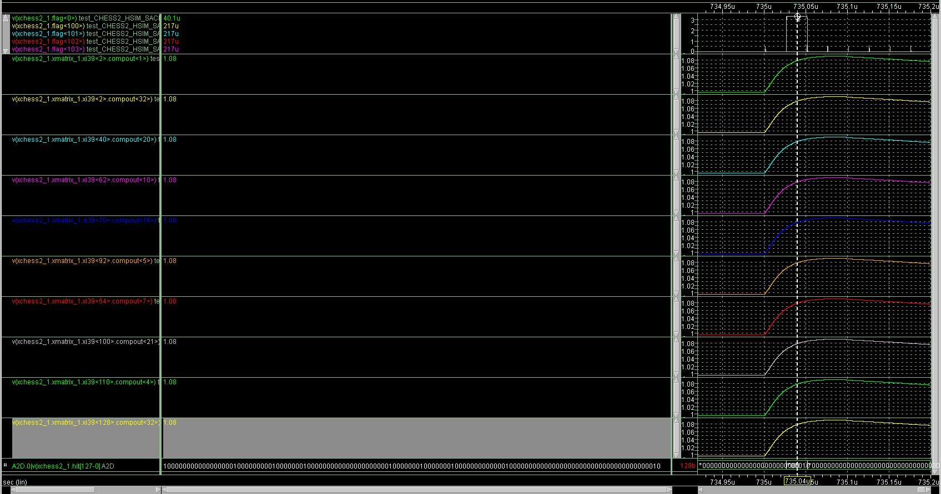
_SACItest5b

Slide 36
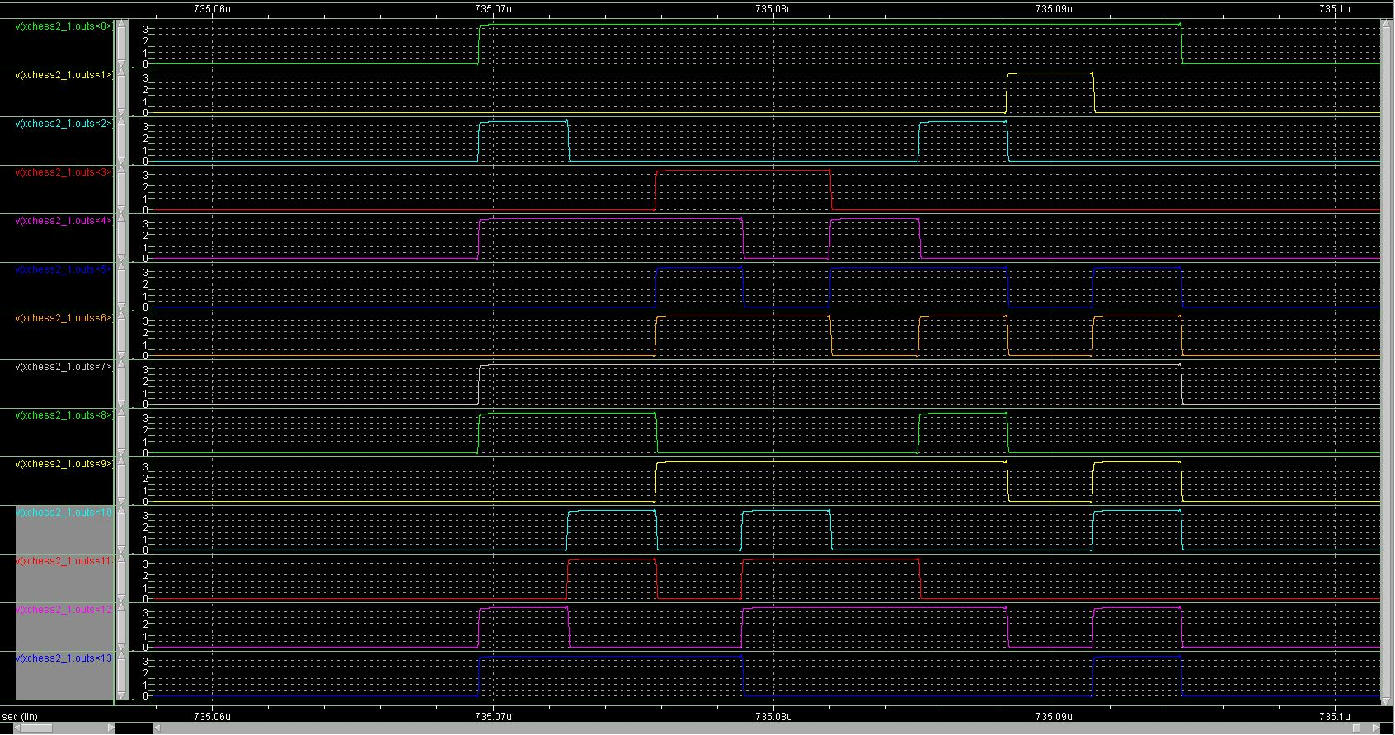
_SACItest5b
F:0
R:99
C:20
F:0
R:91
C:4
F:0
R:69
C:15
F:0
R:61
C:9
F:0
R:53
C:6
F:0
R:39
C:19
F:1
R:1
C:0
F:0
R:109
C:3

Slide 37
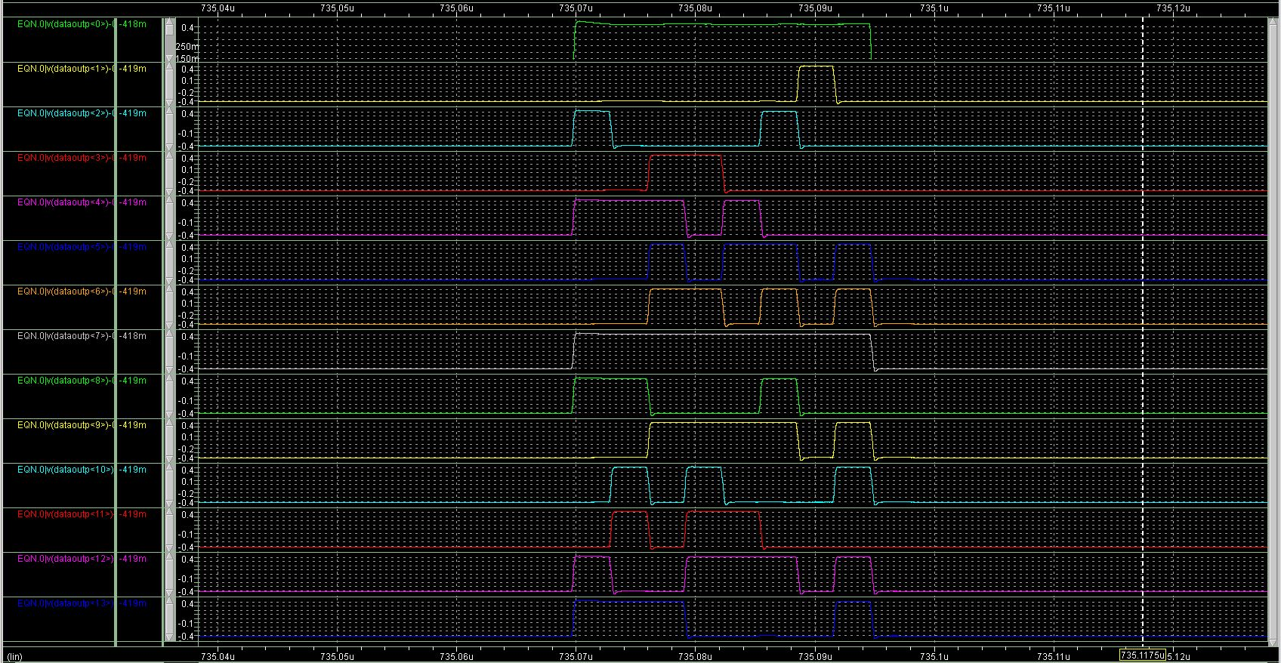
_SACItest5b

Slide 38
Programmability and Debug Mode
Matrix and Hit Encoding clock sync fine tuning
  4 Bits (400ps Step -> Max 6ns)
Hit Encoding pipeline timing optimization
  The write and reset phases length of the two stages of the hit encoding can be independently programmed
Hit Encoding Test Mode
LVDS TX Adjustable current
Digital Monitors
LVDS RX
  AC Mode
  Different input impedance (100 Ω – 300 Ω)

Slide 39
SLAC ASIC Control Interface (SACI)
Serial Interface with handshake protocol
5 Signals
  3 shared: saciClk, saciCmd, saciRsp.
  1 dedicated select line per slave: saciSelL.
  1 Reset Line (RstL) can be shared with the ASIC Global Reset.
Operated between 0V and 3.3V
Allows multiple SACI on same bus (parallel mode).
16 bit Data Bus
Row Pointer
Column Pointer
Global Registers
PIPO with
Read back
12 bit Address Bus
CMD Unit
Ack
CClk
EXEC
R/W
7 bit Command
12 bit Address
32 bit Data Bus
SLAC ASIC Control Interface (SACI)
RstL
saciSelL
saciClk
saciCmd
saciRsp

Slide 40
SACI - Signals
SACIclk
SACIselL
SACIcmd
SACIrsp
SACIrstL
SACIcmd (serial signal):
SET (1bit)
1
RW (1bit)
R/W
CMD (7bit)
CMD
ADDR (12bit)
ADDR
DATA (32bit)
DATA
SACIrsp (serial signal):
SET (1bit)
1
RW (1bit)
1
CMD (7bit)
CMD
ADDR (12bit)
ADDR
Write Mode
SET (1bit)
1
RW (1bit)
0
CMD (7bit)
CMD
ADDR (12bit)
ADDR
DATA (32bit)
DATA
Read Mode

Slide 41
SACI - Commands
SET (1bit)
1
RW (1bit)
RW
CMD (7bit)
CMD
ADDR (12bit)
ADDR
DATA (32bit)
DATA
RW | CMD | ADDR | DATA | Function
0/1 | 1 | Register Address | Data | Read/Write Global Register
1 | 4 | 0 | Data | Write Matrix
0/1 | 5 | 0 | Data | Read/Write Pixel
1 | 8 | 0 | 0 | START Matrix Configuration
0 | 0 | 0 | 0 | END Matrix Configuration
1 | 2 | 0 | 0 | Write all Columns (used to configure a single row)
1 | 3 | 0 | 0 | Write all Row (used to configure a single column)
The ASIC decodes the command last 4 bits. Any given command longer than 4 bits will be interpreted as a 4 bit command.

Slide 42
Global Register Map
 | sel bit |  | Monitor Out
mux0 | mux1 | mux2
0 | 0 | 0 | reseti
0 | 0 | 1 | writeCLKi
0 | 1 | 0 | reset2i
0 | 1 | 1 | writeCLK2i
1 | 0 | 0 | wsi
1 | 0 | 1 | CLKi_1_40MHzi
0 | 1 | 0 | CLKi_2_40MHzi
0 | 1 | 1 | gndd!

Slide 43
Back-End Checklist
 | Simulation | Layout | Verification |  | Integration
 |  |  | DRC | LVS
Control Unit | ✓ (All Corner) | ✓ | ✓ | ✓ | ✓
SACI + Buffer | ✓ | ✓ | ✓ | ✓ | ✓
Command Decoder | ✓ | ✓ | ✓ | ✓ | ✓
Command Logic | ✓ | ✓ | ✓ | ✓ | ✓
Pointers Register | ✓ | ✓ | ✓ | ✓ | ✓
Global Registers | ✓ | ✓ | ✓ | ✓ | ✓
Hit Encoding | ✓ (All Corner + RCX) | ✓ | ✓ | ✓ | ✓
Hit Encoding – Test Mode | ✓ | ✓ | ✓ | ✓ | ✓
Serializer + Buffer | ✓ (All Corner + RCX) | ✓ | ✓ | ✓ | ✓
Digital Mux | ✓ | ✓ | ✓ | ✓ | ✓
LVDS TX/RX | ✓ (All Corner + RCX + Mismatch) | ✓ | ✓ | ✓ | ✓

Slide 44
Number of rad-hard NMOS Digital Back-end
 | NMOS RAD SOFT | NMOS RAD HARD
Control Unit | 2954 | 2688
Hit Encoding | 0 | 38463
Serializer + Buffer | 0 | 2059
LVDS TX/RX | 103 | 0
TOTAL | 3057 | 43210

Slide 45
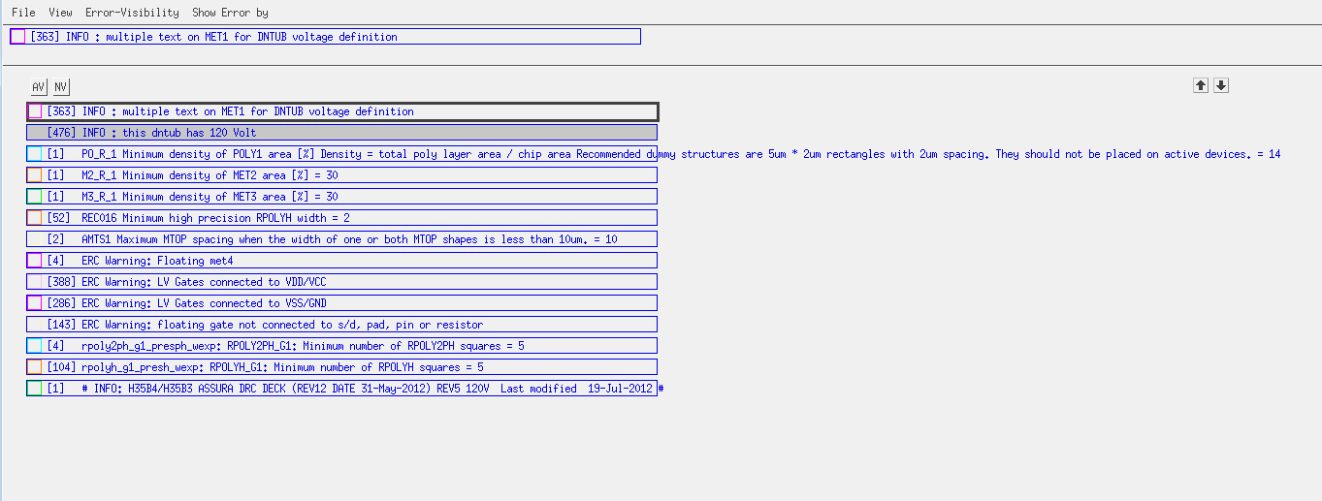
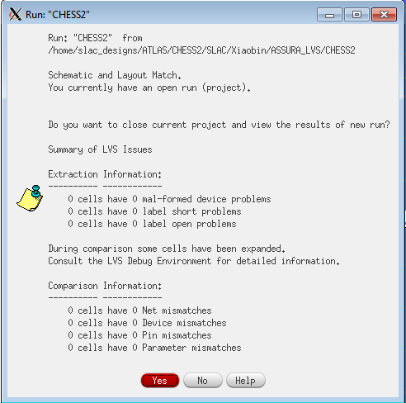
Balcony Verification Errors (No Matrix, Bias and Pads)
DRC
LVS
A
B
C
D
D
E
F
F
No Local Density Error (Density will be fixed at top level)
INFO are ok
A: 38 on LVDS RX (Ratio of Resistor), 14 on LVDS TX Current Generation (Programmable)
B: Will go away after PAD integration
C: Will go away after PAD integration (Floating Injection signal metal)
D: Initial Condition on registers.
E: Will go away after Matrix and PAD integration
F: LVDS RX Resistors.

