Slide 1
Chess2 Review Frontend and Top
Hervé Grabas, V. Fadeyev, P. Caragiulo*, C. Tamma, X. Xiaobin, A. Dragone, C. Kenney, P. Grenier, Su Dong

Slide 2
TOP LAYOUT & PADS

Slide 3
CHESS2 reticle layout view –test structures not included
2 array mirrored
Shared pads
20mm
3mm
Possible dice line
1 array standalone
Independent pads
Can be diced away.
24.3mm

Slide 4
CHESS2 reticle layout – pads
98 independent pads
55 independent pads

Slide 5
CHESS2 reticle layout – pads
LVDS pads 1
LVDS pads 2
LVDS pads 3

Slide 6
One array - dimensions
128x32 pixels
5.120mm
20.160mm
4.2mm
dead

Slide 7
Mirrored pads
120µm separation

Slide 8
List of pads and protection
1x HV
1x HV Ground
1x Ground Digital
1x Ground Analog
1x Supply 3.3V Analog
1x Supply 3.3V Digital
1x Supply 1.8V Analog
1x Supply 2.5V Digital
1x Bias 3.6V [UNPROTECTED]
1x Bias Cascode [ESD PROTECTED]
1x Bias Threshold [ESD PROTECTED]
1x Bias Baseline [ESD PROTECTED]
1x Bias BaselineFilter [ESD PROTECTED]
1x Signal Injection [UNPROTECTED]
14x2 LVDS Data [UNPROTECTED]
1x LVDS Supply
1x LVDS Ground
1x LVDS Bias TX
1x LVDS TX Vcommon
1x2 LVDS RX 320MHz [UNPROTECTED]
1x CMOS 40MHz [ESD PROTECTED]
1x SACIsel [ESD PROTECTED]
1x SACIclk [ESD PROTECTED]
1x SACIrsp [ESD PROTECTED]
1x SACIcmd [ESD PROTECTED]
1x Global Reset [ESD PROTECTED]
1x Digital Monitor [ESD PROTECTED]
Total = 55 pads 13 common pads 42 independent pads per 128strips

Slide 9
HV – CHESS2 protection strategy

Slide 10
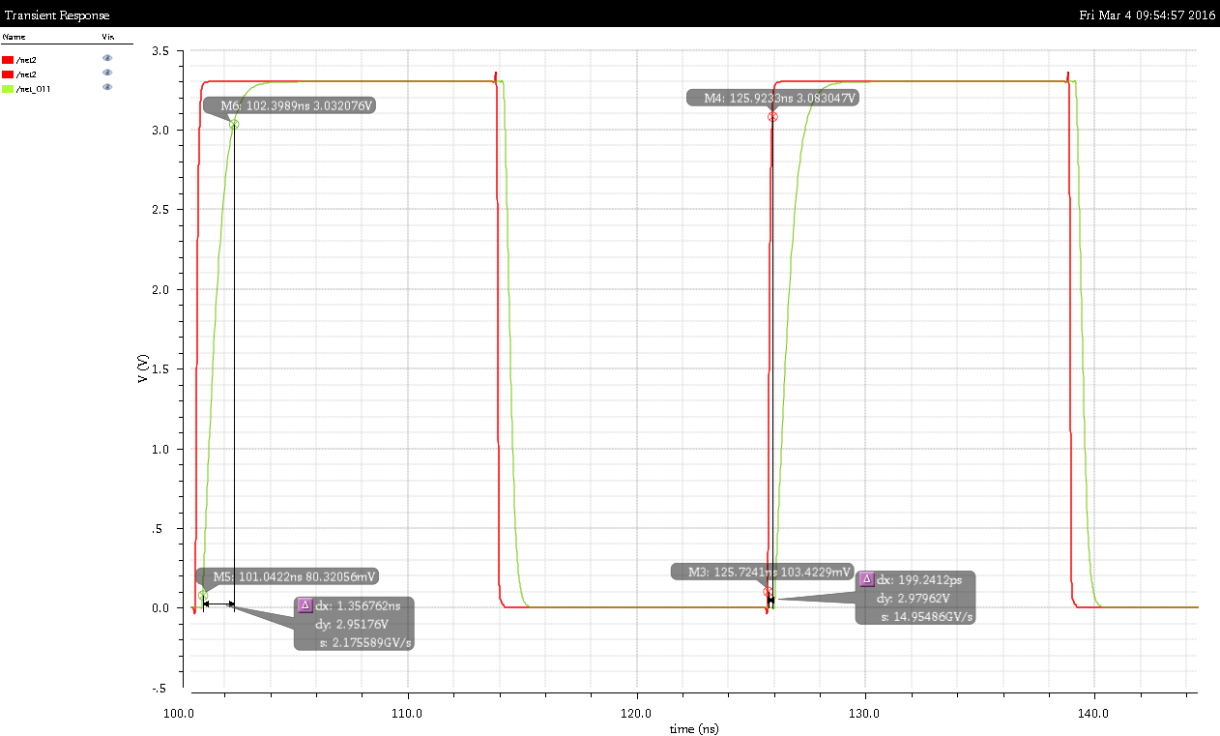
Clock buffer – 1ns risetime on 50pF
Buffer added for the following pads:
1x CMOS 40MHz
1x SACIsel
1x SACIclk
1x SACIrsp
1x SACIcmd
1x Global Reset
1x Digital Monitor

Slide 11
Pixel & Amplifier

Slide 12
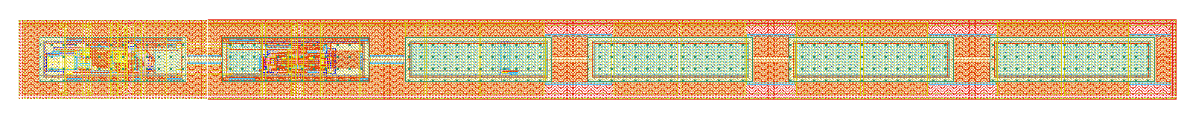
Pixel dimensions and layout
630µm
40µm
6 connected NWELLS: 24.3µm x 80.2µm – 53.3% coverage
120V design rules
No inter-wells substrate contacts
Diode biased with external supply

Slide 13
Pixel amplifier – programmable - external
Injection
IFB
RowENB
RAMWrEn
3.3
ColENB
1.8
Load
Th
1/2
Casc
1/2/4/8
InSF = 1µA
Comp = 10µA
In = 20µA
Baseline

Slide 14
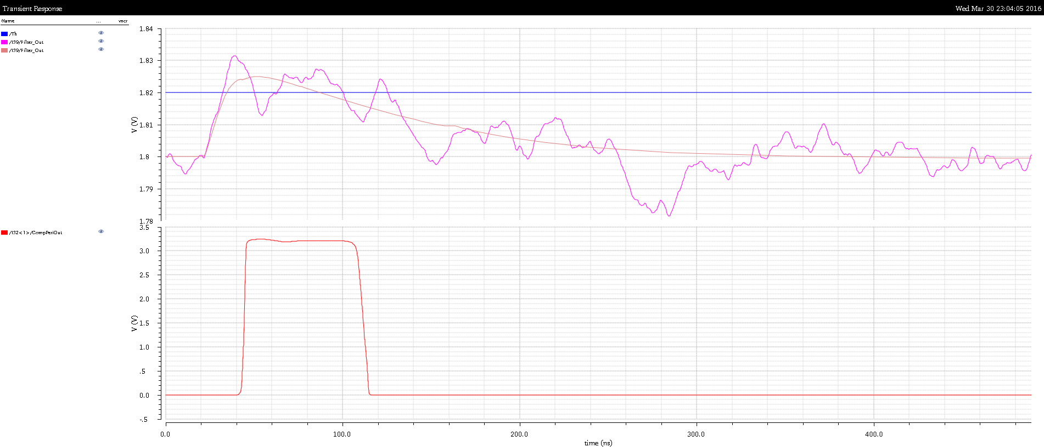
1 MIP signal simulated with noise

Slide 15
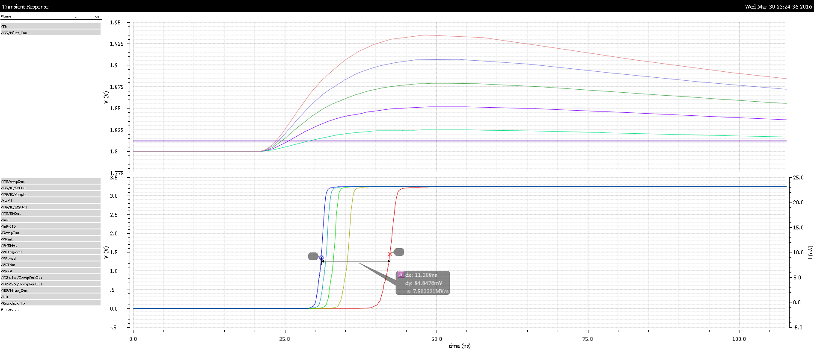
Multiple MIPs - 1 to 5 MIPS
11ns delta

Slide 16
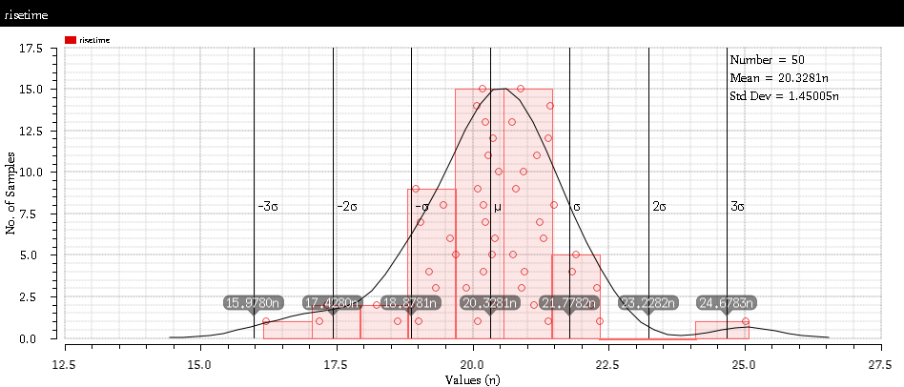
Rise-time MC analysis – mismatch only

Slide 17
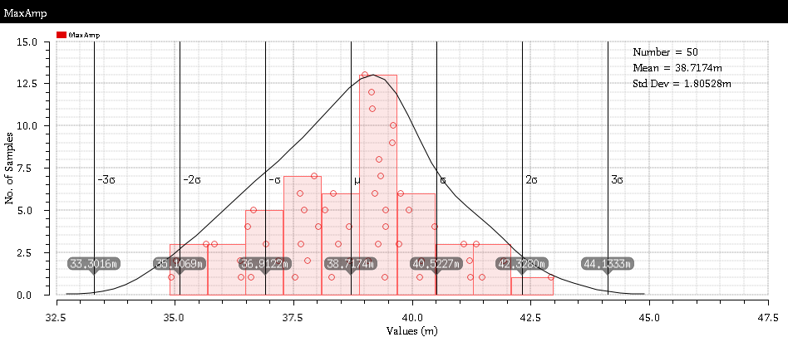
Amplitude variation MC – mismatch only

Slide 18
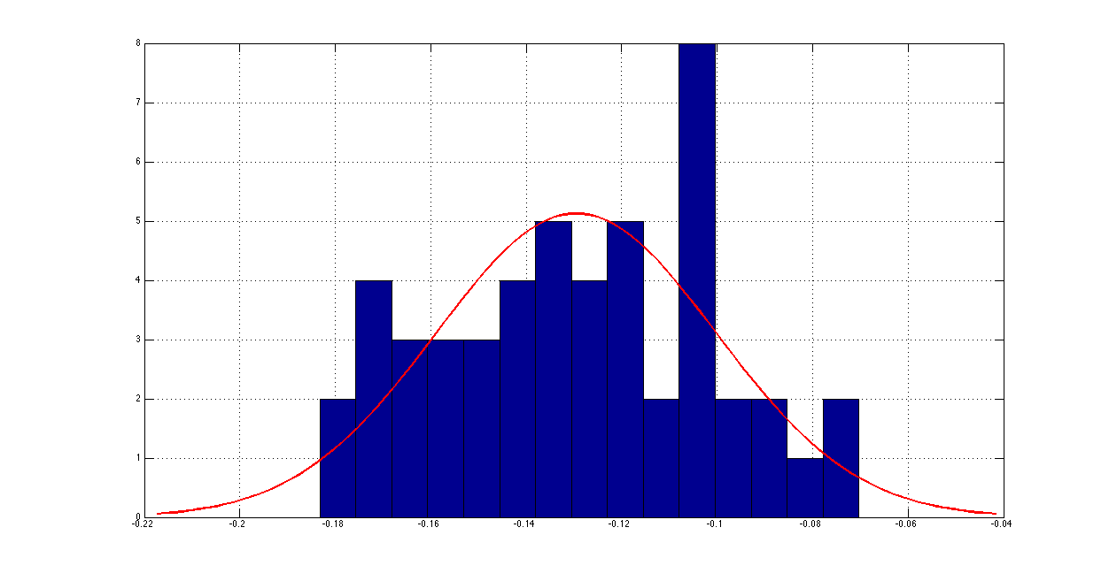
Histograms of the offsets
Histogram of the offsets at the input of the comparator.
Range = 100mV

Slide 19
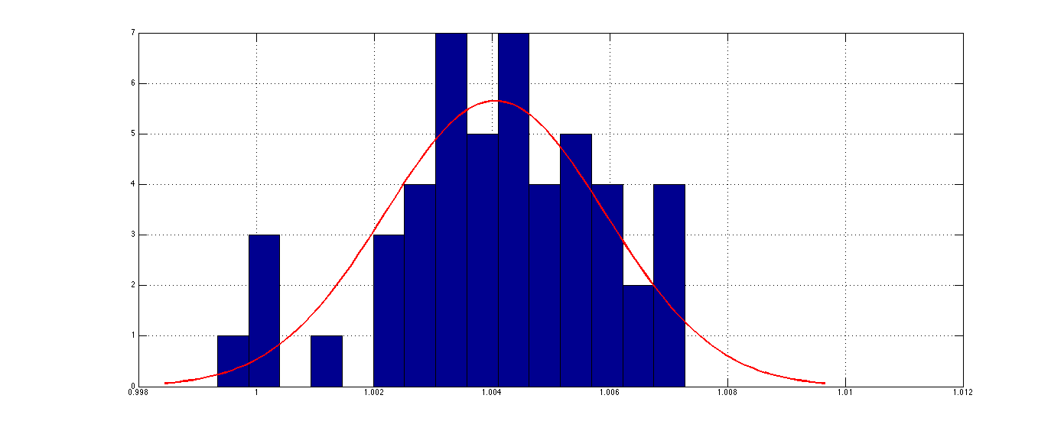
Histogram of the comparator output
Histogram of the corresponding signal that can be adjusted using the TRIM RAM

Slide 20
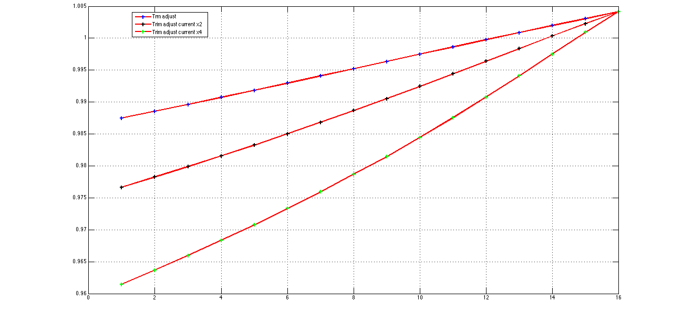
Trim RAM adjustment – 4bit programmable
Correction curves given by sweeping the 4 bits of the TRIM RAM for different RAM bias

Slide 21
Trim RAM conclusion
100mV of offset at the input of the comparator
4 bit TRIM ram can reduce it by a factor 16
In the end after trim adjustment the offset is ~6mV

Slide 22
SRAM
SRAM includes a PMOS than opens the loop to configure multiple SRAM at the same time.
The column and row selectors implementation with SACI allow to:
  Configure individual SRAM cells
  Configure a column of 128 SRAM
  Configure a row of 32 SRAM
  Configure all 4096 SRAM
Load
DataIn

Slide 23
Improvements compared to CHESS1
  Gain variation observed in CHESS1 if due to radiation damage is likely to stay.
  Improvements:
  NWELL Diode bias – less noise
  Constant reset done from the source follower – faster and higher gain.
  Direct connection from the amplifier to the discriminator - faster
  Real current mirrors to bias the pixels – better controlled, brings less noise
  Internal bias blocks – less noise
  TRIM RAM to adjust the discriminator internally

Slide 24
HIT ENCODING & BIAS

Slide 25
CHESS periphery
Kill sig.
HitPrev
HitNext
Global Reset
1 bit hit flag
1/2
5 bit hit address
Sel
1 bit hit to encoding
Hit Latch
Ck
Hit Flag Logic
x32
RowENB
RAMWrEn
ColENB

Slide 26
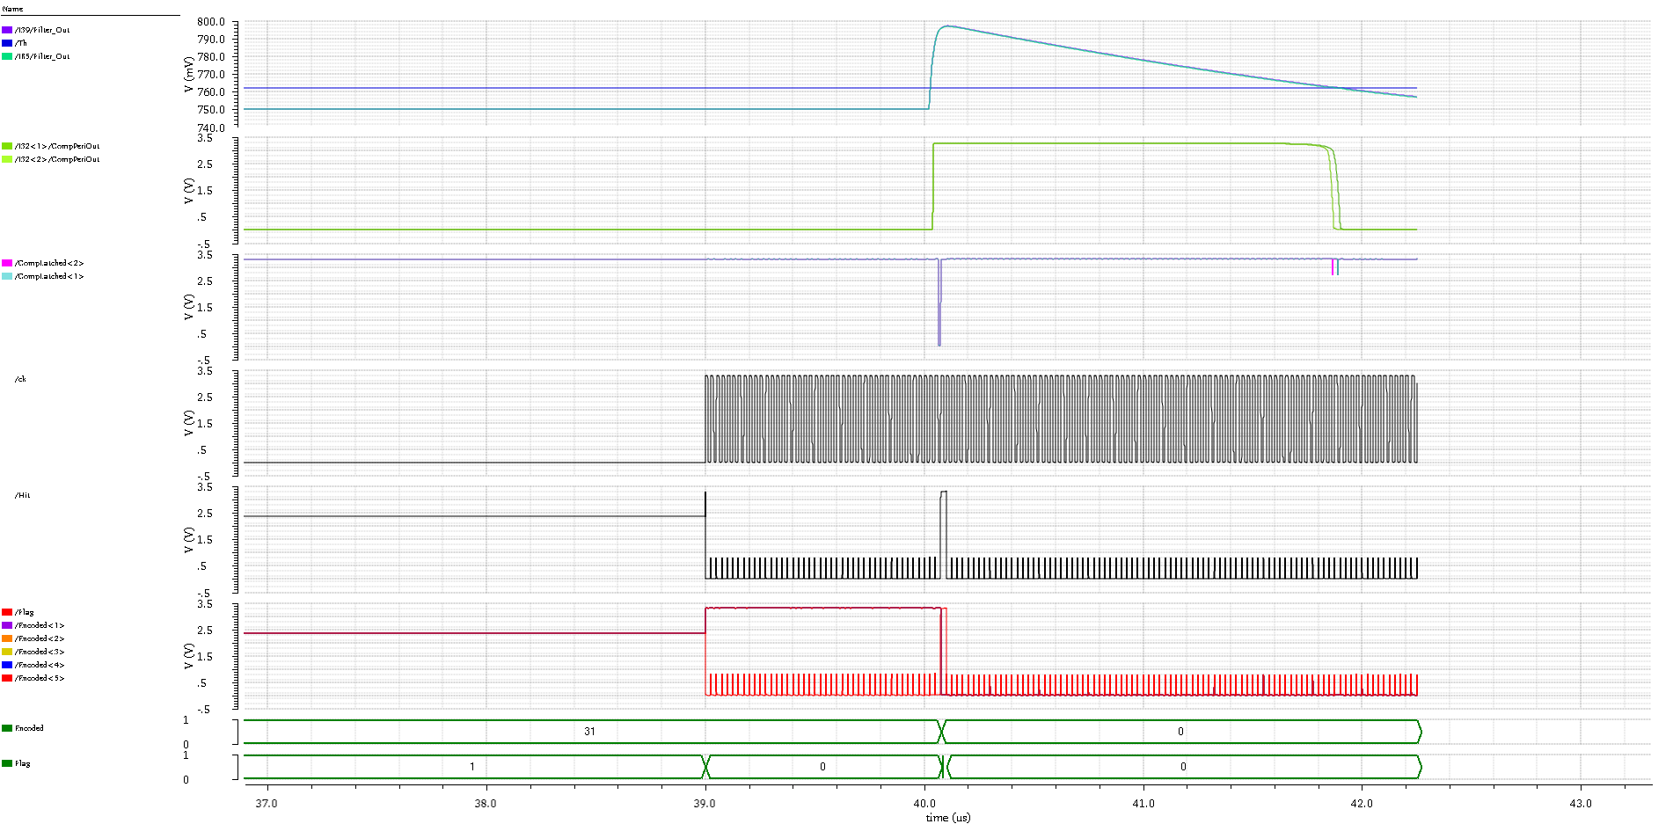

Slide 27
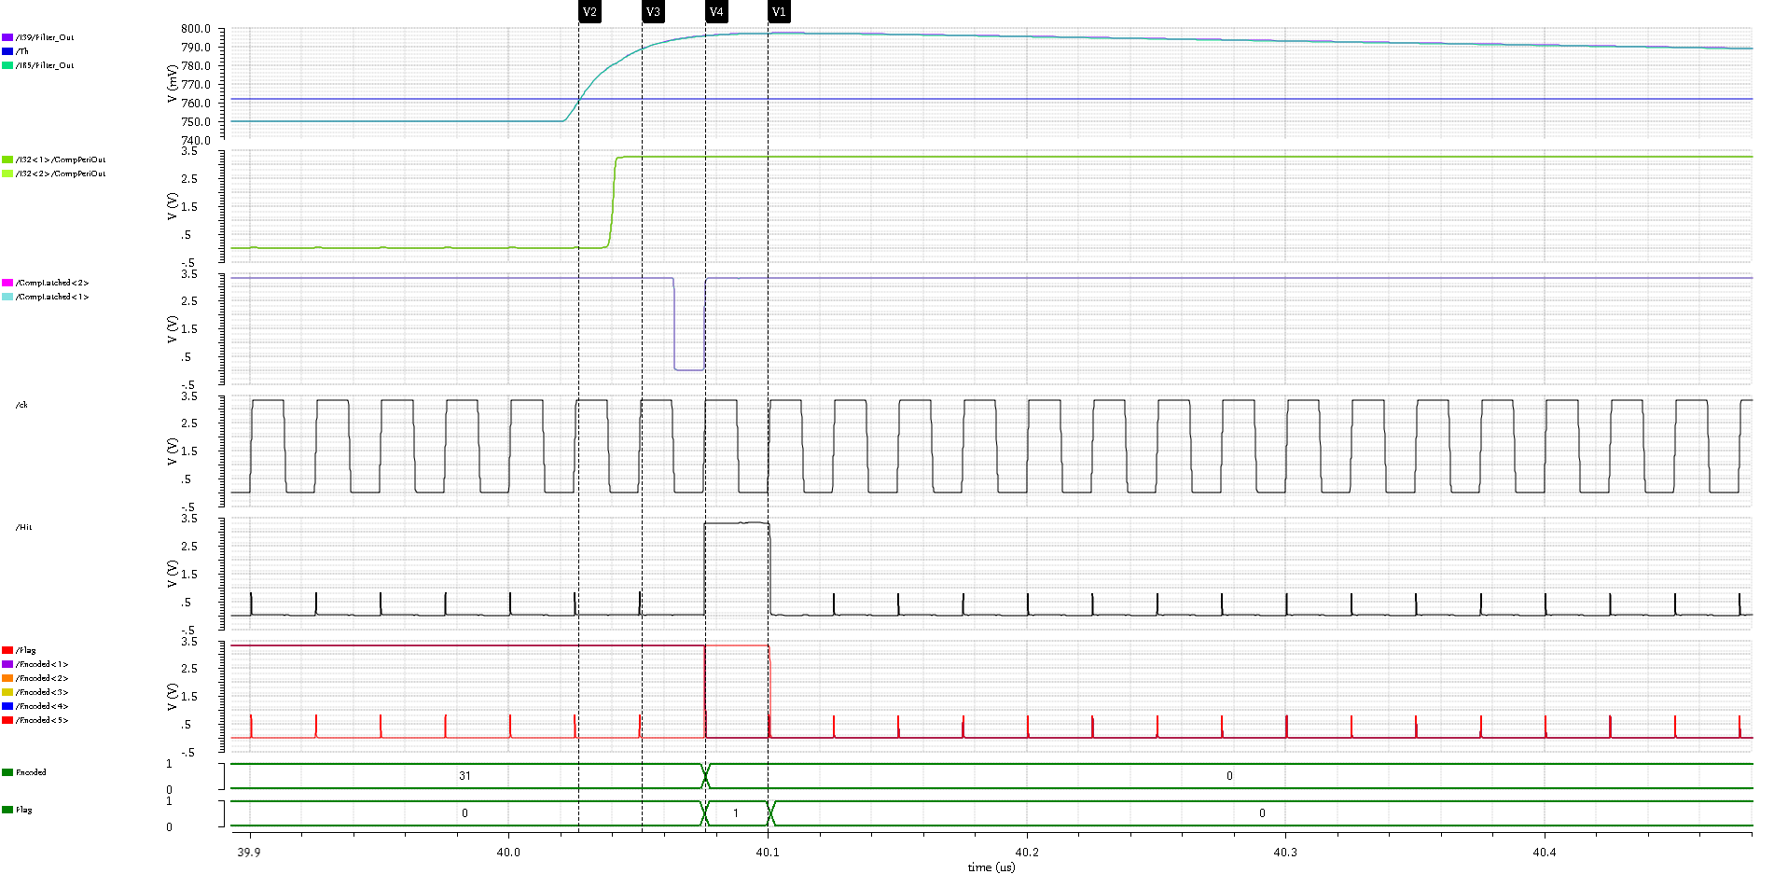

Slide 28
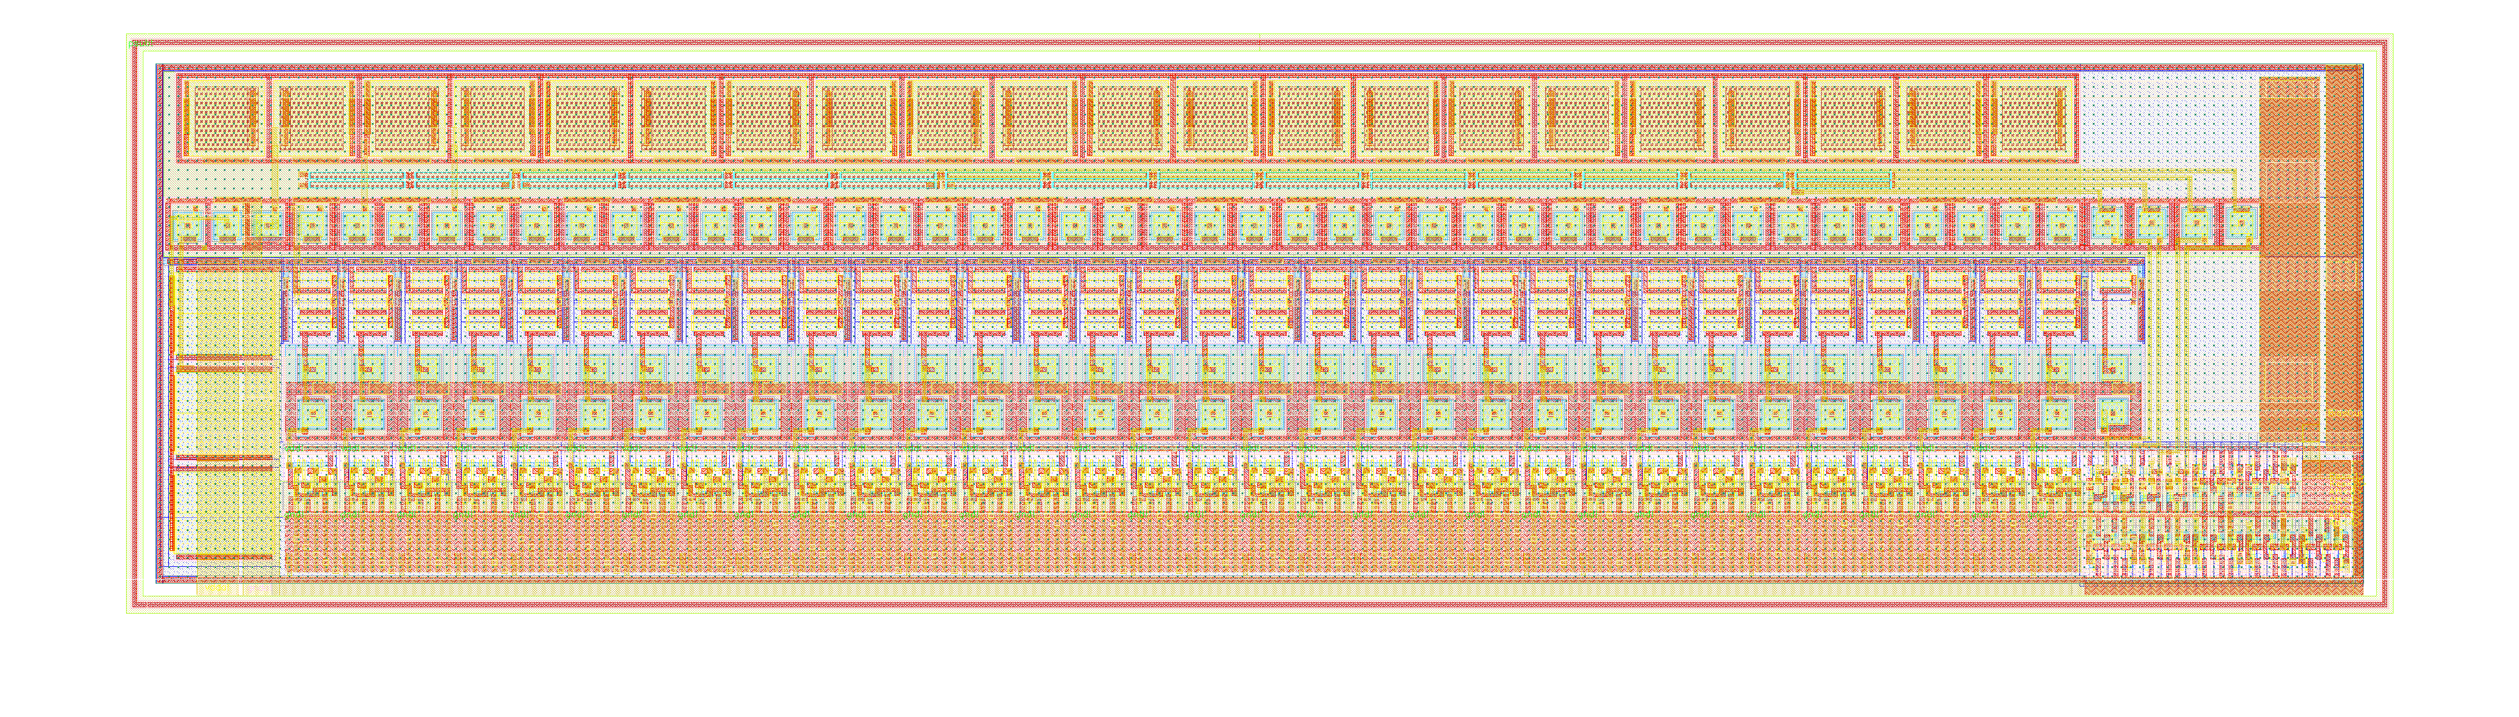
Bias block
Size: 300µm by 80µm
7 inputs per block from the registers.
Current output from 25µA down to 1pA
Filtered output
Used to control:
Feedback current
Amplifier current
Comparator current
Source follower current
Trim DAC current
Load current
Pre-programmed in SACI registers
Signals controlled externally
Threshold voltage
Baseline voltage
High pass filter voltage
Cascode voltage

Slide 29
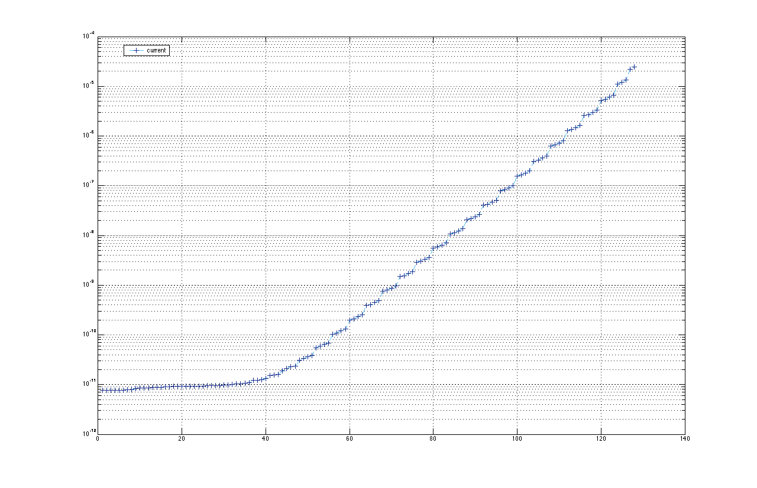
Cuurent (A)
Logarithmic behavior
desirable for feedback
current adjustment
7bit adjustable

Slide 30
SHIELDING

Slide 31
Capacitance NWELL to dynamic nets
Shield to the NWELLs has been added for all dynamic nets
Dynamic net: half comparator output
  Parasitic capacitance from the half-comparator output net to nwells = 1.32fF
  Dynamic signal on the half-comparator output net ~25mV
  Charge injected by the half-comparator to the subsequent pixels: 200e-
Dynamic net: charge injection signal
  Parasitic capacitance from the charge injection to the nwell : 82aF
  Real capacitance for the charge injection signal: 2.3fF
  SNR of the charge injection signal = 28

Slide 32
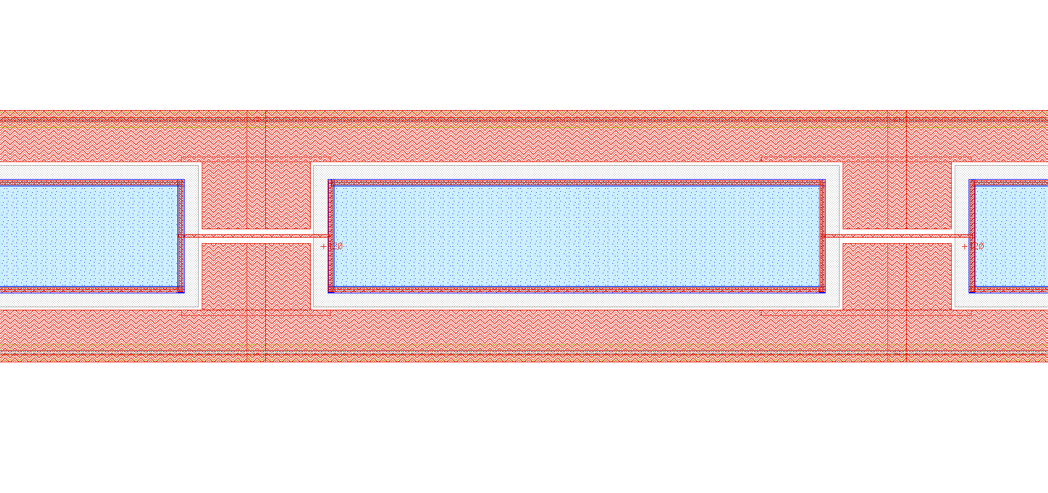
NWELL connectivity

Slide 33
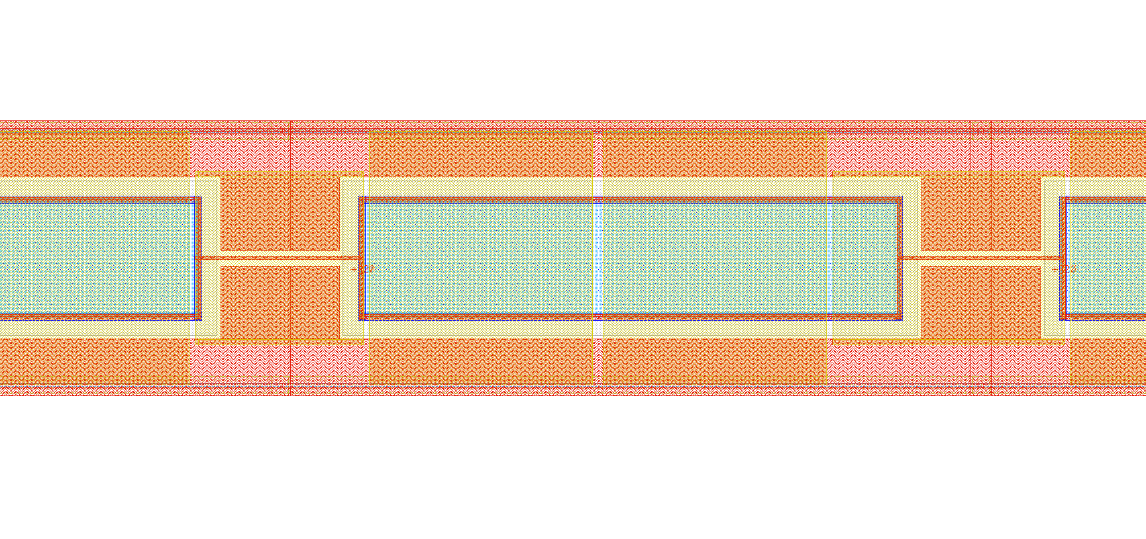
M2 shield on top of NWELLS (yellow)

Slide 34
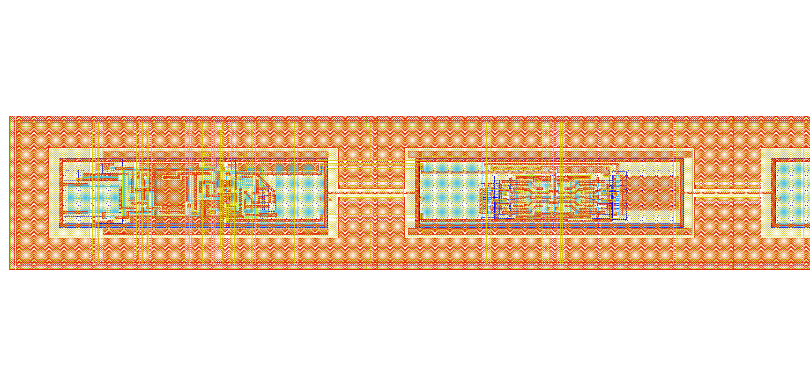
Shield and bias [acting as shields] on top of amplifier

Slide 35
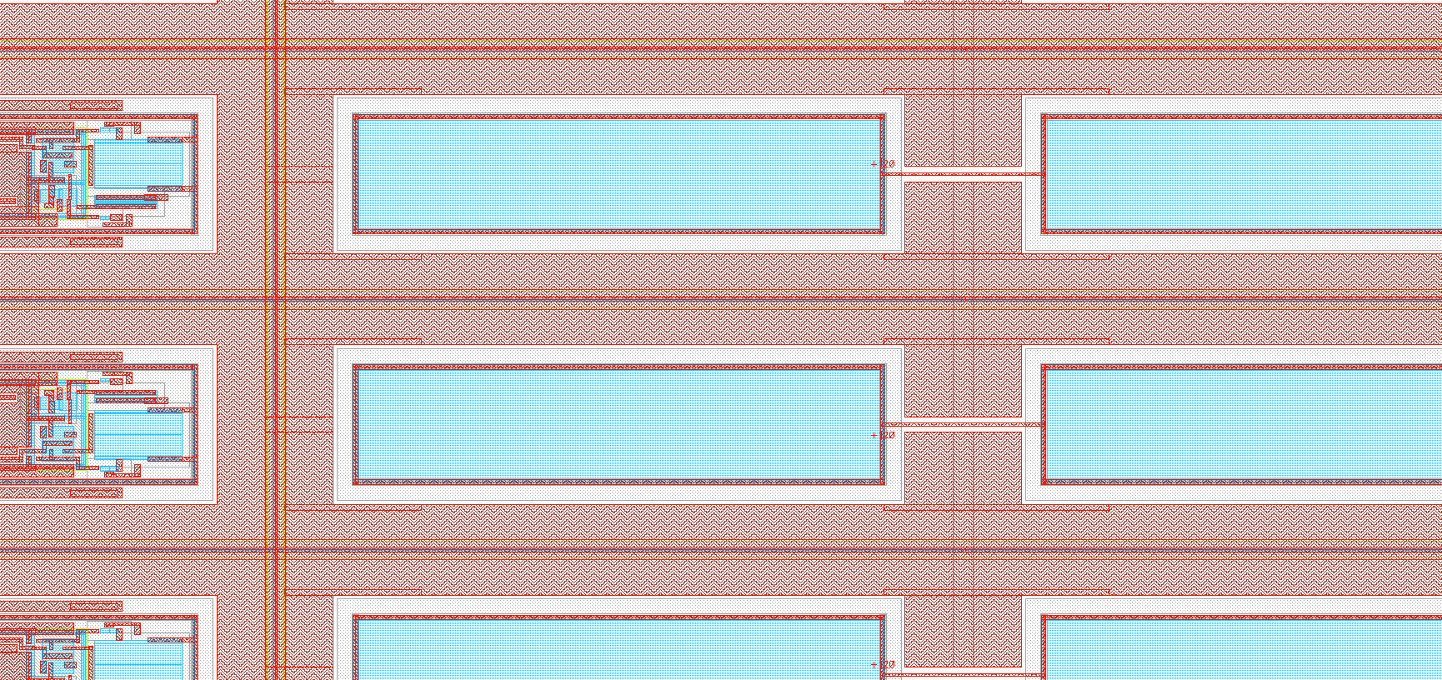
HV contact in blue around pixels
No contacts added here

Slide 36
POWER DISTRIBUTION

Slide 37
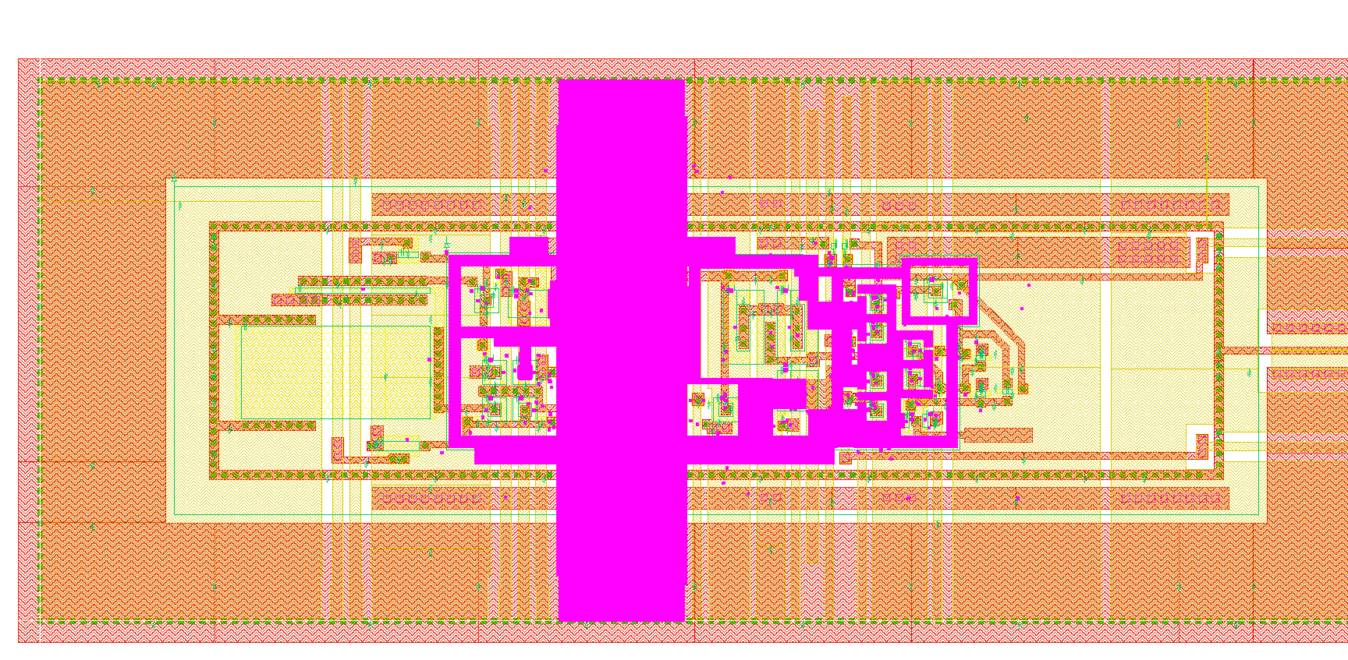
Pixel ground distribution

Slide 38
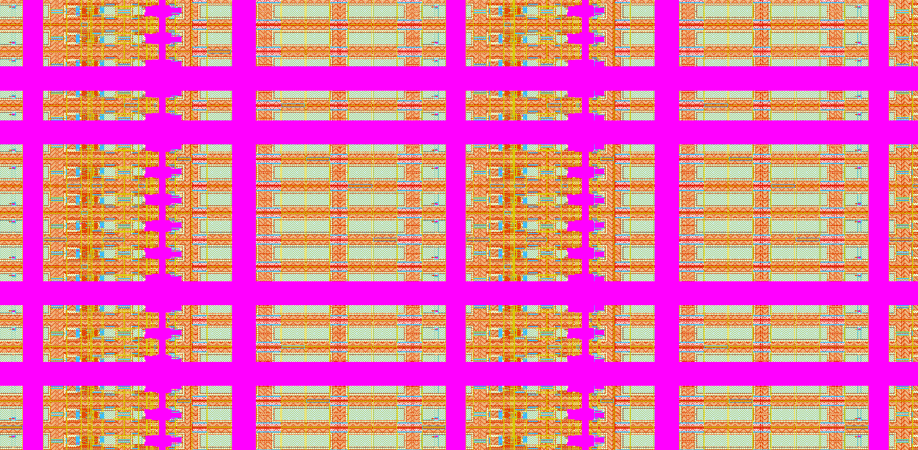
Ground mesh - detail

Slide 39
Ground mesh – all pixels

Slide 40
Ground connection strategy
Ground bus added next to pads
Resistance in the mesh is ~20mOhm across each 630µm column -> 2.4mV drop
2.5mm – 26 connection
0.1Ohms
10mV drop @ 100mA

Slide 41
RADHARD NMOS & STATUS

Slide 42
Number of rad-hard NMOS - Pixel part
 | Total NMOS RAD_SOFT | Total NMOS RAD-HARD
Pixels | 0 | 114688
Comparator periphery | 0 | 67840
Latching | 0 | 65408
Column selector | 952 | 0
Column selector periphery | 403 | 0
Row selector | 1427 | 0
Bias | 1134 | 255
Total | 3916 | 248191
These numbers for 128 strips. Need to be multiplied by x3
~4mA of leakage current on the digital supply - ok

Slide 43
 | Simulation | LVS + DRC | Integration
Pixel | ✓ | ✓ | ✓
Amplifier | ✓ | ✓ | ✓
Comparator | ✓ | ✓ | ✓
Hit latching | ✓ | ✓ | ✓
Hit encoding | ✓ | ✓ | ✓
Hit Buffering and synchronization | ✓ | ✓ | ✓
Trim RAM | ✓ | ✓ | ✓
Threshold Trimming | Trimming functionality verified | ✓ | ✓
Signal injection | ✓ | ✓ | ✓
Pads | ✓ | ✓ | ✓
Pad buffers | ✓ | ✓ | ✓
Bias controller | ✓ | ✓ | ✓
Power and bias distribution | Resistance hand calculation and minimization | ✓ | ✓

Slide 44
Last steps
 | Simulation | LVS + DRC | Integration
128 strips | ✓ | ✓ | ✓
2 x 128 strip mirrored | In progress | ✓ | ✓
Test structures | In progress (next week) | In progress (next week) | In progress (next week)
Tape out | Expected End of next week – beginning of following
Test structure to follow Jaya John proposal: TCT on left edge – pads on right edge.

