Slide 1
Speed Poster.
Advanced Laser Synchronization at REGAE.
Mikheil Titberidze
4th ARD ST3 Workshop
Berlin, 13-17 July 2016

Slide 2
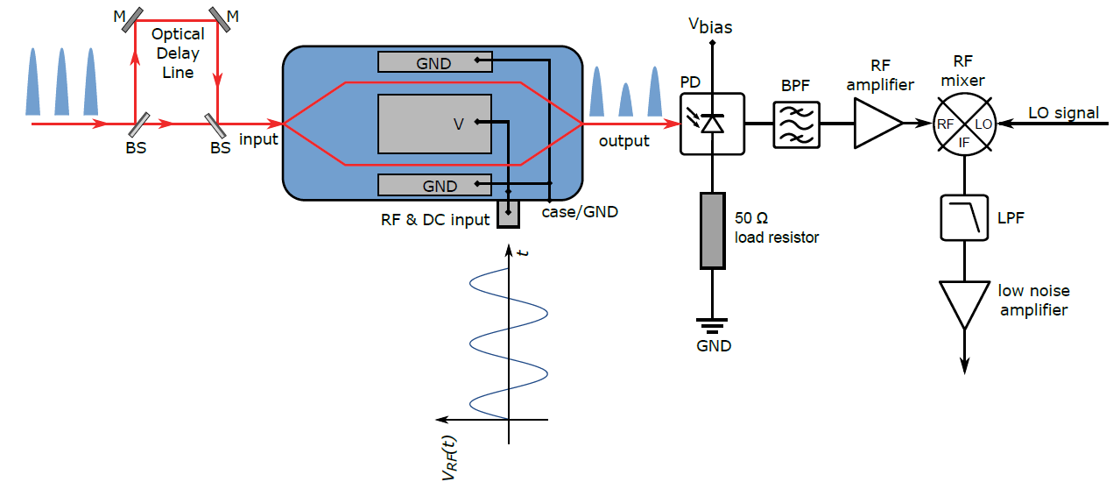
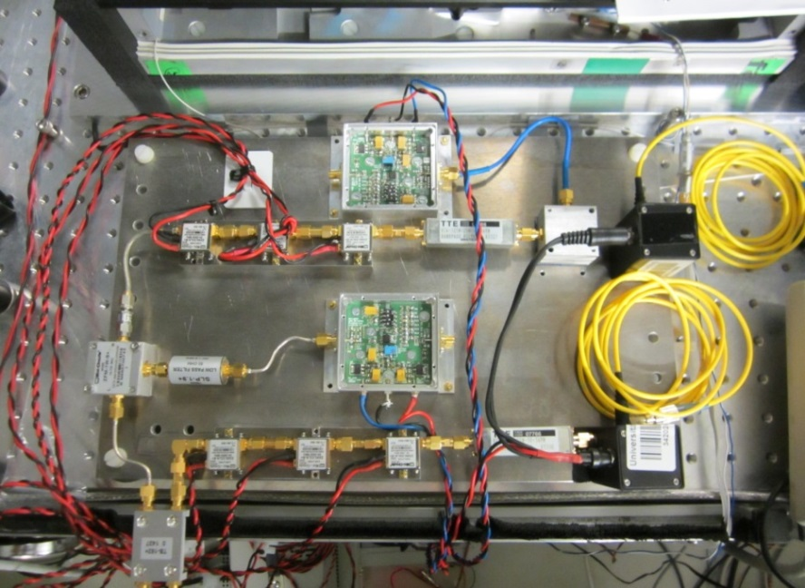
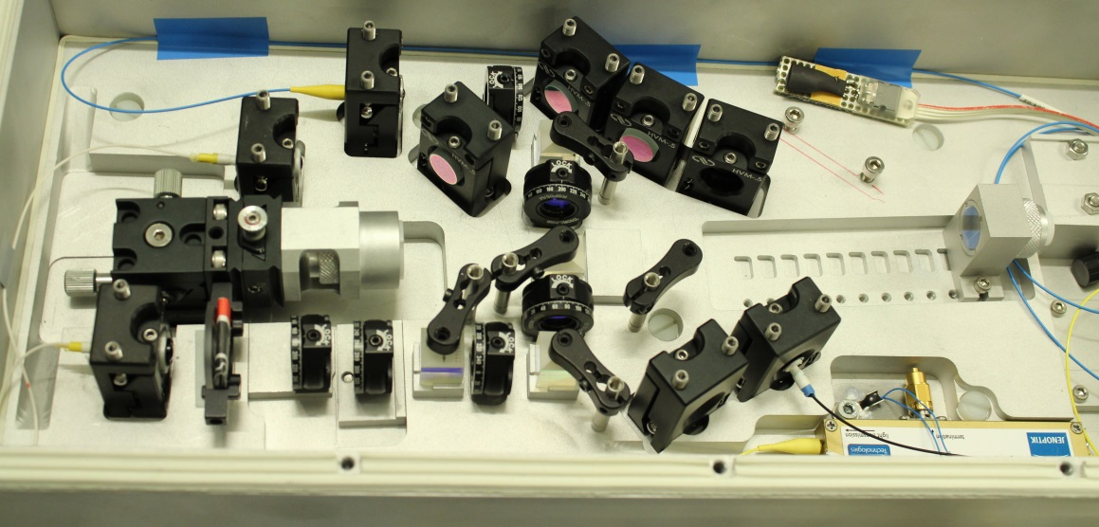
Speed Poster.
The main idea is to convert the relative timing error between the RF reference and Laser pulses to amplitude modulation of the optical pulses using the MZM.

Slide 3
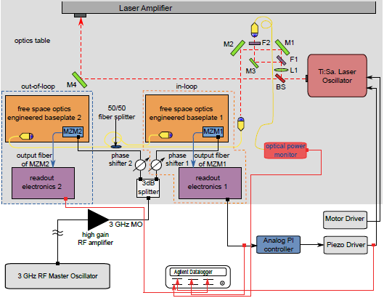
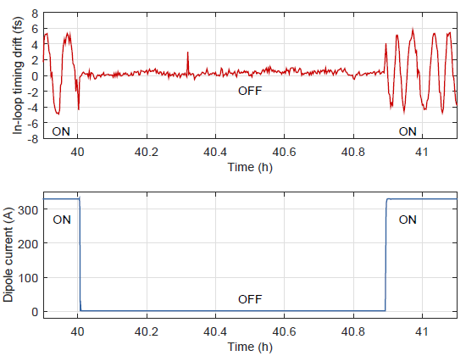
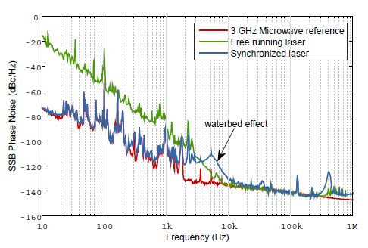
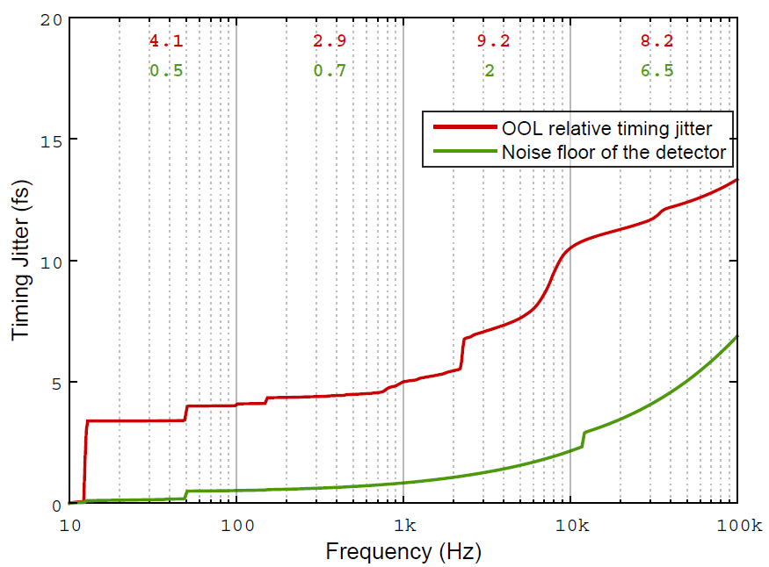
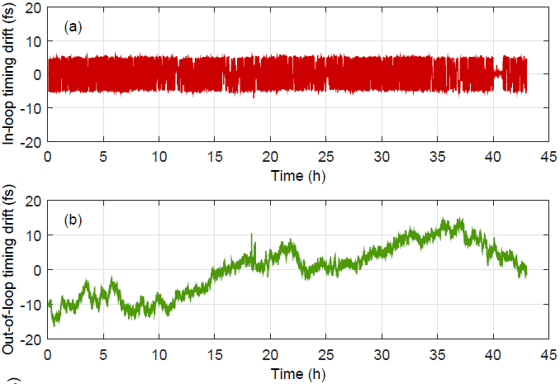
Speed Poster.
12.5 Hz
The locking bandwidth of the laser is ~ 2 kHz.
Timing jitter measured out-of-loop is: ~ 10 fs rms in the BW of [10Hz to 100 kHz].
Peak-to-Peak timing drift of 31 fs has been measured over 43 hr.
There is more room for improvement.

