Slide 1
Speed Poster.
Status of the Optical Synchronization System at European XFEL.
Mikheil Titberidze
on behalf of Lbsync Team
4th ARD ST3 Workshop
Berlin, 13-17 July 2016

Slide 2
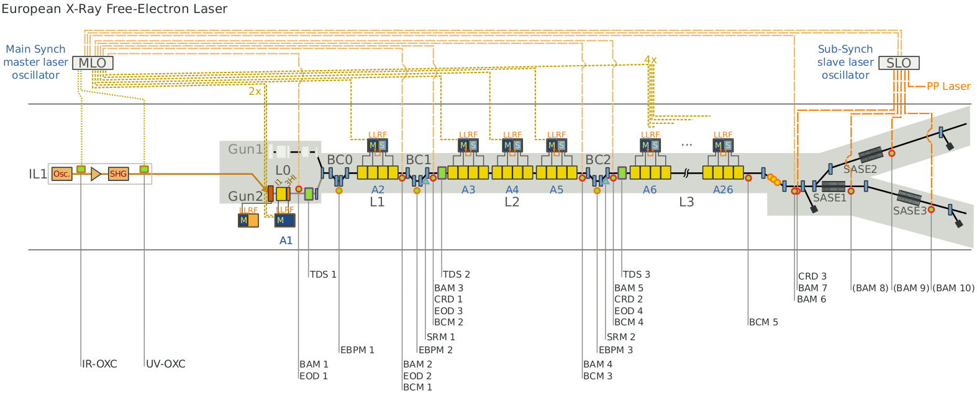
Speed Poster.
Goal is to provide drift-free reference to end-stations along the tunnel for synchronization:
Bunch-Arrival Time Monitors
RF Reference Stabilization (RefmOpt)
Laser Synchronization

Slide 3
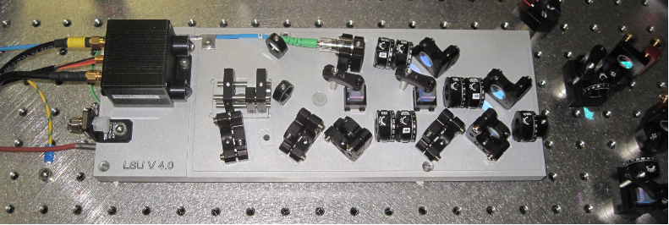
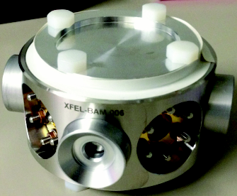
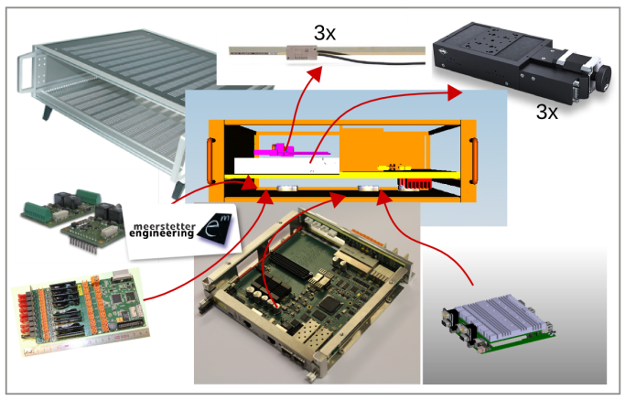
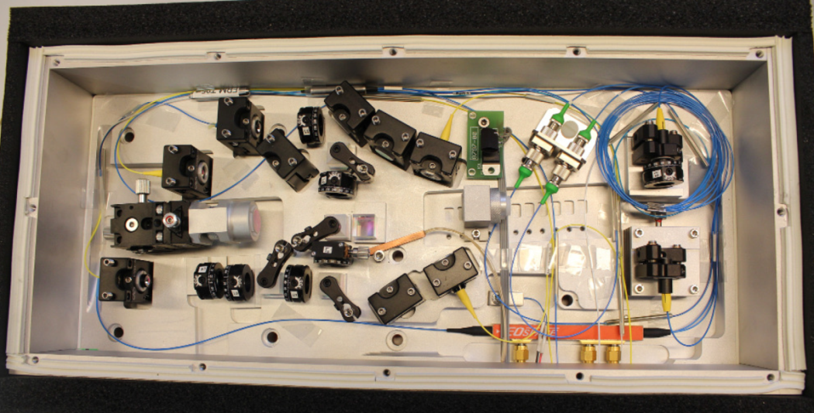
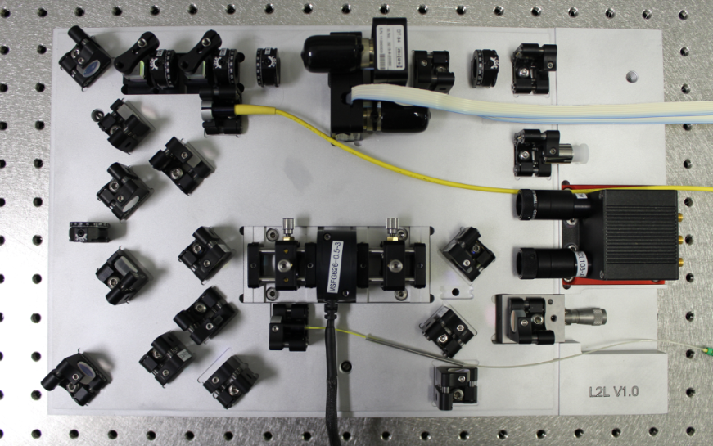
Speed Poster.
Link-Stabilization-Unit (LSU)
Bunch Arrival Time Monitor (BAM)
RF reference stabilization (RefmOpt)
Laser Synchronization (L2L)

