Slide 1
Tutorial I: Insertion Devices – Undulators
Johannes Bahrdt
4th ARD ST3 Workshop: ps-fs Electron and Photon Beams, July 13th - 15th, 2016

Slide 2
History of Insertion Devices
1947 first discussion of undulator radiation by Ginzburg
1951 / 1953 first production of undulator light in
the mm and visible regime by Motz et al.
1976 FEL radiation from a superconducting (SC) helical undulator at Stanford: Madey et al.
1979 / 1980 first operation of permanent magnet undulators in storage rings
(SSRL, LURE, VEPP3)
1980... SC-wavelength shifters in storage rings (VEPP3, SRS, VEPP2M)
1992… In-vacuum undulators
2008… cryogenic permanent magnet undulators (CPMUs)
(ESRF, PSI, SPRING-8, SOLEIL, DIAMOND…)
2009 First FEL lasing & saturation of 1.5A SASE-FEL in Stanford
today about 20 third-generation synchrotron radiation light sources
SASE-FELs from the infrared to the X-ray regime
(Angstrom-FELs: LCLS, USA, SACLA, Japan, XFEL, Germany)

Slide 3
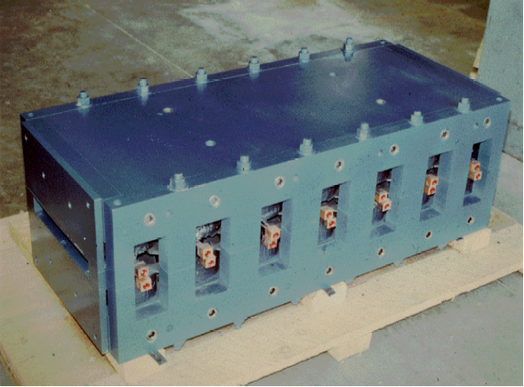
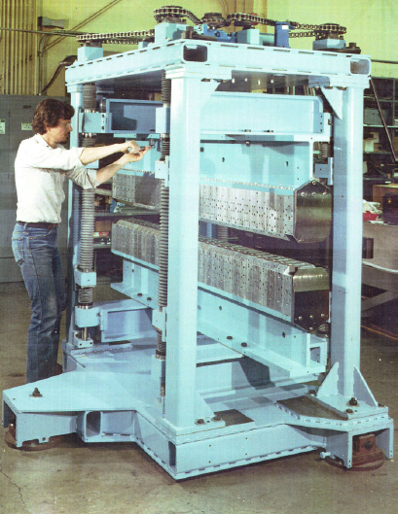
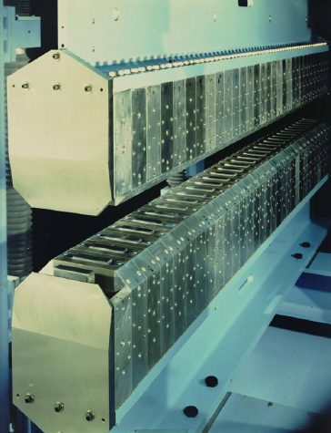
Increasing the Photon Flux vs. SRing Dipole
Wiggler: A Sequence of Alternating Dipoles
brilliance scales linearly with number of poles
incoherent overlap of light from individual poles
spectrum = n times dipole spectrum
SSRL 1978
Electromagnetic 7 poles wiggler
LBL / SSRL 1985
54 poles hybrid wiggler

Slide 4
Spectral properties of IDs

Slide 5
Starting from Lienard-Wiechert Potential
The Lienard-Wiechert potentials are the solution
of the inhomogenious Maxwell equations
The brackets are evaluated at
the retarded time:
The acceleration and velocity fields are derived from these potentials:
A. Liènard, L’Eclaire Electrique 16(5) (1898)
E. Wiechert, Archives Neerlandaises, 1900, p. 546

Slide 6
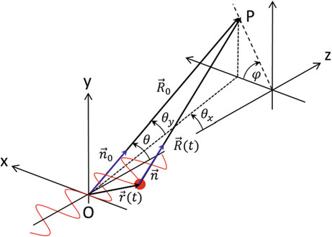
Radiation Emitted by Accelerated Charged Particles
The emitted power
is given by the
poynting vector
The spectrum is evaluated via a Fourier
transformation of the time dependent fields
In the far field we approximate:

Slide 7
Radiatin from Bending Magnets, WLS, Wigglers
ρ=bending
radius
The critical energy divides the
power spectrum into equal parts.
on axis flux density (ph / s / mrad**2 / 0.1%BW)
vertically integrated flux (ph / s / mrad / 0.1%BW)
critical
energy
The critical energy scales
With the second power
of the electron energy

Slide 8
Line Spectrum of Undulators
resonance condition
figure 8 motion in moving frame
produces higher harmonics
on axis: only odd harmonics
off axis: also even harmonics
electric field at observer
spectrum

Slide 9
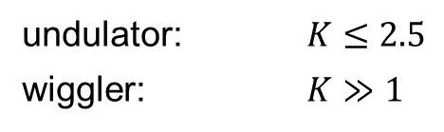

Wigglers & Undulators
Undulator Wiggler
photon phase space
wiggler
undulator
undulator parameter K
undulator: $K≤2.5$
wiggler: $K≫1$
$K=93.4∙B_{0}[T]∙λ_{0}[m]$

Slide 10
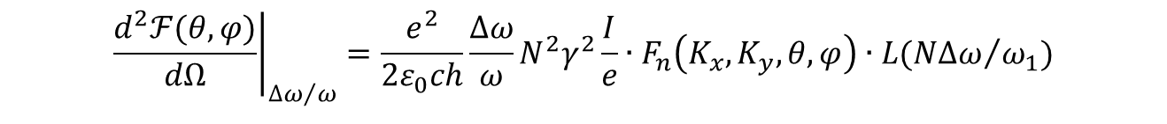


Undulator Spectrum I
$${\left.\frac{d^{2}ℱ(θ,φ)}{dΩ}\right|}_{{∆ω}/ω}=\frac{e^{2}}{2ε_{0}ch}\frac{∆ω}{ω}{N^{2}γ}^{2}\frac{I}{e}∙F_{n}\left(K_{x},K_{y},θ,φ\right)∙L({N∆ω}/{ω_{1})}$$
amplitude term
interference term
$$Φ=0°$$
$$Φ=90°$$
off-axis brightness
exact
dipole series appr.
10

Slide 11
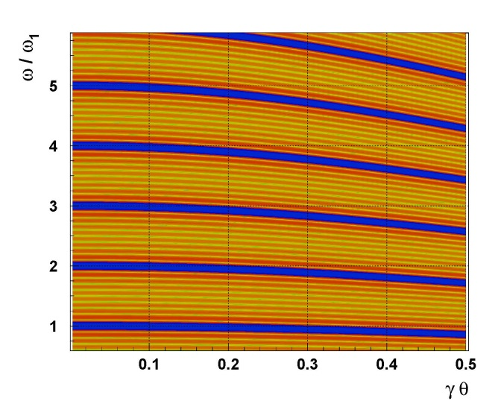
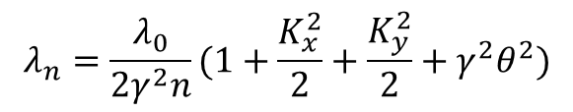
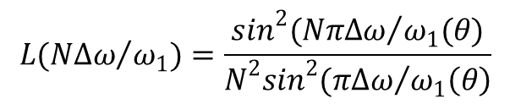
Undulator Spectrum II
Interference term reflects the beam coherence:
Enhancement by orders of magnitude at the harmonics
Intensity suppression between the harmonics
$$L({N∆ω}/{ω_{1})}=\frac{\sin^{2}({Nπ∆ω}/{ω_{1}(θ)}}{N^{2}\sin^{2}({π∆ω}/{ω_{1}\left(θ\right)}}$$
$$λ_{n}=\frac{λ_{0}}{2γ^{2}n}(1+\frac{K_{x}^{2}}{2}+\frac{K_{y}^{2}}{2}+γ^{2}θ^{2})$$
Fine structure @ harmonic
Fine structure off-axis

Slide 12
Useful Equations in Practical Units
On-axis flux density of the n^{th} harmonic (ph / s / mrad**2/ 0.1%BW)
flux inside the central cone (ph / s / mrad**2/ 0.1%BW)
1
1
9
9

Slide 13
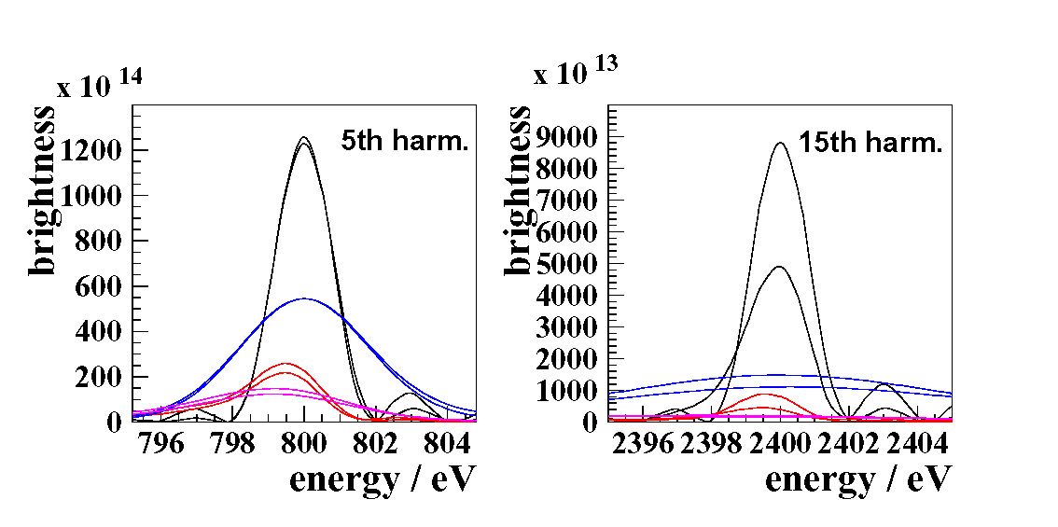
Sources of Brightness Degradation
Undulator errors
Beam parameters
beam emittance: 6 x 10⁻⁹ m rad
= 0.94 m
= 2.1 m
energy spread: 8 x 10⁻⁴
Phase error U41:
(rms) = 2.6°
reduction of on axis
flux density (Walker):
black: without emittance, energy spread
red: emittance included
blue: energy spread included
magenta: emittance and energy spread incl.
Brightness gain with DLSR
phase error from
measured fields:

Slide 14
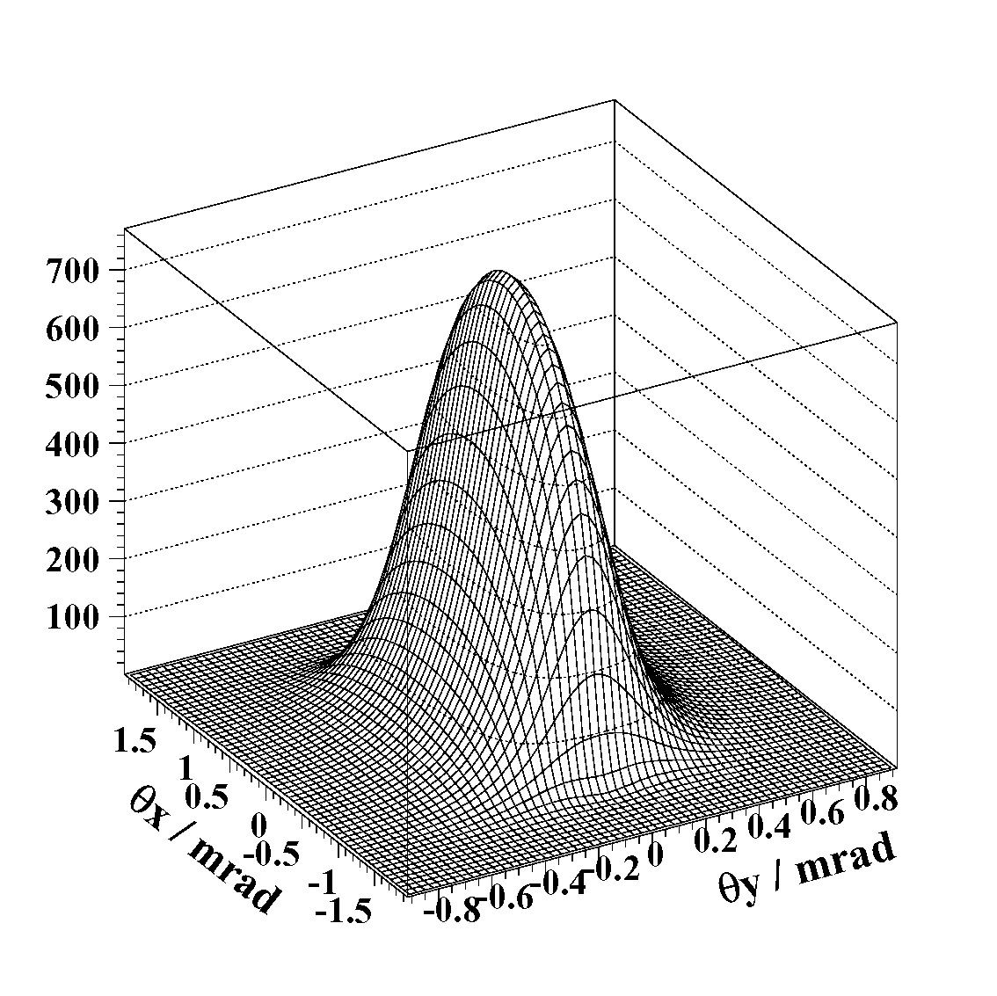
Undulators with Reduced on-Axis Power Density
Planar Undulator: Maximum power density on-axis
leaf undulator
Reduced on-axis power density
knot undulator
helical undulator
figure-8 undulator

Slide 15
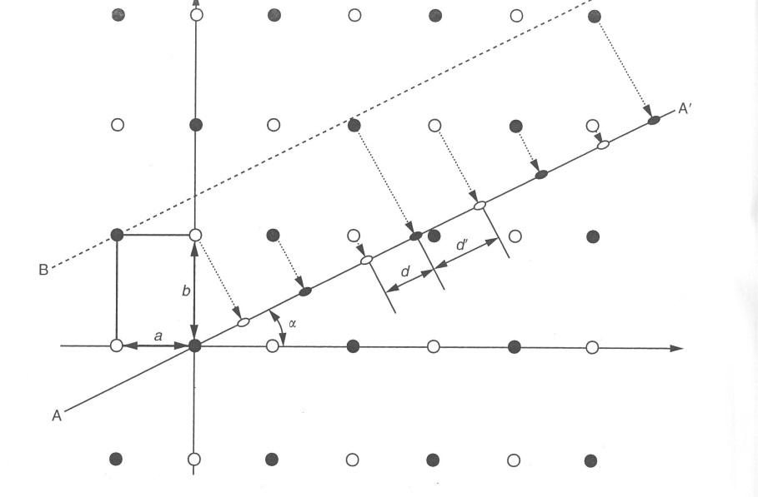
Undulators with Reduced Higher Harmonic Content
Quasiperiodic Undulator
generate 1D-quasiperiodic lattice
ESRF / ELETTRA design
BESSY II design
original design
spectra derived
from measured
magn. fields
S. Sasaki, Conceptual design of new type quasi-periodic undulator. Sincr. Trieste, ST/M-TN-98/24 (1998)
S. Sasaki, New scheme of quasi-periodic undulators, in Proc. of the IPAC, Kyoto (2010), pp. 3141–3143

Slide 16
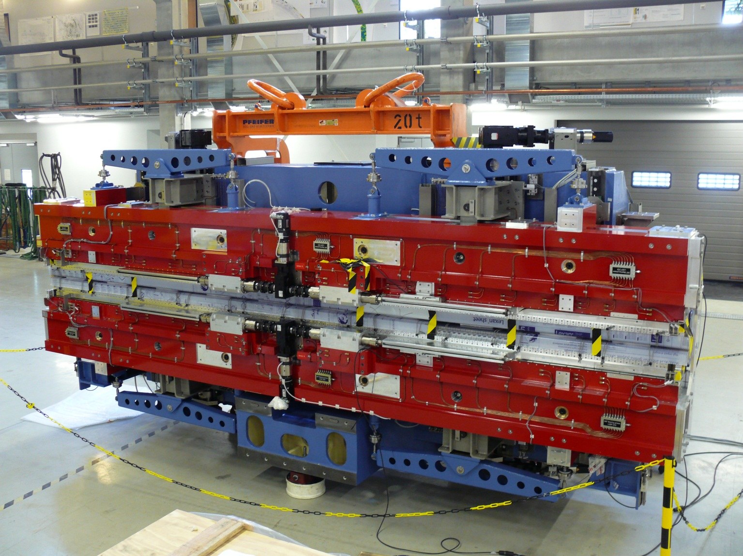
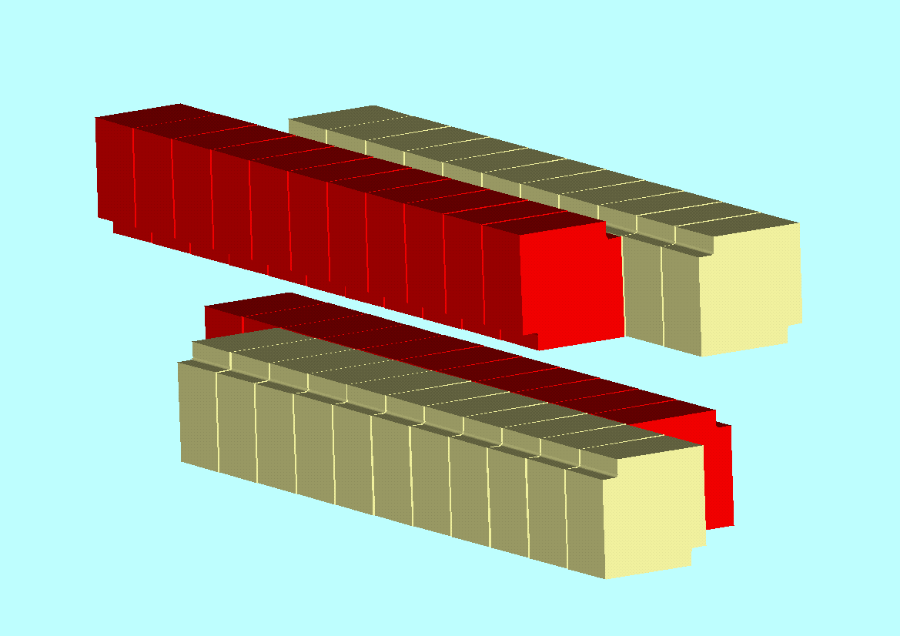
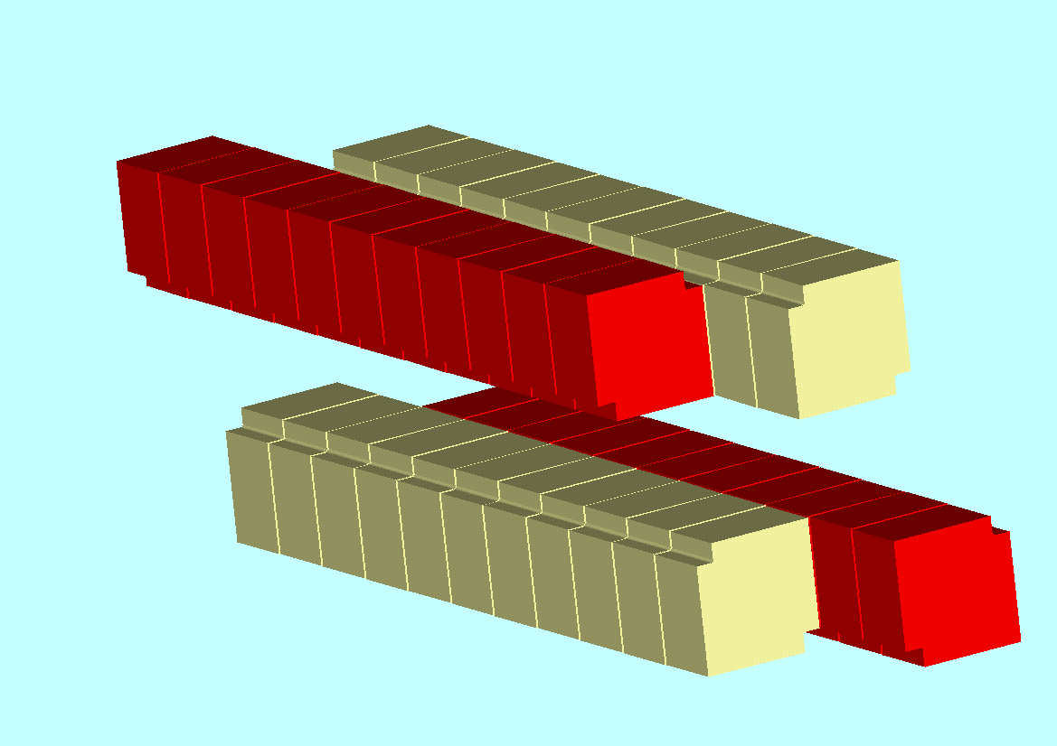
Principle of APPLE II Undulator
The APPLE II design provides the highest fields among all planar VPUs
relative phase of By, Bz
defines ellipticity
ratio By / Bz
defines inclination
effective field
B_{min}
0º
90º
B_{max}
10
- 90º
0º
B_{min}
0,1
J. Bahrdt et al., Proc. EPAC 2008, Genua, Italy; J. Bahrdt et al., SRI 2009, Melbourne Australia
J. Bahrdt et al., IPAC 2010 Kyoto, Jap; J. Bahrdt et al., IPAC 2011 San Sebastian, Spain

Slide 17
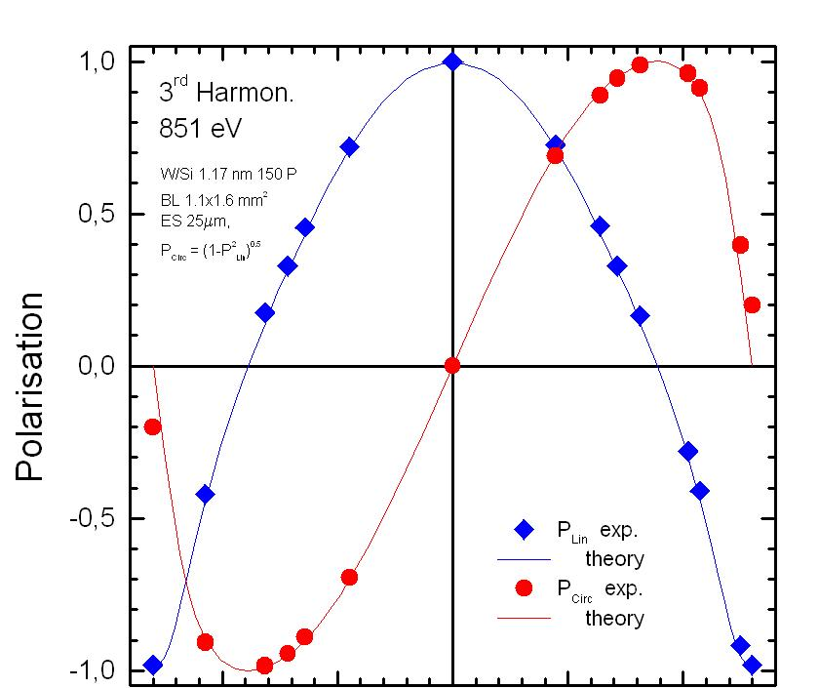
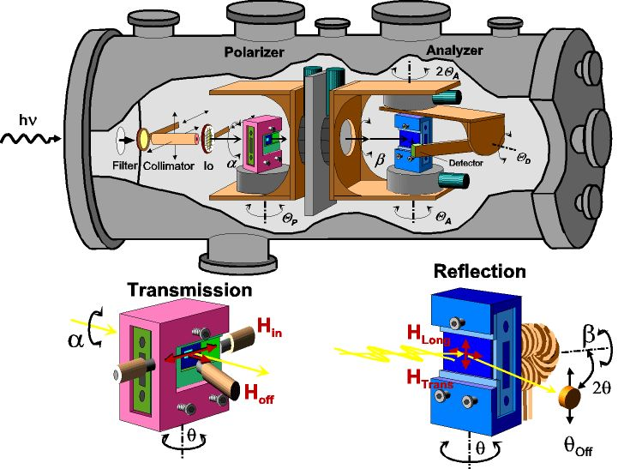
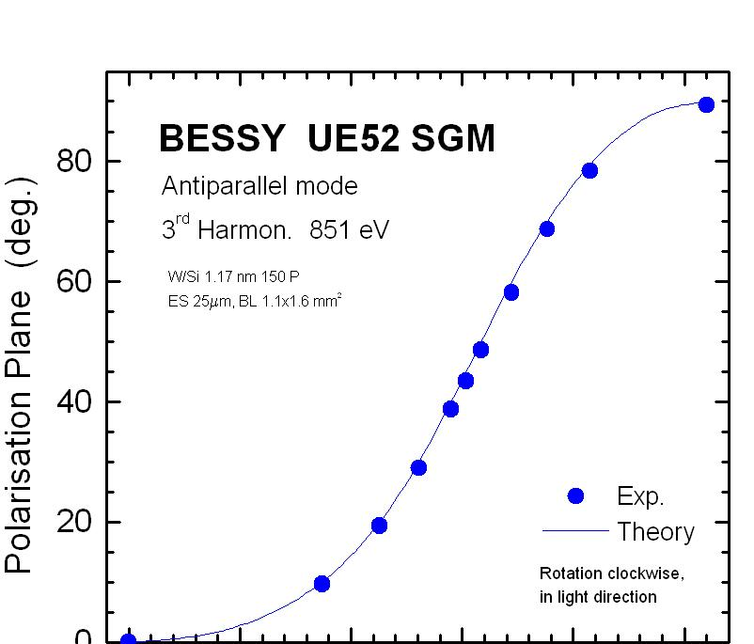
Polarization Characterization
elliptical
mode
inclined
mode
The BESSY II Soft X-ray polarimeter
We observe good agreement
between simulations and measurement
0 undulator phase π

Slide 18
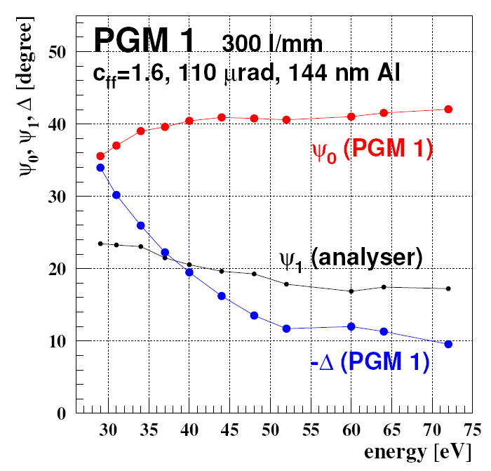
Universal Mode of APPLE Undulator
Modification of undulator radiation polarization by beamline components
Parameters of beamline Müller matrix
and of analyzer vs. photon energy.
Gap and shift settings for normalized
Stokes parameters at the sample.
Müller-Matrix describes beamline effects
transmissions of field amplitudes
phase difference of electric field components
J. Bahrdt et al, SRI 2009,
Melbourne, Australia

Slide 19
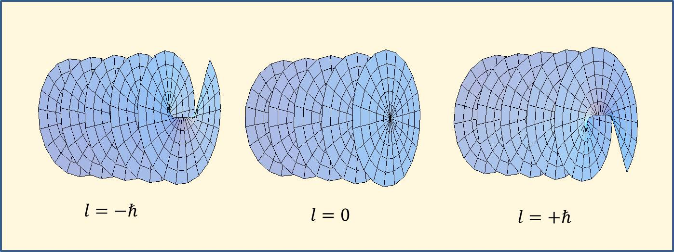
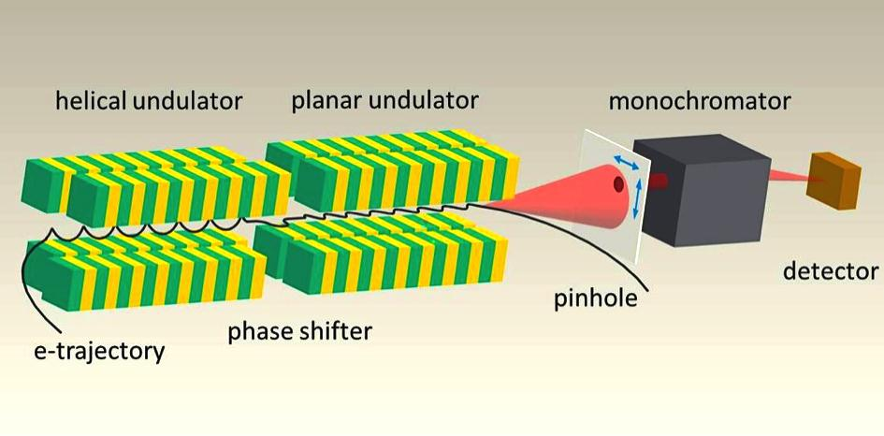
Photons with Orbital Angular Momentum I

Slide 20
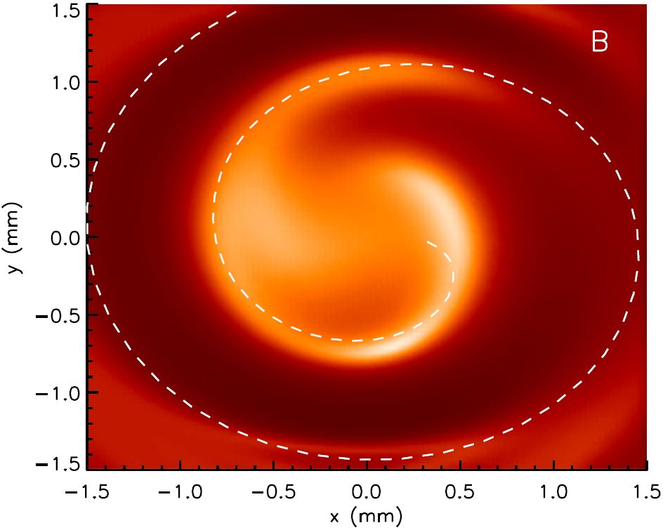
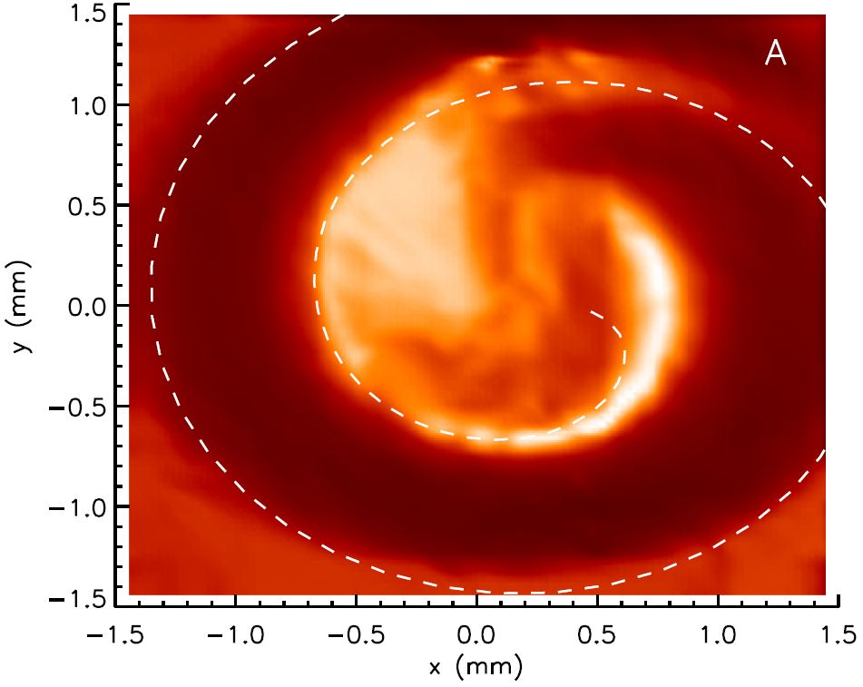
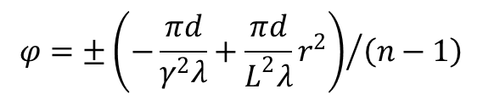

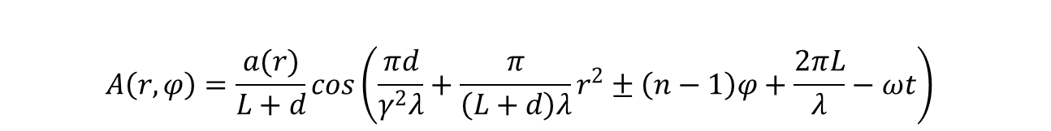
Photons with Orbital Angular Momentum II
$$A\left(r,φ\right)=\frac{a(r)}{L+d}cos\left(\frac{πd}{γ^{2}λ}+\frac{π}{\left(L+d\right)λ}r^{2}±\left(n−1\right)φ+\frac{2πL}{λ}−ωt\right)$$
$$B\left(r,φ\right)=\frac{b(r)}{L}cos\left(\frac{π}{Lλ}r^{2}+\frac{2πL}{λ}−ωt\right)$$
$$I\left(r,φ\right)=\frac{a^{2}}{{2\left(L+d\right)}^{2}}+\frac{b^{2}}{{2L}^{2}}+\frac{ab}{L\left(L+d\right)}cos\left(\frac{πd}{γ^{2}λ}−\frac{πd}{L^{2}λ}r^{2}±\left(n−1\right)φ\right)$$
$$φ=±{\left(−\frac{πd}{γ^{2}λ}+\frac{πd}{L^{2}λ}r^{2}\right)}/{\left(n−1\right)}$$
J. Bahrdt, K. Holldack, P. Kuske, R. Mü ller, M. Scheer, P. Schmid, Phys. Rev. Lett. 111, 034801

Slide 21
Beam Dynamics -Non-Linear Effects

Slide 22

Dynamic Field Integrals of
Planar Undulators / Wigglers I
second order kicks (Elleaume, EPAC 1992):
2nd order kicks do not fullfill 2D-Maxwell equations &
cannot be perfectly shimmed by principle
Halbach ansatz for planar undulators / wigglers
from Maxwell equations
non linear kicks of planar undukator / wiggler:
Quadratic scaling:
period length
field
inverse of e-energy
Notes:
Alignment: Hinweis auf Hein-Dieter Nuhn

Slide 23
Dynamic Field Integrals of
Planar Undulators / Wigglers II
Non-linear kicks in terms of Fourier coefficients of transverse field distribution
These expressions can be used in a thin lens approximation (kick map)
which assumes a localized kick of the strength of the integrated quantity
Only once, the transverse vertical field distribution in the midplane
at one z-position has to be evaluated (more position for longitudinal FCs)

Slide 24


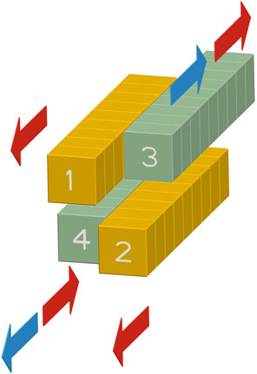
Dynamic Field Integrals of APPLE Undulators I
Modes of
APPLE
operation
elliptical mode
inclined mode
universal mode
generic representation of 2nd order kicks for elliptical and inclined mode
f₀
f_{π}
f_{π/2}
3 generic
functions
inclined mode

Slide 25
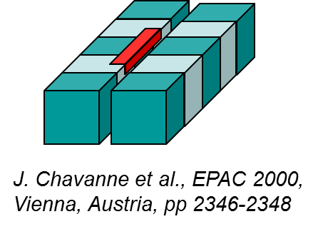
Analytic Representation of Field (Integral)
Examples: APPLE II Field & Shim Field Integral
Description is based on Fourier decomposition in 3 dimensions
Scalar potential of main Field
Scalar Potential of shim field integral
analytic field description
symplectic particle tracker (generating functions)
very fast (several periods in one step)

Slide 26
Accuracy of Field (Integral) Description
Based on Fourier Decomposition
Main fields of APPLE II
analytic representation (black)
simulation with RADIA (red)
Field integrals of L-Shim
analytic representation (black)
simulation with RADIA (red)
Parametrization of magnet field properties with high accuracy
Notes:
Damit habe wir die Tools zusammen und können anfangen mit dem tracken

Slide 27



Dynamic Kicks of APPLE II Undulators II
Elliptical mode (φ₂=0)
$c_{pp}, s_{pp}$ analytic functions of $φ_{1}$
(parallel motion of diag. rows)
$e_{i}, e_{j}$ include gap dependence
Inclined mode (φ₁=0):
$c_{pa}, s_{pa}$ analytic functions of $φ_{2}$
(antiparallel motion)
$$φ_{1}$$
$$φ_{2}$$
J. Bahrdt, G. Wüstefeld,
Phys. Rev. Special Topics, AB 14, 040703 (2011)

Slide 28
Shimming Techniques

Slide 29

Field Optimization
Strategy for APPLE undulator field optimization
single block characterization
initial sorting, assembly, in-situ sorting
trajectory and phase shimming via virtual shimiming
shimming of phase dependent field integrals with Fe-sheets
shimming of phase independent field integrals
with magic fingers at undulator ends
compensation of dynamic multipoles
dynamic field integrals cannot be described by 2D-multipoles
dynamic field integrals cannot be compensated
completely with 2D-shims
Notes:
Measurements and sorting well elaborated
Next step: transfer the knowledge to industry

Slide 30
Limits of 2D-Multipole Expansion
Radius of Convergence
y
Accuracy of field integral description
via multipole expansion around origin(y=z=0)
Wire positions z₀=0,, 10, 20, 30mm and y₀=10mm
thick lines: exact fields integrals,
thin lines: approximation with expansion order m=20.
z₀
Position of shim
y₀
z
multipole expansions is not applicable
outside radius of convergence
(defined by closest magnet field source position)
Notes:
Alignment: Hinweis auf Hein-Dieter Nuhn

Slide 31
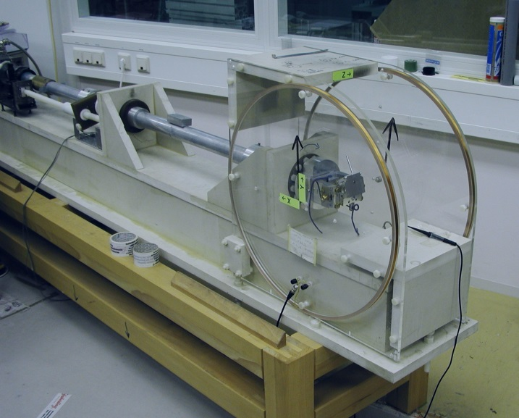
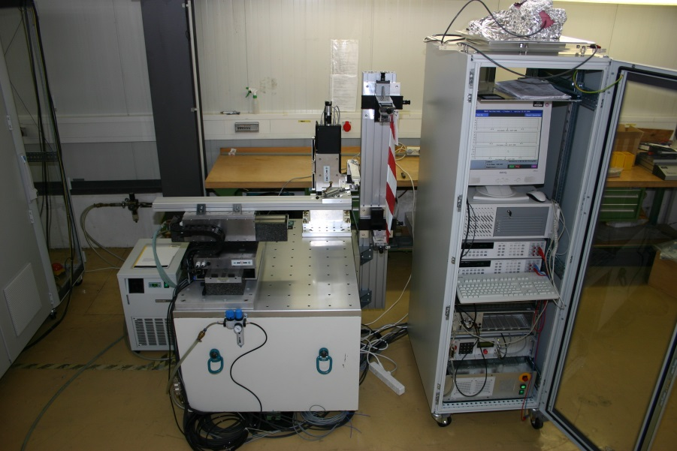
A) Magnet Block Characterization
characterization of dipole errors
(important for larger gaps)
reproducibility:
characterization of inhomogeneities
(important for small gaps)
reproducibility:
A-magnets: 2.0 x 10⁻⁴ Tmm
3.0 x 10⁻⁴ rel.
B-magnets: 1.5 x 10⁻³ Tmm
2.1 x 10⁻⁴ rel.
Automated Helmholtz coil system
Stretched wire system
Notes:
Alte Reproduzierbarkeiten: A 4e-4Tmm, B-magnets 2e-3Tmm, durch Temperatur dominiert?

Slide 32
B) Magnet Sorting
excellent agreement between predicted and measured fields integrals
for BESSY undulators UE52, UE49, UE112…
efficient sorting procedure
field integrals
longitudinal distribution transverse distribution
UE52
blue: prediction
from single block measurements
red: hall probe measurements
Notes:
Measurements and sorting well elaborated
Next step: transfer the knowledge to industry

Slide 33
C) Virtual Shimming
trajectory straightening and phase shimming
method: virtual shimming (VS): horizontal and vertical block movement
VS introduces additional phase dependent field integrals
field integrals as produced by virtual shimming
Unintended side effect:
phase dependent field integrals
as produced by virtual shimming
vertical movement (dy) horizontal movement (dz)

Slide 34
D) Application of Fe-Shims
shimming of phase dependent field integrals
method: Fe-shims with phase dependent response
phases,
dashed:
±λ/4
solid:
±λ/2
shim response of Fe-shims
on APPLE undulator magnets
field integrals before (top)
and after (bottom) shimming
J. Bahrdt et al, Nucl. Instr. and Meth,
in Phys. Res. A 516 (2004) 575-585

Slide 35
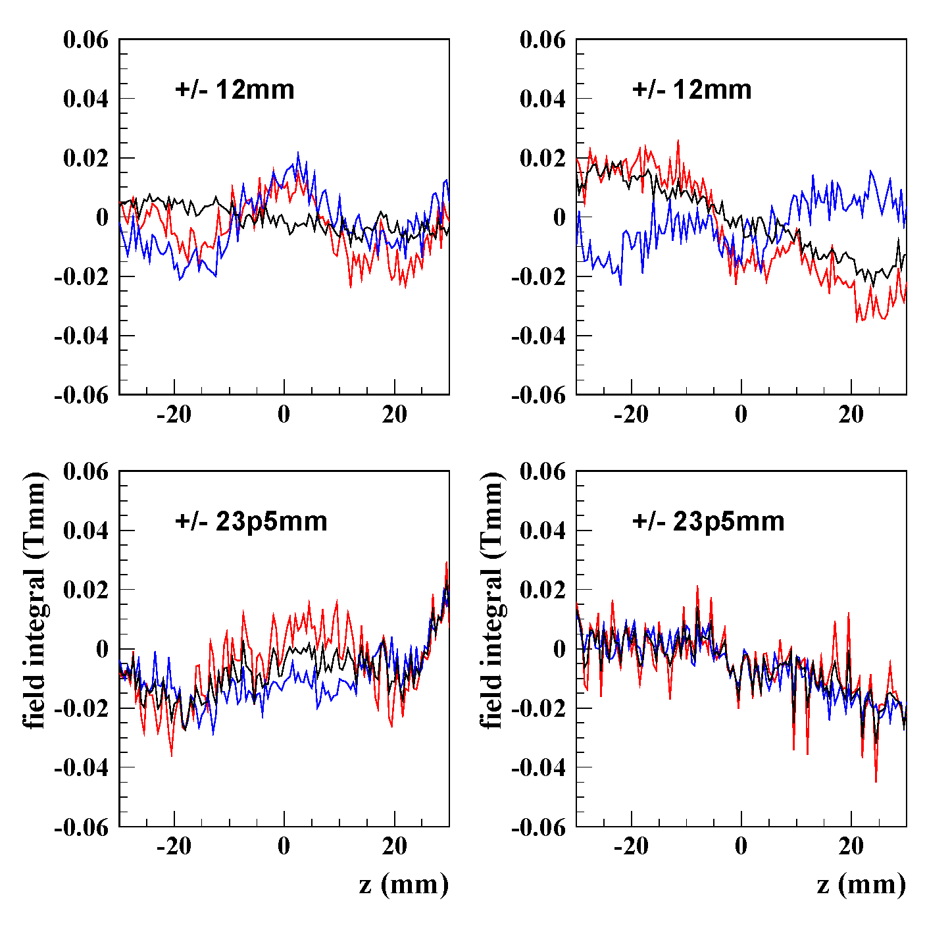
EMIL UE48 APPLE II
Phase Dependent Field Integrals After Shimming
Small phase dependent field integral changes
phase dependent terms
originate from non-unity
of permeanbility
plotted are the differences
with respect to zero phase

Slide 36
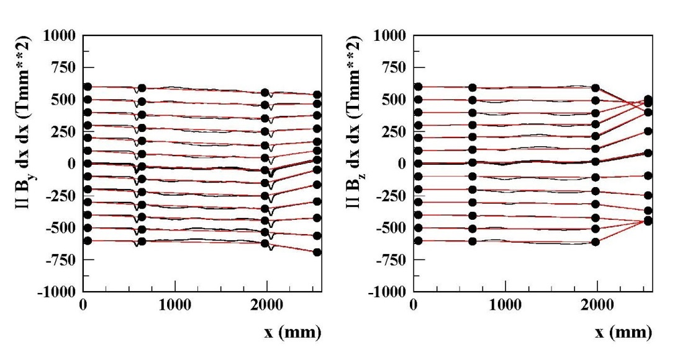
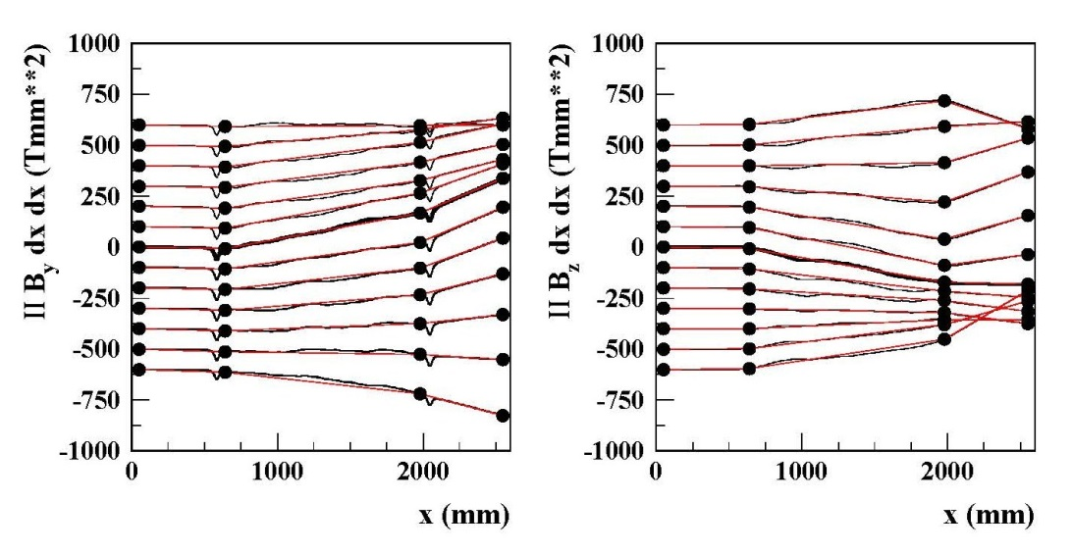
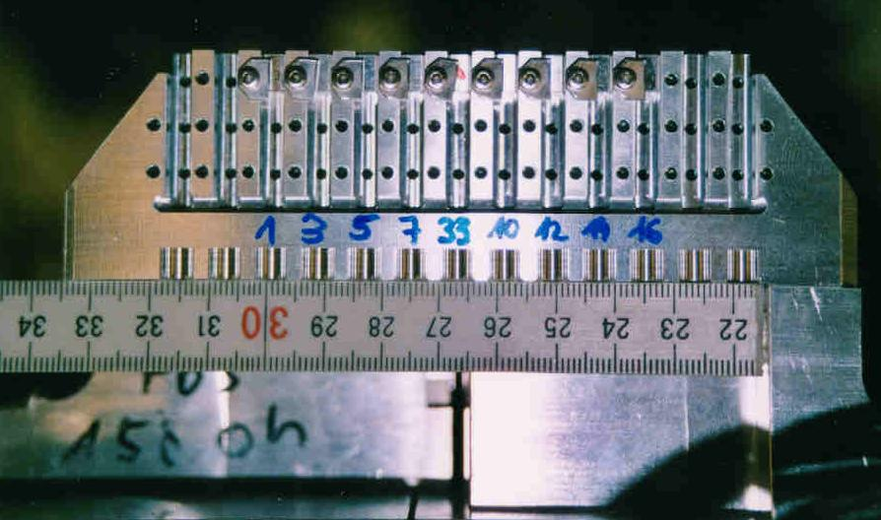
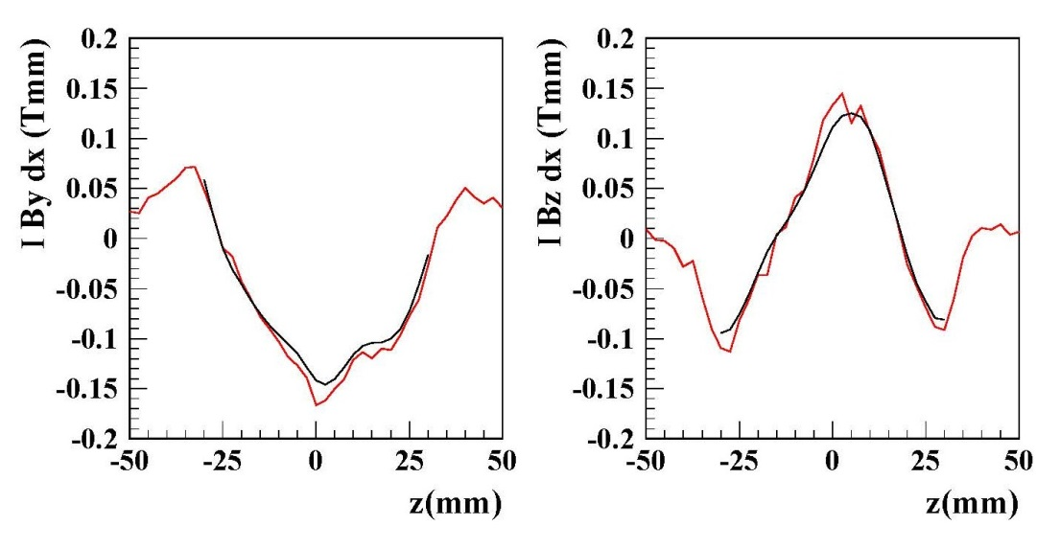
E) Shimming With Magic Fingers
EMIL UE48 APPLE II
vertical field HP-scans
horizontal field HP-scans
Magic finger
Downstream endpole unshimmed
Downstream endpole shimmed
vertical field integrals
horizontal field integrals
Red: difference of data
after and before shimming
Black: predict of shim magnet
array effect
36

Slide 37
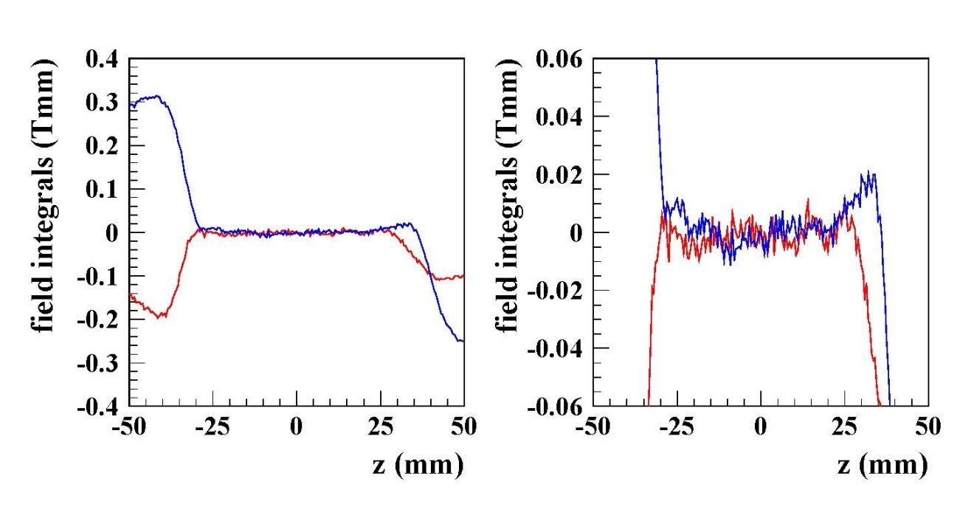
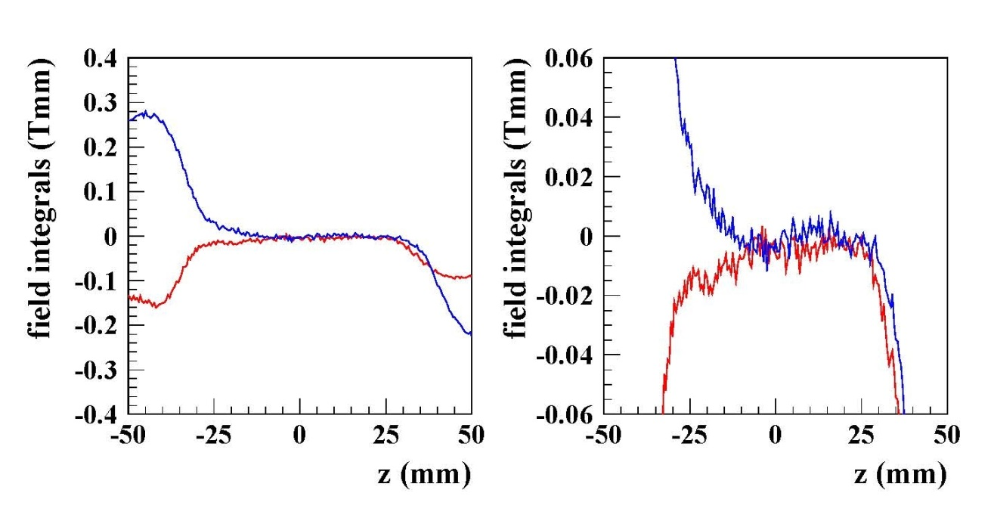
EMIL UE48 Static Field Integrals After Shimming
Small field integrals over a wide region
Gap 15mm
Red:
vertical field integhrals
Regular multipoles
Blue:
Horizontal field integrals
Skew multipoles
Gap 20mm

Slide 38
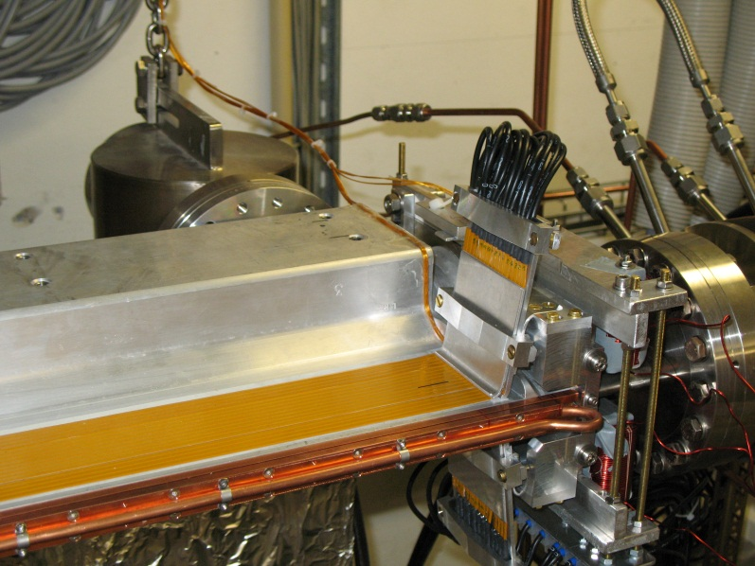
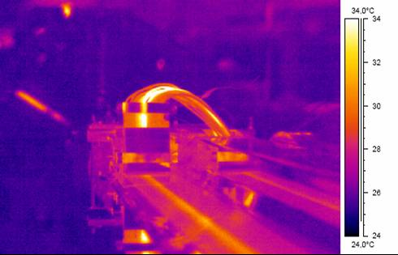
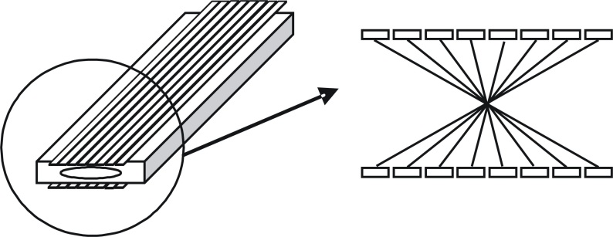
F) Active Shimming of UE112 with Flat Wires
2 x 14 wires, 14 power supplies
maximum currents: 16A
wire diameter: 3 x 0.3mm**2
wire separation: 4mm
Current settings for gaps of 20mm
24mm, 30mm and 40mm

Slide 39
UE112: Recovery of Injection Efficciency
Active shimming of the UE112 is essential for a top-up mode.
inclined mode: no alternative to active compensation
elliptical mode: improvement of passive shimming results
Wires compensate dynamic field integrals in plane
(enhancing their efefcts off-plane)
Notes:
Alignment: Hinweis auf Hein-Dieter Nuhn

Slide 40
Local Lattice Modifications

Slide 41
Short Period Small Gap Devices @ Storage Rings
Mini-beta section at NSLS: short period mini gap devices
Modification of storage ring optics for small gap devices
SPEAR3
DIAMOND
SOLEIL
BESSY II
Sophisticated arrangements of double undulators in one straight
independent users @ ESRF, DIAMOND, BESSY II
Femto Slicing @ BESSY II, SOLEIL, SLS / PSI, ALS
polarization switchng @ BESSY II, SLS / PSI

Slide 42
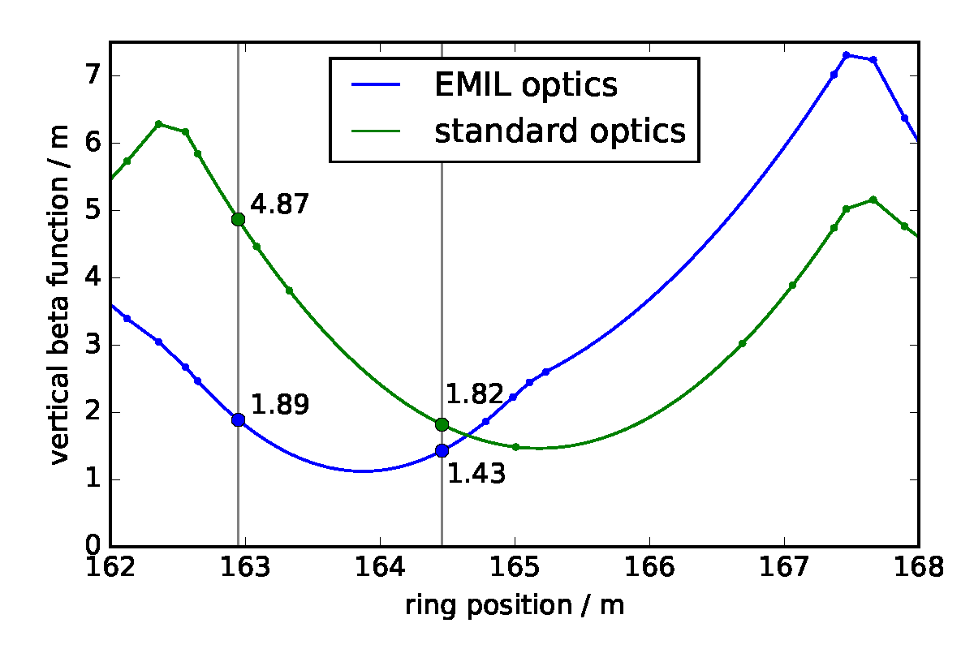
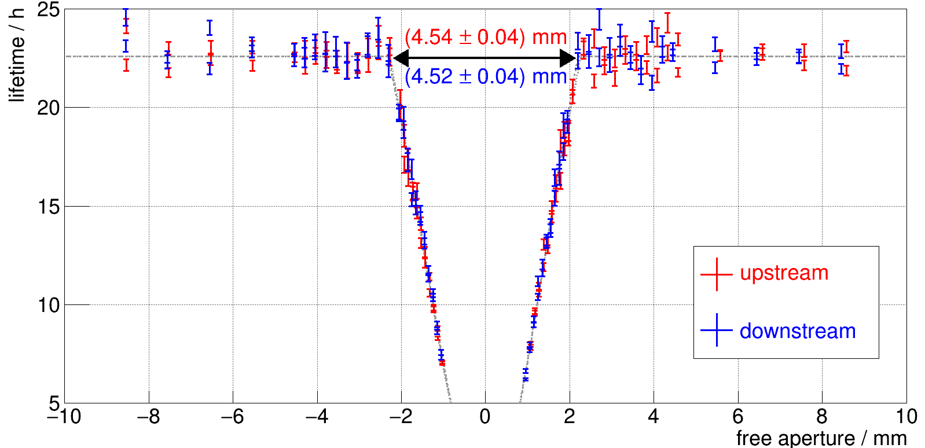
Local Lattice Modification for EMIL @ HZB
CPMU17 requires a physical aperture of 5mm
Lattice modification verified in April 2016
Asymmetric betatron-function as
fitted with LOCO
Data correspond to simulations
http://accelconf.web.cern.ch/AccelConf/IPAC2012/
papers/tuppp007.pdf
Vertical aperture of 4.54mm
as measured with 4 scrapers
in replacement chamber.
CPMU17 can be operated
at smallest gap of 5.5mm
with safety margin
IPAC2016: http://www.ipac16.org/proceedings/papers/thpow039.pdf

Slide 43
Undulator Technologies

Slide 44
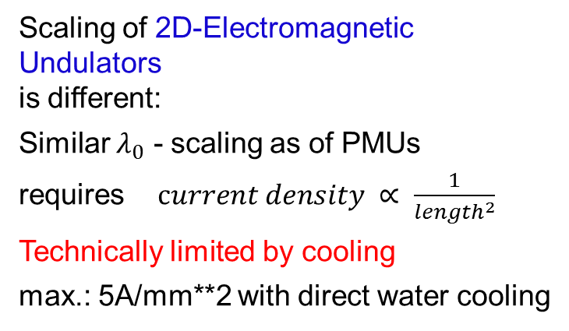
Room Temperature Electromagnetic Undulators
Scaling of Permanent Magnet Undulators
2D periodic structures, e.g. planar PMUs
with linear superposition (Halbach I)
$B=B_{0}e^{−π∙∆g/λ_{0}}$
with crosstalk between girders (Halbach II)
$B=B_{0}e^{\left(−a\left(\frac{∆g}{λ_{0}}\right)+{b\left(\frac{∆g}{λ_{0}}\right)}^{2}\right)}$
Peculiarity of PMUs: surface currents
typically 12kA/cm
independent upon scaling
Scaling of 2D-Electromagnetic Undulators
is different:
Similar $λ_{0}$ - scaling as of PMUs
requires $current density ∝ \frac{1}{{length}^{2}}$
Technically limited by cooling
max.: 5A/mm**2 with direct water cooling
Below $λ_{0}=65mm$at 15mm gap
K-parameter of ELMU drops below 2.5
reduced tuning capabilties

Slide 45
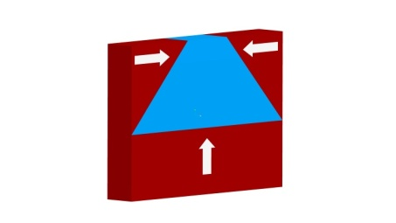
Comparison of Planar CPMUs and SCUs
CPMUs gain at short period lengths as expected
Black bullets: optimized magnet design of CPMU poles
J. Bahrdt, Y. Yvanyushenkov, Short period undulators for storage rings
and free electron lasers. J. Phys. Conf. Ser. 425, 032001-1-6 (2013). SRI, Lyon

Slide 46
PM-Material

Slide 47
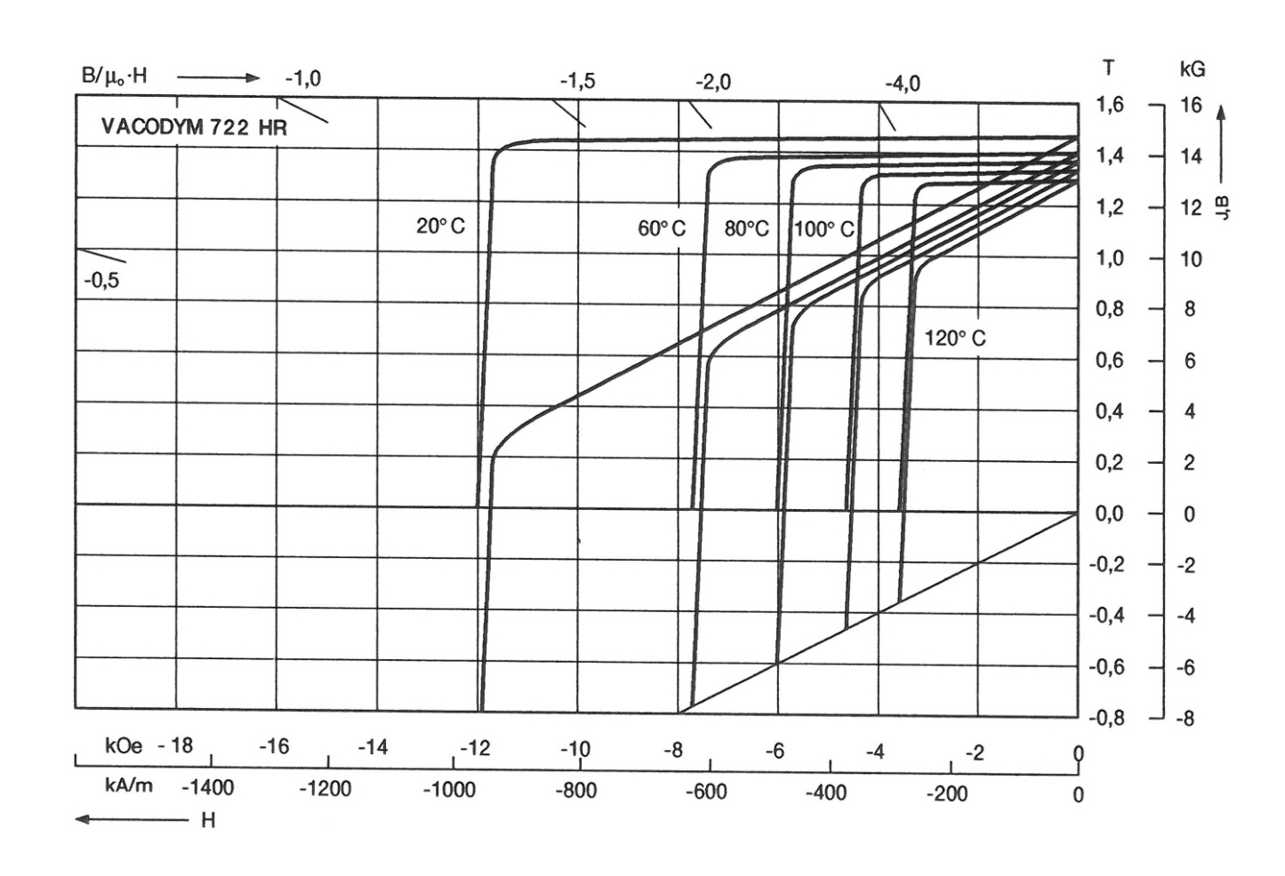
Magnet Material
Sintered or melt spun NdFeB magnets
High remanence
Nd₂Fe₁₇B
B_{r}=1.47 T (typical)
H_{cj}=11 kOe (minimum)
TK (B_{r}) =-0,115
TK (H_{cj})=-0,77
Vacuumschmelze, Data leaflet
DM - VACODYM/VACOMAX , 2007

Slide 48
Fabrication of Sintered Permanent Magnets I
Production process as developed by SUMITOMO
Courtesy of Vacuumschmelze

Slide 49
Fabrication of Sintered Permanent Magnets II
Courtesy of Vacuumschmelze

Slide 50
Pressing Technologies
H
Isostatically pressed magnets
Cold isostatic pressing CIP
Rubber isostatic pressing RIP (M. Sagawa)

Slide 51
Magnet Material Development I
Remanence
Current status:
ρ/ρ₀ > 0.995, is achieved with the so-called liquid phase sintering
f_{φ} > 0.98, high alignment factor, sophisticated timing during pressing
Non-magnet particles typical < 4%
Example: energy product of Nd₂Fe₁₄B
Theory: 509 kJ/m^3 Achieved: 469 kJ/m^3
Not much space for improvement for known materials
Coercivity H_{cj} still one order of magnitude below theory
„Brown‘s paradoxon“

Slide 52

Magnet Material Development II
Grain Boundary Diffusion (GPD)
Known already for 10 years, now commercially avalilable
Coating of magnets with Dy or Tb
Heating the magnets to 800-900 degrees
Fast diffusion of Dy in liquid phase
Slow diffusion from boundary into the bulk
Establishing highly enriched Dy shells around grain bulk
Concentration
Penetration depth of Dy about d = 2.2mm
Extremely useful for
high end small period devices
$$ΔH_{cj}=Ae^{−x^{2}/d^{2}}$$
H. Nakamura et al., J. Phys. D:
Appl. Phys. 44 (2011) 064004-1-5.
PrFeB samples before / after GBD
Courtesy of Vacuumschmelze

Slide 53
Halbach Type Undulators and Wigglers
Periodic magnet structure with field B and period length λ₀
Constructive interference for the wavelength given by
Halbach I: pure permanent magnet
Halbach II: permanent magnet + Fe-pole
L
y
g
ελ₀/M
x
g
M=4
with M=no of magnets / period, ε=filling factor
K. Halbach, Nucl. Instr. and Meth. 187 (1981) 109-117.
“One-sided fluxes -- A magnetic curiosity?”
J. Mallinson, Magnetics, IEEE Transactions on
Vol. 9, No. 4 (1973) pp 678 – 682.
Field parametrization:
P. Elleaume et al., Nucl. Instr.
and Meth. in Phys. Res. A
455 (2000) 503-523

Slide 54
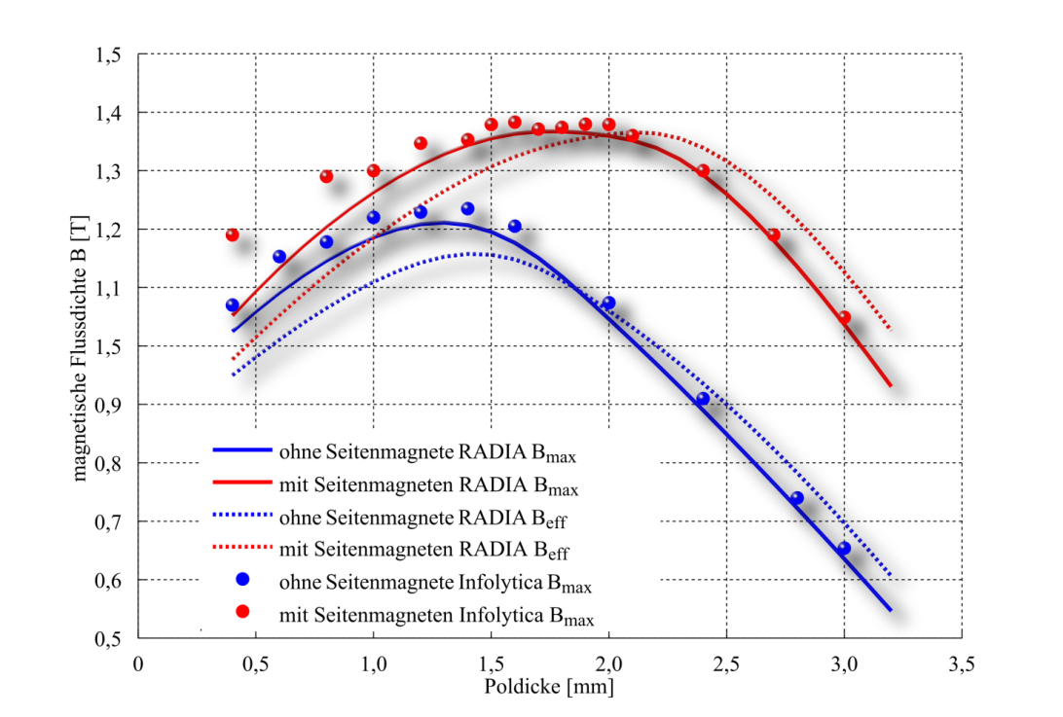
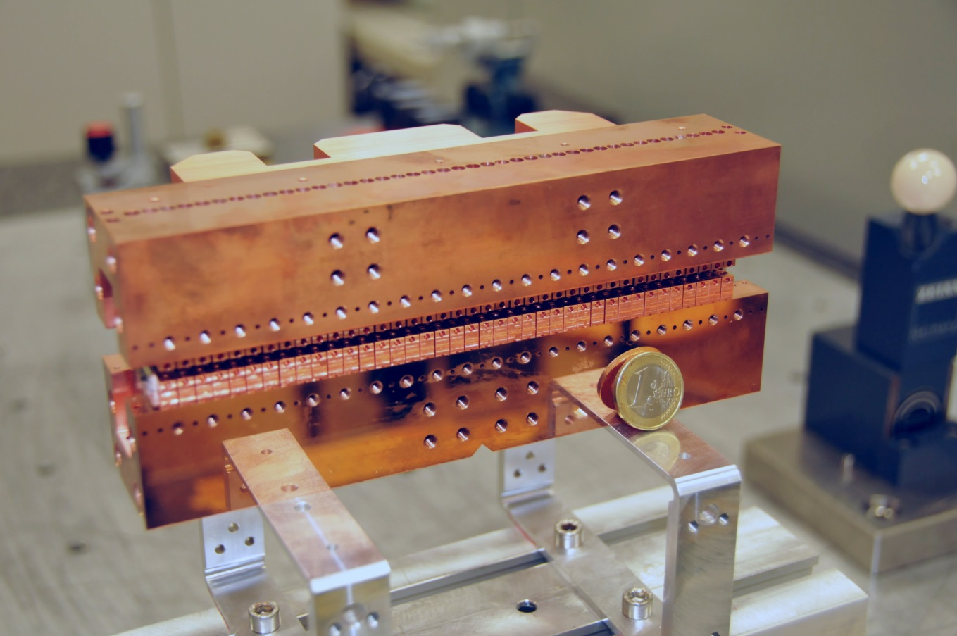
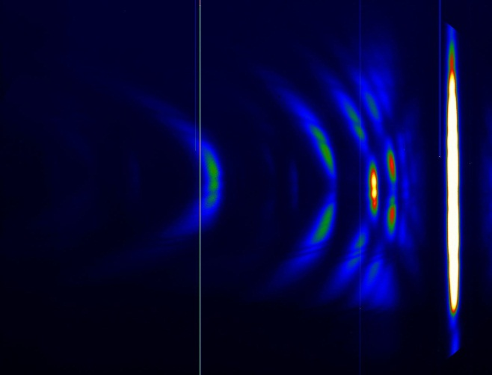
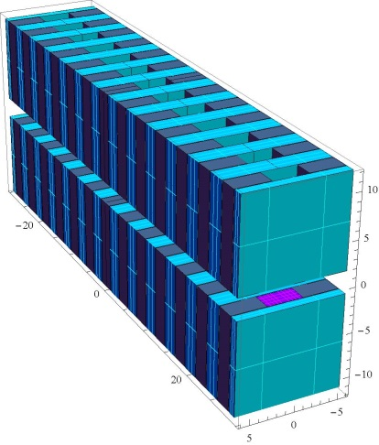
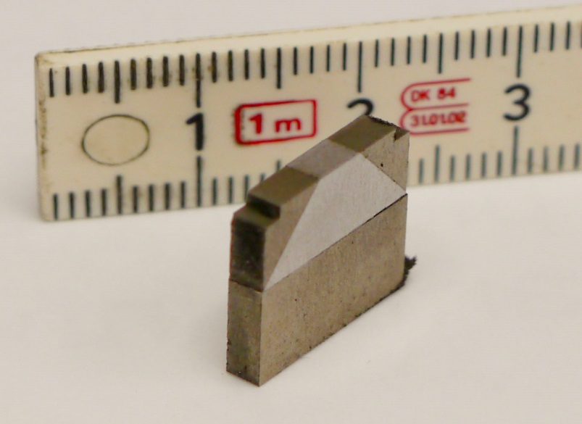


Pushing the Field with Shaped Poles and Additional Side Magnets
minimum dead layer (9µm)
TiN coating (3-4µm)
tight shape tolerances (<10µm)
small air gaps (10-20µm)
Operation
@ MAMI
Conventional Halbach II structure
9mm period, 20 periods, 2.5mm gap
Notes:
rechts oben width = 6mm
rechts unten width = 4mm

Slide 55

Cryogenic Peramanent Magnet Undulators
Advantage of Cryogenic Undulators:
gain in remanence, larger tuning range for short period IDs
stability recovered at low temperatures
less sensitive to thermal variations of magnetic properties
Advantage of PrFeB Undulators:
no spin reorientaion at 135K
cooling with liquid N₂, no heater
gain in stability (coercivity)
Crystal Energy of NdFeB
$$E=K_{1}\sin^{2}\left(θ\right)+K_{2}\sin^{4}\left(θ\right)$$
K. Üstüner et al., 20th Conference on REPM, Crete 2008
Heat capacity

Slide 56


First In-Vacuum Undulators
1987, BESSY, Gudat et al.
magnets still encapsulated
1990, KEK, Kitamura et al.
magnets in vacuum, coating

Slide 57


Cryogenic Undulator Projects at HZB
CPMU 15 built @ HZB
for University Hamburg / DESY
CPMU17 built @ HZB for EMIL BESSY II
Notes:
Assembly is critical (at least in summertime)

Slide 58





Planar Linear Superconducting (SC) Undulator
APS Prototype
SC magnet
He fill/vent turret
LHe vessel
LHe piping
20 K radiation shield
SCU0
$$λ_{0}=16mm$$
21 periods
60 K radiation shield
Beam chamber
Beam chamber
thermal link to cryocooler
Courtesy of Y. Ivanyushenkov, APS
Installed:
SCU1: $λ_{0}=16mm$, 72 periods, 2m cryostat
Future plans:
SCU2: $λ_{0}=16mm$,144 periods, 3m cryostat

Slide 59

The First Helical SCUs
Helical Undulator for FEL at 10.6μm
λ₀= 32mm, 2.4kG, total length 5m, no iron
Helical undulator at Novosibirsk
Maximum Field (kG) | 4.7
Yoke | ARMCO
Number of periods | 8
Period length (cm) | 2.4
Maximum current (A) | 428
Length (cm) | 20
Aperture (cm) | 1.8
Elias et al., Phys. Rev. Lett., Vol 36 (1976) 717-720
A. Anashin, G. Kezerashvily, A. Lysenko,
E. Perevedentsev, Y. Shatunov.,
BINP Preprint 84-111 (1984).
G. Kezerashvily, Nucl. Instr. and Meth.
A314 (1992) 15.

Slide 60



ILC Prototype Undulator
Courtesy J. Clarke
Undulator to be made of 4m long modules
containing 2 x 1.75m helical undulators

Slide 61
In-Vacuum Magnetic Field Measurement Techniques

Slide 62



In-Vacuum Hallprobe Measurement Bench
 | Feed back off | Feed back on
Yaw | 170 µrad | 14 µrad
Pitch | 42 µrad | 11 µrad

Slide 63





Cable Qualification
Teststand
1 single wire damage
after 150.000 cycles
CuBe-sheet damage
after 200.000 cycles
Cable tray long term test:
3 cables, 26 wires each
Resistance monitoring
for damage indication
IPAC2016: http://www.ipac16.org/
proceedings/papers/thpow038.pdf

Slide 64


In-Vacuum Moving Wire
Vacuum chamber not installed
Noise is factor of three larger than for existing HZB-system
Partly due to huge field integrals (0.8 Tmm) and
corresponding sensitivity upon wire vibrations

Slide 65
Summary
Accurate simulation of synchrotron radiation properties
Interaction with electron beam
Field tuning for spectral performance & smooth operation
Undulator design and technology
  Short periods, IVU, SCU
  Polarization control
  On-axis power reduction
  Higher order suppression (quasi periodic)
  Field measurement & shimming

