Slide 1


Tutorial 3: Low Level RF Control Systems
Sven Pfeiffer (DESY)

Slide 2
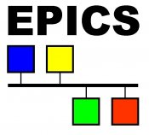


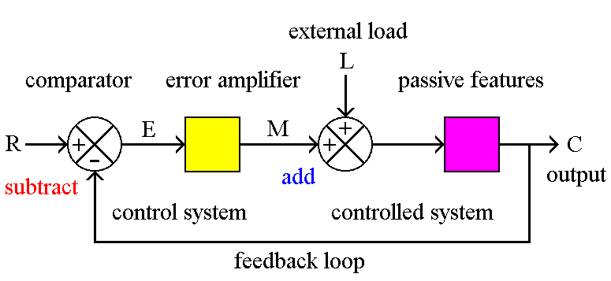

Tutorial 3: Low Level RF Control Systems
This tutorial is not about middleware (control systems)
Sven Pfeiffer (DESY)
Outline:
Introduction/Motivation
System Description
System Modelling
Feedback Controller Design
Examples
www.aps.anl.gov/epics
http://www.tango-controls.org/
http://tesla.desy.de/doocs/index.html
http://www.visaut-solutions.de/
etc…..
→ Talk: M. Killenberg (Control system independent software development)
http://ecetutorials.com/control-systems/

Slide 3
1. Introduction/Motivation
LLRF and Feedback
Examples: ERL and FEL
Basic LLRF components
Disturbances and Noise - Fast and Slow Distortions

Slide 4
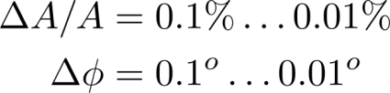
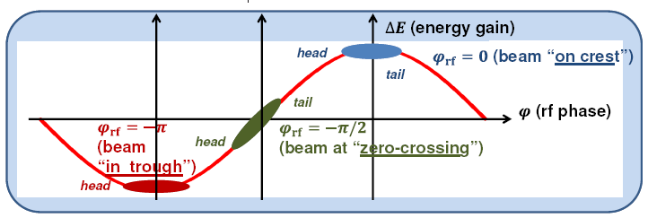

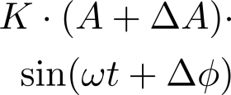

LLRF Controls and Feedbacks
“Bunch Compressor Properties”
Typical RF stability values:
Energy gain
Energy spread
Bunch Length Compressors, S. Di Mitri, CAS 2016
Electron beam
Cavity
~
Actuator
Low power ~V
High power ~MW
Master Oscillator
Amplifier
Sensor
LLRF Controller
(analog or digital)

Slide 5

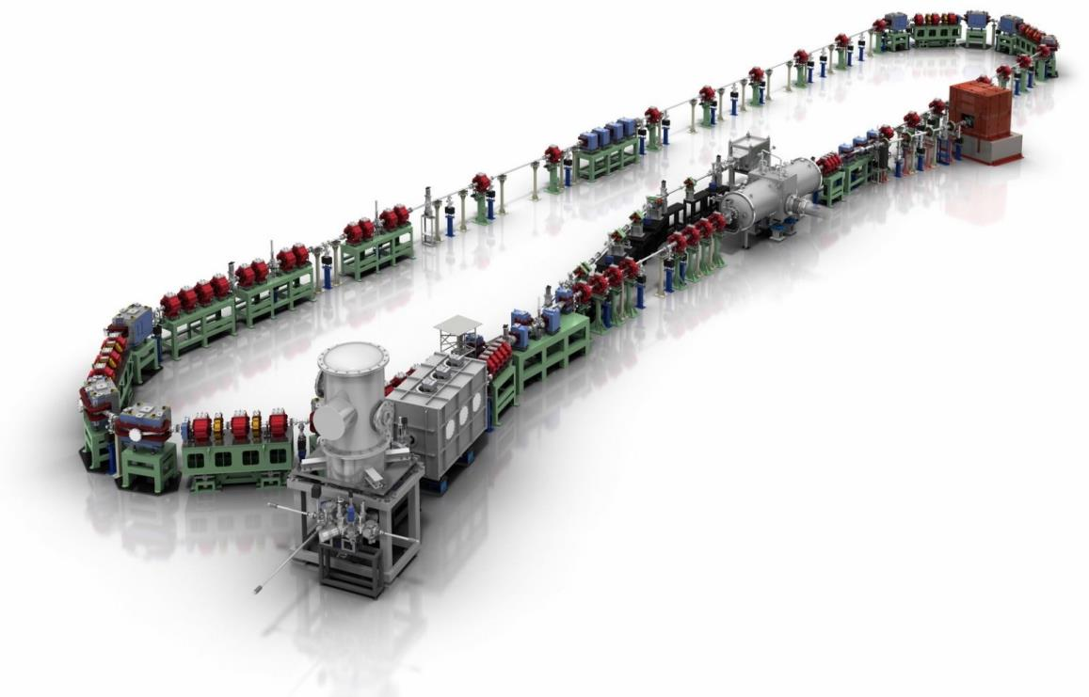
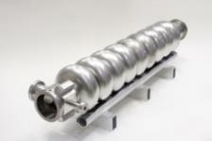
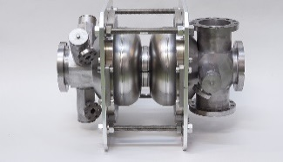
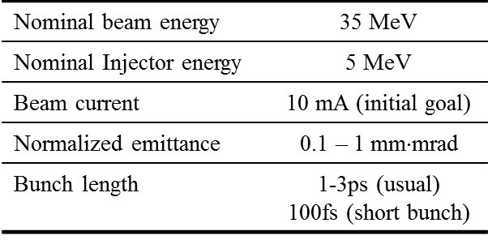
Example 1: Energy Recovery Linac (ERL)
Compact ERL @ KEK [Nakamura2014, Miura2015]
Constructed as a test facility of a 3-GeV ERL future plan.
The commissioning has been started from 2013.
→ Continuous wave mode (CW)
Beam Dump
Circumference ~ 90m
Main LINAC
9-cell SC cavity x 2
Q_{L} = 1× 10⁷
Marger
Injector LINAC
RF frequency= 1.3 GHz
Design parameters of the cERL
©Rey.Hori/KEK
2-cell SC cavity x 3
Photocathode DC gun
Q_{L} = 5×10⁵
NC Buncher
Q_{L} = 1.1×10⁵

Slide 6
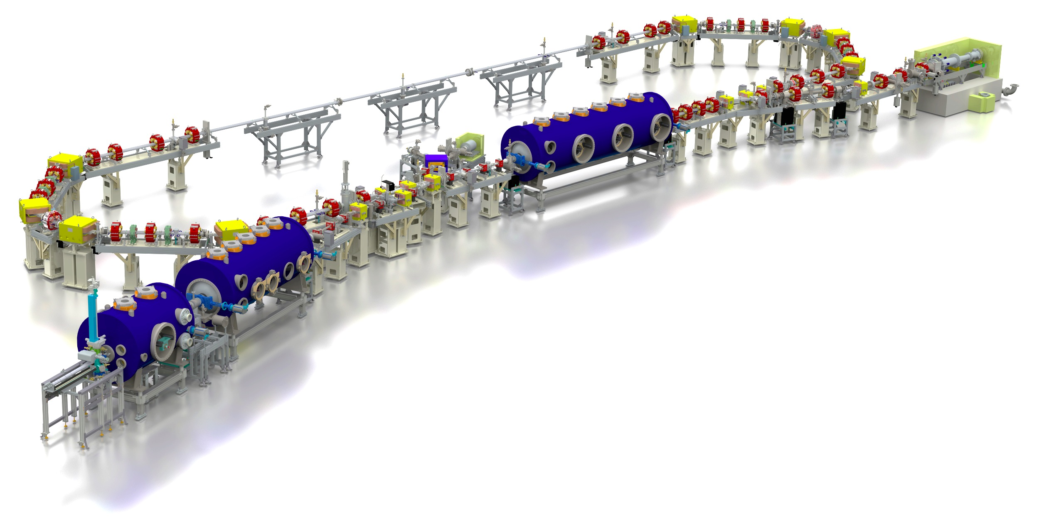

Example 2: Energy Recovery Linac (ERL)
bERLinPro = Berlin Energy Recovery Linac Project
100 mA / low emittance technology demonstrator (covering key aspects of large scale ERL)
test and diagnostic line
(5mA@10MeV dump,
energy & slice diag.)
beam dump
6.5 MeV, 100 mA
= 650 kW
linac module
3 x 7 cell srf cavities
44 MeV
merger
dogleg
modified Cornell booster
3 x 2 cell srf cavities
4.5 MeV
srf-gun
1.4 cell srf cavities
1.5-2.3 MeV, single solenoid,
 | Basic Parameter
max. beam energy | 50 MeV
max. current | 100 mA (77 pC/bunch)
normalized emittance | 1 μm (0.5 μm)
bunch length (straight) | 2 ps or smaller (100 fs)
rep. rate | 1.3 GHz
losses | < 10⁻⁵
Courtesy: Andreas Jankowiak, Concept of Energy Recovery Linacs, CAS2016, Hamburg, 04.06.2016

Slide 7
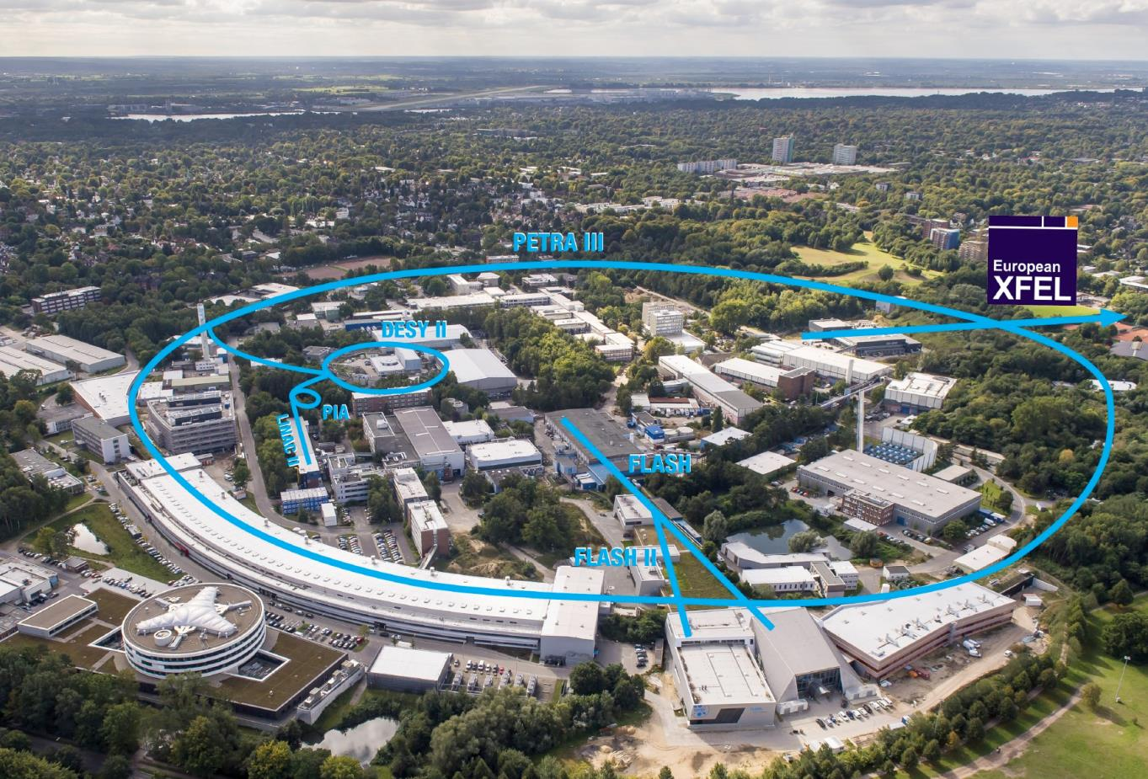
Example 2: Free-Electron Laser (FEL)
© DESY 2015

Slide 8
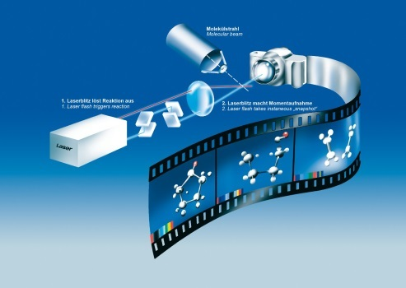
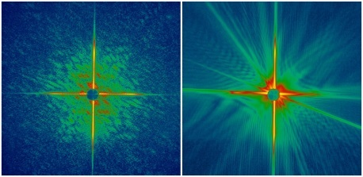
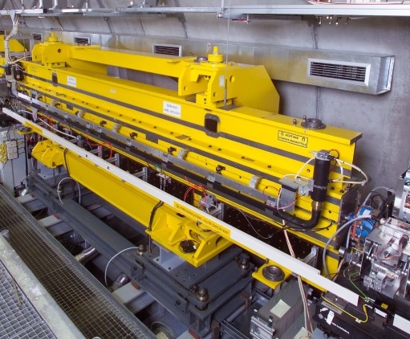
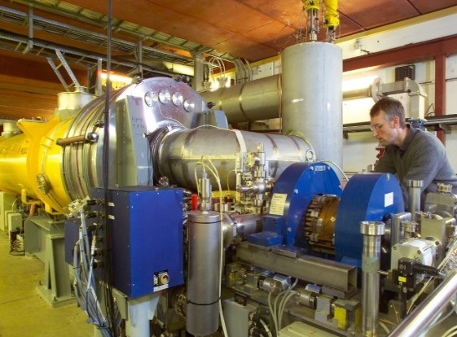
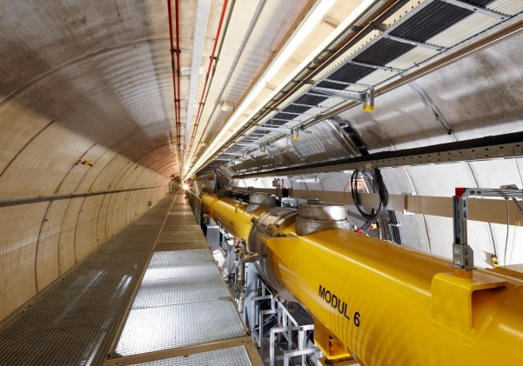
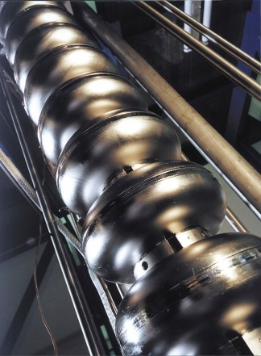
Free-Electron-LASer in Hamburg (FLASH)
Operated at 10 Hz (100 ms)
Pulse length ~ 1ms
→ 1% duty cycle
Max. 1.2 GeV beam energy
Wavelength > 4.1 nm
NRF gun (Q_{L} = 1.2⋅10⁵)
Klystron with 5 MW input power
SRF cavities (Q_{L} = 3⋅10⁶)
Klystron with 5/10 MW input power
R56=180mm
R56=43mm
Gun
ACC1
3rd
ACC2
ACC3
ACC4
ACC5
ACC6
ACC7
FLASH 1
BC2
BC3
Laser
FLASH 2
315 m

Slide 9
Example ERL and FEL Parameters
Compact ERL @ KEK
FLASH @ DESY
Photocathode DC gun
NRF Buncher
Q_{L} = 1.1⋅10⁵
SRF cavities
Q_{L} = 4.8⋅10⁵ ... 1.3⋅10⁷
Driven by SSA, Klystron, (IOT)
1 Amplifier per cavity
→ single cavity regulation
NRF gun
Q_{L} = 1.2⋅10⁵
SRF cavities
Q_{L} = 3.0⋅10⁶
Driven by Klystron
1 amplifier for RF gun
→ single cavity regulation
1 amplifier per 8/16 cavities
→ multi-cavity regulation
Operated in Continuous Wave (CW)
High beam loading (10’s of mA)
100mA @ bERLinPro
Operated in Short Pulse (SP)
Moderate beam loading (mA)
Goal of LLRF Controls and Feedback:
Stabilize certain properties/values to high performance
Being able to measure the quantities

Slide 10

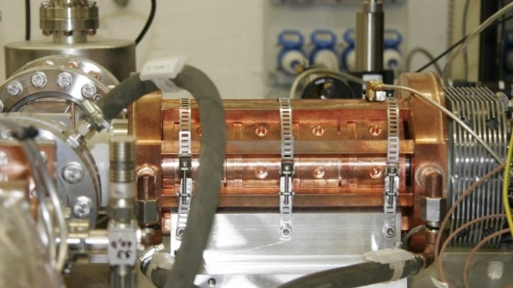
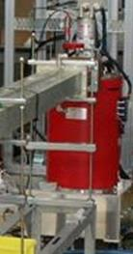
Basic LLRF Components in an RF field Feedback Loop
newsline.linearcollider.org
Plant: Series connection of components
Amplifier (Klystron, Solid State Amplifier (SSA), …)
Cavities (normal- or superconducting – NRF or SRF)
Pre-amplifier etc…
Sensor: Ability to measure signal to be controlled
Pick-ups, antenna, magnetic loop, …
Controller: Processing unit
Analog (resistor, capacitance, operational amplifier, logic blocks, …)
Digital (Microcontroller, DSP, FPGA,…)
LLRF'15, Shanghai, Nov 3-6, 2015 (T. Miura)
reference
error
Controller
input
Plant
output
Sensor
measurement

Slide 11

(LL)RF Applications
Linear or circular machines
Normal-/superconducting RF systems
RF field frequency
Typical in accelerators: MHz … tens of GHz
CW – Continuous Wave
Continuous RF field
Duty factor 100%
Pulsed Mode
Certain amount of time is useable for beam acceleration
LP – Long Pulse Mode
DF 10% - 50%
SP – Short Pulse Mode
DF 1 %, e.g. 1ms on, 99ms off
Amplitude
Time
Pulse duration
Amplitude
Time
Repetition rate

Slide 12
Disturbances and Noise - Fast and Slow Distortions
Disturbance to plant input - d_{u}(t)
DAC, vector modulator, temperature & humidity (PCB)
Disturbance to plant - d_{P}(t)
Pre-amplifier, Klystron, HV modulator, cavity length (motor tuner or water regulation), Beam (beam loading and multi bunch effects)
Noise – n(t)
ADC distortions, noise, quantization noise, temperature & humidity (PCB)
Other:
Aging, switching in electronics (e.g. fans), ground motion and vibrations, faults in devices and components, thermal heating within macro-pulse, …
Electromagnetic interference (EMI)
Drifts
Electronics
Synchronization system
Timing distribution
d_{P}(t)
d_{u}(t)
Plant
d_{y}(t)
r(t)
e(t)
Controller
u_{i}(t)
u_{r}(t)
Pre-Amp,
Klystron,…
Cavity
y_{i}(t)
y_{r}(t)
Delay
n(t)

Slide 13
2. System Description for RF Field Control Loop
Sensor (RF detection)
Actuator (RF manipulation)
Amplifier
Cavity
Energy gain
Energy spread
Electron beam
Cavity
~
Actuator
Master Oscillator
Amplifier
Sensor
LLRF Controller
(analog or digital)

Slide 14
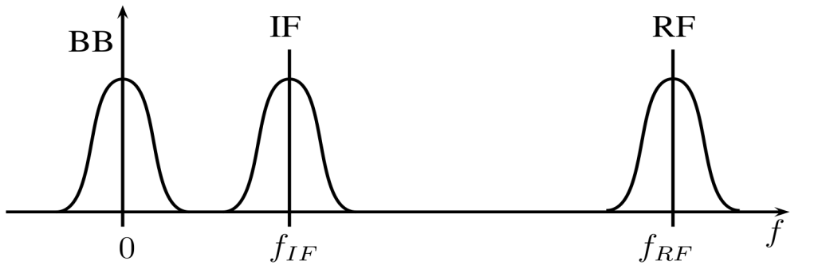
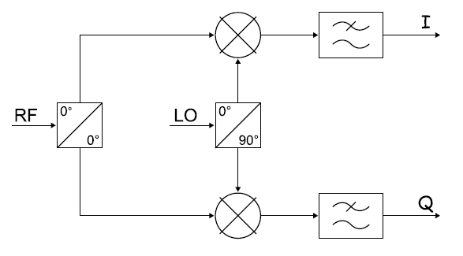
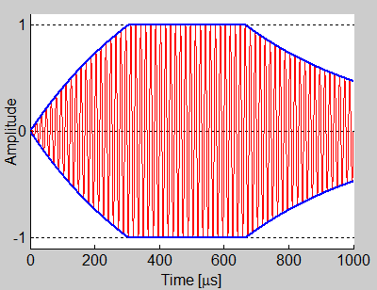
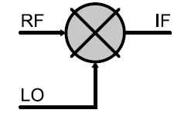

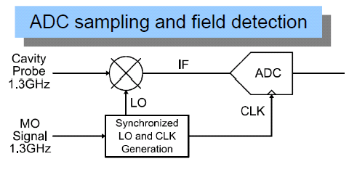
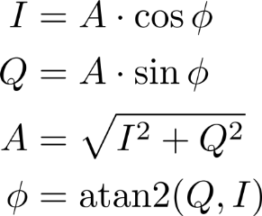
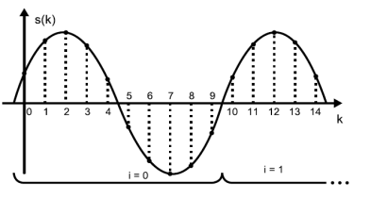

RF detection
Details → see backup slides
Baseband sampling (RF → BB)
Down-conversion from RF → IF → BB
e.g.:
f_{RF} = 1.3 GHz
f_{IF} = 54 MHz
LO split by hybrid
I/Q sampled by 2 ADCs
[Hoffmann.2008]
RF signal
Q
Phasor diagram
$$\vec{V}$$
Sensor
I
Envelope of RF signal
data processing
e.g. LLRF Controller
I/Q pair as amplitude and phase information w.r.t. MO signal

Slide 15
RF Field Control Loop
Sensor (RF detection)
Actuator (RF manipulation)
Amplifier
Cavity
Energy gain
Energy spread
Electron beam
Cavity
~
Actuator
Master Oscillator
Amplifier
Sensor
LLRF Controller
(analog or digital)

Slide 16

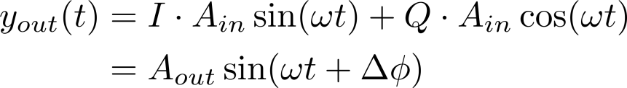
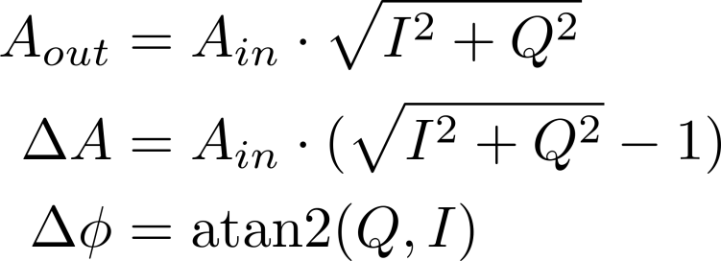

RF field manipulation
Up conversion using vector modulator
MO signal split to 0º and 90º
VM with bandwidth usually tens of MHz (>> cavity BW)
~
Actuator
Master Oscillator
Notes:
Aout = Ain + dA = Ain*sqrt(I^2+Q^2) → dA = ….
Can be also from BB → IF → RF

Slide 17
RF Field Control Loop
Sensor (RF detection)
Actuator (RF manipulation)
Amplifier
Cavity
Energy gain
Energy spread
Electron beam
Cavity
~
Actuator
Master Oscillator
Amplifier
Sensor
LLRF Controller
(analog or digital)

Slide 18
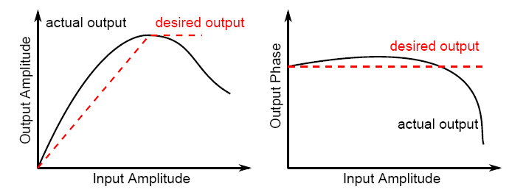
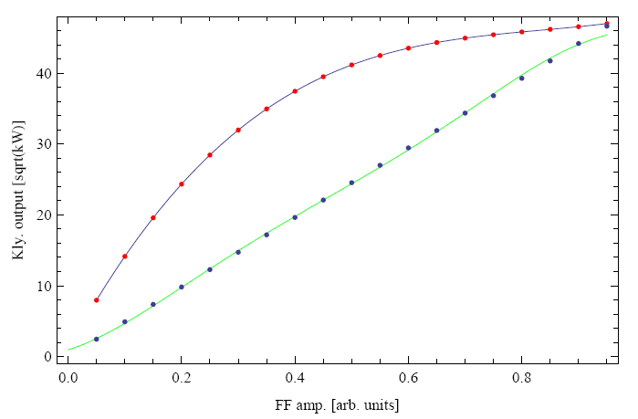
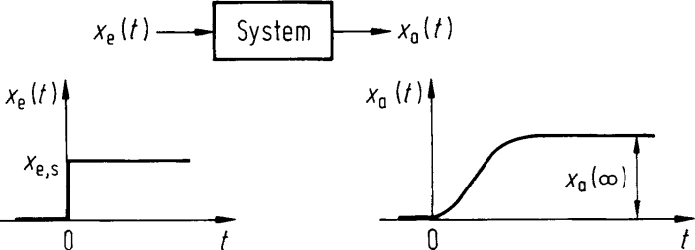
Amplifier Example: Klystron
Non-linear behavior in amplitude (e.g. saturation at max. output) and phase
Linearization of static characteristic curve
Bandwidth usually tens of MHz (>> cavity BW)
Characterization
Linearization
Output amplitude and phase is function of input amplitude
Output
Amplifier
Input
Examples: See PhD Thesis M. Omet, KEK, 2014
http://www-lib.kek.jp/cgi-bin/kiss_prepri.v8?KN=201424001&OF=8.

Slide 19
RF Field Control Loop
Sensor (RF detection)
Actuator (RF manipulation)
Amplifier
Cavity
Energy gain
Energy spread
Electron beam
Cavity
~
Actuator
Master Oscillator
Amplifier
Sensor
LLRF Controller
(analog or digital)

Slide 20
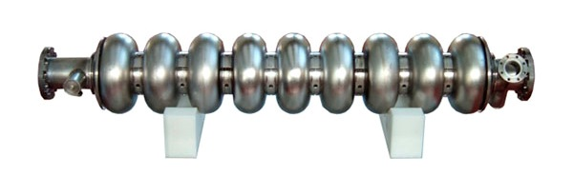
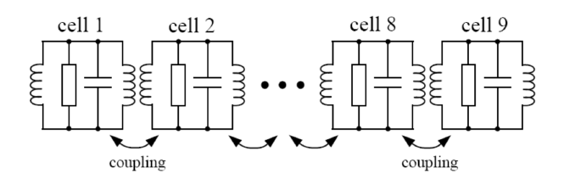
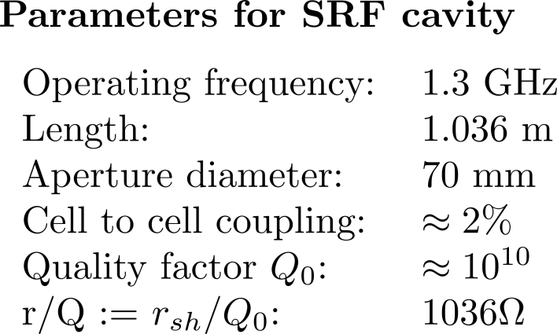
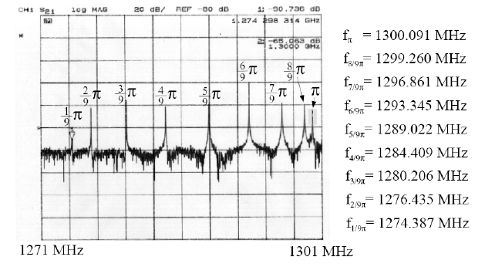
Example: 9 Cell SRF Cavity
[Schilcher.1998]
http://tt.desy.de/desy_technologies/accelerators_magnets_und_cryogenic_technologies/weld_free_cavity/index_eng.html
Modelled with 9 magnetically coupled resonators (RCL circuits)
Pi mode is used for acceleration (TM010 mode)
8pi/9 mode only 800kHz separated from operating frequency → may influence accelerating field stability
Mechanical model is neglected at this point, see example at the end

Slide 21
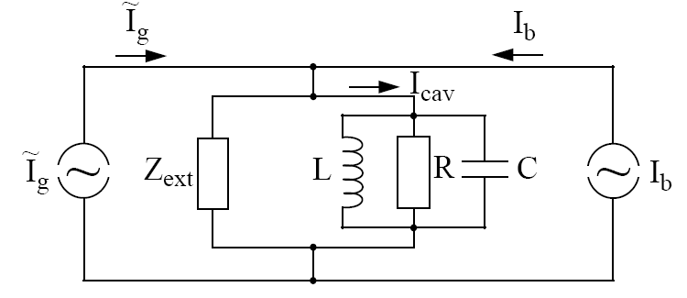
From RCL circuit to cavity characteristics
http://tt.desy.de/desy_technologies/accelerators_magnets_und_cryogenic_technologies/weld_free_cavity/index_eng.html
RCL circuit equations need to be mapped to measurable cavity parameters (bandwidth, shunt impedance, quality factor etc.)
Start with high frequency modelling
End with baseband model required in LLRF control scheme with down-conversion
Consider only 1 RCL circuit
(as simplification)

Slide 22
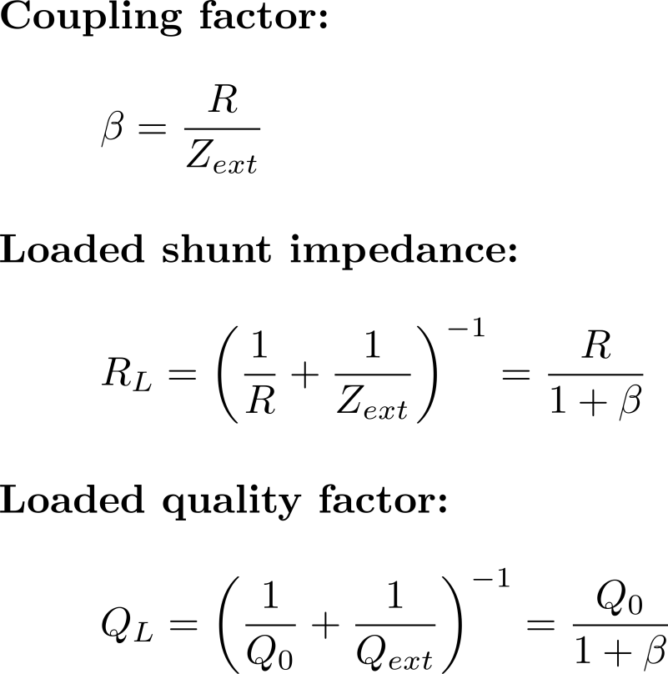
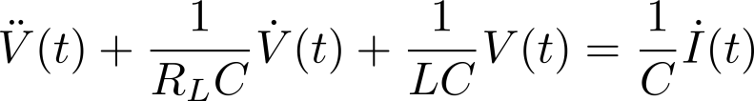
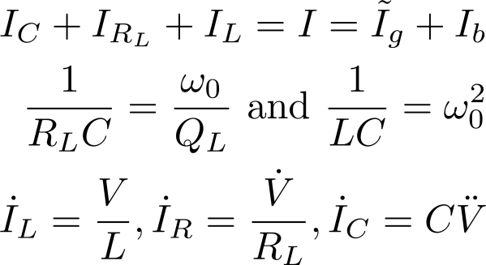
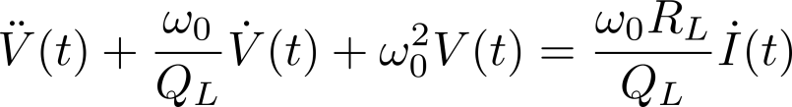

From RCL to differential cavity equation
RCL circuit Cavity characteristics
V
Differential cavity equation with harmonic RF driving term

Slide 23
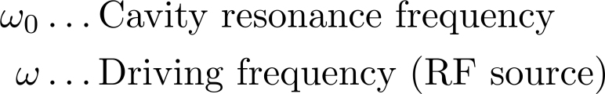



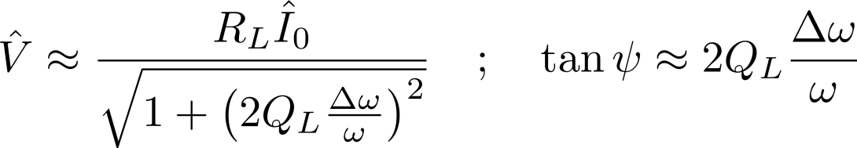
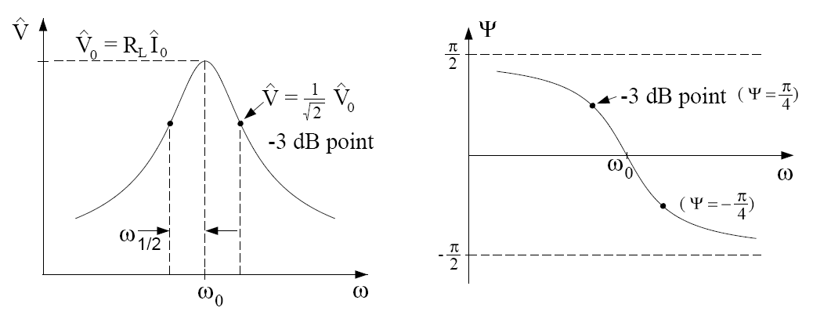
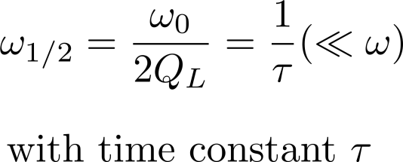
Differential cavity equation
Solution for input signal
(RF source) is given as cavity properties with approximation for high Q cavities :
Cavity detuning
Tuning angle
Angle between driving current and cavity voltage
Steady state amplitude and phase of cavity signal with respect to the RF source
Half cavity bandwidth
Notes:
QL(w0/w – w/w0) = QL ((w0^2 – w^2) / w*w0) = QL(w0-w)(w+w0)/w*w0 = QL(dw)2w/w^2 = 2*QL dw/w

Slide 24
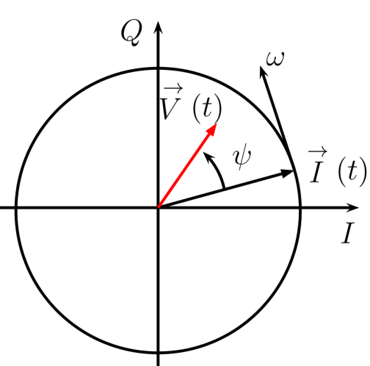
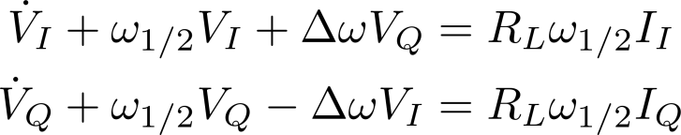

Cavity baseband model
The high (carrier) frequency cavity model is not of our interest for studying the cavity response under feedback operation; we are interested at the baseband model (envelope of RF signal)!
Separation of fast RF oscillations from the slowly changing amplitude and phases of the field vector
I… in-phase (real)
Q… quadrature (imaginary)
First order cavity differential equation for envelope, i.e. the cavity baseband equation:
As short hand notation with complex vector field:
Remove fast changing part!
Phasor diagram

Slide 25
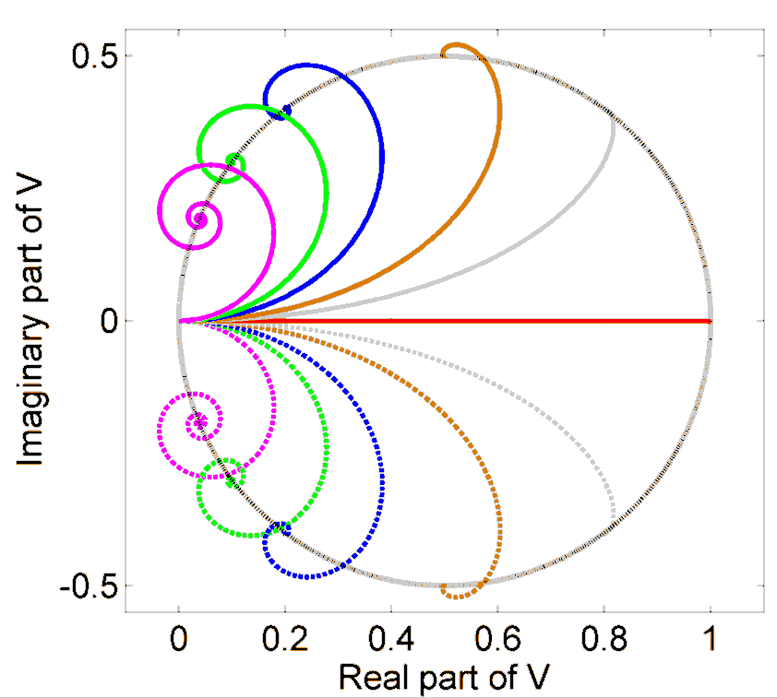
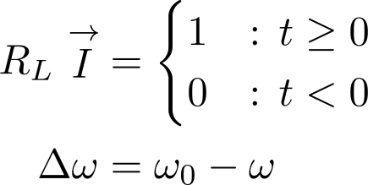
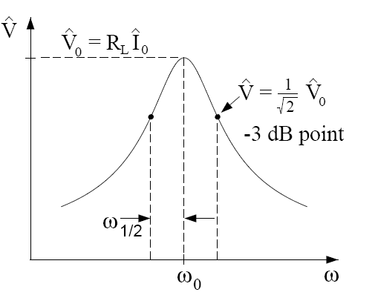
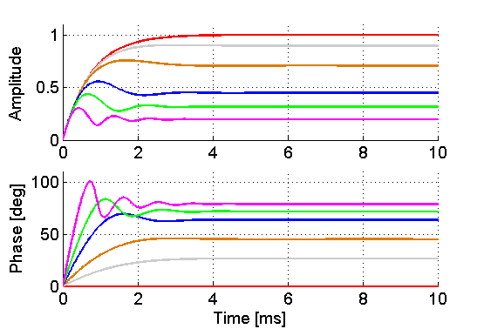

Step response

Slide 26




Additional Passband Modes
Short outline, for details, see [Schilcher.1998] and [Vogel.2007]
n-th mode:
Cavity field is the sum of all passband contributions
For variation in the coupling and loaded quality factor see e.g. [Vogel.2007]

Slide 27
Summary System Description
RF field detection
Down-conversion to baseband (envelop of HF signal)
Direct A/P sampling nowadays possible (high speed ADCs)
→ May worsen SNR of ADC
Preferred method depends on your application
RF field manipulation
Up-conversion from baseband to HF
Bandwidth in tens of MHz range
Amplifier (Klystron)
Mostly non-linear input/output behavior → Linearization desired
Bandwidth in tens of MHz range
Cavity (9-cell SRF cavity)
Differential equation as baseband model
Bandwidth (Hz … kHz), detuning and higher order modes

Slide 28

System Overview – Example at FLASH
Several RF stations
System description will differ (uncertainties, couplings etc.)
→ System identification/modelling ideally with input u(t) and output y(t)
Energy gain
Energy spread
Electron beam
Cavity
~
Actuator
Low power ~V
High power ~MW
Master Oscillator
Amplifier
Sensor
U(s)
LLRF Controller
(analog or digital)
Y(s)

Slide 29
System Overview – Example at FLASH
Several RF stations
System description will differ (uncertainties, couplings etc.)
→ System identification/modelling ideally with input u(t) and output y(t)
Energy gain
Energy spread
System model by identification for model based controller design (LLRF controller)
Electron beam
Cavity
~
Actuator
Actuator
Amplifier
Cavity
Sensor
Low power ~V
High power ~MV
Master Oscillator
Amplifier
Sensor
U(s)
LLRF Controller
(analog or digital)
Y(s)

Slide 30
3. System Modeling - General
System Input-Output Modeling
Laplace Transformation
Bode Diagram
Example: System Modeling using Matlab

Slide 31



System I/O Representation
input u(t)
plant
g(t) ; G(s)
output y(t)
input U(s)
output Y(s)
Time domain
Frequency domain
Convolution of impulse response g(t) and input u(t)
Makes analysis very complicated
Laplace transformation used in system analysis
Multiplication of impulse response G(s) and input U(s)
Makes system analysis easier
Notes:
[Hermann Schmickler CAS 2013 – Trondheim, Lecture “Multi-bunch Feedback Systems”]

Slide 32




Transformation into Frequency Domain
Fourier transformation
Defined for all t
Laplace transformation
Defined for all t ≥ 0 (causal system)
Inverse Laplace transformation

Slide 33





Example: Cavity Equation
Find transformation as table in www
From time domain
To frequency domain
http://electricalstudy.sarutech.com/images/laplace-transform-table1.gif

Slide 34








Example: Cavity Equation
Matlab: >> step(G)

Slide 35






Bode diagram
G(s)

Slide 36










Serial, parallel and feedback connection of blocks
Serial connection
Parallel connection
+
Feedback
+
+
-
Negative FB loop
+
+

Slide 37


System Modelling
A system model is a simplified representation or abstraction of the reality.
Reality is generally too complex to copy exactly.
Much of the complexity is actually irrelevant in problem solving, e.g. controller design.
Fully based on physical description
e.g. cavity equation
Usage of defined input signal u(t) → observation of output signal y(t)
→ G(s) = Y(s)/U(s)
[Pfeiffer.2014]
Grey Box
Model
Parameter estimation based on physical equation
→ Find some free parameters
[Ljung.1999]
→ System identification using special input signals

Slide 38






System Identification using Matlab
System Identification Toolbox for SISO systems
Bandwidth, G(s),
In/out + 1% noise

Slide 39
4. Feedback Controller Design
Ways to control
Control Objective
Stability
Gang of four
Types of control

Slide 40
Ways to Control
Open loop
(simple)
disturbance
Precise knowledge on I/O behavior;
No action on disturbances
input
plant
output
Feed forward
disturbance
Precise knowledge on I/O behavior;
Act by feedforward e.g. on disturbances
→ No action on signal to be controlled
FF
input
plant
output
+
Feedback
disturbance
Feedback and regulate the signal to be controlled by acting on the input
reference
plant
feedback
-
sensor
New system with new properties !
See: connection of systems

Slide 41

Objective of a feedback control problem
Make the output y(t) behave in a desired way by manipulating the plant input u(t)
Regulator problem (output disturbance rejection with constant reference)
Counteract the effect of a disturbance d_{Y}(t)
Servo problem (reference tracking without disturbance)
Manipulate u(t) to keep the output y(t) close to the reference r(t)
Goal: in both cases the control error e(t) = r(t) - y(t) should be minimal
Additional: High robustness to plant/process variations
→ e.g. certain phase margin ~60 deg (see next slides)
Feedback Loop:
Delay
Delay
d_{u}(t)
Plant
d_{y}(t)
r(t)
e(t)
u_{i}(t)
u_{r}(t)
Pre-Amp,
Klystron,…
Cavity
y_{i}(t)
Controller
y_{r}(t)
Delay
n(t)

Slide 42



Stability Criteria's (incomplete!)
A system is stable if for a given bounded input signal the output signal is bounded and finite (BIBO stable); if not, the system is called unstable
Stable if impulse response absolutely integrable and bounded
g(t)
This system has n poles and m zeros, and if it is physically realizable we have n ≥ m.
Pole location
Impulse response
Stable or unstable linear systems
Open loop or closed loop
Unstable open loop: Stabilize closed loop system behavior using feedback controller
Stability check in s-domain by e.g.:
Pole location (all poles in left half plane)
Bode diagram
Nyquist plot
H-infinity norm for MIMO systems
Non-linear systems → harmonic balance
Understanding Digital Signal Processing (2nd Edition)
Mar 25, 2004by Richard G. Lyons

Slide 43




Stability Criteria's (incomplete!)
A system is stable if for a given bounded input signal the output signal is bounded and finite (BIBO stable); if not, the system is called unstable
Stable if impulse response absolutely integrable and bounded
Bode diagram
Gain margin
(at -180 deg.)
g(t)
Stable or unstable linear systems
Open loop or closed loop
Unstable open loop: Stabilize closed loop system behavior using feedback controller
Stability check in s-domain by e.g.:
Pole location (all poles in left half plane)
Bode diagram
Nyquist plot
H-infinity norm for MIMO systems
Non-linear systems → harmonic balance
Phase margin
(at 0 dB)
Nyquist plot
Short: Do not encircle -1!
→ Check stability for “Gang of four”

Slide 44




Gang of Four
2005 - "Respect the Unstable," IEEE Control Systems Magazine, Vol. 23, No. 4, pp. 12-25, August 2003.
Oscillations at high frequencies
Waterbed effect
S(f)

Slide 45






Types of Feedback Control
r(t)
e(t)
C(s)
u(t)
G(s)
y(t)
Modern FB Control
Time domain analysis
State space representation
Classical FB Control
Frequency domain analysis
→ Bode Diagram, Nyquist Plot
Linear-quadratic regulator (LQR) etc.
H-infinity optimization by shaping the sensitivity and complementary sensitivity function

Slide 46



5. Examples
RF field feedback loop
SRF accelerating module
Difference SRF and NRF regulation
NRF accelerating module
Microphonics suppression
Disturbance rejection
Short Pulse (SP)
Continuous Wave (CW)
Mode of operation
Off
USP
SP
LP
CW
Analog FB
schemes
Digital FB schemes
Processing delay and system bandwidth

Slide 47
5. Examples
RF field feedback loop
SRF accelerating module
Difference SRF and NRF regulation
NRF accelerating module
Microphonics suppression
Disturbance rejection
Short Pulse (SP)
Continuous Wave (CW)
Mode of operation
Off
USP
SP
LP
CW
Analog FB
schemes
Digital FB schemes
Processing delay and system bandwidth

Slide 48


Example: RF field Control @ FLASH
Radio Frequency Field
Pulsed operation - 10 Hz
2ms pulse length
(Filling, Flattop and Decay)
Control Strategies
Adaptation by Learning
Fast Controller (FPGA)
Beam Loading Compensation
800 Bunches @ 1MHz (FLASH),
2700 Bunches @ 4.5MHz (XFEL)

Slide 49


Example: RF field Control @ FLASH
[C. Schmidt.2010]
Pulsed mode (10 Hz) @ 1% duty cycle
System Identification
Low frequency
High frequency
LLRF Controls
MIMO FB for intra-pulse FB
Iterative Learning Control for pulse to pulse FF adaptation
BLC

Slide 50



Example: RF field Control @ FLASH
Additional cavity passband modes limits FB gain if no suppression is done
Variation of time delay → feedback the mode with different phases
E.g. pos. or neg. FB
Using only proportional FB (lower left)
Including notch mode (lower right)
unstable
unstable
Oscillations
stable
XFEL spec

Slide 51


Example: RF field Control @ FLASH
Feedback controller design based on HIFOOd
Objective:
S: Sensitivity
CS: Control sensitivity
T: Complementary sensitivity
Shaping filter
S: Low frequency
(e.g. ref. tracking, system bandwidth)
CS: Typically at high frequency
(e.g. limits the control effort)
T: High frequency
(e.g. measurement noise)

Slide 52

Example: RF field Control @ FLASH
Analytical FB controller: Static gain and notch
HIFOOd: Static gain, low pass and notch
This further reduces measurement noise in feedback loop

Slide 53



Example: RF field Control @ FLASH
Learning feedforward
Iterative learning control (ILC)
Norm-optimal ILC (compact form)
In contrast to lifted representation
[N. Amann, D. Owens, E. Rogers, 1996]
Closed loop state space model (A, B, C) to update drive signal from pulse to pulse
Learning from error each lap…
Courtesy: C. Schmidt

Slide 54
5. Examples
RF field feedback loop
SRF accelerating module
Difference SRF and NRF regulation
NRF accelerating module
Microphonics suppression
Disturbance rejection

Slide 55



RF field Control for SRF and NRF cavities.
Plant: SRF
Pulsed mode (~1 ms)
Half Bandwidth ~ 200 Hz
Plant: NRF-SWS
Pulsed mode (~ 6 μs)
Half Bandwidth ~ 200 kHz
x1000
Open loop
A
Baseband
1.3 GHz
f [Hz]
http://newsline.linearcollider.org/2012/03/29/advances-in-scrf-cavity-performance-in-the-technical-design-phase/tesla-type-cavity-2/
http://pitz.desy.de/news/2011/galerie/
TDS@PITZ

Slide 56
RF field Control for SRF and NRF cavities.
Plant: SRF
Pulsed mode (~1 ms)
Half Bandwidth ~ 200 Hz
Delay ~ 2 μs
Plant: NRF-SWS
Pulsed mode (~ 6 μs)
Half Bandwidth ~ 200 kHz
Delay ~ 2 μs
x1000
GM = 40 dB
K_{P} = 100
GM ≈ 0 dB
Open loop
K_{P} < 1
Time delay changes only phase
PM ≈ 60 deg.
0 deg. → +1 (e(t) = r(t) - y(t))
-180 deg. → -1 (e(t) = r(t) + y(t))
From neg. to positive feedback
Unstable closed loop operation
for open magnitude ≥ 1
d_{u}(t)
Plant
d_{y}(t)
r(t)
e(t)
u_{i}(t)
u_{r}(t)
Pre-Amp,
Klystron,…
Cavity
y_{i}(t)
Controller
y_{r}(t)
Delay
n(t)

Slide 57
RF field Control for SRF and NRF cavities.
Plant: SRF
Pulsed mode (~1 ms)
Half Bandwidth ~ 200 Hz
Delay ~ 2 μs
Plant: NRF-SWS
Pulsed mode (~ 6 μs)
Half Bandwidth ~ 200 kHz
Delay ~ 700 ns
GM = 6 dB
K_{P} = 2
x1000
K_{P} = 100
Open loop
~ x 1/3
Single cavity regulation scheme
using 2 instead of 4 MicroTCA.4 boards
PM ≈ 60 deg.
DAC, VM
d_{u}(t)
Plant
d_{y}(t)
Water cooling unit
r(t)
e(t)
u_{i}(t)
u_{r}(t)
Pre-Amp,
Klystron,…
Cavity
y_{i}(t)
Controller
y_{r}(t)
Delay
n(t)
Quantization
noise

Slide 58


RF field Control for SRF and NRF cavities.
Plant: SRF
Pulsed mode (~1 ms)
Half Bandwidth ~ 200 Hz
Delay ~ 2 μs
Plant: NRF-SWS
Pulsed mode (~ 6 μs)
Half Bandwidth ~ 200 kHz
Delay ~ 700 ns
GM = 6 dB
K_{P} = 2
x1000
K_{P} = 100
Open loop
~ x 1/3
Single cavity regulation scheme
using 2 instead of 4 MicroTCA.4 boards
$K_{P}$ = 100
Error suppressed
by 1+K_{P} = 101
$K_{P}$ = 2
Error suppressed
by x3
PM ≈ 60 deg.
Requirements for NRF cavity regulation
Small time delay
Small disturbances
Low noise of subsystems
DAC, VM
d_{u}(t)
Plant
d_{y}(t)
Water cooling unit
r(t)
e(t)
u_{i}(t)
u_{r}(t)
Pre-Amp,
Klystron,…
Cavity
y_{i}(t)
Controller
y_{r}(t)
Delay
n(t)
Quantization
noise

Slide 59
5. Examples
RF field feedback loop
SRF accelerating module
Difference SRF and NRF regulation
NRF accelerating module
Microphonics suppression
Disturbance rejection

Slide 60



Feedback Control for an NRF cavity.
1% DF @ 10 Hz, 4.5 MW
LLRF Controls
Water regulation
→ Coupling between both FB loops
LLRF controls
Long term error ± 1 bit@Resolution
(16 bit ADC) of 0.02 K – 0.03 K
→ 14mK (rms) temperature stability
Required stability for d < 0.01 deg
without LLRF control:
Cooling water regulation

Slide 61






LLRF based temperature estimation
1.3GHz
Optimal temperature is proportional to detuning
Unknown: Tuning angle
LLRF system resolution:
5 mdeg @ 1MHz BW
Averaging over RF pulse (x10 - 25)
-21 kHz/K
Measurable!
12000 for FLASH
Phase difference cavity probe and forward signal within the RF pulse

Slide 62


Cascaded Control Scheme.
Idea: Usage of LLRF Signals
Delayed T_{IRIS} (9s) and T_{IN} (5s) information
Transition from cavity body to sensor
Low pass behavior of temp. sensor
FLASH RF GUN data
Temp. sensor (12 bit ADC)

Slide 63


Cascaded Control Scheme – Result @ FLASH.
Disturbance rejection from water circuit
Use pulse length variation to heat/cool gun body within pre-defined limits
Blue: single pulse, Red: mean 100 pulses (10s@10Hz)
Factor > 3 improvement

Slide 64
5. Examples
RF field feedback loop
SRF accelerating module
Difference SRF and NRF regulation
NRF accelerating module
Microphonics suppression
Disturbance like water temperature variation for NRF cavities
Disturbance rejection

Slide 65



Microphonics and its Suppression
Measurement @ FLASH (Q_{L}… 3⋅10⁶)
→ RF field control is active
→ Large variations in amplitude stability
From pulsed mode to CW: smaller cavity bandwidth (Q_{L}… 10⁷)
Microphonics dominate system performance
Harmonic and stochastic microphonics
Distribution along cavities or modules (phase advance)
Mechanical response on the individual cavities
… due to compacting machine @ XFEL injector (distance ~ 400m)

Slide 66







Example: Microphonics Suppression
A. Neumann, Compensating Microphonics in SRF Cavities to Ensure
Beam Stability for Future Free-Electron-Lasers, PhD thesis, 2008
Individual modes:
Low pass:
Total model:

Slide 67


Example: Microphonics Suppression
Feedback (LP + PI)
Adaptive Feedforward
Blue: open loop
Red: PI control
Black: FF+PI control

Slide 68



Passive & Active Microphonics Reduction
Poster:
K. Przygoda
Measurement at CMTB - DESY
Try to decouple cavities from external noise sources
Microphonics reduced using anti vibration mat for vacuum pump
Courtesy of: Jürgen Eschke
Black: Pump on
Blue: Pump off
Red: Pump on/isolated
Courtesy of: Radoslaw Rybaniec
Applied feedback
Detuning [Hz]
Passive measurement
Time [s]
Red: active noise cancellation (ANC) off
Blue: ANC on
Courtesy of: Radoslaw Rybaniec
Time [s]
[Rybaniec.2016]

Slide 69
5. Examples
RF field feedback loop
Microphonics suppression
Disturbance rejection

Slide 70




Example: Disturbance rejection @ cERL (KEK)
Reference:
F. Qiu et al., Phys. Rev. ST Accel. Beams 18, 092801, 2015.
PI feedback loop (CW mode) and disturbance rejection loop
Estimate the disturbance d using plant inverse and filter Q(s)
→ Disturbance Observer Based control (DOB)
Power-supply ripples rejection
Beam loading as disturbance 1.6ms and 800 μA
This approach may also be helpful for microphonics reduction

Slide 71




Outlook: Timing and Synchronization
Basic assumption for digital control: Clock is working exactly!
Reality: Clock is working up to some accuracy & precision ...
The clock is synchronized to the MO. The clock is connected to all digital LLRF components!
FPGA, ADC, DAC, etc.
Goal: Improve the clock (timing and synchronization system)
→ Use feedback control to enhance the behavior
→ By this you can keep the assumption of ideal clock!
Poster:
M. Heuer
M. Titberidze
Energy gain
Energy spread
Electron beam
Cavity
~
Actuator
Master Oscillator
Amplifier
Sensor
LLRF Controller
(analog or digital)

Slide 72

Questions???
Thank you for your attention!
Contact: sven.pfeiffer@desy.de
Many thanks for the contributions and useful discussions to
J. Branlard, L. Butkowski, K. Flöttmann, M. Heuer, M. Hierholzer, M. Hoffmann, M. Killenberg, F. Ludwig, A. Nawaz, M. Omet, K. Przygoda, R. Rybaniec, C. Schmidt, H. Schlarb, F. Stephan, E. Vogel, A. Jankowiak, S. Di Mitri, A. Neumann, T. Schilcher, F. Qiu
and all these many people I have not mentioned here…

Slide 73


Bibliography
[Nakamura.2014] "Nakamura, Norio and others", Present Status of the Compact ERL at KEK, IPAC 2014
[Miura.2015] “Performance of the cERL LLRF System” LLRF workshop, 2015
[Hoffmann.2008], DESY Thesis; http://www-library.desy.de/cgi-bin/showprep.pl?desy-thesis-08-028
[Omet.2014], http://www-lib.kek.jp/cgi-bin/kiss_prepri.v8?KN=201424001&OF=8, PhD Thesis, KEK, 2014
[Schmidt.2010], DESY Thesis; http://www-library.desy.de/cgi-bin/showprep.pl?desy-thesis-11-019
[Pfeiffer.2014], DESY Thesis, http://www-library.desy.de/cgi-bin/showprep.pl?desy-thesis-14-030
[Schilcher.1998], Vector sum control of pulsed accelerating fields in lorentz force detuned superconducting cavities, Ph.D. thesis, Hamburg University, 1998
[Vogel.2007], High gain proportional rf control stability at TESLA cavities. Physical Review Special Topics - Accelerators and Beams 10, 2007
[Ljung.1999], (1999), System Identification, Theory for the User, Prentice-Hall Inc. USA, 2nd edition, ISBN 0-13-656695-2.
[Skogestad.2005], Skogestad, S. and Postlethwaite, I. (2005), Multivariable feedback control: Analysis and design, Chichester: Wiley, 2 edition, ISBN 9780470011676
[Stein.2003] - "Respect the Unstable," IEEE Control Systems Magazine, Vol. 23, No. 4, pp. 12-25, August 2003.
[Rybaniec.2016], FPGA based RF and piezo controllers for SRF cavities in CW mode, 20th Real Time Conference, 2016, Padova, Italy
Pictures from DESY website; https://media.desy.de/DESYmediabank/?l=de&c=3976 and other sources in www

Slide 74
Backup Slides

Slide 75

1. Introduction/Motivation
Brief history of feedback control (human designed)
Automatic feedback control systems have been known and used for more than 2000 years (300 B.C. by a Greek mechanican)
Water clock – slow tickle of water into measuring container
Ensure at constant flowing rate → Float regulator similar to todays flush toilet
If water level in the supply tank not at correct level the float opens or closes the water supply → 1st feedback to keep supply tank at constant level
Around 1681 Denis Papin’s invention of a safety valve for regulation of steam pressure
In the 17th century Cornelis Drebbel invented a purely mechanical temperature control system
1745 speed control was applied to a windmill by Edmund Lee
Nowadays control systems theory began in the latter half of the 19th century
Started with stability criteria for a third order system based on the coefficients of the differential equation
[Nise, Norman S. 2004, Control Systems Engineering, 4th Edition, Wiley, USA.]
Notes:
[http://controlrc.ifac-control.org/history/history-of-control#3BC]
270 B.C Water clock invented by a Greek mechanician named Ktesibios. ([3] p112)([4] p4) The water clock, invented by the Greek mechanism Ktesibios, is the earliest known control device to be constructed. The device worked by way of a slow trickle of water, flowing at a constant rate, into a measuring container, where an indicator in the measuring container would then tell the time as the water level rises. In order for the device to be successful the supply tank had to be at a constant level so the water would flow into the measuring container at a constant rate. To do this Ktesbios used a float regulator, similar to the device used in today’s flush toilet. When the water in the supply tank is at the right level, the float only allows enough water into the timekeeping tank for the system to operate correctly. If the water level in the supply tank falls below or rises above the desired level, the float opens or closes the water supply until the water level returns to the desired level. From this description you can deduce that the water clock uses feedback to keep the supply tank at a constant level, therefore making it also the first device to incorporate feedback.
[Nise, Norman S. 2004, Control Systems Engineering, 4th Edition, Wiley, USA.]

Slide 76

Digital vs. Analog Control

Slide 77


RF detection
Direct Amplitude and Phase Detection
No down-conversion
Analog or digital (up to 800MHz ADCs)
Baseband sampling (analog I/Q detector)
Digital I/Q sampling
IF Sampling (non-I/Q sampling)
2.-4. is based on mixing a reference signal (LO) with the RF signal → RF signal down-converted to an intermediate frequency and into base-band
e.g.:
f_{RF} = 1.3 GHz
f_{IF} = 54 MHz

Slide 78


Baseband sampling
Analog I/Q detector (direct conversion from RF to BB)
Multiplication with LO
LO split by hybrid → phase difference of 90 deg
2 ADCs necessary for digitalization
→ Higher costs, more space, reduced reliability
Problem:
I/Q imbalance and offsets
→ Phase dependent amplitude measurement

Slide 79


Digital I/Q sampling
Alternative to baseband sampling: only 1 ADC and switched LO (by 90 deg)
Output signal represents I, Q, -I, -Q
Field vector computed by 2 samples (I/Q value) and shifted by n ⋅ 90 deg (n…0,1,2,3)
Problems:
Nyquist frequency is f_{s}/4
Rectangular output signal → high bandwidth needed (amplifier etc.)
Notes:
1 ADC instead of 2 → cost efficient

Slide 80

IF Sampling (non-I/Q sampling)
RF signal mixed down to an intermediate frequency (IF)
Lower sideband
Upper sideband
If LO and RF frequency equal ⇒ lower sideband at DC, upper sideband at 2 f_{RF}
If phase is 0 deg between LO and RF ⇒ amplitude detector (in phase) I
If phase is 90 deg between LO and RF ⇒ phase detector (in quadrature) Q

Slide 81


IF Sampling (non-I/Q sampling)
RF signal mixed down to an intermediate frequency (IF)
→ sampled and mapped into base-band
Lower sideband
Low pass filtered
Upper sideband
I/Q pair as amplitude and phase information w.r.t. MO signal
Step-window for I/Q detection

Slide 82





Differential cavity equation
$ω_{0}$ … Cavity resonance frequency
$ω$ … Driving frequency
Solution for input signal
(RF source) is given as cavity properties with approximation for high Q cavities :
Tuning angle
$${ψ(t)= ∠\left(I(t),V(t)\right) }_{ }$$
Angle between driving current and cavity voltage
As cavity properties with approximation for high Q cavities:
$$tan ψ=Q_{L}\left(\frac{ω_{0}}{ω} −\frac{ω}{ω_{0}}\right)$$
$≈2Q_{L}\frac{Δω}{ω}$ for $ω_{0}≈ω$
$$\hat{V}\left(Δω\right)≈\frac{R_{L}{\hat{I}}_{0}}{\sqrt{1+{\left(2Q_{L}\frac{Δω}{ω}\right)}^{2}}}$$
Cavity detuning
$${Δω=ω_{0}−ω≪ω}_{ }$$
Phase and Amplitude of cavity signal with respect to the RF source
Notes:
QL(w0/w – w/w0) = QL ((w0^2 – w^2) / w*w0) = QL(w0-w)(w+w0)/w*w0 = QL(dw)2w/w^2 = 2*QL dw/w

Slide 83


Differential cavity equation
Resonance curve for amplitude and phase in steady state (no transients)
Half cavity bandwidth
$ω_{1/2}=\frac{ω_{0}}{2Q_{L}}=\frac{1}{τ}\left(≪ω\right)$
$$\ddot{V}\left(t\right)+2ω_{1/2}\dot{V}\left(t\right)+ω_{0}^{2} V\left(t\right)=2ω_{1/2} R_{L} \dot{I}\left(t\right)$$
The high (carrier) frequency cavity model is not of our interest for studying the cavity response under feedback operation; we are interested at the baseband model (envelope of HF signal)!
With time constant $τ$

Slide 84





Differential cavity equation
Steady state solution of cavity model (field) for sinusoidal input signal (RF source) with amplitude of one
Black: RF source
Red: Cavity field
Variation of cavity detuning
Phasor diagram

Slide 85





Example: SRF Cavity (vector-sum)
Grey box modelling - MIMO
Low frequency (index r)
High frequency (index c)

Slide 86
RF field Control for an NRF cavity.
RF-field control → LLRF control
GOAL: Maintain constant acceleration field in amplitude and phase
LLRF controls
How: Variation of input signal P_{IN}
Disturbance for water circuit
Separation of both feedback loops is impossible for precision regulation
Cooling water regulation
GOAL: Constant cooling, i.e. keep geometry and reflected signal constant
How: Variation of input water temperature T_{IN}
Disturbance for LLRF regulation
Cooling water regulation

Slide 87
Water regulation/RF gun cooling
With applied RF power in steady state
nominal operation @ 4.5MW, 600us RF pulse
Mixing valves are controlled via PLC with PI control scheme
Goal: Keep RF GUN (IRIS) temperature constant, e.g. on-resonance
Cold water and valve position to be controlled
Water to GUN
Water from GUN
Long term error ± 1 bit@Resolution
(16 bit ADC) of 0.02 K – 0.03 K
→ 14mK (rms) temperature stability
Required stability for d < 0.01 deg
without LLRF control:
Warm water, pump, heater, tank

Slide 88







Example: RF GUN Frequency Control @ FLASH
RF gun temperature disturbance rejection
Normal conducting RF (NRF) cavity as heater @ FLASH
Same y-scaling for both panels
Operated in pulsed mode
Pulse Width Modulation
to keep cavity on resonance
Factor > 3 improvement
$ΔT$ [K]
Pk2pk ~ 0.1K
$ΔT$ [K]
Pk2pk ~ 0.03K
PWM off
PWM on
$Δφ$ [deg.]
Pk2pk ~ 0.4º
$Δφ$ [deg.]
Pk2pk ~ 0.17º
Detuning: $ψ=φ_{P}−φ_{F} ; ΔT=\frac{\tan{ψ⋅f_{0}}}{2Q_{L}K_{f/T}}$
K_{f/T} = 21 kHz/K
Q_{L} = 10.000
f₀ = 1.3 GHz
Extremely precise frequency control is essential for all NRF cavities due to limited FB gain caused by high bandwidth (e.g. QL = 10000 → f_{1/2}= 65kHz) and relatively large system delay (~1 μs)!
Resolution ~ 0.1 mK
(Sub-mK)

