Slide 1
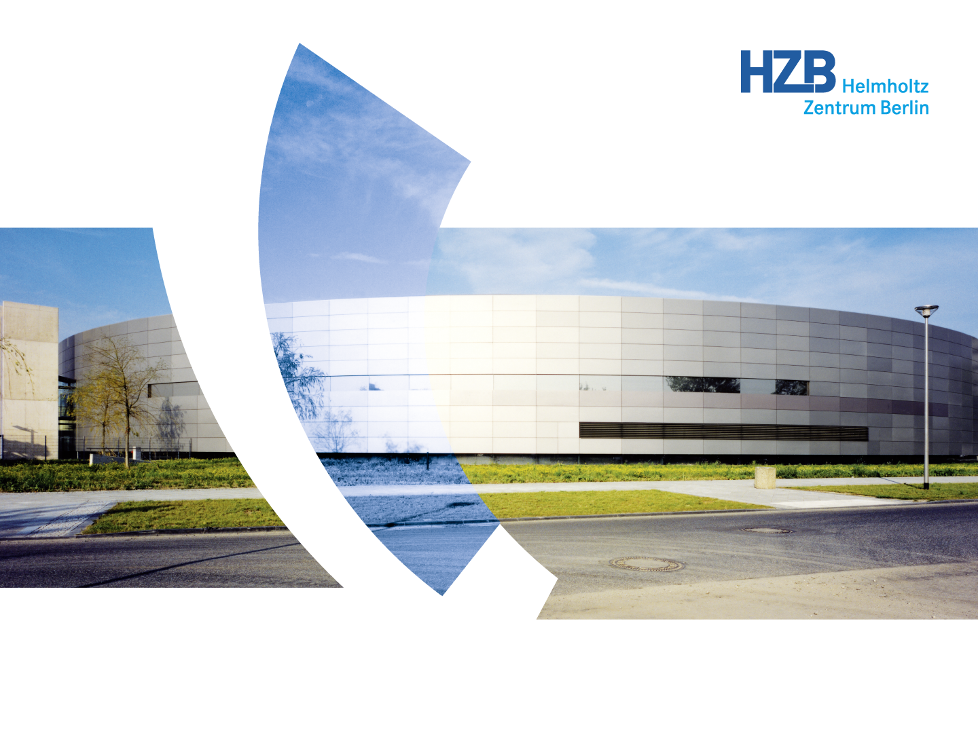
FEMTOSPEX: Overview and
Science with 100 fs FWHM x-ray pulses
Karsten Holldack
Institut für Methoden und Instrumente der Forschung mit Synchrotronstrahlung
Team: R.Mitzner, N. Pontius, C. Schüssler-Langeheine, T. Kachel, N.Tiedemann, D. Schick
ARD workshop, 2016

Slide 2
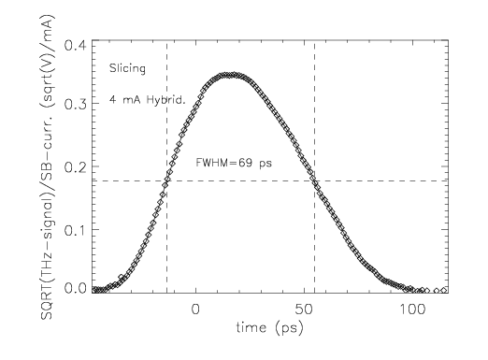
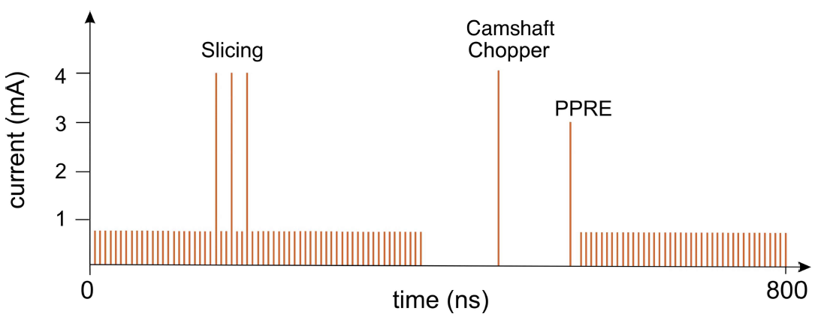
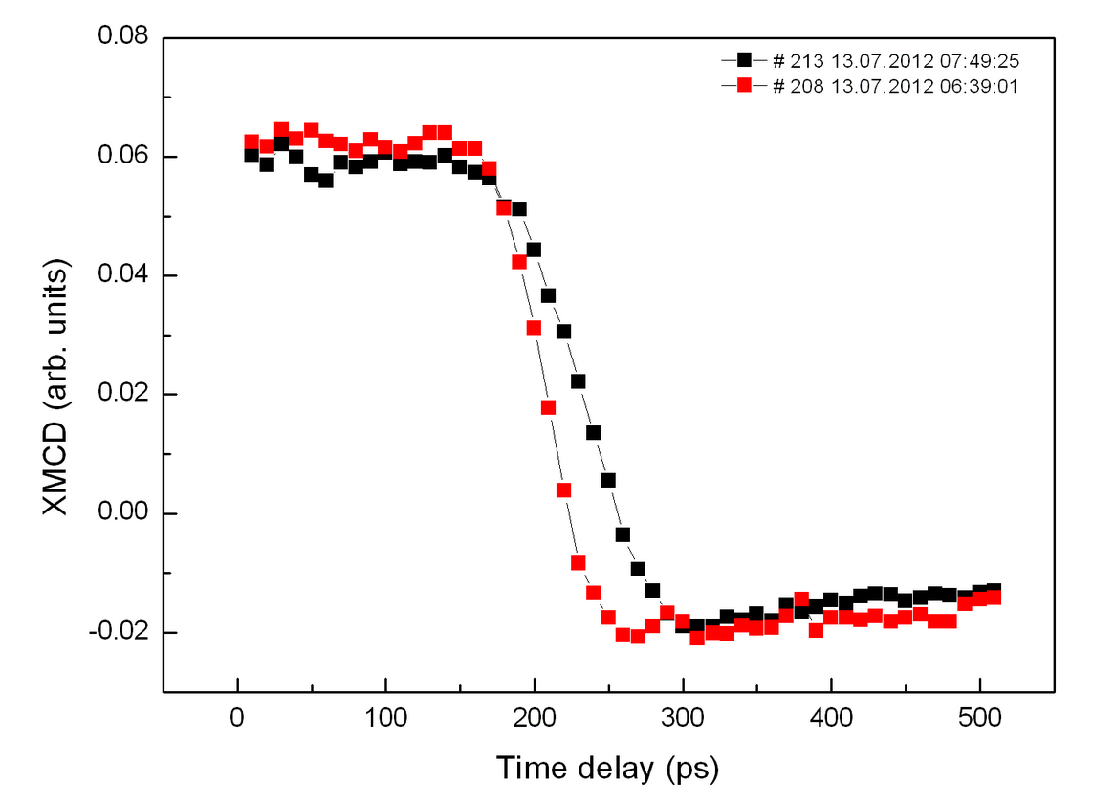
X-ray pulses from Storage rings: too long for many experiments
X-ray pulse lengths from storage rings = length of electron bunches: few 10-100 ps
result of equilibrium dynamics of relativistic electrons in closed orbit
Bunch length depends on bunch current
now: 4 mA – 70 ps (FWHM) = 30 ps rms
Low alpha: ca. 10 ps (FWHM) = 3 ps rms
! too long to study ultrafast spindynamics !
Normal mode tr-XMCD pump-probe results on Ni
black 4 mA, red: 2 mA in camshaft
- fast decay is probe pulse limited
- only physics slower than 100 ps can be studied
-> shorter pulses needed: sub-ps !

Slide 3
FemtoSpeX – pump-probe facility with 100 fs X-rays (Femtoslicing)
Slicing at BESSY started 2004 with elliptically polarized X-rays
employing laser energy modulation in a wiggler
- modulator and radiator in one straight
- helical ID as radiator (UE56-1)
- horizontal angular separation scheme
- improved spatio-temporal stability (FOBF, TopUp)
- 2-3 orders of magnitude more photons on the sample since 2004
BESSY II design: S. Khan et al, Phys. Rev. Lett. 97, 074801 (2006)

Slide 4
Why do we need a wiggler ?
A. A. Zholents, M. Zolotorev, Phys. Rev. Lett. 76 (6) 912 (1996), demonstrated by ALS, Berkeley 2000.

Slide 5
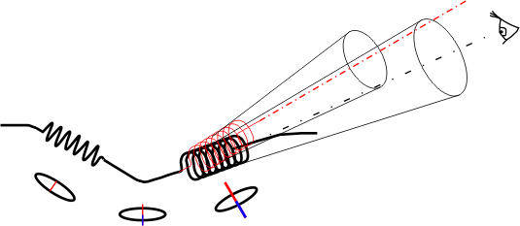
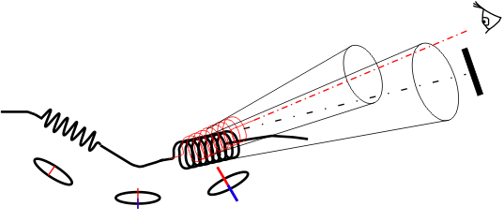
Slicing Principle and uniqueness of the HZB setup
Lacking photons ?
Unique:
variable (circular) polarization
250 – 1400 eV, 100 fs FWHM
“Femtobump“ switching
sequenced slicing
natural synchronization
we pioneered:
undulator based slicing
dedicated THz – beamline
sequenced slicing
fs tr-XMCD
Local orbit bump, the „Femtobump“

Slide 6
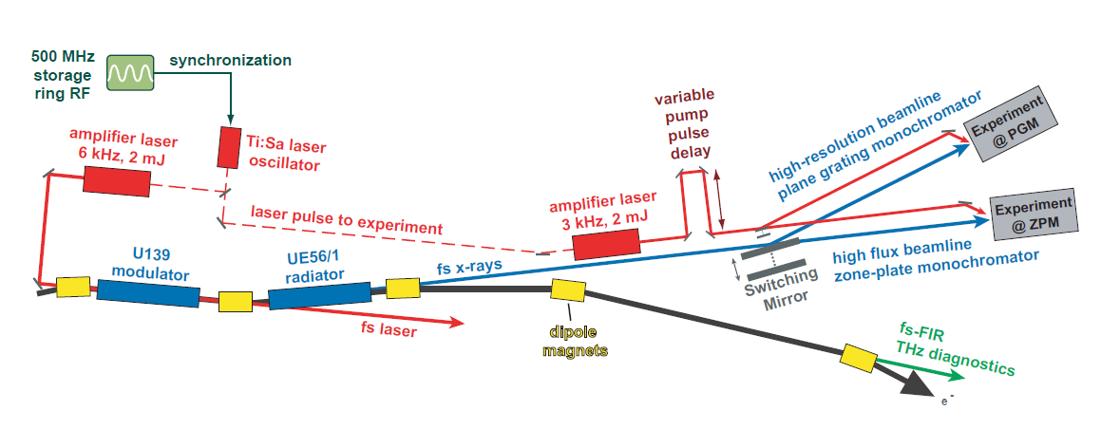
The FEMTOSPEX after upgrade in 2010
high spatio-temporal and energy stability
tunable 250 – 1400 eV, variable elliptical polarization
very high and stable time resolution of ~100 fs
24 h user operation since 2012, high overbooking (3-5)
tr-XMCD (transm./refl.), tr-XAS, tr-RSXRD, tr-ARTOF
variable excitation wavelength (SHG,THG,OPA)
1e6 ph/sec at 6 kHz on sample at ZPM

Slide 7
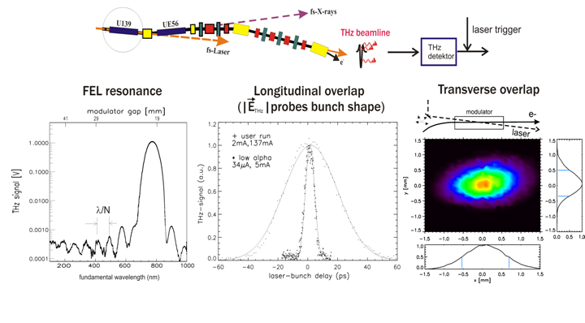
How to set this up ?
THz pulses indicate laser energy modulation of electrons
-> dedicated THz-beamline built 2004 – first slicing overlap 4/2004
no THz – no slicing: THz pulse is crucial to find and maintain fs-X-ray generation in Femtoslicing, active feedbacks
appear with 6 kHz, single cycle, naturally synchronized
Why not using them for experiments ?
K. Holldack et al., Phys Rev. Lett, 2006, A.A. Zholents, K. Holldack, Proc. FEL2006

Slide 8
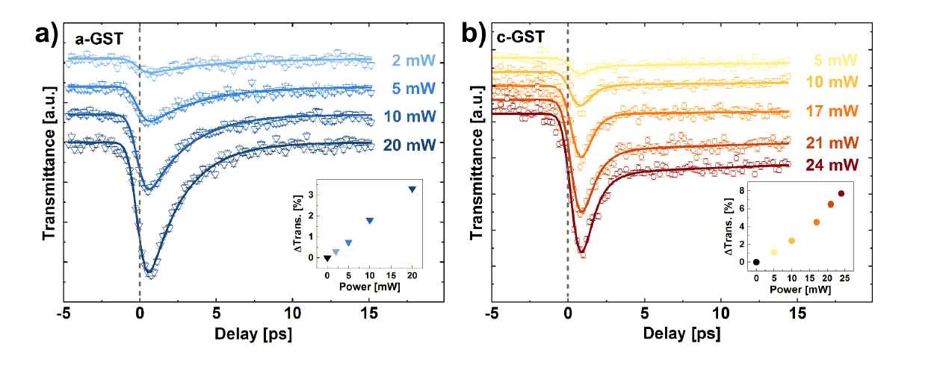
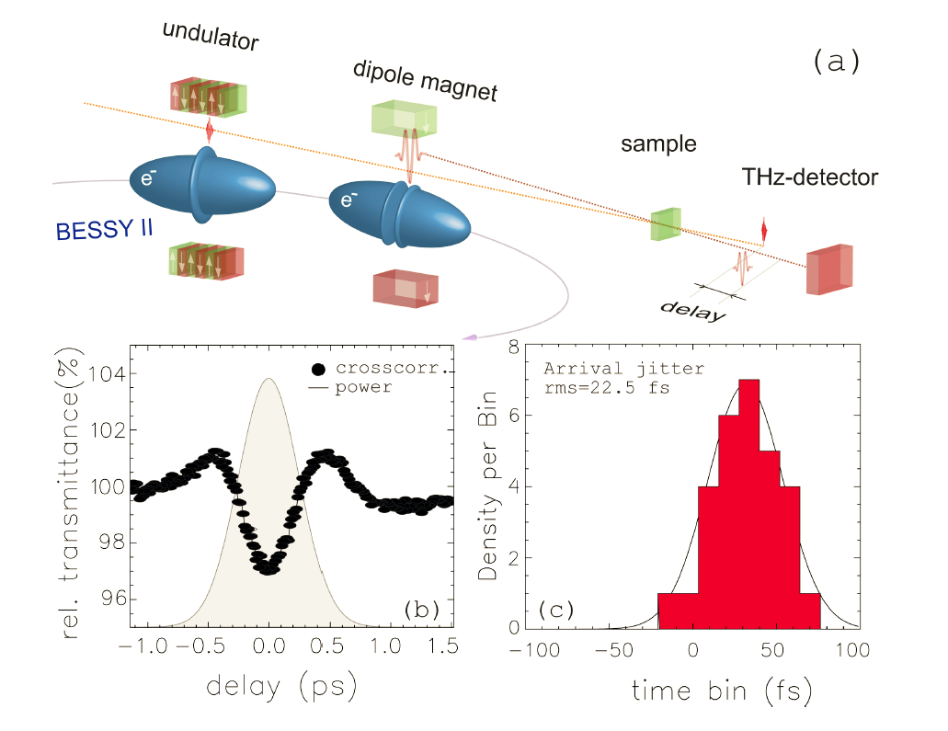
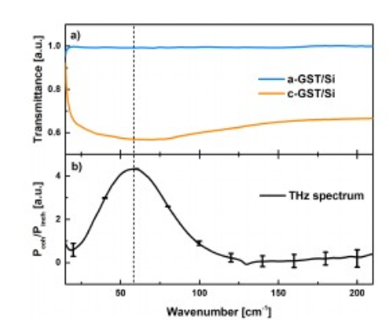
Application example with THz CSR from Femtoslicing
How phase change memory material GST326 responds to single cycle
THz transients
“Slicing” generates sub-ps THz field transients
naturally synchronized at 6 kHz
high stability, tunable spectrum, 10-100 nJ
probing phonon region at ~2 THz
under sub-treshold excitation at 800 nm
V. Bragaglia et al. Nature Sci. Rep. 6, 28560 (2016) and V. Bragaglia, submitted

Slide 9
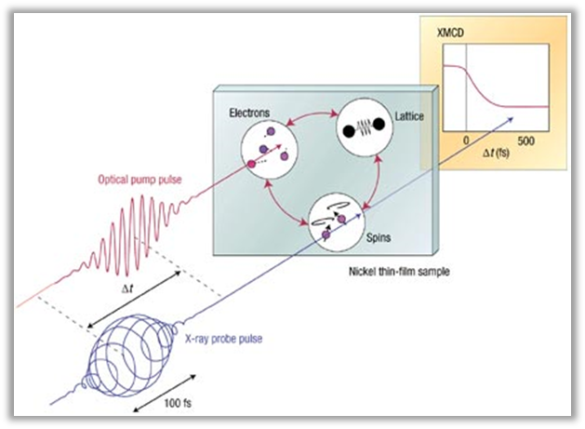
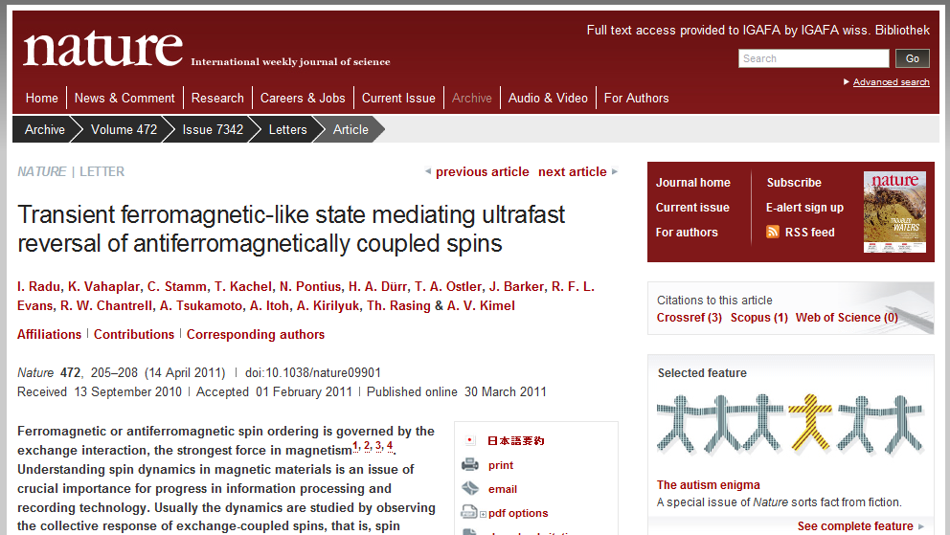
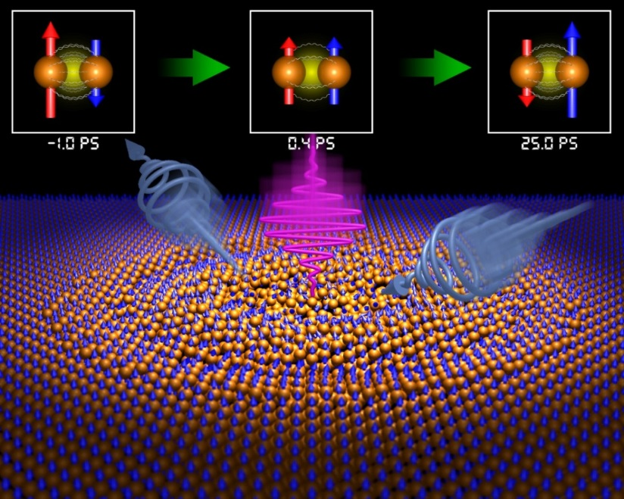
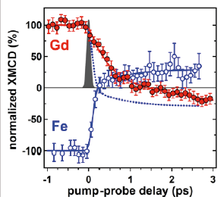
The science case for “slicing” at BESSY II
Aim: explore ultrafast dynamics of magnetic structural and electronic dynamics in sub-ps range
desired source properties:
Reprate ~10 kHz
stable 100 fs time resolution
circular x-rays
(tr-XMCD, tr-XAS, tr-XRD)
cover L and M edges
of relevant elements
range ca. 250 eV ... 1.5 keV
natural synchronization
(few 10 fs jitter, drifts)
2016: Other sources
HHG (VUV only, not circular)
FELs (first similar results from LCLS delta undulator)
9

Slide 10
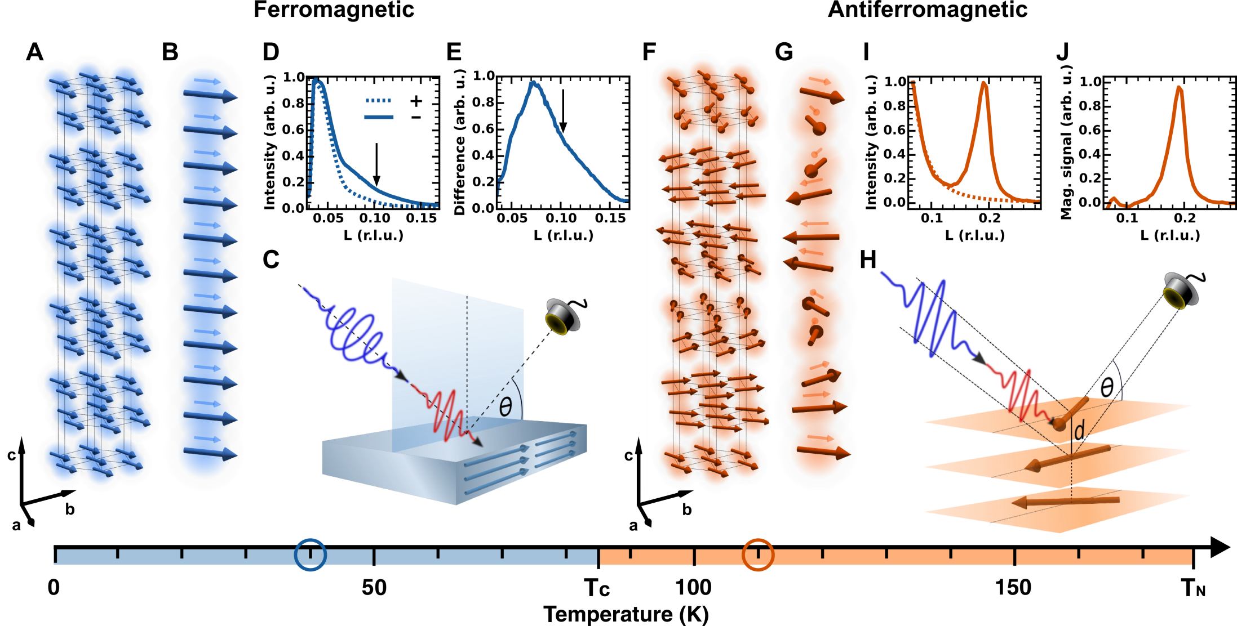
Magnetic structure in Dysprosium
N. Thielemann-Kühn, N. Pontius, Ch. Schüssler-Langeheine et al., submitted

Slide 11
Magnetic structure in Dysprosium
magnetic moment transfer rate
FM vs. AFM “demagnetization”
highly efficient ultrafast interatomic angular momentum transfer between atoms of non‑collinear spins !!
N. Thielemann-Kühn, N. Pontius, Ch. Schüssler-Langeheine et al., submitted

Slide 12
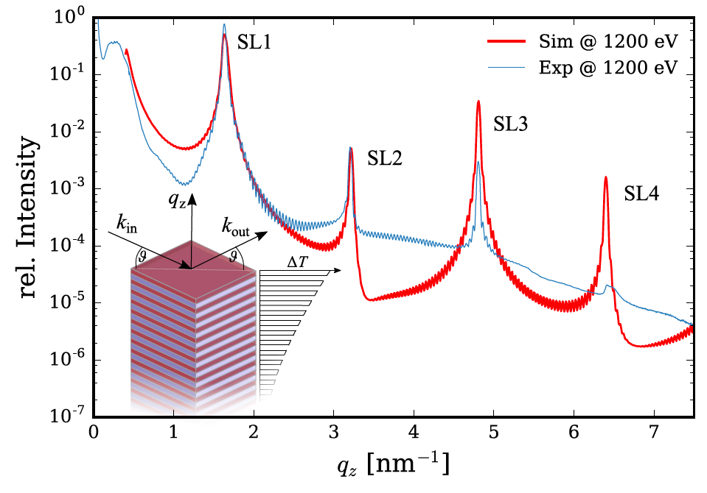
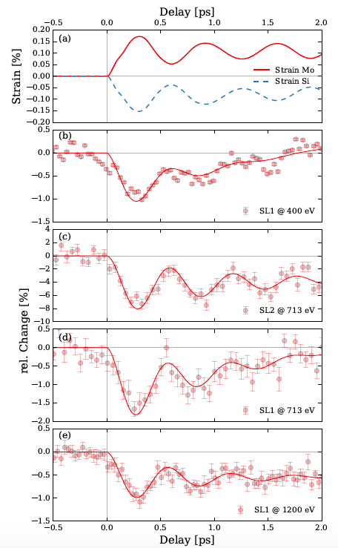
Structural dynamics in superlattices
Broad band detection of
coherent structural fs dynamics in
superlattices possible at slicing !!
- needs 100 fs time resolution
D. Schick et al., in preparation

Slide 13
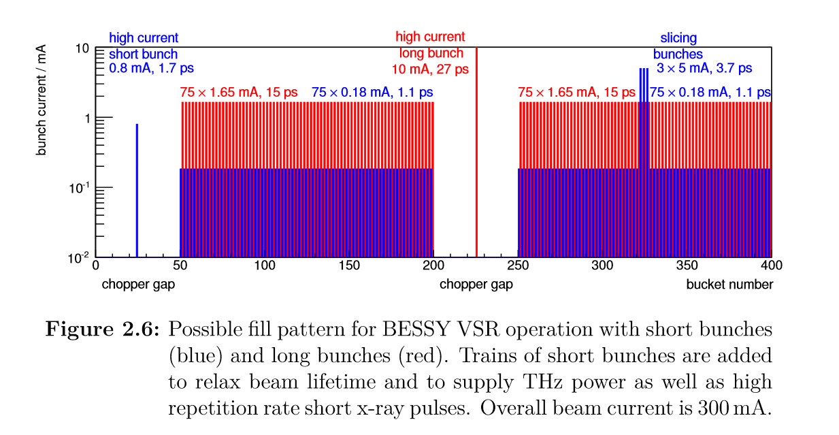
Slicing at BESSY VSR
Upgrade project of BESSY II with superconducting cavities
VSR: short and long bunches filled at the same time
-> time resolved user experiments on demand
With VSR and laser upgrades we expect:
more fs X-rays from slicing (1e7-1e8 ph/sec at few 10 kHz reprate)
µJ THz pulses from slicing at few 10 kHz reprate
high reprate broad band THz-CSR emission (blue bunches)
https://www.helmholtz-berlin.de/media/
media/angebote/bibliothek/reports/
r0001-bessy-vsr-tds.pdf

Slide 14
Conclusions
Our ultrafast user community demands 100 fs FWHM pulses
naturally synchronized to external lasers to study sub-ps phenomena
Femtoslicing generates soft X-rays (250-1400 eV) of variable polarization
with 100 fs FWHM (42 fs rms) naturally synchronized)
Apps: tr-XMCD, tr-RSXRD, tr-XAS, tr-Xrefl
BESSY VSR + laser upgrades will further boost FemtospeX:
- 10-25 times more X-ray flux, µJ THz pulses at few 10 kHz reprate
- usable: 1.7 ps (4 ps rms) time resolution in normal user mode (no nat. synch.)
- is sub-ps pump-probe time resolution in VSR low alpha possible ?
Femtoslicing generates usable naturally synchronized single cycle THz pulses
for ultrafast experiments at sub-ps time resolution
Apps: ultrafast tr-THz spectroscopy
Why are we competitive: - high availability (24 h user facility)
- full energy and polarization tunability
- high temporal stability
- constant pulse length (100 fs FWHM)

