Slide 1

Photon Diagnostics for soft and hard X-ray FELs.
Kai Tiedtke
4th ARD ST3 Workshop, 14th July 2016

Slide 2
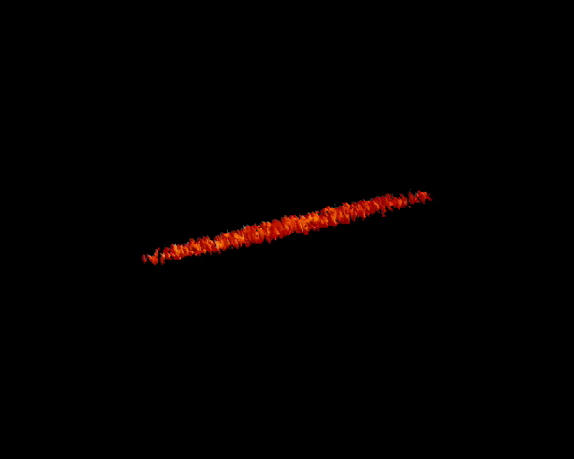
Diagnostic tools for FELs.
What kind of diagnostic tools do user need to make efficient use of FELs?
  intensity
  beam position
  focus size
  spectral distribution
  temporal radiation pulse profile
  coherence
  polarization
Courtesy S. Reiche
Due to the SASE specific shot-to-shot fluctuation the users need most this information for every single pulse => online, non-destructive

Slide 3
Diagnostic tools .
The Atomic Photoionization Process is a perfect candidate for non-destructive, pulse-resolved photon metrology tools.
  intensity Gas-Monitor Detectors (GMD)
  beam position GMD Split Electrodes
  focus size wave-front sensor
  spectral distribution Photoionization spectra
  temporal radiation pulse profile Non-linear autocorrelation or streaking
  coherence
  polarisation Photoemission distribution
The effort for developing such detector systems is extremely high, in particular due to the tight requirements on robustness and reliability.

Slide 4
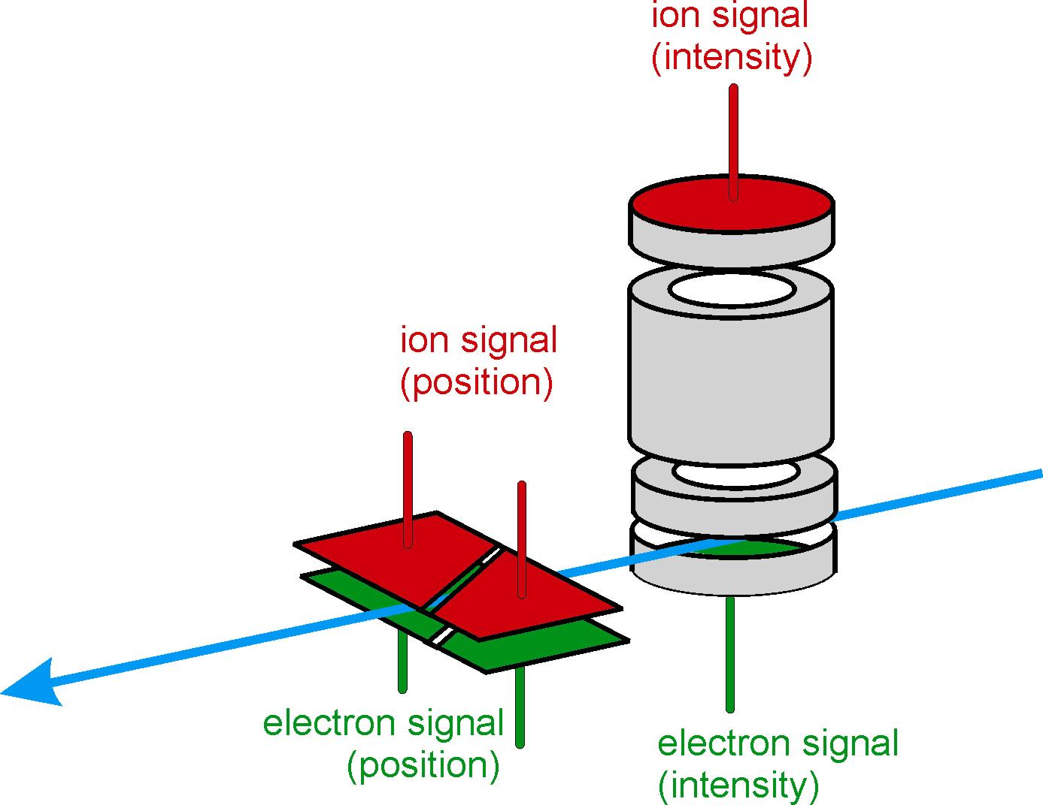

Example: Gas-monitor detectors for online intensity and beam position monitoring.
Based on atomic photoionization => no degradation, indestructible
Low particle density =>
transparent
Calibrated in the PTB laboratory
Uncertainty for the pulse energy: less than 10%
Photon beam
10⁻⁶ - 10⁻⁴ mbar
Reference number at the German Patent Office: 102 44 303

Slide 5
Equation behind the Gas-Monitor Detector.
Number of particles detected (electrons or ions). Average photoionization charge needed to evaluate.
Quantum Efficiency
Atomic Gas Density (requires temperature and pressure info)
Cross Section
Detection Efficiency
Charge accumulated
by the detector
Detector Acceptance Length
Elementary charge
Mean ion charge

Slide 6
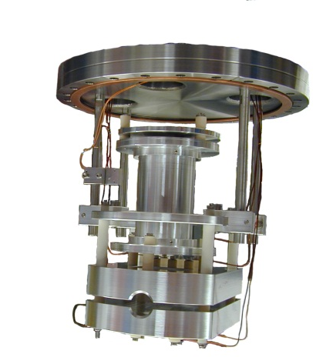
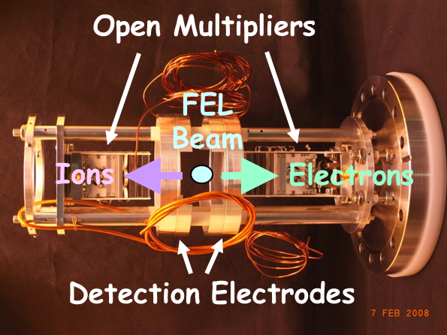
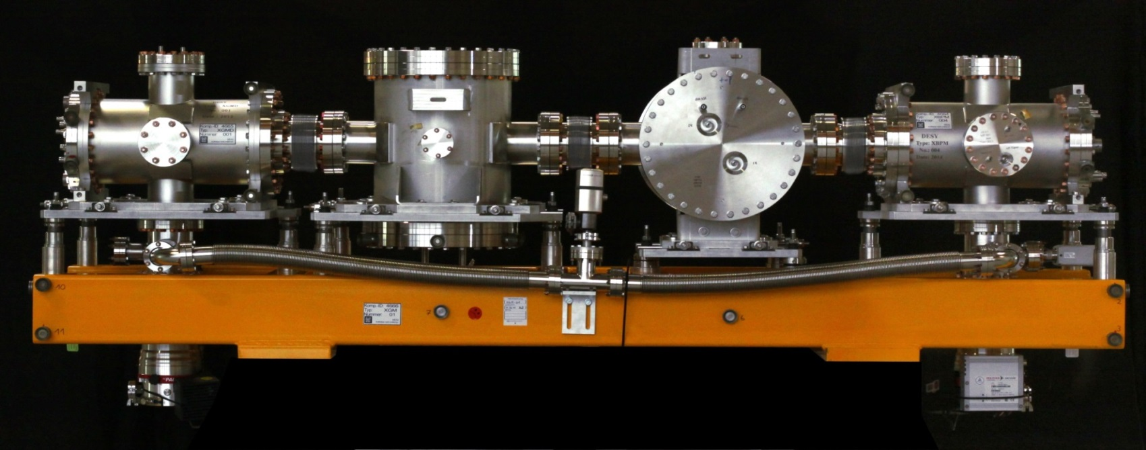
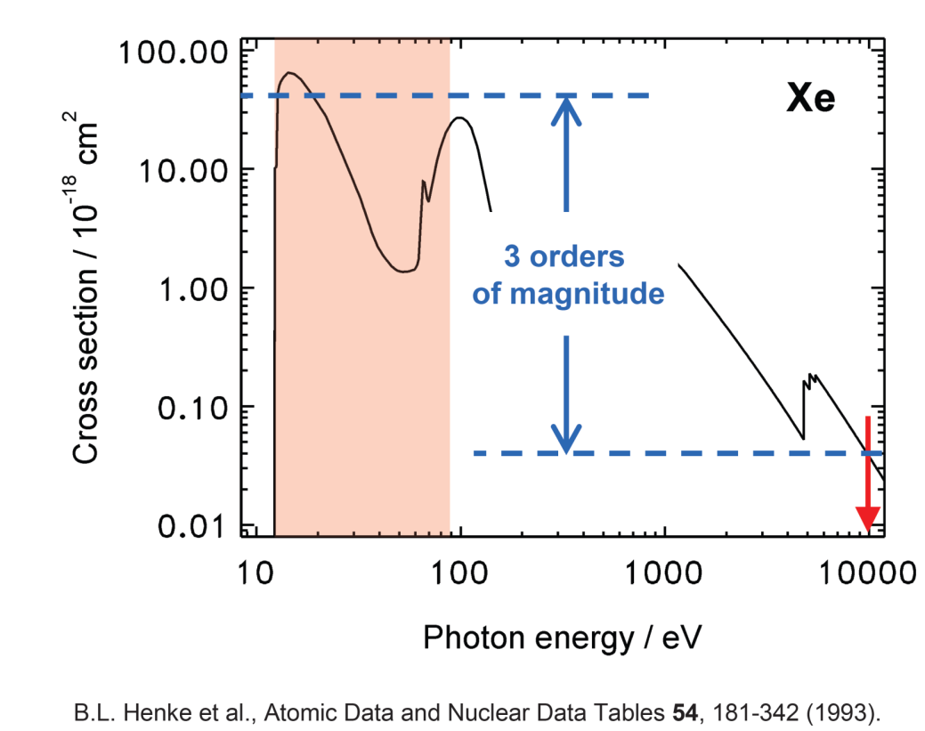
FEL intensity monitor GMD - new design for XFEL application.
1st generation GMD (FLASH1)
Advanced GMD used for cross calibration
measurements at all existing SASE FELs
3rd generation GMD (XFEL, SwissFEL, and FLASH2)
X
y
New XGM design copes with enhanced demands of the XFEL wavelength range:
  higher sensitivity
  (larger XGMD absorption length)
  higher dynamic range
  (tunable HAMP stage voltages)
XGMD
HAMP
Photon energy / eV
HAMP
XGMD
B.L. Henke et al.
Atomic Data and Nuclear Data Tables 54, 181 (1993)

Slide 7
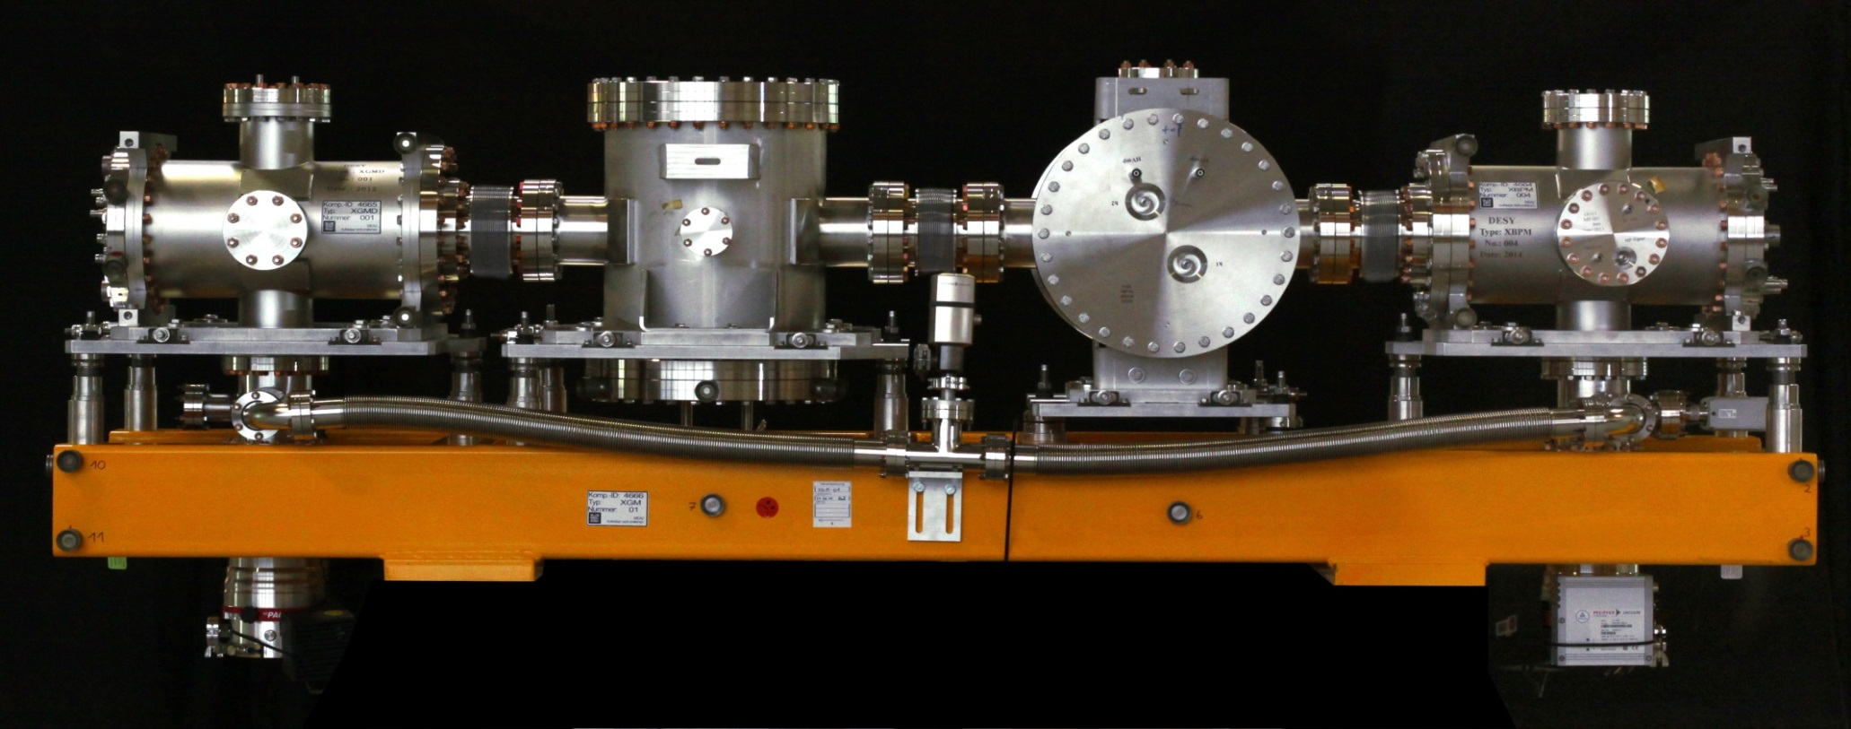
XGM for European XFEL and SwissFEL:
Intensity and beam position with an extended dynamic range.
X
y
XGMD with spilt Faraday cup detection electrodes
(horizontal beam position)
Two HAMPs with huge area open electron multipliers each equipped with a pair of split anodes (horizontal X and vertical Y beam position)
XGMD with spilt Faraday cup detection electrodes
(vertical beam position)

Slide 8

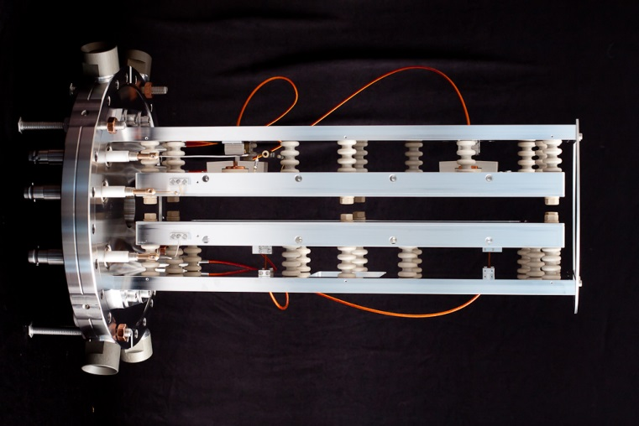
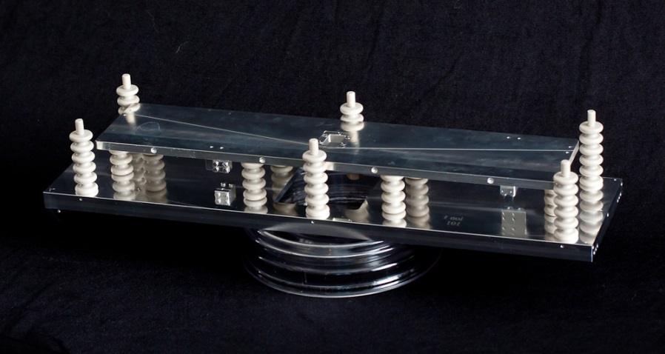
3rd generation GMD for European XFEL and SwissFEL-
Intensity and beam position with an extended energy and dynamic range.
X
y
Photon energy range: up to 20 keV
Uncertainty for the pulse energy: <10 %
Time resolution: < 200 ns
Operating pressure: 10⁻⁶ mbar – 10⁻⁴ mbar
We have build 6 XGM for XFEL and 1 for PSI
High extraction voltage of up to 20 kV has to be applied to prevent detection of highly energetic photoelectrons by the ion detector.

Slide 9
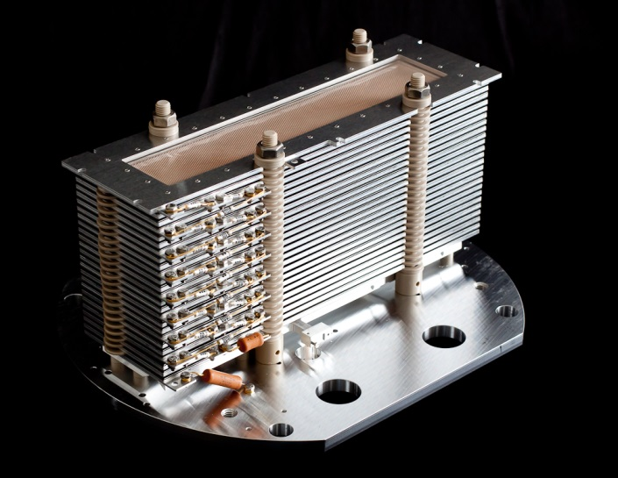
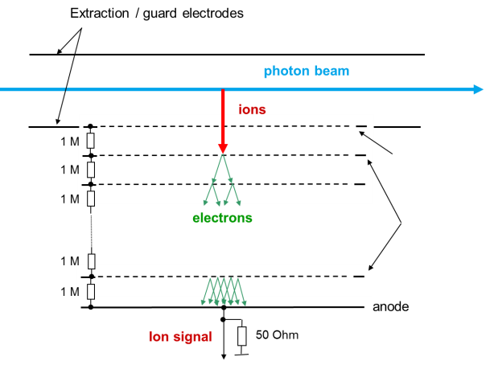
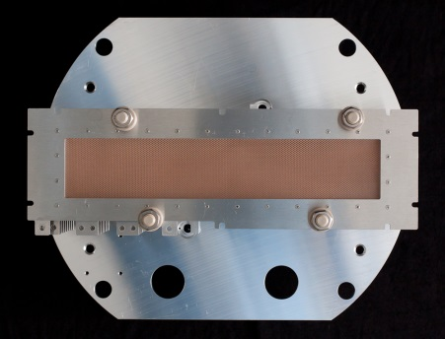
3rd generation GMD for European XFEL and SwissFEL-
Intensity and beam position with an extended energy and dynamic range.
X
y
New detector to solve the dynamic range problem
It’s a giant multiplier with 20cmx3cm open area
CuBeO dynodes own design
Gain: 10⁷
Split electrode to measure beam position
Robust
Operating pressure: 10⁻⁸ mbar – 10⁻⁴ mbar
Relative uncertainty (pulse to pulse): < 1 -5 %
Notes:
Lamellar structure: thickness of the plates is 0.3 mm, depth is 8 mm, spacing between the thin plates is 0.8 mm

Slide 10
XGMD signal: average ion current from Faraday cup.

Slide 11
XGMD signal: number of ions per pulse.

Slide 12
XGMD signal: relative uncertainty of the pulse-resolved signal
due to statistical nature of photoionization process.

Slide 13
XGMD signal: number of ions per pulse.

Slide 14
XGMD signal: relative uncertainty of the pulse-resolved signal due to statistical nature of photoionization.

Slide 15
Gas based detectors at FLASH.
Spectral distribution: Online spectrometer at FLASHII
Measuring the wavelength by means of photoionization
of rare gas targets using time-of-flight spectrometers:
  non-invasive
  online monitoring
  single bunch resolved measurement
3x eTOF
increasing photon energy
Advantages:
operational in the full FLASH wavelength range
measuring the complete wavelength range

Slide 16


OPIS at FLASH1: Cross-calibration campaign.
Cross-calibration involving PG, CS and VLS grating spectrometers as a reference
Measurements at different wavelength covering the FLASH range
Scanning the FLASH wavelength over ~1nm during SASE operation
wavelength measurement
spectral distribution
online monitoring
Braune et al., JSR 23, 10 (2016)

Slide 17
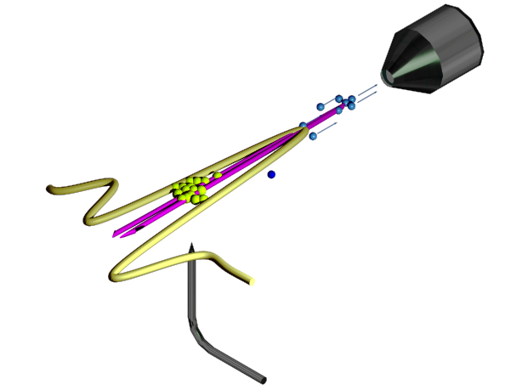
Gas based detectors at FLASH.
Polarisation: Measurement of angular
distribution of the emitted photoelectrons.
Temporal radiation pulse profile: THZ Streaking at FLASHII (permanent installation planned for 2017)
Measuring the pulse duration and arrival time
by means of a single cycle THz streaking field:
  non-invasive
  online monitoring
  single bunch resolved measurement
photoelectron
Electron TOF
spectrometer
Single-cycle
THz pulse
sample
X-ray
Gas jet

Slide 18





Acknowledgments
Many thanks to:
FLASH Photon diagnostics and controls group:
Y. Bican, S. Bonfigt, M. Braune, L. Dammann, S. Düsterer, S. Grunewald, R. Ivanov, S. Klumpp, F. Jastrow, E. Müller, and A. Sorokin

Slide 19
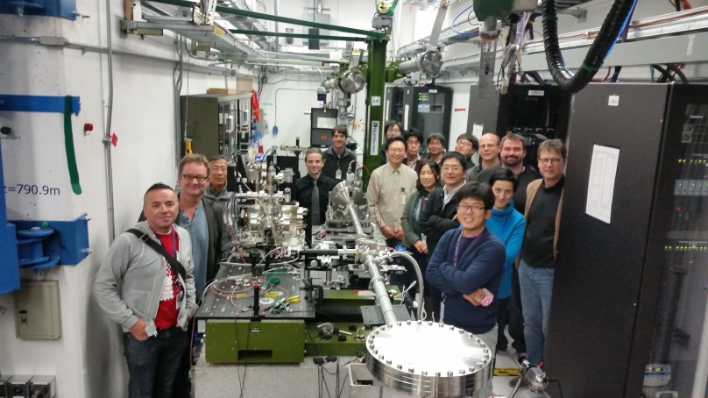
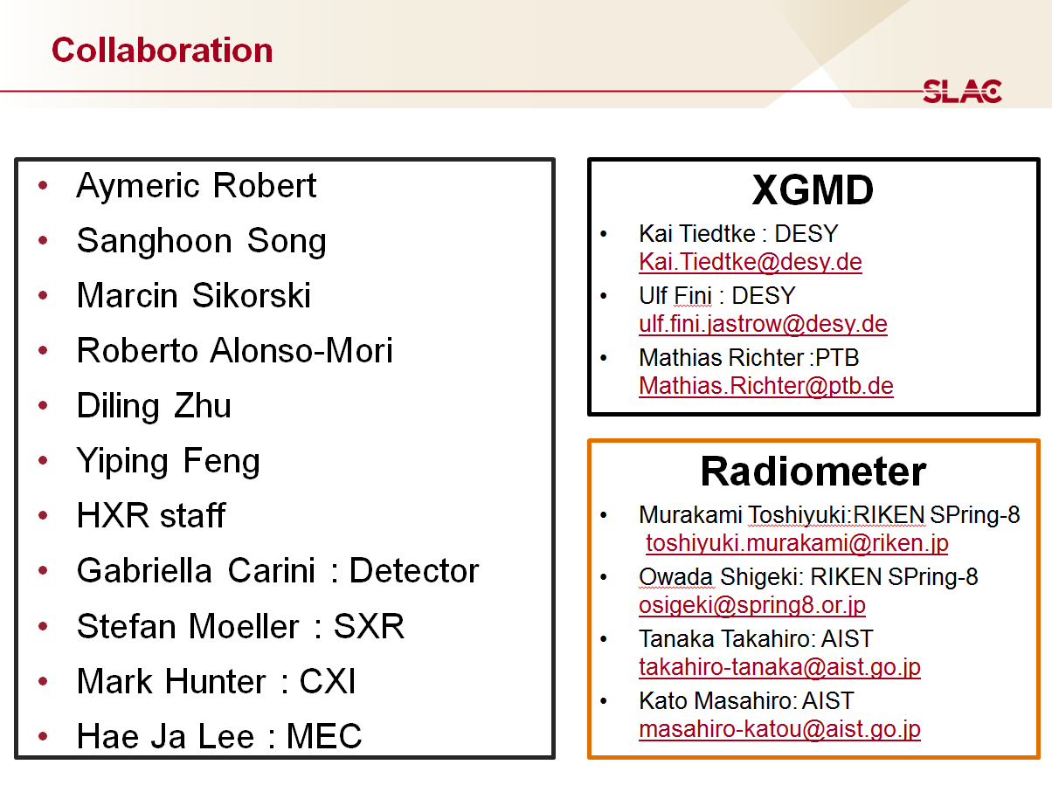
Measurements of the absolute number of photons of LCLS hard X-ray line
Comparison between the XGM pulse energy monitor with a cryogenic radiometer of AIST.
by DESY/PTB and LCLS/AIST
January 21-24, 2015

Slide 20
Measurements of the absolute number of photon of LCLS hard X-ray line – Preliminary results
by DESY/PTB and LCLS/AIST
January 21-24, 2015
9.0 keV
9.0 keV
Attenuator T% | XGMD [µJ] | Cryogentic radiometer [µW] | Ratio XGMD/Radiometer
1 | 7.25 | 660 | 0.96
2 | 15 | 1300 | 1.01
3 | 22.4 | 1920 | 1.02
4 | 36.5 | 3090 | 1.03
5 | 52.1 | 4380 | 1.04
6 | 65.1 | 5470 | 1.04
7.5 | 83.3 | 7020 | 1.04
9 | 107.5 | 8960 | 1.05
6.0 keV
Confirmation of our PI cross section and mean charge values

Slide 21
Measurements of the absolute number of photon of LCLS hard X-ray line – Preliminary results
by DESY/PTB and LCLS/AIST
January 21-24, 2015
6.0 keV
9.0 keV
Attenuator T% | XGMD [µJ] | Cryogentic radiometer [µW] | Ratio XGMD/Radiometer
2 | 3.2 | 530 | 0.24
4 | 7.5 | 690 | 0.43
8 | 15.5 | 1000 | 0.62
15 | 25.5 | 1340 | 0.76
28 | 50.8 | 1700 | 0.93
52 | 120.7 | 4820 | 1.00
100 | 245.6 | 9300 | 1.05
6.0 keV
Contribution from higher harmonics

