Slide 1







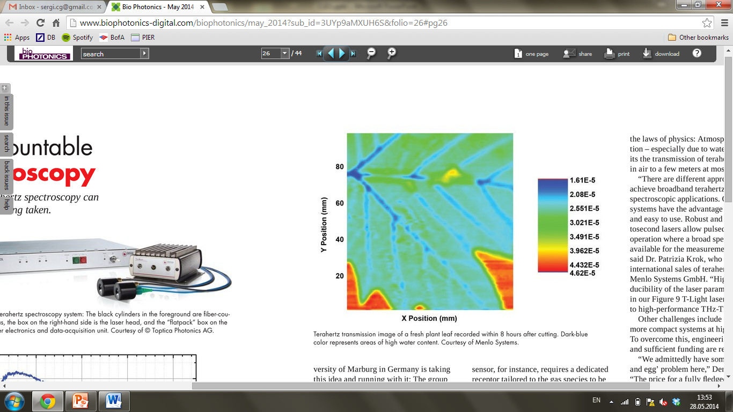
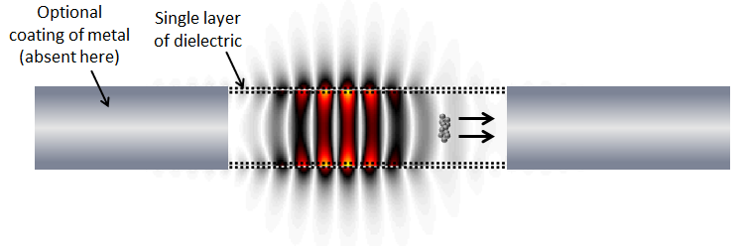
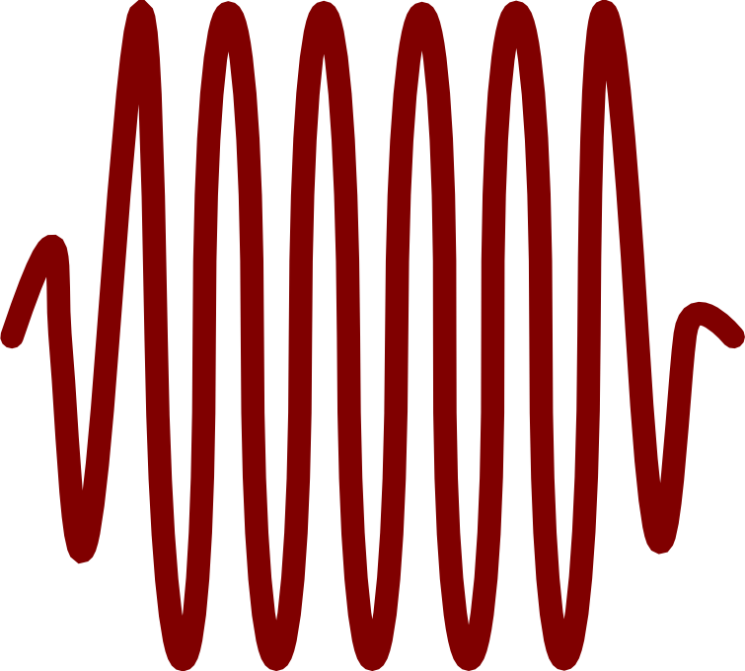

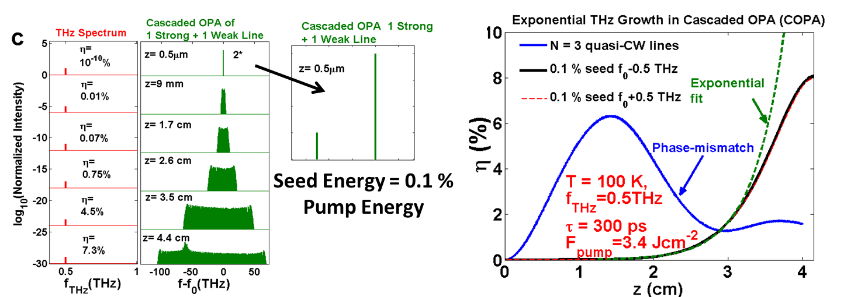
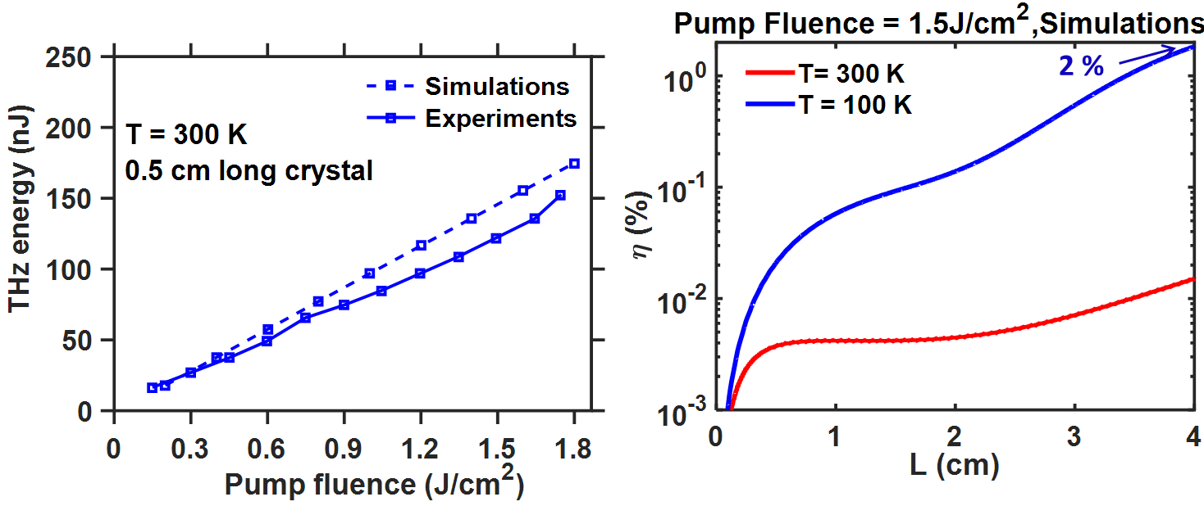
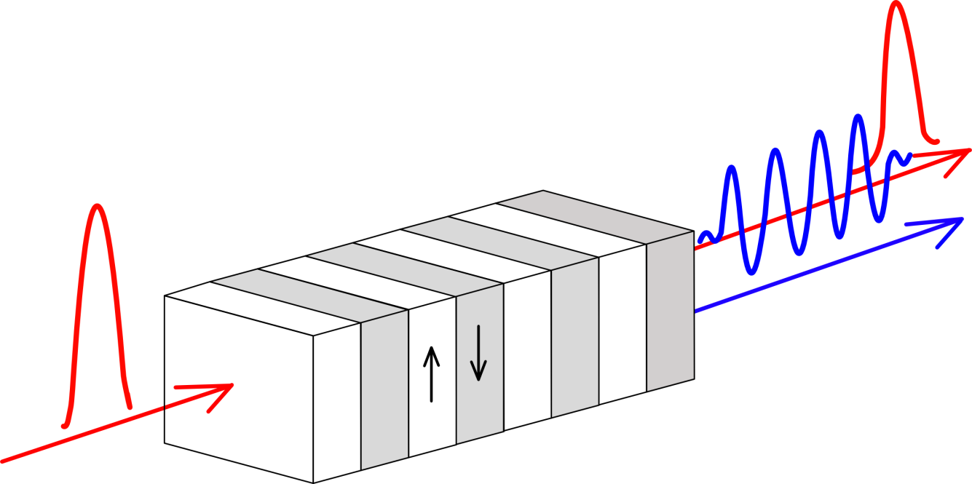
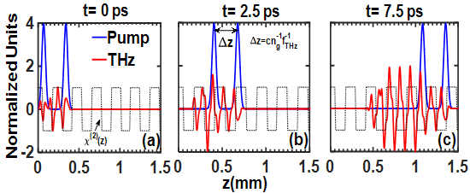
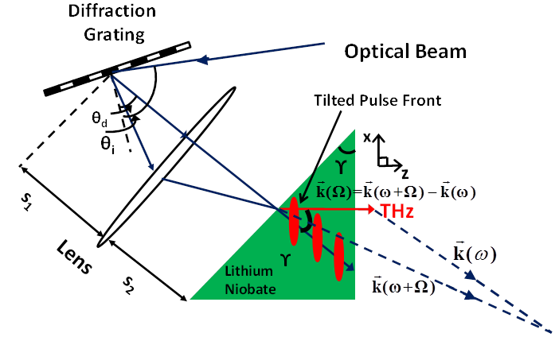
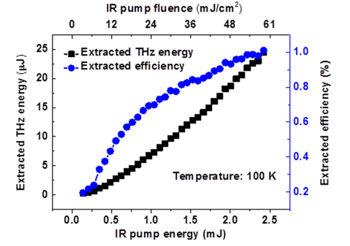
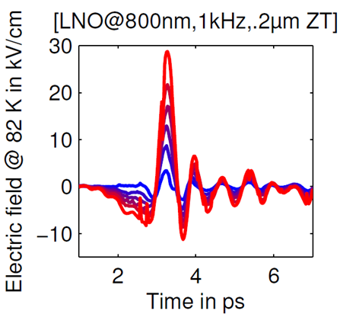
Laser Driven High Field Terahertz Sources for Compact Electron Acceleration
Koustuban Ravi^{1,3},Frederike Ahr^{1,2},Anne-Laure Calendron¹,Huseyin Cankaya¹,Giovanni Cirmi^{1,4},Arya Fallahi¹, Anthony Hartin¹,Wenqian Huang³,Francois Lemery¹,Fabian Reichert¹,Damian Schimpf^{1,4},Xiaojun Wu^{1,4}, Alireza Yahaghi¹, Chun Zhou¹,Luis E.Zapata¹,Oliver D.Mücke^{1,4},Nicholas H.Matlis¹ and Franz X.Kӓrtner^{1,2,3,4}
Ultrafast Optics and X-Rays Division
¹Center for Free-Electron Laser Science & DESY, Notkestraße 85, 22607 Hamburg, Germany
²Department of Physics, University of Hamburg, Luruper Chausee 149, 22761 Hamburg, Germany
³ Research Laboratory of Electronics, Massachusetts Institute of Technology, 77 Massachusetts Avenue, Cambridge, Massachusetts 02139, USA
⁴The Hamburg Center for Ultrafast Imaging, Luruper Chaussee 149, 22761 Hamburg, Germany
Motivation: Strong field THz applications
THz Spectroscopy
Charged particle acceleration
~ 20 mJ
~ 100 cycles
e
THz spectroscopy and THz pump-probe experiments improving due to high THz fields
Compact electron acceleration and bunch compression in THz waveguides [1]
THz
Abstract:
Cascaded Optical Parametric Amplification
We propose a family of approaches relying on the repeated energy down-conversion of optical photons to terahertz photons to produce unprecedented conversion efficiencies ~ 10 % . All approaches use cryogenically cooled Lithium Niobate as the material system. Experimental demonstrations of multiple and single cycle pulses verifying predictions are presented.
A method to self-generate pulse sequences [4]
Starting with a seed with 0.1% of pump energy -> Self-starts Cascading
1 J pump 300 ps → 1 mJ 300 ps seed in a PPLN crystal at 100 K
Exponential THz growth, η~10 % at T = 100 K, 4 cm crystals
Strongly coupled Multi- Triplet Interaction → Independent of seed location
Theory: Cascaded Difference Frequency Generation
Optical rectification for generating
THz pulses
High efficiency due to cascading
Optical photon ~ 300 THz (~ 1 µm).
THz photon ~ 0.3 THz.
η ~ 0.1 % for single photon conversion
Use repeated energy down-conversion
to get >> 0.1 % conversion efficiency
Initial Proof of concept Experiments and Simulations
Multi-cycle Terahertz Generation with Pulse Sequences
PPLN
THz
IR
Single pulse pumping : limited by walk-off and damage threshold of PPLN
IR
Record efficiency [2]:
Λ: domain period
0.12% at 100 K
Future experiments at cryogenic cooling should lead to conversion efficiencies
>> 1%
Solution : Use multiple pulses to reduce damage threshold, increase efficiency [3]
Single Cycle Terahertz Generation
Terahertz generation using tilted-pulse-fronts yields η> 1 %, single-cycle pulses in cryogenically cooled lithium niobate due to cascading.
Longer pulses : Higher damage fluence
Conversion efficiency increases for multiple pulses
Dramatic Cascading of the Optical Spectrum
Conclusion
A family approaches all relying on the repeated energy down-conversion of optical photons to terahertz photons or cascading was presented. Terahertz generation using a sequence of pulses for very high efficiency multi-cycle generation was proposed and experimentally verified. A method to self generate the sequence of pulses by cascaded optical parametric amplification was introduced and experimentally verified. Single cycle generation at > 1% efficiency was demonstrated using tilted-pulse-front schemes.
Room temperature Experiments : Normalized THz energy vs delay
Direct comparison between single-compressed and pulse-train pumping
 | Single Pulse | Pulse-train
Input energy | 1.33 mJ | 1.29 mJ
THz energy | 135 nJ | 122 nJ
Conversion efficiency | 1.19 10⁻⁴ | 1.11 10⁻⁴
References
[1] Nanni, E. A. et al., “Terahertz-driven linear electron acceleration”, Nat. Commun. 6, 8486 (2015).
[2] S. Carbajo, et al., “Efficient narrowband terahertz generation in cryogenically cooled periodically poled lithium niobate”, Opt. Lett. 40, 5762 (2015).
[3] K.Ravi et al, “Pulse Sequences for Efficient Multi-Cycle Terahertz Generation in Periodically Poled lithium Niobate”, arXiv 1606.05278 (2016); F.Ahr et al, JTh2A.58,CLEO ’16, San Jose.
[4] K.Ravi et al, “Cascaded Parametric Amplification for Highly Efficient Terahertz Generation”, arXiv 1604.08919 (2016); G. Cirmi et al, SM2L.4,CLEO’16, San Jose; M.Hemmer et al, Ultrafast Phenomena, Santa Fe (2016).
Efficiency remains constant for lower peak intensity

