Slide 1

Next steps
28 April 2016
W. Fedorko, J. J. John, M. Warren

Slide 2
Agenda
Need for CERN accounts for SVN access
Schedule update
Review allocation of tasks to institutes
Review current work and discuss steps for next week

Slide 3
Repository access
For access to the ITSDAQ SVN repository at CERN, everyone will need CERN accounts.
Let’s see with Hongbo and Weiguo how to arrange that for everyone from USTC.

Slide 4
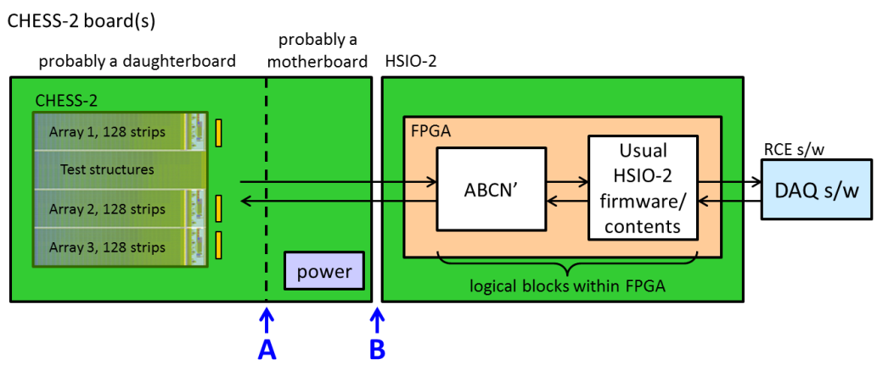
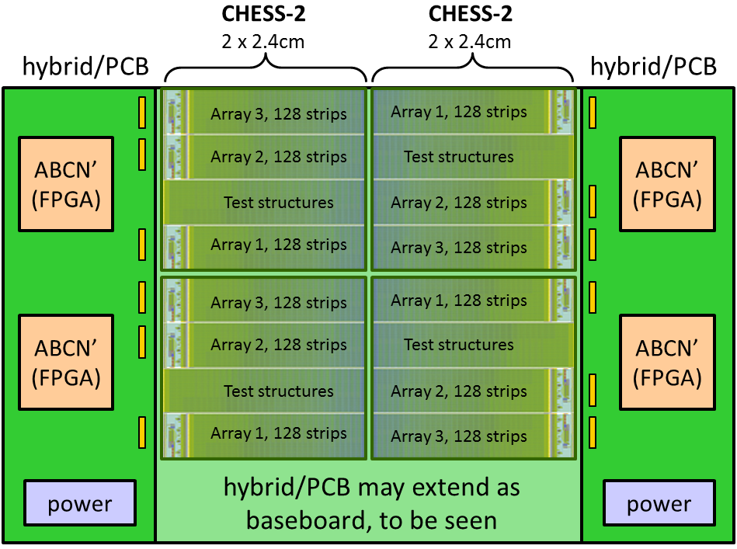
Schedule update
A reminder: the Strip CMOS programme is evaluated annually at a checkpoint review.
The next review will be this September.
The mandatory deliverable is to demonstrate the ABCN' running on an FPGA.
  I interpret this as demonstrate with a CHESS-2 sensor.
The next deliverable is the hybrid (circuit board) with FPGAs. It would be very good if we could have this for the September review. It would be nearly mandatory for the Strips TDR review -- which is “Q4 2016”.
First step = identify the size of FPGA needed to include the ABCN’.
Phase 3 hardware
Phase 4 hardware

Slide 5
Allocation of blocks
This is our current rough planning.
Is there any update from USTC and IHEP on this?
USTC?
USTC and IHEP? for datapath changes
need to see later if CF will still apply ?
also needs datapath changes
CHESS-2 Data Emulator
(for now)
later: CHESS-2 sensor
either way,
128 strips
(based on ABC130*)
?
?
L1/R3
L0/Cmd
ABC130 Command Decoder
UBC
L0/Cmd
SACI signals
SACI command bridge
including SACI block from SLAC
Oxford?

Slide 6
Current actions
Weiguo: [done] gather list of e-mail addresses/CERN accounts for those who need access to the repositories. E-mail this list to Matt Warren (for ITSDAQ SVN access) and Wojtek (for ABCN’ GitLab access).
Wojtek and Jaya John: set up their Nexys Video with current ITSDAQ firmware and SCTDAQ software – on CentOS for UBC, Windows for Oxford
Wojtek: check the ABC130* code from Matt (ITSDAQ repo) in to GitLab. Could also check in the ABC130 command decoder, but could be later also.
Jaya John: [done] e-mail Weiguo a link to Nexys Video by Digilent.
Jaya John: [done] e-mail ABC130 emulator random hit code and document to Wojtek.
Jaya John: add the SACI code to GitLab
Jaya John: start on mini-spec for CHESS-2 data emulator
Jaya John: [done] speak with Marcel, Richard and Vitaliy about the deliverables for September, to be sure we meet requirements for the year 2 review of Strip CMOS.

