Slide 1

Next steps
28 April 2016 this version is the minutes – with notes added
J. J. John

Slide 2
Agenda
Need for CERN accounts for SVN access
Schedule update
Review allocation of tasks to institutes
Review current work and discuss steps for next week

Slide 3
Repository access
For access to the ITSDAQ SVN repository at CERN, everyone will need CERN accounts.
Let’s see with Hongbo and Weiguo how to arrange that for everyone from USTC.

Slide 4
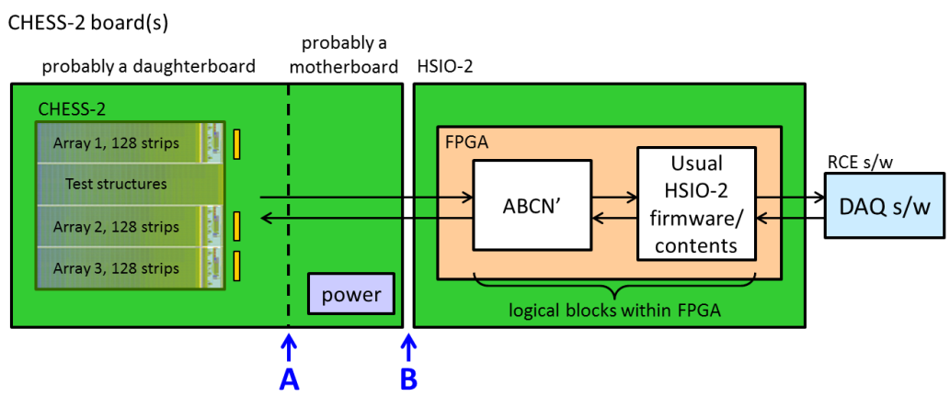
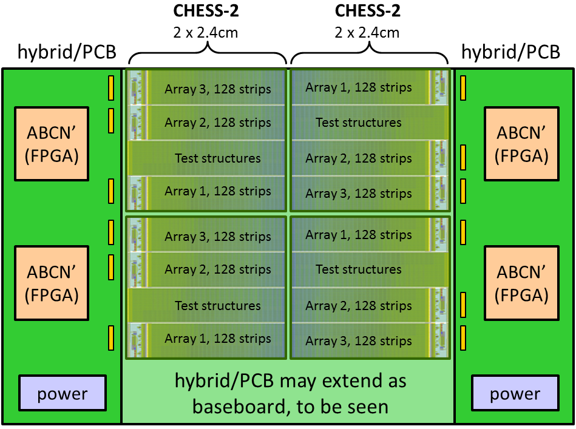
Schedule update
A reminder: the Strip CMOS programme is evaluated annually at a checkpoint review.
The next review will be this September.
The mandatory deliverable is to demonstrate the ABCN' running on an FPGA.
  I interpret this as demonstrate with a CHESS-2 sensor.
The next deliverable is the hybrid (circuit board) with FPGAs. It would be very good if we could have this for the September review. It would be nearly mandatory for the Strips TDR review -- which is “Q4 2016”.
First step = identify the FPGA (size, type) needed to include the ABCN’.
This will not be specified as the smallest-possible FPGA, but rather a sensible/comfortable size that gives some margin of additional space, in case of later changes.
Phase 3 hardware
in practice, this may be with the Nexys Video,
provided that interface B is an FMC connector
Phase 4 hardware

Slide 5
Allocation of blocks
This is our current rough planning.
This seemed all right to the group. We noted that we will need the CHESS-2 specification to make progress.
We agreed to start like this, and review this allocation as we go along.
For UCL, it’s best not to assign a block due to workload, but Matt will support us with getting the ABCN’ integrated into the ITSDAQ firmware build.
USTC?
USTC and IHEP? for datapath changes
need to see later if CF will still apply ?
also needs datapath changes
CHESS-2 Data Emulator
(for now)
later: CHESS-2 sensor
either way,
128 strips
(based on ABC130*)
?
?
L1/R3
L0/Cmd
ABC130 Command Decoder
UBC
L0/Cmd
SACI signals
SACI command bridge
including SACI block from SLAC
Oxford?

Slide 6
Completed actions (since last week)
Weiguo: [done] gather list of e-mail addresses/CERN accounts for those who need access to the repositories. E-mail this list to Matt Warren (for ITSDAQ SVN access) and Wojtek (for ABCN’ GitLab access).
Jaya John: [done] e-mail Weiguo a link to Nexys Video by Digilent.
Jaya John: [done] e-mail ABC130 emulator random hit code and document to Wojtek.
Jaya John: [done] speak with Marcel, Richard and Vitaliy about the deliverables for September, to be sure we meet requirements for the year 2 review of Strip CMOS.

Slide 7
Ongoing and new actions
Wojtek and Jaya John: [in progress] set up their Nexys Video with current ITSDAQ firmware and SCTDAQ software – on CentOS for UBC, Windows for Oxford. So far, CentOS is not the most friendly distribution to set up, requires some extra steps and installations.
Jaya John: send link to CHESS-2 review slides to Wojtek
Jaya John: e-mail ABC130 emulator random hit code and document to everyone at USTC.
Wojtek: [in progress] check the ABC130* code from Matt (ITSDAQ repo) in to GitLab. Could also check in the ABC130 command decoder, but could be later also.
Jaya John: add the SACI code to GitLab
Jaya John: prepare a mini-spec for CHESS-2 data emulator
Jaya John: also ask CHESS-2 designers about timeframe for the CHESS-2 specification. Even a partial spec will be a great help for understanding.
Hongbo and Weiguo: assist our colleagues at USTC to obtain CERN accounts, for gaining access to the ITSDAQ repository.

