Slide 1

Next steps and CHESS-2 data flow
5 May 2016 this version is the minutes – with notes added
J. J. John

Slide 2
Agenda
Review current work and discuss steps for next week
Walk through CHESS-2 data format
Walk through spec for CHESS-2 data emulator

Slide 3
Completed actions (since last week)
Jaya John: send link to CHESS-2 review slides to Wojtek
Jaya John: e-mail ABC130 emulator random hit code and document to everyone at USTC.

Slide 4
Ongoing and new actions
Wojtek and Jaya John: [in progress] set up their Nexys Video with current ITSDAQ firmware and SCTDAQ software – on CentOS for UBC, Windows for Oxford. So far, CentOS is not the most friendly distribution to set up, requires some extra steps and installations.
Wojtek: [in progress] check the ABC130* code from Matt (ITSDAQ repo) in to GitLab. Could also check in the ABC130 command decoder, but could be later also.
Jaya John: add the SACI code to GitLab
Jaya John: prepare a mini-spec for CHESS-2 data emulator
Jaya John: also ask CHESS-2 designers about timeframe for the CHESS-2 specification. Even a partial spec will be a great help for understanding.
Hongbo and Weiguo: assist our colleagues at USTC to obtain CERN accounts, for gaining access to the ITSDAQ repository.

Slide 5
CHESS-2 data format
Introduction to this key topic for the ABCN’:
How does CHESS-2 process and encode the hits received on the pixel array?
What is the format of data the ABCN’ will receive from CHESS-2?
These slides are all based on Pietro Caragiulo’s CHESS-2 slides presented at ATLAS Upgrade Week, 18 April.

Slide 6
CHESS-2 Architecture
Block diagram of the sensor:
Column Decoder
128 x 32
pixels
Half Comparator,
Latch & Strip encoding
Hit Encoding
Global DACs
Matrix
Pointers
SACI
Control Logic
Global Registers
Row Decoder
Serializer
LVDS TX/RX
Pixels are organised as:
128 strips, containing 32 pixels each
also: 128 rows x 32 columns
Acquisition
Encoding
Configuration and Calibration
Read-out
diagram: P. Caragiulo, SLAC

Slide 7
CHESS-2 Data Flow – 1/4
This is a high-level overview only of the data flow.
The following slides will go into details of the data format at each step.
Column Decoder
128 x 32
pixels
Half Comparator,
Latch & Strip encoding
Hit Encoding
Global DACs
Matrix
Pointers
SACI
Control Logic
Global Registers
Row Decoder
Serializer
LVDS TX/RX
1) the pixels detect hits which are over a threshold
diagram: P. Caragiulo, SLAC

Slide 8
CHESS-2 Data Flow – 2/4
This is a high-level overview only of the data flow.
The following slides will go into details of the data format at each step.
Column Decoder
128 x 32
pixels
Half Comparator,
Latch & Strip encoding
Hit Encoding
Global DACs
Matrix
Pointers
SACI
Control Logic
Global Registers
Row Decoder
Serializer
LVDS TX/RX
1) the pixels detect hits which are over a threshold
2) strip encoding represents the hits occurring on each strip
diagram: P. Caragiulo, SLAC

Slide 9
CHESS-2 Data Flow – 3/4
This is a high-level overview only of the data flow.
The following slides will go into details of the data format at each step.
Column Decoder
128 x 32
pixels
Half Comparator,
Latch & Strip encoding
Hit Encoding
Global DACs
Matrix
Pointers
SACI
Control Logic
Global Registers
Row Decoder
Serializer
LVDS TX/RX
1) the pixels detect hits which are over a threshold
2) strip encoding represents the hits occurring on each strip
3) hit encoding reduces the data to the first 8 hits among the 128 rows
diagram: P. Caragiulo, SLAC

Slide 10
CHESS-2 Data Flow – 4/4
This is a high-level overview only of the data flow.
The following slides will go into details of the data format at each step.
Column Decoder
128 x 32
pixels
Half Comparator,
Latch & Strip encoding
Hit Encoding
Global DACs
Matrix
Pointers
SACI
Control Logic
Global Registers
Row Decoder
Serializer
LVDS TX/RX
1) the pixels detect hits which are over a threshold
2) strip encoding represents the hits occurring on each strip
3) hit encoding reduces the data to the first 8 hits among the 128 rows
4) the hit encoding is serialized, then transmitted off-chip using LVDS
diagram: P. Caragiulo, SLAC

Slide 11
CHESS-2 Floor Plan (sensor layout) – 1/4
Pixels – Row, Column selectors
Columns Selector
Pixels
Rowss Selector
2cm
4mm
-- P. Caragiulo, SLAC

Slide 12
CHESS-2 Floor Plan (sensor layout) – 2/4
Strip Encoding
Strip
Encoding
-- P. Caragiulo, SLAC

Slide 13
CHESS-2 Floor Plan (sensor layout) – 3/4
8 Hit Encoding Logic & Memories
8 Hits
Selection
and memories
-- P. Caragiulo, SLAC

Slide 14
CHESS-2 Floor Plan (sensor layout) – 4/4
Serializer – LVDS TX/RX
Serializer & LVDS TX/RX
-- P. Caragiulo, SLAC

Slide 15

Strip encoding
This first stage of encoding represents the state of each of the 128 strips (rows) as 7 bits in all:
The first hit in a strip appears as a 5-bit address
This is followed by a 1-bit flag to indicate if there were more hits within a strip
There is also a 1-bit hit/no hit indicator, to help the hit encoding
0
1
2
31
Hit address & Flag
(6 bits)
Hit/No Hit
128 rows = 128 strips
-- P. Caragiulo, SLAC
32 columns = 32 pixels in each strip

Slide 16
Hit encoding
The second stage of encoding sparsifies the strip data:
The strip-encoded data is checked for each of the 128 strips
The first 8 hits within the array are encoded to output as 13 bits:
  column address (5 bits) + double hit flag (1 bit) + row address (7 bit)
Output bus 8x13b
add
or
skip
Hit payload
Strip address
add
or
skip
add
or
skip
1
add
or
skip
add
or
skip
add
or
skip
add
or
skip
128 rows = 128 strips
add
or
skip
add
or
skip
add
or
skip
2
add
or
skip
3
add
or
skip
add
or
skip
add
or
skip
add
or
skip
add
or
skip
Memory
-- P. Caragiulo, SLAC

Slide 17
Back-up slides
(from last week – in case needed during discussion)

Slide 18
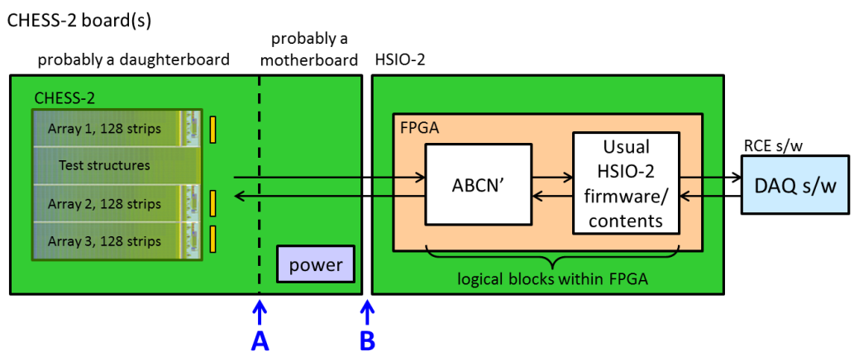
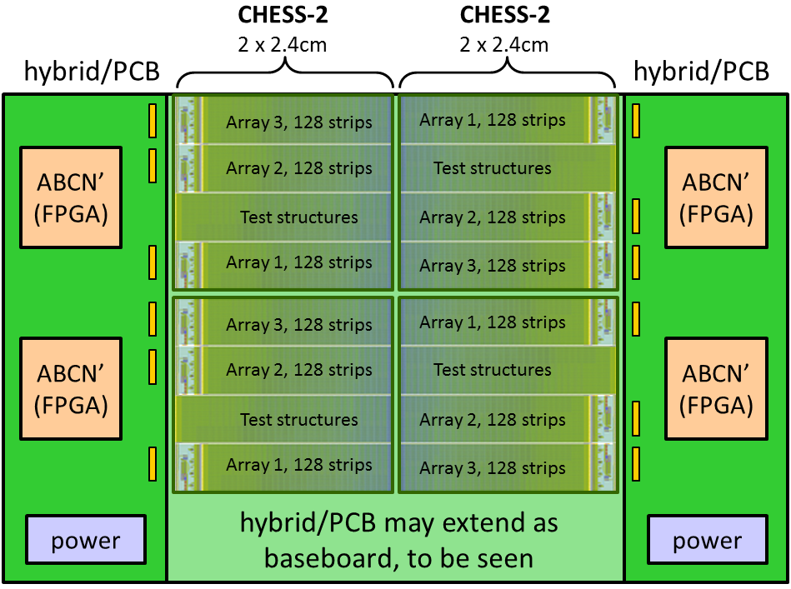
Schedule update
A reminder: the Strip CMOS programme is evaluated annually at a checkpoint review.
The next review will be this September.
The mandatory deliverable is to demonstrate the ABCN' running on an FPGA.
  I interpret this as demonstrate with a CHESS-2 sensor.
The next deliverable is the hybrid (circuit board) with FPGAs. It would be very good if we could have this for the September review. It would be nearly mandatory for the Strips TDR review -- which is “Q4 2016”.
First step = identify the FPGA (size, type) needed to include the ABCN’.
This will not be specified as the smallest-possible FPGA, but rather a sensible/comfortable size that gives some margin of additional space, in case of later changes.
Phase 3 hardware
in practice, this may be with the Nexys Video,
provided that interface B is an FMC connector
Phase 4 hardware

Slide 19
Allocation of blocks
This is our current rough planning.
This seemed all right to the group. We noted that we will need the CHESS-2 specification to make progress.
We agreed to start like this, and review this allocation as we go along.
For UCL, it’s best not to assign a block due to workload, but Matt will support us with getting the ABCN’ integrated into the ITSDAQ firmware build.
USTC?
USTC and IHEP? for datapath changes
need to see later if CF will still apply ?
also needs datapath changes
CHESS-2 Data Emulator
(for now)
later: CHESS-2 sensor
either way,
128 strips
(based on ABC130*)
?
?
L1/R3
L0/Cmd
ABC130 Command Decoder
UBC
L0/Cmd
SACI signals
SACI command bridge
including SACI block from SLAC
Oxford?

