Slide 1
Status of test kit and ABCN’ work
20 May 2016
T. Huffman, J. J. John, H. Grabas
with help from many colleagues

Slide 2
CHESS-2-AMS analogue daughterboard
Reminder: this will be a new daughterboard plugging into the CHESS-1 motherboard, to test the test structures on CHESS-2.
Have been discussing with Hervé, Pietro and colleagues to gather details of the test structures and signals in/out.
We’re converging on the connections needed for the CHESS-2 test structures versus available signals on the CHESS-1 motherboard/daughterboard interface.

Slide 3
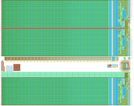
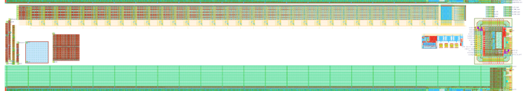
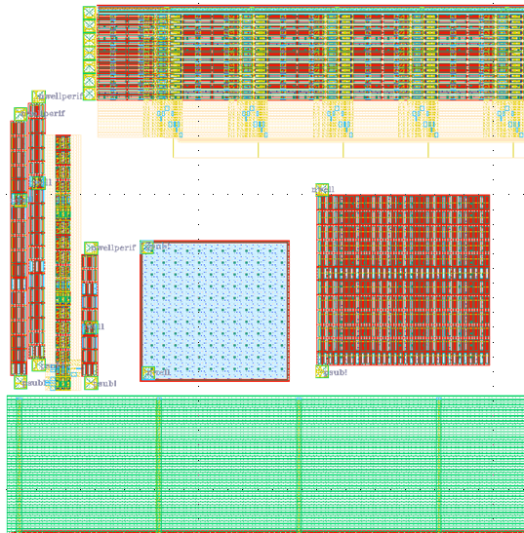
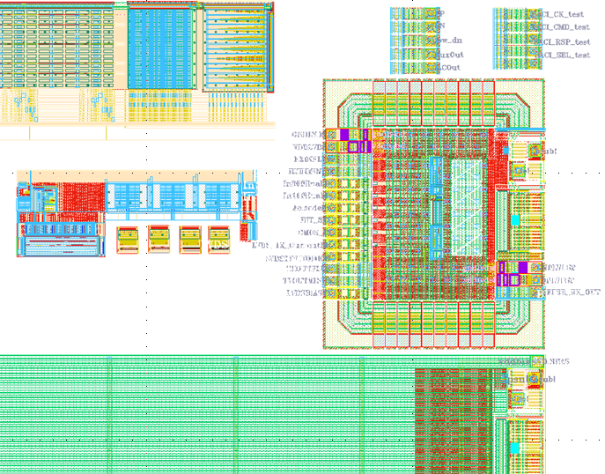
CHESS-2-AMS test structures
CHESS-2-AMS
reticule
CHESS-2-AMS test structures
16 strips of 32 pixels each = 512 pixels in all
1 digital output, muxed from 512 pixels
7 analogue outputs from the 512 pixels
SACI bus for test structures
various
E-TCT test structures
LVDS test structure:
Tx-Rx CMOS to LVDS and LVDS low power to LVDS full power driver
+ 4 radsoft DACs
left side structures
right side structures

Slide 4
CHESS-2-AMS irradiation plans
Todd spoke with Federico at the PS.
The next available slot is in late September.
Are we happy to go ahead and make plans for this?
Are we planning to also irradiate at other facilities?

Slide 5
ABCN’ update
Next meeting will be Thursday 12 May, usual 15:30 Geneva time
Most recent minutes (annotated slides): link
Update:
We worked through CHESS-2 data format with Hervé and Pietro, per slides shown earlier
We are next working on the spec for CHESS-2 data emulator
UBC (Vancouver) have a co-op student who has started, who will be working on the ABCN’
(co-op placement = an undergrad work term in Canada, ~12-14 weeks long)

