Slide 1
Zugang zu den Undulatoreinhausungen am Beispiel von SASE1
J. Pflüger, WP71

Slide 2
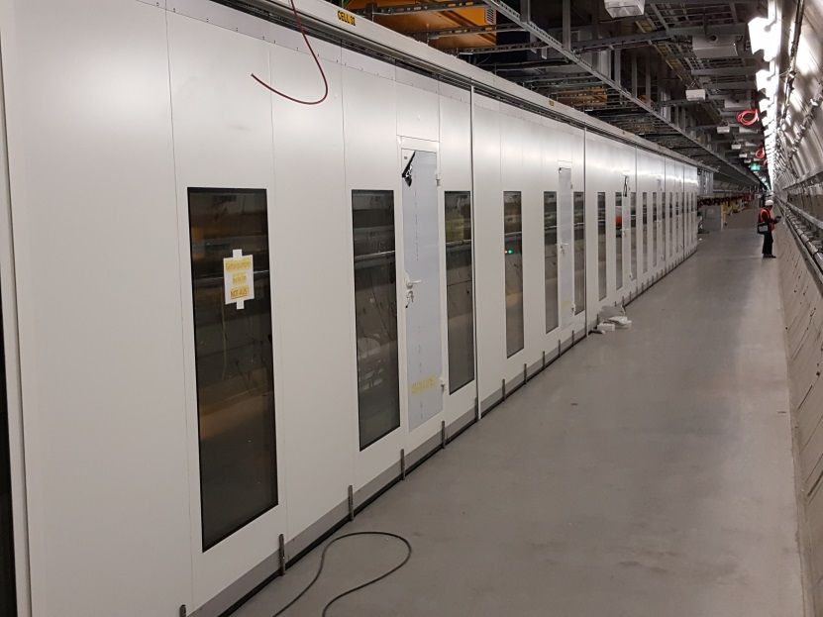
Status SASE1
Undulator hardware installed
Vacuum system installed -- operationaö
Control system installed and wired – operational
Control System operational, can be remotely controled
Installation of enclosure started not yet finished
Status: 18.5.2016

Slide 3
SASE1 Next Steps
Complete enclosures - until 31.5.2016
Do remaining work inside the enclosures:
BLMs: in work
Pilotherme cables: in work
220V Connectors: promised
Quadrupole Covers (Sicherheitsabdeckungen): in work
Magnetic clamp of laser fiducial (Haftmagnet in Vermessungsmarke): known
Tunnel search (Flash lights, loudspeakers, …..??? ) status unclear
More ?
Hardware commissioning, hot commissioning phase:
Remove wooden safety covers and protective foils
Adjust vacuum chamber and undulator close gap to 10.000mm
Adjust Hardstops, limit switches and CALs
Mount and adjust RADFETs
Mount and align Air Coils and connect cooling water
→ Ready for Operation

Slide 4
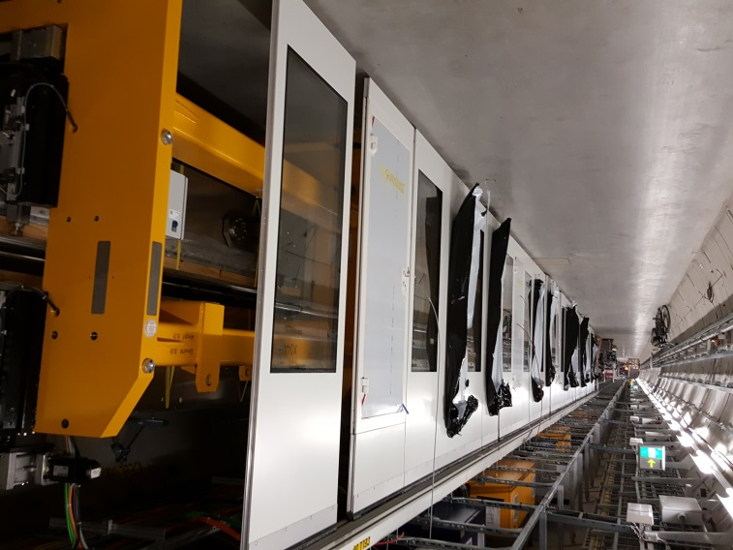
Removal of protective covers:
Safety issue → Precautionary measures needed → discussed with SAVE

Slide 5
New Hazards
Only inside the enclosure after removal of protective covers
Strong magnetic fields
Danger with magnetic tools
Danger for bearer of implants (Implantatsträger) Cardiadic pacemaker etc.
Danger for credit cards, bank cards etc.
Crushing Hazard (Quetschgefahr) by slowly moving parts
Max. gap speed 10mm/s
Remote control of undulator maybe enabled

Slide 6
Consequences
Removal of protective covers defines beginning of new safety regulations inside the enclosures:
Inside the enclosure it is very tight and space is very limited
Keep enclosure closed and stay out. It is the best, 100% protection
Strict access control for un-avoidable work:
Control / approval / permission through WP71
Instructions/tutorial by WP71
No magnetic tools!

Slide 7
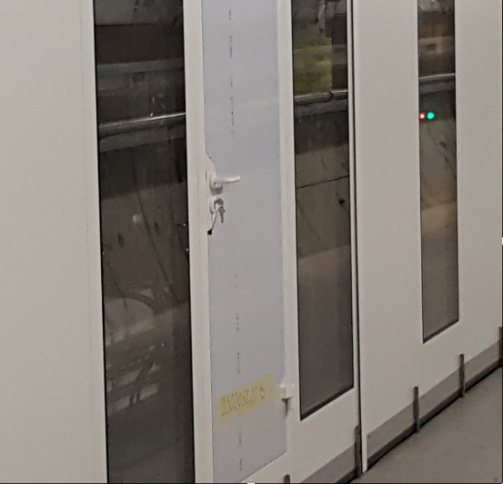
Measures
Keep enclosures closed
There is a door in every cell with a handle and a lock.
Restrict access by announcement
Attach warning and instruction signs in agreement with SAVE on every n^{th} cell n= 1..5

Slide 8
Undulatorsystem im Testbetrieb!
In der Einhausung Gefährdung durch:
Starke Magnetfelder durch offene, starke Permanentmagnete, die nicht abgeschaltet werden können.
Quetschgefahr durch bewegliche, ferngesteuerte Magnetstrukturen
Vorsichtsmaßnahmen:
Türen und Seitenwände immer geschlossen halten
Kein Zutritt für Träger von Herzschrittmachern und Implantaten
Kein magnetisches Werkzeug: Verletzungsgefahr
Gefahr der Beschädigung von Uhren, Bank-, Scheck- und Kreditkarten
Zutritt und Arbeiten nur nach Absprache und Einweisung durch die XFEL Undulatorgruppe, WP71.
Kontakt: G.Deron, 3341; S. Karabekyan, 4797 J. Pflüger, 3242 M. Yakopov, 5635

Slide 9
Appeal (Appell)
To all having work in the XTD2 enclosures:
Do all work as soon as possible, especially
BLMs:
Pilotherme cables:
220V Connectors:
Quadrupole Safety Covers (Sicherheitsabdeckungen):
Magnetic clamp of laser fiducial (Haftmagnet in Vermessungsmarke):
Tunnel search (Flash lights, loudspeakers, …..??? )
Work in XTD4 and XTD1 Convenient access if neither phase shifters, undulators and enclosures are installed.
Installation Plans for XTD4:
Phase Shifters by 27.5. ; Undulators by 10.6.
Enclosures in July
Installation plan for XTD1
Same procedures in 4-5 months

