Slide 1
Update on E-TCT measurements with passive pixels on
CHESS-1 chip irradiated with PS protons
I. Mandić, B. Hiti et al.,
Jožef Stefan Institute, Ljubljana, Slovenia

Slide 2
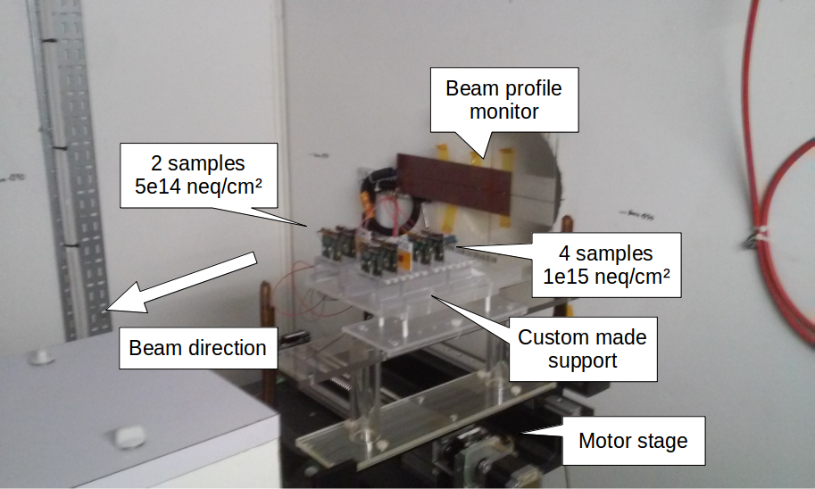
Reminder:
6 chess1 chips mounted on daughter boards irradiated with 24 GeV protons
at CERN PS in november 2015
  More detail in slides by B. Hiti from November 10th 2015
https://indico.desy.de/conferenceDisplay.py?confId=13299
due to broader beam and missalignment the actual equivalent fluences were
3.3e14 n/cm2 and 4.6e14 n/cm2

Slide 3
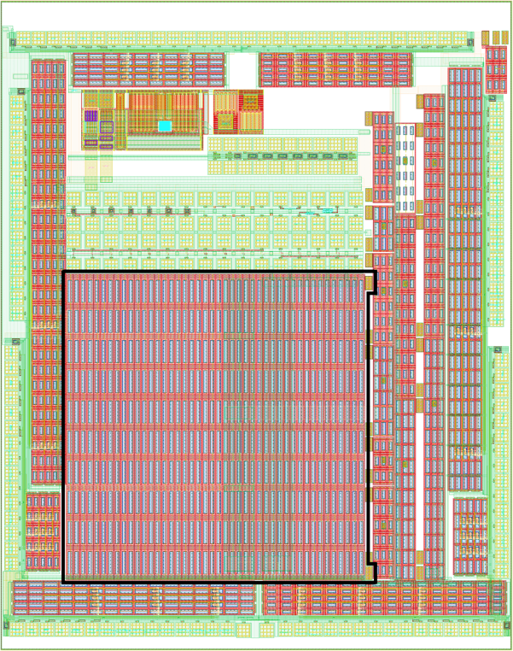
E-TCT on passive pixel array PPA9
Beam
direction
Beam
Two connection versions:
1) perimeter to high voltage
signal to high voltage and to readout
2) signal and perimeter to high voltage and to readout

Slide 4
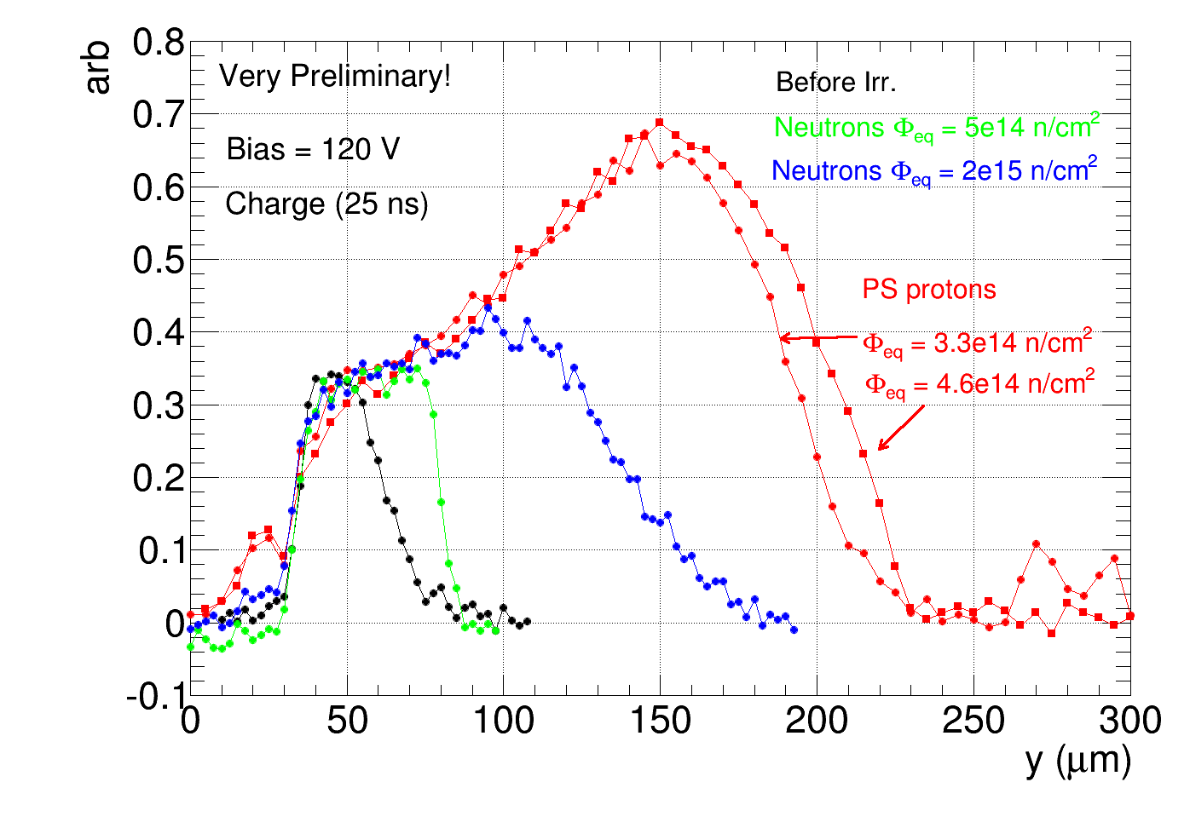
E-TCT passive pixel array (PPA9), central pixel read out
large charge collection width measured on sample irradiated with protons
➔ larger than the largest irradiated with neutrons (at 1e15 n/cm2 or 2e15 n/cm2)

Slide 5
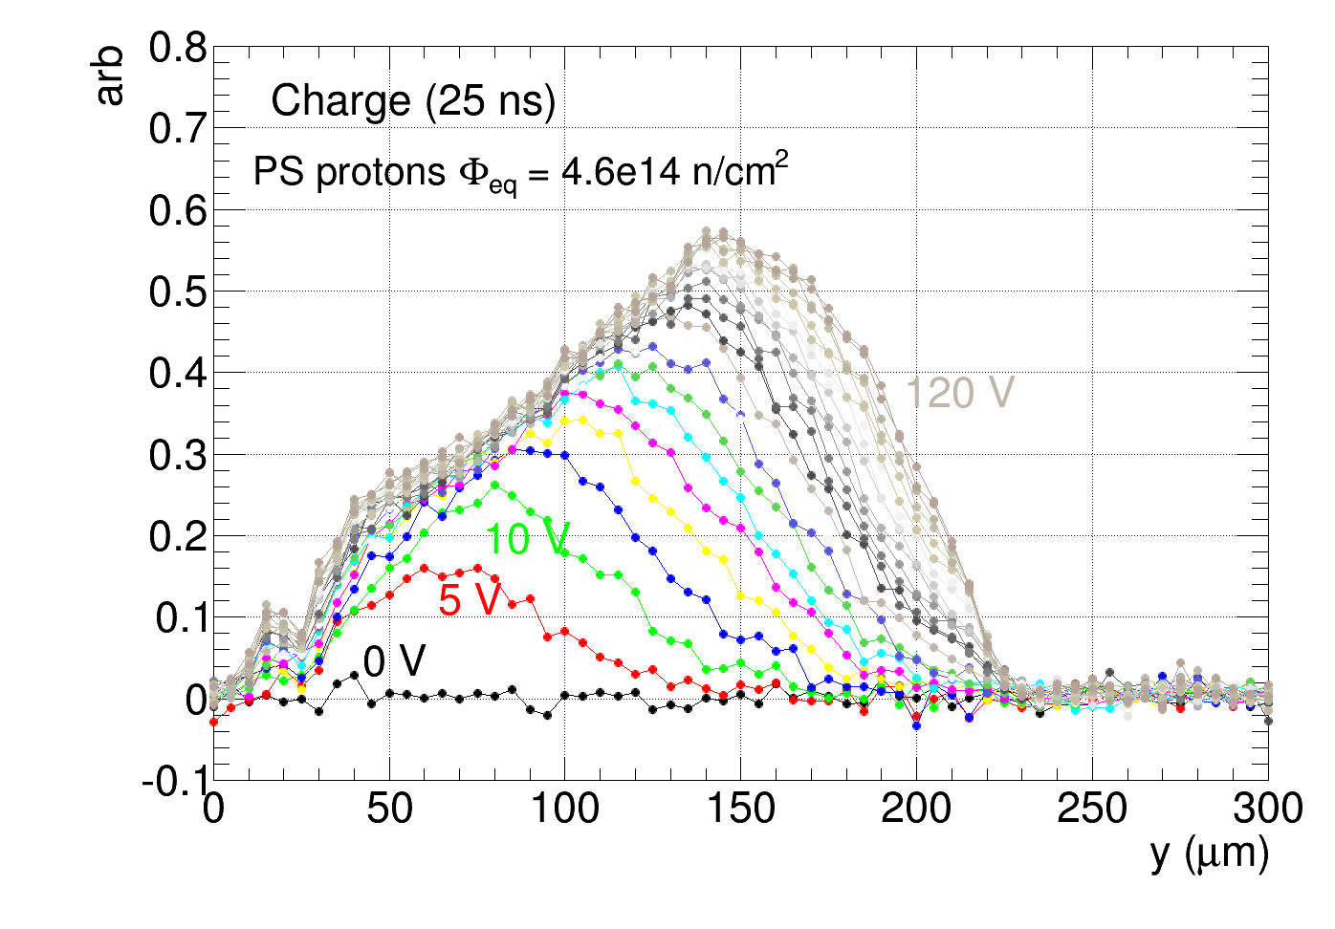
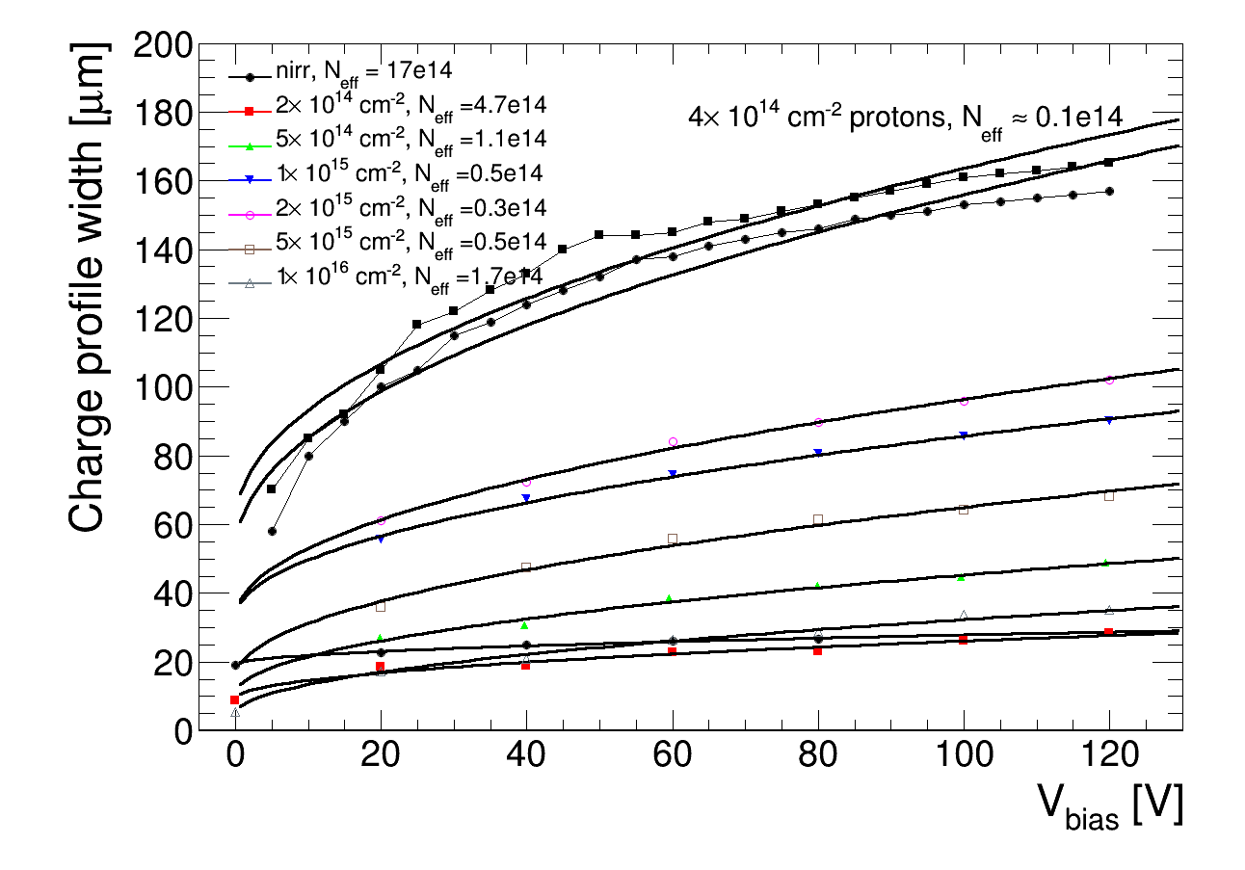
Fit collection width with vs bias:
Protons:
large offset at low bias voltage
fit compatible with N_{eff} ~ 0.1e14 cm⁻³
similar Neff as after ~2e15 neutrons
→ faster initial acceptor removal
neutrons

Slide 6
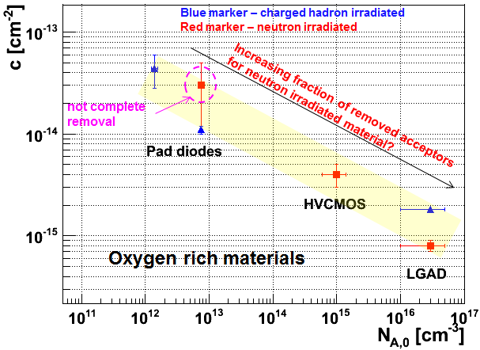
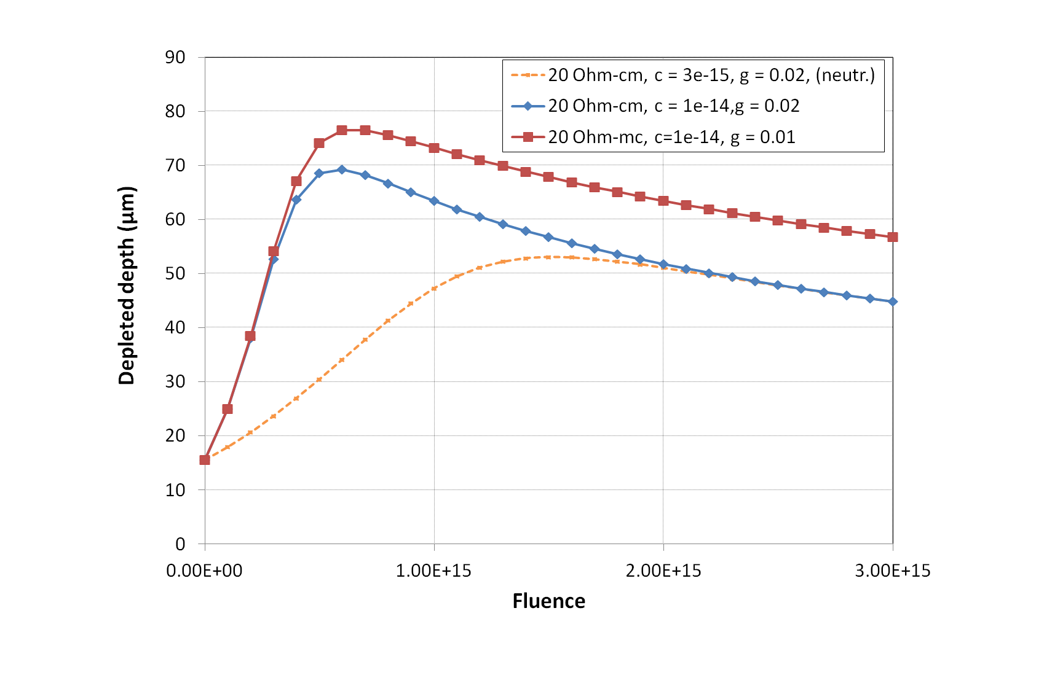
in LGAD acceptor removal constant larger for charged hadrons than for neutrons
→ seems to be so also for AMS 20 Ohm-cm material
Depleted depth vs. fluence calculated for
different constants:
➔ max. depleted depth expected at lower fluences for protons than for neutrons
difference larger if also g smaller for protons (expected in oxigenated Si)

