Slide 1
Status of test kit and ABCN’ work
24 May 2016
T. Huffman, J. J. John, H. Grabas
with help from many colleagues

Slide 2
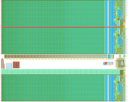
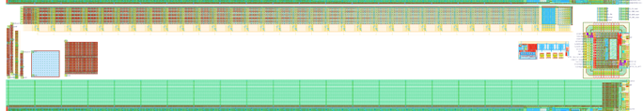
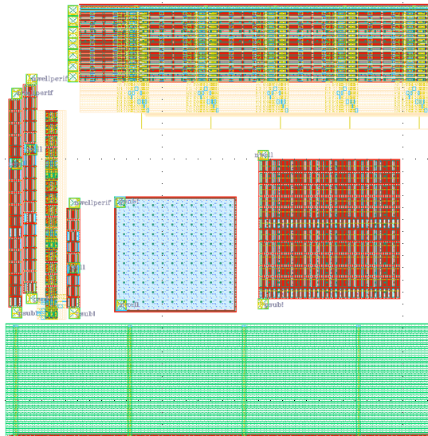
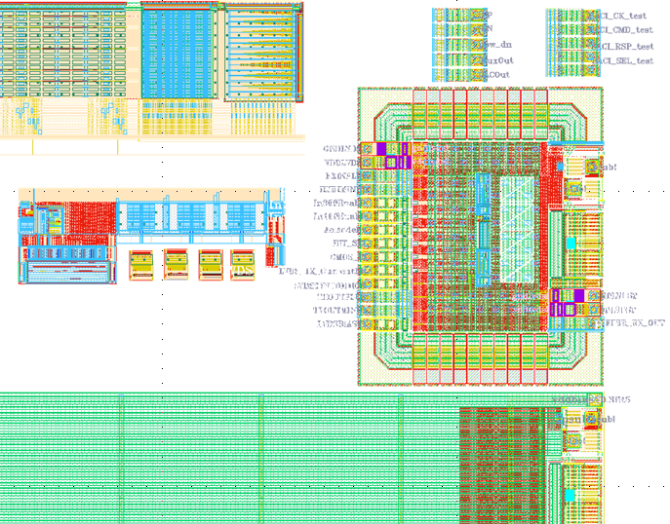
CHESS-2-AMS test structures, reminder
CHESS-2-AMS
reticule
CHESS-2-AMS test structures
16 strips of 32 pixels each = 512 pixels in all
1 digital output, muxed from 512 pixels
7 analogue outputs from the 512 pixels
SACI bus for test structures
various
E-TCT test structures
LVDS test structure:
Tx-Rx CMOS to LVDS and LVDS low power to LVDS full power driver
+ 4 radsoft DACs
left side structures
right side structures

Slide 3
Test structures – what’s needed?
Current understanding of connections required:
Section | # of supplies/ bias/HV | # of inputs – changeable | # of inputs – fixed (high/low) | # of outputs
Test structures: Strips | 5: 0V, 1.8V, 3.3V, 3.6V, HV 0V: gndd!_array, gnda!_test, gndd!_test; 1.8V: vdd18; 3.3V: vddd!_array, vdda!_test, vddd!_test, vddo! 3.6V: vddbias; HV: psub! | 7 ck, global_reset, charge_inj, saci_ck_test + saci_ck_array, saci_sel_test, saci_sel_array, saci_cmd_test + saci_cmd_array + means commoned on board | 0 | 10 ana_out1 to ana_out7, Out_mux, saci_rsp_test, saci_rsp_array,
Test structures: DACs | 0 new | 1 DAC_EnB | 2 RP, RN | 4 Cascode, Baseline, Baseline_R, Threshold
Test structures: Edge TCT | 0 new (all HV) nwell_periphery_hv, nwell_no_side_contacts_hv, nwell_half_hv, big_nwell_hv, big_array_hv | 0 | 0 | 8 nwell, nwell_periphery, nwell_no_side_contacts, nwell_no_side_contacts_periphery, nwell_half, nwell_half_periphery, big_nwell, big_array
Test structures: LVDS | 0 new 0V: gndlvds1 3.3V: vddlvds1, vddo! HV: psub! | 10 cmos_in, rxinplus, rxminus, lvdsbiastx, acmodeEn, In100Enable, In300Enable, BIT_SEL, LVDS_TX_CurrentBit, LVDSTXVCOMMON | 0 | 3 buffer_rx_out, txoutplus, txoutminus
Bottom array | 0 new? (to confirm) | 0 new? (to confirm) | 0 new? (to confirm) | 14 LVDS pairs? = 28 connections

Slide 4
Test structures – summary of needs
Current understanding of connections required:
Section | # of supplies/ bias/HV | # of inputs – changeable | # of inputs – fixed (high/low) | # of outputs
Test structures: Strips, DACs, Edge TCT | 5: 0V, 1.8V, 3.3V, 3.6V, HV 0V: gndd!_array, gnda!_test, gndd!_test; 1.8V: vdd18; 3.3V: vddd!_array, vdda!_test, vddd!_test, vddo! 3.6V: vddbias; HV: psub! nwell_periphery_hv, nwell_no_side_contacts_hv, nwell_half_hv, big_nwell_hv, big_array_hv | 8 ck, global_reset, charge_inj, saci_ck_test + saci_ck_array, saci_sel_test, saci_sel_array, saci_cmd_test + saci_cmd_array, DAC_EnB + means commoned on board | 2 RP, RN | 22 ana_out1 to ana_out7, Out_mux, saci_rsp_test, saci_rsp_array, Cascode, Baseline, Baseline_R, Threshold nwell, nwell_periphery, nwell_no_side_contacts, nwell_no_side_contacts_periphery, nwell_half, nwell_half_periphery, big_nwell, big_array
Total for all of the above + bottom array | 5 | 8 (to confirm) | 2 (to confirm) | 50 (+ 28 connections, to confirm)
Additional signals for Test structures: LVDS | + 0 new 0V: gndlvds1 3.3V: vddlvds1, vddo! HV: psub! | + 10 cmos_in, rxinplus, rxminus, lvdsbiastx, acmodeEn, In100Enable, In300Enable, BIT_SEL, LVDS_TX_CurrentBit, LVDSTXVCOMMON | + 0 | + 3 buffer_rx_out, txoutplus, txoutminus

Slide 5
Daughterboard connector – what’s available?
Section | # of supplies/ bias/HV | # of inputs – fast changing | # of inputs – slow changing | # of outputs
CHESS-1 daughterboard connector | 4 supplies: 0V, 1.8V, 3.3V, HV 7 Bias DACs | 4 in all: 1 suitable for clock 1 for analogue injection 2 connections to digital I/O of FPGA | 7 Bias DACs | 79
Comments | As far as I can see, the bias DACs on the motherboard aren’t needed to supply any bias voltages to CHESS-2? To be confirmed | The proposed clock line is the digital reset for TJ-CHESS. The 2 connections to the FPGA were daughterboard flavour ID bits, intended as outputs of d/b, but can be repurposed. | If not needed to provide bias levels to CHESS-2, then the 7 Bias DACs can be used as slow digital inputs to CHESS-2.

Slide 6
Proposal: what to include on daughterboard
My current thinking is:
We have enough connections to cover these test structures:
  Strips
  DACs
  Edge TCT structures
We have enough outputs to also connect the digital outputs of the bottom array to the motherboard’s analogue outputs.
  I *think* we have enough inputs to work with the bottom array.
  Need to check more points with the design team.
  Since we need to have the bottom array’s SACI bus connected anyway to work with the test structures, this is worth trying.
The LVDS test structures require more inputs than the CHESS-1 system can provide. Also, the outputs would pass through a switch and a buffer, so the outputs would undergo some changes.
  It seems better to me to make a separate test board for the LVDS testing.

Slide 7
CHESS-2-AMS irradiation plans
Update from Todd:
Planning with Federico for irradiation at PS: end of Sept or start of Oct.
We can only have two different exposure levels.
What levels do people think we should use?
Todd suggests 0.5 and 1.0 x 10¹⁵ n/cm² equivalent.

Slide 8
ABCN’ update
Next meeting will be Thursday 26 May, usual 15:30 Geneva time
Most recent minutes (annotated slides) will be placed here by the time of the meeting: link
Update:
We have firmed up the spec for the CHESS-2 data emulator. USTC is working on this.
UBC is working on the firmware build to include the present ABC130* code on the Nexys Video with Matt’s help.
For the high-level design, we are working on the data path changes and the processing of triggers.
Reminder: we are using the ABC130 format of L0/CMD and L1/R3 serial multiplexed inputs.

