Slide 1
Chess2 Emulator update

Slide 2
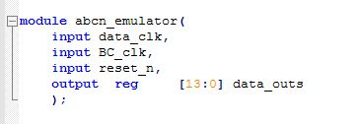
First Step
Make a fundamental interface module of data emulator
Basic requirement: 2 clock inputs and 14-bits data output
Add an input to reset module
Build an independent module to generate data
Make the data to be the pattern we wanted

Slide 3
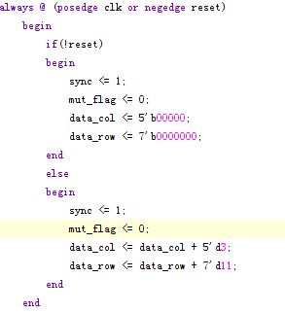
First Step
Generator module
In this module, 5-bits data is added 3 each time, and 7-bits data is added 11 to generate data for the emulator.
Notes:
Mut

Slide 4
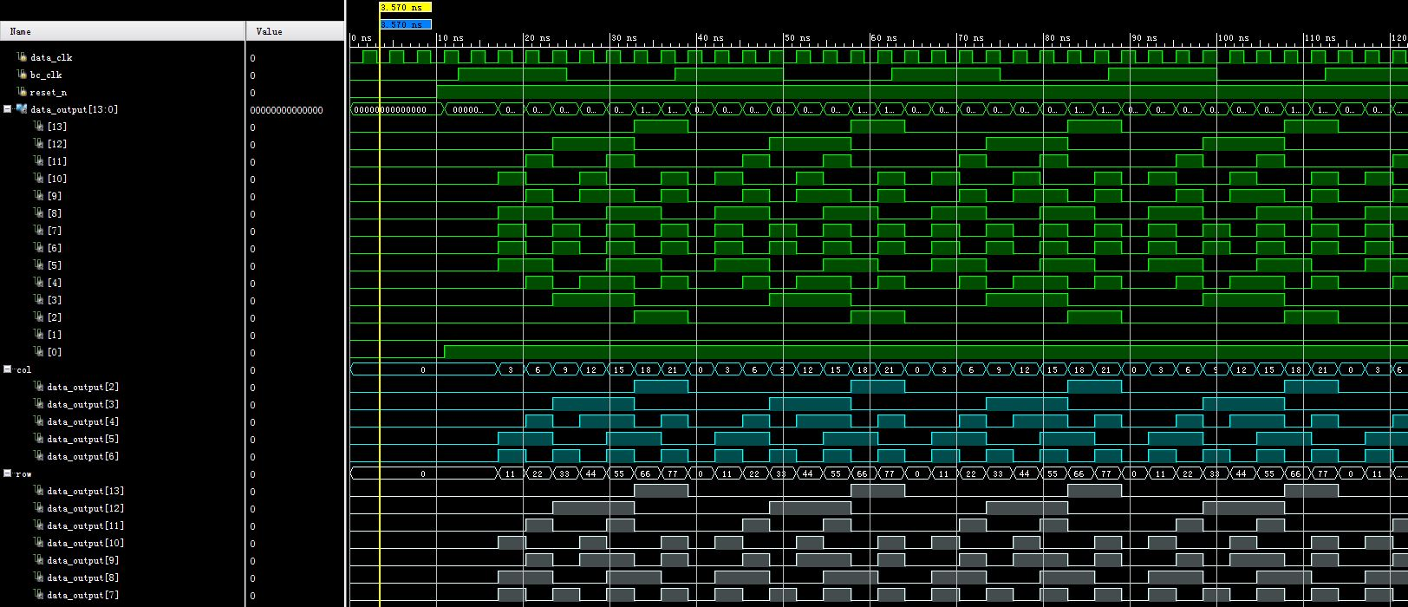
First Step

Slide 5
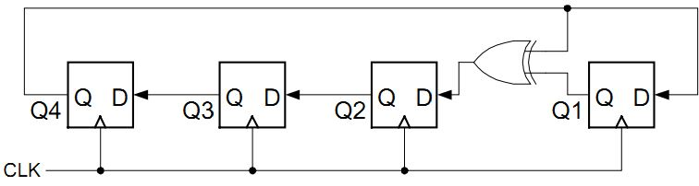
Second Step
Build a random data generator
According to the former algorithm in vhdl from Jaya, Linear Feedback Shift Registers (LFSRs) is a good method to generate random data.
LFSR is concise way to build a pseudo-random number generator. It only use very little hardware resource, and the speed of this operation is high.

Slide 6

Second Step
5-bit and 7-bit random generators are what we need now
5-bit LFSR

Slide 7
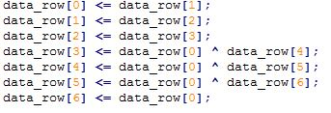
Second Step
7-bit LFSR

Slide 8
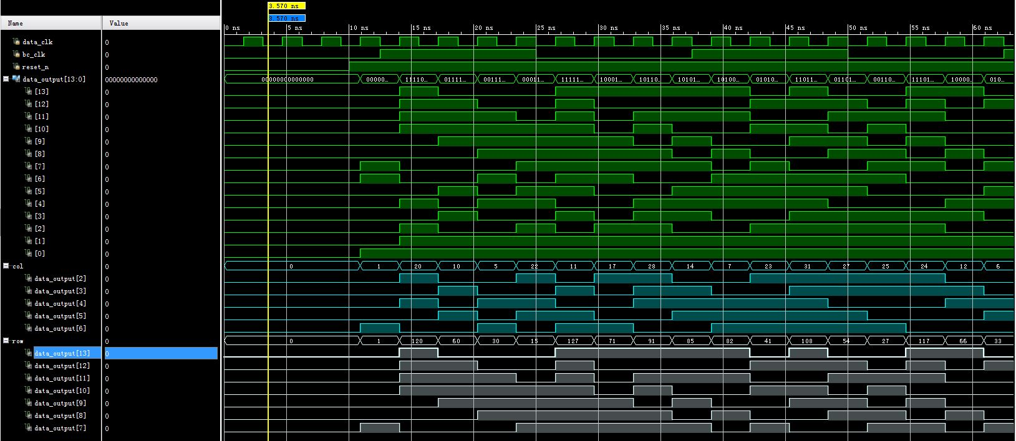
Second Step

Slide 9
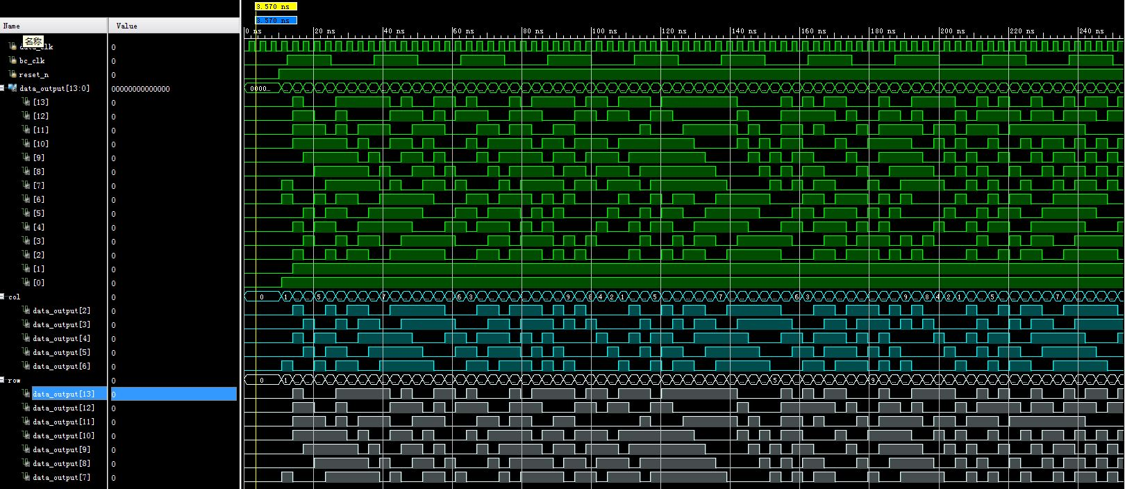
Second Step
5-bit period: 96.875ns(31 clock period)
7-bit period: 396.875ns(127 clock period)

Slide 10
Second Step
I just find out maybe a 13-bit random generator is a much better way to make this data more complicated. Odd bits give the row data, and even bits give the column data and double hits flag bit.

