Slide 1
Top_Logic
Weiguo Lu
16 June 2016

Slide 2
Interfaces
Communicates with EvtBuffer(only control read), CF, ReadOut
PR_Enable, LP_Enable, RRmod[1:0]
(config bits)
RRforce
TopLogic
empty_fifo_PR
PR_ReadEnable
L0L1
empty_fifo_LP
LP_ReadEnable
L0L1
ReadVeto
L1BReadVeto
CF
CF_Busy
RR_Start
ReadOut
Data_Busy
ReadOut
RR_Busy
RR_Empty
clk(40MHz)
rst_b

Slide 3
Inputs
empty_fifo_PR : PR read address FIFO flag (1 = Empty)
empty_fifo_LP : LP read address FIFO flag
ReadVeto : blocks R3_readEnable or L1_ReadEnable signals until (ReadVeto) is released
CF_Busy : indicating CF is busy processing (1= Busy)
Data_Busy : indicating Readout-serializer is busy with current data packets
RR_Busy : indicating Readout-serializer is busy with current registers packets
RR_Empty: indicating Registers Read FIFO empty
PR_Enable,LP_Enable: configure bits to control the data read
RRforce: a one BC signal that triggers one readout sequence if conditions met
RRmode[1:0] : defines the register read mode

Slide 4
Outputs
PR_ReadEnable : Read command to the R3FIFO (get address) and the L1Buffer (get hit data). Starts the CF process.
LP_ReadEnable : Read command to the L1FIFO (get address) and the L1Buffer (get hit data). Starts the CF process.
L1BReadVeto: veto control to the L0L1 block
RR_Start : Read command to the Read Register FIFO.

Slide 5
Register Read Mode
Read Register control according to the readreg Packet transmission criterias :
  RR_mode[1:0]=00 : No read Reg transmission (even if the ReadReg FIFO gets filled or full)
  RR_mode[1:0]=01 : Automatic Read Reg as soon as no LP or PR and Read Reg pending
  RR_mode[1:0]=10 : Enforce one Read Reg sequence when receiving a command and the PR queue is empty

Slide 6
Defined states
Defined states
State | Condition | Do(Output signals are 1BC long, active high)
WAIT | (void) | Reset, return of other states
PR_PCSS | PR_enable && (~empty_fifo_PR && ~CF_Busy && ~RR_Busy) | PR_ReadEnable (to L0L1)
LP_PCSS | LP_Enable && (~empty_fifo_LP && empty_fifo_PR && ~CF_Busy && ~RR_Busy) | LP_ReadEnable (to L0L1)
RR0_PCSS | RRmod[0] && (empty_fifo_PR && empty_fifo_LP && ~RR_Empty && ~RR_Busy&&~CF_Busy) | RR_start (to ReadOut)
RR1_PCSS | RRmod[1] && (RRenforce && empty_fifo_PR && ~RR_Empty && ~RR_Busy&&~CF_Busy) | RR_start (to ReadOut)
VETO | ReadVeto | (Void)

Slide 7
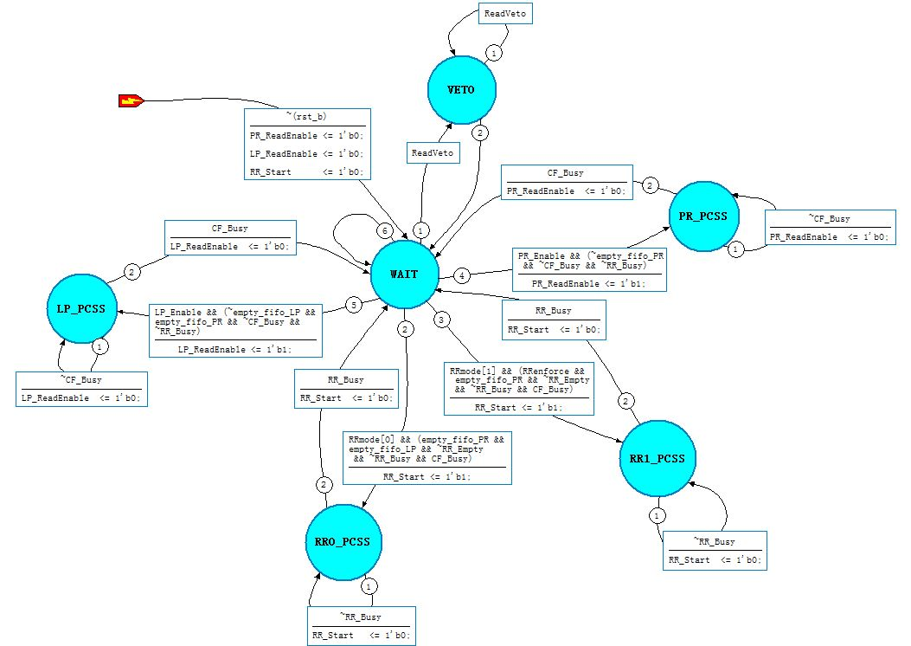
State diagram

