Slide 1
Status of test kit and ABCN’ work
7 June 2016
J. J. John and T. Huffman
with help from many colleagues

Slide 2
Test structures – current understanding
Section | # of supplies/ bias/HV | # of inputs – changeable | # of inputs – fixed (high/low) | # of outputs
Test structures: Strips | 5: 0V, 1.8V, 3.3V, 3.6V, HV 0V: gndd!_array, gnda!_test, gndd!_test; 1.8V: vdd18; 3.3V: vddd!_array, vdda!_test, vddd!_test, vddo! 3.6V: vddbias; HV: psub! | 7 ck, global_reset, charge_inj, saci_ck_test + saci_ck_array, saci_sel_test, saci_sel_array, saci_cmd_test + saci_cmd_array + means commoned on board | 0 | 10 ana_out1 to ana_out7, Out_mux, saci_rsp_test, saci_rsp_array,
Test structures: DACs | 0 new if internal DACs are used + 4 if external DACs are used: DAC_EnB, Cascode, Baseline, Baseline_R, Threshold | + 1 DAC_EnB | + 2 RP, RN | + 4 if internal DACs are used: Cascode, Baseline, Baseline_R, Threshold
Test structures: Edge TCT | 0 new (all HV) nwell_periphery_hv, nwell_no_side_contacts_hv, nwell_half_hv, big_nwell_hv, big_array_hv | 0 | 0 | + 8 nwell, nwell_periphery, nwell_no_side_contacts, nwell_no_side_contacts_periphery, nwell_half, nwell_half_periphery, big_nwell, big_array
Test structures: LVDS | 0 new 0V: gndlvds1 3.3V: vddlvds1, vddo! HV: psub! | + 10 cmos_in, rxinplus, rxminus, lvdsbiastx, acmodeEn, In100Enable, In300Enable, BIT_SEL, LVDS_TX_CurrentBit, LVDSTXVCOMMON | 0 | + 3 buffer_rx_out, txoutplus, txoutminus
Bottom array | 0 new | + 1 LVDS clock pair in = 2 connections to be able to read data | 0 new | + 14 LVDS pairs out = 28 connections
these are trivial, so not included in later slides

Slide 3
Test structures – summary of needs
Current understanding – categorise inputs as fast or slow changing:
Section | # of supplies/ bias/HV | # of inputs – fast changing | # of inputs – slow changing | # of outputs
Test structures: Strips, DACs, Edge TCT | 5 if internal DACs: 0V, 1.8V, 3.3V, 3.6V, HV 0V: gndd!_array, gnda!_test, gndd!_test; 1.8V: vdd18; 3.3V: vddd!_array, vdda!_test, vddd!_test, vddo! 3.6V: vddbias; HV: psub! nwell_periphery_hv, nwell_no_side_contacts_hv, nwell_half_hv, big_nwell_hv, big_array_hv 9 if external DACs: add: Cascode, Baseline, Baseline_R, Threshold | 2: ck (40 MHz), charge_inj | 6: global_reset, saci_ck_test + saci_ck_array, saci_sel_test, saci_sel_array, saci_cmd_test + saci_cmd_array, DAC_EnB | 22 if internal DACs: ana_out1 to ana_out7, Out_mux, saci_rsp_test, saci_rsp_array, Cascode, Baseline, Baseline_R, Threshold nwell, nwell_periphery, nwell_no_side_contacts, nwell_no_side_contacts_periphery, nwell_half, nwell_half_periphery, big_nwell, big_array 18 if external DACs
Additional signals to read the bottom array | + 0 new | + 2: add: 1 LVDS pair for 320MHz readout clock for bottom array | + 0 new | + 14 LVDS pairs out => + 28 outputs
Additional signals for Test structures: LVDS | + 0 new 0V: gndlvds1 3.3V: vddlvds1, vddo! HV: psub! | + 3: cmos_in, rxinplus, rxminus | + 7: lvdsbiastx, acmodeEn, In100Enable, In300Enable, BIT_SEL, LVDS_TX_CurrentBit, LVDSTXVCOMMON | + 3: buffer_rx_out, txoutplus, txoutminus

Slide 4
Daughterboard connector – what’s available?
Section | # of supplies/ bias/HV | # of inputs – fast changing | # of inputs – slow changing | # of outputs
CHESS-1 daughterboard connector | 4 supplies: 0V, 1.8V, 3.3V, HV 1 Bias DAC for 3.6V, or 5 Bias DACs if external DACs | 4 in all: 1 suitable for clock, 1 for analogue inj, 2 connections to digital I/O of FPGA | 6 Bias DACs left of 7, if internal DACs are used or 2 Bias DACs left, if external DACs. | 79
versus
Section | # of supplies/ bias/HV | # of inputs – fast changing | # of inputs – slow changing | # of outputs
Test structures: Strips, DACs, Edge TCT | 5 if internal DACs, 9 if external DACs | 2 | 6 – ok if internal DACs, can’t fit if external DACs | 22 if internal DACs, 18 if external DACs
All of the above + read bottom array | 5 if internal DACs, 9 if external DACs | 4 | 6 – ok if internal DACs, can’t fit if external DACs | 50 if internal DACs, 46 if external DACs
All of the above + LVDS Test structures | 5 if internal DACs, 9 if external DACs | 7 | 13 | 53 if internal DACs, 49 if external DACs

Slide 5
CHESS-2-AMS irradiation plans
Planning with Federico for irradiation at PS: start of October.
Based on feedback from the previous CMOS Fortnightly meeting, the exposure levels of 0.5 and 1.0 x 10¹⁵ n/cm² equivalent are confirmed.
(Reminder, we can only have two different exposure levels due to PS constraints)

Slide 6
Backup slides

Slide 7
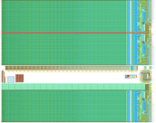
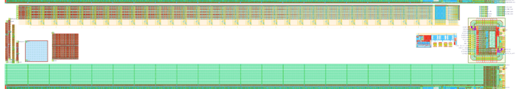
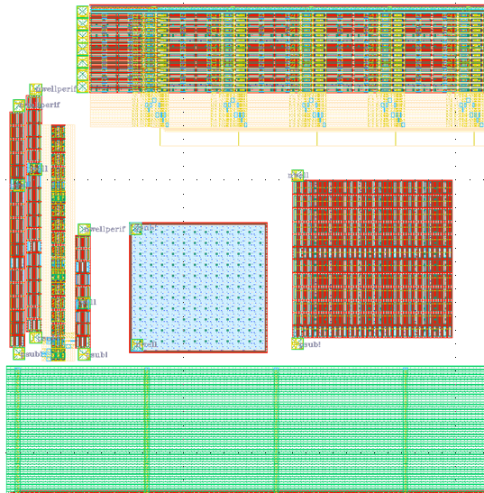
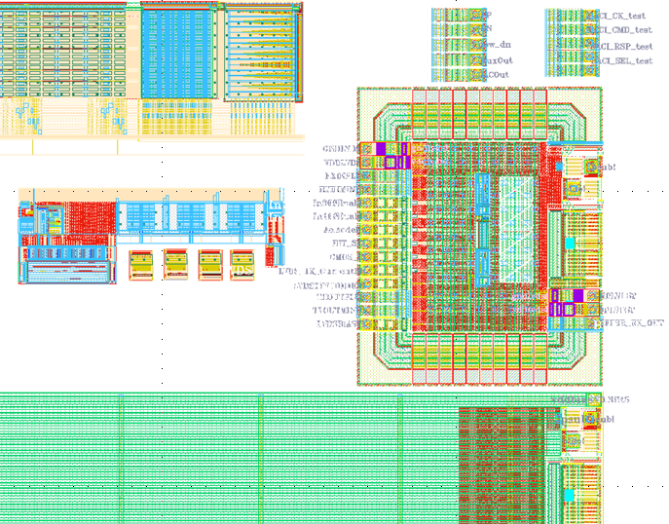
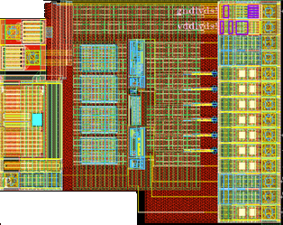
CHESS-2-AMS test structures, reminder
CHESS-2-AMS
reticule
CHESS-2-AMS test structures
16 strips of 32 pixels each = 512 pixels in all
1 digital output, muxed from 512 pixels
7 analogue outputs from the 512 pixels
SACI bus for test structures
various
E-TCT test structures
LVDS test structure:
Tx-Rx CMOS to LVDS and LVDS low power to LVDS full power driver
+ 4 radsoft DACs
left side structures
right side structures

