Slide 1
Status of test kit and ABCN’ work
21 June 2016
J. J. John and T. Huffman
with help from many colleagues

Slide 2
CHESS-2 d/b for CHESS-1 m/b: reminder
Current understanding – categorise inputs as fast or slow changing:
Section | # of supplies/ bias/HV | # of inputs – fast changing | # of inputs – slow changing | # of outputs
Test structures: Strips, DACs, Edge TCT | 5 if internal DACs: 0V, 1.8V, 3.3V, 3.6V, HV 0V: gndd!_array, gnda!_test, gndd!_test; 1.8V: vdd18; 3.3V: vddd!_array, vdda!_test, vddd!_test, vddo! 3.6V: vddbias; HV: psub! nwell_periphery_hv, nwell_no_side_contacts_hv, nwell_half_hv, big_nwell_hv, big_array_hv 9 if external DACs: add: Cascode, Baseline, Baseline_R, Threshold | 2: ck (40 MHz), charge_inj | 6: global_reset, saci_ck_test + saci_ck_array, saci_sel_test, saci_sel_array, saci_cmd_test + saci_cmd_array, DAC_EnB | 22 if internal DACs: ana_out1 to ana_out7, Out_mux, saci_rsp_test, saci_rsp_array, Cascode, Baseline, Baseline_R, Threshold nwell, nwell_periphery, nwell_no_side_contacts, nwell_no_side_contacts_periphery, nwell_half, nwell_half_periphery, big_nwell, big_array 18 if external DACs
Additional signals to read the bottom array | + 0 new | + 2: add: 1 LVDS pair for 320MHz readout clock for bottom array | + 0 new | + 14 LVDS pairs out => + 28 outputs
Additional signals for Test structures: LVDS | + 0 new 0V: gndlvds1 3.3V: vddlvds1, vddo! HV: psub! | + 3: cmos_in, rxinplus, rxminus | + 7: lvdsbiastx, acmodeEn, In100Enable, In300Enable, BIT_SEL, LVDS_TX_CurrentBit, LVDSTXVCOMMON | + 3: buffer_rx_out, txoutplus, txoutminus
ok
ok
too many, not feasible

Slide 3
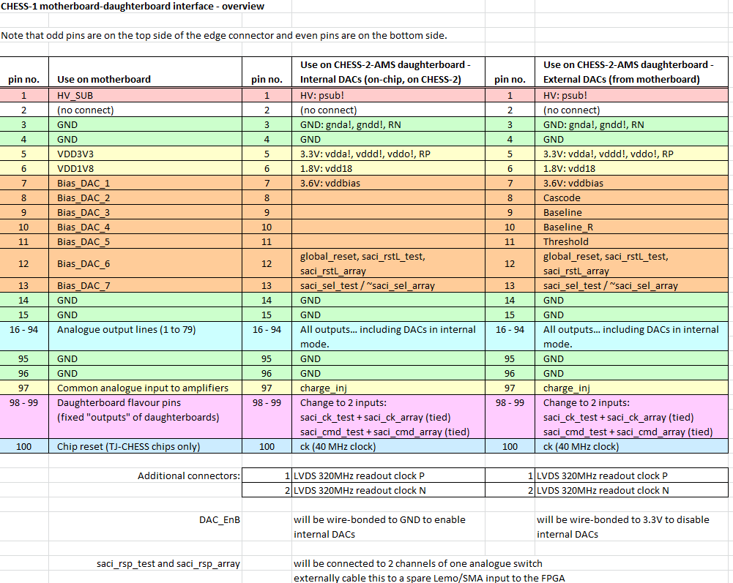
Proposed mapping

Slide 4
Notes on mapping (1/2)
Because we may need to operate with externally-supplied DACs (4 biases from motherboard) AND the SACI bus to configure CHESS-2,
this requires some creativity to get all control inputs up onto the daughterboard.
So far I think the best way is to re-use the DaughterboardID outputs from the daughterboard, as SACI inputs (=> some changes to motherboard)
We also have to combine the SACI bus select signals, which enable either the test structures’ SACI bus or the bottom array’s SACI bus, into one input line to the daughterboard.
=> we need an inverter on the daughterboard, which is a soldered component – presents issue for irradiation due to activation of solder

Slide 5
Notes on mapping (2/2)
So the proposal is that there will be a snap-off “ear” extension on the daughterboard:
Prior to irradiation, any soldered components – inverter, connector for LVDS clock – are soldered onto the snap-off “ear”
Then the daughterboard can be characterised
Then the “ear” is snapped off and the daughterboard can be irradiated solder-free
Then components – inverter, connector – can be soldered onto the daughterboard proper for post-irradiation operation.

Slide 6
320 MHz operation…
…will not be 320 MHz with this daughterboard.
It may be half or quarter speed, considering the limitations of cabling and the CHESS-1 motherboard’s analogue switches.
It looks like the best way to bring the fast data clock onto the daughterboard is to use a twisted pair.

Slide 7
ABCN’ update
Next meeting this Thursday 23 June, 15:30 CERN time: https://indico.desy.de/conferenceDisplay.py?confId=15524
The design is progressing:
Data path adaptations for CHESS-2 data format now in place for input from CHESS-2 and output to HCC* (readout)
A first iteration of the CHESS-2 emulator producing pseudo-random is working.

