Slide 1
The Bunch Arrival-Time Monitors for SwissFEL
Vladimir Arsov:: T&S, Bunch Arrival-Time :: Paul Scherrer Institute
6th Mini-Workshop on Longitudinal Diagnostics for FELs, The Cockroft Institute, Daresbury, 20-21.10.2016

Slide 2
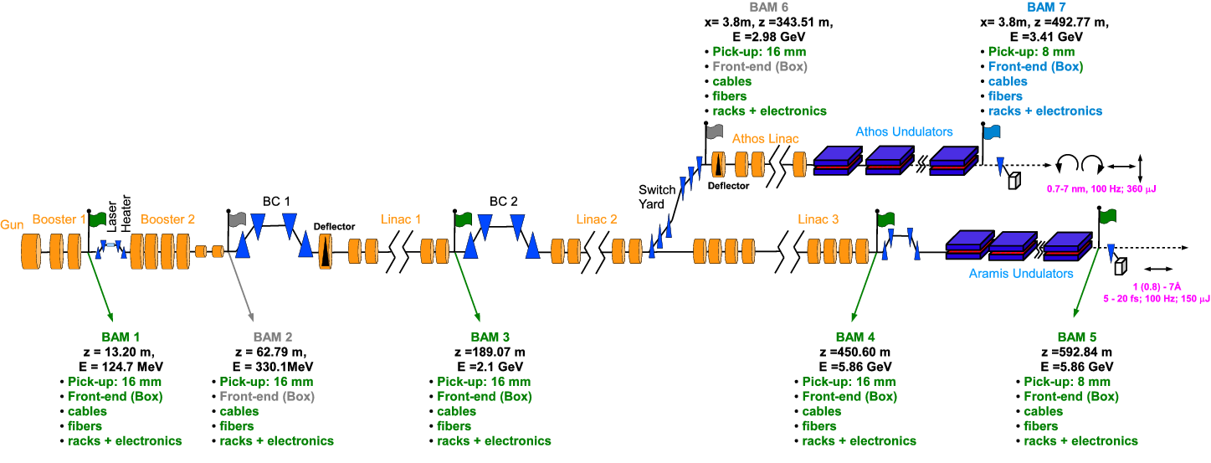
BAM Installation Status
Color Legend:
Phase 1: 4 BAM-Stations
Phase 2: 1 BAM-Station
Put on delay depending on budget: 2 BAM Stations (front-end only)
 | status | comment
40 GHz Pick-up, 16 mm vac. chamber+girder support | 6x delivered, tested & assembled | Installed BAM1-4
40 GHz Pick-up, 8 mm vac. chamber+girder support | 3x delivered, tested & assembled | Installed BAM5, but DCR for relocation
Single-mode fibers | blown for all 7 Stations | Stations (4+5) & (6+7) to be tested for transmission + length; short patches to the Boxes TBD
Cables & Racks electronics | 3x Stations fully installed, except GPAC-ADCs&PAC | installation ongoing with the corresponding machine sections
Front-end (box) | 2x now being assembled 2x Q2/2017

