Slide 1
PoSSIBILITY of CIRcular Colliders
(AN OLD IDEA)
6 Dec 2016
K. Oide (KEK) @ F³iA

Slide 2
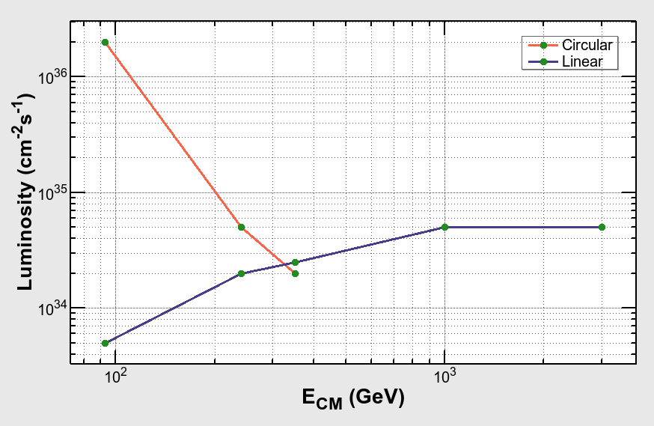
Luminosity of e+e- Colliders
FCC-ee
ILC/CLIC
Circular collider: luminosity is limited by the synchrotron radiation power:
At high energies beamstrahlung sets another limitation.
Is there any way to overcome this limitation?

Slide 3
An old idea
U. Amaldi
Linear collider was a ring collider when it was first proposed.
The particles and beam energy are totally recovered.
The recirculated arc at a low energy works as a part of damping ring.
The synchrotron radiation is independent of the collision energy.
Does this scheme work?

Slide 4
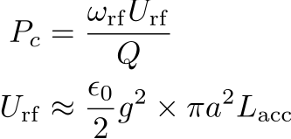
Power dissipation at the energy recovery linac
The energy recovery linac must use a standing CW, otherwise the synchronization with the counter rotating beam is difficult. Then:
Examples at Ecm = 3 TeV:
This power dissipation is independent of beam current/luminosity.
scheme | frf (GHz) | Q | a (mm) | g (MV/m) | Pc (GW) | P300K (GW)
X-band | 12 | 10⁵ | 3.5 | 100 | 39 | 39
SRF @ 2K | 1.3 | 2x10¹⁰ | 70 | 40 | 0.0033 | 0.50
P-W | 12 | 5000 | 0.3 | 1000 | 57 | 57
P-W extreme | 12 | 5000 | 0.03 | 1000 | 0.57 | 0.57

Slide 5
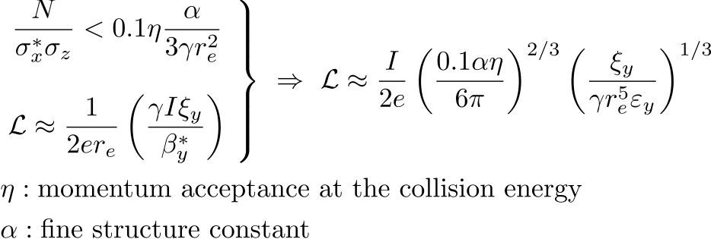
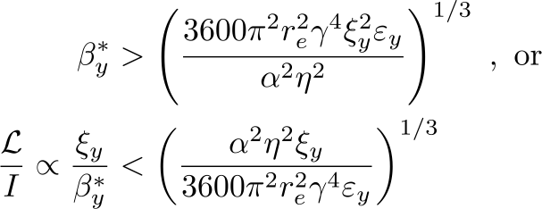
Beamstrahlung
A criteria of beamstrahlung for a circular collider has been given by V. Telnov:
The two notations of the luminosity give:
The momentum acceptance at collision:

Slide 6
A possible parameter set for 10³⁵ cm⁻²s⁻¹ @ 3 TeV
Beam Energy (TeV) | 1.5
Beam current (mA) | 14
β*x,y (mm) | 460, 4.6
ε*x,y (pm) @ 1.5 TeV | 1, 0.01
σ*x,y (nm) | 680, 6.8
σz (mm) | 5
Particles / bunch (10¹⁰) | 0.065
ξx,y | 0.1, 0.1
Bunch separation (ns) | 7.4
Arc energy (GeV) | 10
Energy Acceptance @ collision (%) | 2
Luminosity (10³⁴ cm⁻²s⁻¹) | 10

Slide 7
Issues
The Higher order mode loss in the accelerating structures.
Efficiency of the energy recovery
TMCI, microwave, CBI, e-Cloud, etc.
Dynamic aperture through the long linac
Bootstrap / stability of the system

