Slide 1
The AGIPD Project December 2016 – XDAC

Slide 2
The AGIPD Read Out-Principle
Sensor
Electronics per pixel
Pixel matrix
…
HV
Analog Mem
CDS
Read Out bus
+
SW
RO Amp
…
-
CTRL
DAC
Analog Mem
THR
Calibration circuitry
ASIC periphery
Chip output driver
Mux
Adaptive gain amplifier
352 analog memory cells
2
Notes:
Mention random vetoing possibility.

Slide 3
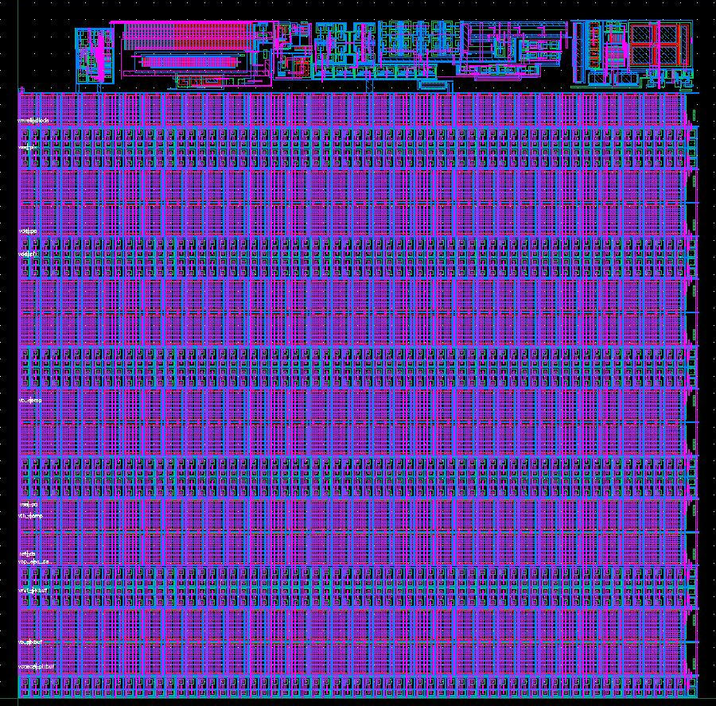
The AGIPD Parameters
200 x 200 micron² pixels
352 storage cells + veto possibilities.
Minumum signal ~ 300 e⁻ =
0.1 photon of 12.4 keV
Maximum signal ~ 33x10⁶ e⁻ =
10⁴ photons of 12.4 keV
4.5 MHz frame rate
64 x 64 pixels per ASIC
2 x 8 ASICs per module (128x512 pixels, no dead area)
4 modules per quadrant
Total of 1 Million pixels
3

Slide 4
The AGIPD system
4

Slide 5
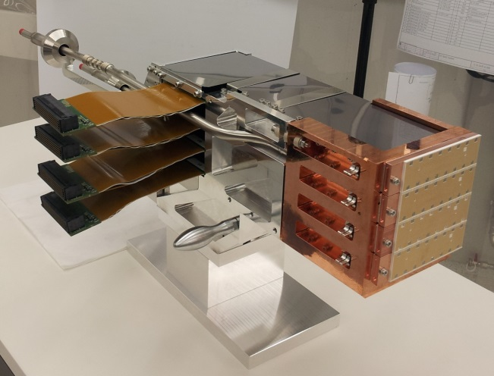
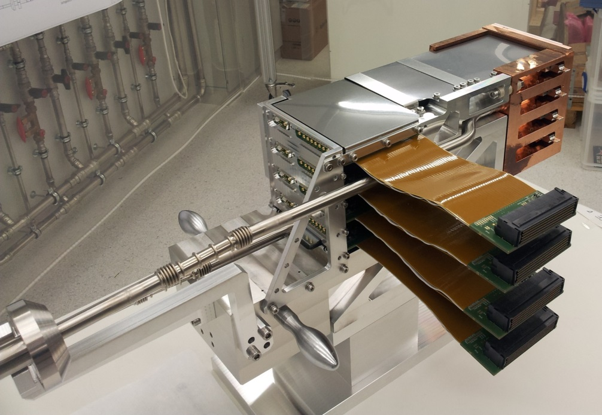
Fully assembled quadrant
5

Slide 6
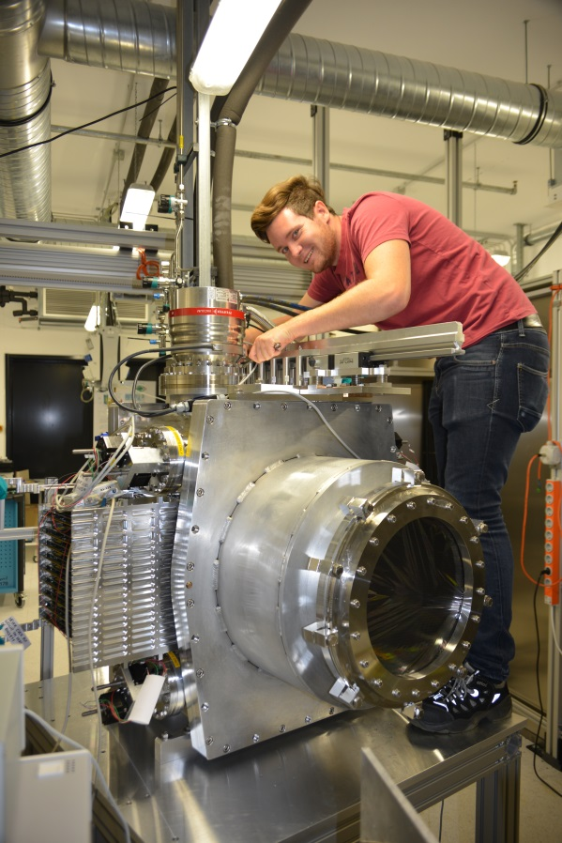
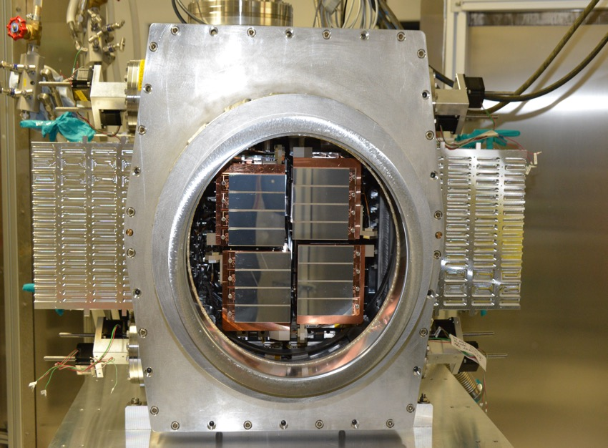
The 1-Million pixel system

Slide 7
Time to exchange a quadrant
Prepare the detector for removing a quad. → 1.5 days with 2 persons
Exchange a quad. → ½ day with 2 persons
Put everything back into place, close the detector, (mount pump) and cooling tubes. → 2 days with 2 persons
Calculate time for pumping down and cooling down before restart of the system.

Slide 8
Status Firm- and Software
Firmware with complete readout chain adapted for uC Integration fully operational.
Double Images(Analog + Gains) per memory cell (AGIPD 1.0) agreed with XFEL and Train builder Format implementation updated
Clock & Control System hardware integration is done. Full communication protocol is implemented. Relevant XFEL bunch structure and timing on firmware level are implemented and can be tuned in real time via user GUI

Slide 9
Outlook Firm- and Software
HERA South Integration tests
As the Train Build Format test with XFEL PC layer was successful, XFEL would like to wait until the full 1M detector ready in HERA South for test with real TB
Clock & Control System integration and tuning with HERA South environment
Remote upgrade firmware via Ethernet
Firmware optimization for AGIPD 1.1

Slide 10
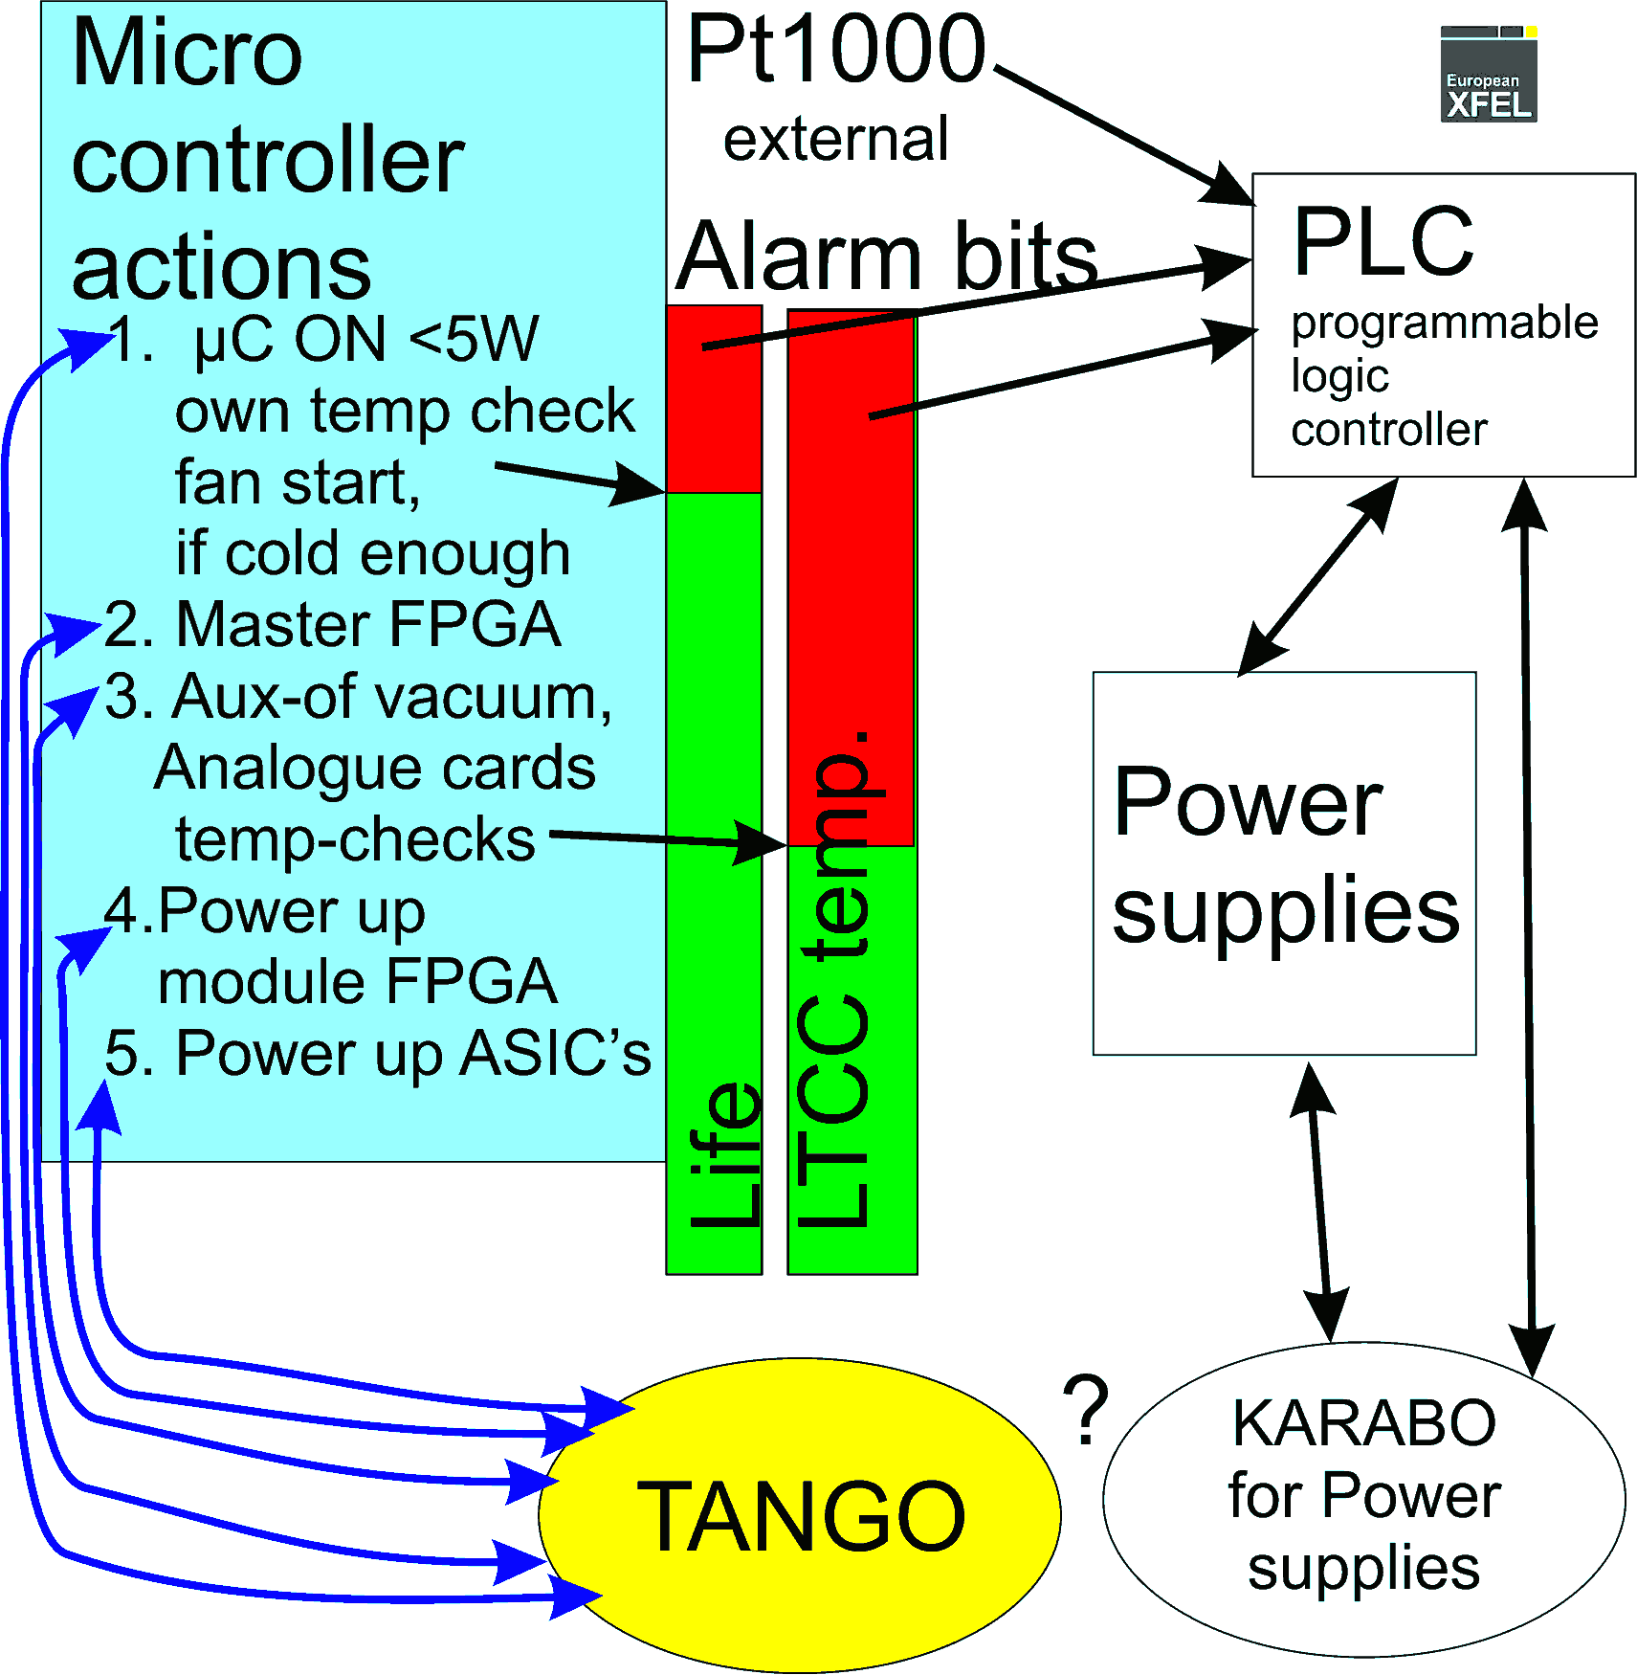
Power-up procedure
Partially coded to µC-firmware
Alarms are available
Temporary command
reception in µC is
available
Analogue cards:
Per default on
Most cards have own hardware protection

Slide 11
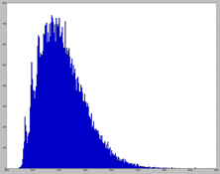
Calibration activities
AGIPD calibration on delivery
pedestal maps noise maps Gain maps for 3 gain stages | Raw data, calibration routines and processed data delivered to XFEL
Raw data
Sum of 50k frames
Dead
ASIC
Pedestal corrected
Sum of 50k frames
Ongoing activities
Analysis of „Grid-data“
4-5Photons

Slide 12
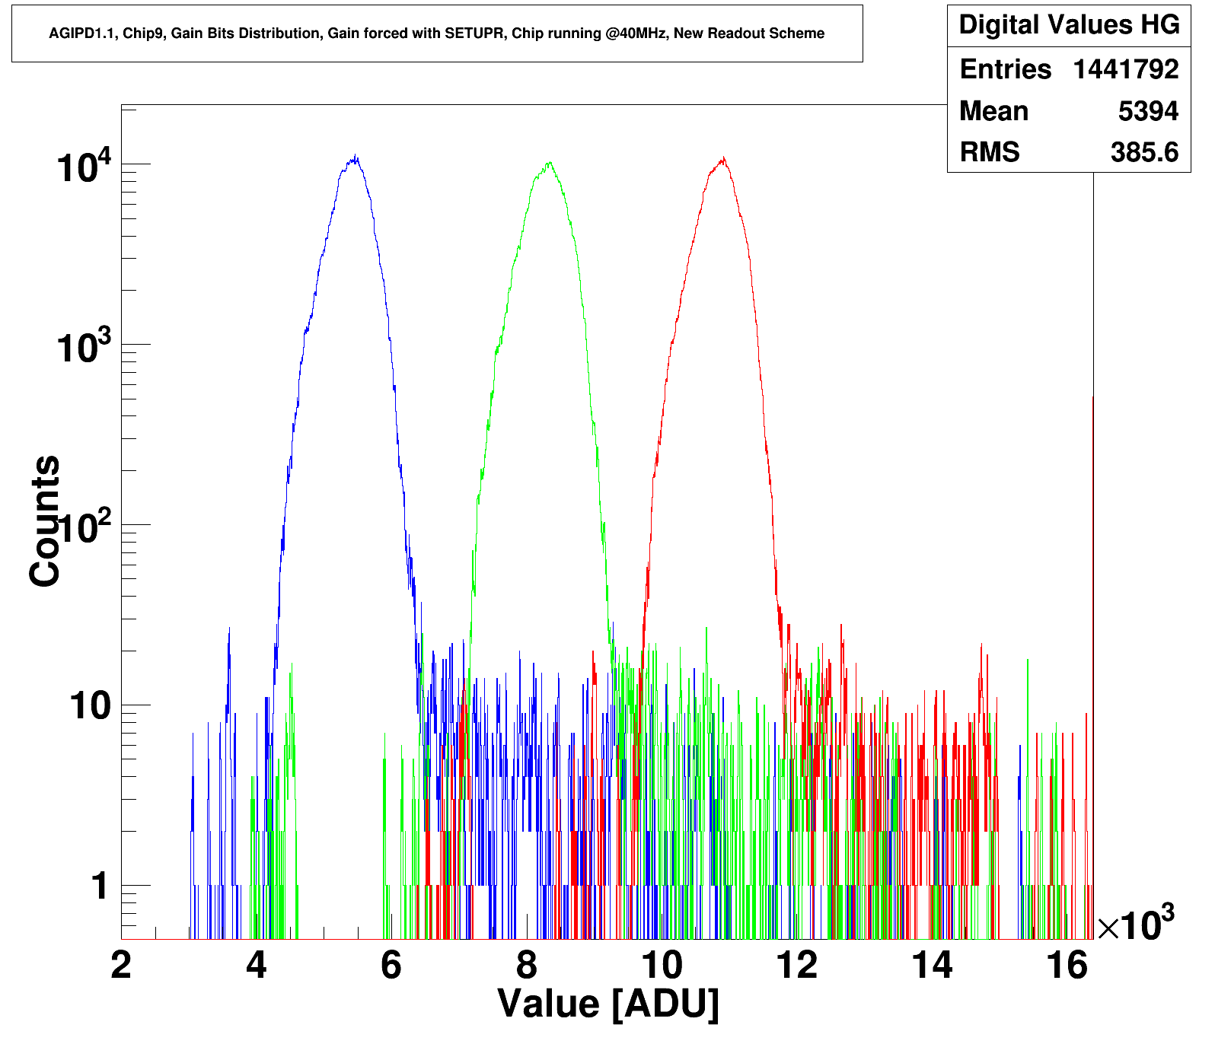
Calibration activities
AGIPD calibration on delivery
pedestal maps noise maps Gain maps for 3 gain stages | Raw data, calibration routines and processed data delivered to XFEL
Ongoing activities
Analysis of „Grid-data“ Threshold table for on the fly gain bit correction. Bad pixel maps

Slide 13
Calibration activities
Ongoing activities
Analysis of „Grid-data“ Threshold table for on the fly gain bit correction. Bad pixel maps Test of calibration procedure in the course of analysis of protein crystallography data from beam line P11
Experiment, calibration and data correction and analysis were performed in close cooperation with EMBL and FS-CXI

Slide 14
Calibration activities of the next 6 months
Calibration activities of the next 6 months
Optimize calibration and DAQ patterns for AGIPD 1.1 Modification of calibration routines for AGIPD 1.1 Systematic droop investigation for AGIPD 1.1 Calibration of AGIPD 1.1 for MID delivery and SPB replacement¹

Slide 15
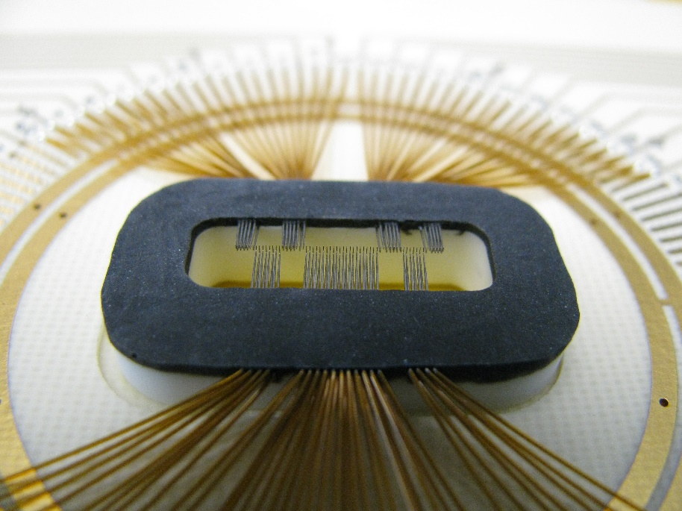
Wafer-Scale Testing of AGIPD 1.1
A testing procedure for AGIPD 1.1. ASICS has been developed
It uses:
Cascade Mirotec (SUSS) PA200 probe station
Custom probe card
PSI “Chiptesterbox” (based on Mythen readout)
LABview and custom software
What it tests:
Baseline & Gain in Hi-Gain mode for
all 352 storage cells with
Pulsed Capacitor stimulus
The 3 gain bit levels for
All 352 storage cells
Medium and low gain
for one storage cell with
Current Source stimulus
Power consumption

Slide 16
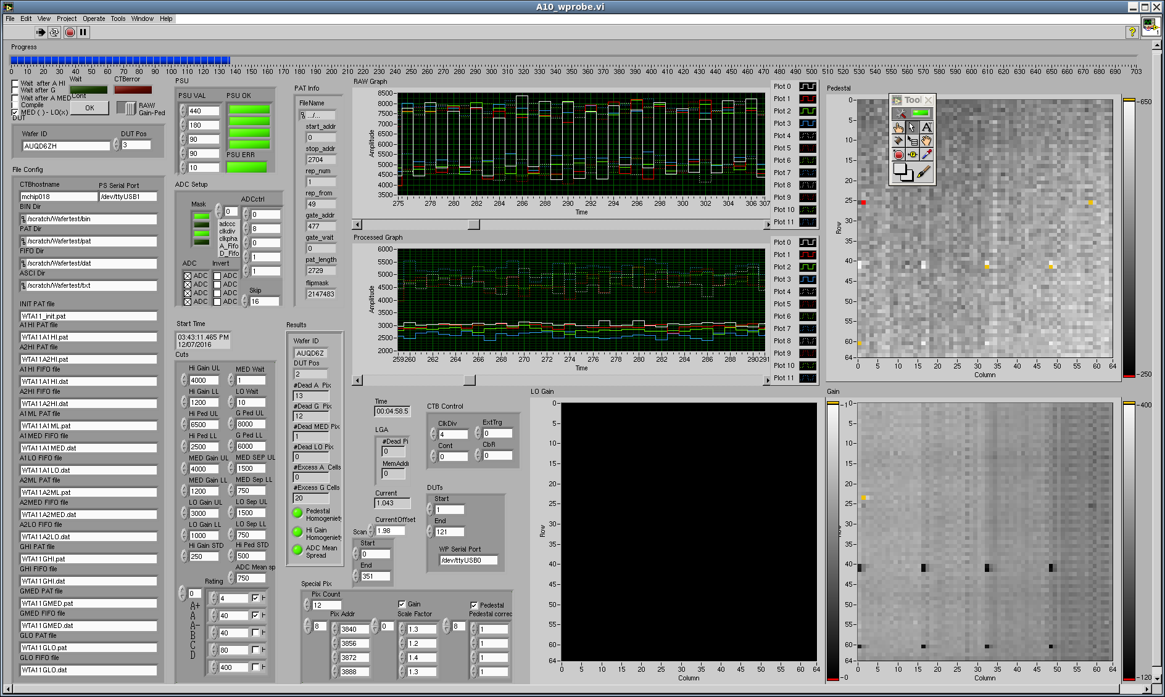
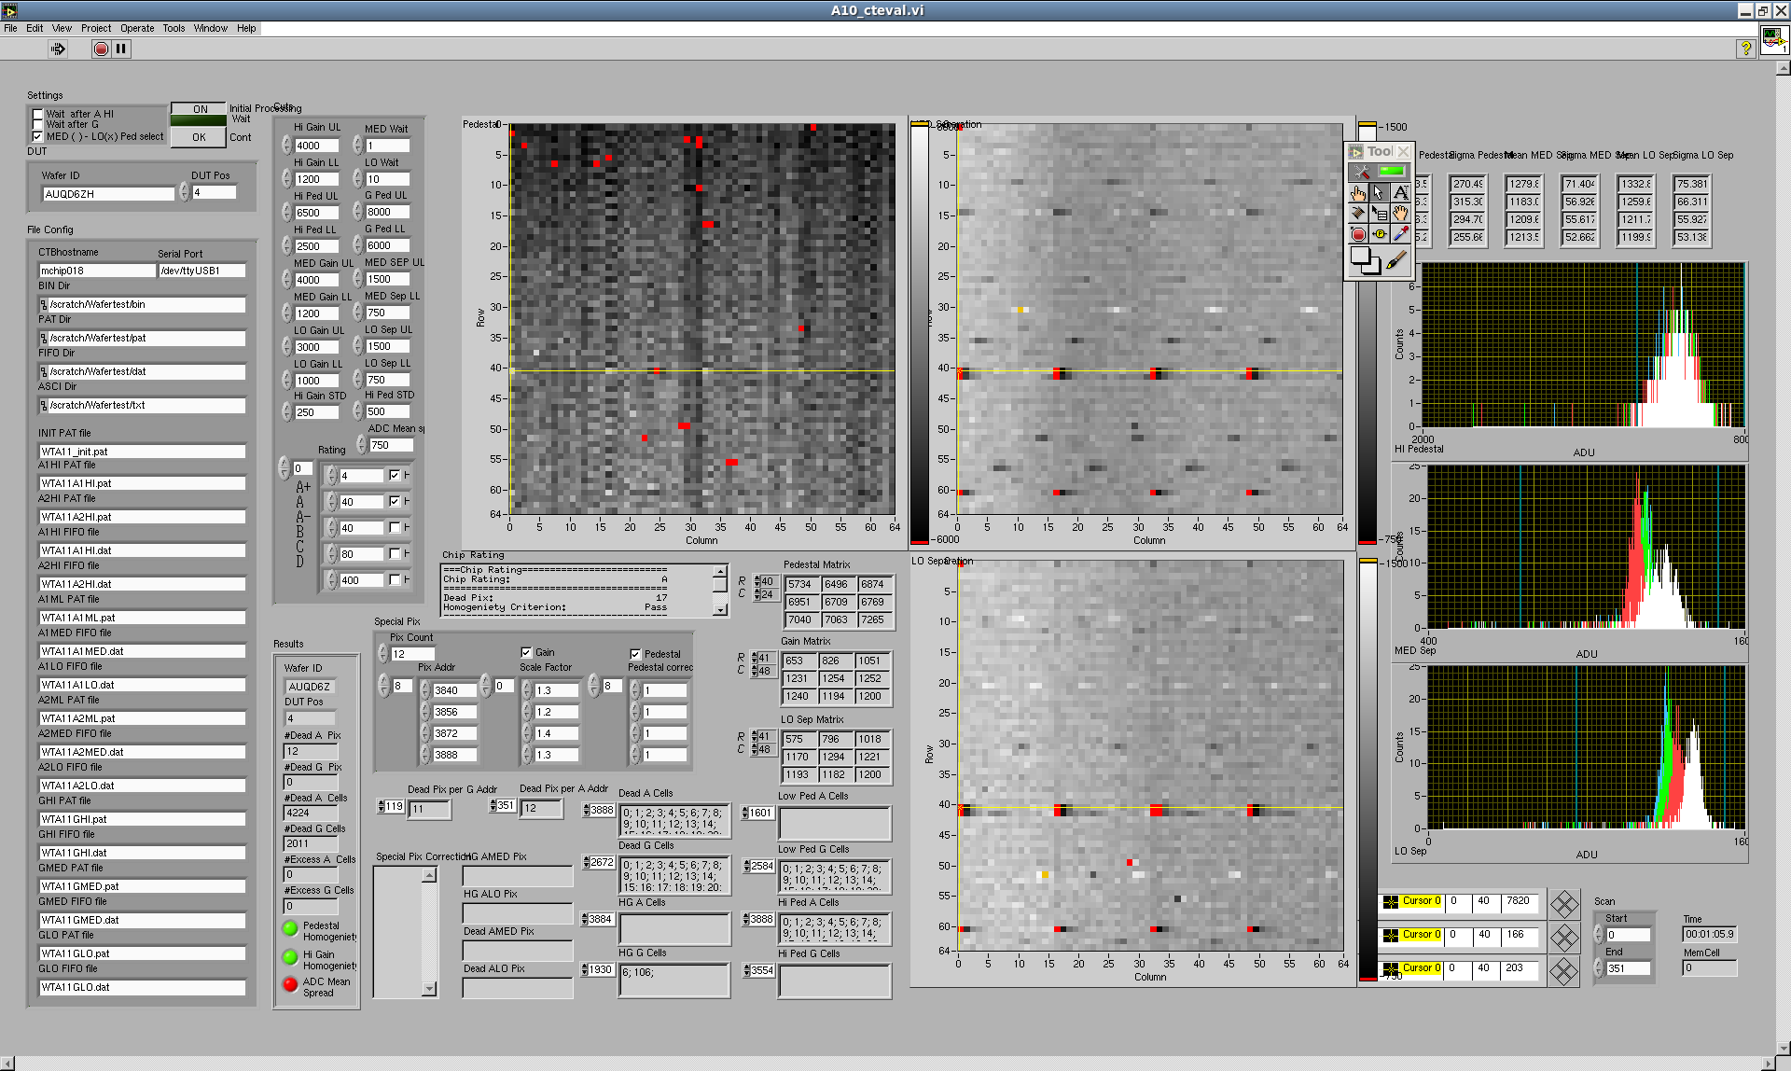
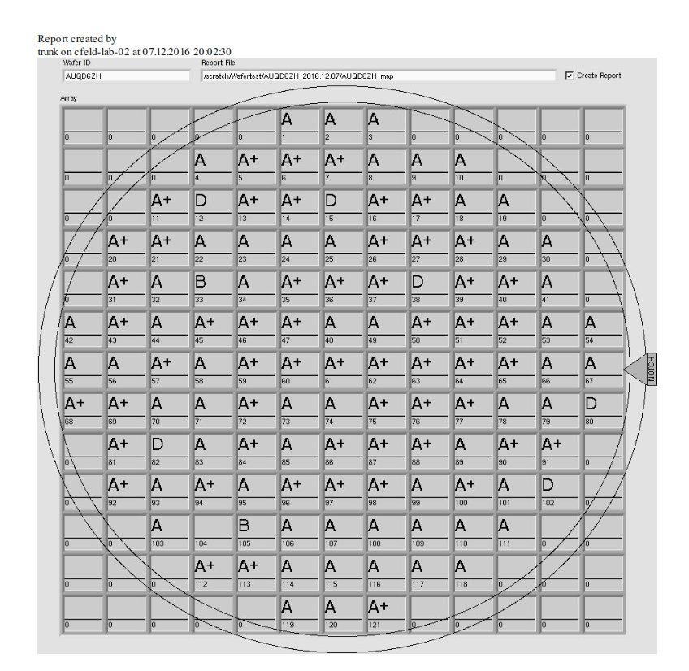
Wafer-Scale Testing of AGIPD 1.1
Raw data: Test signal in even and odd pixels
Cuts
The LABview software consists of four parts:
A10_wprobe.vi - A routine to step the wafer, to accquire the data and to format it into matrices written to disc. It calls the
A10_cteval.vi - Evaluation Routine for every Chip and
A10_wmap.vi at the end, which produces a graphical wafer map.
A10_eval.vi – same as A10_wprobe.vi, but reading from disk
Calculated gains and pedestals
Matrices read from disk
Statistics (Pedestal and separation of gain bits)
Cuts
Detailed results, e.g. dead storage cell map
Gain- and pedestal matrices written to disc
Evaluation Results (from A10_cteval.vi)

Slide 17
Timeline until acceptance 1st 1M
Delivery of current system to XFEL HERA-South Dec. 2016
Support of XFEL during integration and operation
Production of new Front-end Modules (AGIPD 1.1)
At PSI: first modules bump-bonded mid January 2017; followed by assembly and testing at DESY, end January. Followed by rest of modules in February.
At IZM: first modules bump-bonded by mid January; followed by testing at DESY in January; followed by more modules in February.
New mounting procedure (better thermal contact) by mid January
Update of Firm and software in January
Calibration in February and March (at DESY), using MID chamber
Delivery AGIPD 1.1 Modules to Eu.XFEL April 2017. Modules for testing will be delivered much earlier (January)
17

Slide 18
Project until delivery 2nd 1M
All parts are in hand (except for front-end modules)
Finish assembly of system in January.
Note: we can start as soon as the SPB system is out of the lab
Note: vacuum chamber plus motion stages area already commissioned
Assembly of quadrants
Mounting quadrants into vacuum chamber
Mounting of all flanges onto chamber
Start commissioning system in February, using the AGIPD 1.1 modules for SPB.
Continue commissioning system until April 2017.
18

