Slide 1
Calibration Data Processing and Simulation 21st Detector Advisory Committee
Steffen Hauf for the Detector Group
Hamburg, 14.12.16

Slide 2
Overview
Progress since last X-DAC
Highlights: FastCCD, LPD, Angle of Incidence Simulations
Outlook, Open Issues, Conclusion

Slide 3
Progress Since last X-DAC
Progress since last X-DAC is limited, as S. Hauf was assigned to Karabo Consolidation within CAS for previous months: Karabo 2.0 has been released!
Central Eventloop to improve broker messaging
Multi-topic support in core: allows for further load balancing in future
Central Project DB based on eXistDB, a noSQL database
Unified States – allows for global awareness of states
Central Alarm Service
Full documentation coverage using a facility hosted read-the-docs server
Pipelined processing now supports meta data – coordinated with DM&DAQ
Single multidimensional datatype: NDArray
Revise GUI backend: unified data model allows for easy future extensions
Clarification of APIs: hardware interaction with C++ and Python bound, middle-layer for high level controls
Karabo provided run configuration – together with ITDM
…

Slide 4
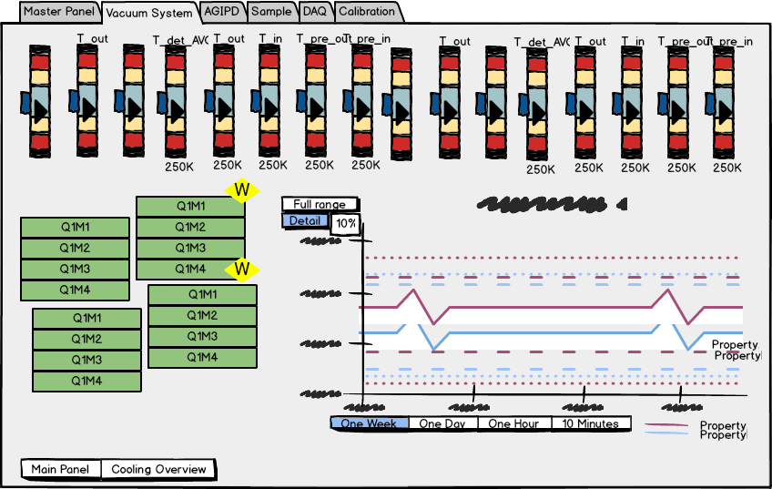
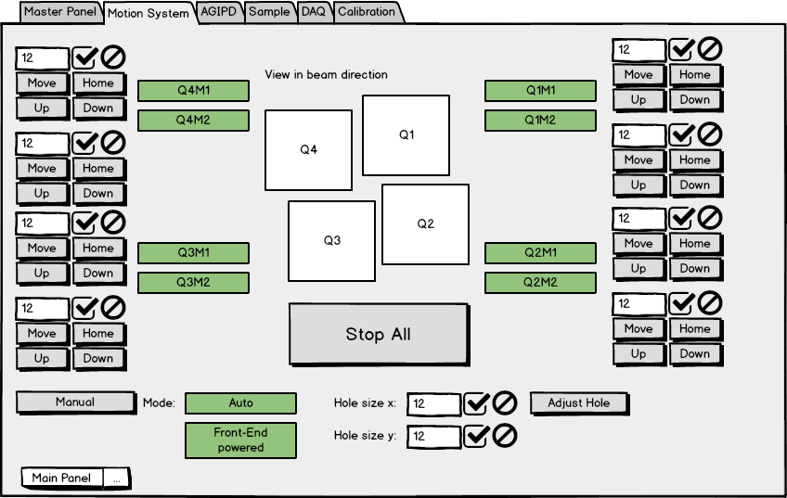
Control & GUI Requirements
Control & GUI requirements for AGIPD and LPD have been documented. A. Münnich created user stories for these detectors.

Slide 5
Progress Since last X-DAC
Aside from Karabo work limiting calibration software development, calibration analysis was performed for:
FastCCD: full pyDetLib characterization and calibration implemented. Discovery of synch. Issues, severely hampering device performance
LPD: pyDetLib and additional specific analysis for charge injection analysis, relative gain determination.
AGIPD: pyDetLib based analysis used to verify AGIPD performance and calibration as provided by consortium
Simulation work:
Ongoing work for angle-of-incidence (AOI) studies. Can now model approximate response with analytic convolution.

Slide 6
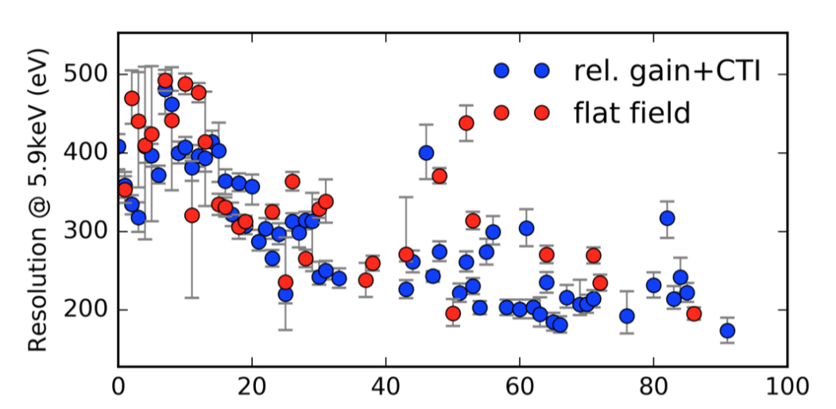
Highlights: FastCCD Analysis
Careful analysis (F. Januschek) shows that a syncing issue exists on the device.
Significantly hampers proper characterization and corrections
LBNL will provide a firmware update to resolve issue
Ivana Klackova has finalized thesis on this analysis. Will return as student researcher in 2017!
Offset
sub.
CM
correct.
Rel. Gain correct.
CTI correct.
Split
events
iterate
Gain correct.
Per-super column energy resolution for the lower hemisphere of the FastCCD at XFEL.EU

Slide 7
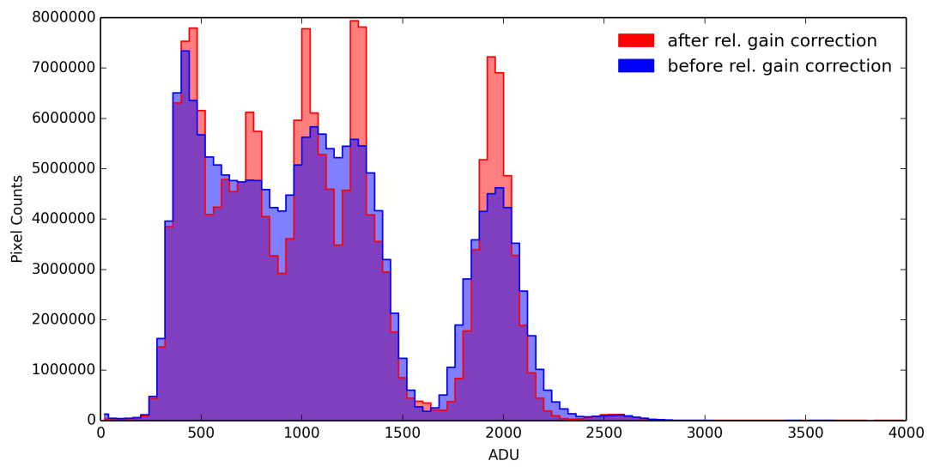
Highlights: LPD Analysis
Offset
sub.
CM
correct.
Super-column
Rel. Gain correct.
Uncorrected and relative gain corrected charge injection spectrum
Uses a weighted
average method
Status last XDAC: relative gain characterization with internal charge injection implemented but:
Results showed non-linear gain
Problems identified with PyDetlib and custom Python code by P. Lang. Together with RAL, remedy has been found
Gain correct.

Slide 8
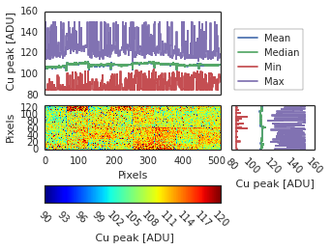
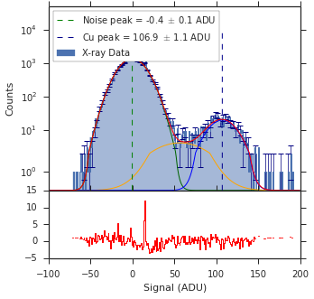
Highlights: AGIPD Analysis
J. Sztuk is using python code to verify AGIPD calibration. Tests:
pipelined processing
fitting using iMinuit
Next steps: implement a concurrent fitting routine, which can be used: single core performance ~30 minutes per module. Can be handled massively parallel.

Slide 9
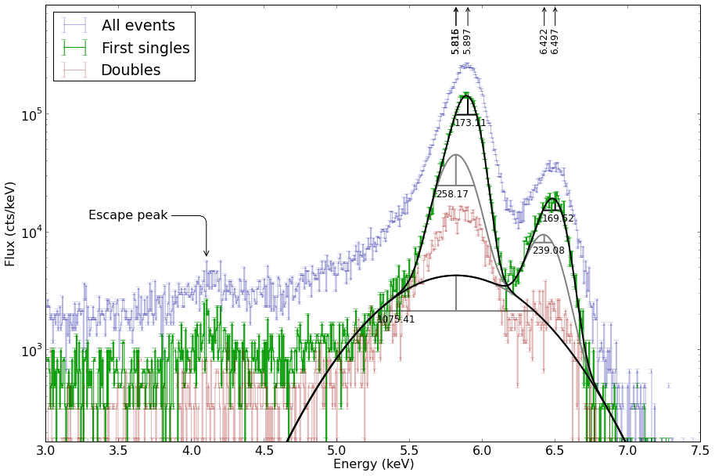
Reminder: pnCCD Benchmark
PnCCD with proper calibration can be operated almost at Fano limit
requires precise characterization and correction / calibration
benchmark for performance of XFEL calibration software
Offset
sub.
CM
correct.
Rel. Gain correct.
CTI correct.
Split
events
iterate
Gain correct.
FWHM
173.1 ± 0.7 eV vs. 189.0 eV
at same efficiency
Fe-55 spectrum taken with pnCCD and corrected with XFEL pipeline on GPU

Slide 10
Angle of Incidence Studies - Motivation
How does the point- and line-spread function look like at higher angles of incidence?
Do we still gain in resolution through smaller pixels? What is the benefit (if at all) with increasing detector size?
Are segmented detectors a possible solution? Can we minimize systematic uncertainties of position resolution by segmenting the detector
vs.

Slide 11
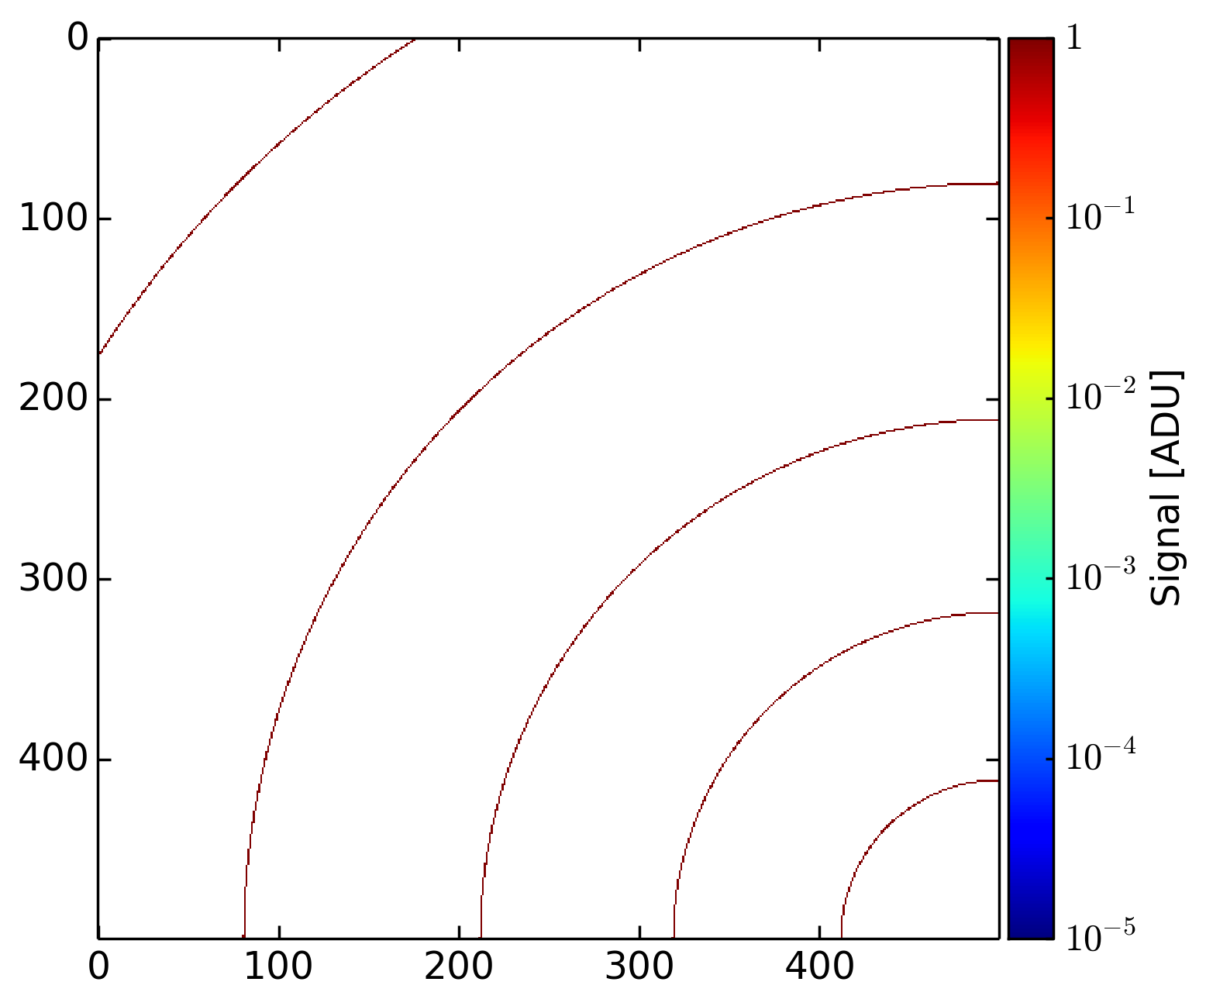
Angle of Incidence Studies - Motivation
How does the point- and line-spread function look like at higher angles of incidence?
Do we still gain in resolution through smaller pixels? What is the benefit (if at all) with increasing detector size?
Are segmented detectors a possible solution? Can we minimize systematic uncertainties of position resolution by segmenting the detector

Slide 12
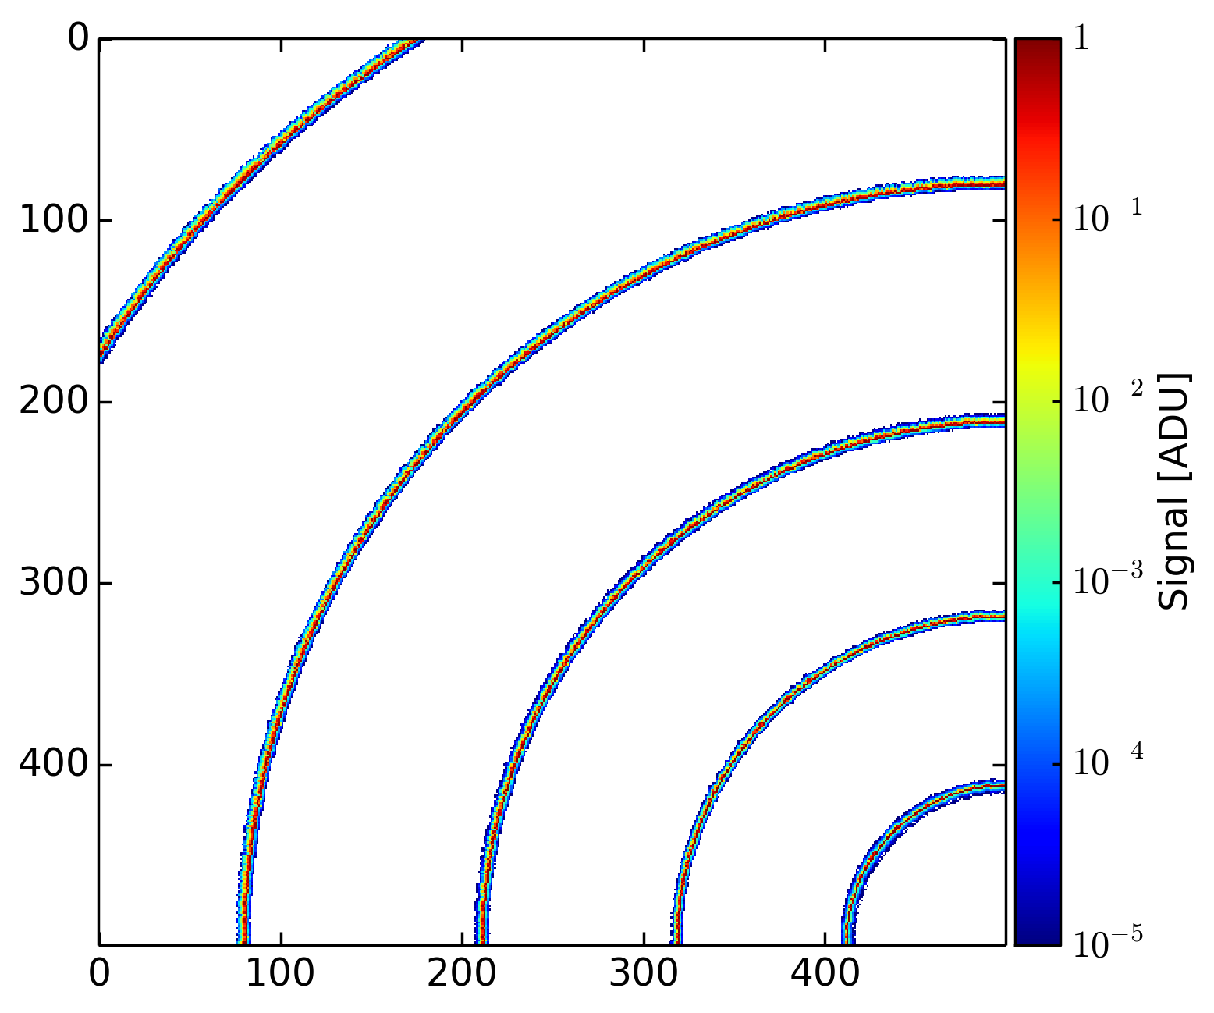
Angle of Incidence Studies - Motivation
How does the point- and line-spread function look like at higher angles of incidence?
Do we still gain in resolution through smaller pixels? What is the benefit (if at all) with increasing detector size?
Are segmented detectors a possible solution? Can we minimize systematic uncertainties of position resolution by segmenting the detector

Slide 13
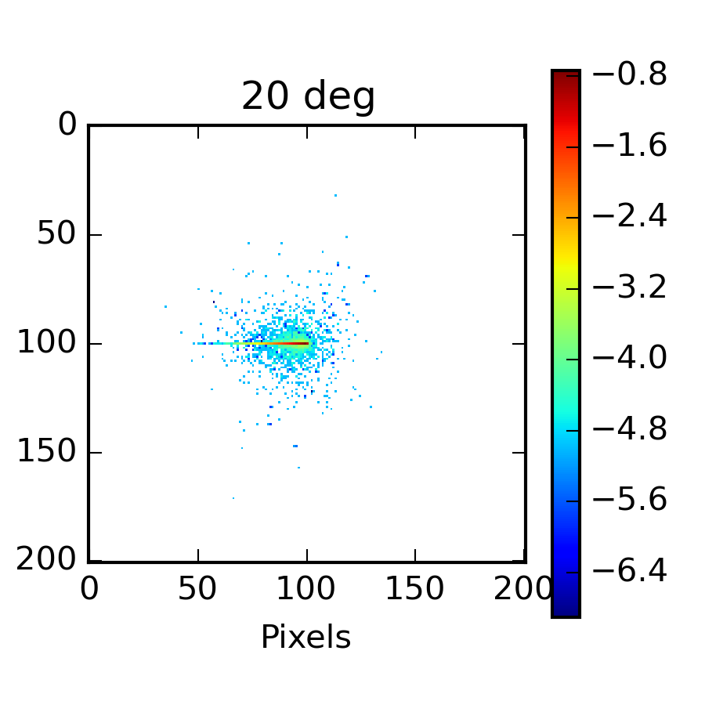
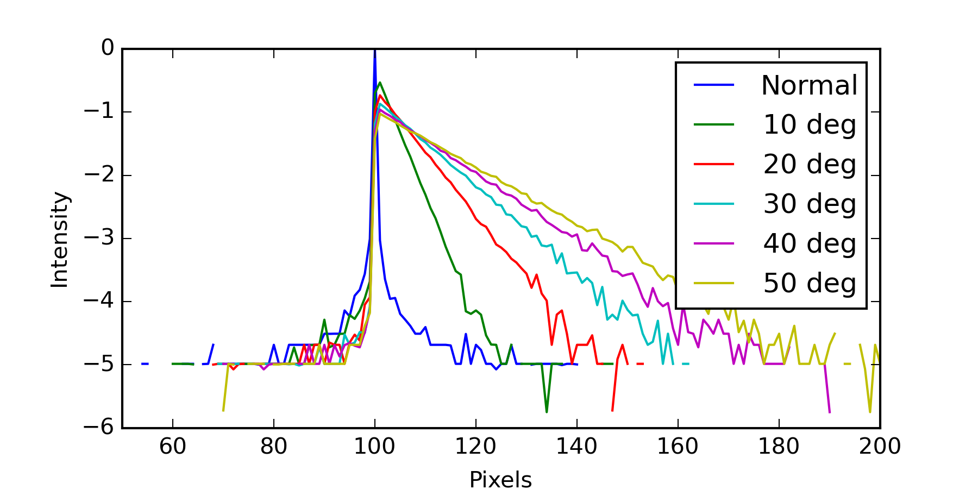
Highlights: Simulation
Simulation studies for AOI performed by T. Rüter
Using X-CSIT and Detector Simulation Pipelines (DSPs) of our in-house framework to estimate charge cloud size at different AOI.
Position (arb. units)
Position (arb. units)
Charge/Event distribution for normal incidence, 10, 20, 30, 40 50 degree incidence. Note the logarithmic scale. Beam from the left.

Slide 14
Angle of Incidence Studies – Preliminary Results
Larger angle of incidence
Larger displacement error

Slide 15
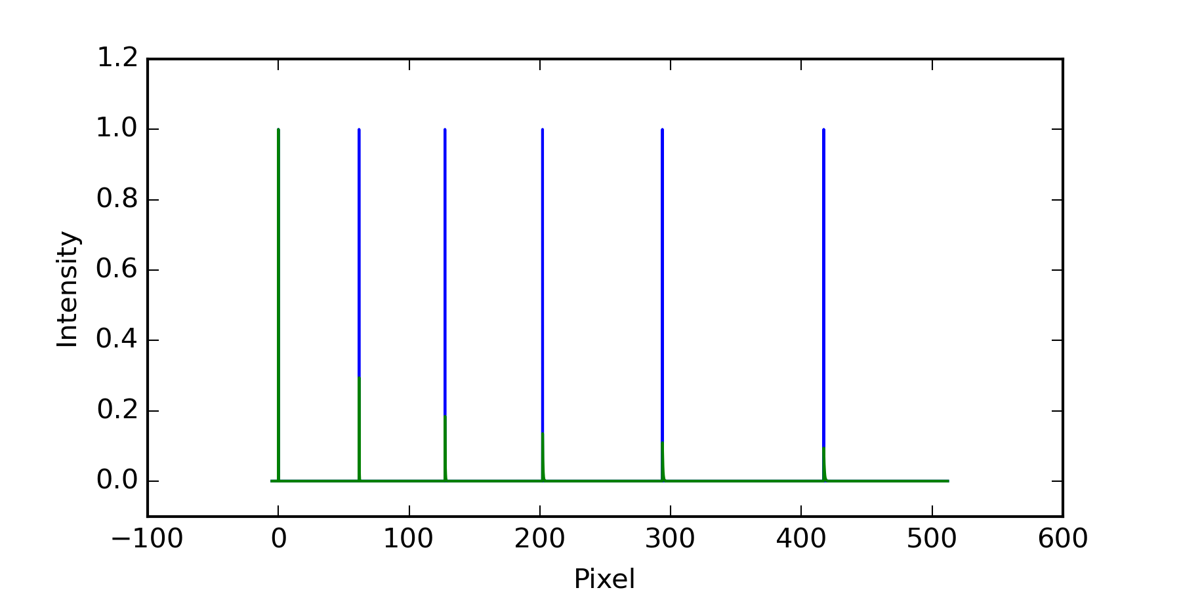
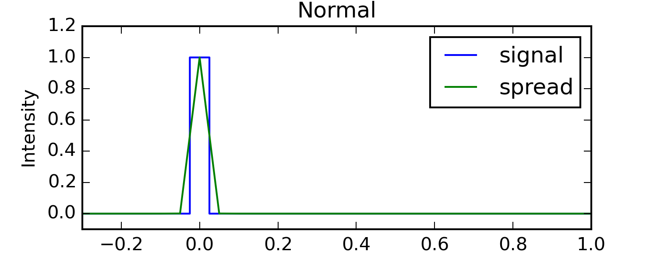
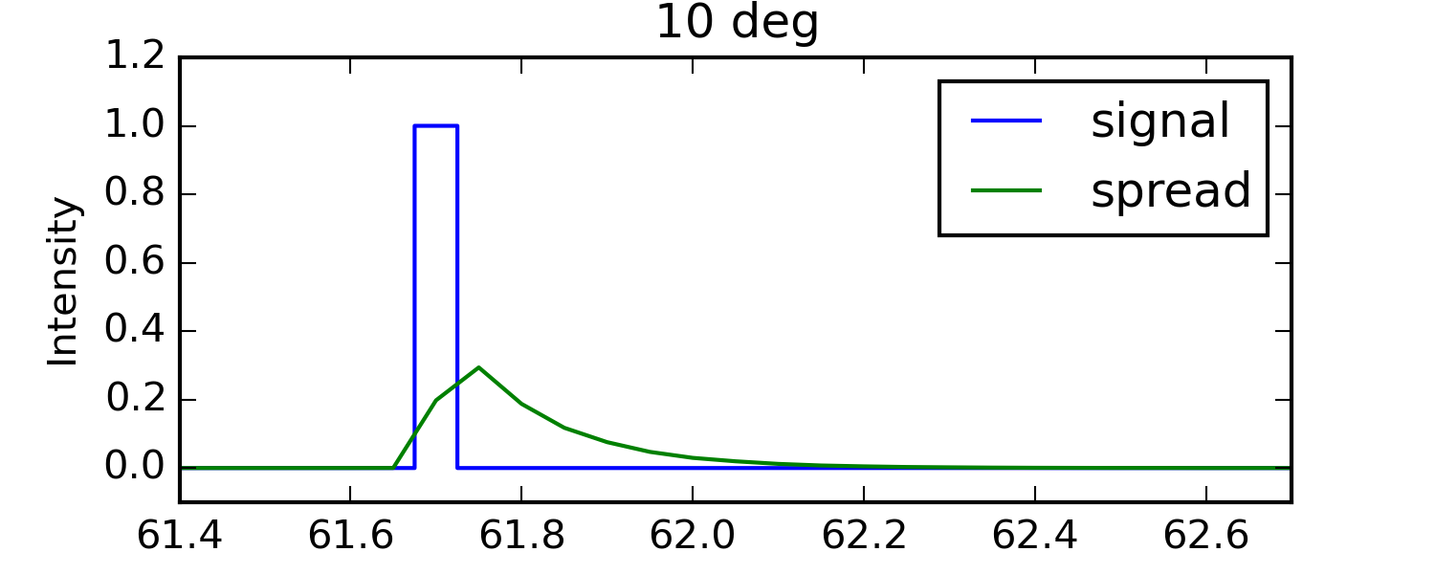
Simulation: Preliminary Results
Larger angle of incidence
Signals spaced at 0, 10, 20, 30, 40, 50 degree irradiance from a source 7 cm from a 1Mpix detector with 200um pixels (right hemisphere)
→ In general all is parameterized, simulations planned for pixel sizes 40-200um
Signal function (blue) and convolution kernel for AOI simulations (green) at normal and 10 degree incidence

Slide 16
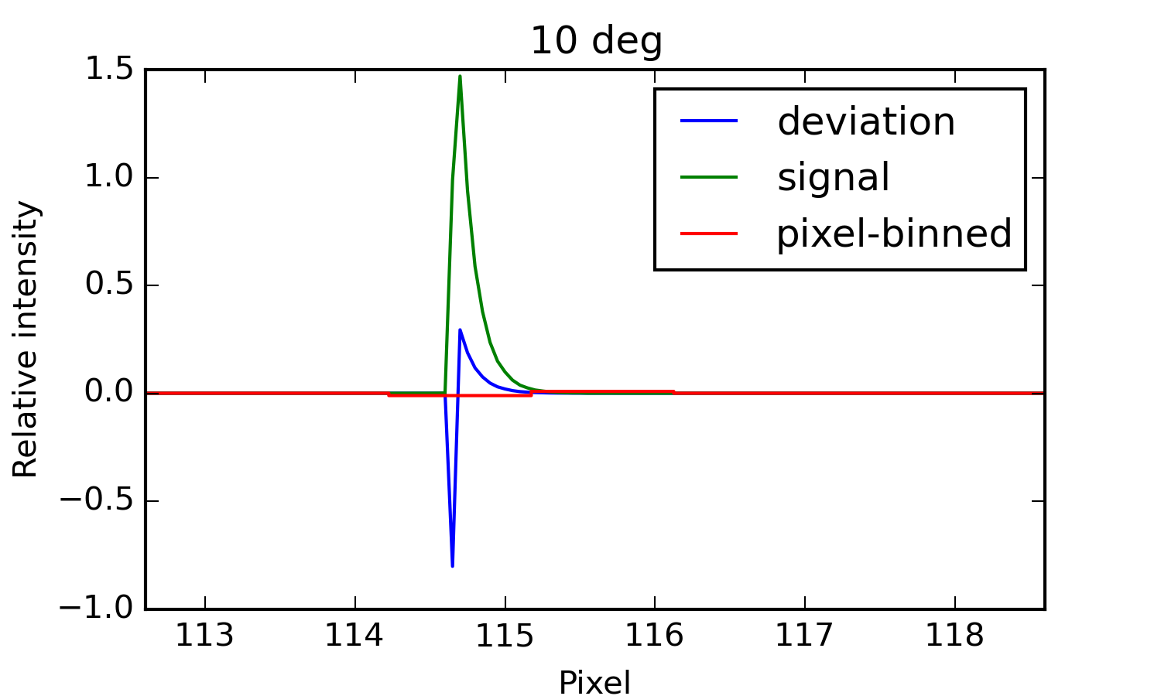
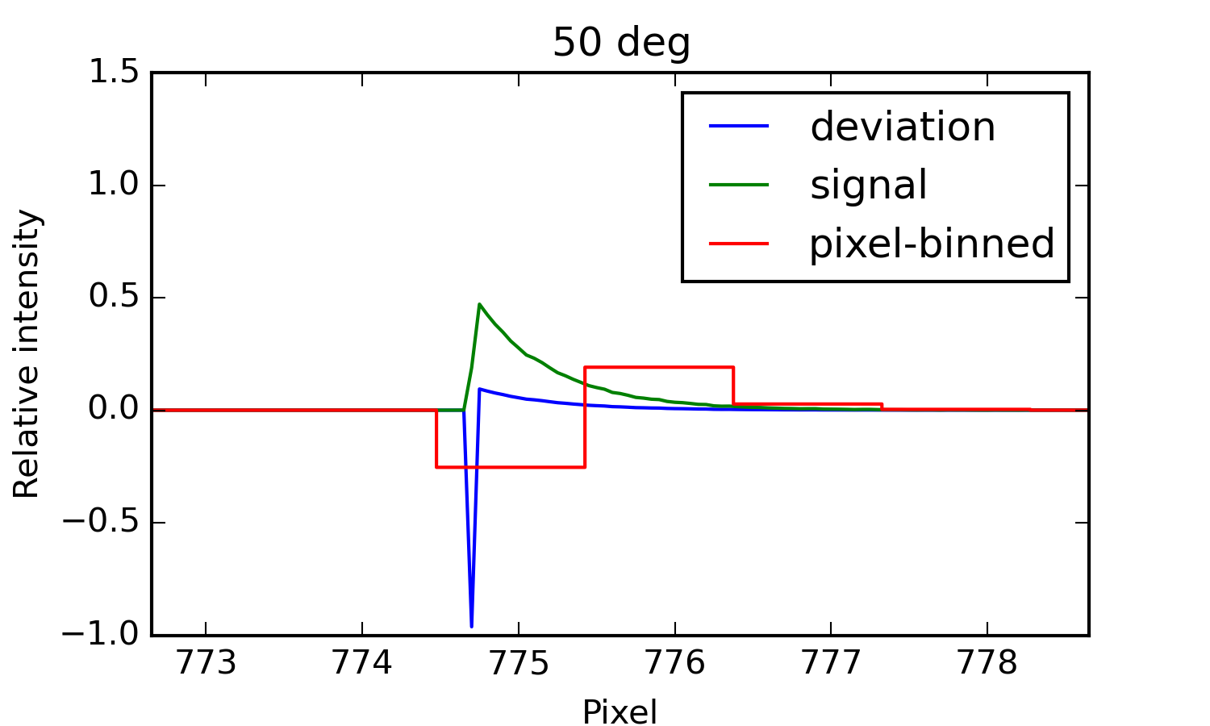
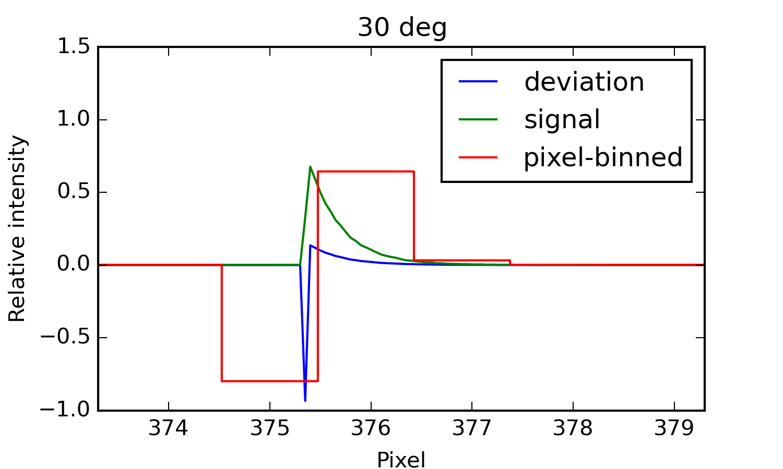
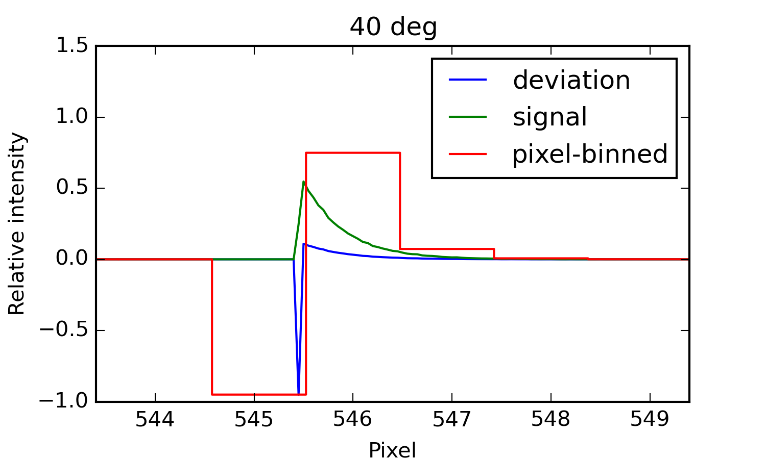
Simulation: Preliminary Results
Relative intensity deviation from ideal signal by AOI effects, sub-pixel evaluated (blue) and re-binned to pixel boundaries (red), with scaled signal superimposed (green). Above 30 degrees charge majority pixel is wrong.

Slide 17
Conclusion
Progress on calibration processing software development has been slowed by man power needs for CAS and Karabo 2.0. Nevertheless:
WP-75 migrated most devices already to Karabo 2.0
Gui-sketches and requirement documents have been worked out
Karabo 2.0 will be introduced to XFEL on Dec. 19th
Existing software in steady state:
Two bug fixes in last six months
Extensive use in analysis for FastCCD, LPD, AGIPD (in-house), Simulations
Results obtained frequently led to feedback to consortia and improvements in detector operation as well as correction and characterization methodology.

Slide 18
Conclusion
Angle of incidence studies show that segmented detector can reduce errors
At >30 degrees, majority charge pixel may be incorrectly attributed, even at 200um pixel size
Correction for certain experimental scenarios may be possible, but potentially large uncertainties: interplay between AOI effects, charge cloud size, split event generation, and noise thresholds in split-charge detection → simulations are enabled to look at these details
Segmenting detector reduces errors, as AOI is reduced
Initial tool-chain to simulate arbitrary pixel sizes: plan 40-200 um in steps using full XCSIT – DSP toolchain (e.g. add effects of electronics and signal processing).

