Slide 1
Calibration Working Group and
Calibration Infrastructure
Jola Sztuk-Dambietz and Natascha Raab
on behalf of
the European XFEL Calibration Group
December, 14th 2016
21st Meeting of the XFEL Detector Advisory Committee
European XFEL GmbH, Schenefeld
Notes:
How to edit the title slide
Upper area: Title of your talk, max. 2 rows of the defined size (55 pt)
Lower area (subtitle): Conference/meeting/workshop, location, date,
your name and affiliation,
max. 4 rows of the defined size (32 pt)
Change the partner logos or add others in the last row.

Slide 2
Outline
Part 1
Calibration Status and high-lights from the calibration meeting
Part 2
Infrastructure for detector calibration and tests at the XFEL – status

Slide 3
Calibration activity at XFEL
Development and characterization of laboratory X-ray infrastructure
Development of calibration software tools, simulation → S. Hauf’s presentation
Most of the LPD calibration activity was taken over by XFEL
DSSC calibration activity is performed mostly by XFEL people
Preparation for calibration cross check during End-to-End tests
Characterization and calibration of FastCCD detector
Coordination of calibration activity

Slide 4
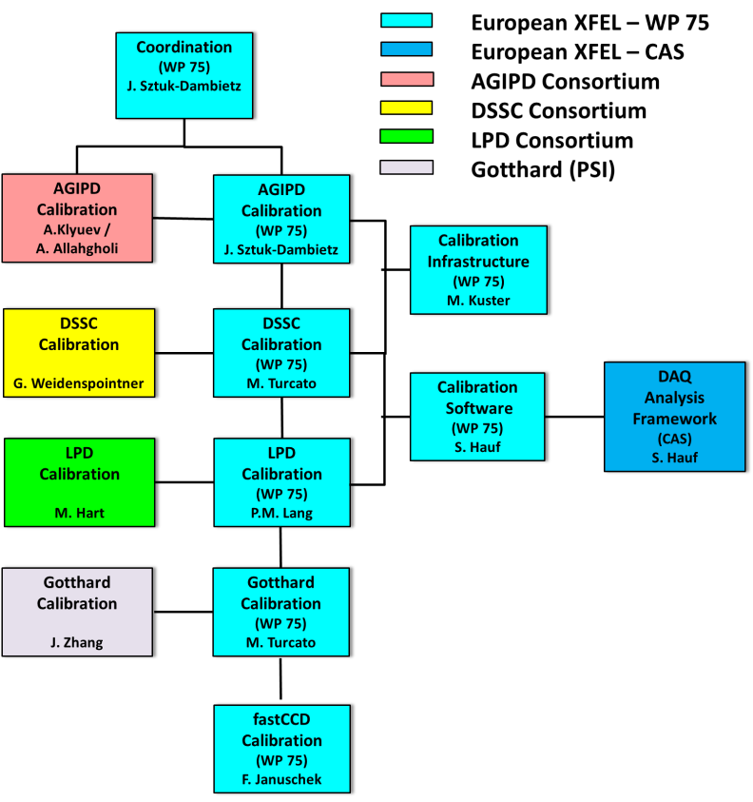
Calibration Working Group
Work done by detector consortia, WP-75, CAS
Experts from consortia available beyond start-up phase of the project
Involvement of beamline scientist → we expect even stronger involvement in the near future
Involvement of user community through SAC is under discussion
Responsible contact persons of the group:
Indico page with presentations and documents:
https://indico.desy.de/categoryDisplay.py?categId=278
Calibration Working Group site @ Alfresco - https://docs.xfel.eu/share/page/site/calibration/dashboard
Last meeting November 2016
Exchange of information and discussion on progress and open issues, definition of next steps

Slide 5
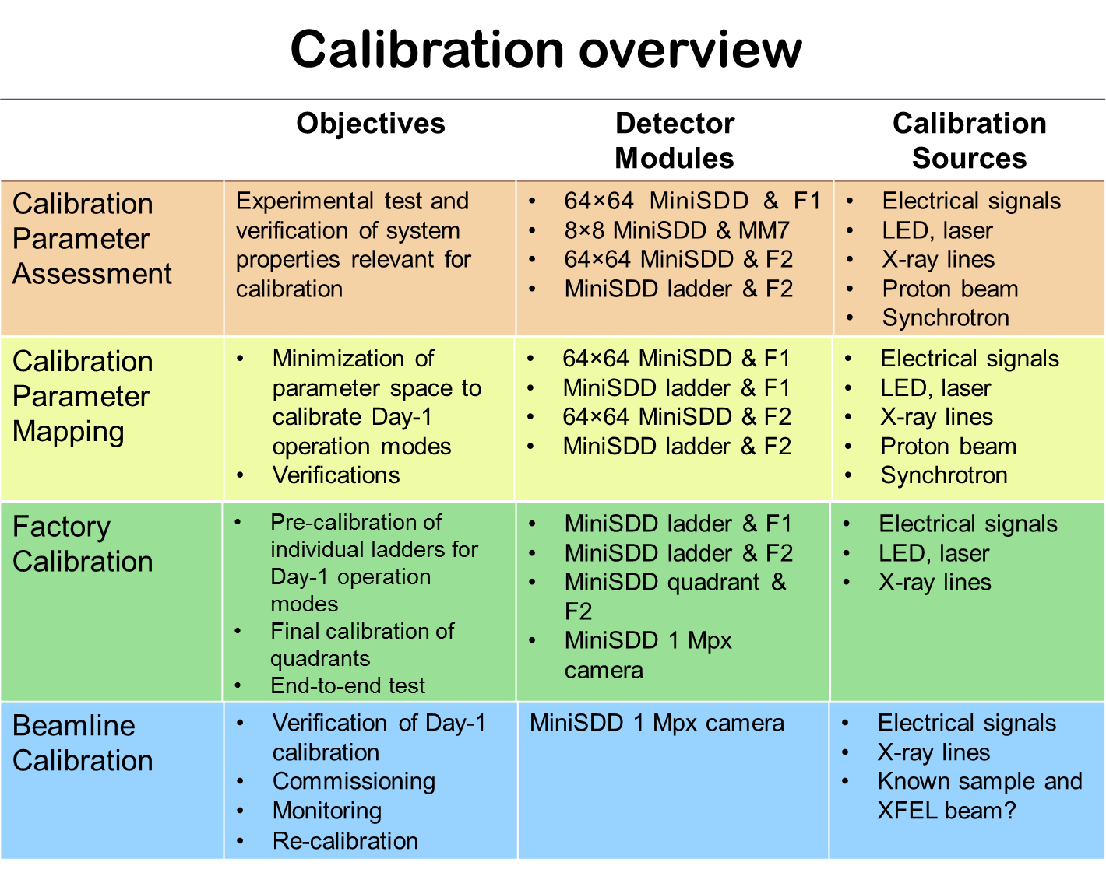
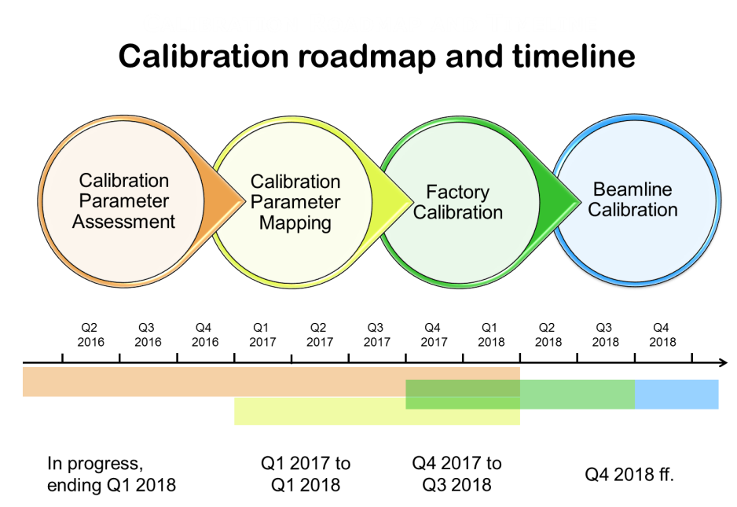
Calibration Plan and Activity – DSSC with miniSDD
DSSC – planning for calibration up to operation at beamline (including scheduling for XFEL X-ray calibration infrastructure) , evolving document
Setup for 64x64 mini-SDD with F1 ASIC and available in Munich lab → tests ongoing

Slide 6
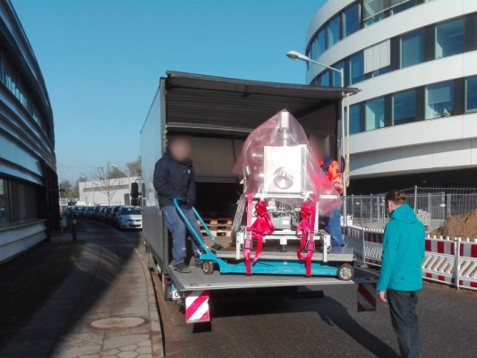
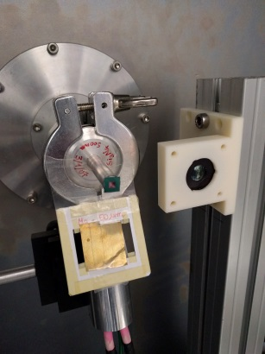
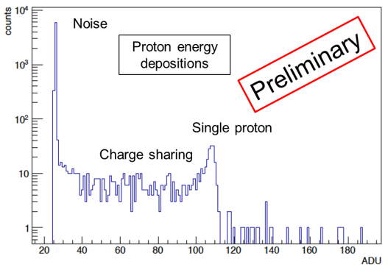
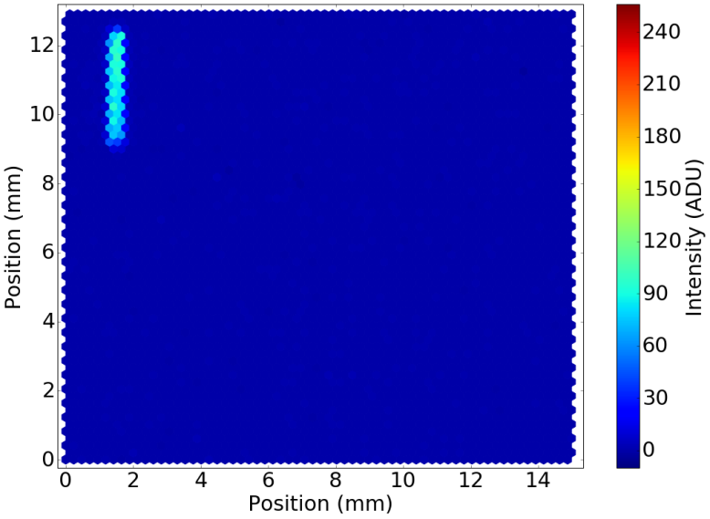
DSSC with miniSDD – Beam tests
LABEC - singe MeV protons
PETRAIII – pulsed 1 keV photons
Goal: demonstrate the consistency and correctness of calibration procedure for system characteristic
Low energy: X-ray lines provide absolute reference
Charge pulses to scan system characteristic
High energy: MeV protons provide absolute reference
Goal: study system performance for pulsed photon signal
Synchronization with photon beam
System stability
Flat fields as function of photon flux
Mask patterns as function of photon flux
Proton energy spectrum @ LaBeC
Line scan with direct PETRA III beam
Proton beam
Laser
X-ray tube

Slide 7
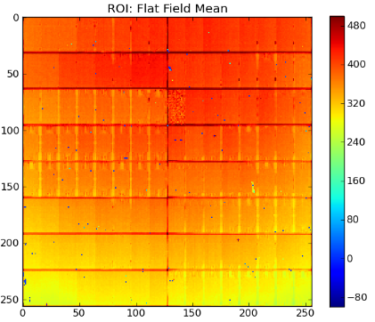
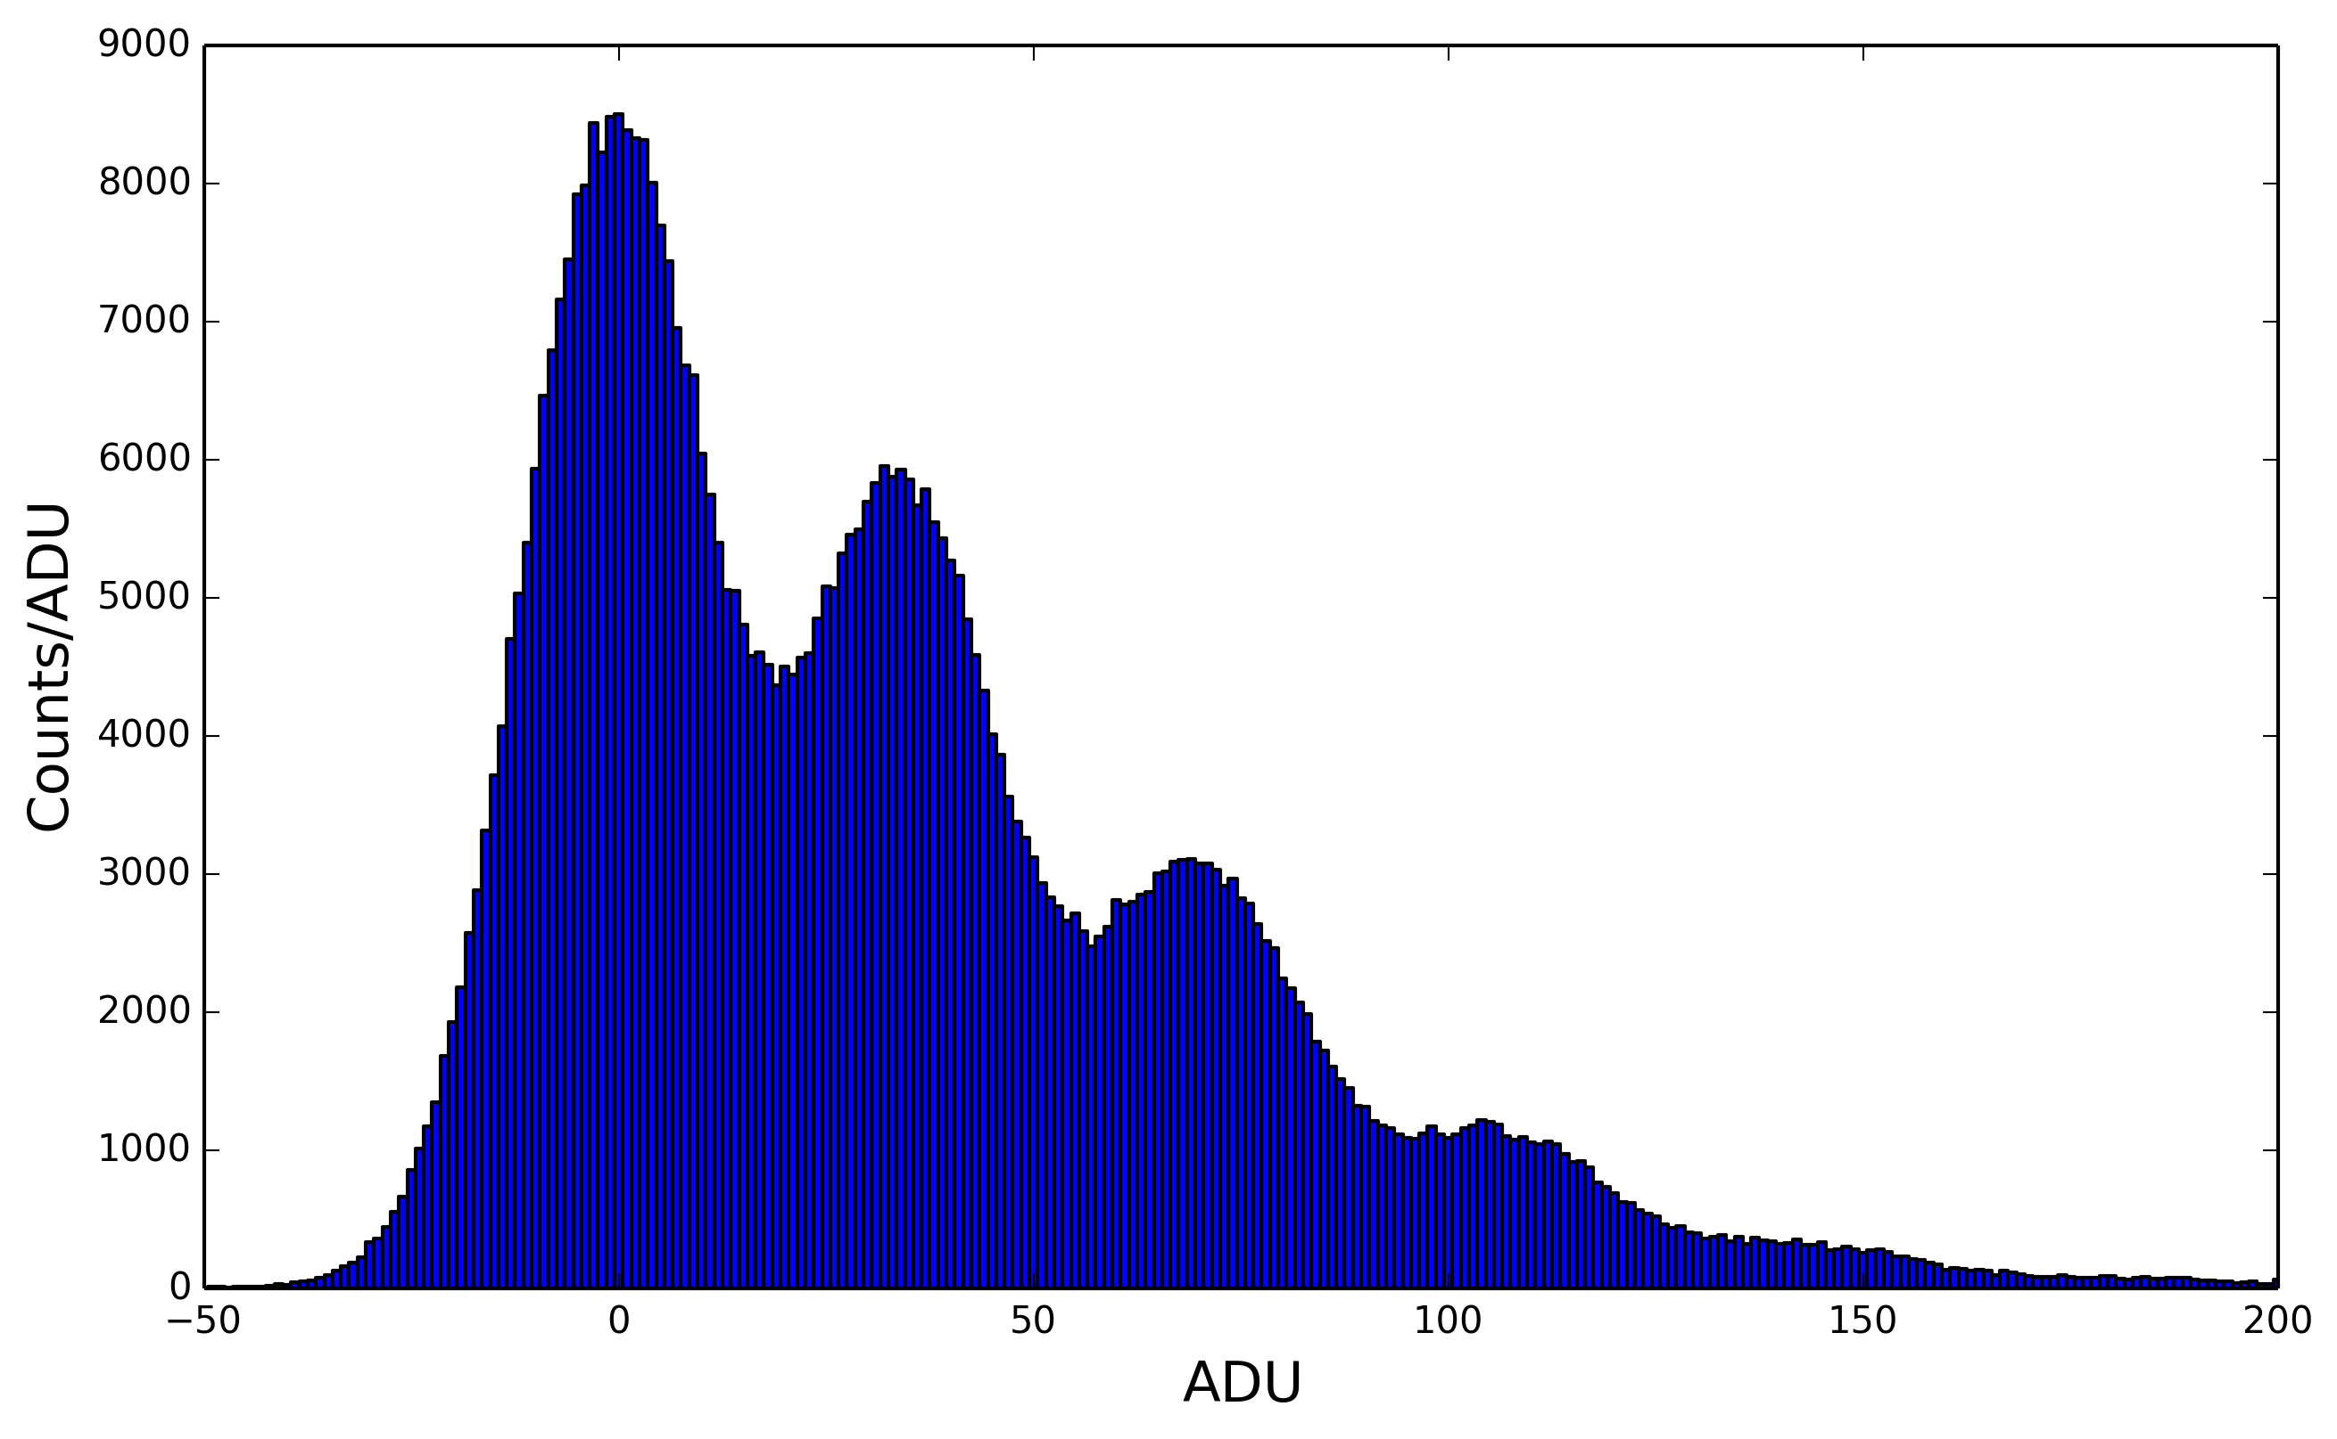
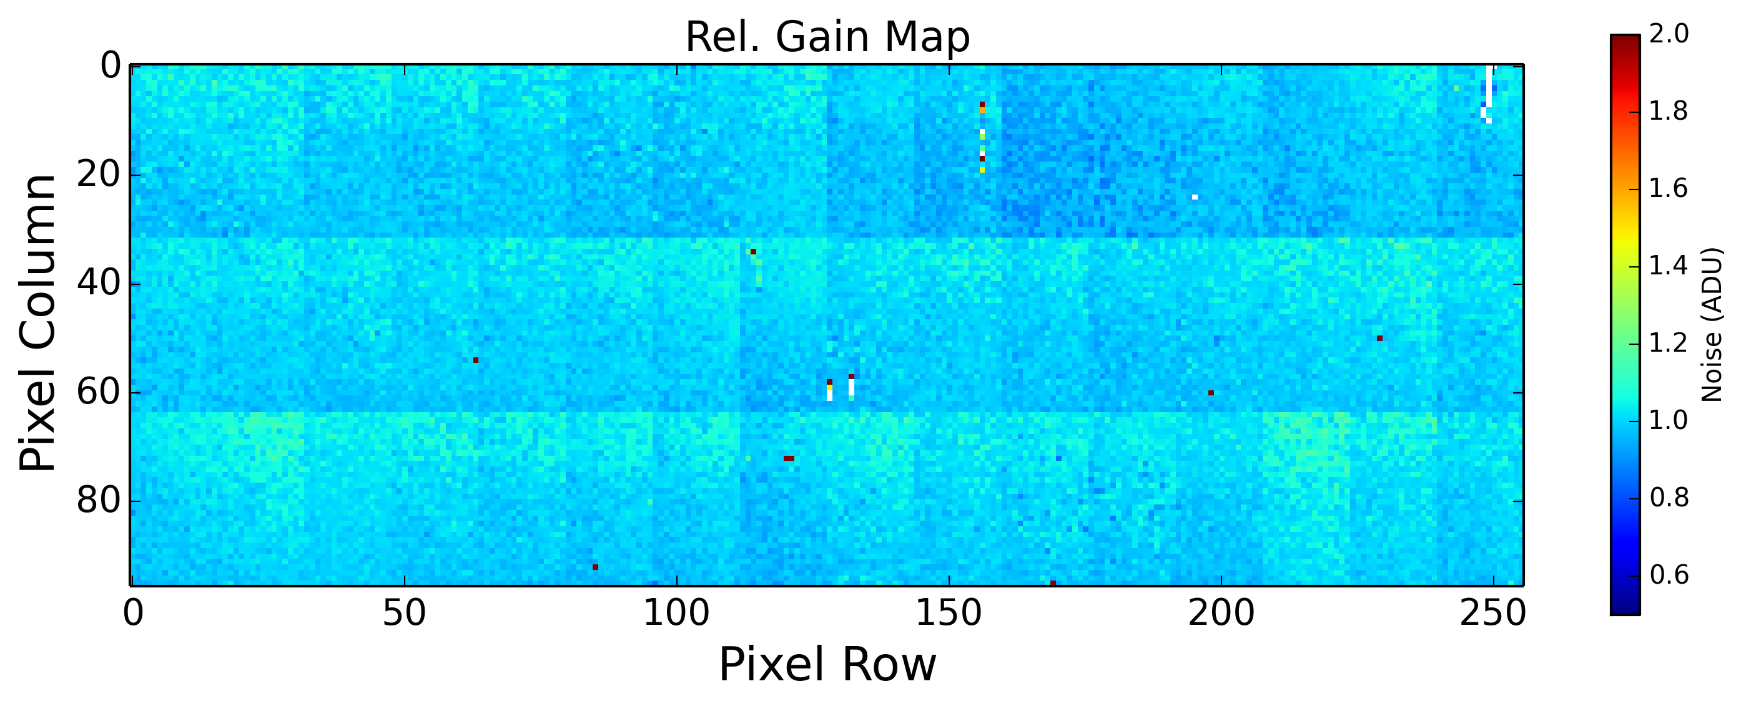
Calibration Activity - LPD
  LPD calibration – tests and characterization of the final LPD tiles ongoing at XFEL and RAL
  Most of the calibration activity was taken over by XFEL ( study CI for dynamic range scan, rel. gain correction, edge pixel effect, etc..)
“Flat field” from RAL X-ray set
    Strategy:
    Obtain relative amplification map via charge injection circuit
    Limited use for lowest gain as charge injection does not completely cover this range (→ higher uncertainty)
    Verification with X-rays (e.g. Big Amber)
    Conversion gain factor (mono-energetic, pulsed X-rays)
    Edge pixel correction (flat field, e.g. RAL X-ray setup)
Photon spectrum at 18 keV
Pixel Column
ADU
Pixel Row
Rel. Amplification Map from Charge Injection (high gain)

Slide 8
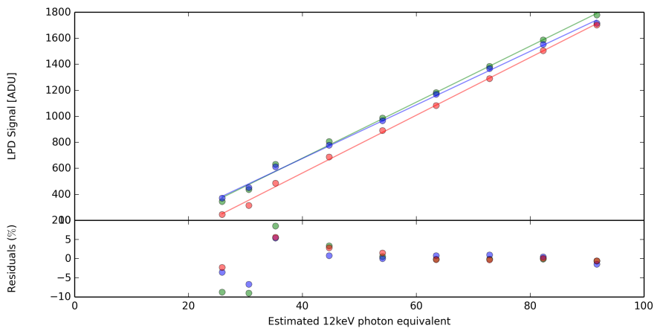
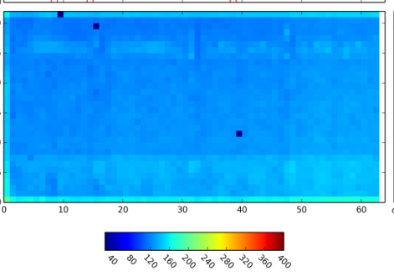
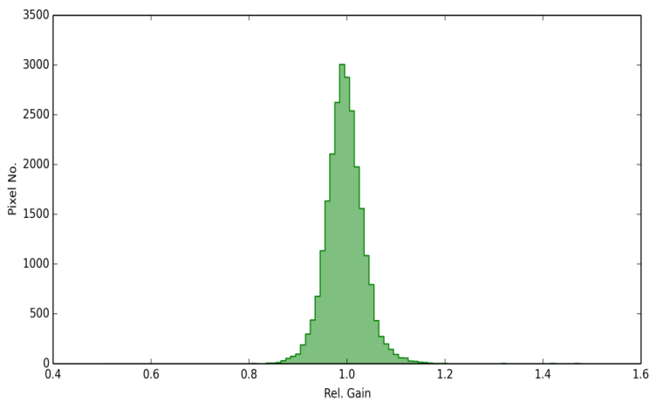
Relative Amplification Corrections - LPD
High gain
Relative correction of the injected charge
Correction per pixel (not per memory cell)
Does not correct for particular sensor features (e.g. size of edge pixels or proxi-mity of dead pixels)
Data taking time for calibration: ~60 hours
Preliminary
LPD intensity map before edge pixel correction
Distribution of relative amplification – std ~4.8%

Slide 9
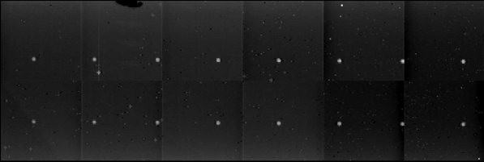
Calibration of AGIPD detector – Status
Calibration of 1MPix system with AGIPD1.0 ongoing
Module-wise calibration inside the final AGIPD 1Mpix chamber → allows calibration under „real conditions“ (i.e. temperature, vacuum)
Procedures and tools to take calibration data implemented for AGIPD1.0 → 12 TB of raw data for 1Mpix
Preliminary framework for generation of calibration/correction parameters exists, needs to be updated for AGIPD1.1 → ~ 50 GB of calibration and correction parameters (noise, offset, gain, etc..)
Work on alignment method ongoing
Calibration will be verified and validated during the E2E tests at HERA South as far as possible and later during the commissioning of the AGIPD detector at the SPB instrument
Alignment data taken with X-ray tube
4-5 photons
Pix_Y
Pix_X

Slide 10
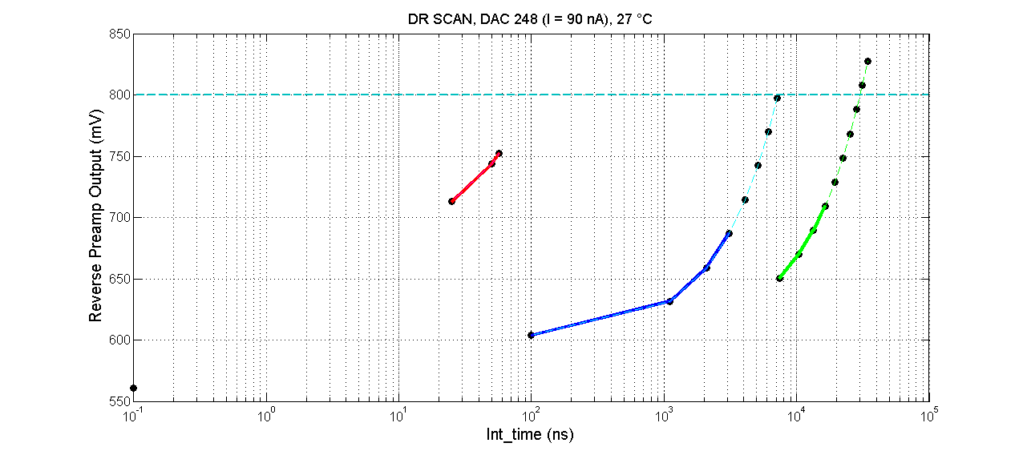
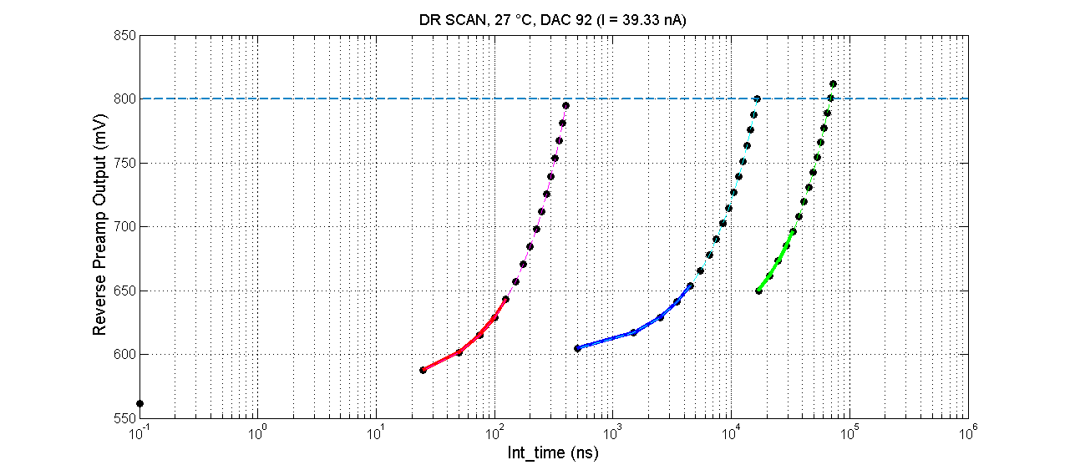
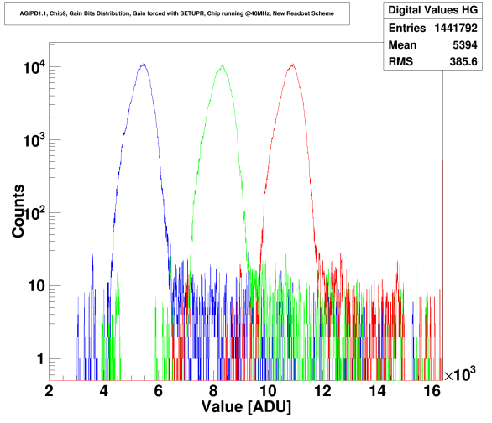
Calibration of AGIPD detector – Towards AGIPD1.1
Production of FE modules with AGIPD1.1 ongoing -> first assembly expected in February 2017
Communication files (patterns) between FPGA and ASIC have to be adjusted to cope with AGIPD 1.1
As the current source will now reach high gain as well, cross calibration between pulse capacitor and current source is not necessary anymore.
  Adjustment of patterns
  Adjustment of calibration routines (fitting routine for dynamic range has to deal with high gain as well)
Gain threshold map (2ths x1M pixels x 352 cells) and evaluation logic for gain bit distribution needed to be supplied by the AGIPD Consortium
Memory droop investigation for AGIPD 1.1 before and after irradiation
Relative amplification from current source
AGIPD 1.0 .
AGIPD 1.1 .
Gain bit distribution

Slide 11
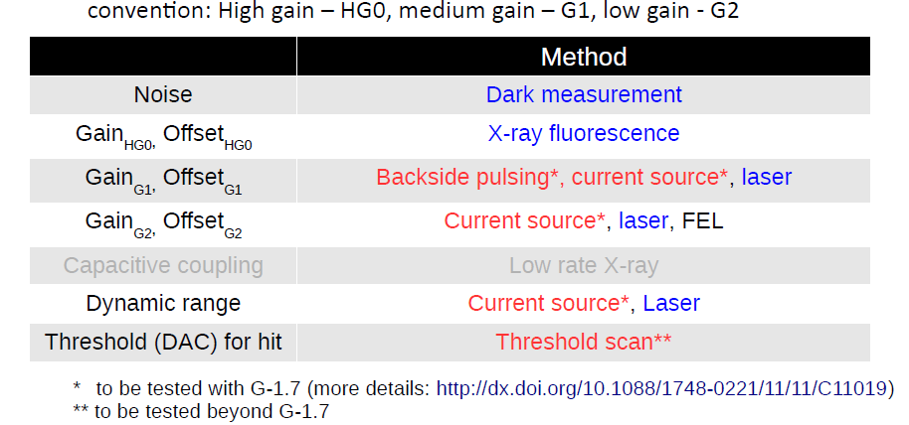
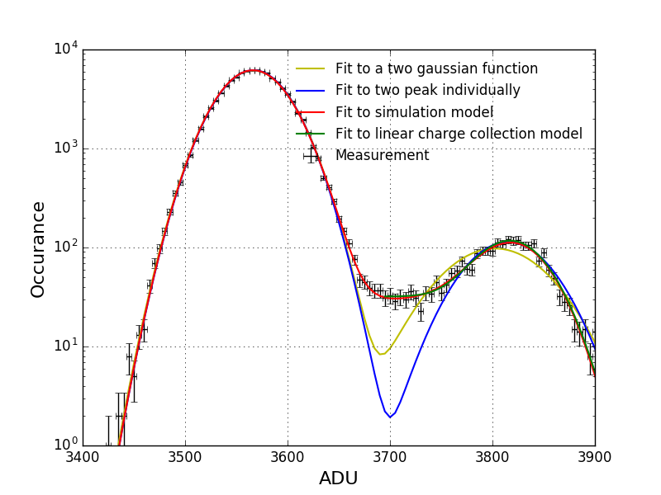
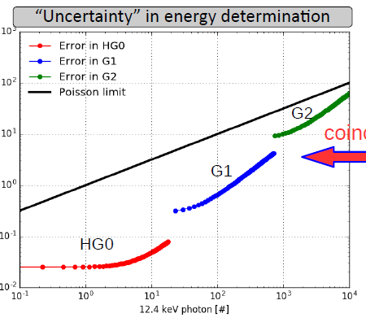
Gotthard detector
Characterization of Gotthard 1 and 1.5 → starting point for Gotthard II
Testing the strategy for calibration of Gotthard II is ongoing
Conversion gain from ADU to photon needs high precision in order to limit the uncertainty below Poisson limit → Study of conversion gain method

Slide 12
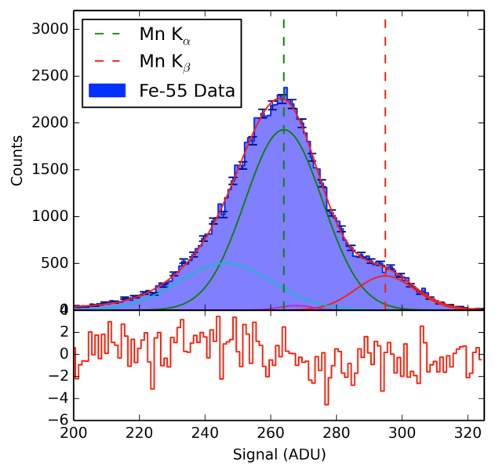
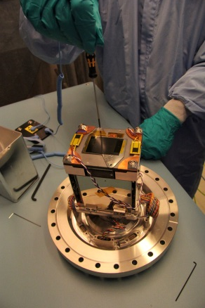
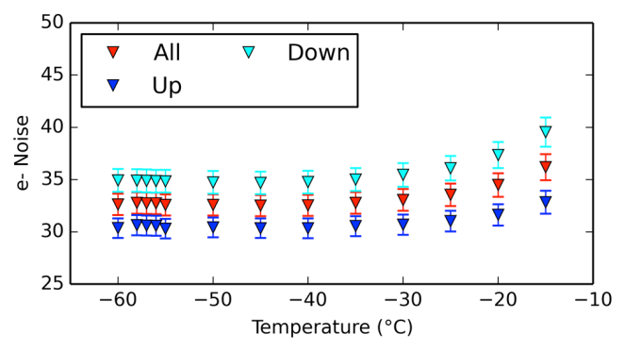
FastCCD
Characterization and calibration of the FastCCD detector ongoing in the XFEL detector laboratory using our X-ray infrastructure
Full analysis based on the existing and tested CCD calibration pipeline
Energy resolution σ = 262 ± 4 eV @ 6 keV
Expected to improve after all corrections can be applied (e.g. CTI), which will only be possible after firmware update
Conversion gain for highest gain setting:
  22.26±0.2 eV/ADU (about 6.1 e⁻/ADU)
Mn-K_{α} and K_{β} single event spectrum
Noise vs. Temperature

Slide 13
Conclusions
Calibration/characterization plans and strategies are under tests → verification with small scale prototypes and full scale detector systems ongoing
Calibration work in the Consortia and at the European XFEL is ongoing → a lot of work has been done and still a lot of work is ahead of us

Slide 14
Part 2
Infrastructure for detector calibration and tests at the XFEL – status
  → Different sources and setups:
Small portable Setups, operational with low power X-ray tubes and an Fe-55 source
    Little Amber for ambient operation of small detector prototypes (6 / 9 / 20 keV)
    Pheobe for vacuum operation, attachable to vacuum vessels of detectors (6/ 9 keV)
Fixed Setups for up to 1 Mpx detector systems:
    Big Amber (Ambient test setup for Mpx detectors)
    PulXar Pulsed Multi-Target X-ray test setup

Slide 15
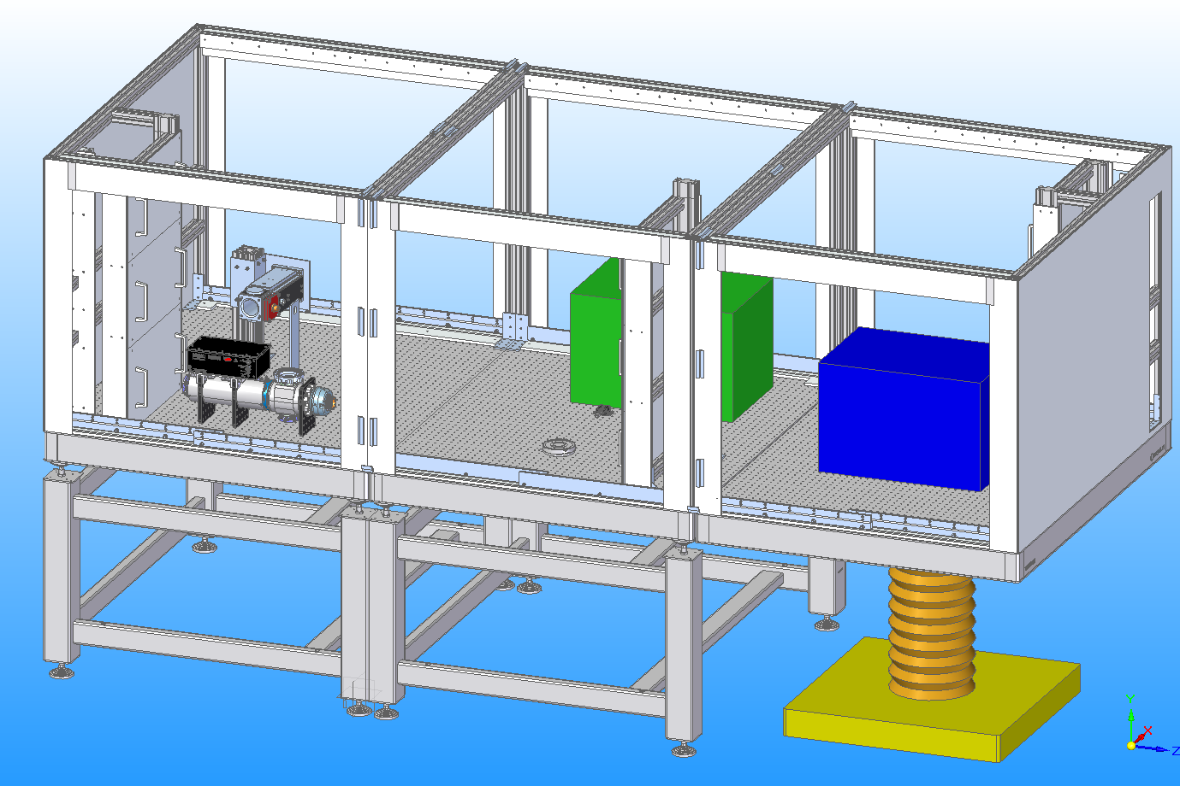
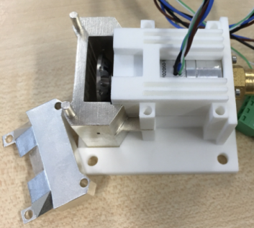
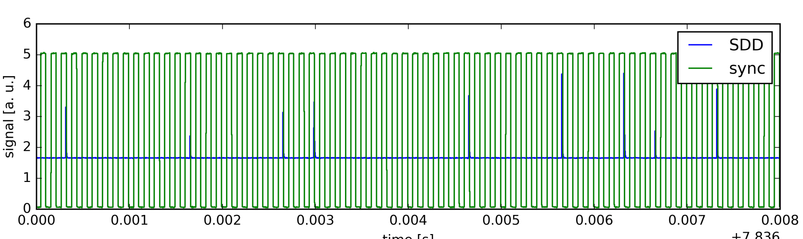
Ambient X-ray test Setup Big Amber: Reminder
Ambient X-ray test setup Big Amber
1,5 m
Modular setup for large area and small area detectors
Mpx detector system
X-ray tube
X-ray sources:
Commercial high power X-ray tubes: (V < 60 kV and P < 1.6/2 kW), anodes: Cu (8 keV) and Mo (17 keV)
+ Polycapillary focusing optics
Parameters of the focal spot:
2 m
¼ Mpx
detector
system
1,6 m
1,2 m
1,2 m
Beam chopper for pulsed structure
Signal from chopper (150 krpm) and SDD:
E (keV) | CrK | CuK
Spot size (µm) | 39 | 40
Intensity gain | 11275 | 12772
3 signals per revolution
time [s]

Slide 16
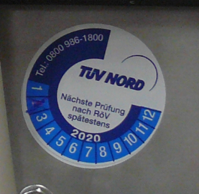
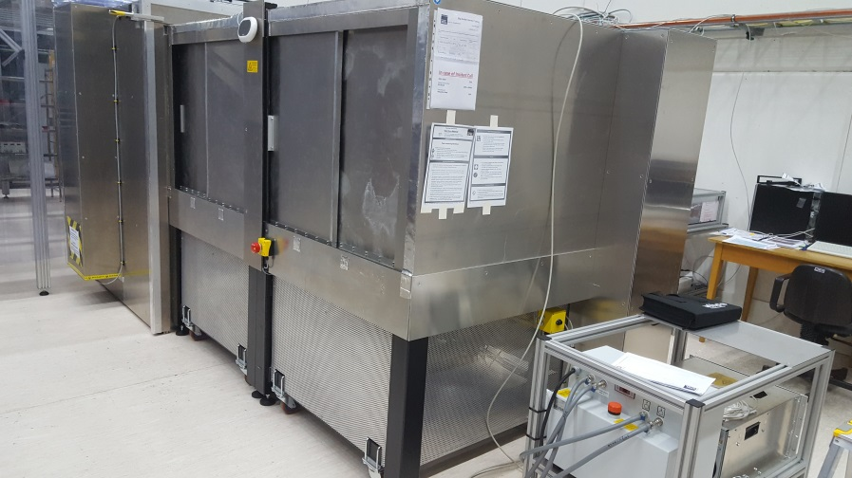
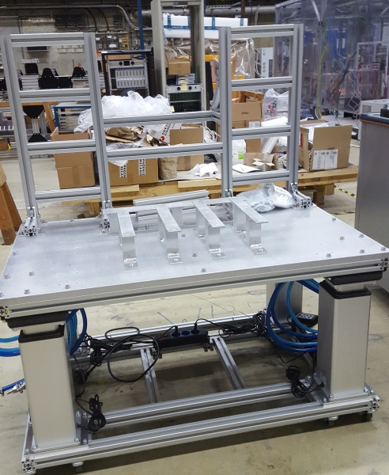
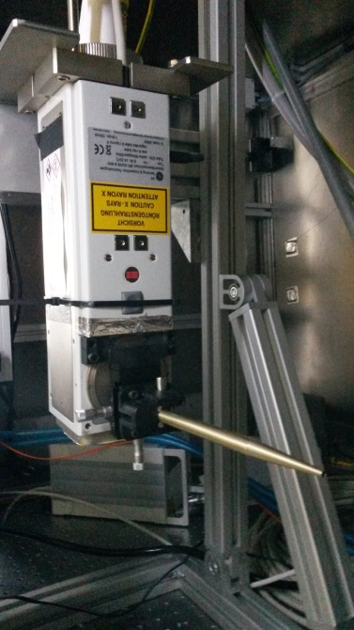
Ambient X-ray test Setup Big Amber: Status
operational
Status:
Three module setup operational
Use with and without optics approved
Polycapillary optics installed (on preliminary manual holder)
Fast chopper was tested
Second X-ray generator is ordered
Detector Support for AGIPD is ready
→ ready for arrival of 1 Mpx AGIPD detector
3rd module,
1 Mpx detectors
1st module,
commercial X-ray tubes
Cable Support
Next steps :
Exchange holder of the optic when it is delivered
Commissioning of optics
Install second generator
1,2 m
0,6 - 0,9 m
Tube housing
with optics
Notes:
The concept is to built up infrastructure for XFEL in several steps.
Problem is …
→ go through right part of the slide
What are the specifications, requirements → next slide

Slide 17
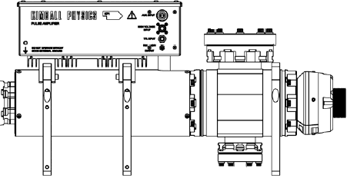
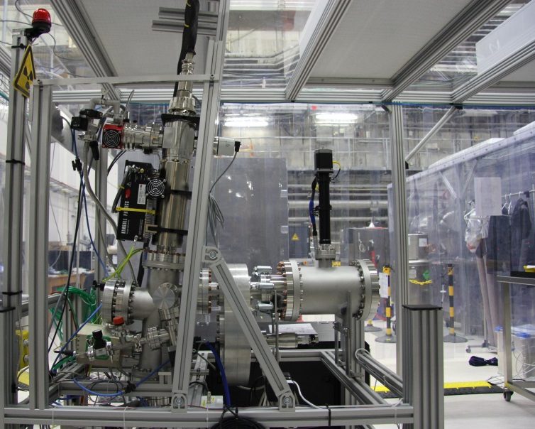
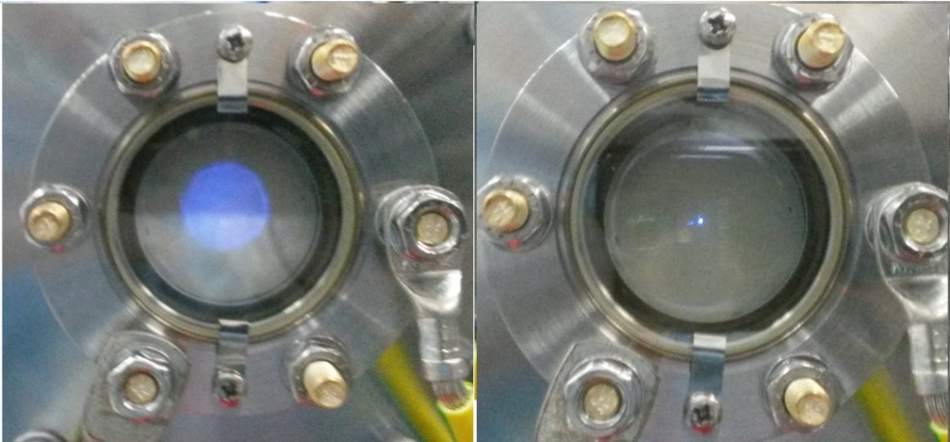
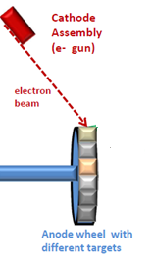
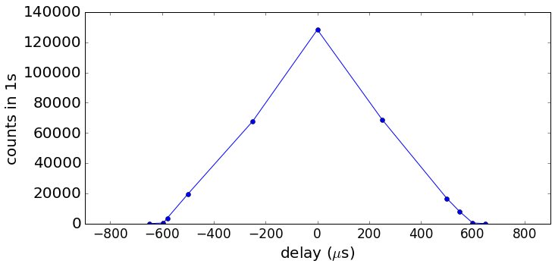
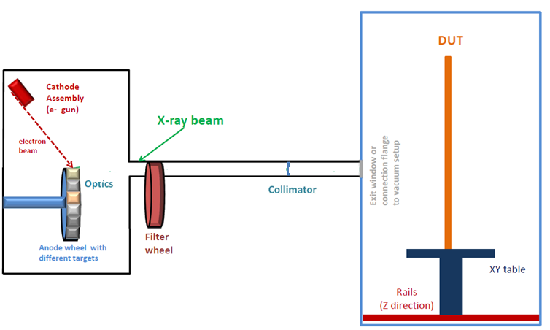
Multi-target pulsed X-ray setup PulXar 0.1
PulXar 0.1
Pulsed e- gun
Filter wheel
SDD
detector
chamber
Pulse length : 600 µm
Gate for SDD detector:
600 µm
Status:
Alignment was checked and improved
10 Hz pulsing checked
Characterization measurements with different targets and filters were done
Next steps:
Commissioning of 4.5 MHz pulsing and synchronization to SDD ongoing
Synchronization to XFEL timing

Slide 18
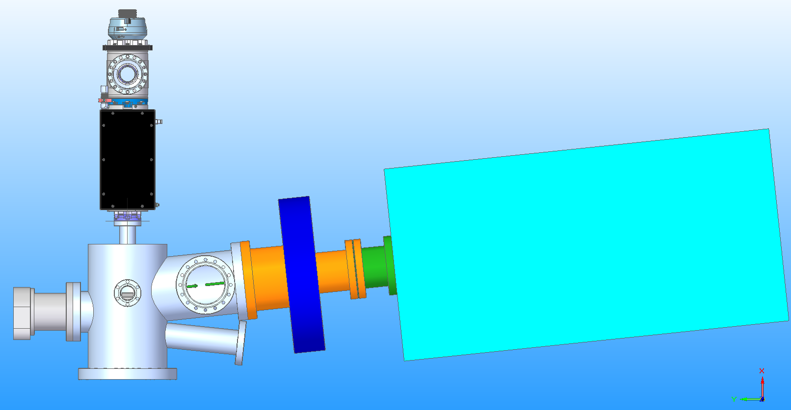
Multi-target pulsed X-ray setup PulXar - reminder
Multi-target X-ray setup for up to 1MPix detector systems
Pulsed electron source
First step: PANTER X-ray source* assembled & operated at the XFEL as test bed - done
Next steps:
PulXar v.0.1: Replace the existing electron source with a customized pulsed electron source by Kimball (V < 15 keV, I<1mA) under commissioning
PulXar 0.2: design and build new vessel with motorized target, filter wheels and polycapillary optics
e- gun
Filter wheel
Detectors under test
vacuum or ambient conditions
Anode wheel
with different targets
Optics
Parameter of e-gun | Pulsed mode | DC mode
Electron energy | 1 - 50 keV | 1 - 60 keV
Electron beam current | 10 μA - 20 mA | 10μA - 6mA
Beam diameter | 0.15 - 10 mm | 0.1 - 10 mm
Pulsed beam parameters | - Length: τ = 25 -150 ns - XFEL burst mode | n.a.
*Cooperation with PANTER X-ray test facility of the Max-Planck Inst. for extraterrestrial Physics

Slide 19
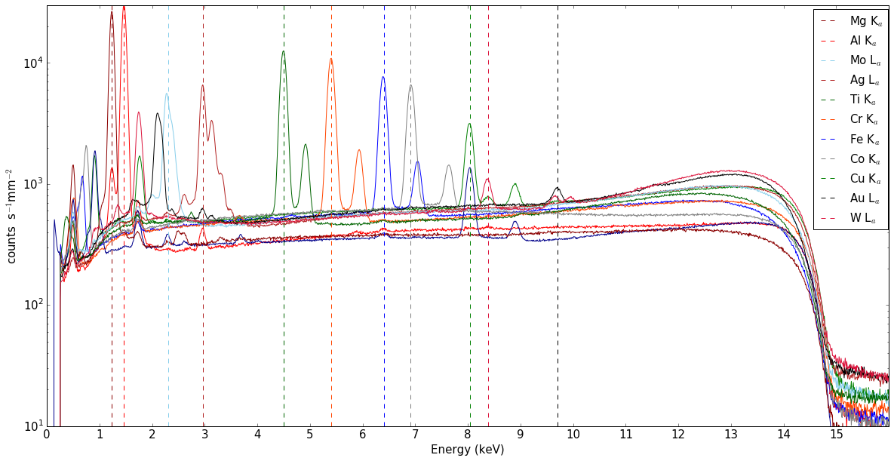

Multi-target pulsed X-ray setup PulXar 0.1
PulXar 0.1
Pulsed e- gun
Filter wheel
SDD
detector
chamber
Pulse length : 600 µm
Gate for SDD detector:
600 µm
Status:
Alignment was checked and improved
10 Hz pulsing checked
Characterization measurements with different targets and filters were done
Next steps:
Commissioning of 4.5 MHz pulsing and synchronization to SDD ongoing
Synchronization to XFEL timing

Slide 20
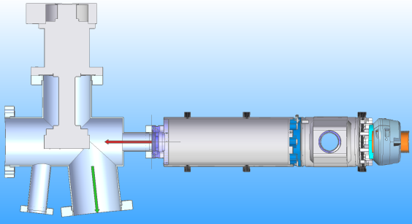
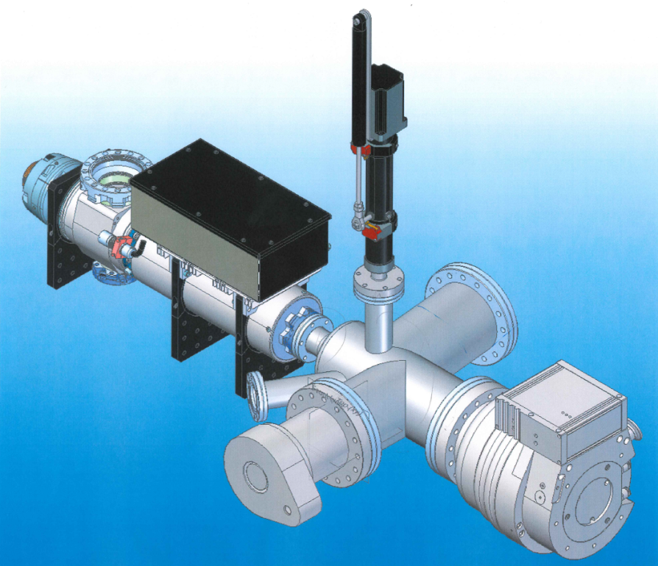
Multi-target (pulsed) X-ray setup PulXar
Multi-target pulsed X-ray setup PulXar 0.2
Third step - PulXar 0.2:
Design and build new vessel with target wheel and new filter wheel
Pulsed mode: V < 50kV (20kV), I < 20mA, t (pulse) > 25 ns
DC mode: V<60kV (20kV), I<5mA
e- Beam
X-ray Beam
PulXar v0.2 – vessel (preliminary)
Status:
Target wheel is ordered, adjustments of target fixation are implemented
Design of the vessel is ongoing
Next steps
Define parameters of collimating polycapillary optics
Finish design of housing
Design of target chamber/ filter wheel
X-ray Beam
Port for target monitoring
Target wheel

Slide 21
Summary
Calibration laboratory X-ray infrastructure
    Portable test setups Pheobe (vacuum) and little Amber (ambient) are operational and in use (for tests with FastCCD, Gotthard, … )
    Permanent ambient X-ray test setup Big Amber:
    3 module version operational and ready for the 1 Mpx versions of AGIPD and LPD
    Pulsed Multi-Target X-ray test setup PulXar
    Version 0.1 – commissioning in progress, ready Q1 2017
    Version 0.2 – design ongoing

Slide 22
Backup slides

Slide 23
Size of Detector Parameter Space
AGIPD
x 352 memory cells
x 1 million pixel
x 3 gain stages
~ 10⁹ parameters
Conclusions
Impossible to calibrate and commission many combinations for first day of operation (finite time) →
Focus on most important operating conditions for day-one
Parameter Dependence
Temperature
Integration time/sampling speed
Irradiated dose
Bias voltage
Day-one operation modes discussed and agreed with instrument scientists

Slide 24
Base Line Detector Operation Modes for Day-one
Non Linear System Response
DSSC
AGIPD
LPD
 | Mode I | Mode II | Mode III
Read Out Frequency | 4.5 MHz
Photon Energy | 1 keV | 1.5 keV | 0.7 keV
Max # of ph/pulse/pixel | 3 x 10³ @1keV (maximum achievable)
Read Out Geometry | Full Frame
Single Photon Sensitivity | No
Alignment Precision | 1/10 of the pixel size (quadrant level)
Veto Capability | Yes&
Memory | 800 Cells (full memory)
Mode I | Mode II | Mode III
4.5 MHz
8.6 keV# | 15 keV | 7 keV
10⁴ @12.4 keV (maximum achievable)
Full Frame
Yes 0.15 ph RMS Noise | Yes 0.084 ph RMS Noise | No
1/10 of the pixel size
Yes&
352 Cells (full memory)
Mode I | Mode II | Mode III
4.5 MHz |  | < 4.5 MHz
12 keV* | 20 keV | 12 keV*
> 10⁴ @12.4 keV (maximum achievable)
Full Frame
Yes 0.35 ph RMS Noise | Yes 0.21 ph RMS Noise | Yes$ < 0.21 ph RMS Noise
1/10 of the pixel size
Yes&
512 Cells (full memory)
&Remove empty frames for different bunch patterns
#Same performance is expected for 7 – 12 keV
*Same performance is expected for 7 – 9 keV
$Feasibility to be confirmed
Notes:
LPD
Operation mode 1
E=12 keV (the same performance is expected at 7-9 keV)
RMS noise = 1200 e- (0.35 ph@12 keV)
Single photon sensitivity at 7-9 keV is not required
Max. nr of ph/pulse/pixel before saturation > 10⁴ photons
Full frame readout
4.5MHz repetition rate (full memory, i.e. 512 memory cells)
Veto/data reduction capability to adjust to the pulse rate
Alignment precision – according to WP-75 definition (see “Detector Alignment at European XFEL: Concepts & Responsibilities” on Alfresco)
Operation mode 2:
E= 20 keV
0.21 ph noise @ 20 keV
Rest stays the same as in the mode 1
Operation mode 3:
E= 12 keV (the same performance expected at 7-9 keV)
Longer readout circle (no 4.5MHz speed) mainly for longer reset (noise reduction) if the feasibility study will show improvement in the detector performance (i.e. lower noise)
Rest stays the same as in the mode 1

Slide 25
Calibration of AGIPD detector
First calibration
Provided by the Consortium (methodology and software tools agreed and compatible with XFEL.EU requirements)
    in the laboratory using lab. X-ray sources and internal calibration circuits
Calibration will be evaluated/tested and improved (if necessary) during AGIPD detector tests first in XFEL detector lab and then during commissioning at SPB instrument
Recalibration at XFEL.EU
Provided by XFEL.EU
    in the experimental hutch using internal calibration circuit, FEL beam and radioactive sources
Calibrated data is the standard data product with which Users will be provided.

Slide 26
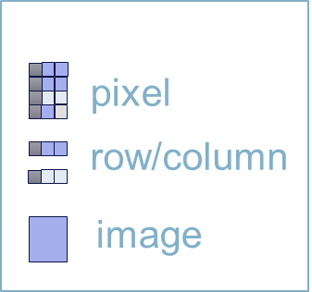
Calibration of AGIPD detector – Status
First calibration ongoing
Module wise inside the final AGIPD 1Mpix chamber → allows calibration under „real conditions“ (i.e., cooling, vacuum)
Procedures and tools to take calibration data implemented → 12 TB of raw data for 1Mpix detector
Framework for generation of calibration constants exists → ~ 50 GB of calibration constants (noise, offset, gain, etc..)
Application pipeline and calibration data base exists→ to be tested during tests at the detector laboratory at XFEL.EU
Split
events
Possible components of correction pipelines
Offset
sub.
CM
correct.
Droop
correct.
Gain correct.

Slide 27
Calibration method for each pixel (and memory cell)
Gain stage
Analog data
Saturation
ADU
Low Gain
High Gain
Medium Gain
N of photons (Energy)

Slide 28
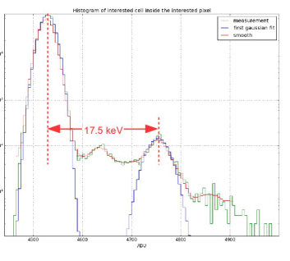
Calibration method for each pixel (and memory cell)
Gain stage
Analog data
Saturation
ADU
High gain extraction with X-ray photons
Extraction of slope, offset and gain bit using internal (electrical) calibration circuits
Low Gain
High Gain
Medium Gain
N of photons (Energy)

Slide 29
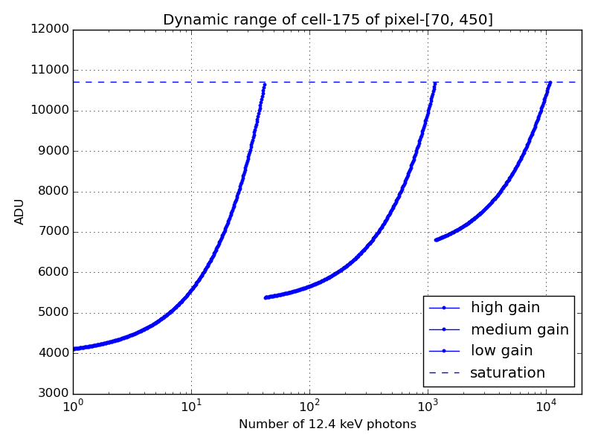
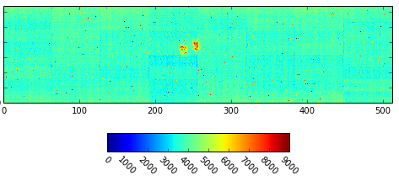
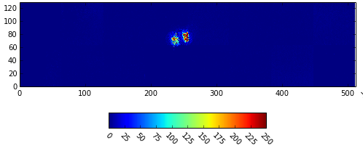
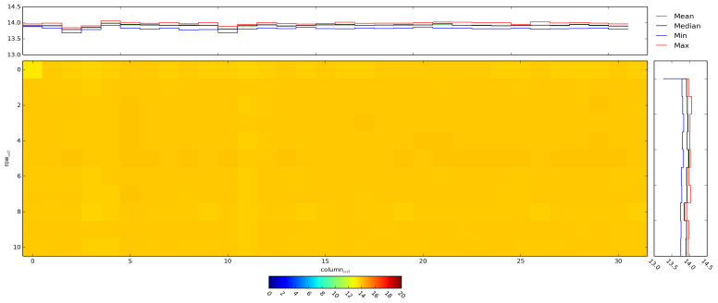
Example – Calibration Constants and Application
Dynamic range of single memory cell in one pixel
Raw data → single image (infrared LED)
ADU
Calibrated data
High gain map for single pixel and all 352 memory cells
keV

Slide 30


End-to-End Test of AGIPD in Detector Laboratory
Goal of the E2E Test
Demonstrate the functionality of the detector system including all subcomponents and identify potential problems before system acceptance and integration at SPB beam line.
What will be tested?
Vacuum, cooling and movement system
Detector control system
C&C and veto system
DAQ and data management system including calibration data base
Data processing pipeline and calibration pipeline
Detector operation modes for first day operation
Data and calibration data quality checks
Where and how will the testing be done?
Detector laboratory
Data taking with and without X-rays
Sequentially for all four quadrants of a detector at full speed, i.e. 4.5 MHz
Preparation for AGIPD E2E Tests is in the final stage

Slide 31
Schedule
Q1 2017 – End-to-End tests of 1MPix AGIPD in WP-75 laboratory
Q2 2017 – SPB ready for 1MPix AGIPD
Q2/Q3 2017 – Installation and commissioning of AGIPD detector at SPB
September 2017 – 1Mpix AGIPD detector ready for User Operation

Slide 32
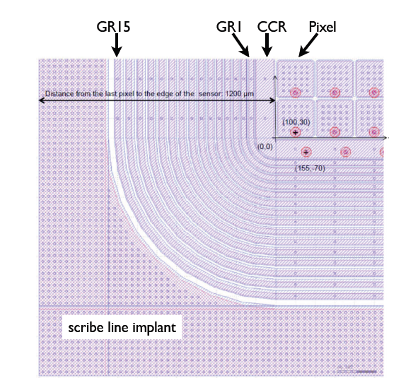
AGIPD Sensor - Radiation hardness design
No bulk damage expected for E < 300 keV ☺
BUT
Surface and interface damage:
Higher leakage current
Higher depletion voltage
Lower breakdown voltage
Charge losses at interface
Increased inter-pixel capacitance
Special high voltage design with 15 guard rings:
- radiation tolerant up to 1GGy ☺
- introduced additional non-sensitive
area between detector modules ☹
Distance from the last pixel to the
edge of the sensor 1200 μm
JINST (2013) 8 C12015,
DOI: 10.1088/1748-0221/8/01/C01015,
e-Print: arXiv:1210.0430 [physics.ins-det]

Slide 33
Calibration Strategy – where calibration will be done
XFEL.EU Project Phase | Detector Laboratory | FELs/Synchrotrons/ Particle Accelerators
 |  | External Sources | XFEL. EU
 |  |  | Instr. Hutches | Dedicated beam
Start-up | Initial detailed calib. and characterization of det. prototypes, modules | Response of detector vs. either rep. rate or intensity
Commissio-ning | Initial detailed calib. and characterization of full systems | Calibration of 1MPix 2D cameras is NOT feasible due to the demanding infrastructure requirements | Cross-check lab. calibration Characterization of the detector response under real conditions (rep.rate and intensity)
User Operation | Calibration of the full system only if necessary (accident, detailed detector response investigation, etc..) |  | Scientific. exp: Part of regular exp. procedure (shall take a few mins) Maintainance time - Calibration/tests using in-hutch sources | Detailed detector response investigation under real conditions (rep.rate and intensity)

Slide 34
Possible components of correction pipelines – and importance of throughput
granularity
pixel
row/column
image
40%
7%
Droop
correct.
Split
events
7%
40%
7%
Offset
sub.
CM
correct.
CTI correct.
Gain correct.

Slide 35
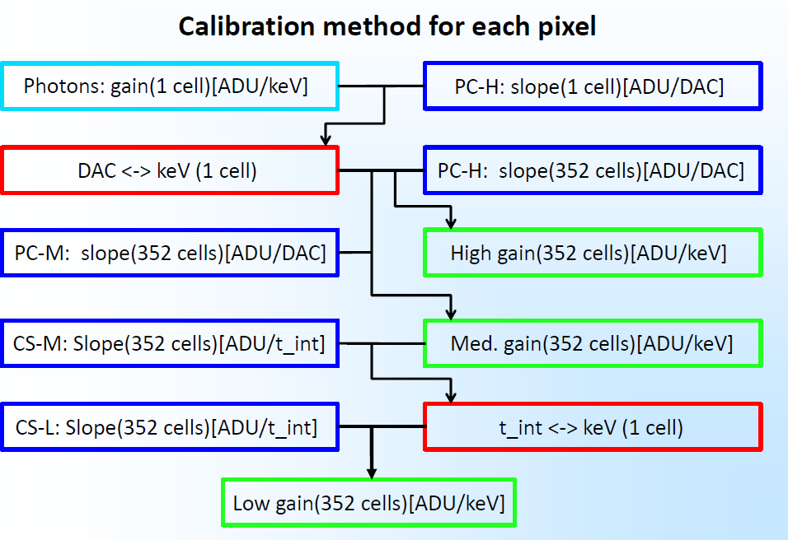
Calibration method for each pixel (and memory cell)
Conversion from ADU to photon energy

Slide 36
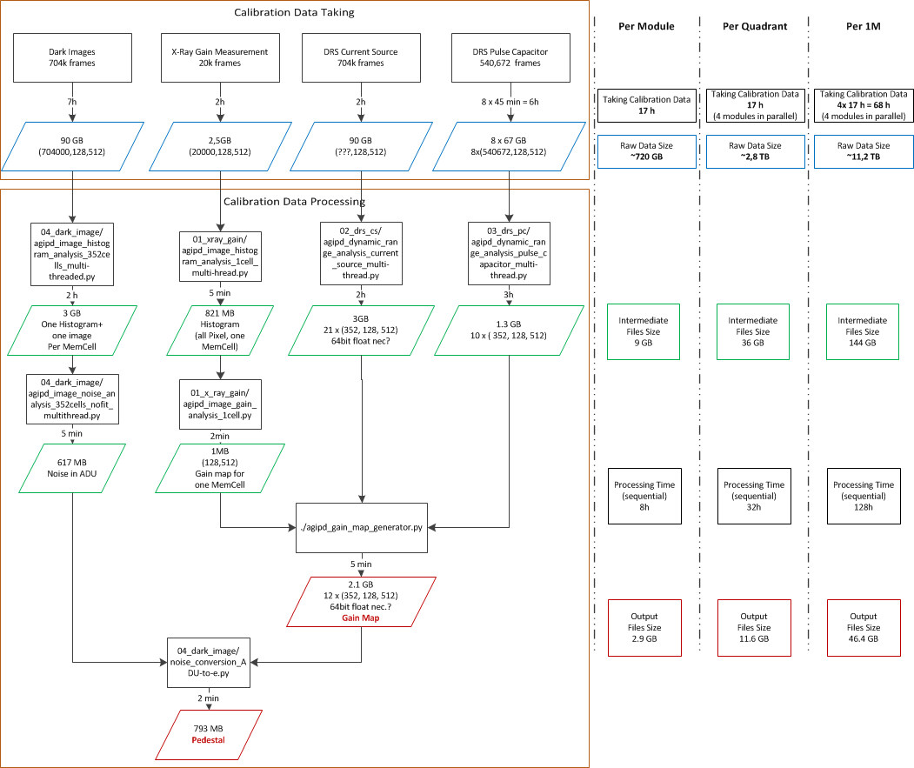
Calibration procedure

Slide 37
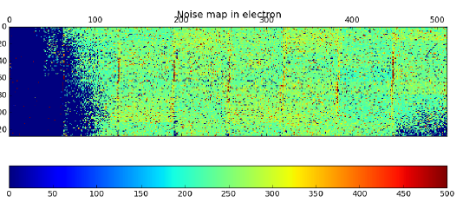


Noise Performance
Noise in electrons for single memory cell and all pixels in single module → average below 350 e- r.m.s.
Noise in electrons for single pixel and all memory cells

Slide 38


Gain and Dynamic Range

Slide 39


Memory Droop (signal losses)
99%
Droop before irradiation < 1%
The effect has to be monitored and corrected if necessary

Slide 40
Calibration and Correction Parameters of XFEL Detectors

