Slide 1

Next steps
20 July 2016 this version is the minutes – with notes added (in pink)
J. J. John on behalf of the team

Slide 2
Agenda
Special focus: physical interfacing to CHESS-2

Slide 3
Update on CHESS-2 DAQ design
Please see Larry Ruckman’s update from Tuesday 19th:
https://indico.desy.de/getFile.py/access?contribId=1&sessionId=0&resId=0&materialId=slides&confId=15722
Main points:
SLAC is aiming to have boards back at the start of September
The design is being simplified a bit to help with this
We discussed connectors – more on next slides

Slide 4
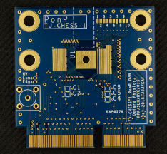
Connectors
The Strip CMOS main meeting of Tuesday 19th discussed
the idea of having edge connectors only, to favour
radiation hardness testing.
A solution could be 2 x 100 pin edge connectors used for
CHESS-1.
But this make the daughterboard too wide
(~3.8cm per connector)
After discussion, those present in the main Strip CMOS meeting decided that:
it’s ok not to be able to fully characterise CHESS-2, then irradiate, then characterise again (note, doing this would require no soldered connectors, only edge connectors)
So we can live with a soldered connector
(continues on next slide…)
100 pins, double-sided,
3.8cm wide

Slide 5
Connectors, continued
But we want to do a basic sanity check on the CHESS-2 sensor prior to irradiation, before the complex connector gets soldered down.
So we now have a hybrid proposal:
    use the QTH connector for most signals, especially data out
    have a small edge connector for an essential sanity check
    we think this means:
      power and bias
      SACI bus including the SACI response line
This would be enough to mount the chips, test that they power up all right and respond to SACI commands, then send them away for irradiation.
The QTH connector will be soldered once the boards return.
Then the sensors will be fully tested.

Slide 6
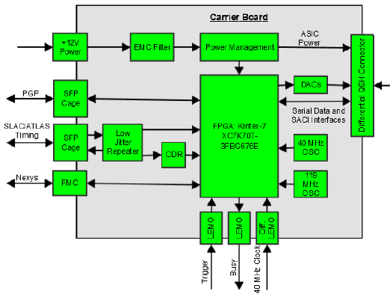
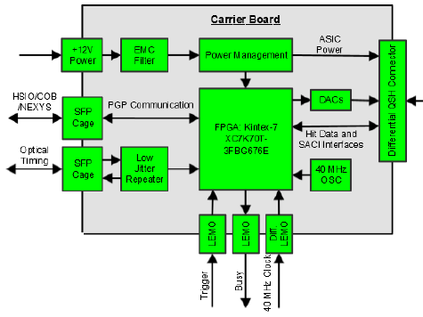
Motherboard changes and FMC
Another important point to note: for time reasons, to simplify the mother board, SLAC feels it is important to remove the FMC connector on the motherboard and to simplify the timing interface:
previous
current

Slide 7
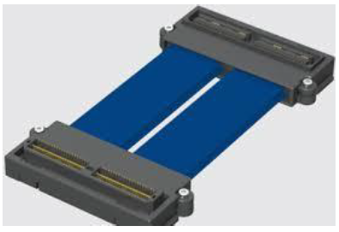
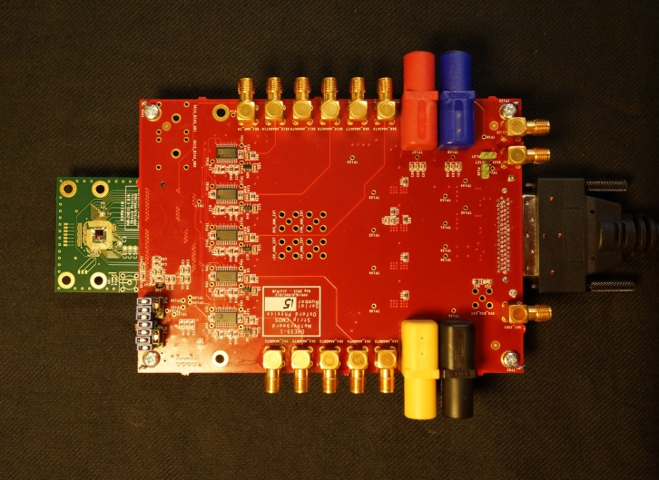
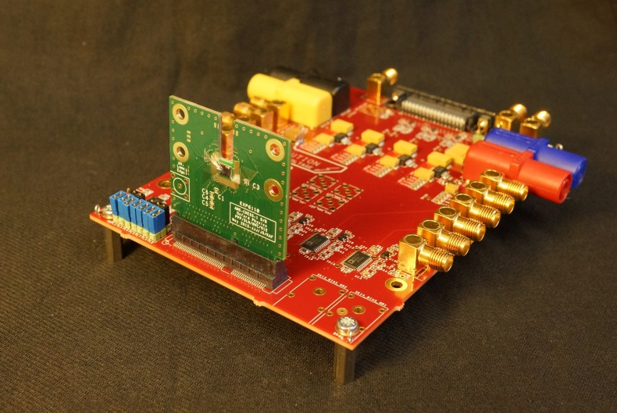
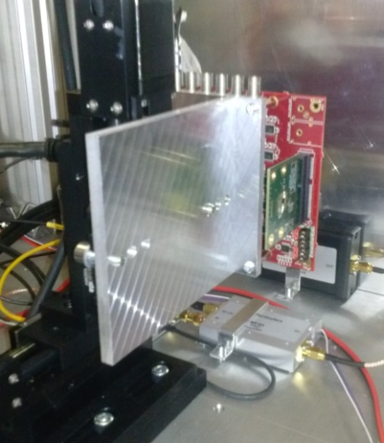
Mechanical flexibility
One reason SLAC favours the QSH/QTH connectors is the mechanical flexibility of the cabling possibility:
In general for the various ways of testing
sensors: lasers, sources, test beams, it has
been a minimum to offer two orientations
of daughterboard to motherboard:
this will be complicated by the request to have an edge connector for essential testing…

Slide 8
Our choices now
Still aim to connect the CHESS-2 daughterboard directly to the Nexys Video
    Reminder: low pin count FMC => read out 1 array only
    Request the QTH to become probably 2 x FMC?
    Make an adaptor board
Adapt the ABCN’ firmware to fit within the Kintex on the CHESS-2 motherboard
Both of these have trade-offs of schedule, funds, extra work of some form or another.
Let’s work on the details to see how best to go about this.

Slide 9
Back up slides
Usual agenda items:
Review current work and discuss steps for next week
Update on datapath blocks (Kevin and Wojtek)
Update on CHESS-2 data emulator (Tianbo)

Slide 10
Ongoing and new actions – 1/2
new actions in blue
updates in pink
(actions which were already done last week have been removed)
Kevin and Matt: any update on ITSDAQ code for this week? --Kevin set up simulations of the whole ABCN’ with Matt’s test benches, including configuration of registers, 10 L0 triggers, then 10 L1 triggers. Readout of data is successful in these simulations. One issue: the ClusterFinder has a limit of 4 packets out. This needs to change to 10 or 11 to reflect more data out of CHESS-2.
Kevin also wrote some C code to query the Nexys Video running the ABCN’ inside of ITSDAQ. Matt noted: need to set up the readout streams first though. This is why Kevin wasn’t seeing data out yet. The data out should come out on streams 0 and 1, but depends where the ABCN’ was hooked up. Can enable all streams initially, then monitor with WireShark to learn which streams are connected in practice.
Note that the test bench uses a 160MHz readout clock but ITSDAQ uses 80MHz. Kevin tried 80MHz but the readout broke due to insufficient readout rate, so the FIFO got misaligned and rolled over. This clock is assigned in the dio_abc130 block. Matt suggests changing to 160MHz readout clock.
Kevin isn’t seeing trigger data go out in ChipScope yet – needs more investigation. Also the internal blocks aren’t receiving trigger-related signals. Will need to go back and forth between
Kevin confirmed that L0/CMD and LP/PR are switched now in the demultiplexers. There is a register in ITSDAQ which will switch the muxes in ITSDAQ. Kevin has hardcoded for now to ensure L0 and CMD arrive at the right points in the ABCN’.
There is an Ethernet timing constraint problem still. There are many clocks and derived constraints. Matt will need to have a look. Try to push the registers into the IOBs.
Modes: DAQ Mode: looks for a 0→1 transition, then stores packets and builds them into captures packets and
Capture Mode: captures anything on the output lines. Needs to know when to start. Usually starts based on receiving a trigger.
The Stream Configuration register controls the mode for each stream. Use the StreamConfig opcode to do this. Rate, Mode, ABC vs HCC.

Slide 11
Ongoing and new actions – 2/2
new actions in blue
updates in pink
(actions which were already done last week have been removed)
ITSDAQ discussion, continued:
Matt also suggests verifying that writes to registers are taking place successfully. In the simulation, Kevin verified writes then reads. Currently using a broadcast ChipID at the moment.
It’s possible to start ITSDAQ Capture Mode based on a RAWSIG. This would allow capturing register read data. There is a TWiki page describing the packet format. Use that to examine the bits.
Note that the ABC130 and HCC have fixed readout sizes of 64 bits. (add note about CMOS data)
Matt: e-mail Kevin the details of the ITSDAQ register which switches the muxes and the Stream Configuration registers.
Kevin: [done] implement single packet containing 0x7FD when the ABCN’ saw no hits in a given bunch crossing. --.
Tianbo: [ongoing] working on CHESS-2 Data Emulator. --.
Jaya John: [ongoing] prepare a tidied-up block diagram for the ABCN’
Jaya John: [ongoing] understand CHESS-2 configuration registers and how to map them into the ABCN’ memory map.

