Slide 1
Shopping list:
HVStripv1 Sr-90 Min-I signals
TJ p-on-p CHESS1 passives - VI and CV curves
CHESS1 – Connecting passive to amp

Slide 2
HVStripV1 revisited
HVStripV1
Sr-90 source and reading ch(13,1)
We see change with bias voltage
Running with 40 volts over-night tonight
Self-triggered
Metal layers seem to stop non-min-I electrons.

Slide 3
TJ p-on-p CHESS1 passive devices
New probe station at Oxford
Chip floating
Use probes to measure current and apply HV to passive diodes on the chip.
  Positive HV put on the signal pad
  Guard rings floating
  Vbias held to ground
Similar procedure for CV measurements

Slide 4
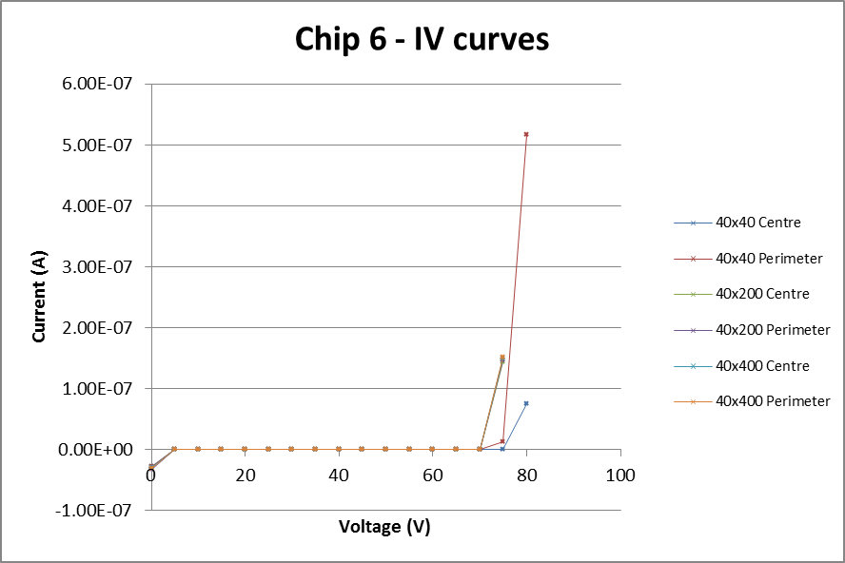
They hold positive voltage → Todd gets excited again!
Notes:
Two 40x40 curves are the easy ones to see, broke down a little later than the other diodes
All other diodes are almost entirely overlaying each other
If allowed to continue, would create a smooth rise, but would be dangerous due to sudden jumps in current
Other chips gave almost exactly the same results, overlaid on top of each other

Slide 5
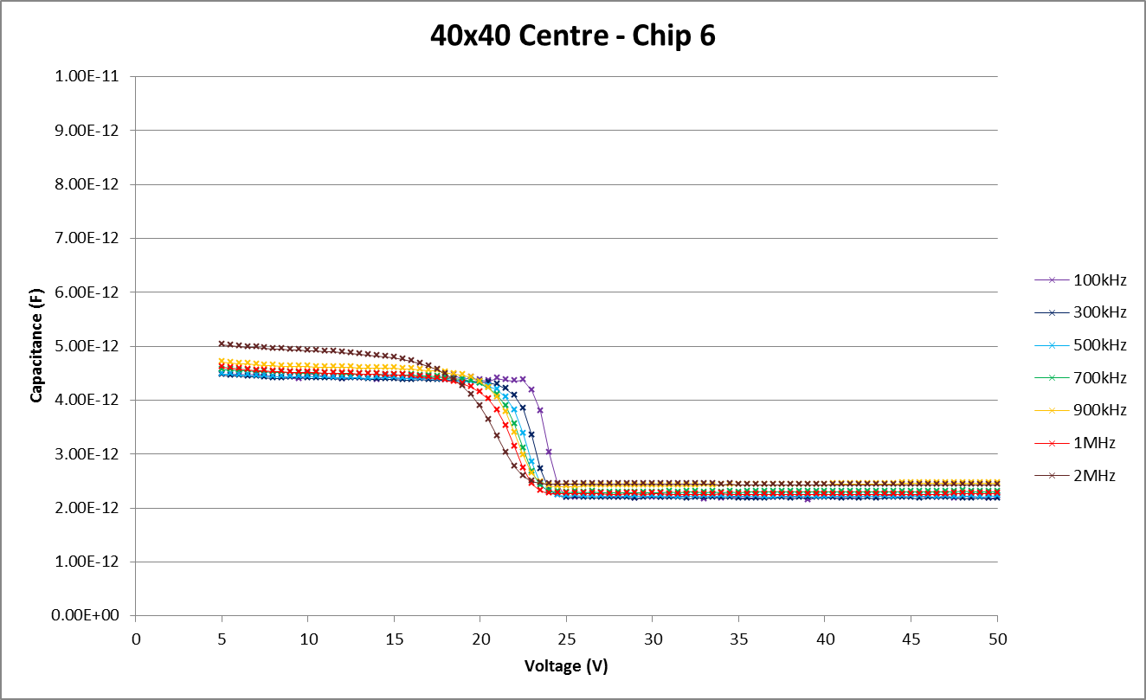
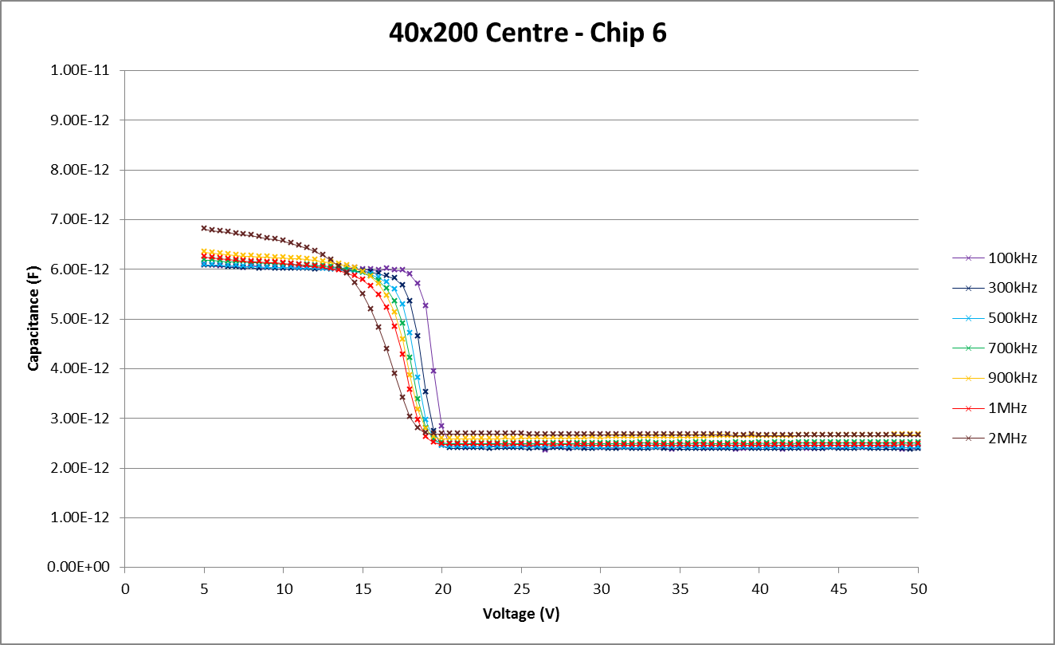
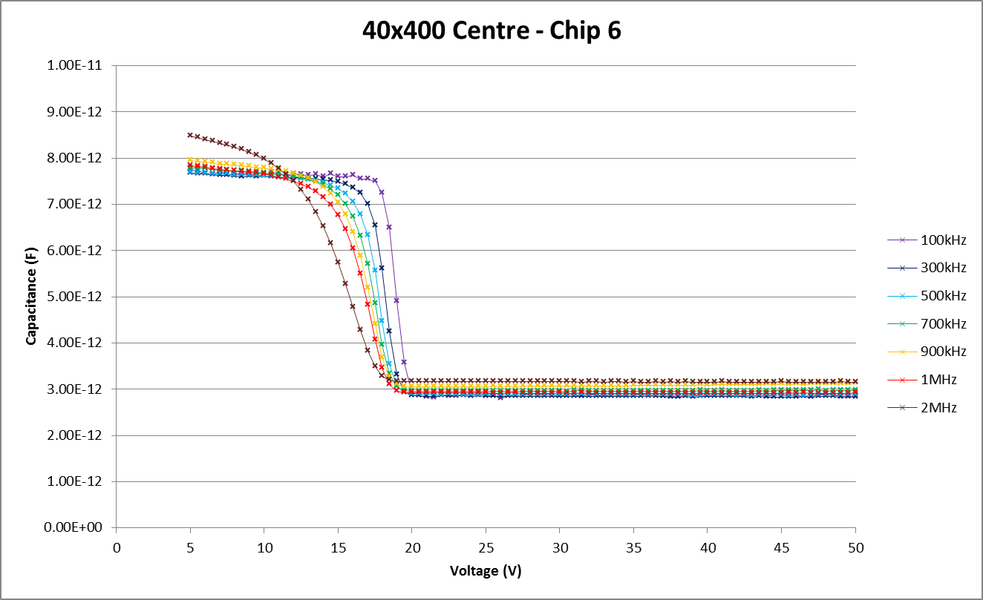
CV Chip 6
Can we figure out a way to amplify a fullly depleted passive sensor??
Notes:
Can see that the capacitance is higher for the larger chips
The curve is smoother at higher frequencies for testing
40x40 depleted around 25V, whereas the other two are closer to 20V
Means that operating voltage for the 40x400 and 40x200 is between 20V and 70V

Slide 6
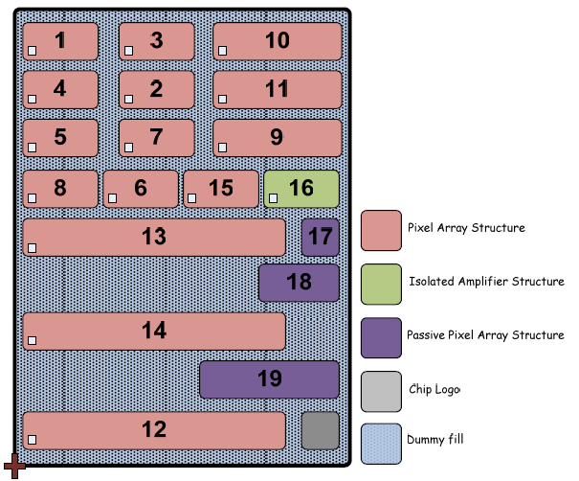
TJ-CHESS-1 PonP daughterboard – bonding diagram
Each of the following pages shows a portion of the bonds needed. Please combine all bonds shown.
This diagram applies to both the v1 blue and v2 black PonP daughterboards.
Bonding Layout | X21
Version | 1
Date | 02/08/2016
Changes since previous version: v1: Very experimental
This is a new layout for connecting the passive pixels to the amplifiers. It is NOT in the document “OverMOS1_PPD_testing_proposal.docx” by Fergus Wilson. See Richard or Todd for feedback/input/coffee.
Which structures are bonded in this layout:
TJ-CHESS-1 PonP structure numbering:
Pad group | Structure(s) bonded
Pad group FA | 3
Pad group FB | 0
Pad group FC | 0
Pad group CA | 0
Pad group CB | 0
Pad group CC | 0
Pad group CD | 0
Passive pixels pads | 17, 18, 19
p. 6

Slide 7
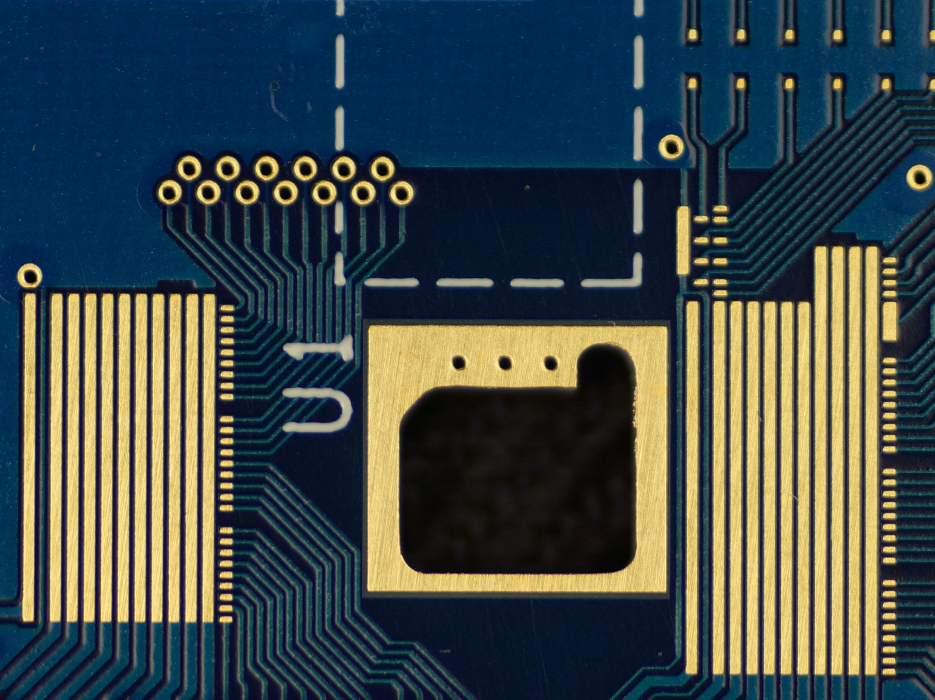
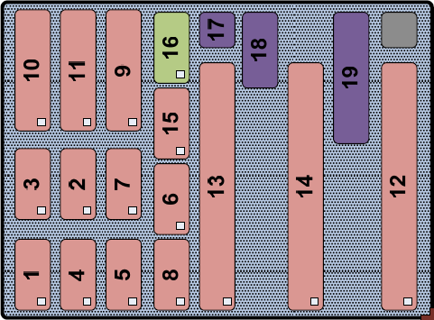
TJ-CHESS-1 PonP daughterboard – bonding diagram
- introductory page
Passive Pixel Pads
Pad Groups
Bonds anywhere along these long pads are equivalent.
Pad Groups
4
CD
9
FC
1
AMP_IN
Vout
9
1
CC
9
iBiasPreAmp
preRstInt_in
iBias_SF
iBiasShaper
vShaperCascN
VSS (GND)
vPreAmpCascN
Bias_GR1
VDD1V8
Bias_GR2
VDD3V3
FB
1
Vout
9
vShaperCascN
vPreAmpCascN
iBiasPreAmp
Bias_GR1
iBias_SF
VDD1V8
Bias_GR2
preRstInt_in
VDD3V3
NOT TO SCALE
iBiasShaper
VSS (GND)
1
CB
9
FA
1
Vout
9
1
Chip pad - high voltage bias
Pad size: 6186.8μm x 5517.4μm
Expected diced chip size is: max 5989μm x 5217.4μm
CA
Small pads are
130μm x 300μm
with 100μm gap
1

Slide 8
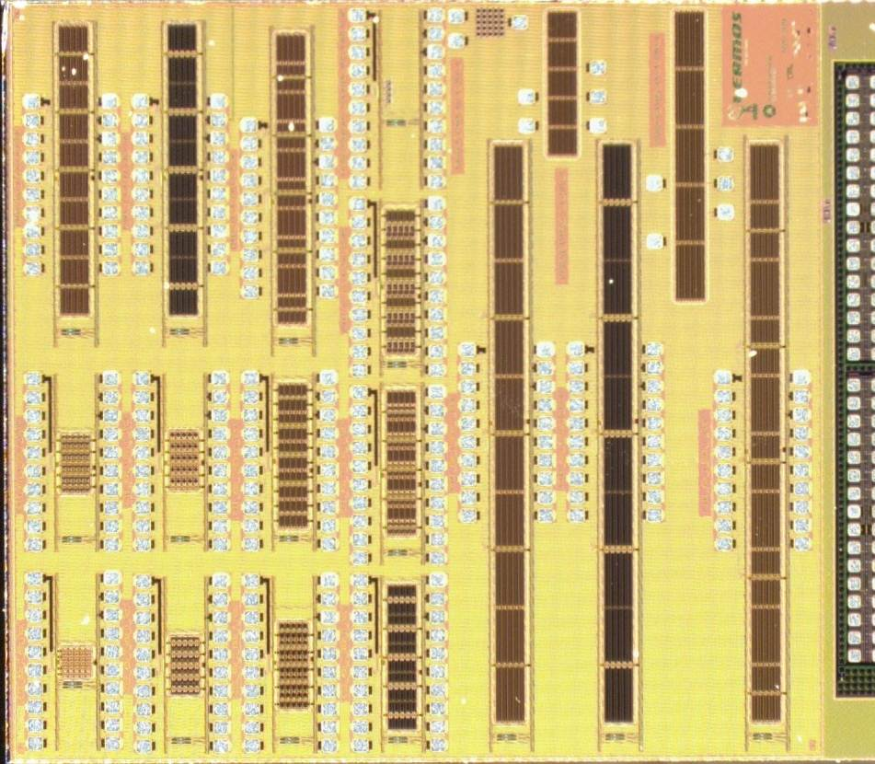
TJ-CHESS-1 PonP daughterboard – bonding diagram
[2/5] This page shows the outer or upper level (throw) of bond wires, for the passive pixels. Connect these second.
Blue = inner or lower level of wire bonds
Red = outer or upper level of wire bonds
16
17
NC
NC
NC
18
10
11
9
19
15
3
2
7
6
13
14
12
1
4
5
8

Slide 9
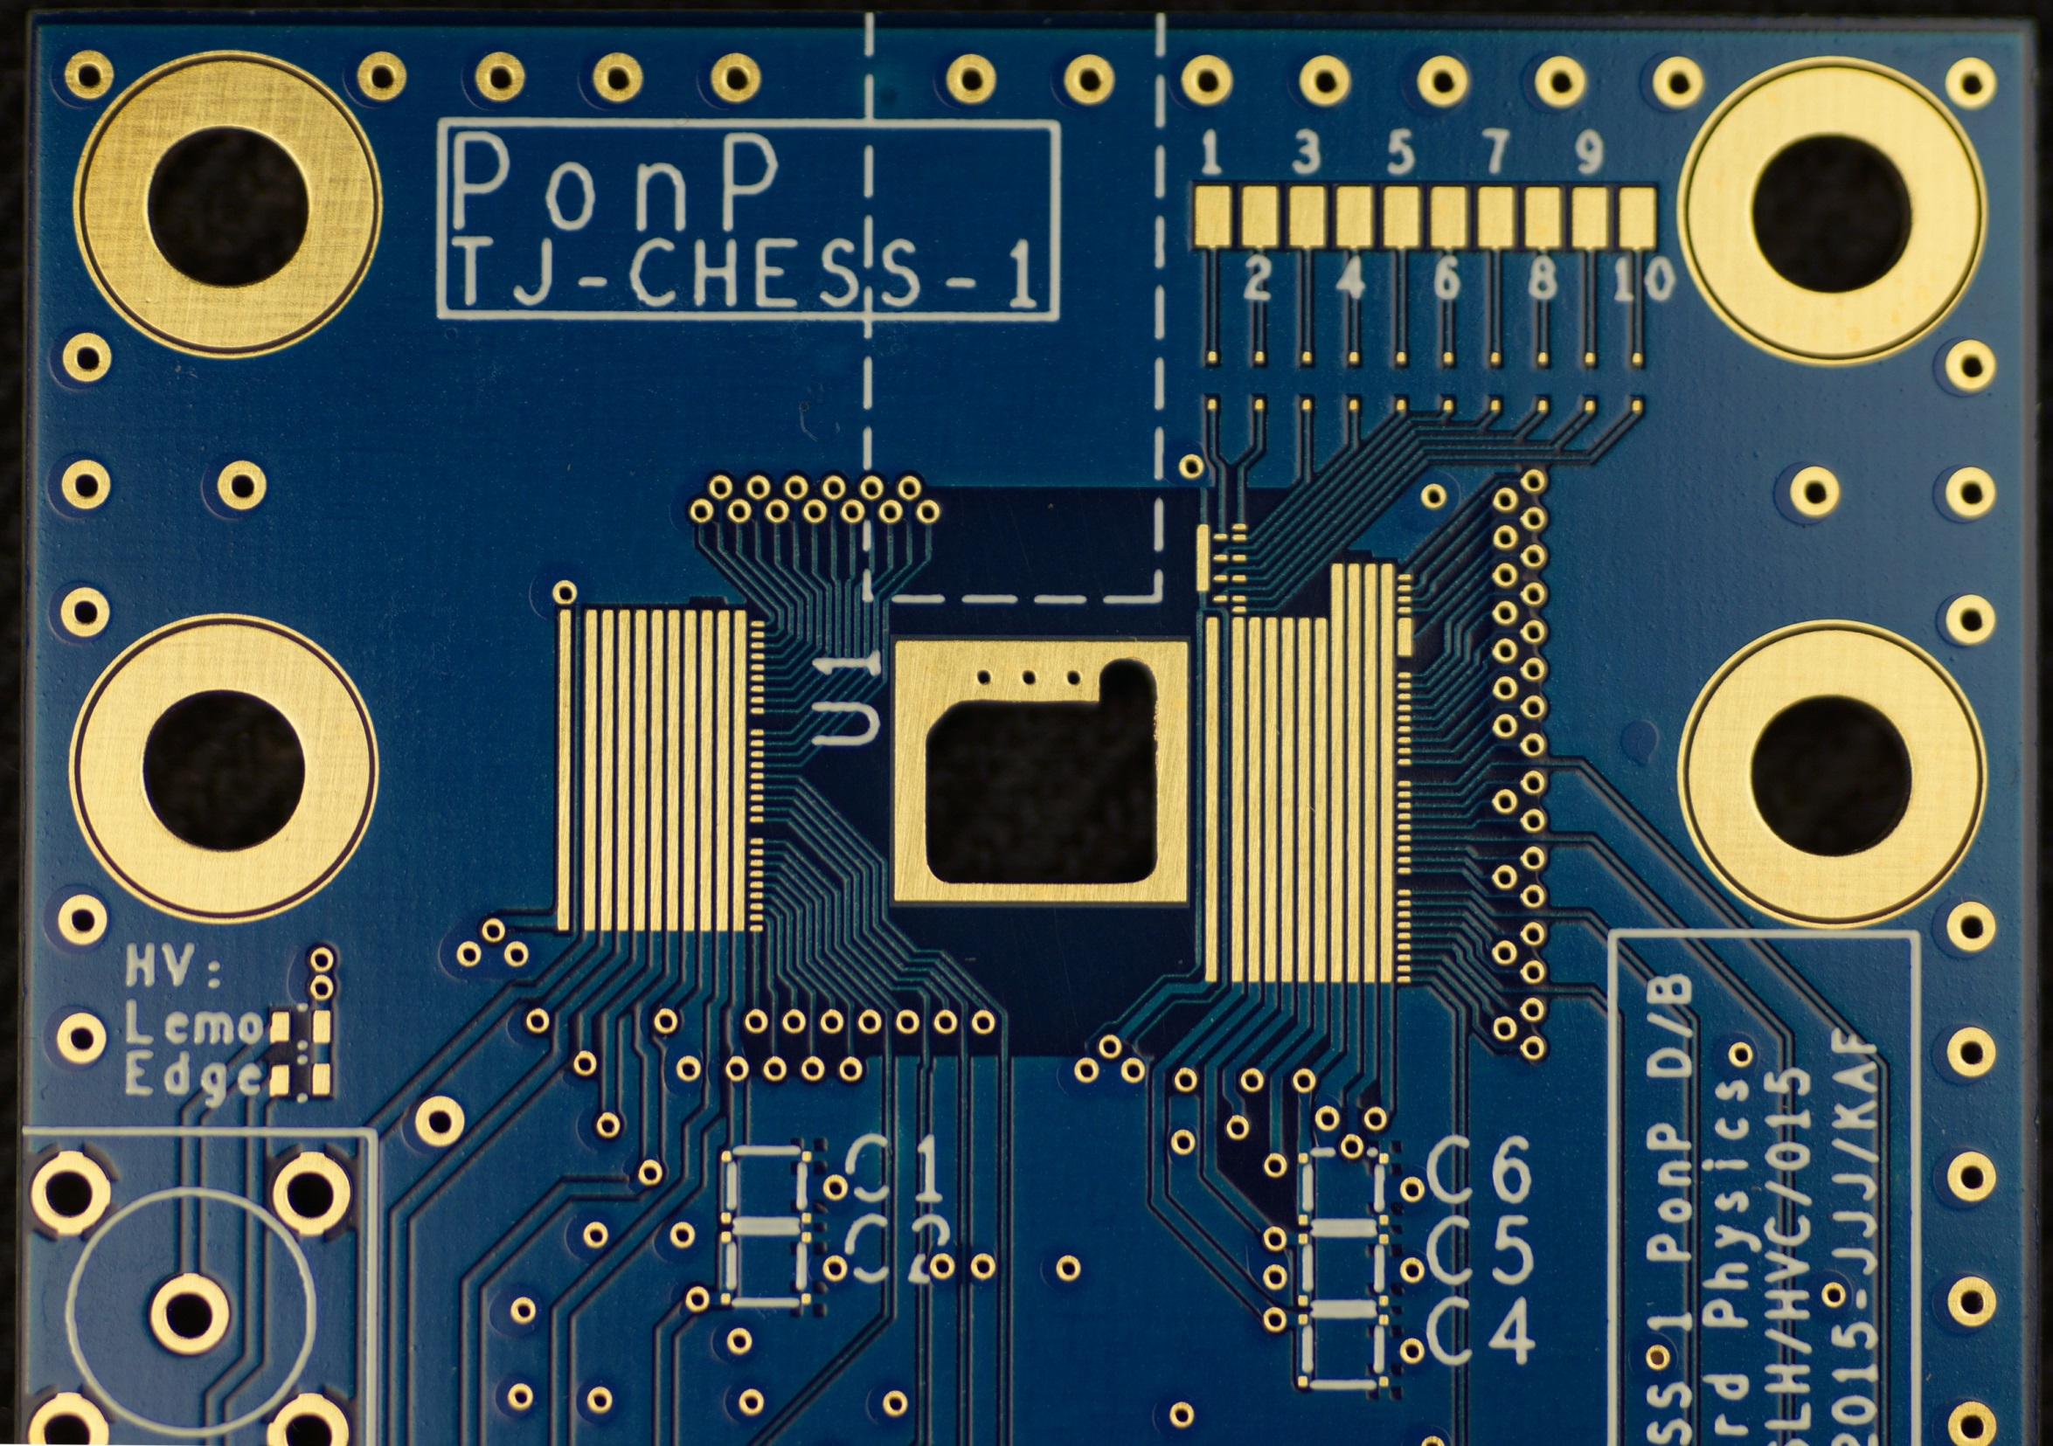
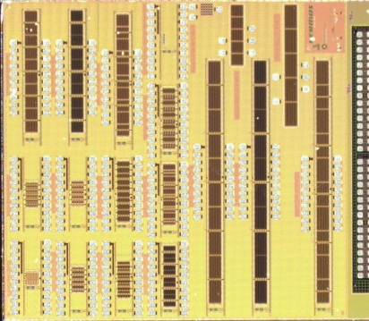

C1
TJ-CHESS-1 PonP daughterboard – bonding diagram
This page shows the wire bonds for the capacitors,
high voltage and passive pixel ‘jumpers’
DC blocking
Capacitor
Blue = wire bonds
If using large pads to probe passive pixels, jumper these pads.
Flying lead to C1/Pad 8

Slide 10
Summary
HVStrip1 showing signs of increased signal with increased bias voltage
Passive devices on TJ CHESS1 Can hold voltage if you bias the input pad
  This will not work on active devices because of a current path to the on-sensor amplifier.
    But we CAN AC couple the passive devices to the stand-alone amplifiers on the chip! So we are going to try this.
  CV curves obtained; how do they look?
Studying (again) how to run CHESS1 motherboard.

