Slide 1
Recursion Relations for Integral Coefficients
David A. Kosower Institut de Physique Théorique, CEA–Saclay
work with Adriano Lo Presti
RADCOR 2017
work also supported by the Ambrose Monell Foundation at the IAS

Slide 2
Improve Technologies for Loops
Focus here on one-loop amplitudes
NNLO calculations will require more intensive calculation of one-loop amplitudes (lone-singular integrations)
Improvements in efficiency welcome
Generalization will apply to higher-loop amplitudes as well

Slide 3
Implementation
Each amplitude will be evaluated 10⁵–10⁷ times
Want a numerically efficient & stable implementation
Analytics are nice for low-point amplitudes
Not necessarily feasible for higher-point amplitudes
And may not even be fastest
Hybrid: analytics for integrals, purely numerical evaluation for their coefficients $c_{j}(ε)$

Slide 4
Computing Amplitudes
Process-dependent Rational function of spinors
Master formula (all loops)
Master integrals determined for all L-loop processes, or restricted to set for given process, using IBP
Coefficients to be computed using generalized unitarity
Process-independent

Slide 5
Generalized Unitarity: Contour Integration
Cut all propagators in the target integral topology
Reduces corresponding amplitude to product of trees
Cut is implemented by contour integration
Real Integration → Complex Integration → Contour Integration
Feynman Integrals → Their Coefficients
Contours: Multidimensional tori that encircle global poles: common singularities of all cut propagators

Slide 6
Generalized Unitarity
Coefficients
Coefficients $a_{Γ}$ determined by requirement that total derivatives give no contribution
Many examples known, no general formula yet
limited to D=4 cuts
integrals with leading singularities only
Restrict attention to coefficients with factorizable poles

Slide 7
A Generic Coefficient
Perform maximal cut, then a multivariate contour integral over remaining degrees of freedom
Restrict attention to coefficients for which we can isolate contours cleanly
Change variables to factorize poles

Slide 8
In one dimension, contour integration corresponds to performing a Laurent expansion, and taking the coefficient of the simple pole,
The analogous statement holds in higher complex dimensions when the integrand factorizes

Slide 9
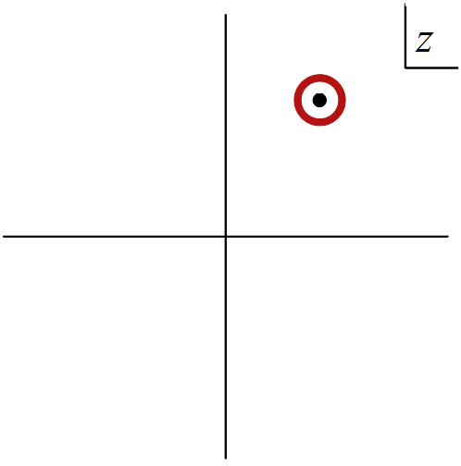
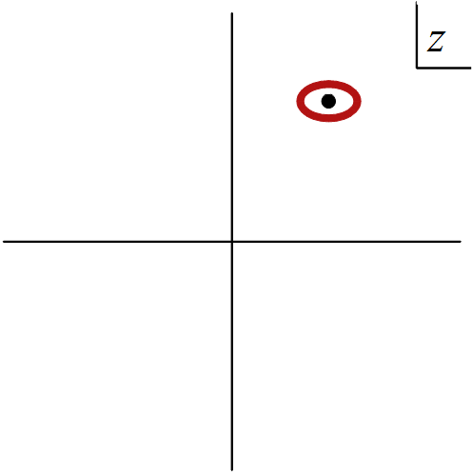
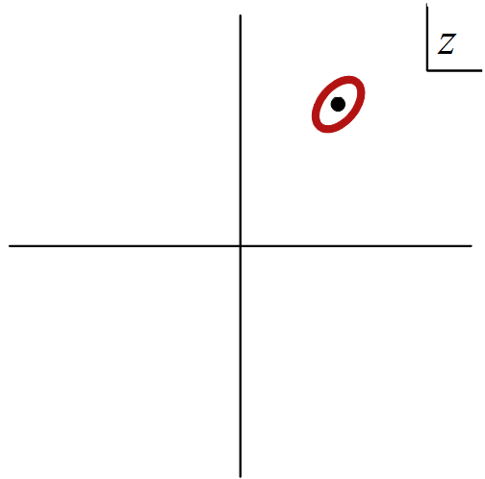
Fun with Multivariate Contour Integration
One-dimensional contour integrals are independent of the contour’s shape
Unique contour (yielding non-vanishing residue) for each pole

Slide 10
Fun with Multivariate Contour Integration
Not true in higher dimensions!
Consider
Requiring any two denominators to vanish forces $z_{1}=z_{2}=0$
“Degenerate” residue: denominator can vanish on some contours encircling the global pole
Nonhomologous contours: more than one for each global pole
Corresponds to different groupings of denominators in algebraic approach (Griffiths & Harris; Cattani & Dickenstein)

Slide 11
Nonhomologous Contours
Arise for double boxes
Performing integrations non-democratically (heptacut + z contour) isolates one of the two topologies:
Horizontal double box
Vertical double box
“Bad” sharing vanquished
Within each topology, different masters (different numerators) isolated by different linear combinations of heptacut solutions + z contour: these share some contours

Slide 12
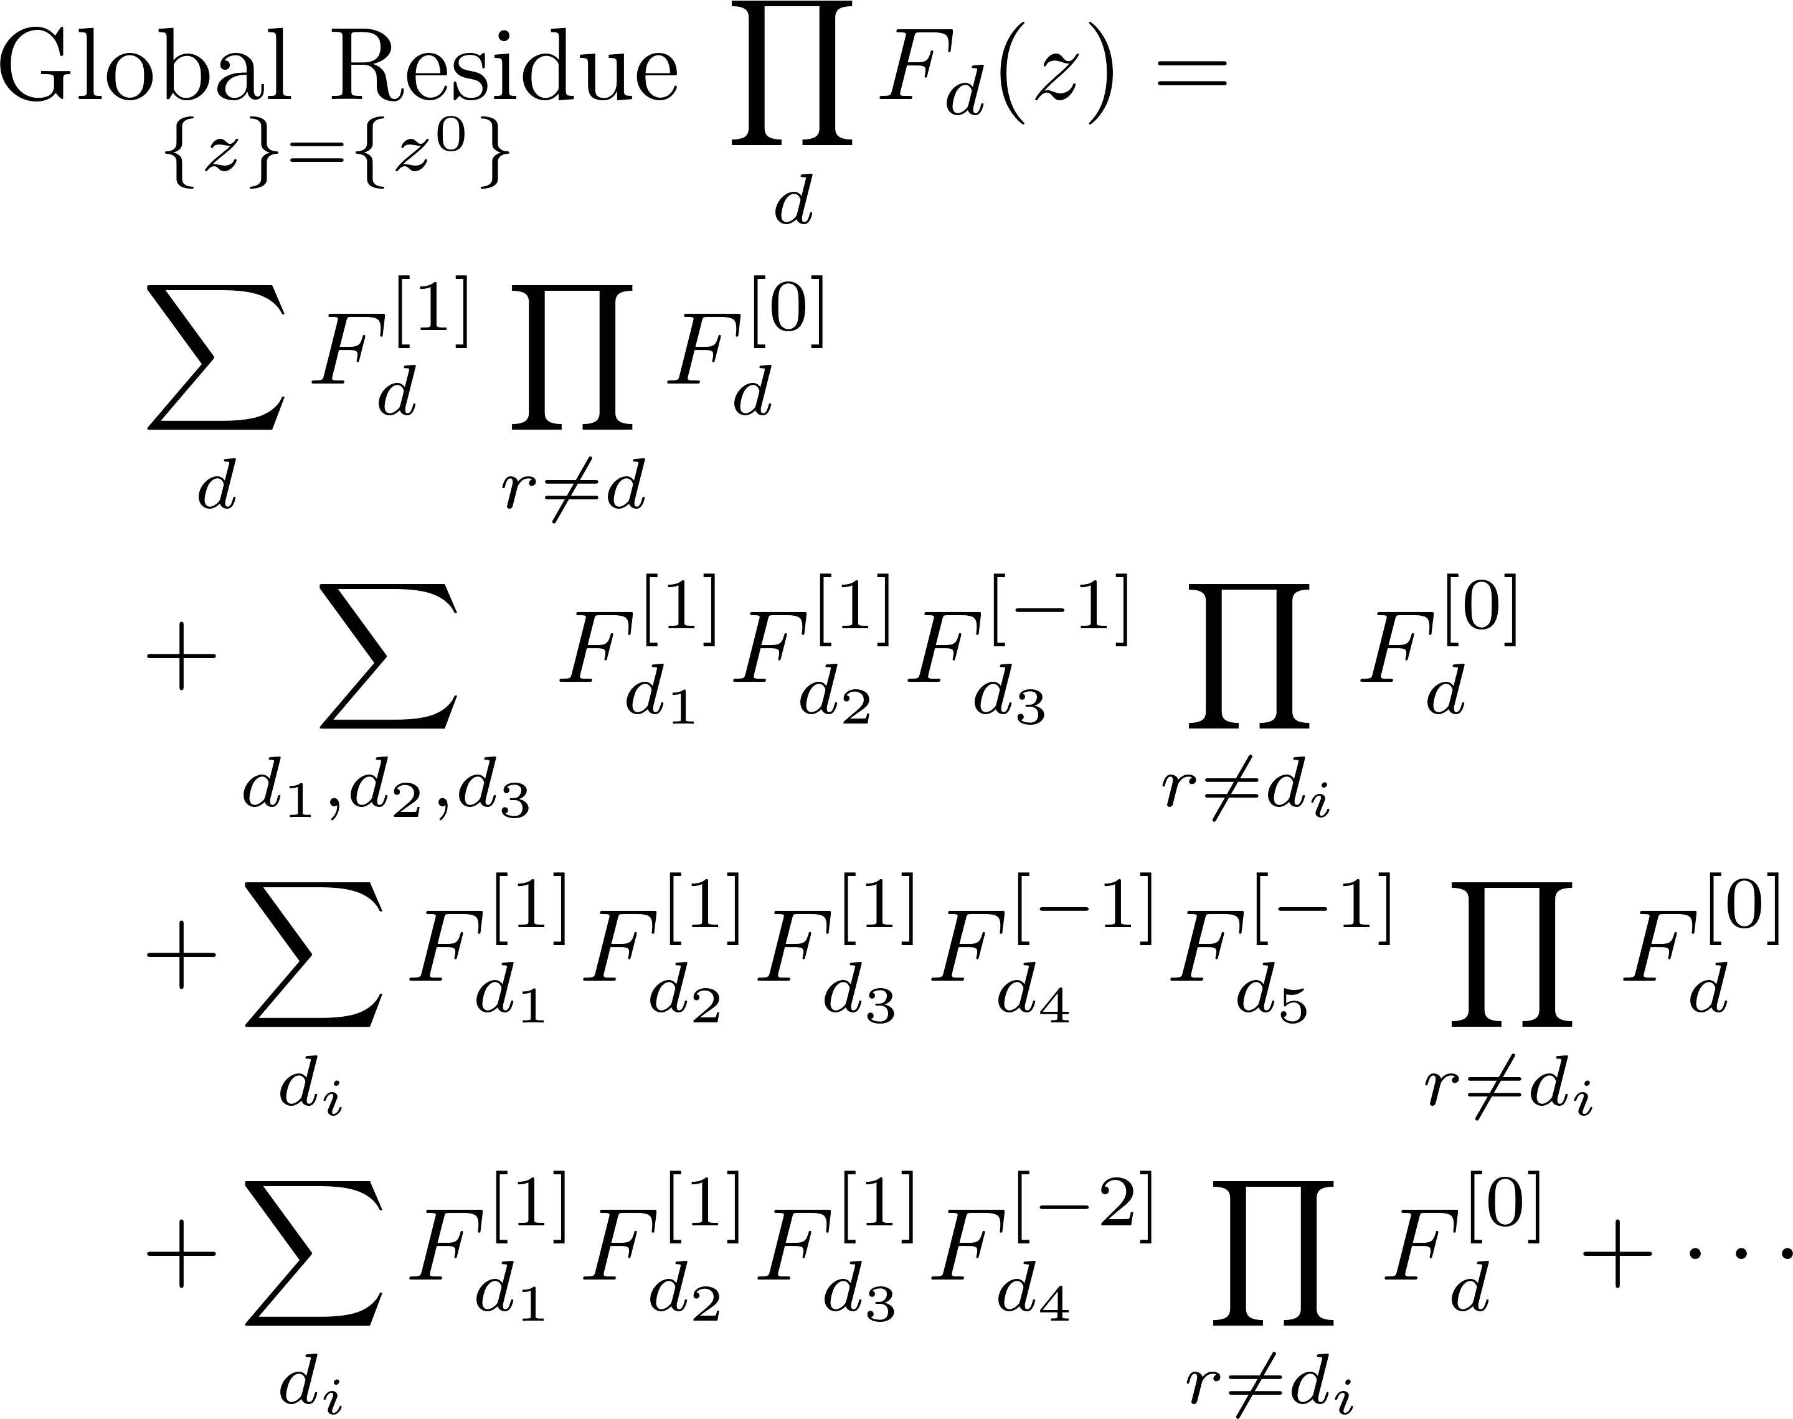
Assume that all factors have only “simple” poles
Peer into the Laurent expansions to get a more explicit formula for the global residue
or appropriate multivariate generalization

Slide 13
Calculating Laurent[Amplitude]
How can we calculate A^{[j]}?
Calculate the A analytically, then extract the Laurent expansion analytically
suitable for small number of legs
But:
not efficient at larger n (exponential vs polynomial complexity)
not amenable to direct numerical calculation
doesn’t allow combining subexpressions across coefficients
Seek recursive approach

Slide 14
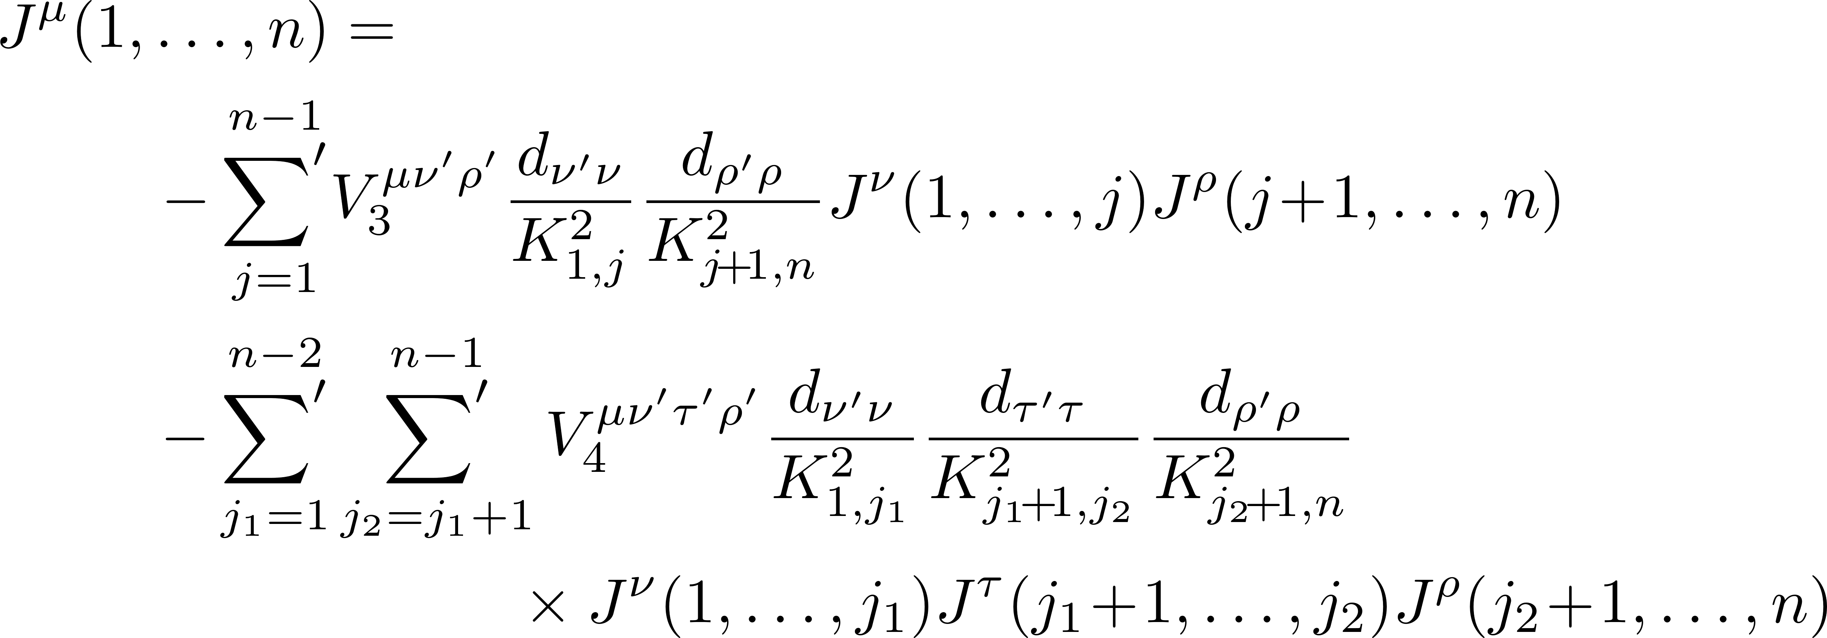
Apply this to recursion relation
BCFW not so suitable
Use Berends–Giele instead
Recursion for off-shell current $J_{μ}$
Schematically (in amputated form)

Slide 15
Continuing schematically
We obtain a system of recursions for the expansion coefficients

Slide 16
Example: One-Loop Triangle
Master formula for one-loop amplitudes
Basis consists of boxes, triangles, and bubbles
Process-dependent $ε$-free Rational function of spinors
Process-independent
D-dimensional unitarity: coefficient of $μ^{2}$ integrals
D=4 Unitarity

Slide 17
Example: Triangle Coefficients
Four-fold contour integral translates into maximal cuts, plus one additional degree of freedom for triangles.
Coefficients given by residues at ∞ Forde (2007)
Can also write this as ${−\text{Inf}}_{t}\left(A_{1}\left(t\right)A_{2}\left(t\right)A_{3}\left(t\right)\right){\left.​\right|}_{t=0}$
where Inf is the expansion as $t→∞$
2
1
3

Slide 18
Example: Triangle Coefficients
In BlackHat, contour integral is evaluated numerically using a discrete Fourier projection (exact!)
Known box integrand first subtracted for numerical stability as in the OPP procedure Ossola–Papadopoulos–Pittau

Slide 19
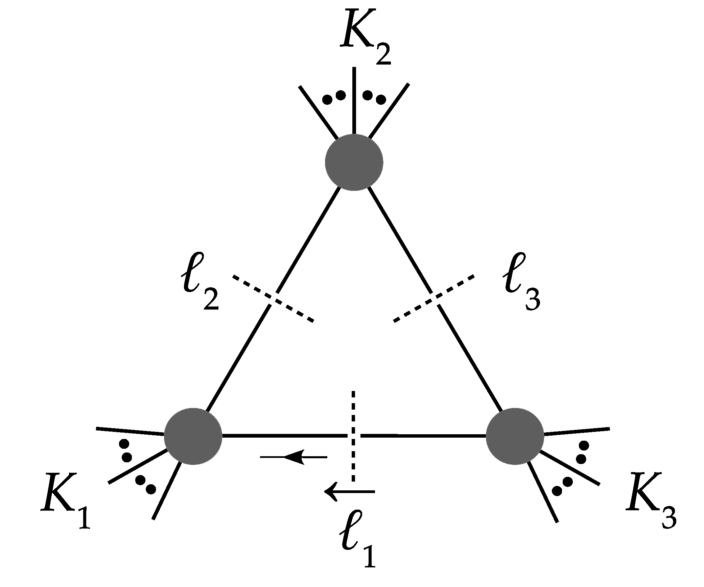
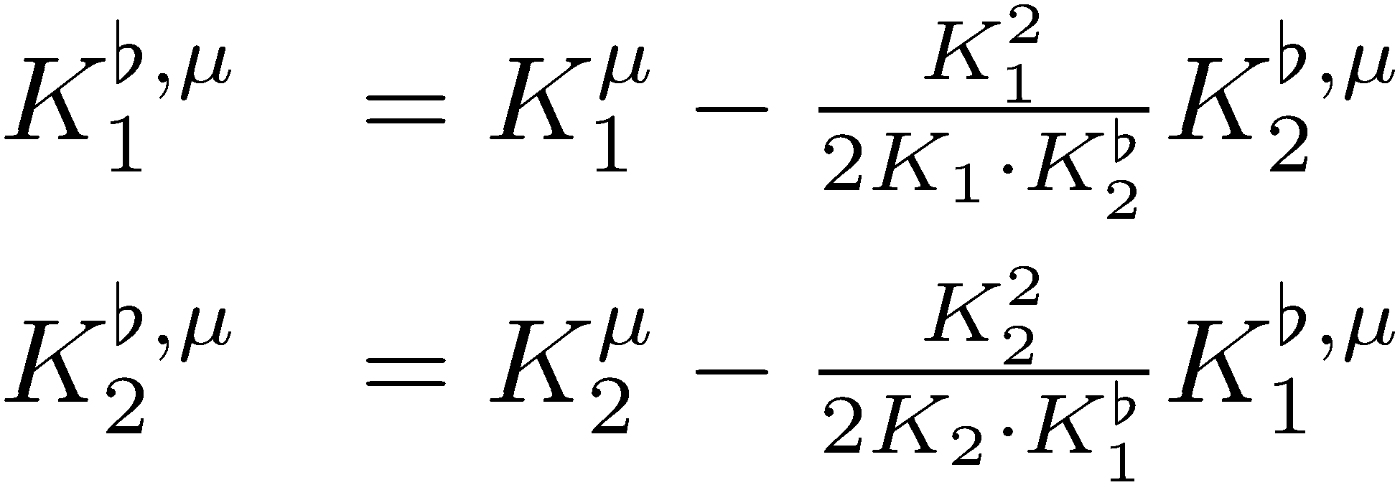
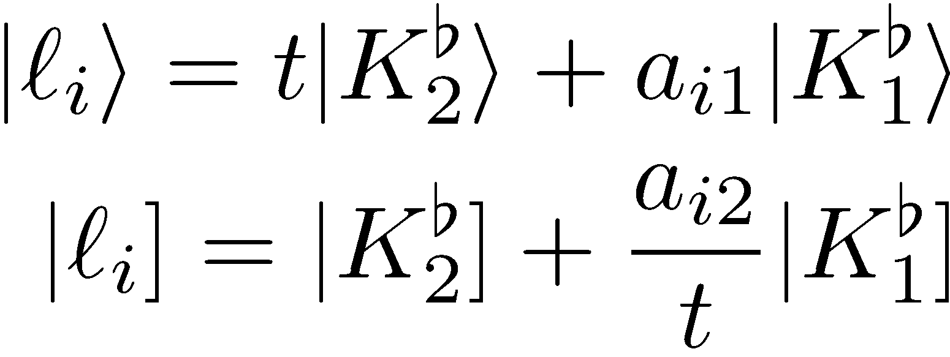
Example: Triangle Coefficient
Build massless momenta
Parametrization
t is the remaining degree of freedom; Jacobian is t

Slide 20
Large-t Behavior
Behavior depends only on helicities of cut legs
$$A=A^{\left[1\right]}t+A^{\left[0\right]}+A^{\left[−1\right]}t^{−1}+A^{\left[−2\right]}t^{−2}+⋯$$
(except for (+,+) helicities, where $A\sim t^{−3}$)
Side remark about gravity
Naively $\sim$ $t^{n−1}$
Because of KLT, $\sim$ $t^{2}$

Slide 21
Global Residue
Want global residue at $t=∞$
Extract coefficient of $t^{0}$ in $A_{1}A_{2}A_{3}$
Formula for triangle coefficient
Want direct recursive equations for the $A_{i}^{[j]}$

Slide 22
BCFW is awkward:
If shift legs aren’t $ℓ_{1},ℓ_{2}$, ⇒ in general some contributions have a $t$-dependent internal line
the shift induces $t$ dependence on other lines in the lower-point amplitudes
We then have to track new kinds of amplitudes, with $t$ expansions on many legs
Shift legs $ℓ_{1},ℓ_{2}$ require additional factors to adjust the $t$ power-counting, and the rules for assigning them are cumbersome
Instead, use Berends–Giele recursion
Also has better large-$n$ scaling

Slide 23
Interchange with Recursion
Berends–Giele (1988)
explicitly
recursively

Slide 24
First, rewrite it to make it purely cubic (still amputating the propagator)
Duhr, Höche, Maltoni; Gleisberg, Höche
$J^{μ}$ is a fictitious-tensor current, which also has a cubic recursion
(more recent alternative by Mafra & Schlotterer, effectively one equation for the current & another to a current associated to $F^{μν}$)

Slide 25
Next, switch to a helicity form
Switch to light-cone gauge
Using massless momentum
Rewrite
This gives us three terms in a sum ($±,$0) instead of summing over four momentum components, and definite-helicity currents
many terms in sum drop out
adjust phases to make $t$ power-counting cleaner
non-zero vertices are $V_{3}\left(−− +\right), V_{3}\left(++−\right),V_{3}(0− +)$ & cyclic, $V_{T}\left(−+[−+]\right), V_{T}(+−[−+])$
absorb additional factors into $V_{3}(0− +)$ vertex

Slide 26
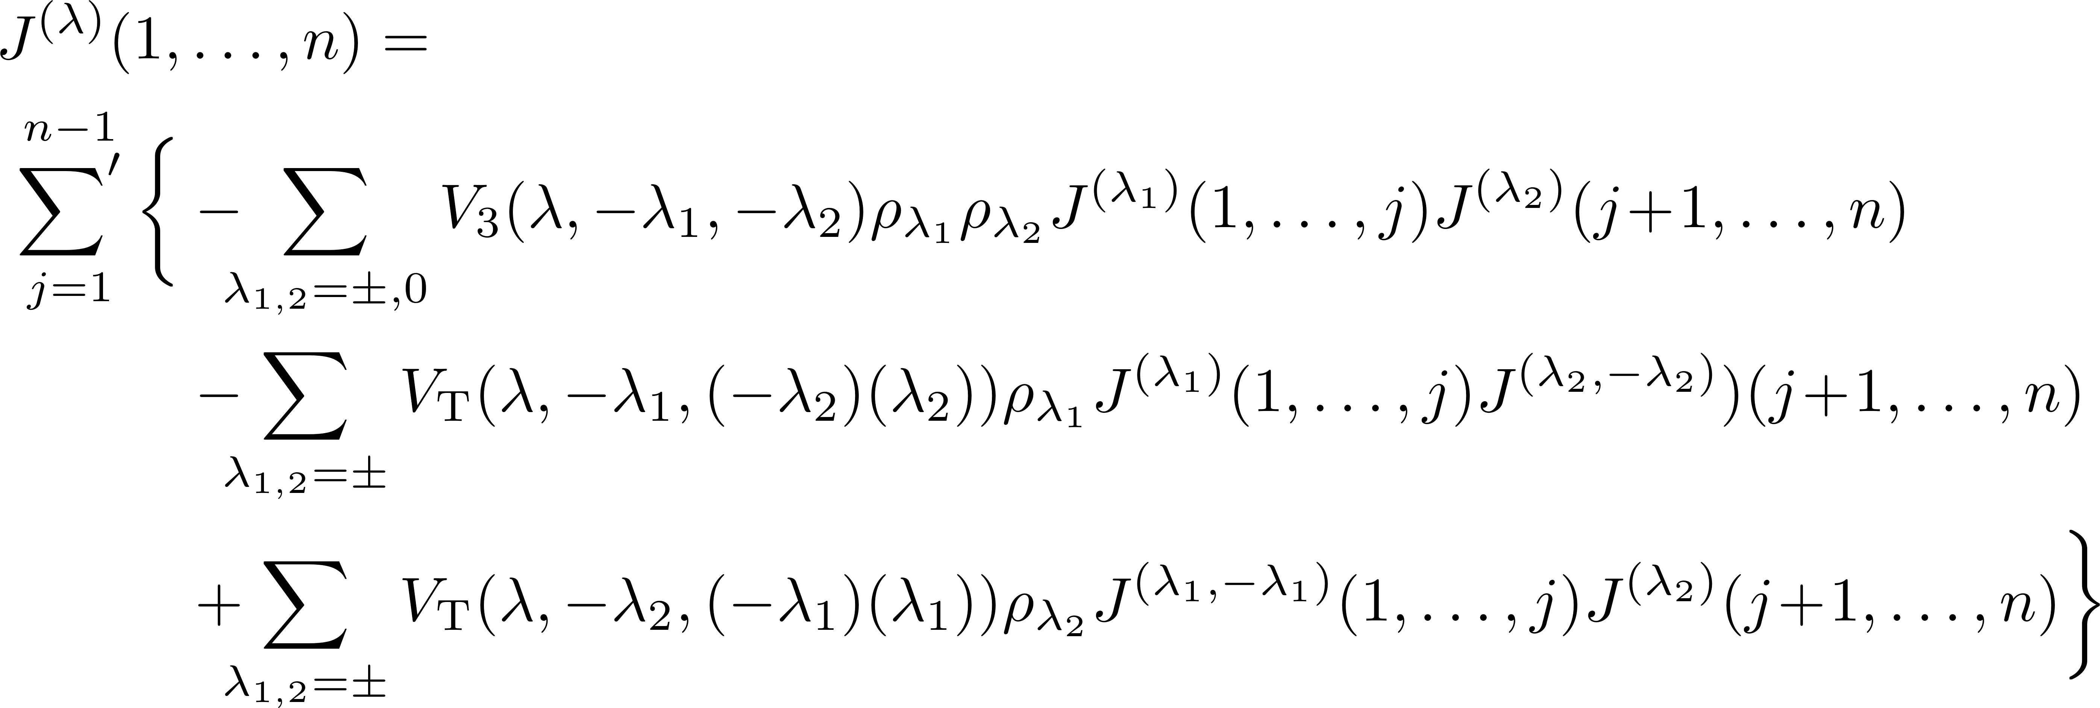
With $ρ_{±}=\frac{1}{K^{2}}, ρ_{0}=\frac{1}{q⋅K}$, the recursion is

Slide 27
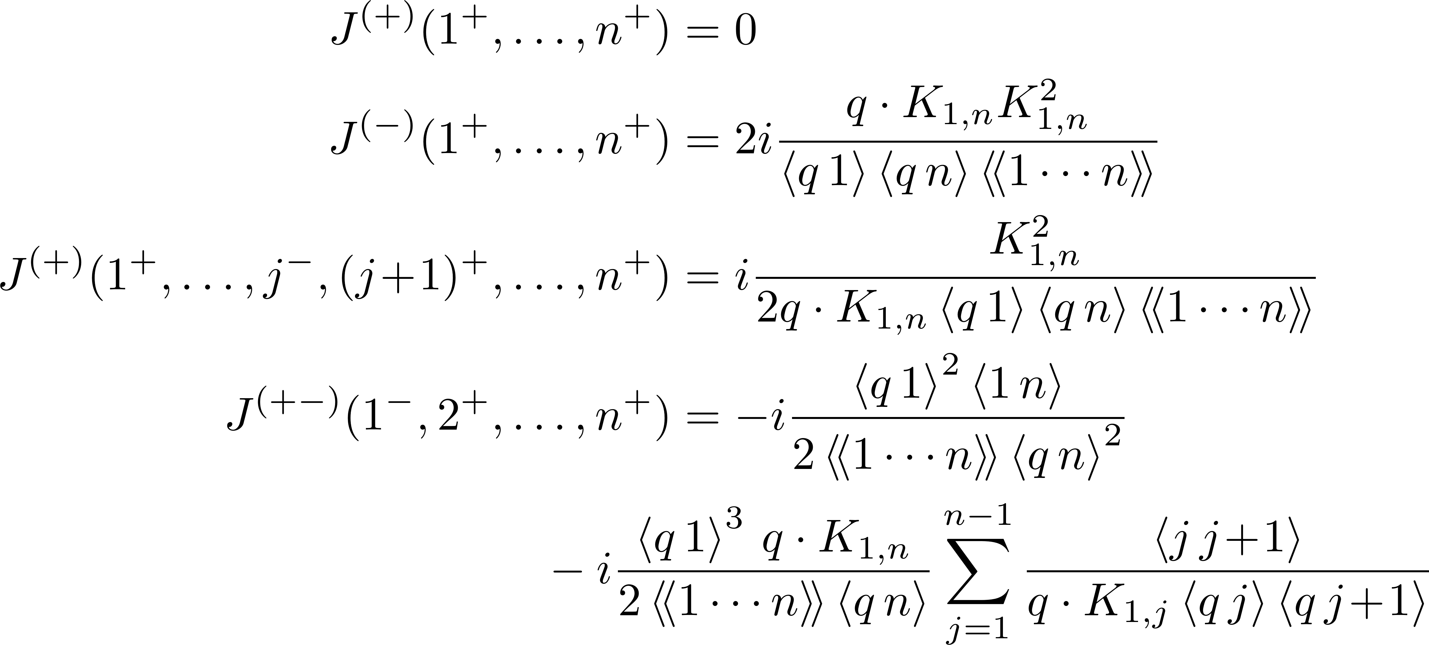
Example: Simple forms
Shorthand $〈〈1⋯n〉〉≡〈12〉〈23〉⋯〈\left(n−1\right)n〉$

Slide 28
Recursions
Take off-shell to be $−ℓ_{1}$, on-shell legs to be $ℓ_{2}$, 1, 2, …
Only first current $(ℓ_{2}1⋯j)$ is $t$-dependent; second $(j+1⋯n)$ is just the usual tree current
$V_{3} \sim O(t)$, $\frac{1}{{\left(ℓ_{2}+K_{1⋯j}\right)}^{2}} \sim O\left(t^{−1}\right)$
Schematically

Slide 29
Tower of Recursions
$J^{[1]}$ is a function of lower-point $J^{[1]}$ and $J^{tree}$
$J^{[0]}$ is a function of lower-point $J^{[1]}$, $J^{[0]}$, and $J^{tree}$
$J^{[−1]}$ is a function of lower-point $J^{[1]}$, $J^{[0]}$, $J^{[−1]}$, and $J^{tree}$

Slide 30
Example
Simplest configuration

Slide 31
Next: Purely Rational Terms
Can be recast as contour integrals for $I_{4}[μ^{4}]$, $I_{3}[μ^{2}]$, $I_{2}[μ^{2}]$ where $μ^{2}$ are $(−2ε)$-dimensional components
Badger
Single-variable expansion in $μ^{2}$ for the box
Two-variable expansion in $μ^{2}$ and $t$ for the triangle
Bubbles will need some additional tricks

Slide 32
Summary
Recursive approach to integral coefficients
Exploit general structure of integral coefficients as global residues, and interchange Laurent expansion and recursion
Compatible with purely numerical evaluation
Opens possibilities for more common sub-expression evaluation

