Slide 1

DSIT Report

Slide 2
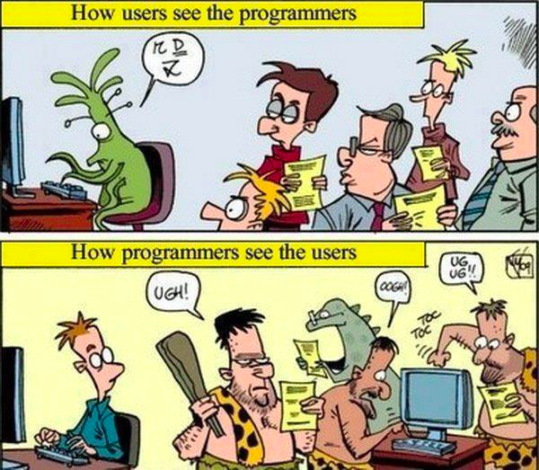

Slide 3
DSIT WP1
Federated AAI
With contributions from
Marcus
Paul
Shiraz Patrick
Arsen
GSI

Slide 4
Authentication & Authorisation Infrastructures
OIDC+SSH
  Status: Feasibility demonstrator
  Idea: Use google / b2access / IAM / ..... to log-in via SSH
  Login via web-browser at webpage (using OIDC or SAML)
  Obtain short lived token
  Use token in ssh commandline

Slide 5
Authentication & Authorisation Infrastructures
IDH – Identity Harmonisation Service
  Status: Feasibility demonstration
  Idea: Exact account linkage in local site user management
  Alice links her X.509 certificate, her SAML and google accounts together
    Map her to same UID
      Login with X.509 (e.g. gridFTP)
      Login with SAML (e.g. SSH)
      Login with OIDC (e.g. CDMI)
    Unify group information
      Alice will have groups from X.509 (e.g. VO) and SAML (e.g. KIT-users) available with CDMI logins

Slide 6
Authentication & Authorisation Infrastructures
Token Translation Service – TTS
  Status: Productive use / final bugfixing
  Idea:
    Authenticate user via OIDC
    Return “whatever it takes¹” for the user to log in to a service
  Plugin architecture to support many backends
    SSH, S3, X.509, OpenNEbula
  Used in distributed testbed of INDIGO for LHC-CMS Experiment
  REST + Web interface to support admins and Users
¹: Mario Draghi, ECB

Slide 7
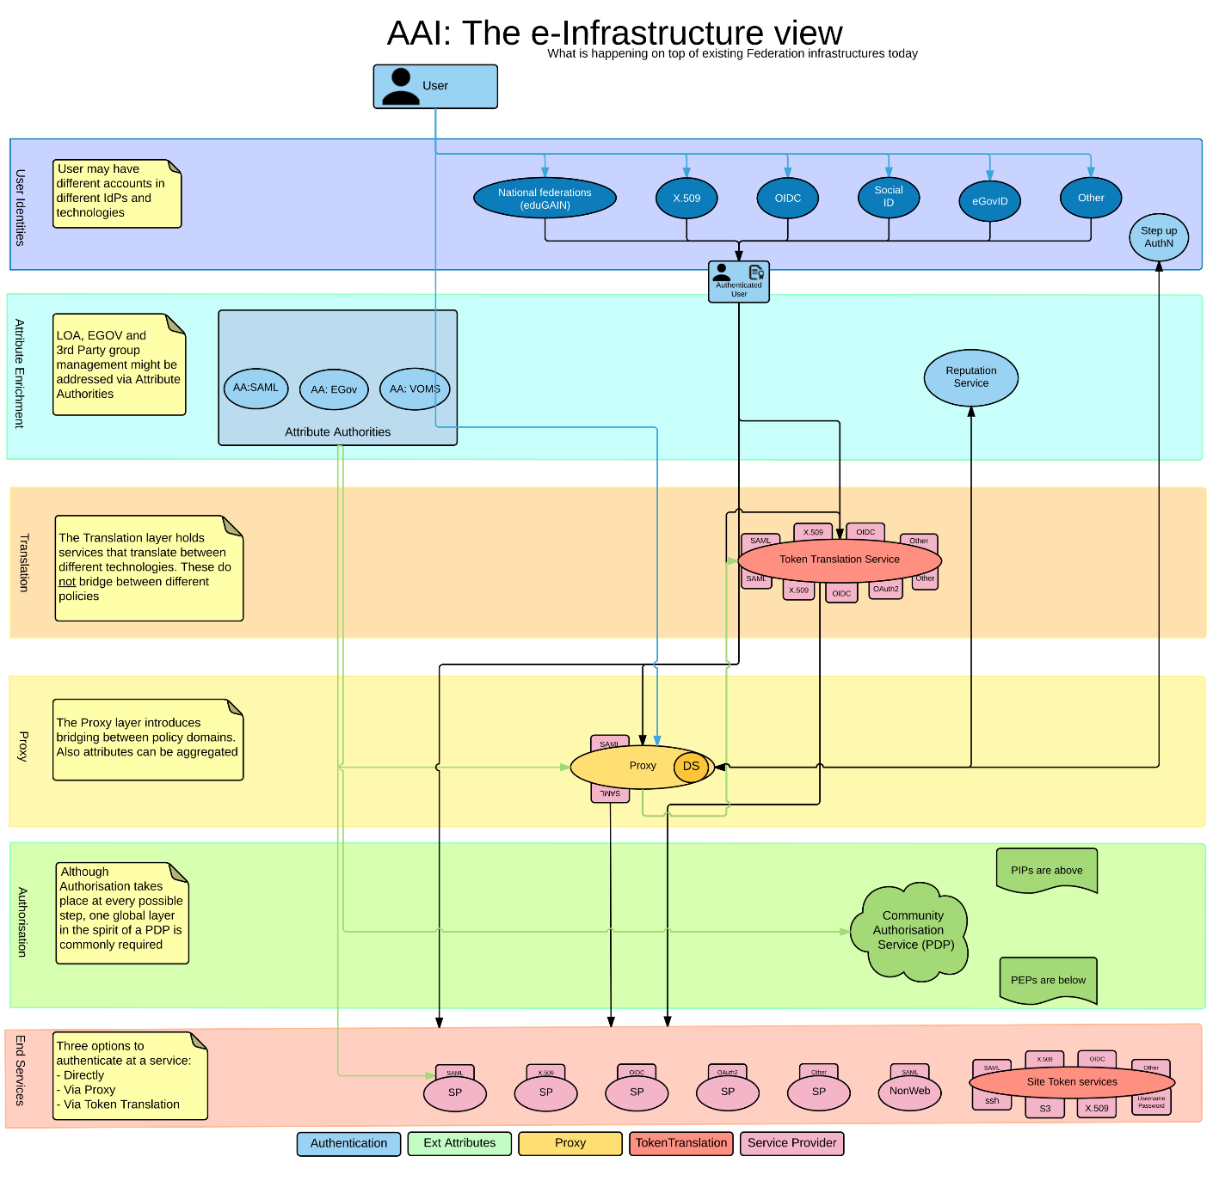
Authentication & Authorisation Infrastructures
Blueprint Architectures (within AARC)
  Six layers to order the AAI field
  Description of components and interplay
User Identities
Attribute Enrichment
Translation
Proxy
Authorisation
End Services
https://docs.google.com/document/d/15-e0hpqWPZefbhcLJodzRMZNt8Qpe1gPpyNz2LX1Wvw/edit#heading=h.6c0z8puhopoo

Slide 8
DSIT WP2
Federated Storage
With contributions from
Marcus
Paul
Shiraz Patrick
Arsen
GSI

Slide 9
Cloud Storage Virtualisation
Four activities to Enable smart management of data on on the IaaS level.
Object Storage <=> File system translation
Identity Harmonisation
Standardisation
Implementation of CDMI extensions

Slide 10
Cloud Storage Virtualisation
Enable smart management of data on a low level
Object Storage <=> File system translation
  POSIX-like access to a CEPH backend
  Realised via (long) integration chains
      CEPH <=> S3 <=> S3FS <=> POSIX
  Realized within dCache supporting all dCache features.
Identity Harmonisation
  Support consistent access to data with linked accounts

Slide 11
Cloud Storage Virtualisation
Standardisation:
  RDA – Research Data Alliance
    Working Group (about to be) accepted: QoS-DataLC Definitions WG
      https://rd-alliance.org/groups/qos-datalc-definitions-wg
    Open platform to receive input from end-users
    SKOS editor available to submit specific input
      https://editor.vocabs.ands.org.au/rda_qos/0.html
    Your input is welcome
  SNIA
    Participation in SNIA to submit extensions to the CDMI-Standard
    Storage-QoS management in a standardised way

Slide 12
Cloud Storage Virtualisation
Implementation of CDMI extensions
  Built in Java/spring-boot, based on CDMI reference implementation
  Understand endpoint storage qualities
    Information system to provide details about storage quality
    Initial attributes supported:
      Access latency (estimated time to first byte)
      Location of data (on a country-level granularity for legal purposes)
      Number of copies of data
      List of available storage qualities into which a migration is available
  Modify storage quality
    “Bring online” by moving between the available storage classes
  Storage systems supported via plugins:
    TSM/StoRM, dCache, CEPH, HPSS

Slide 13
Cloud Storage Virtualisation
Implementation of CDMI extensions (cont.)
  Webservice at KIT continuously verifying 5 evaluation endpoints:
  http://seemon.data.kit.edu
    KIT, BARI, CNAF, POZNAN, DESY

Slide 14
Data Services Integration Team
WP3 – Metadata Catalogues
Richard Grunzke, Bernd Schuller, André Giesler,Stephan Kindermann, Volker Hartmann, Thomas Jejkal, Rainer Stotzka,Ajinkya Prabhune

Slide 15
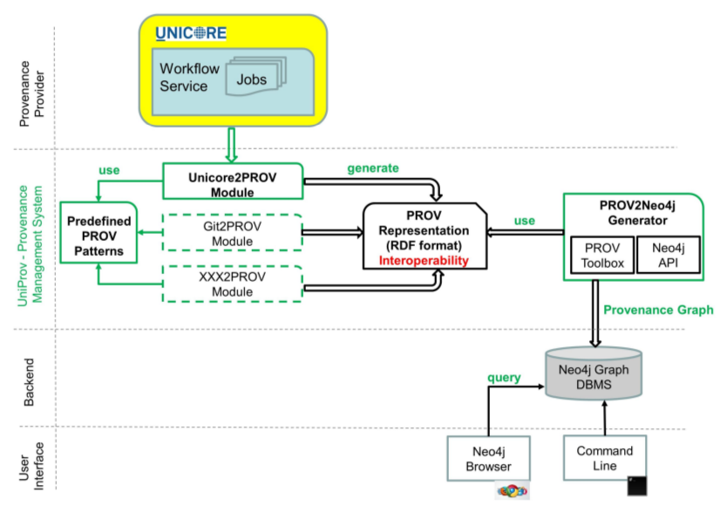
UNICORE – UniProv
“A flexible Provenance Tracking System for UNICORE”
UNICORE as provenance source & Neo4j graph db for visualization
Integration with MASi as
provenance source planed
Published at JHPCS'16
Notes:
Hier sind nur die Neuigkeiten aus den letzten 6 Monaten aufgeführt!
KIT Data Manager als Version 1.0 veröffentlicht. (open source)
Es gibt nun einen generischen Klienten um Datensätze ins Repository zu schreiben.
Metadaten: Nur administrative metadaten und alle von Apache Tika unterstützten
Datenformate. (Falls kein eigener Extraktor vorhanden.)
Es wurde ein Workflow entworfen, der Metadaten aus gescannten Manuscripten extrahiert
Und die Metadaten am Ende visualisiert.
Der Workflow soll in den KIT DataManager integriert werden und kann dann (hoffentlich ;-) )
An neue Anforderungen angepasst werden.
Desweiteren wurden die Metadaten ausgewertet und visualisiert (Stand letztes Mal schon drin
Allerdings ohne das datamining.) (Visualisierung mit D3)
Auf der ‘Suche’ nach einer geeigneten Visualisierung der Daten.

Slide 16

KIT Data Manager - Development
See WP6
http://www.kitdatamanager.net
Notes:
Hier sind nur die Neuigkeiten aus den letzten 6 Monaten aufgeführt!
KIT Data Manager als Version 1.0 veröffentlicht. (open source)
Es gibt nun einen generischen Klienten um Datensätze ins Repository zu schreiben.
Metadaten: Nur administrative metadaten und alle von Apache Tika unterstützten
Datenformate. (Falls kein eigener Extraktor vorhanden.)
Es wurde ein Workflow entworfen, der Metadaten aus gescannten Manuscripten extrahiert
Und die Metadaten am Ende visualisiert.
Der Workflow soll in den KIT DataManager integriert werden und kann dann (hoffentlich ;-) )
An neue Anforderungen angepasst werden.
Desweiteren wurden die Metadaten ausgewertet und visualisiert (Stand letztes Mal schon drin
Allerdings ohne das datamining.) (Visualisierung mit D3)
Auf der ‘Suche’ nach einer geeigneten Visualisierung der Daten.

Slide 17
Metadata Research at ZIH
Work in and coordination of MASi project
Dissertation defended and published
  Thank you for flexible LSDMA funding!

Slide 18
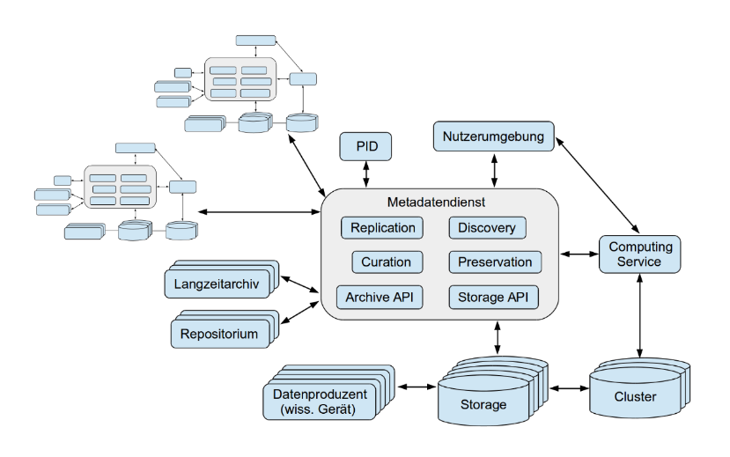
MASi (Meta)data Service
Generic research (meta)data service
Generic graphical interface in prototype status
  Liferay integration for common web capabilities
  Generic web portlet with increasingly advanced integration and graphical capabilities
  For quick community adaptations
  Low barrier of entry
Community integration prototype status
Paper accepted

Slide 19
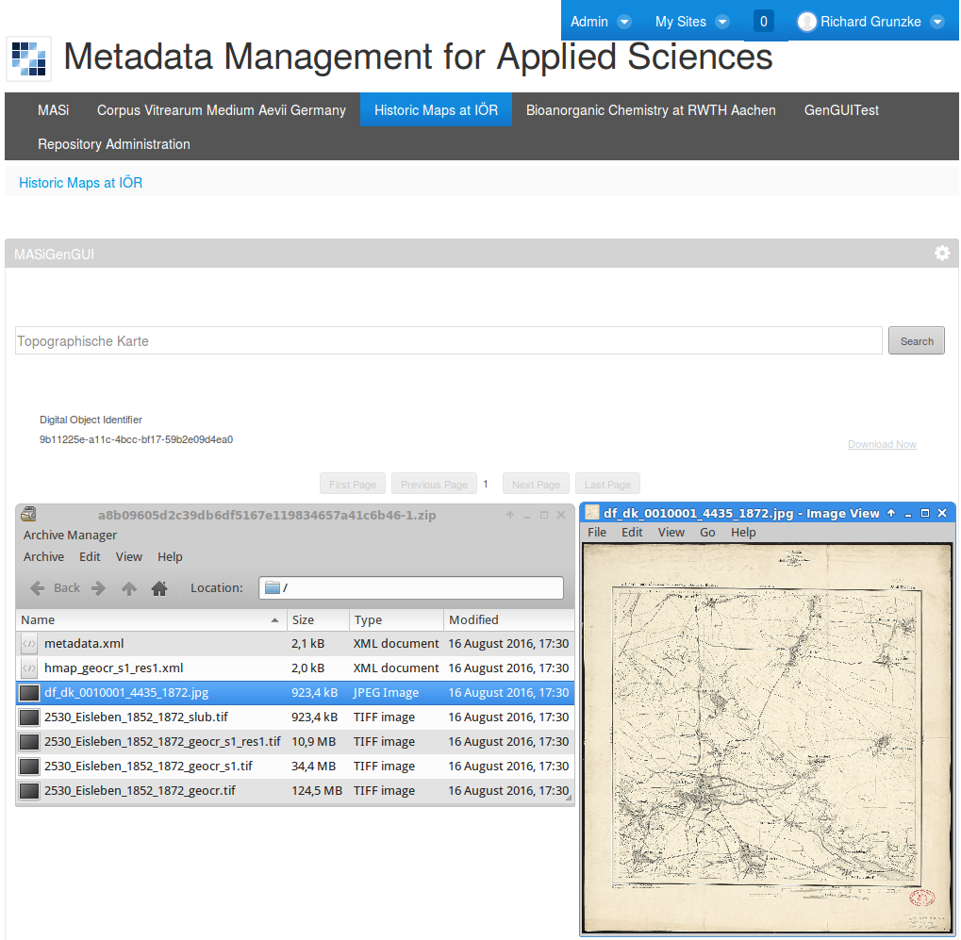

Slide 20
MASi (Meta)data Service
Definition of METS profile as generic metadata schema
  Facilitation of data protability
Metadata schema (XSD) for content metadata
  Registration and use for validation
  Tool for generating new schemas based on key/value
Generic metadata extraction modules: XML, EXIF
Client-side KIT DM upload GUI
under development
Integration in KIT DM underway

Slide 21


MASi (Meta)data Service
Access layer
… RESTful Metadata API Web client GUI client
KIT Data Manager
Metastore Access Interface
(REST)
Repository Access Interface (REST)
…
XSD
METS
Extract Plugins
OAI-PMH
PID
Audit
Additional Metadata
Metadata
Data

Slide 22
Publications
A. Giesler, M. Czekala, B. Hagemeier and R. Grunzke: UniProv: A flexible Provenance Tracking System for UNICORE, JARA-HPCS-Symposium 2016 (JHPCS'16), 2016, accepted.
R. Grunzke: Generic Metadata Handling in Scientific Data Life Cycles, Doctoral Thesis, Technische Universität Dresden, Doctoral Thesis, Technische Universität Dresden, 2016.
R. Grunzke, J. Krüger, R. Jäkel, W. E. Nagel, S. Herres-Pawlis and A. Hoffmann: Metadata Management in the MoSGrid Science Gateway - Evaluation and the Expansion of Quantum Chemistry Support, Journal of Grid Computing, 2016.
R. Grunzke, V. Hartmann, T. Jejkal, A. Prabhune, S. Herres-Pawlis, A. Hoffmann, A. Deicke, T. Schrade, H. Herold, G. Meinel, R. Stotzka and W. E. Nagel: Towards a Metadata-driven Multi-community Research Data Management Service, 2016 8th International Workshop on Science Gateways (IWSG), 2016, accepted.

Slide 23

DSIT WP4 - Archives
All hands meeting, October 2016
Enabling permanent access to data

Slide 24
Gradient from long time storage to archive
Business cases from 2013 (adapted October 2016)
Project store
  Temporary storage for large data, 3 to 4 years
  Primary and cold experiment data
  Simple upload with accepted protocols
Good scientific practice store, long term storage
  All of A above plus
  At least 10 years, conformity with good scientific practice
  Expiration, Integrity checks
  Minimal set of meta data, PID reference
Archive - repository
  All of B above plus
  Forever or as long as is needed (or funding at hand)
  Interaction with community
  Data curation management
  Conformity with OAIS, certification of repository (DSA, ISO16363)
bwDataArchive storage
bwDIM light publication
EUDAT B2SAFE
EUDAT B2FIND
RADAR OpARA
repositories

Slide 25

TU – Dresden
OpARA - Open Access Repository and Archive
  Institutional repository with long term preservation
  In implementation phase (based on DSpace)
  Aim for open access but has embargo features
  Data entry via web and command line (i.e.. for large data sets)
  Metadata access via OAI-PMH, DOI
  Currently progresses on first prototype → user testing
  Shibboleth authentication (planned)
Integration of MASi data life cycle system und OpARA
  Collaboration with WP3 – Richard Grunzke

Slide 26







Archives for scientific data
bwData
HDF
collaboration of LSDMA WP4 with
EUDAT, bwDIM, INDIGO: definition of API for Archives:
+ checksumming
+ ‘technical’ metadata
+ asynchronous access
+ storage quality / costs
bwDataArchive
POSIX storage - IO
archive control - REST
data
archive interface
LSDMA
AAI
bwIDM
Access Control
Administration
IO & caching
Bit Preservation
Disk
Tape
Metadata
user registration workflow
Archive System
Standard dual copy, geolocation separated storage
Access with SFTP and GridFTP/GT

Slide 27
Data service integration (status October 2016)
Archive storage interface design (with EUDAT, bwDIM *) and INDIGO)
  Hashes/checksums (EUDAT)
    prototype finished, being integrated with iRODS
  Storage quality (INDIGO)
    bring on-line, dual copy etc. in progress
  Support for technical / administrative (PREMIS based) metadata
    prototype with REST-full interface: ready, integration with HPSS follows
Long time storage service
  Baden-Wuerttemberg state funded Project: see presentation on Thursday 6.10
  user registration workflow and integration with archive service: finished
  registration for external users and connection with O-Auth: planned
    cooperation with WP1
*) bwDIM: bridges archive and repository

Slide 28
Data Services Integration Team
WP5 – Performance and Power Optimization

Slide 29
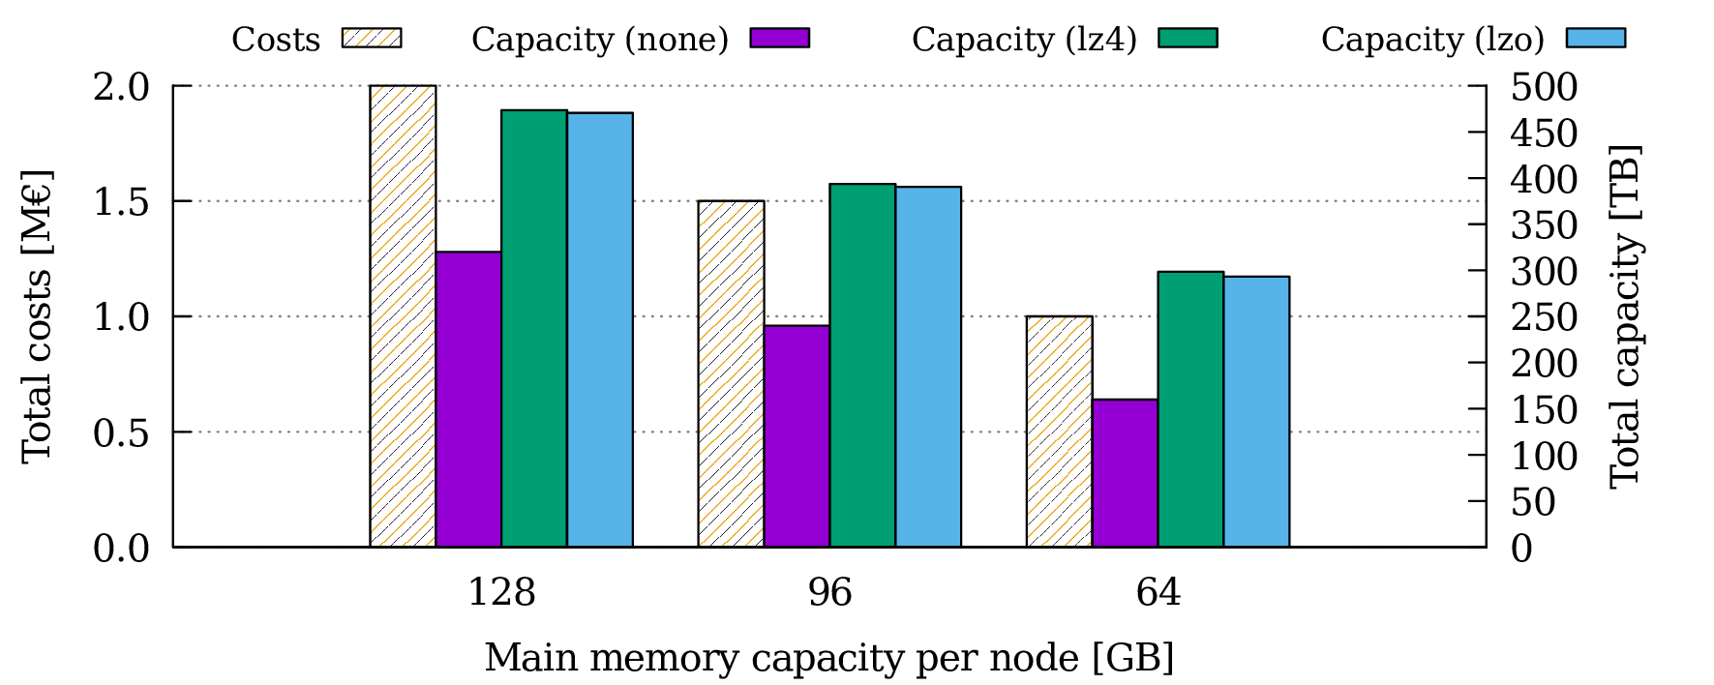
Main memory compression
zram can be used to compress main memory
  lzo and lz4, multiple compression streams
Reach a per-node capacity of 128 GB
  Compress as much as necessary, leave rest uncompressed
Leads to more data we have to store

Slide 30
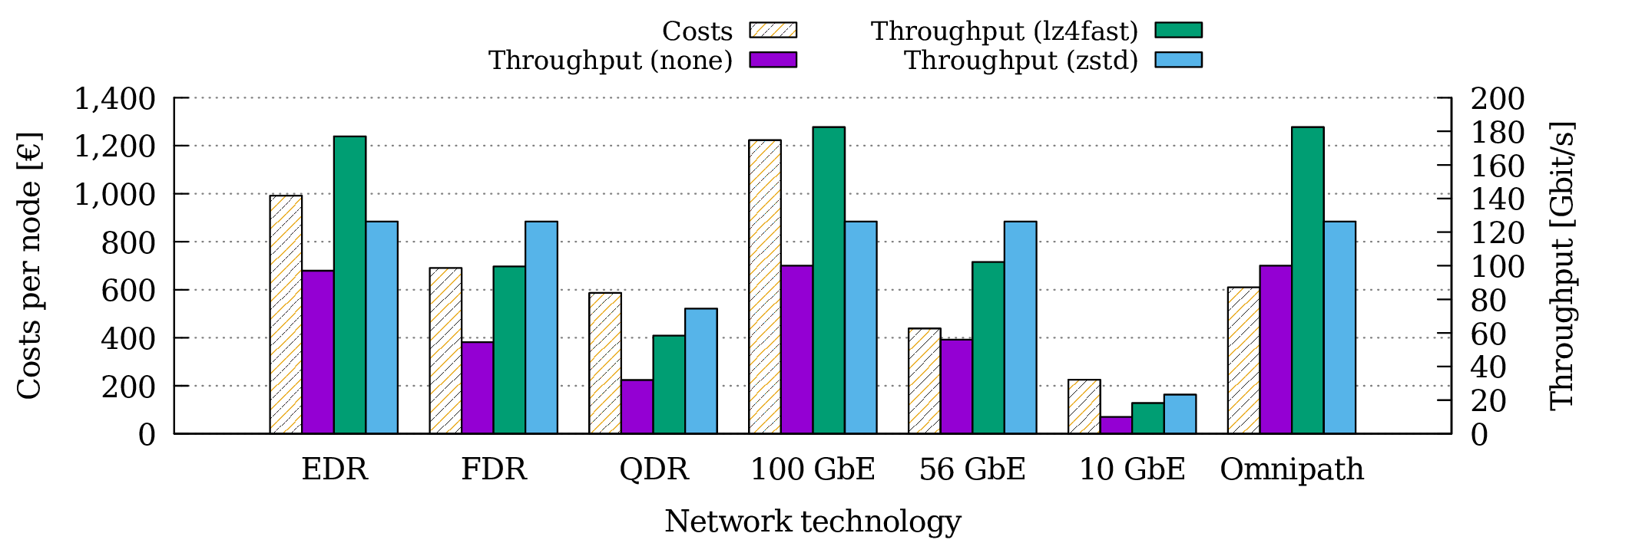
Network compression
Per-node throughput could be improved
  100 Gbit/s (lz4fast) or 125 Gbit/s (zstd)
  zstd limits throughput for networks faster than 54 Gbits/s
Could also decrease costs by replacing FDR with QDR

Slide 31
Storage compression
Consider existing storage system: 50 PB with 650 GB/s throughput
  Costs: € 6,000,000, 60 servers, base costs per server: € 10,000
  Additional costs for compression: € 1,500
S1: Purchase as many fully equipped storage servers as necessary
  Lower costs: Buy minimal amount of hardware
  Decreased throughput: Missing servers impact performance
S2: Purchase as many HDDs as necessary and distribute them across 60 servers
  Slightly higher costs: Base costs for servers
  Higher throughput: No servers are missing

Slide 32
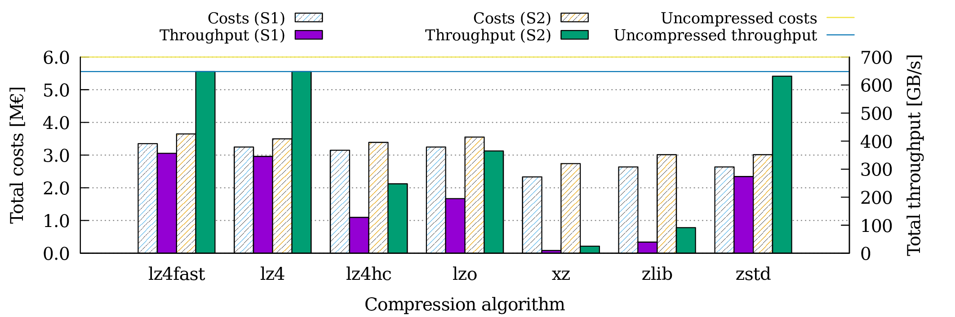
Storage compression
lz4 and lz4fast do not degrade performance, costs decrease to roughly € 3,500,000
zstd decreases throughput by 20 GB/s, costs to € 3,000,000

Slide 33
Variable clustering
Apply hierarchical clustering
Use data annotation, name and type as a first step
Split first level clusters with dissimilarity metric defined from actual data values

Slide 34
Cactus clustering results of 3D double variable
Compression benefit for different clusters
  (uncompressed size – compressed size) * 100 / uncompressed size

Slide 35
Adaptive compression
Find the appropriate compression algorithm for each cluster
Analyze input data
Skip parts of the data that will be hard to compress without significant benefit
Identify variables that can be compressed with lossy algorithms with negligible distortion

Slide 36
Enzo checkpoint file variables
Evaluate multiple lossless compression algorithms
  Different types/dimensionality
  FPZIP performs best for Enzo

Slide 37
Cactus checkpoint variables compression
Evaluate multiple lossless compression algorithms
  Different types/dimensionality
  ZLIB performs best for Cactus

Slide 38
Compression system workflow
First level compression
  Tailored to the specific cluster
  Takes into consideration variable types, dimensionality and actual values
  Second level compression
  Compress the output buffer of first level compression using generic compression algorithms (gzip, bzip2 etc.)

Slide 39
Data Services Integration Team
WP6 - Data Intensive Computing
Thomas Jejkal, Bernd Schuller, Richard Grunzke

Slide 40

Infrastructure and Service (1.1)
UNICORE 7.6 and 7.7 releases
New features:
  Completed REST API
    Data management
    Service registry
  Full support for clustering/load balancing of UNICORE servers

Slide 41
Infrastructure and Service (1.2)
Planned features towards 8.0
  Improve support for heterogeneous clusters
  Improve existing OpenStack support
  Python Client API
  Secure interaction with Docker
  Job execution on Amazon EC2 systems

Slide 42
Infrastructure and Service (2.1)
Releases of versions 1.3
  Support for data transformation before download
  Direct data access via REST interfaces
  Possibility to provide public access to data
  Performance improvements
Preparation of version 1.4
  Integration of audit functionalities
  Implementation of METS export
  Implementation of OAI-PMH support for metadata harvesting
  More flexible data access
  Configurable authentication and authorization

Slide 43
Infrastructure and Service (2.2)
Implementation of Data Workflow Service use cases
  NORDR, CodiHub, MASi
  Evaluation and bugfixing
Evaluation (and realization?) of UNICORE integration into
Data Workflow Service
  Relevant for DFG project MASi
  Basic single job submission

Slide 44
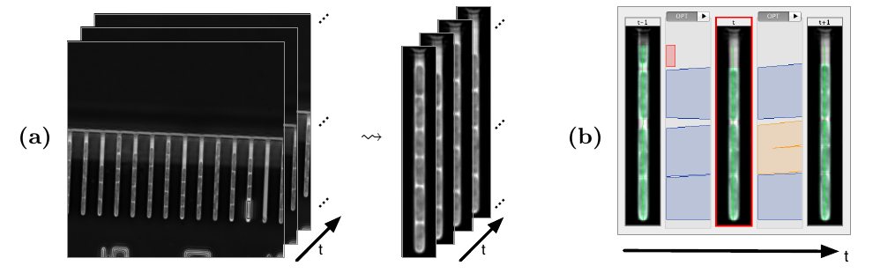
Execution of large data-driven workflows
Challenge: support execution of data-intensive workflows in HPC
No prior HPC-knowledge required on user side
Formulation of workload directly in workflow environment
Solution: combination of well-known and widely used tools
  Middleware UNICORE for HPC integration
  KNIME for workload formulation
Use Case: processing pipeline for cell tracking over time (E.coli)
Notes:
Hier sind nur die Neuigkeiten aus den letzten 6 Monaten aufgeführt!
KIT Data Manager als Version 1.0 veröffentlicht. (open source)
Es gibt nun einen generischen Klienten um Datensätze ins Repository zu schreiben.
Metadaten: Nur administrative metadaten und alle von Apache Tika unterstützten
Datenformate. (Falls kein eigener Extraktor vorhanden.)
Es wurde ein Workflow entworfen, der Metadaten aus gescannten Manuscripten extrahiert
Und die Metadaten am Ende visualisiert.
Der Workflow soll in den KIT DataManager integriert werden und kann dann (hoffentlich ;-) )
An neue Anforderungen angepasst werden.
Desweiteren wurden die Metadaten ausgewertet und visualisiert (Stand letztes Mal schon drin
Allerdings ohne das datamining.) (Visualisierung mit D3)
Auf der ‘Suche’ nach einer geeigneten Visualisierung der Daten.

Slide 45
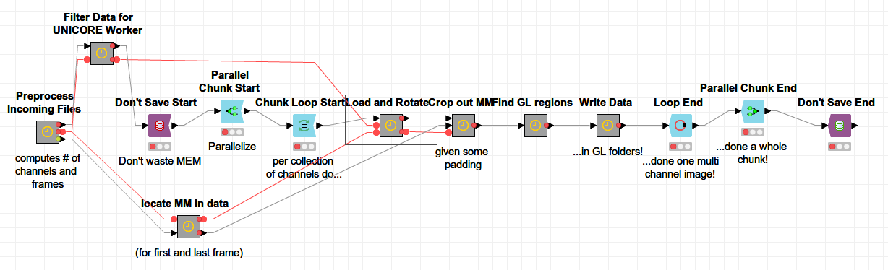
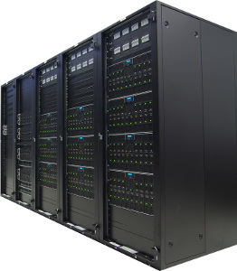



Execution of large data-driven workflows
First: export of workflow and input data
Second: automatic generation of compute jobs and execution on HPC
2.
1.
Automatic generation of thousands of computing jobs if required
Notes:
Hier sind nur die Neuigkeiten aus den letzten 6 Monaten aufgeführt!
KIT Data Manager als Version 1.0 veröffentlicht. (open source)
Es gibt nun einen generischen Klienten um Datensätze ins Repository zu schreiben.
Metadaten: Nur administrative metadaten und alle von Apache Tika unterstützten
Datenformate. (Falls kein eigener Extraktor vorhanden.)
Es wurde ein Workflow entworfen, der Metadaten aus gescannten Manuscripten extrahiert
Und die Metadaten am Ende visualisiert.
Der Workflow soll in den KIT DataManager integriert werden und kann dann (hoffentlich ;-) )
An neue Anforderungen angepasst werden.
Desweiteren wurden die Metadaten ausgewertet und visualisiert (Stand letztes Mal schon drin
Allerdings ohne das datamining.) (Visualisierung mit D3)
Auf der ‘Suche’ nach einer geeigneten Visualisierung der Daten.

Slide 46
Execution of large data-driven workflows
Evaluation data set:
  1,8 TB in ~7,5 M files
Runtime improvement:
  Previously 17d on 4 cores, now 2h on 800 cores
→ 200x faster
Next steps:
  Fully automated pipeline connecting microscope with HPC environment and MASi research data repository
Notes:
Hier sind nur die Neuigkeiten aus den letzten 6 Monaten aufgeführt!
KIT Data Manager als Version 1.0 veröffentlicht. (open source)
Es gibt nun einen generischen Klienten um Datensätze ins Repository zu schreiben.
Metadaten: Nur administrative metadaten und alle von Apache Tika unterstützten
Datenformate. (Falls kein eigener Extraktor vorhanden.)
Es wurde ein Workflow entworfen, der Metadaten aus gescannten Manuscripten extrahiert
Und die Metadaten am Ende visualisiert.
Der Workflow soll in den KIT DataManager integriert werden und kann dann (hoffentlich ;-) )
An neue Anforderungen angepasst werden.
Desweiteren wurden die Metadaten ausgewertet und visualisiert (Stand letztes Mal schon drin
Allerdings ohne das datamining.) (Visualisierung mit D3)
Auf der ‘Suche’ nach einer geeigneten Visualisierung der Daten.

