Slide 1

LSDMA All Hands Meeting October 2016
DLCL Energy
Karl-Uwe Stucky, Wilfried Jakob, Fabian Rigoll, Artem Schumilin, Wolfgang Süß, Hartmut Schmeck

Slide 2
Energy Lab
Control, Monitoring and Visualization Center
Wind Power
(planned)
Solar Power
Storage Facility
Storage
(HP Gas)
Thermal Storage
(DLR)
Electrolysis Facility
(FZ Jülich)
Consumer
(Buildings)
SCADA
Control, Monitoring
and Visualization Center
LSDF
(SCC)
Process Communication Hardware - Scada Infrastructure
Profiles
Grid Config.
Weather, …
Raw Data
External Big Data
Storage and
Archiving
SEnSSiCC Services for Data Acquisition, Preparation,
Preprocessing, and Staging
Off-the-shelf
Control Center Infrastructure
(External)
Tools
Simulation and Analysis Service Infrastructure
Visualization
(Simulation, Analysis)
Editor Grid Models
Editor Grid Models
Editor Grid Models
Simulation Lab
Smart Grid Lab
Software
Simulator
Hardware-in-the-Loop Simulator
Control Room Monitors (Visualization)
Notes:
Repeating from last year.

Slide 3
IT Infrastructure
Energy Lab 2.0 – Energy System 2050

Slide 4
Relevant Time Series Data
EDR
  Data Quality
  Error correction in aggregated CSV data
Voltage and current time series from Janitza measurement devices
File-based measurement data from Janitza (rate: 20 kHz) and Beckhoff devices
Databases
  OpenTSDB
  InfluxDB
  MongoDB
  (Cassandra)
Data Formats
  JSON
  XML
  CSV

Slide 5
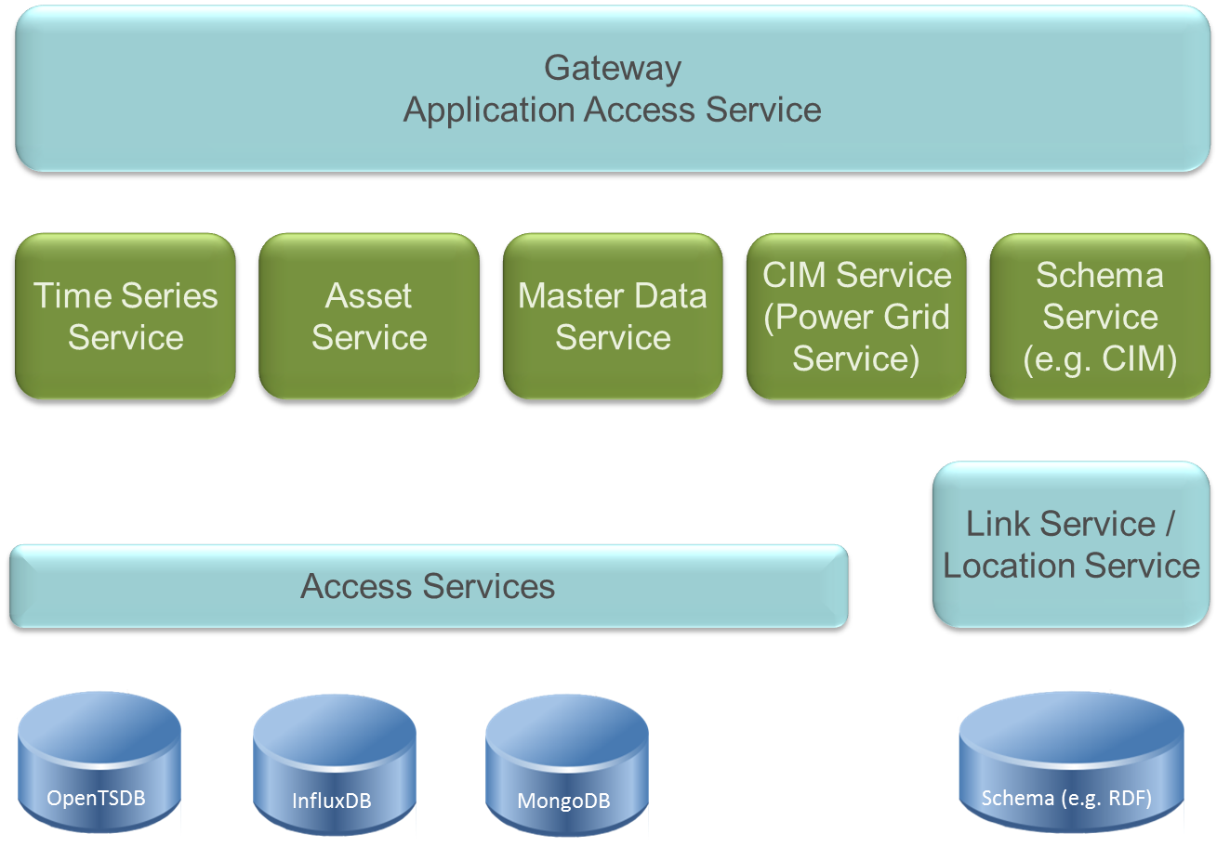
Important Services in a Microservice-oriented Architecture
Notes:
EDR – Data Quality, error correction in aggregated CSV data
Voltage and current time series from Beckhoff and Janitza Measurement devices
File-based measurement data from Janitza (rate: 20 kHz)
Databases: OpenTSDB, InfluxDB, MongoDB, Cassandra
Data Formats: JSON, XML

Slide 6
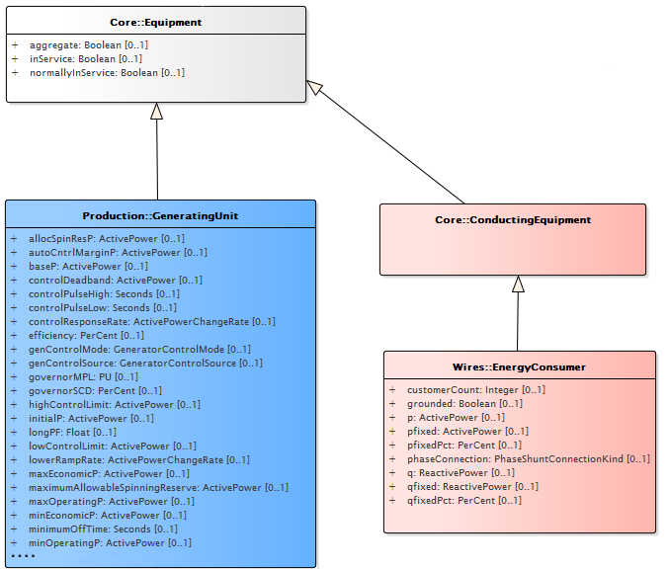
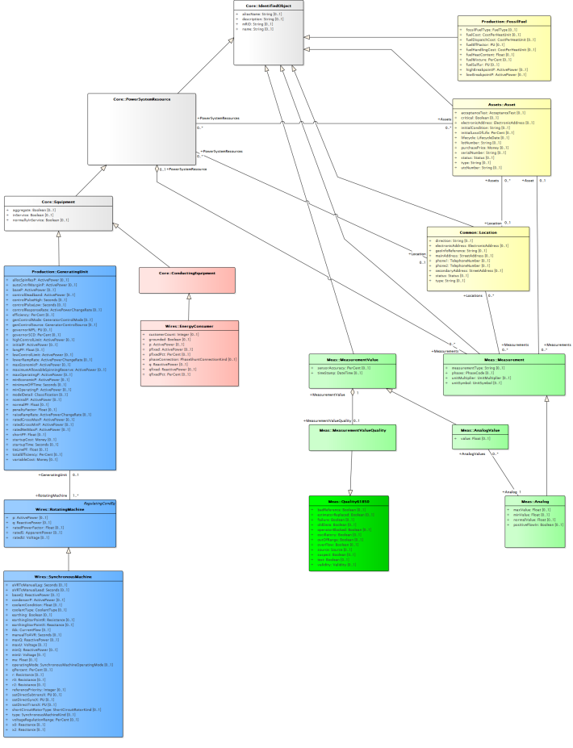
Semantic Model Based Data Storage
CIM
Extracting a CIM profile
→ Enterprise Archtiect
Code Generation, e.g. Java classes
→ Enterprise Architect
Instantiating objects
Evaluation: CIM as a common schema
for exchanging power grid data
Data exchange formats:
  JSON
  XML
  RDF (Triple Store)
  OWL (Web Ontology Language)
Energy data (power grid) mapped to
CIM objects
*) http://ka.stadtwiki.net/Datei:Umspannwerk_Daxlanden_20070930-123936.hk.jpg
Attribution Noncommercial ShareAlike 2.0
Notes:
CIM OBDA

Slide 7
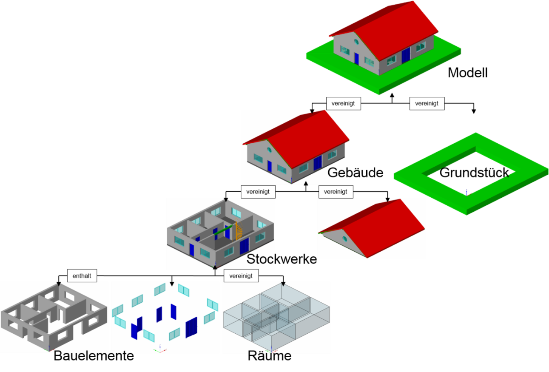
Semantic Data Model for Buildings –
Industry Foundation Classes
Current version IFC4
Based on EXPRESS
Instances as STEP Physical File (SPF - STEP Part 21) or XML (STEP Part 28)
653 entities
Predefined Property sets
Property sets can be added arbitrarily
IfcElectricalDomain contains entities
and property sets to describe
the electrical system
in buildings

Slide 8
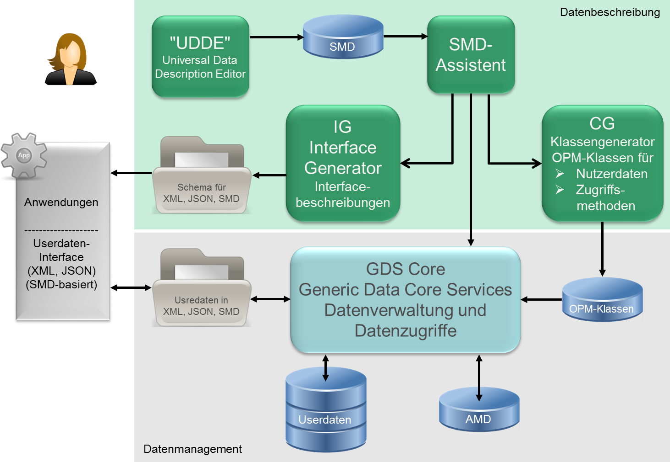
Generic Data Services
Project Thesis
Frederic Sinn
Notes:
Realizations marked

Slide 9
Future Work - Cooperations
Cooperation with Energy Lab 2.0
Cooperation with the Helmholtz Energy Programme SCI
  Storage and Cross-linked Infrastructures
  AIFB is leading data management activities in Topic 6
  RegEnKibo: Master Thesis together with IRS
  ITEP: Power Hardware-in-the-Loop
  Fabian is about to finish his PHD thesis
  Helmholtz initiative Energy System 2050
    Leading Subtopic 5.1
      Data formats, data management,
      and data quality
      Topic 5:
      Toolbox with Databases
      Partners:
      RTW Aachen ( FZJ (JARA)
      GFZ
      IPP
Notes:
To be renewed

