Slide 1

Next steps
11 August 2016 this version is the minutes – with notes added (in pink)
J. J. John on behalf of the team

Slide 2
Agenda
Review current work and discuss steps for next week
Update on datapath blocks (Kevin and Wojtek)
Update on CHESS-2 data emulator (Tianbo)
Update on CHESS-2 hardware
  CHESS-2 digital system (Jaya John)
  CHESS-2-to-FMC adaptor board (Jaya John and Colin)
Plan meetings for rest of August:
  Jaya John could chair next Weds 17 August
  Could someone else chair the following 2 weeks?
  (Jaya John away ~Thurs 18 Aug – Weds 31 Aug)

Slide 3
Ongoing and new actions –
new actions in blue
updates in pink
(actions which were already done last week have been removed)
Kevin and Matt: update on ITSDAQ code for this week: –
Tianbo: [ongoing] working on CHESS-2 Data Emulator. –
Jaya John: [on hold until Sept now] prepare a tidied-up block diagram for the ABCN’
Jaya John: [on hold until Sept now] understand CHESS-2 configuration registers and how to map them into the ABCN’ memory map.

Slide 4
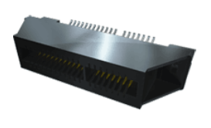
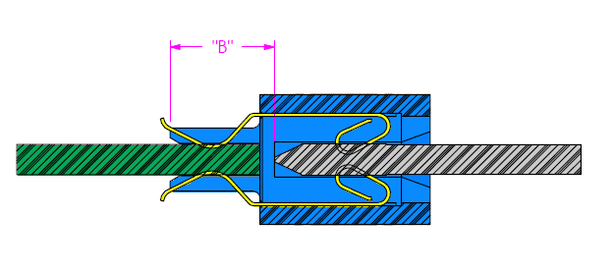
Status of CHESS-2 hardware
CHESS-2 digital system
    Larry Ruckman at SLAC settled on this edge connector for the CHESS-2 digital daughterboard: MEC1-170-EM –
    see https://www.samtec.com/products/mec1-em
    and http://suddendocs.samtec.com/catalog_english/mec1_em.pdf
        1mm pitch
        140 pins – 70 on each side of the daughterboard
        Edge mount geometry – boards lie in same plane
        1.8A per pin
motherboard or
adaptor board
daughterboard
images from Samtec

Slide 5
Status of CHESS-2 hardware
  CHESS-2-to-FMC adaptor board
      Current draw details for power supplies sent to Dave and Francis
      Details still needed by Dave:
        final pinout of daughterboard
        final pinout of FMC – would be good to discuss this

