Slide 1

Next steps
11 August 2016 this version is the minutes – with notes added (in pink)
J. J. John on behalf of the team

Slide 2
Agenda
Review current work and discuss steps for next week
Update on datapath blocks (Kevin and Wojtek)
Update on CHESS-2 data emulator (Tianbo and Weiguo)
Update on CHESS-2 hardware
  CHESS-2 digital system (Jaya John)
  CHESS-2-to-FMC adaptor board (Jaya John and Colin)
Plan meetings for rest of August:
  Jaya John could chair next Weds 17 August
  Could someone else chair the 25th Aug? Wojtek will chair 25th
  (Jaya John away ~Thurs 18 Aug – Weds 31 Aug)
    Colin is away next week. Wojtek is away near the end of August.

Slide 3
Ongoing and new actions
new actions in blue
updates in pink
(actions which were already done last week have been removed)
Kevin and Matt: update on ITSDAQ code for this week: – Kevin sent the SCTDAQ macros for reading out the ABCN’. Matt forwarded Bruce Kevin’s e-mail. Matt will check into /macros directory of the software.
In current testing, Kevin is using fixed data. Not yet integrated with Data Emulator.
Tianbo: [ongoing] working on CHESS-2 Data Emulator. –– Weiguo understood there is a synthesis issue with the present code for the emulator. Weiguo will speak with Tianbo to see if they can fix that and check a new version in.
Jaya John: [on hold until Sept now] prepare a tidied-up block diagram for the ABCN’
Jaya John: [on hold until Sept now] understand CHESS-2 configuration registers and how to map them into the ABCN’ memory map.

Slide 4
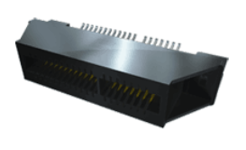
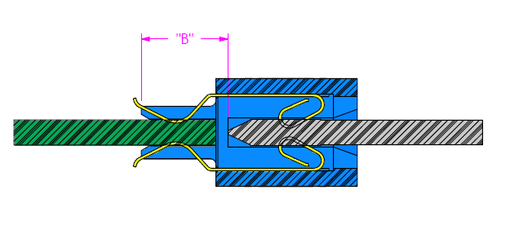
Status of CHESS-2 hardware
CHESS-2 digital system
    Larry Ruckman at SLAC settled on this edge connector for the CHESS-2 digital daughterboard: MEC1-170-EM –
    see https://www.samtec.com/products/mec1-em
    and http://suddendocs.samtec.com/catalog_english/mec1_em.pdf
        1mm pitch
        140 pins – 70 on each side of the daughterboard
        Edge mount geometry – boards lie in same plane
        1.8A per pin
motherboard or
adaptor board
daughterboard
images from Samtec

Slide 5
Status of CHESS-2 hardware
  CHESS-2-to-FMC adaptor board
      Current draw details for power supplies sent to Dave and Francis
      Details still needed by Dave:
        final pinout of daughterboard
        final pinout of FMC – would be good to discuss this
Note end of August deadline for the adaptor board completion. So we need to expedite getting all information to Dave and Francis.
Let’s have another Skype/Vidyo meeting between Jaya John, Dave and Francis and hopefully Wojtek. Colin will ask Dave and Francis when we could meet up – will aim for Monday 15 August.
Wojtek: will help to look at High Pin Count FMC connections for specific boards. In real life, different manufacturers connect up different subsets of the HPC pins. So we can’t assign the HPC pins blindly without checking the details of specific boards. Will look at Xilinx’s KC7xx board and Digilent’s Genesys – boards which have academic pricing.
JJJ to put Larry and Dave and Francis in touch for obtaining final schematics of the SLAC daughterboard.
JJJ to provide pinout for FMC. Matt will review.
For wiring up the Low Pin Count FMC pins, note that the Nexys Video connects other chips to the JTAG and I2C buses, so those pins can’t be reassigned on the FMC.

