Slide 1


MTCA at FAIR

Slide 2
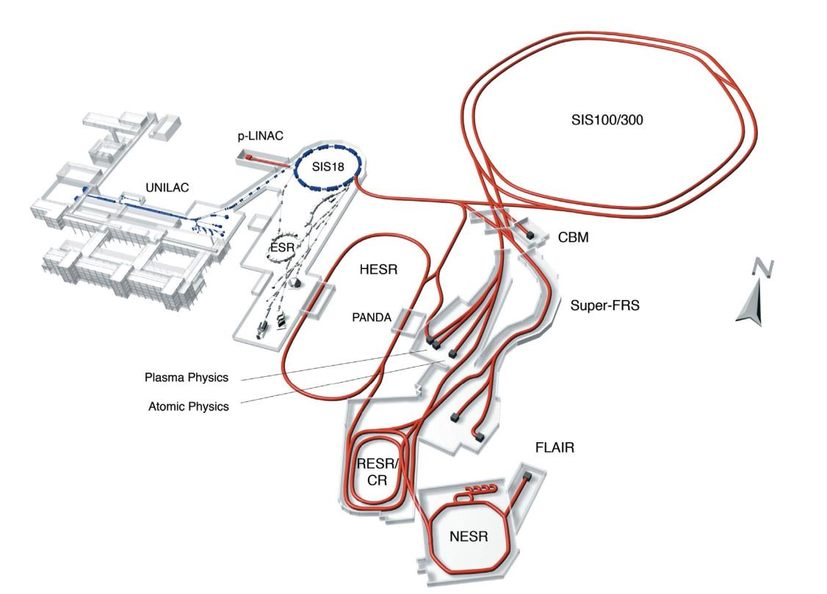
GSI and FAIR
primary beams:
up to 35 GeV/u Uranium
up to 90 GeV/u Protons
secondary beams:
broad range of radioactive beams
antiprotons 0 - 30 GeV
storage and cooler rings:
radioactive beams
10¹¹ stored and cooled 0.8 - 14.5 GeV antiprotons
100m
very high diversity
all elements from p to U
10 new large facilities
parallel beam operation
www.fair-center.eu

Slide 3
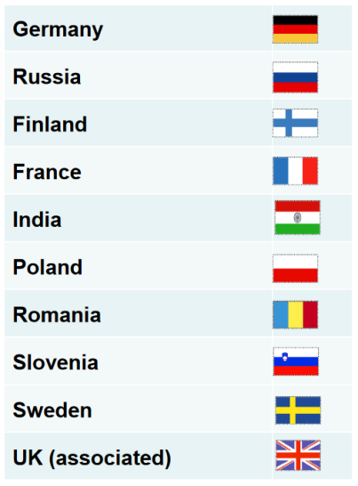
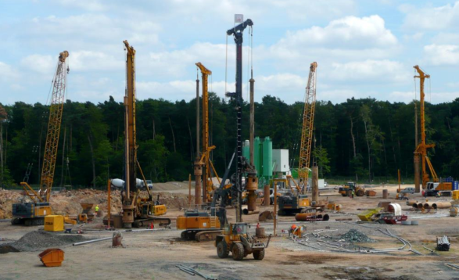
FAIR in short
(Facility for Antiproton and Ion Research)
HEBT, Super FRS, CR, p-Linac, SIS100, pBar Target, HESR (later: NESR, SIS300, RESR)
Scientific experimental collaborations: APPA, PANDA, NUSTAR and CBM
First beam in 2022 after delay and cost increase (civil construction)
10 Member states
Total cost of ~1.6 Billion € (German funds ~70%)
www.fair-center.eu

Slide 4
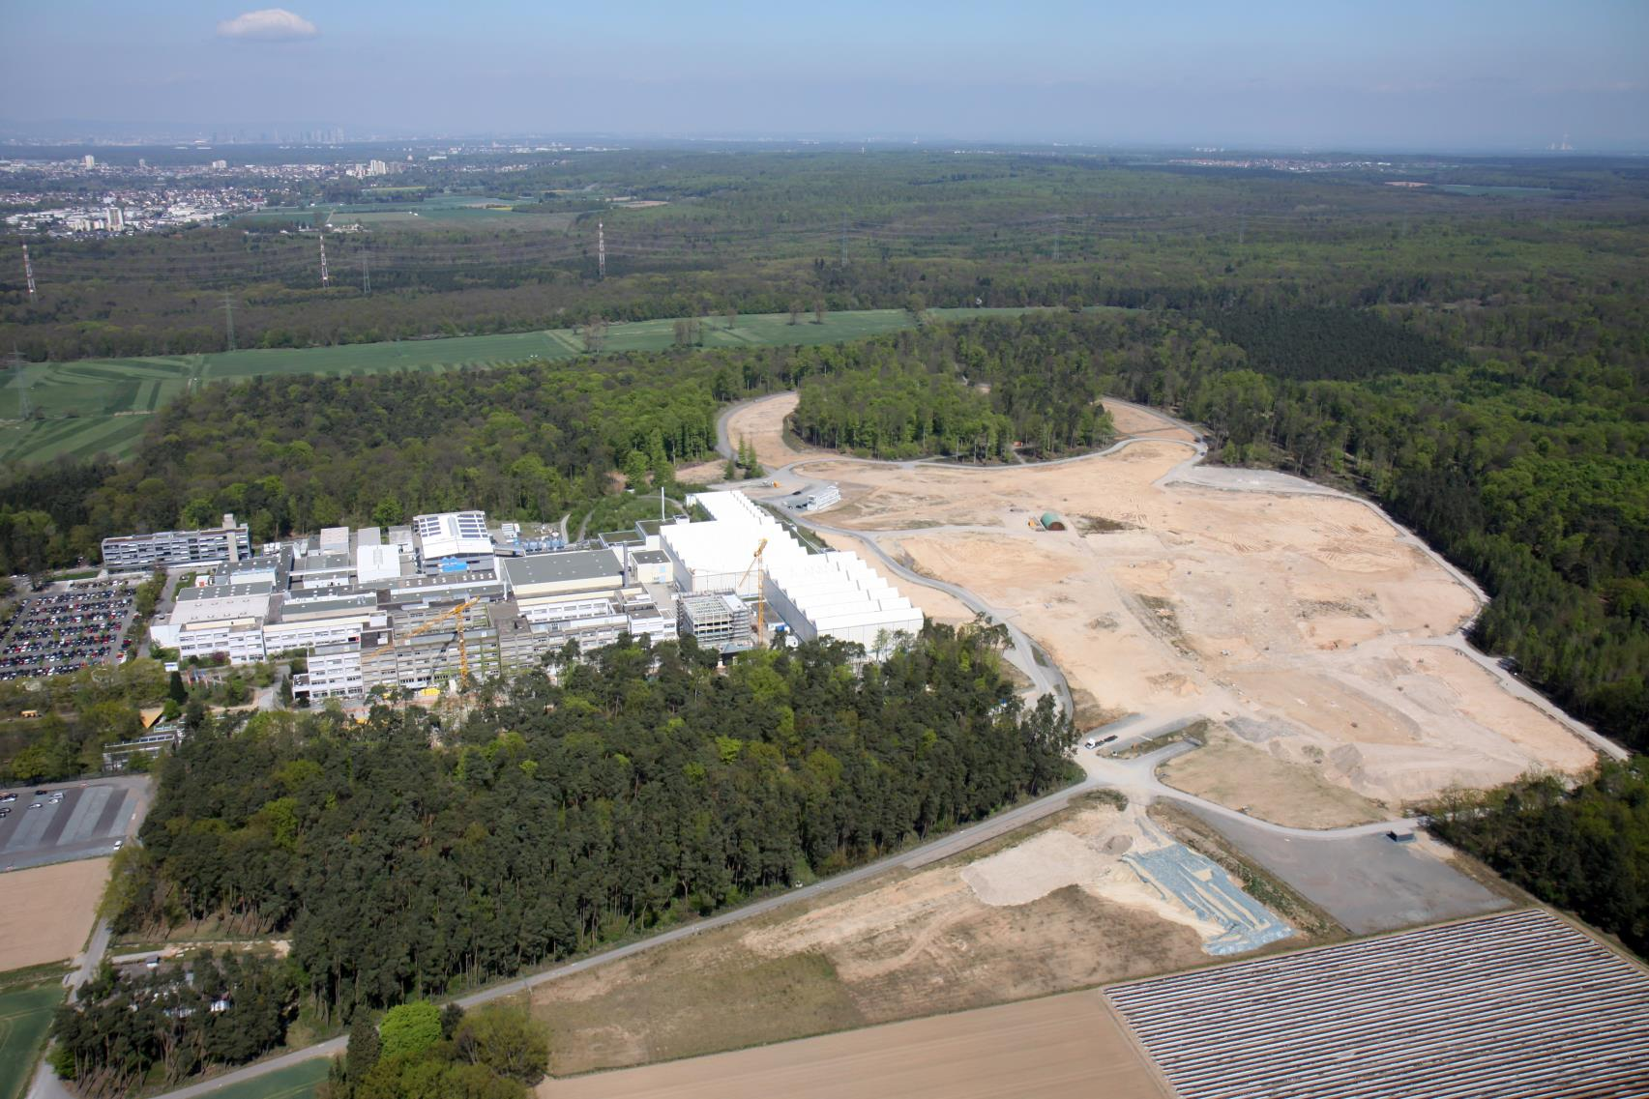

Slide 5
FAIR Beam Instrumentation in short
24 different types of Beam Instrumentation systems, 17 electronic rooms,
total sum of approx. 1000 channels of diverse signal types
Control System: FESA (Front-End Software Architecture, CERN)
White Rabbit Timing System
VME, IPC and µTCA supported
Slow controls: Siemens PLC, Profinet
High radiation
  no digital electronics near the beam pipe
  remote control
  high reliability, high availability

Slide 6
MTCA at GSI and FAIR
CRYRING BPM System
CBM Experiment
GSI UNILAC LLRF
FAIR Timing Receiver Node (FTRN)
FAIR BI Particle Detector Readout

Slide 7
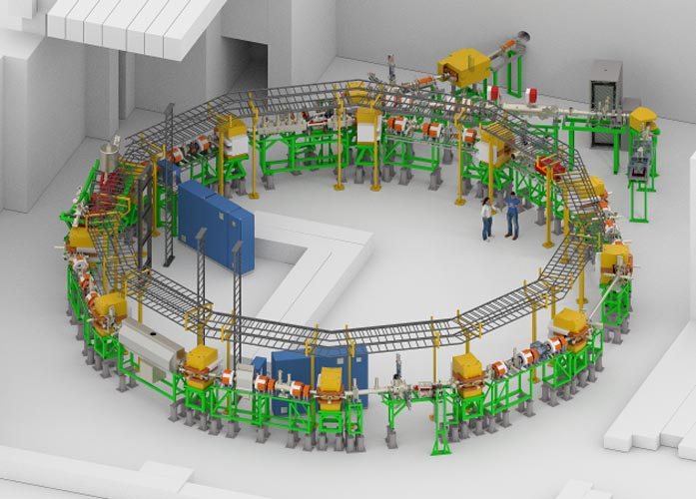
CRYRING BPM System

Slide 8
CRYRING BPM System
CRYRING@ESR:
INDEPENDENT test facility for FAIR relevant technologies:
Control System
Settings Management
Beam Instrumentation
Slow Controls (Profinet) and many more
Injector: 108 MHz 300keV/u RFQ linac with a 50 kV MINIS ion source platform
Synchrotron: 1,44Tm, e- Cooler, experiment section
Circumference: 54,18m
max. Energy: 96 MeV protons
¹²C⁶⁺ from ESR: 24.7MeV/u
²³⁸U⁹²⁺ from ESR: 14.8 MeV/u
Magnet ramp rates: (7 T/s), 4 T/s, 1 T/s

Slide 9
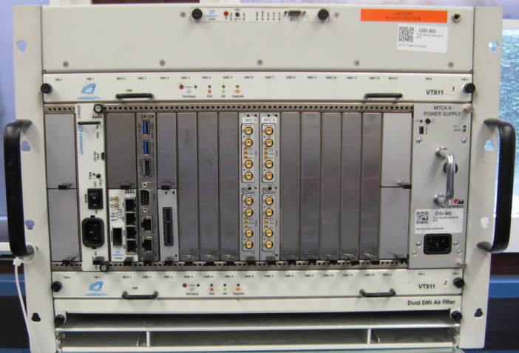
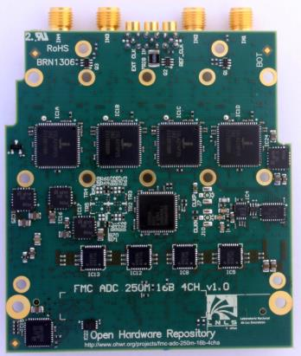
CRYRING BPM System
8 Linear Cut BPMs
Vadatech MTCA.4 chassis (VT811)
Vadatech UTC002 MCH
Wiener Power Supply
Concurrent AM 902/411-12 CPU
Creotech FMC 250MHz 16bit ADC and AFCv2 FMC carrier (www.ohwr.org)
GSI Matpex PCIe Extender (Timing)
Issues:
Firmware on AFCv2 MMC
Firmware on AFCv2 -> PCIe and DDR issues
PCIe routing required other CPU with FP2
Quality aspects

Slide 10
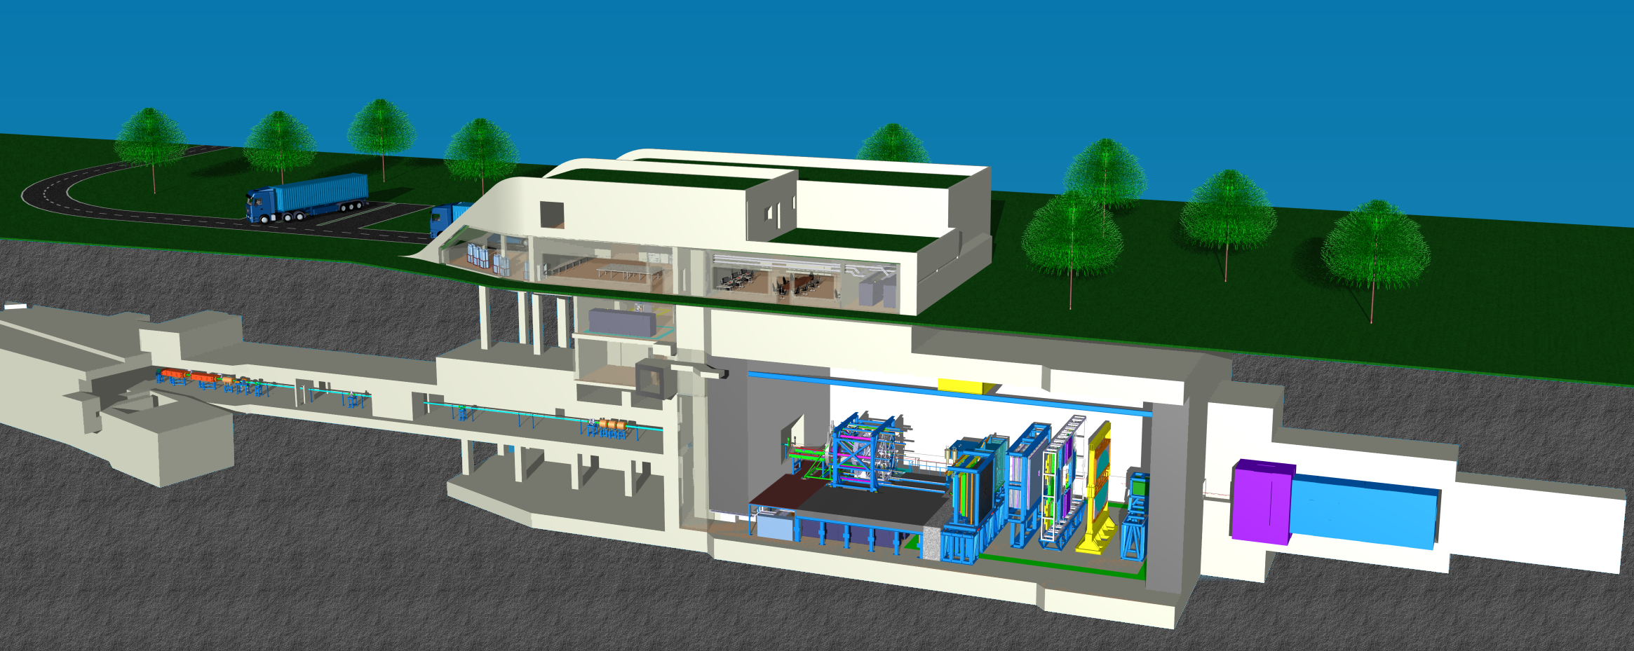
CBM Experiment
10

Slide 11
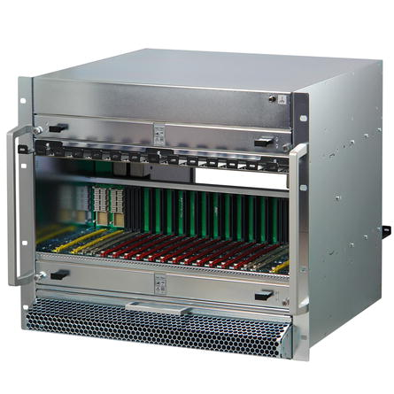
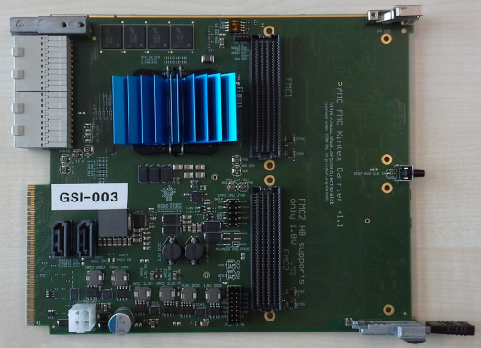
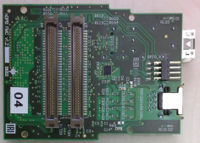
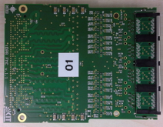
CBM Experiment
A
F
C
K
MC
MC
arrier
intex
Schroff Std and CERN Crates
Creotech AFCK FMC Carrier
FM-S14 FMC – 4x10GB/s (COTS)
CBM FMC developments:
  tDPB FMC (L. Meder, KIT)
  tDPB FMC (C. Garcia, IRI)
  gDPB FMC (J. Frühauf, GSI)
Readout of:
Time-Of-Flight (TOF)
Muon Chamber (MUCH)
Silicon Tracking System (STS) Transition Radiation Detector (TRD)
Mainly TDC and ADC readout.
FMC1
AFCK
FMC2
11

Slide 12
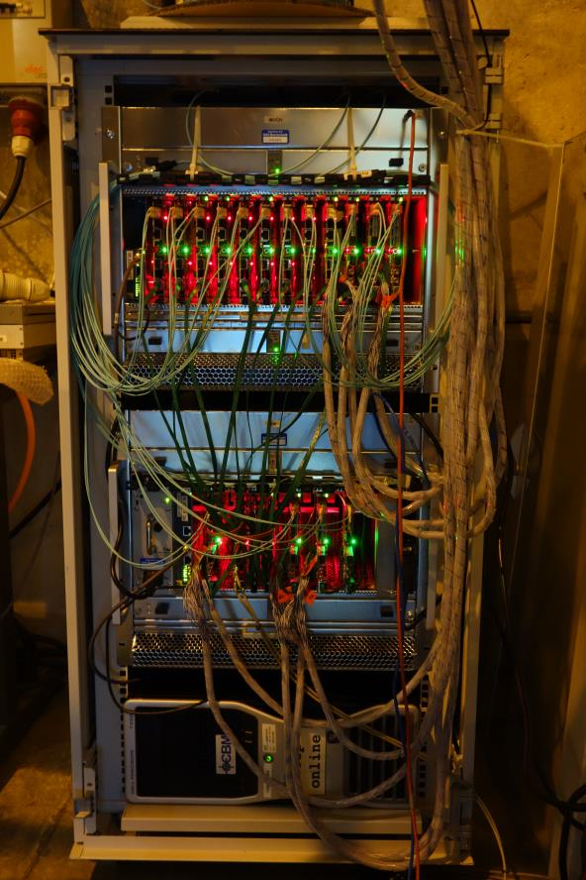
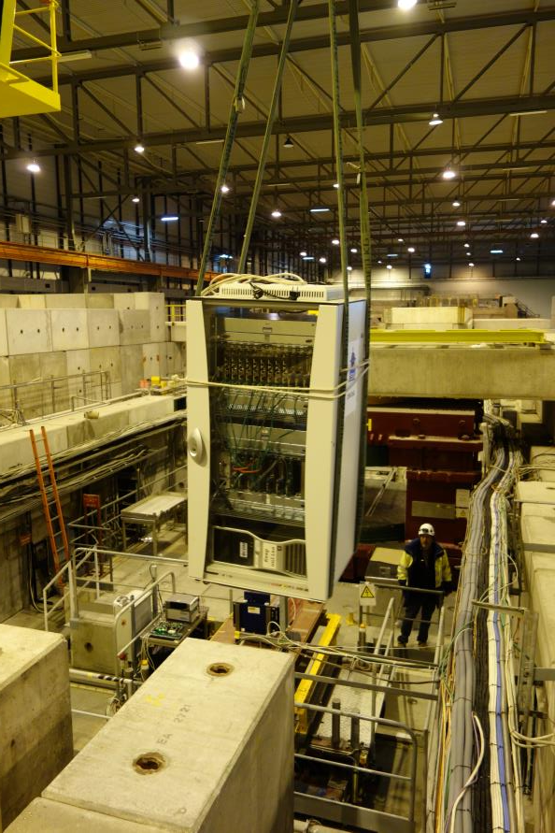
CBM Experiment

Slide 13
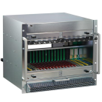
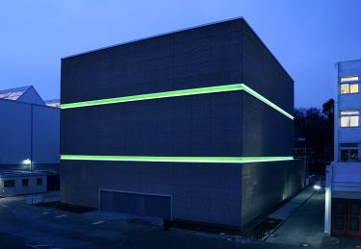
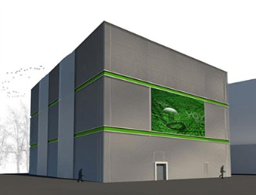
CBM Experiment
DPB data
pre-processing
in many μTCA crates
online event building and selection
green
cube
~700m
green cube
flow
1 TB/s
data
~80m
David Emschermann, CBM

Slide 14
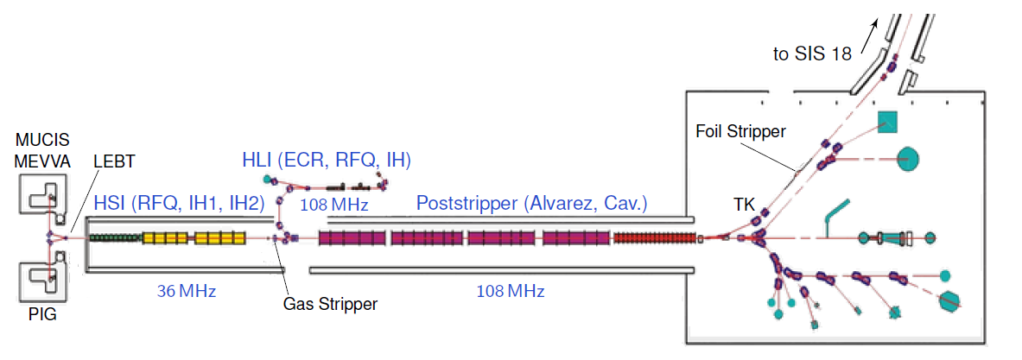
GSI UNILAC LLRF
The need for a new LLRF:
Part of the planned RF systems modernisation
Due to long lifetime of analog LLRF difficult to find replacement parts
Requirements
High dynamic range in pulse width and pulse amplitude
Two different frequencies (36:1 MHz, 108:4 MHz)
Various transient behaviours (cavities)
Non-linear amplifier characteristics
Long-term reliability

Slide 15
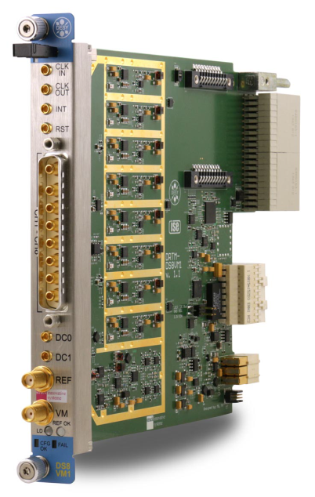
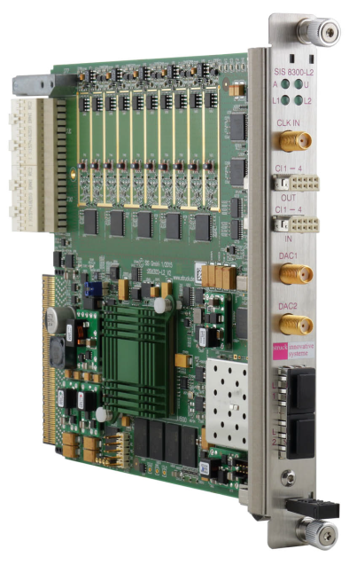
GSI UNILAC LLRF
DS8VM1
SIS8300-L2
SIS8300-L2:
8 AC- & 2 DC ADC channels, 16bit, 125MHz
DESY Vector Modulator RTM:
2 DAC channels, 16bit, 250MHz
Basic features:
Direct sampling of RF signals
Separate “slow" feedback for amplitude & phase
“Fast" adaptive and beam-based feedforward
Pulse-by-pulse variable attenuators
Linearisation of amplier characteristics
No tuner control for the moment
Optional features:
“RF tuning": varying the RF frequency for faster warm-up
Network analyser functionality
SIS, under license from DESY
J. Zappai, B. Schlitt, A. Schnase, G. Schreiber

Slide 16
GSI UNILAC LLRF
Jens Zappai, GSI, UNILAC rf

Slide 17
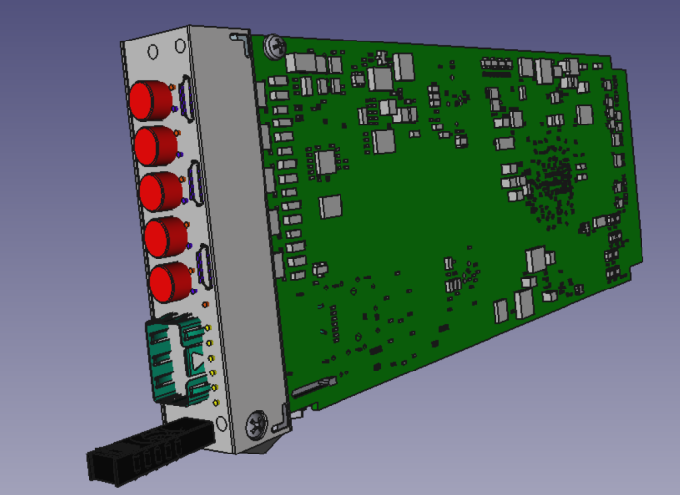
FAIR Timing Receiver Node (FTRN)
White Rabbit AMC FTRN
Under development by COSYLAB as FAIR In-Kind partner
Not true MTCA.4 -> Single Width for Libera Systems
clock and time synchronization with a clock master according to the WR specifications
record arrival time of a digital pulse (e.g. LVTTL)
generate a digital pulse or a pulse sequence at a given time
generate clock signals with a given frequency and phase
generate specified interrupts at given times

Slide 18
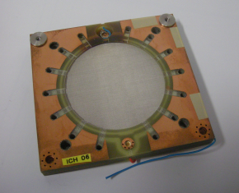
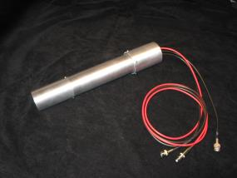
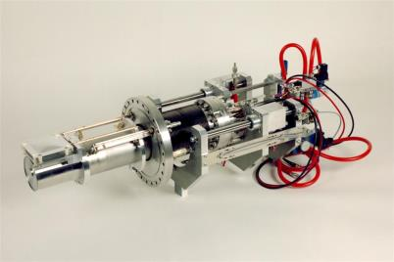
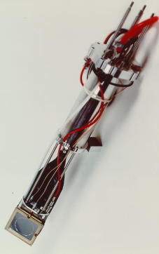
FAIR BI Particle Detector Readout
LASSIE: Large Analog Signal and Scaling Information Environment
Multichannel Scaler System
Modular
Analog Signal Discrimination
DAQ System for:
  Ionisation Chambers (IC)
  Secondary Electron Monitors (SEM)
  Plastic Scintillators (Sc)
  Beam Loss Monitors (BLM)
  Proportional frequency signals from other sources
    Transformer
    Cavity rf
    Master rf
    Magnet ramps

Slide 19
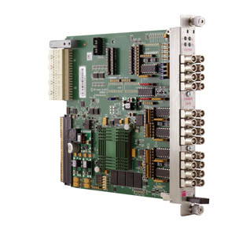
FAIR BI Particle Detector Readout
Struck Innovative Systeme SIS8800
MTCA.4
4 lane PCI Express Connectivity
16 Front Panel Counter Channels
Count rate up to 200 MHz (NIM and ECL)
4 Control In- and 4 Control
Outputs NIM/TTL LEMO or ECL/TTL flat cable versions Gigabit Link Port Implementation to Backplane
Virtex 6 FPGA
2 GByte Memory
In Field Firmware Upgrade Support
DESY MMC1.0

Slide 20
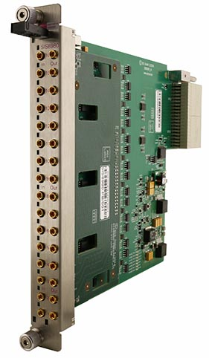
FAIR BI Particle Detector Readout
Struck Innovative Systeme SIS8980
MTCA.4 RTM
16 Discriminator Inputs, Connector Type MMCX
Leading Edge
50 Ohm +/- 1% DC Inputs
14 Bit Threshold DAC for each Channel, 0,4 mV/Step
16 Outputs with NIM Level, Connector Type MMCX
Programmable Pulse Length 10 ns - 250 ns
16 Front Panel Channel Activity LEDs
MMC 1.0 compatible
Zone 3 class D1.1 compatible
Thanks to Matthias Kirsch and Tino Häupke, SIS !!

Slide 21
The End
Thank you for your attention !
Questions?

Slide 22
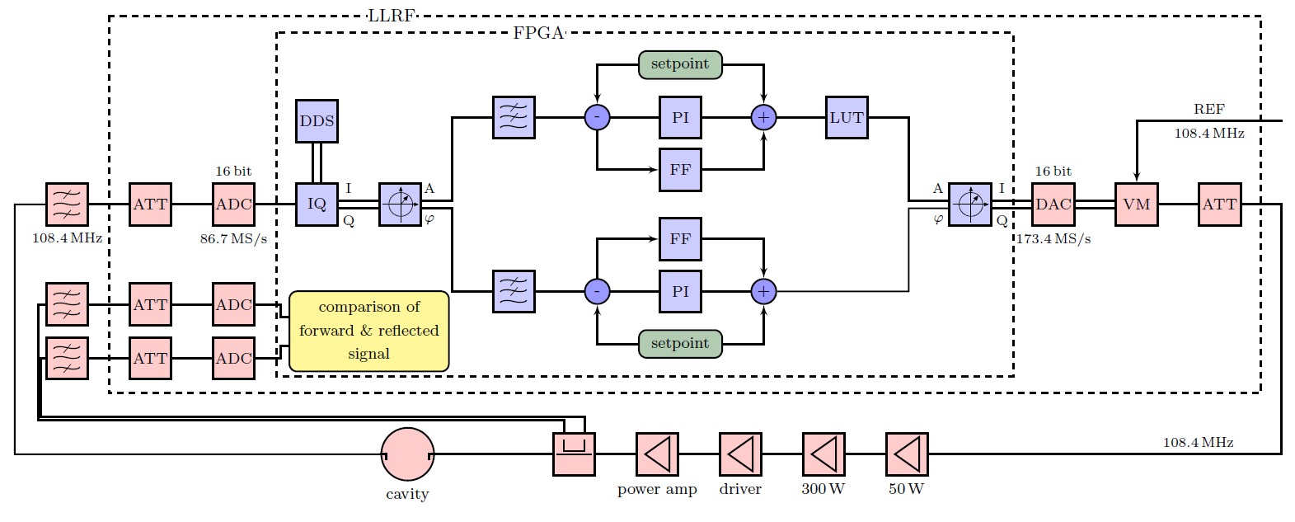
The End
Thank you for your attention !
Questions?

